Slide 1
Factors that Affect Reaction Rates
Kinetics is the study of how fast chemical reactions occur.
There are 4 important factors which affect rates of reaction
  Reactant Concentration,
  Temperature,
  Action of Catalysts, and
  Surface area.
Goal: to understand chemical reactions at the molecular level.

Slide 2
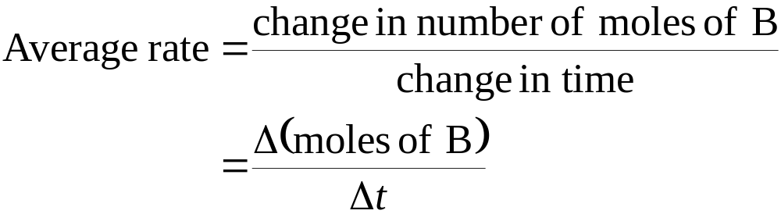
Reaction Rates
Speed of a reaction is measured by the change in concentration with time.
For a reaction A → B
Suppose A reacts to form B. Let us begin with 1.00 mol A.

Slide 3
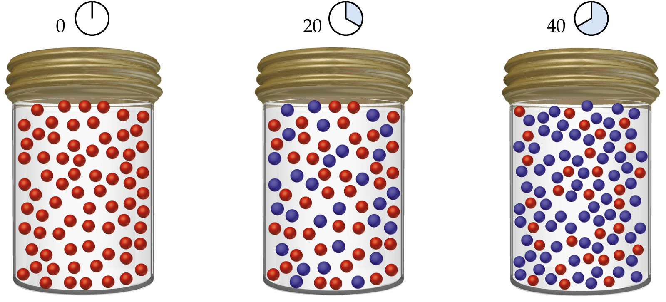
Reaction Rates

Slide 4
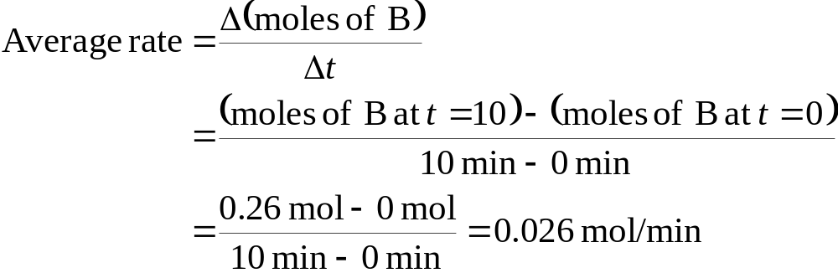
Reaction Rates
  At t = 0 (time zero) there is 1.00 mol A (100 red spheres) and no B present.
  At t = 20 min, there is 0.54 mol A and 0.46 mol B.
  At t = 40 min, there is 0.30 mol A and 0.70 mol B.
  Calculating,

Slide 5
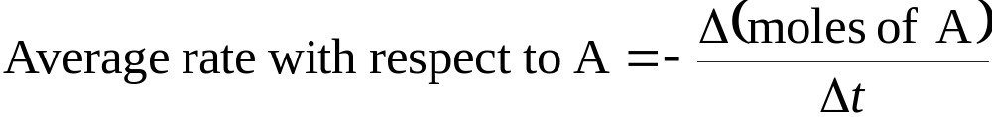
Reaction Rates
For the reaction A → B there are two ways of measuring rate:
  the speed at which the products appear (i.e. change in moles of B per unit time), or
  the speed at which the reactants disappear (i.e. the change in moles of A per unit time).

Slide 6
Reaction Rates
Change of Rate with Time
For the reaction A → B there are two ways of
Most useful units for rates are to look at molarity. Since volume is constant, molarity and moles are directly proportional.
Consider:
C₄H₉Cl(aq) + H₂O(l) → C₄H₉OH(aq) + HCl(aq)

Slide 7
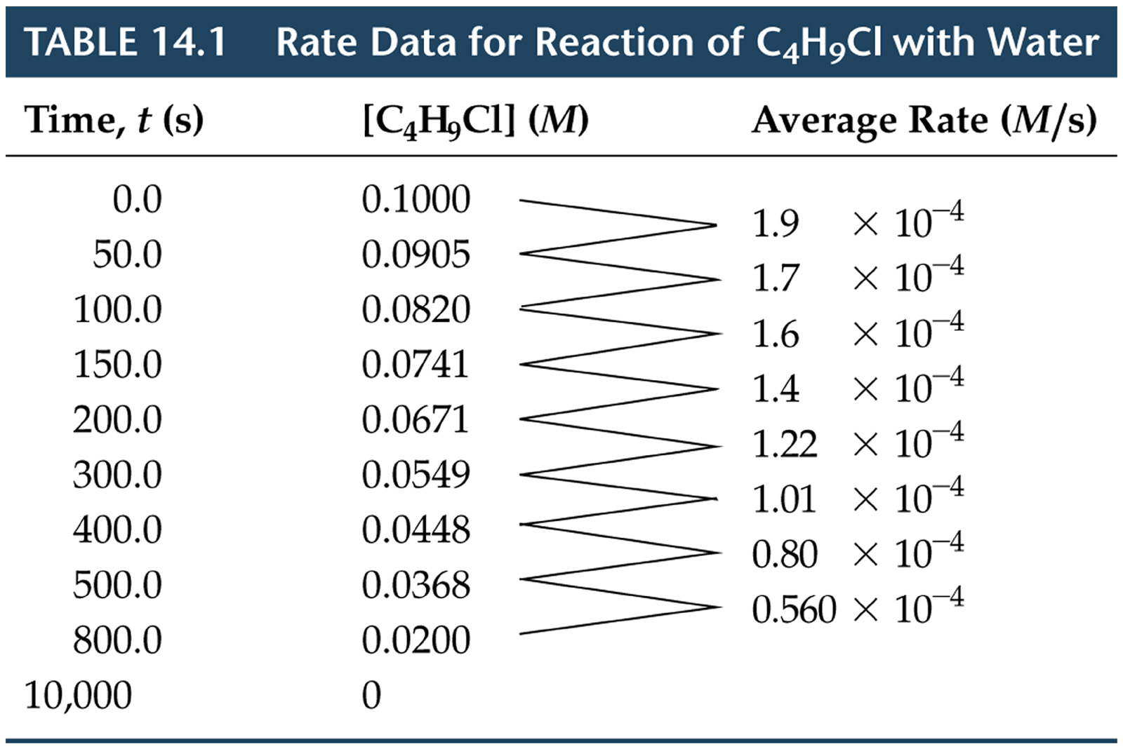

Slide 8
Reaction Rates
Change of Rate with Time
C₄H₉Cl(aq) + H₂O(l) → C₄H₉OH(aq) + HCl(aq)
  We can calculate the average rate in terms of the disappearance of C₄H₉Cl.
  The units for average rate are mol/L·s or M/s.
  The average rate decreases with time.
  We plot [C₄H₉Cl] versus time.
  The rate at any instant in time (instantaneous rate) is the slope of the tangent to the curve.
  Instantaneous rate is different from average rate.
  We usually call the instantaneous rate the rate.

Slide 9
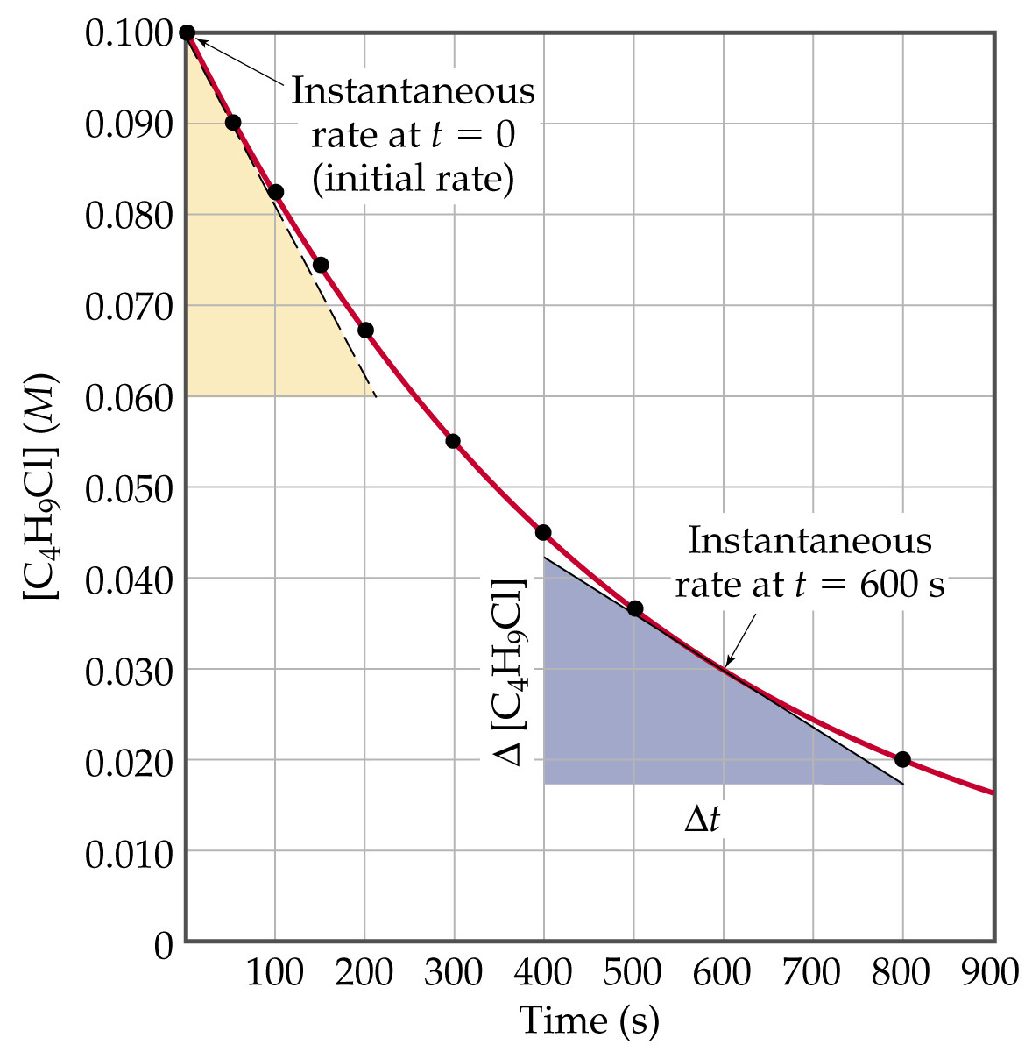

Slide 10
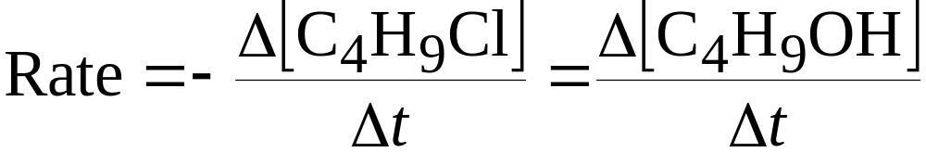
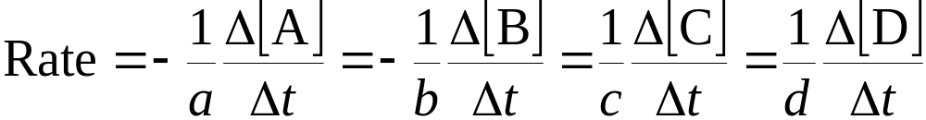
Reaction Rates
Reaction Rate and Stoichiometry
For the reaction
C₄H₉Cl(aq) + H₂O(l) → C₄H₉OH(aq) + HCl(aq)
we know
In general for
aA + bB → cC + dD

Slide 11
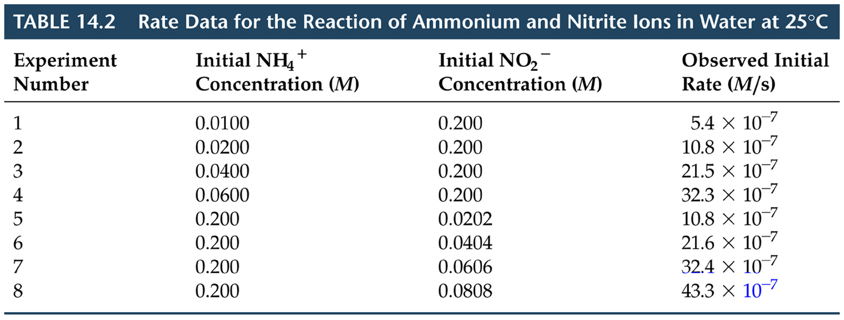
Concentration and Rate
In general rates increase as concentrations increase.
NH₄⁺(aq) + NO₂⁻(aq) → N₂(g) + 2H₂O(l)

Slide 12
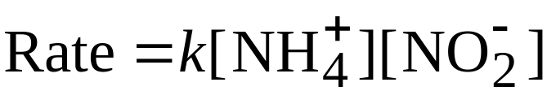
Concentration and Rate
For the reaction
NH₄⁺(aq) + NO₂⁻(aq) → N₂(g) + 2H₂O(l)
we note
  as [NH₄⁺] doubles with [NO₂⁻] constant the rate doubles,
  as [NO₂⁻] doubles with [NH₄⁺] constant, the rate doubles,
  We conclude rate ∝ [NH₄⁺][NO₂⁻].
Rate law:
The constant k is the rate constant.

Slide 13
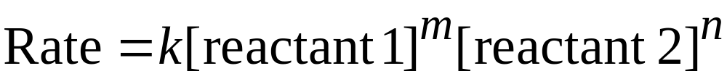
Concentration and Rate
Exponents in the Rate Law
For a general reaction with rate law
we say the reaction is mth order in reactant 1 and nth order in reactant 2.
The overall order of reaction is m + n + ….
A reaction can be zeroth order if m, n, … are zero.
Note the values of the exponents (orders) have to be determined experimentally. They are not simply related to stoichiometry.

Slide 14
Concentration and Rate
Using Initial Rates to Determines Rate Laws
A reaction is zero order in a reactant if the change in concentration of that reactant produces no effect.
A reaction is first order if doubling the concentration causes the rate to double.
A reacting is nth order if doubling the concentration causes an 2^{n} increase in rate.
Note that the rate constant does not depend on concentration.

