Slide 1
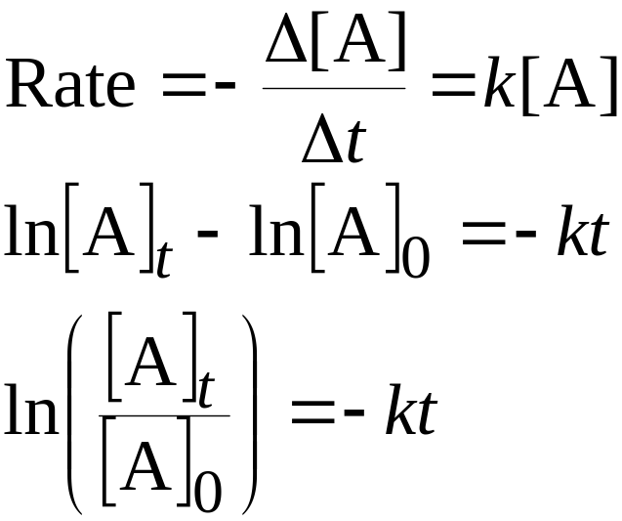
Rate Laws
Concentration [time]
First Order Reactions
Goal: convert rate law into a convenient equation to give concentrations as a function of time.
For a first order reaction, the rate doubles as the concentration of a reactant doubles.

Slide 2
Rate Laws
Concentration [time]
First Order Reactions
A plot of ln[A]_{t} versus t is a straight line with slope -k and intercept ln[A]₀.
In the above we use the natural logarithm, ln, which is log to the base e.

Slide 3

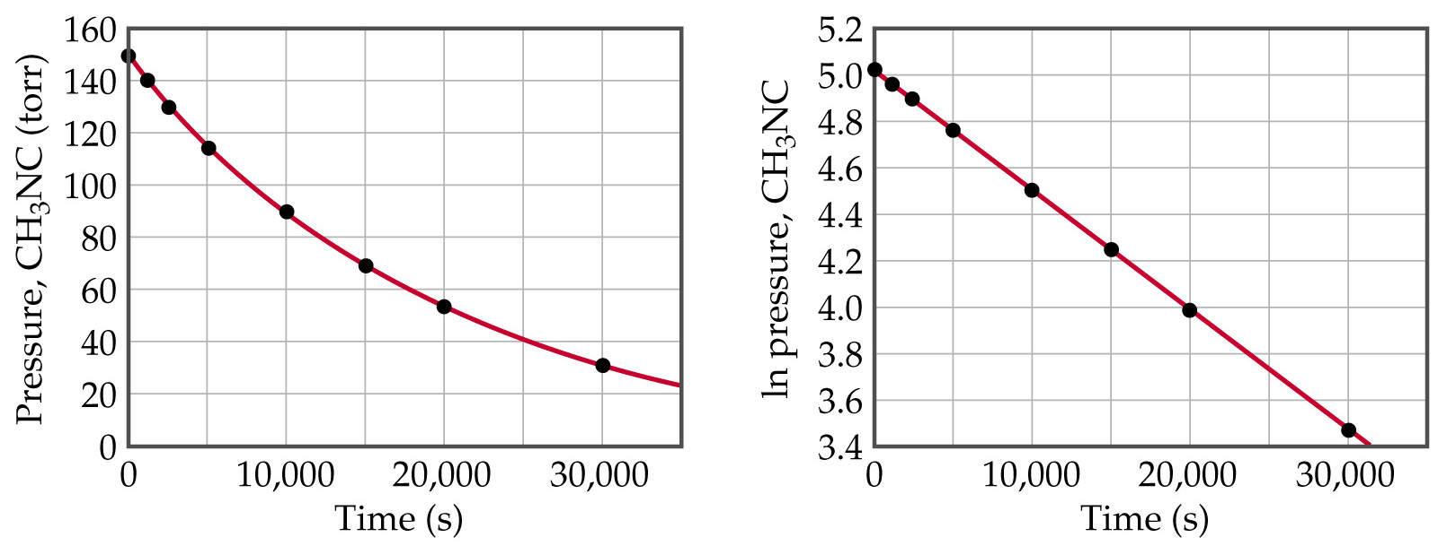
Rate Laws
Concentration [time]
First Order Reactions

Slide 4
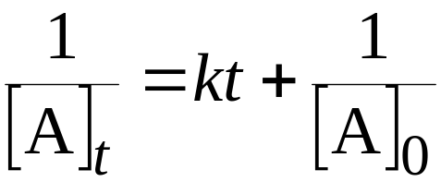
Rate Laws
Concentration [time]
Second Order Reactions
For a second order reaction with just one reactant
A plot of 1/[A]_{t} versus t is a straight line with slope k and intercept 1/[A]₀
For a second order reaction, a plot of ln[A]_{t} vs. t is not linear.

Slide 5
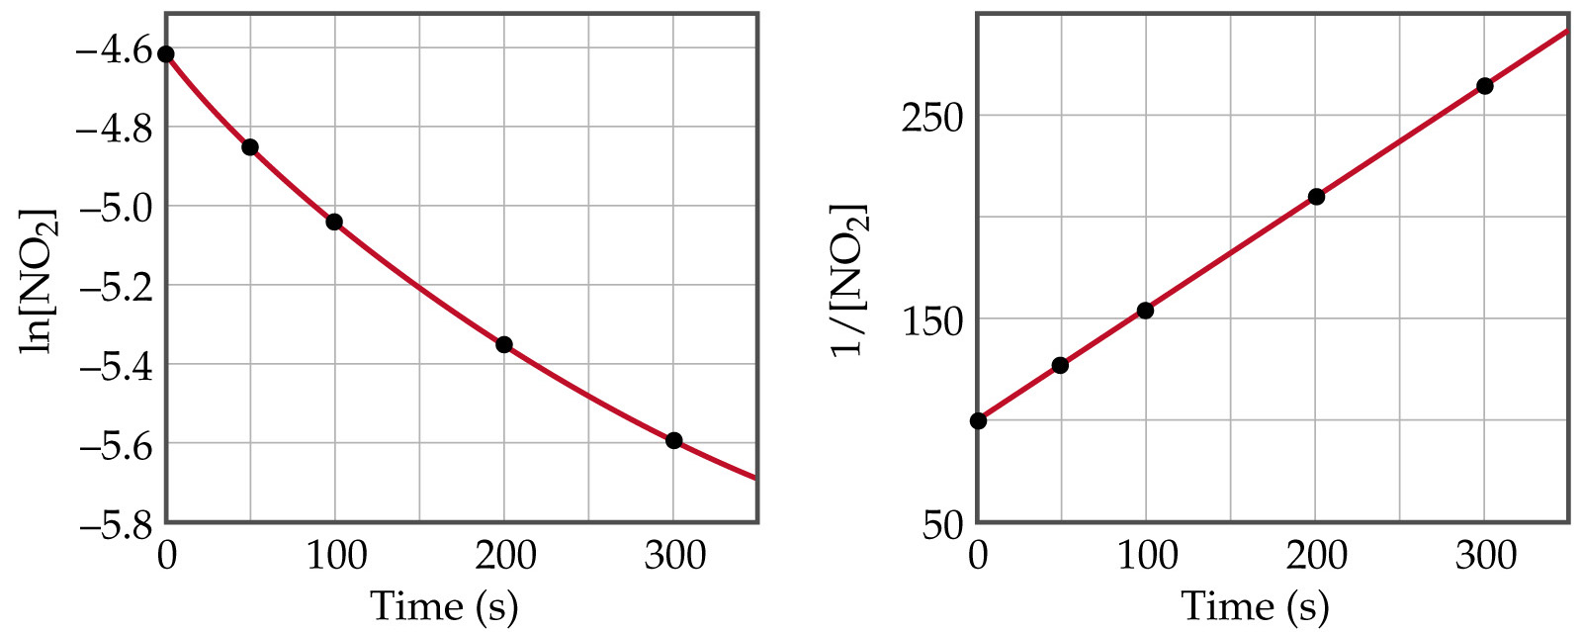
Rate Laws
Concentration [time]
Second Order Reactions

Slide 6
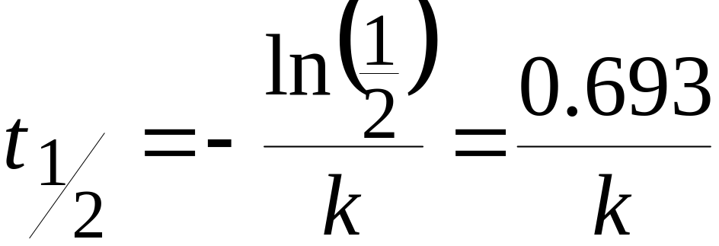
Rate Laws
Concentration [time]
Half-Life
Half-life is the time taken for the concentration of a reactant to drop to half its original value.
For a FIRST ORDER process, half life, t_{½} is the time taken for [A]₀ to reach ½[A]₀.
Mathematically,

Slide 7
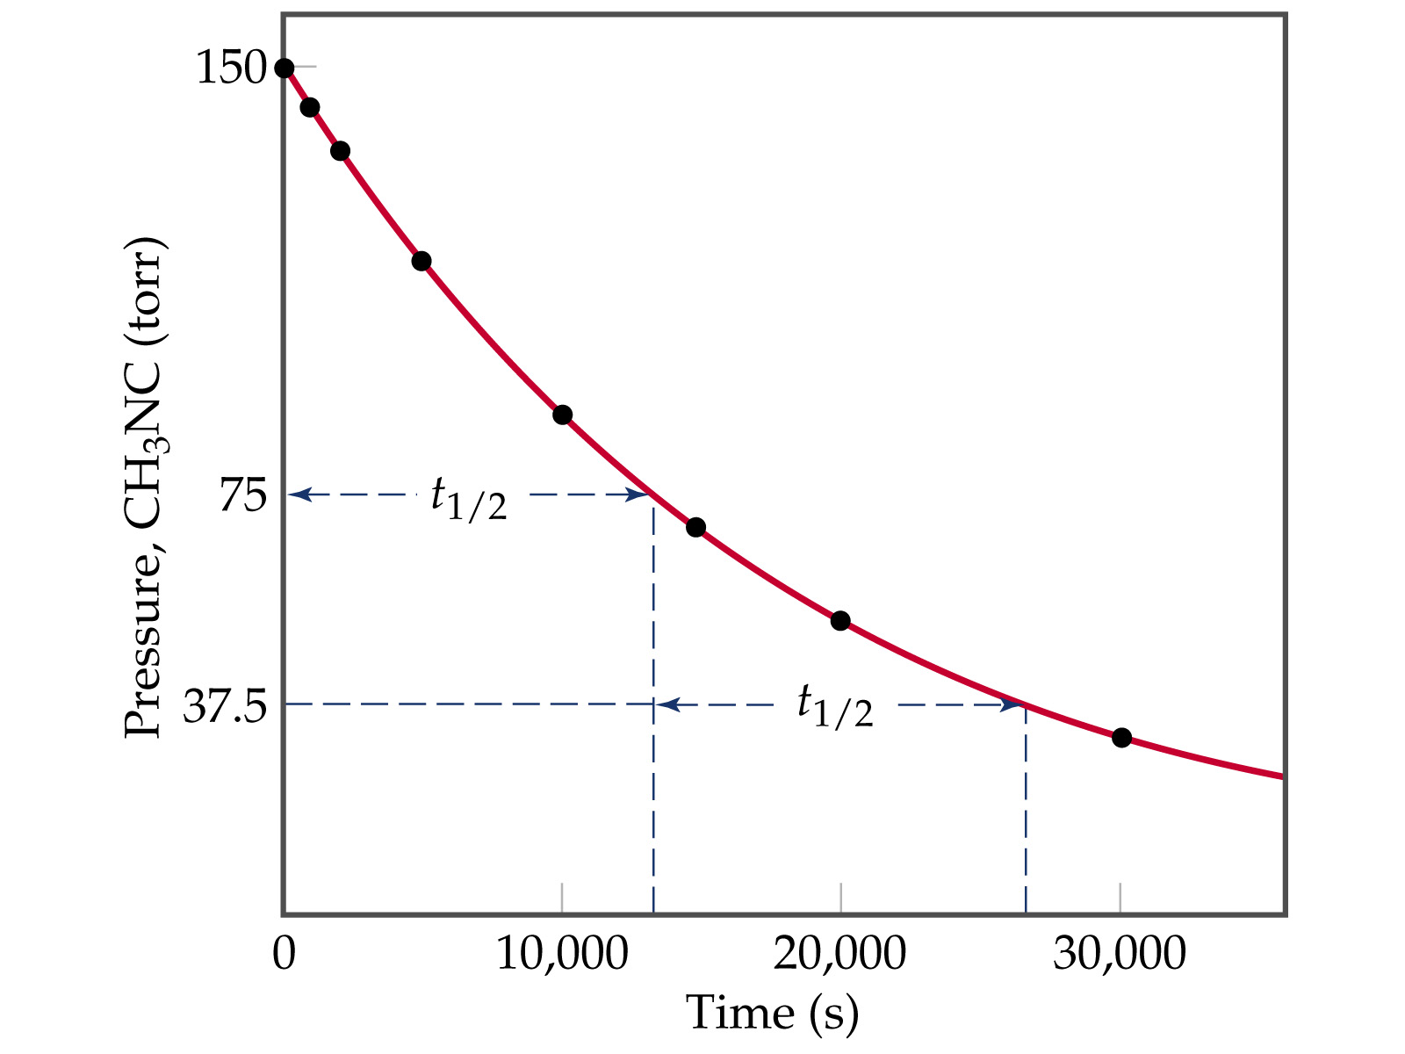

Slide 8
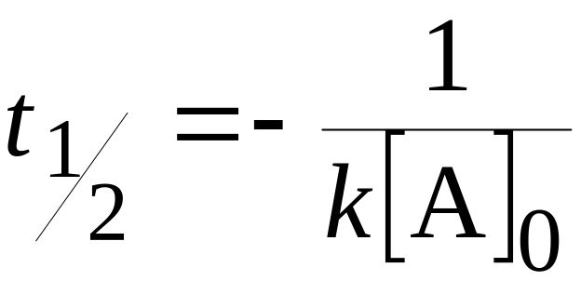
Rate Laws
Concentration [time]
Half-Life
For a SECOND ORDER half-life depends in the initial concentration:

Slide 9
Rate Laws
Concentration [time]
First Order Reactions
Goal: convert rate law into a convenient equation to give concentrations as a function of time.
For a first order reaction, the rate doubles as the concentration of a reactant doubles.

Slide 10
Rate Laws
Concentration [time]
First Order Reactions
A plot of ln[A]_{t} versus t is a straight line with slope -k and intercept ln[A]₀.
In the above we use the natural logarithm, ln, which is log to the base e.

Slide 11
Rate Laws
Concentration [time]
First Order Reactions

Slide 12
Rate Laws
Concentration [time]
Second Order Reactions
For a second order reaction with just one reactant
A plot of 1/[A]_{t} versus t is a straight line with slope k and intercept 1/[A]₀
For a second order reaction, a plot of ln[A]_{t} vs. t is not linear.

Slide 13
Rate Laws
Concentration [time]
Second Order Reactions

Slide 14
Rate Laws
Concentration [time]
Half-Life
Half-life is the time taken for the concentration of a reactant to drop to half its original value.
For a FIRST ORDER process, half life, t_{½} is the time taken for [A]₀ to reach ½[A]₀.
Mathematically,

Slide 16
Rate Laws
Concentration [time]
Half-Life
For a SECOND ORDER half-life depends in the initial concentration:

