Slide 1
Temperature and Rate
The Collision Model
Most reactions speed up as temperature increases. (E.g. food spoils when not refrigerated.)
When two light sticks are placed in water: one at room temperature and one in ice, the one at room temperature is brighter than the one in ice.
The chemical reaction responsible for chemiluminescence is dependent on temperature: the higher the temperature, the faster the reaction and the brighter the light.

Slide 2
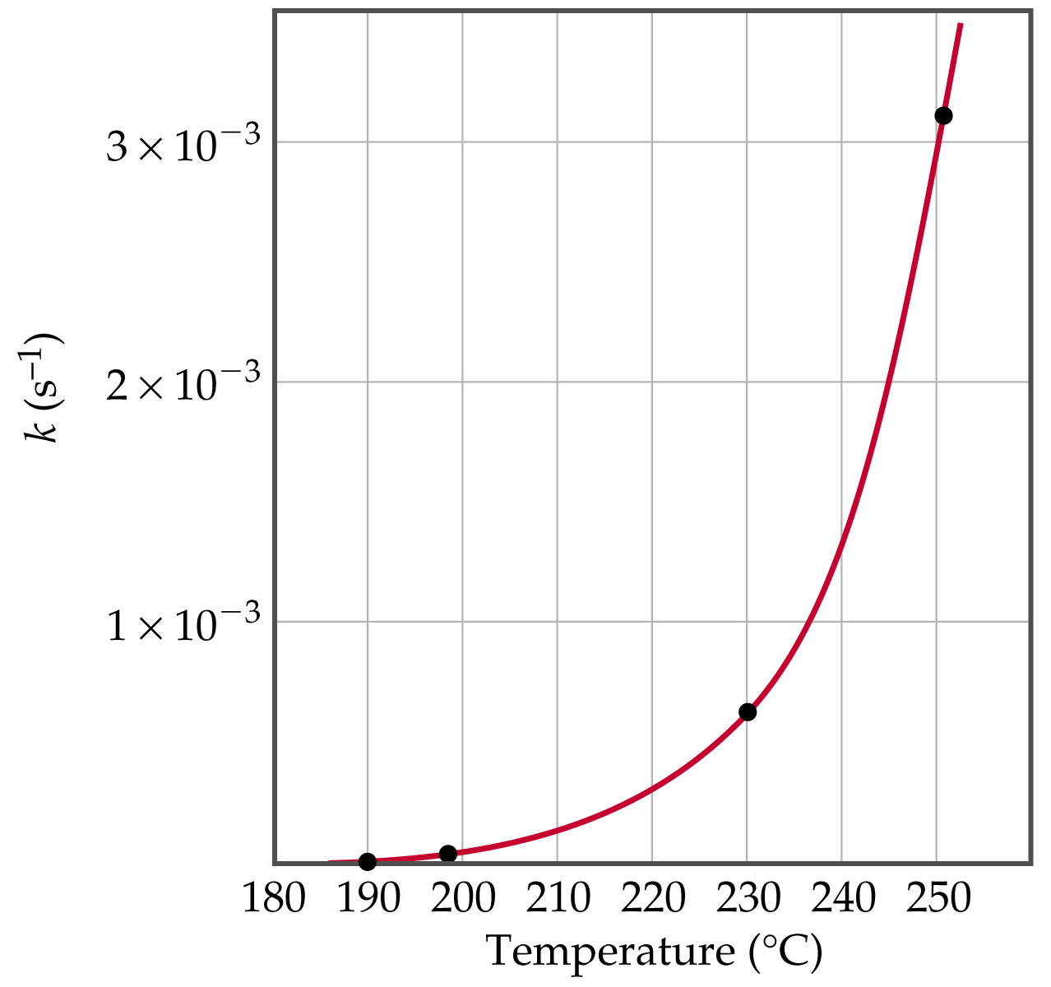
Temperature and Rate
As Temperature Increases,
the Rate Increases.
Collision Model

Slide 3
Temperature and Rate
The Collision Model
Since the rate law has no temperature term in it, the rate constant must depend on temperature.
Consider the first order reaction CH₃NC → CH₃CN.
  As temperature increases from 190 °C to 250 °C the rate constant increases from 2.52 × 10⁻⁵ s⁻¹ to 3.16 × 10⁻³ s⁻¹.
The temperature effect is quite dramatic. Why?
Observations: rates of reactions are affected by concentration and temperature.

Slide 4
Temperature and Rate
The Collision Model
Goal: develop a model that explains why rates of reactions increase as concentration and temperature increases.
The collision model: in order for molecules to react they must collide.
The greater the number of collisions the faster the rate.
The more molecules present, the greater the probability of collision and the faster the rate.

Slide 5
Temperature and Rate
The Collision Model
The higher the temperature, the more energy available to the molecules and the faster the rate.
Complication: not all collisions lead to products. In fact, only a small fraction of collisions lead to product.
The Orientation Factor
In order for reaction to occur the reactant molecules must collide in the correct orientation and with enough energy to form products.

Slide 6
Temperature and Rate
The Orientation Factor
Consider:
Cl + NOCl → NO + Cl₂
There are two possible ways that Cl atoms and NOCl molecules can collide; one is effective and one is not.

Slide 7
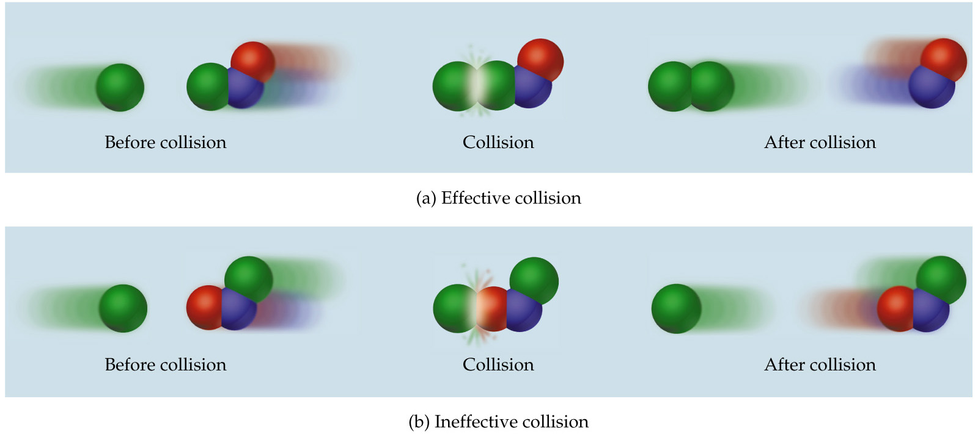
Temperature and Rate
The Orientation Factor

Slide 8
Temperature and Rate
Activation Energy
Arrhenius: molecules must posses a minimum amount of energy to react. Why?
  In order to form products, bonds must be broken in the reactants.
  Bond breakage requires energy.
Activation energy, E_{a}, is the minimum energy required to initiate a chemical reaction.

Slide 9
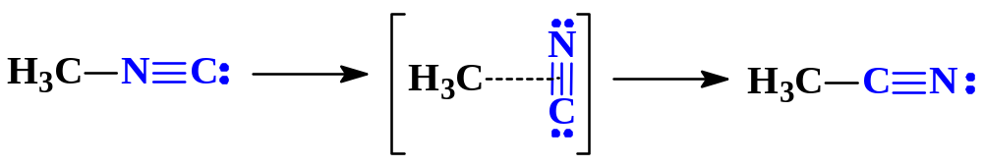
Temperature and Rate
Activation Energy
Consider the rearrangement of methyl isonitrile:
  In H₃C-N≡C, the C-N≡C bond bends until the C-N bond breaks and the N≡C portion is perpendicular to the H₃C portion. This structure is called the activated complex or transition state.
  The energy required for the above twist and break is the activation energy, E_{a}.
  Once the C-N bond is broken, the N≡C portion can continue to rotate forming a C-C≡N bond.

Slide 10
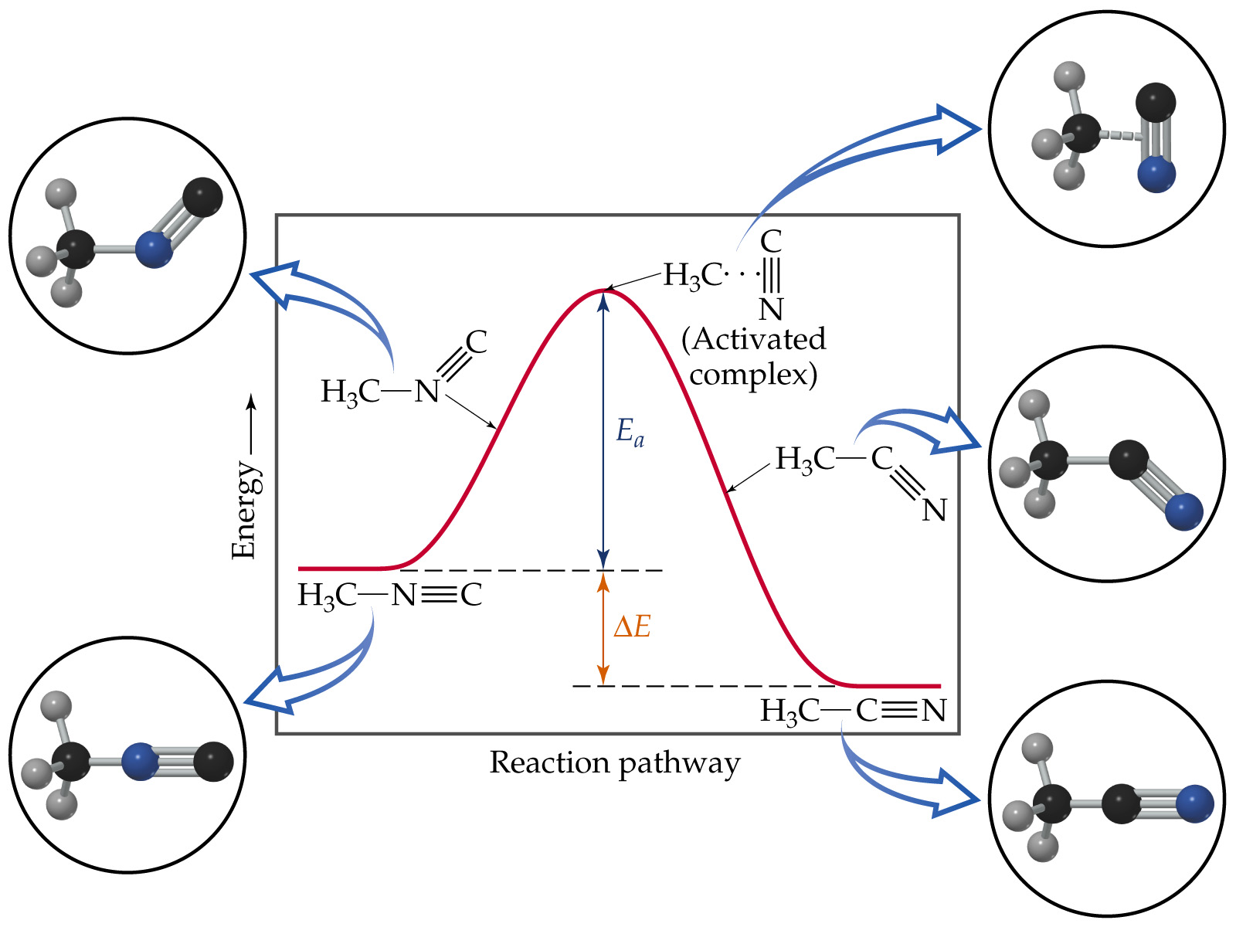

Slide 11
Temperature and Rate
Activation Energy
The change in energy for the reaction is the difference in energy between CH₃NC and CH₃CN.
The activation energy is the difference in energy between reactants, CH₃NC and transition state.
The rate depends on E_{a}.
Notice that if a forward reaction is exothermic (CH₃NC → CH₃CN), then the reverse reaction is endothermic (CH₃CN → CH₃NC).

Slide 12
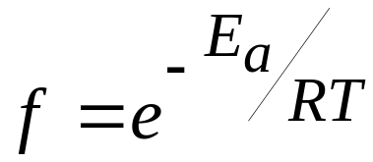
Temperature and Rate
Activation Energy
How does a methyl isonitrile molecule gain enough energy to overcome the activation energy barrier?
From kinetic molecular theory, we know that as temperature increases, the total kinetic energy increases.
We can show the fraction of molecules, f, with energy equal to or greater than E_{a} is
  where R is the gas constant (8.314 J/mol·K).

Slide 13
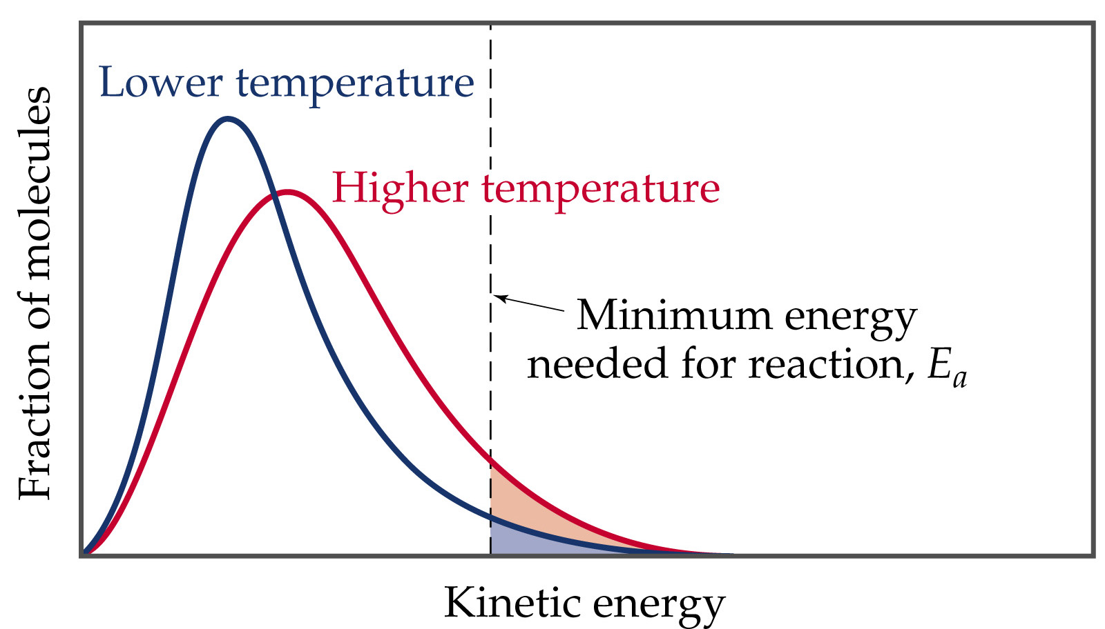
Temperature and Rate
Activation Energy

Slide 14
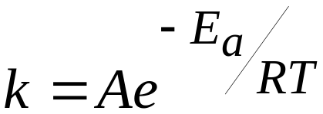
Temperature and Rate
The Arrhenius Equation
Arrhenius discovered most reaction-rate data obeyed the Arrhenius equation:
  k is the rate constant, E_{a} is the activation energy, R is the gas constant (8.314 J/K-mol) and T is the temperature in K.
  A is called the frequency factor.
  A is a measure of the probability of a favorable collision.
  Both A and E_{a} are specific to a given reaction.

Slide 15
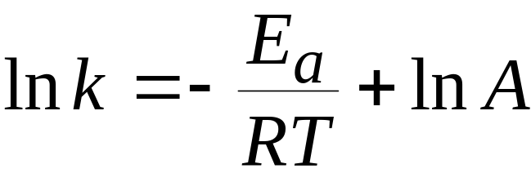
Temperature and Rate
Determining the Activation Energy
If we have a lot of data, we can determine E_{a} and A graphically by rearranging the Arrhenius equation:
From the above equation, a plot of ln k versus 1/T will have slope of –E_{a}/R and intercept of ln A.

Slide 16
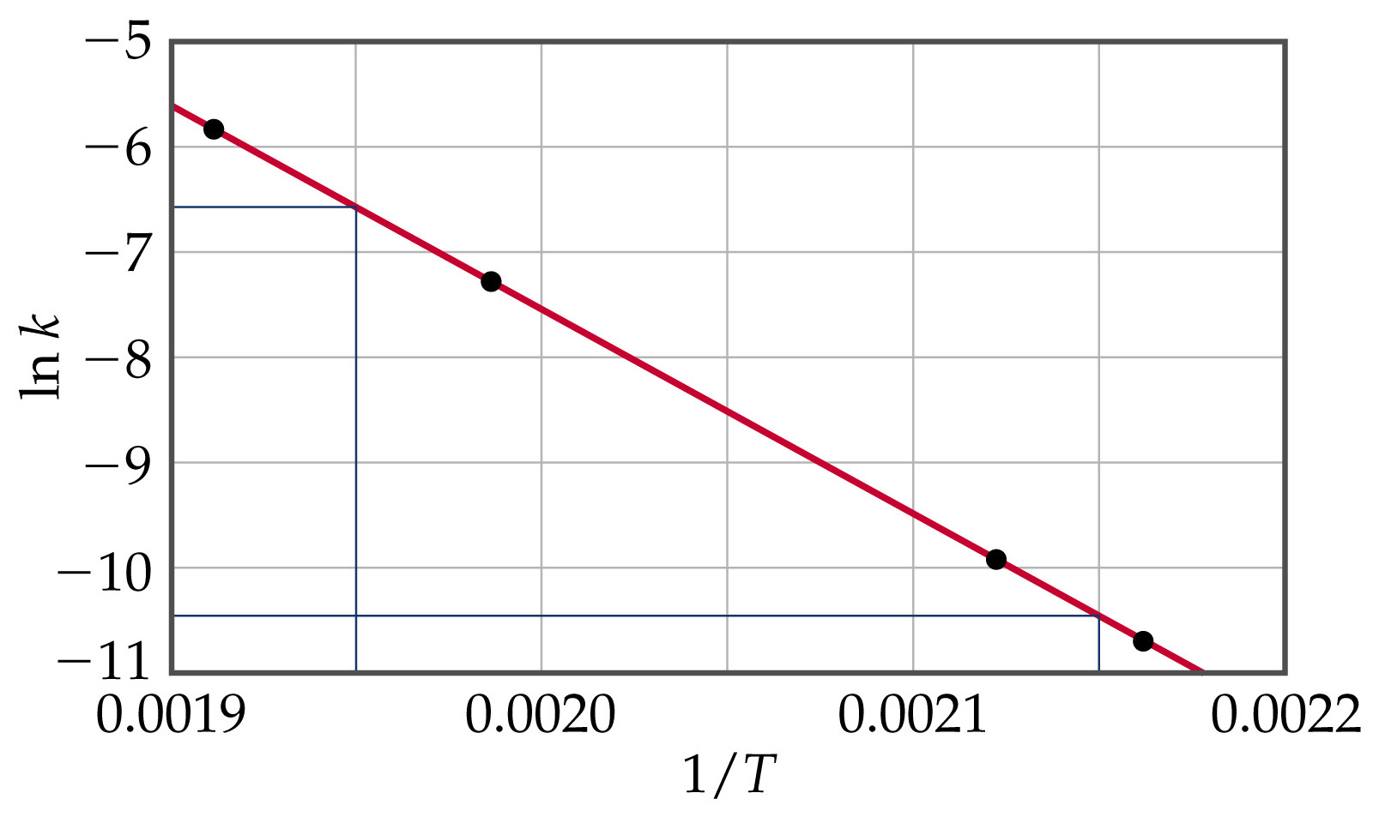
Temperature and Rate

Slide 17
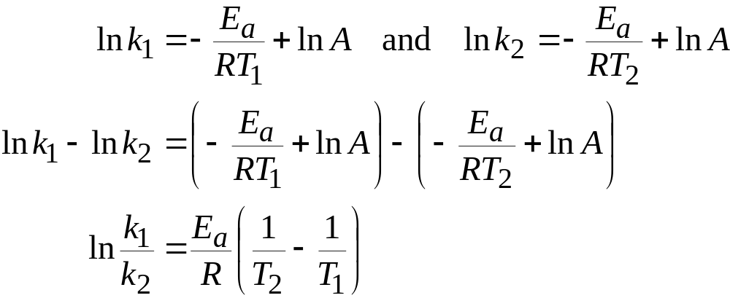
Temperature and Rate
Determining the Activation Energy
If we do not have a lot of data, then we recognize

