Slide 1
Reaction Mechanisms
The balanced chemical equation provides information about the beginning and end of reaction.
The reaction mechanism gives the path of the reaction.
Mechanisms provide a very detailed picture of which bonds are broken and formed during the course of a reaction.
Elementary Steps
Elementary step: any process that occurs in a single step.

Slide 2

Reaction Mechanisms
Elementary Steps
Molecularity: the number of molecules present in an elementary step.
  Unimolecular: one molecule in the elementary step,
  Bimolecular: two molecules in the elementary step, and
  Termolecular: three molecules in the elementary step.
It is not common to see termolecular processes (statistically improbable).

Slide 3
Reaction Mechanisms
Multistep Mechanisms
Some reaction proceed through more than one step:
NO₂(g) + NO₂(g) → NO₃(g) + NO(g)
NO₃(g) + CO(g) → NO₂(g) + CO₂(g)
Notice that if we add the above steps, we get the overall reaction:
NO₂(g) + CO(g) → NO(g) + CO₂(g)

Slide 4
Reaction Mechanisms
Multistep Mechanisms
If a reaction proceeds via several elementary steps, then the elementary steps must add to give the balanced chemical equation.
Intermediate: a species which appears in an elementary step which is not a reactant or product.

Slide 5
Reaction Mechanisms
Rate Laws for Elementary Steps
The rate law of an elementary step is determined by its molecularity:
  Unimolecular processes are first order,
  Bimolecular processes are second order, and
  Termolecular processes are third order.
Rate Laws for Multistep Mechanisms
Rate-determining step: is the slowest of the elementary steps.

Slide 6
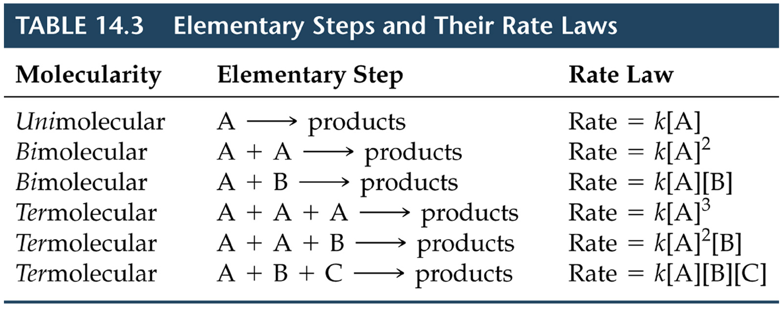
Reaction Mechanisms
Rate Laws for Elementary Steps

Slide 7
Reaction Mechanisms
  Rate Laws for Multistep Mechanisms
Therefore, the rate-determining step governs the overall rate law for the reaction.
  Mechanisms with an Initial Fast Step
It is possible for an intermediate to be a reactant.
Consider
2NO(g) + Br₂(g) → 2NOBr(g)

Slide 8
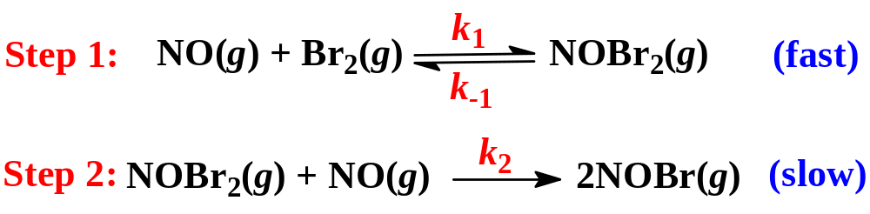
Reaction Mechanisms
  Mechanisms with an Initial Fast Step
2NO(g) + Br₂(g) → 2NOBr(g)
The experimentally determined rate law is
Rate = k[NO]²[Br₂]
Consider the following mechanism

Slide 9
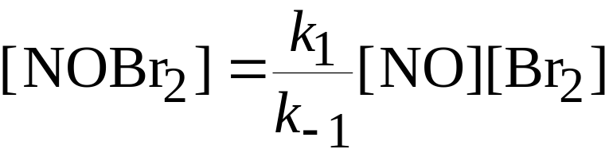
Reaction Mechanisms
  Mechanisms with an Initial Fast Step
The rate law is (based on Step 2):
Rate = k₂[NOBr₂][NO]
The rate law should not depend on the concentration of an intermediate (intermediates are usually unstable).
Assume NOBr₂ is unstable, so we express the concentration of NOBr₂ in terms of NOBr and Br₂ assuming there is an equilibrium in step 1 we have

Slide 10

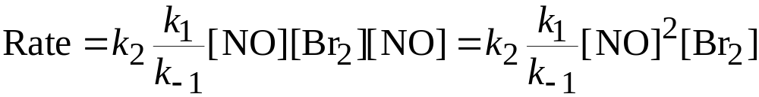
Reaction Mechanisms
  Mechanisms with an Initial Fast Step
By definition of equilibrium:
Therefore, the overall rate law becomes
Note the final rate law is consistent with the experimentally observed rate law.

Slide 11
Catalysis
A catalyst changes the rate of a chemical reaction.
There are two types of catalyst:
  homogeneous, and
  heterogeneous.
Chlorine atoms are catalysts for the destruction of ozone.
  Homogeneous Catalysis
The catalyst and reaction is in one phase.

Slide 12
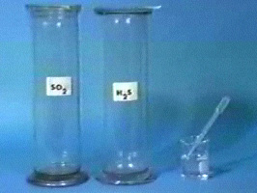
Catalysis

Slide 13
Catalysis
  Homogeneous Catalysis
Hydrogen peroxide decomposes very slowly:
2H₂O₂(aq) → 2H₂O(l) + O₂(g)
In the presence of the bromide ion, the decomposition occurs rapidly:
  2Br⁻(aq) + H₂O₂(aq) + 2H⁺(aq) → Br₂(aq) + 2H₂O(l).
  Br₂(aq) is brown.
  Br₂(aq) + H₂O₂(aq) → 2Br⁻(aq) + 2H⁺(aq) + O₂(g).
  Br⁻ is a catalyst because it can be recovered at the end of the reaction.

Slide 14
Catalysis
  Homogeneous Catalysis
Generally, catalysts operate by lowering the activation energy for a reaction.

