Slide 1
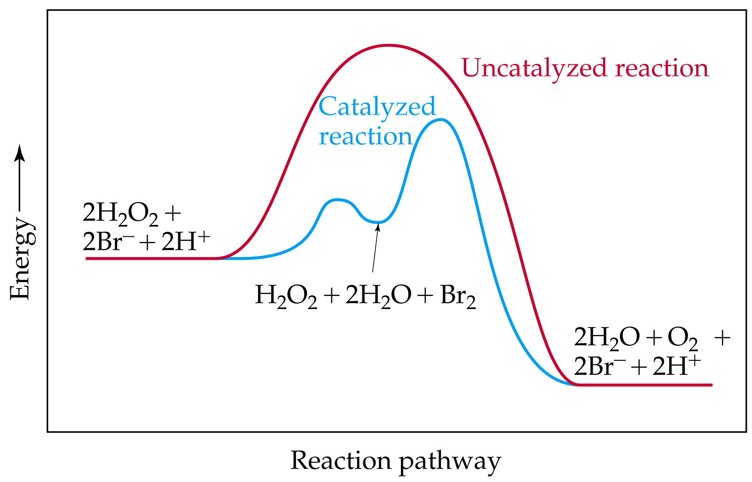
Catalysis

Slide 2
Catalysis
  Homogeneous Catalysis
Catalysts can operate by increasing the number of effective collisions.
That is, from the Arrhenius equation: catalysts increase k be increasing A or decreasing E_{a}.
A catalyst may add intermediates to the reaction.
Example: In the presence of Br⁻, Br₂(aq) is generated as an intermediate in the decomposition of H₂O₂.

Slide 3
Catalysis
  Homogeneous Catalysis
When a catalyst adds an intermediate, the activation energies for both steps must be lower than the activation energy for the uncatalyzed reaction. The catalyst is in a different phase than the reactants and products.
  Heterogeneous Catalysis
Typical example: solid catalyst, gaseous reactants and products (catalytic converters in cars).
Most industrial catalysts are heterogeneous.

Slide 4
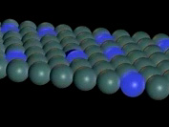
Catalysis
  Heterogeneous Catalysis
First step is adsorption (the binding of reactant molecules to the catalyst surface).
Adsorbed species (atoms or ions) are very reactive.
Molecules are adsorbed onto active sites on the catalyst surface.

Slide 5
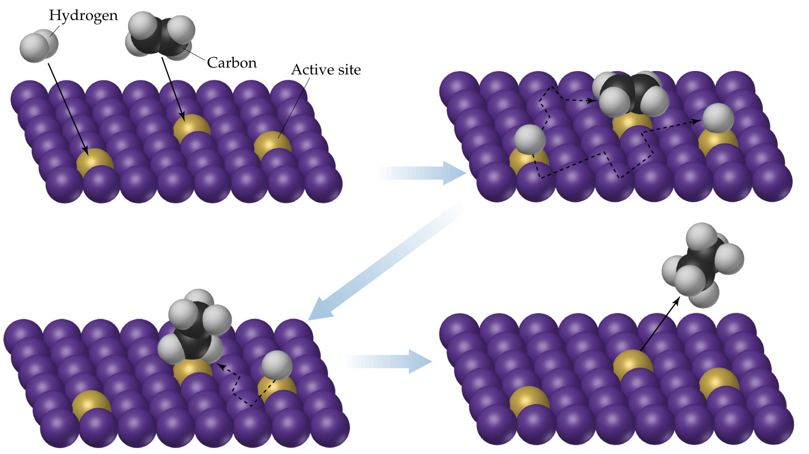
Catalysis

Slide 6
Catalysis
  Heterogeneous Catalysis
Consider the hydrogenation of ethylene:
C₂H₄(g) + H₂(g) → C₂H₆(g), ΔH = -136 kJ/mol.
  The reaction is slow in the absence of a catalyst.
  In the presence of a metal catalyst (Ni, Pt or Pd) the reaction occurs quickly at room temperature.
  First the ethylene and hydrogen molecules are adsorbed onto active sites on the metal surface.
  The H-H bond breaks and the H atoms migrate about the metal surface.

Slide 7
Catalysis
  Heterogeneous Catalysis
  When an H atom collides with an ethylene molecule on the surface, the C-C π bond breaks and a C-H σ bond forms.
  When C₂H₆ forms it desorbs from the surface.
  When ethylene and hydrogen are adsorbed onto a surface, less energy is required to break the bonds and the activation energy for the reaction is lowered.
  Enzymes
Enzymes are biological catalysts.
Most enzymes are protein molecules with large molecular masses (10,000 to 10⁶ amu).

Slide 8
Catalysis
  Enzymes
Enzymes have very specific shapes.
Most enzymes catalyze very specific reactions.
Substrates undergo reaction at the active site of an enzyme.
A substrate locks into an enzyme and a fast reaction occurs.
The products then move away from the enzyme.

Slide 9
Catalysis
  Enzymes
Only substrates that fit into the enzyme lock can be involved in the reaction.
If a molecule binds tightly to an enzyme so that another substrate cannot displace it, then the active site is blocked and the catalyst is inhibited (enzyme inhibitors).
The number of events (turnover number) catalyzed is large for enzymes (10³ - 10⁷ per second).

Slide 10
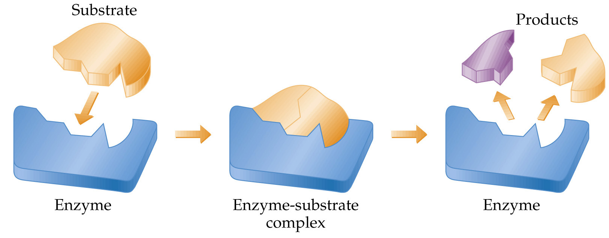
Catalysis
  Enzymes

