Slide 1
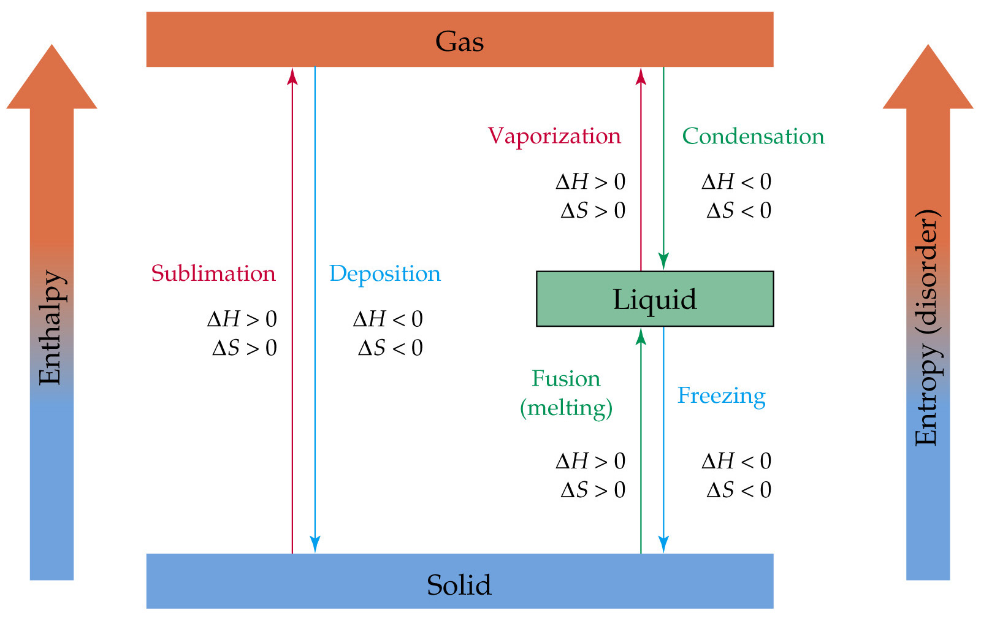
Notes:
Figure: 10-09
Title:
Enthalpy and entropy of phase changes
Caption:
Figure 10.9 Changes from a less random phase to a more random one have positive values of DH and DS. Changes from a more random phase to a less random one have negative values of DH and DS.

Slide 2
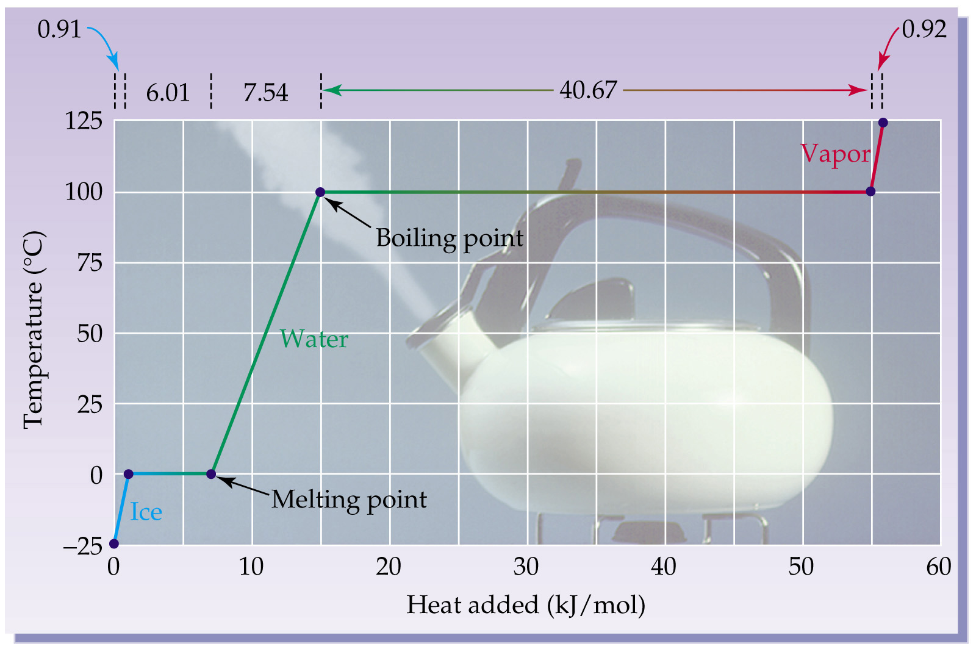
Notes:
Figure: 10-10
Title:
Heating curve for water
Caption:
Figure 10.10 A heating curve for H2O, showing the temperature changes and phase transitions that occur when heat is added. The plateau at 0°C represents the melting of solid ice, and the plateau at 100°C represents the boiling of liquid water.

Slide 3
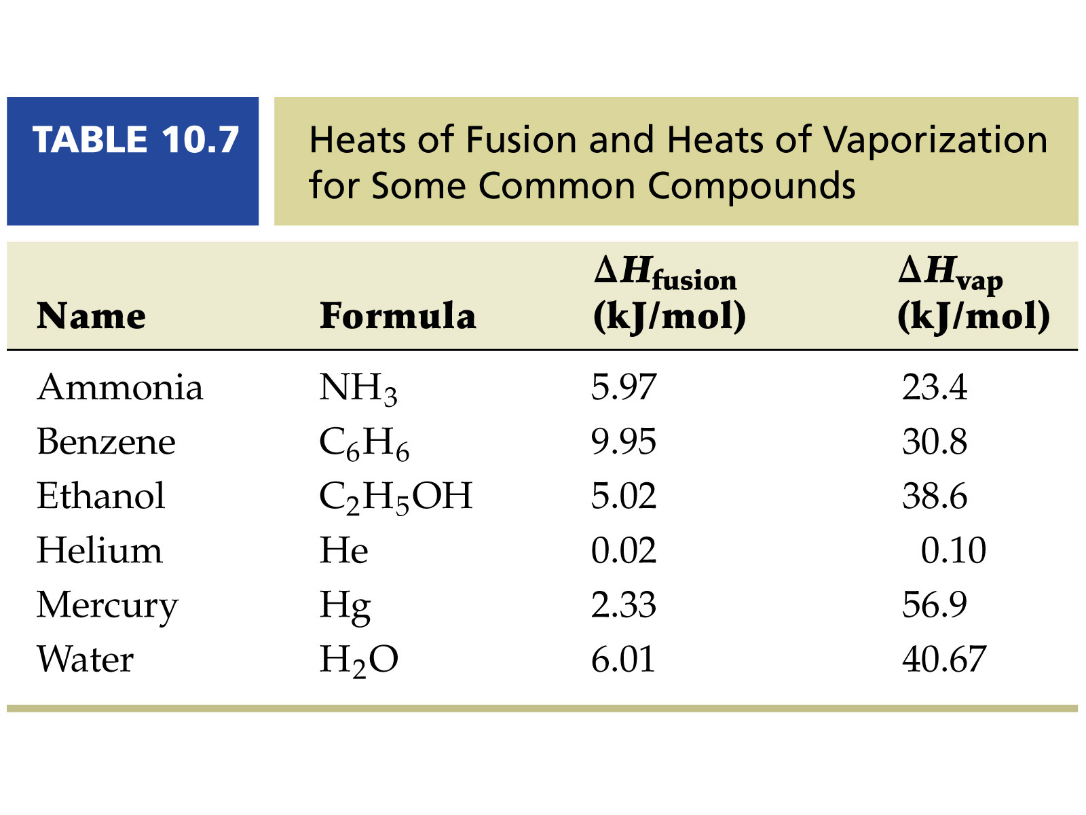
Notes:
Figure: Table 10.7
Title:
Caption:

Slide 4
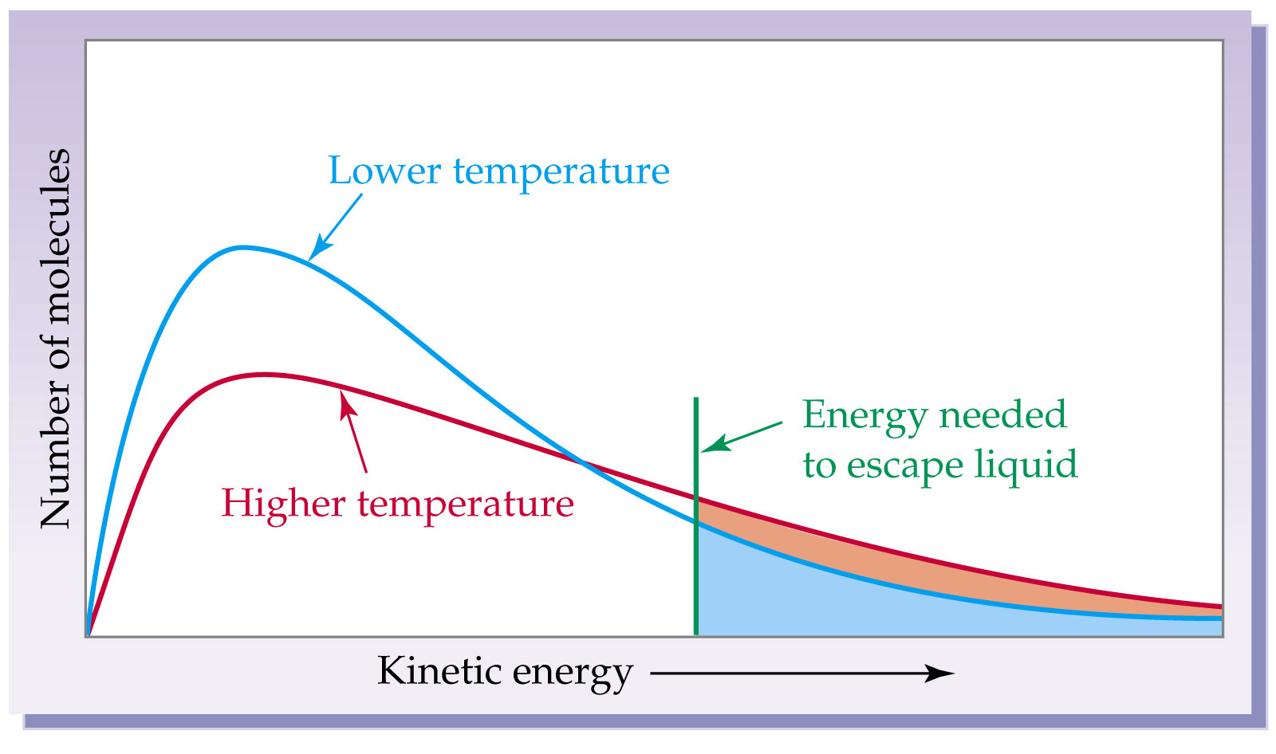
Notes:
Figure: 10-12
Title:
Molecular kinetic energies of a liquid
Caption:
Figure 10.12 The distribution of molecular kinetic energies in a liquid at two temperatures. Only the faster-moving molecules have sufficient kinetic energy to escape from the liquid and enter the vapor. The higher the temperature, the larger the number of molecules with enough energy to escape.

Slide 5
Vapor Pressure
Vapor Pressure and Boiling Point
Liquids boil when the external pressure equals the vapor pressure.
Temperature of boiling point increases as pressure increases.

Slide 6
Phase Diagrams
Phase diagram: plot of pressure vs. Temperature summarizing all equilibria between phases.
Given a temperature and pressure, phase diagrams tell us which phase will exist.
Any temperature and pressure combination not on a curve represents a single phase.

Slide 7
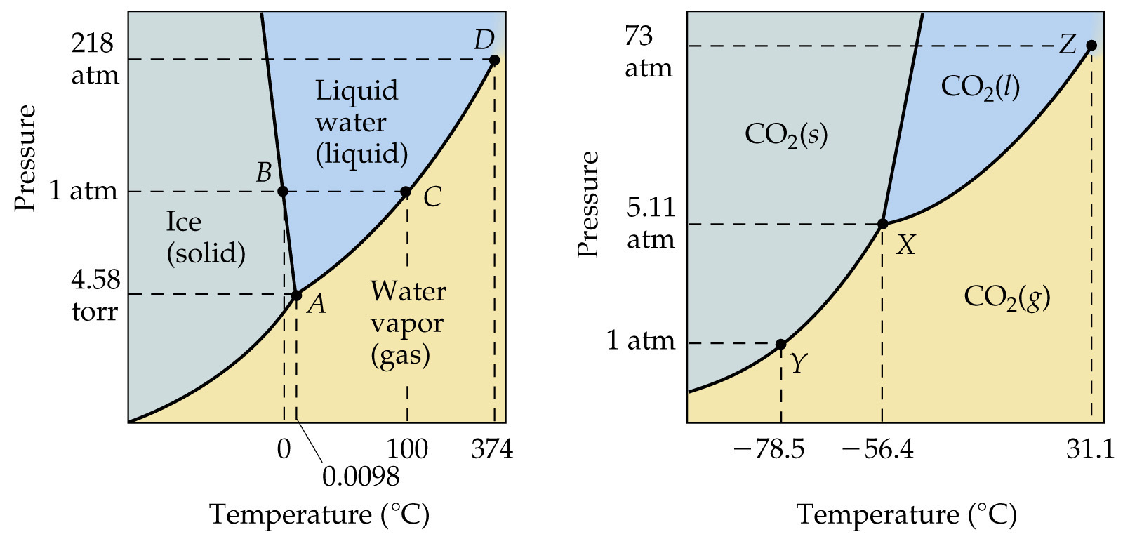
Phase Diagrams
The Phase Diagrams of H₂O and CO₂

Slide 8
Phase Diagrams
The Phase Diagrams of H₂O and CO₂
Water:
  The melting point curve slopes to the left because ice is less dense than water.
  Triple point occurs at 0.0098°C and 4.58 mmHg.
  Normal melting (freezing) point is 0°C.
  Normal boiling point is 100°C.
  Critical point is 374°C and 218 atm.

Slide 9
Phase Diagrams
The Phase Diagrams of H₂O and CO₂
Carbon Dioxide:
  Triple point occurs at -56.4°C and 5.11 atm.
  Normal sublimation point is -78.5°C. (At 1 atm CO₂ sublimes it does not melt.)
  Critical point occurs at 31.1°C and 73 atm.

Slide 10
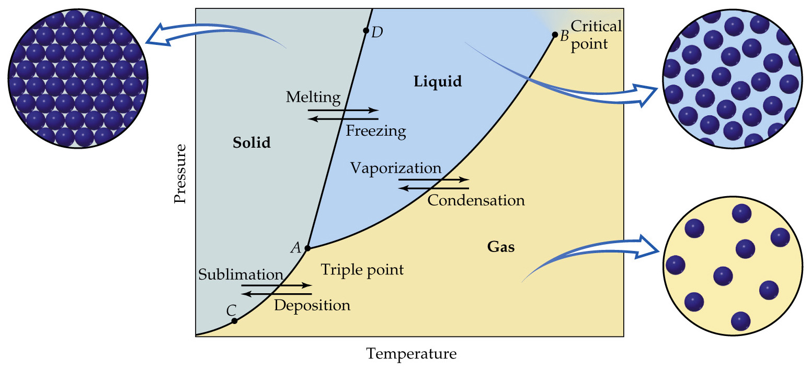
Phase Diagrams

Slide 11
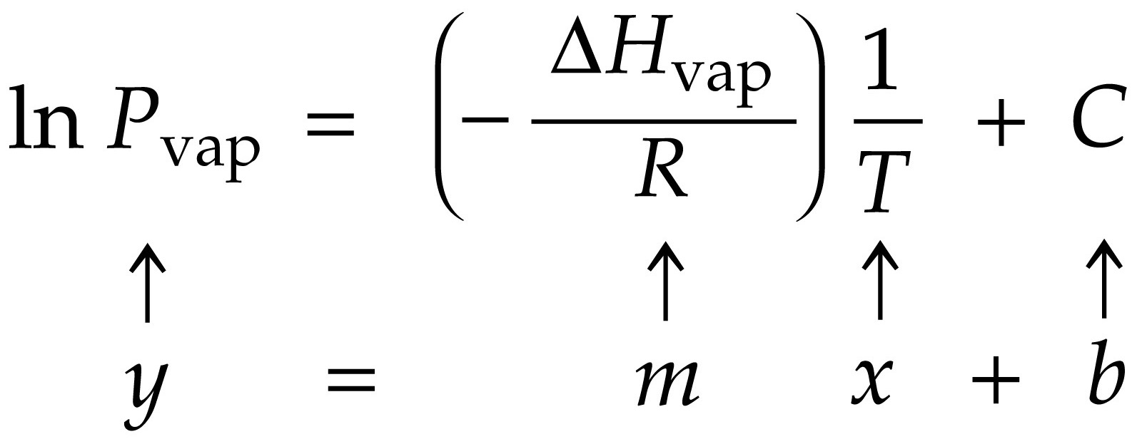
Notes:
Figure: 10-12-01UN
Title:
The Clausius–Clapeyron Equation
Caption:
The inverse relationship between ln Pvap and temperature is linear according to the Clausius–Clapeyron equation.

Slide 12
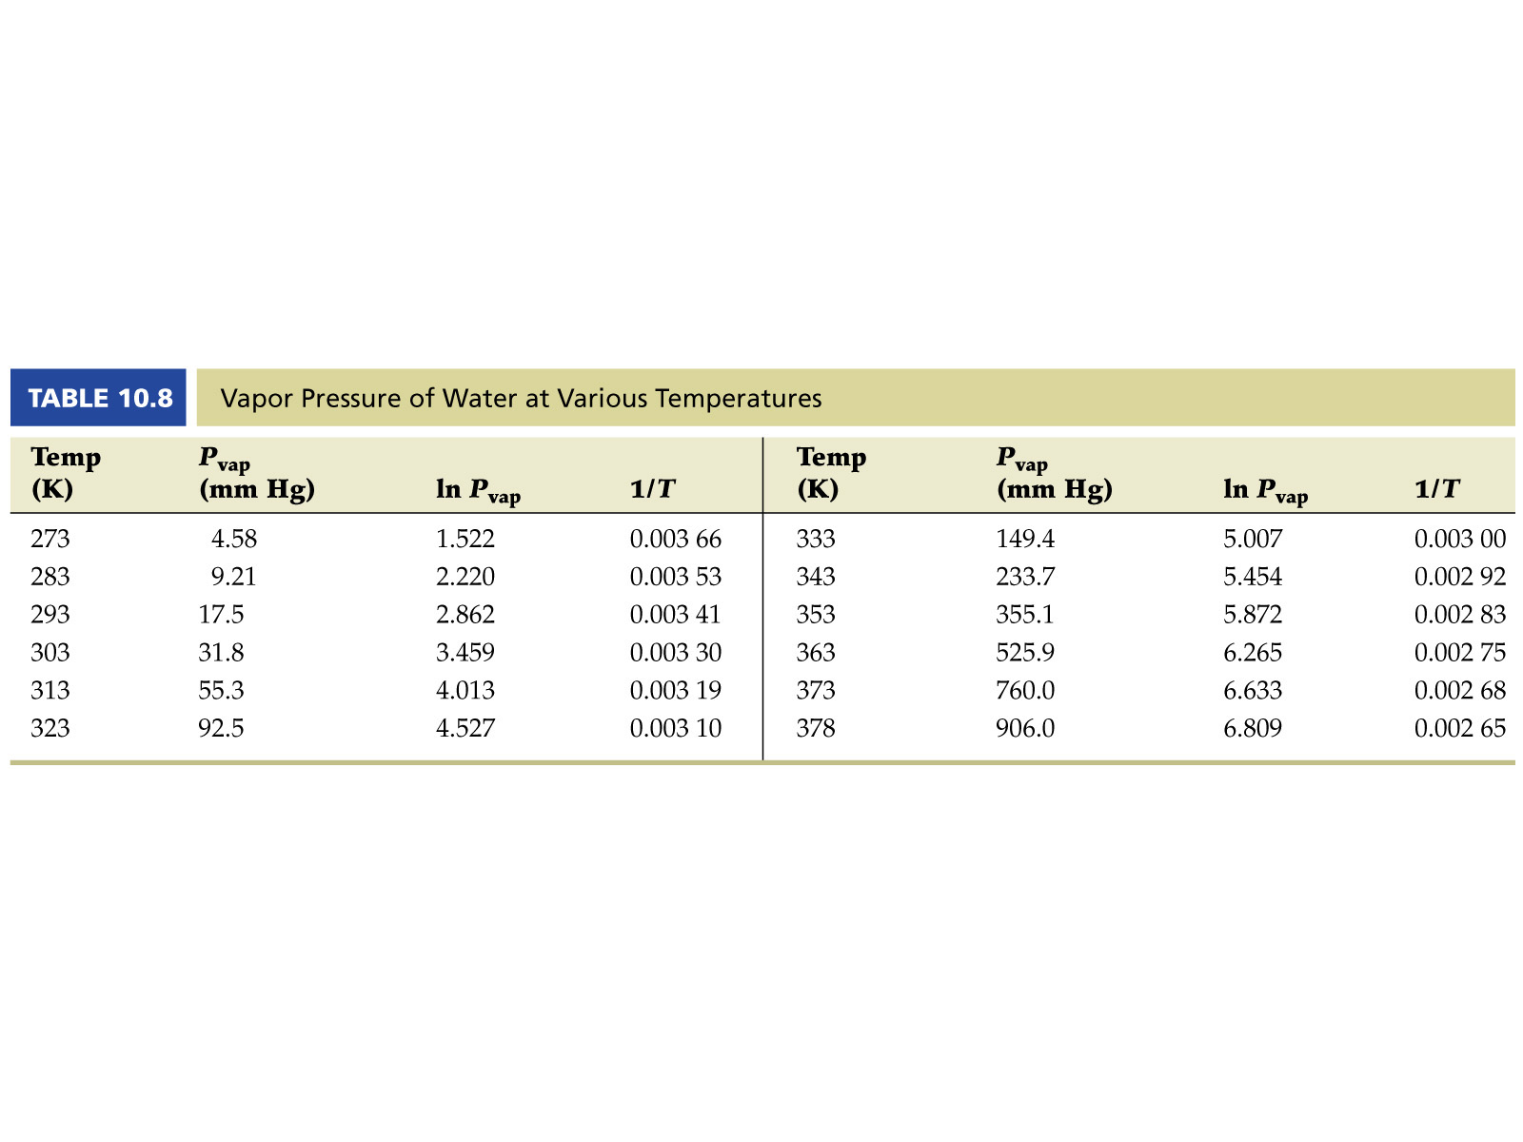
Notes:
Figure: Table 10.8
Title:
Caption:

Slide 13
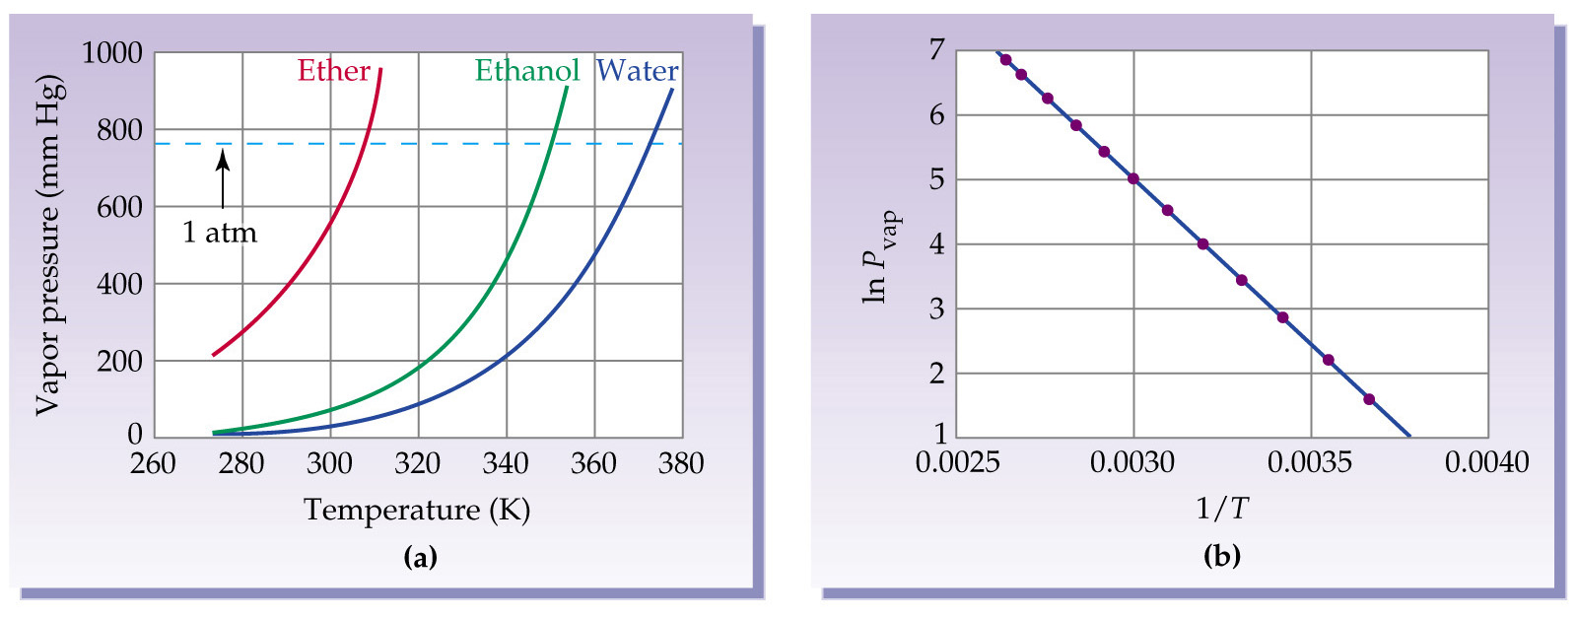
Notes:
Figure: 10-13
Title:
Vapor Pressure and Temperature
Caption:
Figure 10.13 (a) The vapor pressures of water, ethanol, and diethyl ether show a nonlinear rise when plotted as a function of temperature. (b) A plot of ln Pvap versus 1/T (Kelvin) for water, prepared from the data in Table 10.8, shows a linear relationship.

Slide 14
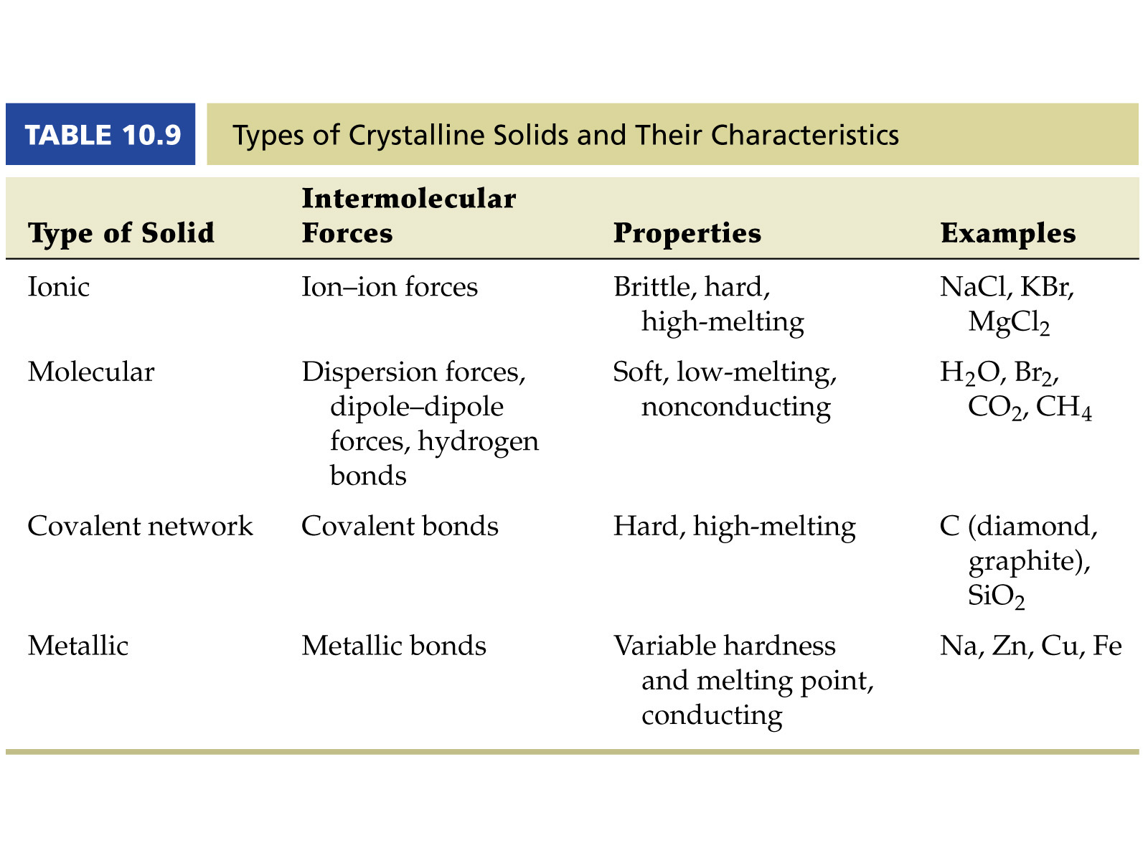
Notes:
Figure: Table 10.9
Title:
Caption:

Slide 15
Structures of Solids
Unit Cells
Crystalline solid: well-ordered, definite arrangements of molecules, atoms or ions.
Crystals have an ordered, repeated structure.
The smallest repeating unit in a crystal is a unit cell.
Unit cell is the smallest unit with all the symmetry of the entire crystal.
Three-dimensional stacking of unit cells is the crystal lattice.

Slide 16
Structures of Solids
Unit Cells
Three common types of unit cell.
  Primitive cubic, atoms at the corners of a simple cube,
    each atom shared by 8 unit cells;
  Body-centered cubic (bcc), atoms at the corners of a cube plus one in the center of the body of the cube,
    corner atoms shared by 8 unit cells, center atom completely enclosed in one unit cell;
  Face-centered cubic (fcc), atoms at the corners of a cube plus one atom in the center of each face of the cube,
    corner atoms shared by 8 unit cells, face atoms shared by 2 unit cells.

Slide 17
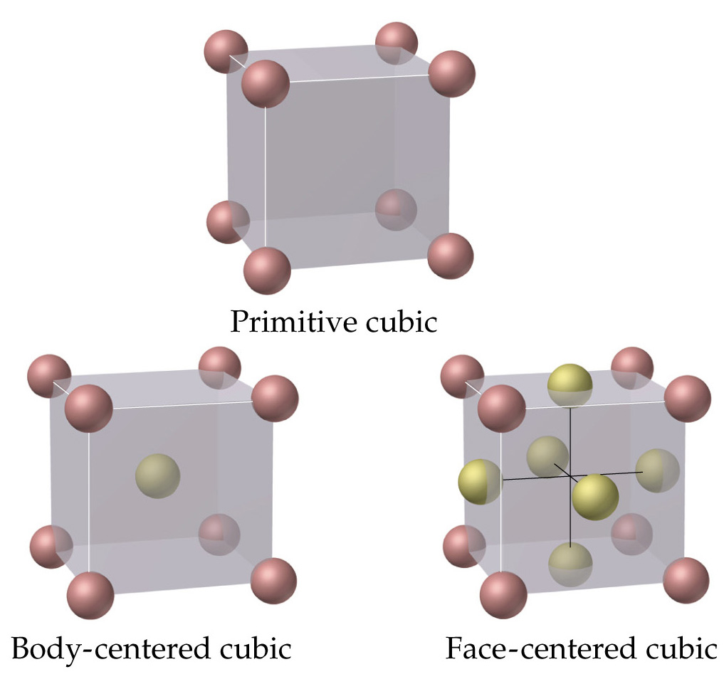
Unit Cells

Slide 18
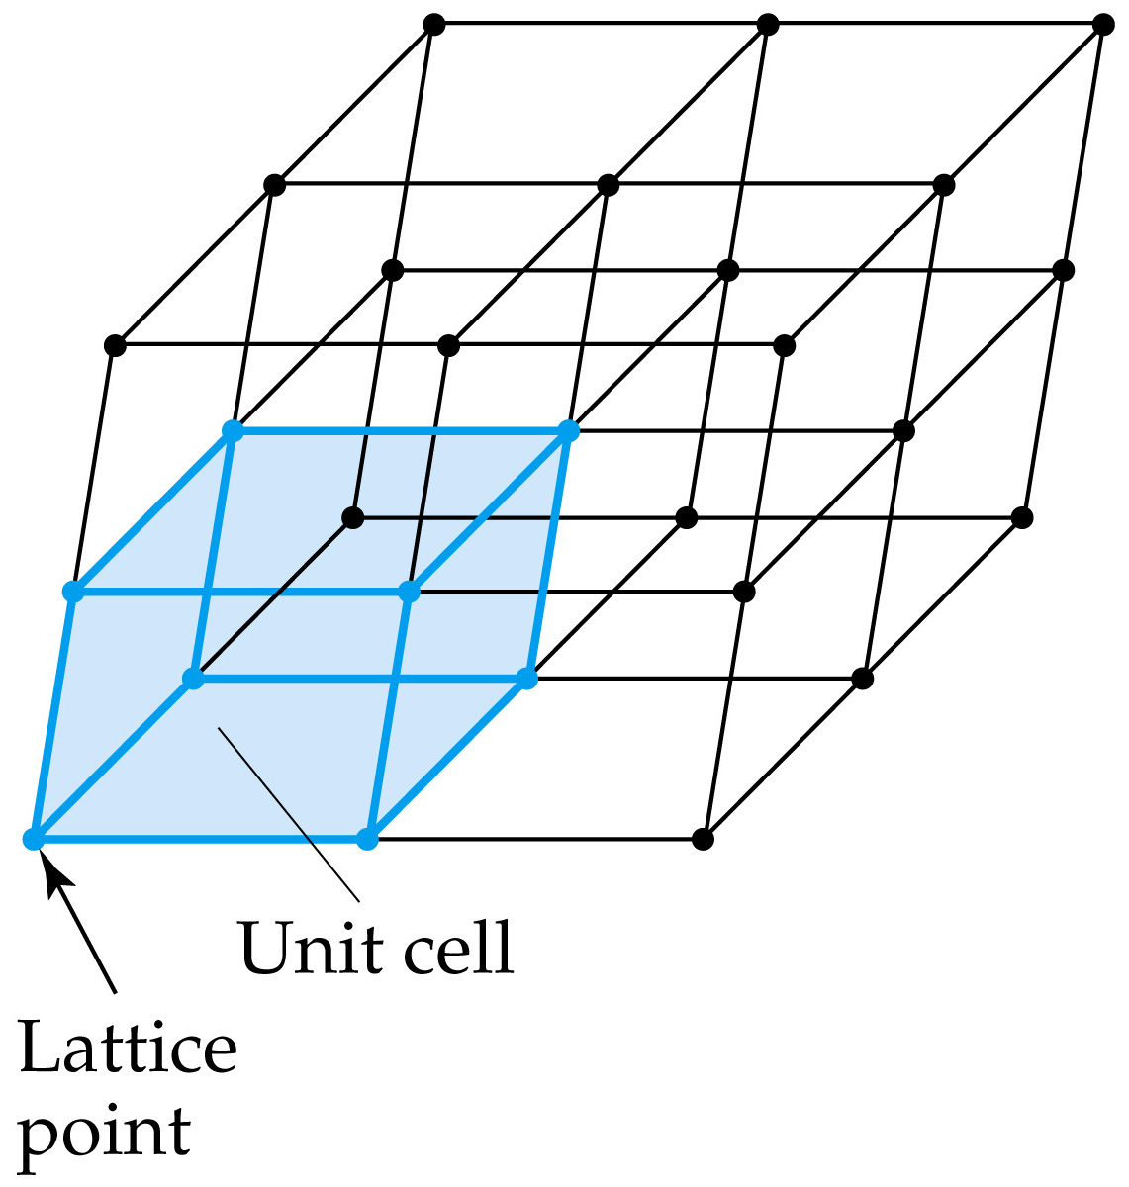
Structures of Solids
Unit Cells

Slide 19
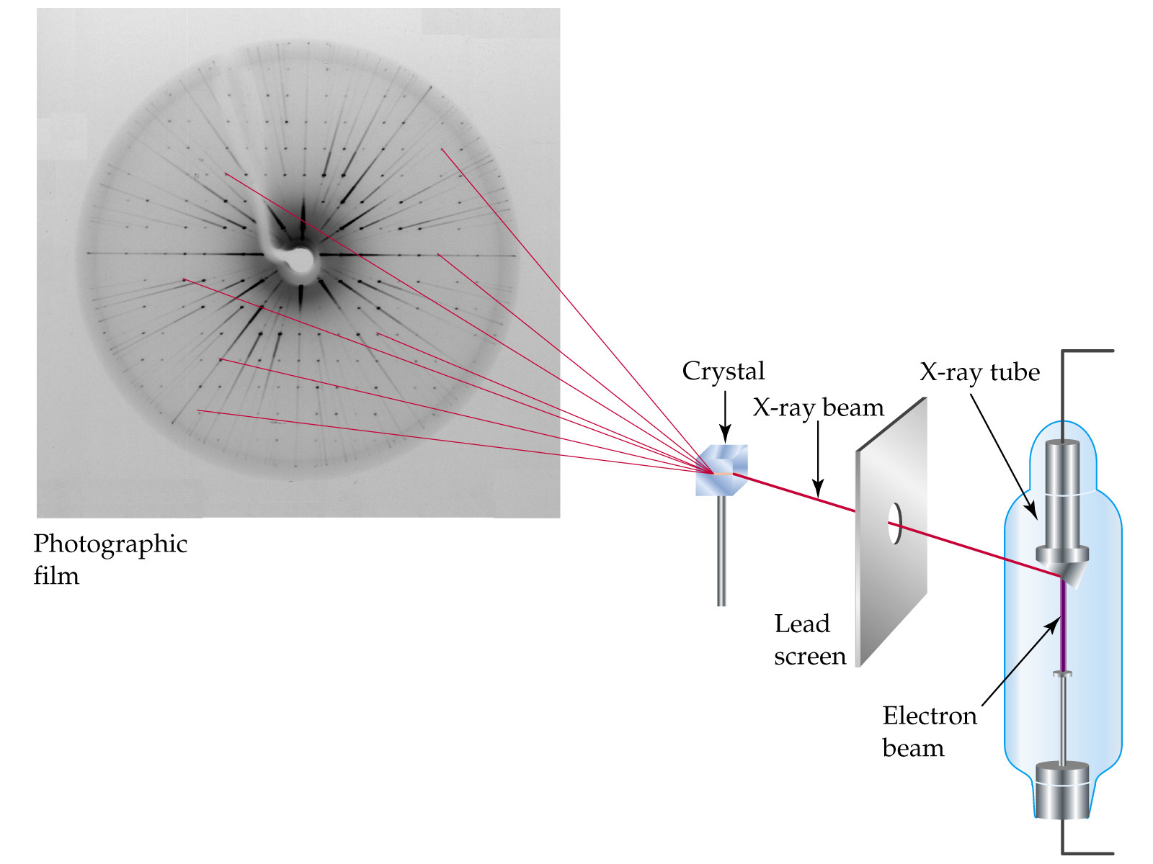
Notes:
Figure: 10-16
Title:
X-ray diffraction
Caption:
Figure 10.16 An X-ray diffraction experiment. A beam of X rays is passed through a crystal and allowed to strike a photographic film. The rays are diffracted by atoms in the crystal, giving rise to a regular pattern of spots on the film.

Slide 20

Interference:
Constructive Destructive

Slide 21
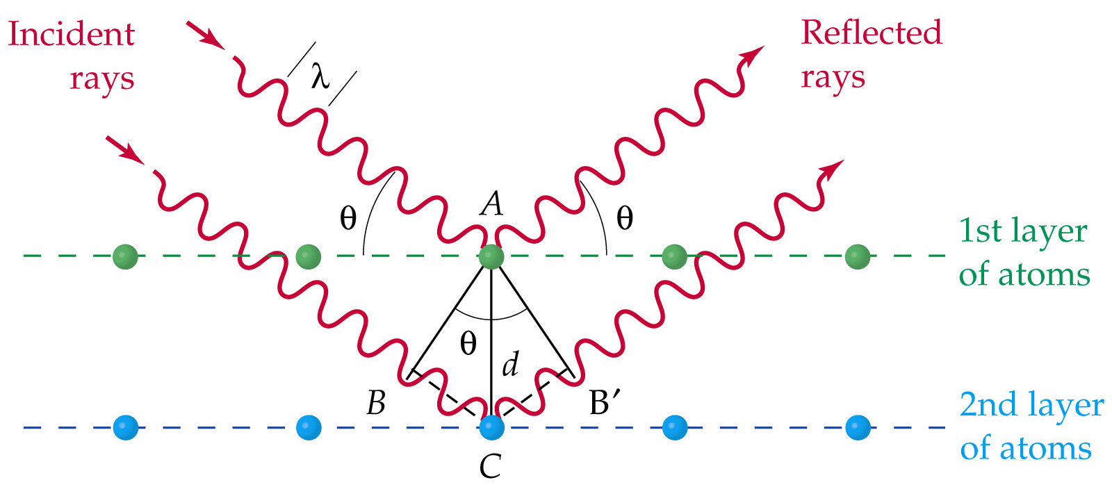
Bragg Equation(Diffraction) nλ = 2 d sinθ

Slide 22
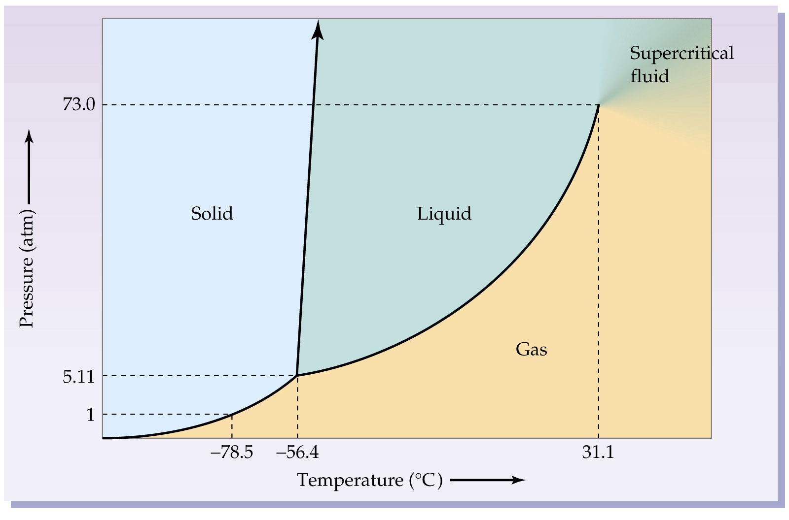
Notes:
Figure: 10-29
Title:
Phase diagram for carbon dioxide
Caption:
Figure 10.29 A phase diagram for CO2, showing a positive slope for the solid/liquid boundary. The pressure and temperature axes are not to scale.

Slide 23
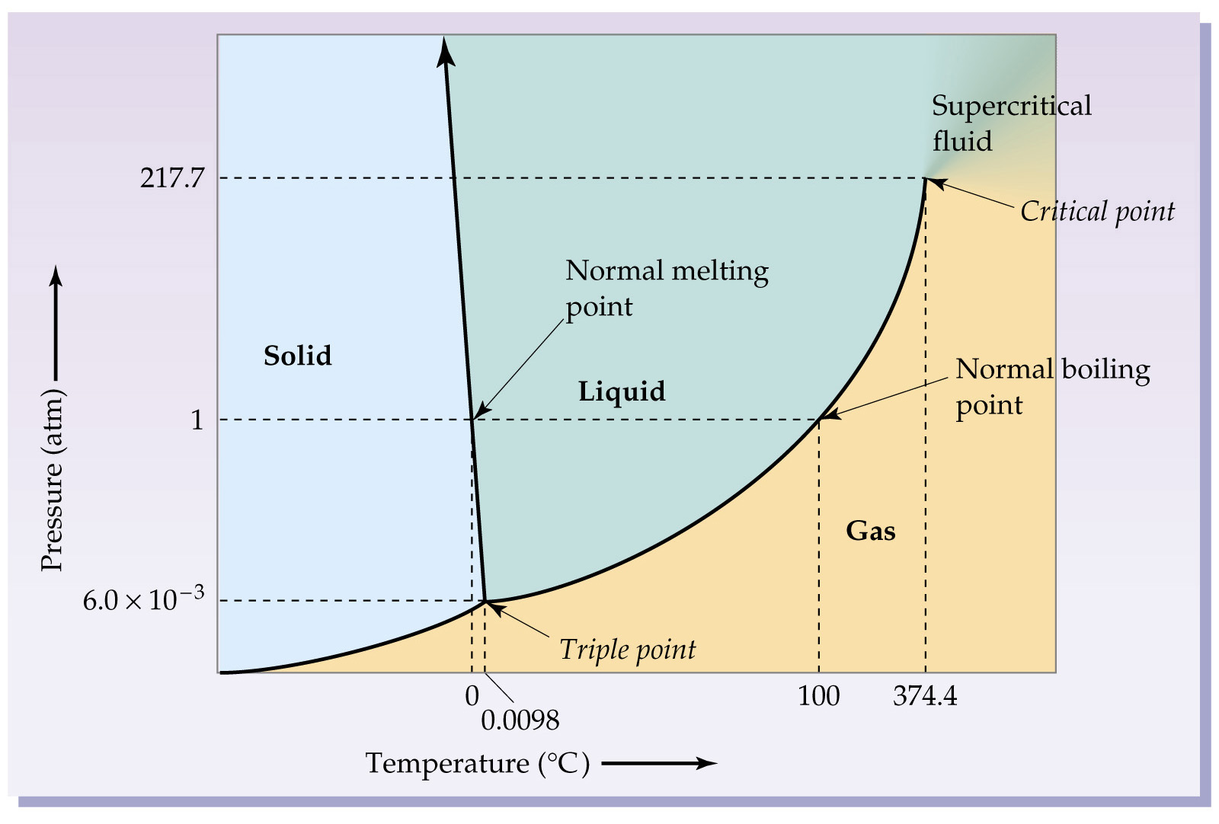
Notes:
Figure: 10-28
Title:
Phase diagram for water
Caption:
Figure 10.28 A phase diagram for H2O, showing a negative slope for the solid/liquid boundary. Various features of the diagram are discussed in the text. Note that the pressure and temperature axes are not drawn to scale.

