Slide 1

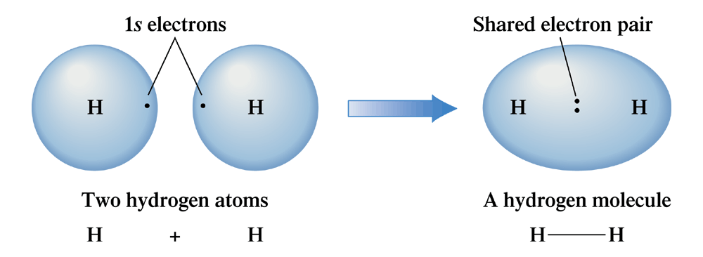
Figure 5.1 Electron sharing can occur only when electron orbitals from two different atoms overlap.

Slide 2
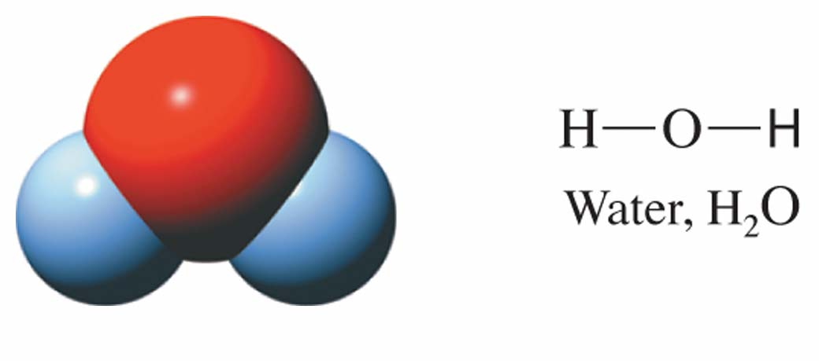
Figure 5.2 The number of covalent bonds formed by a nonmetallic element is directly correlated with the number of electrons it must share in order to obtain an octet of electrons. O, with six valance electrons, forms two covalent bonds.

Slide 3
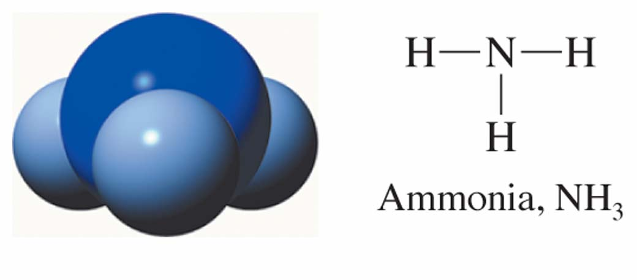
Figure 5.2 The number of covalent bonds formed by a nonmetallic element is directly correlated with the number of electrons it must share in order to obtain an octet of electrons. N, with five valence electrons, forms three covalent bonds.

Slide 4
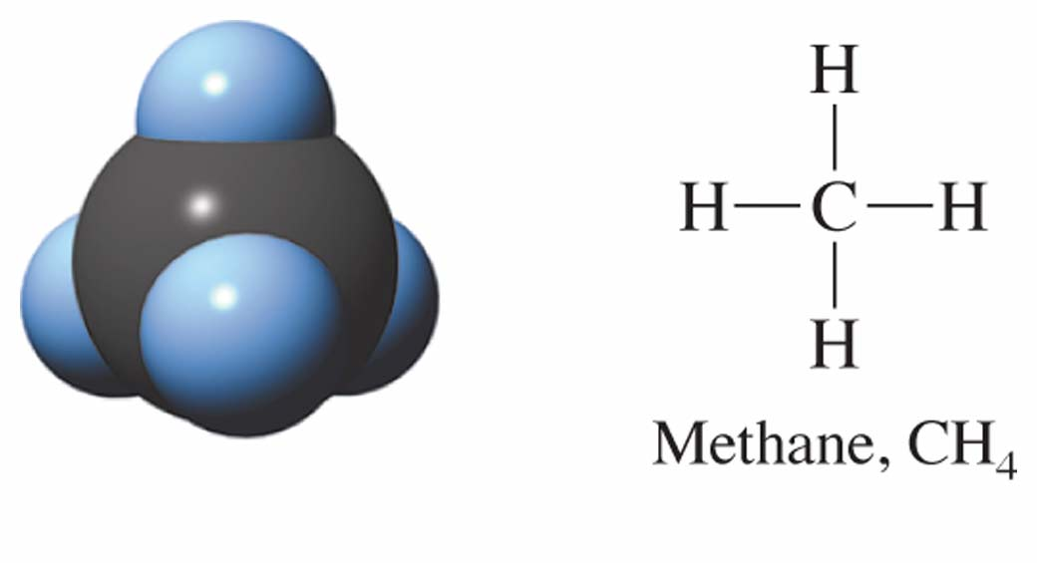
Figure 5.2 The number of covalent bonds formed by a nonmetallic element is directly correlated with the number of electrons it must share in order to obtain an octet of electrons. C, with four valence electrons, forms four covalent bonds.

Slide 5
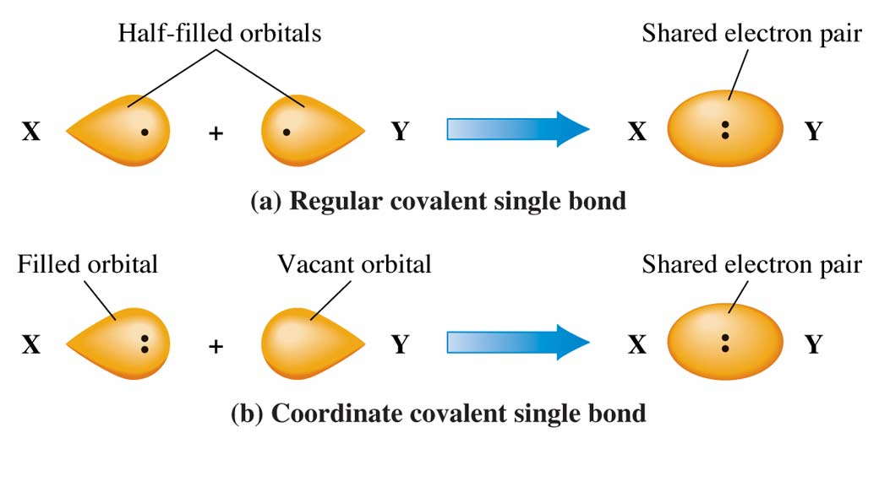
Figure 5.3 (a) A “regular” covalent single bond is the result of overlap of two half-filled orbitals. (b) A coordinate covalent single bond is the result of overlap of a filled and a vacant orbital.

Slide 6
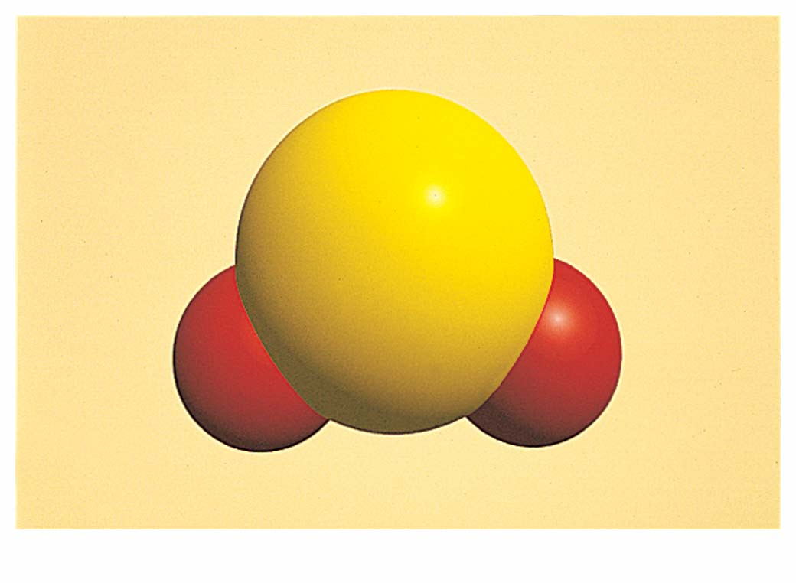
Figure 5.4 The sulfur dioxide (SO₂) molecule.
A computer-generated model.

Slide 7
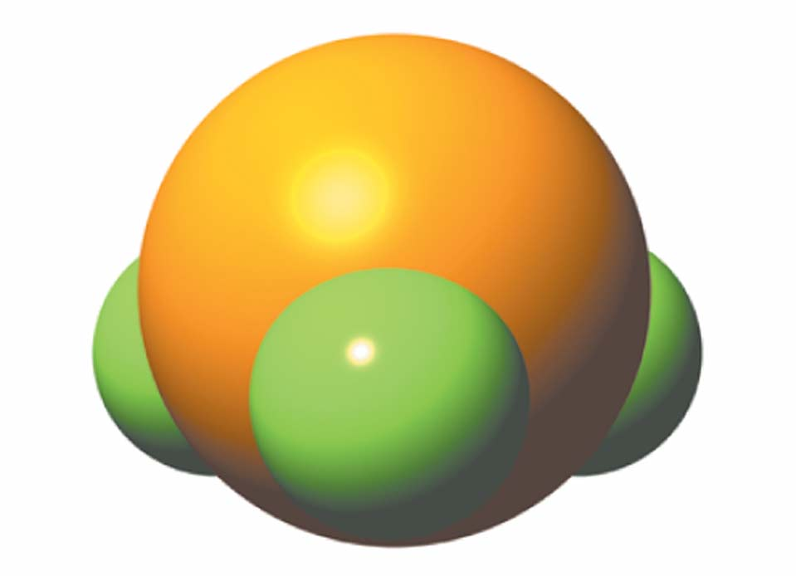
Figure 5.5 The phosphorous trifluoride (PF₃) molecule. A computer-generated model.

Slide 8
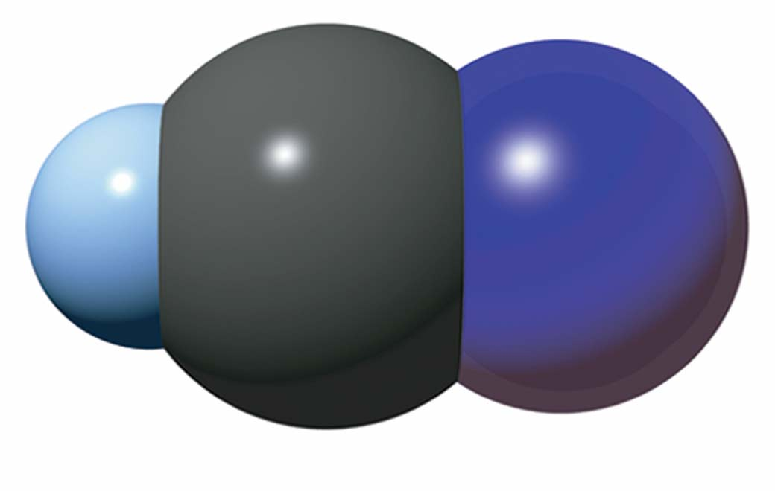
Figure 5.6 The hydrogen cyanide (HCN) molecule. A computer-generated model.

Slide 9
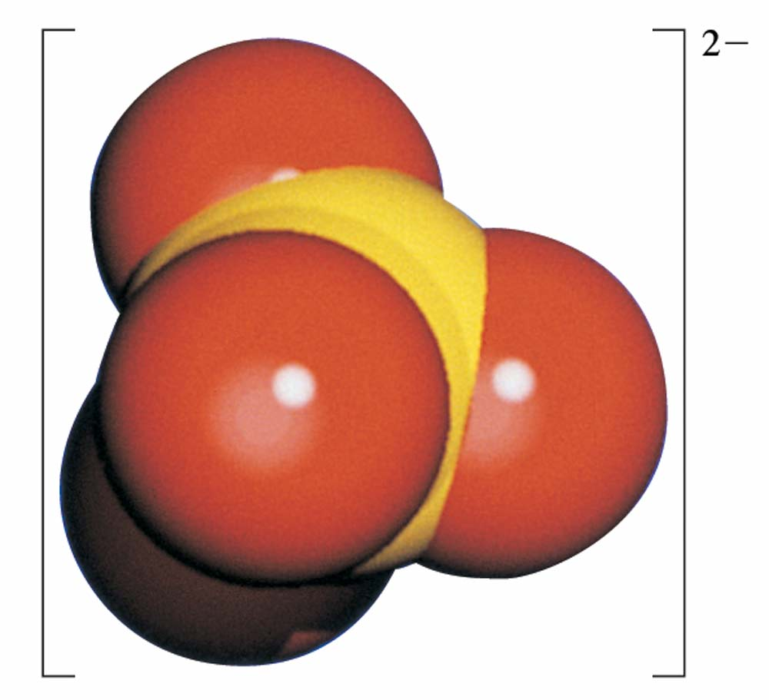
Figure 5.7 The sulfate ion (SO₄²⁻).
A computer-generated model.

Slide 10
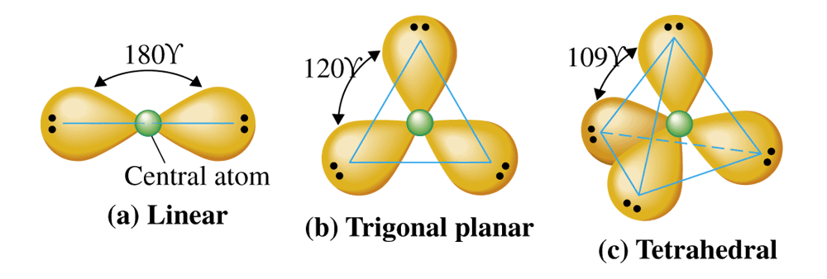
Figure 5.8 Arrangements of valence electron pairs about a central atom that minimize repulsions between the pairs.

Slide 11
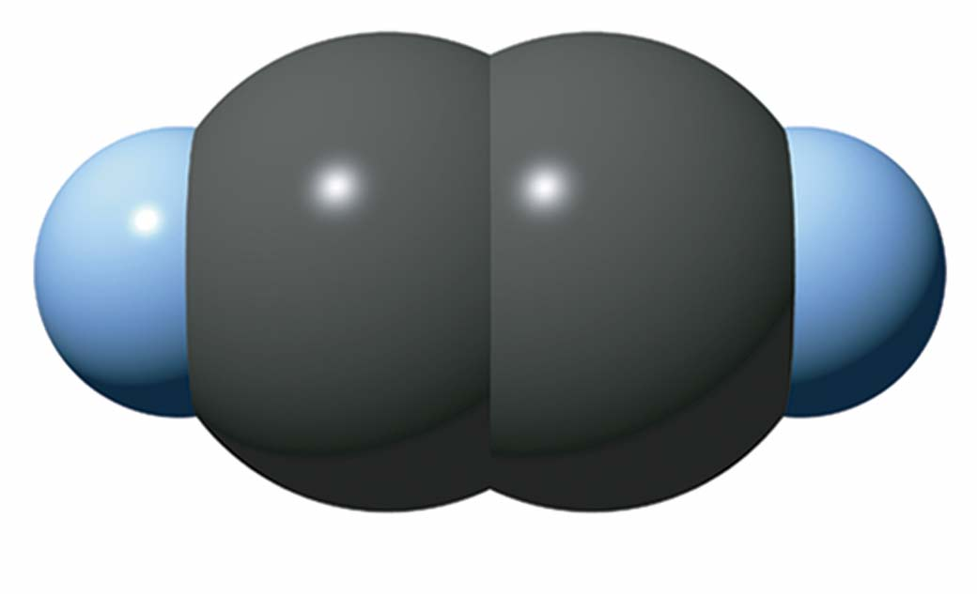
Figure 5.9 Computer-generated model of C₂H₂.

Slide 12
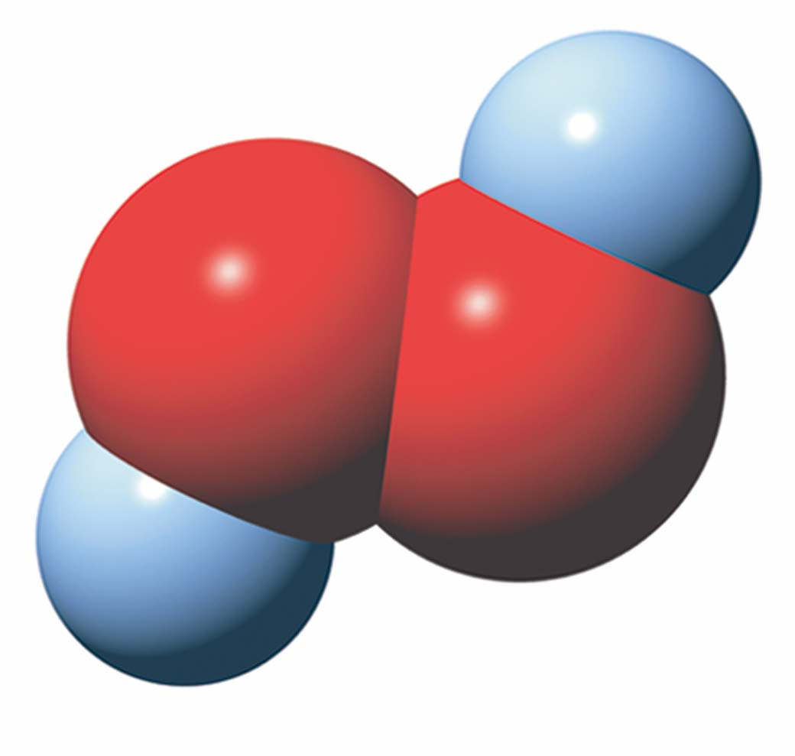
Figure 5.9 Computer-generated model of H₂O₂.

Slide 13
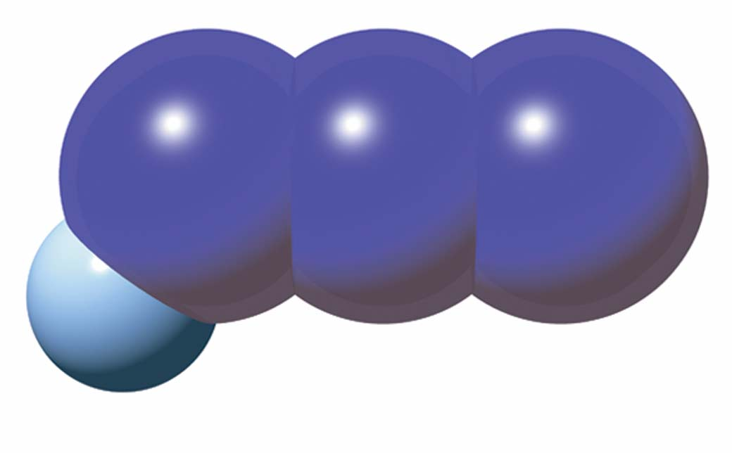
Figure 5.9 Computer-generated model of NH₃.

Slide 14
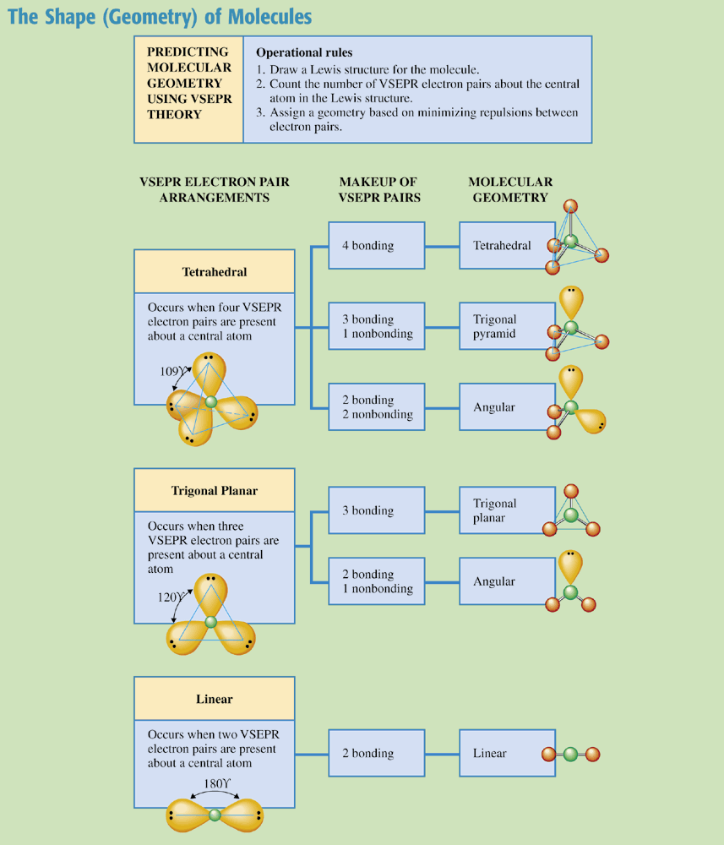
Chemistry at a Glance:
The Shape (Geometry) of Molecules

Slide 15
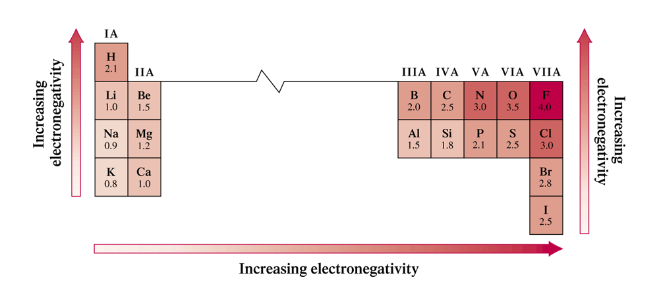
Figure 5.11 Abbreviated periodic table showing Pauling electronegativity values for selected representative elements.

Slide 16
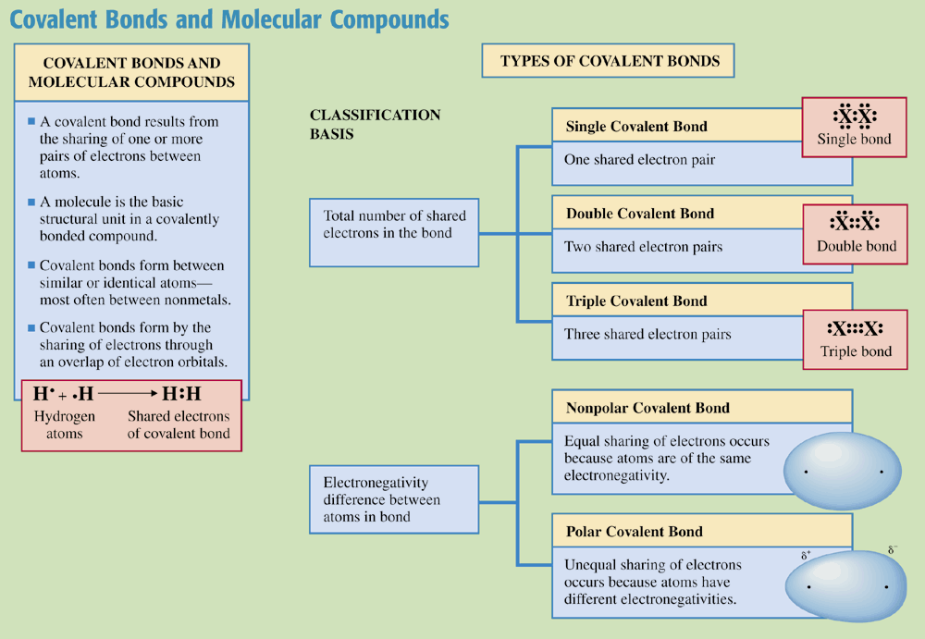
Chemistry at a Glance:
Covalent Bonds and Molecular Compounds

Slide 17
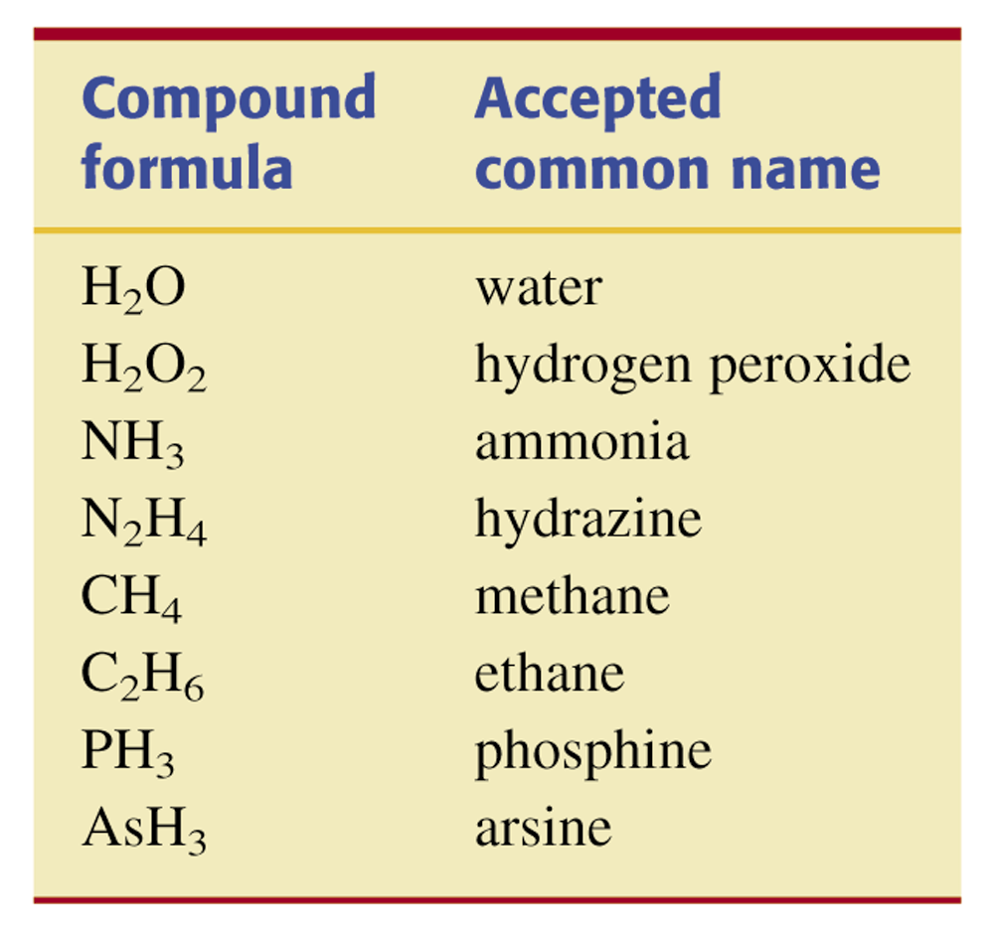
Table 5.2 Selected Binary Molecular Compounds that Have Common Names.

Slide 18
