Slide 1

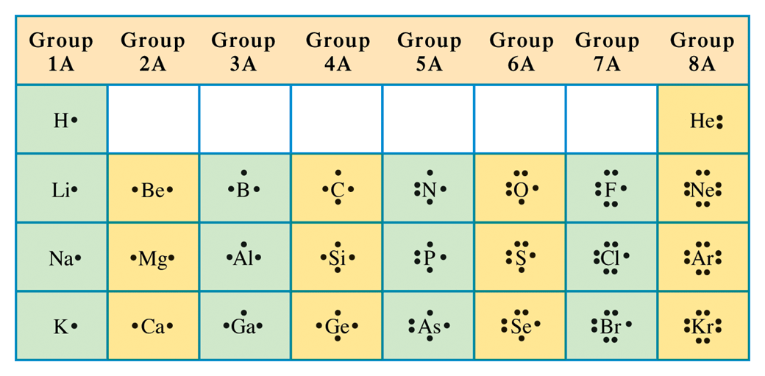
Figure 4.1 Lewis structures for selected representative and noble-gas elements.

Slide 2
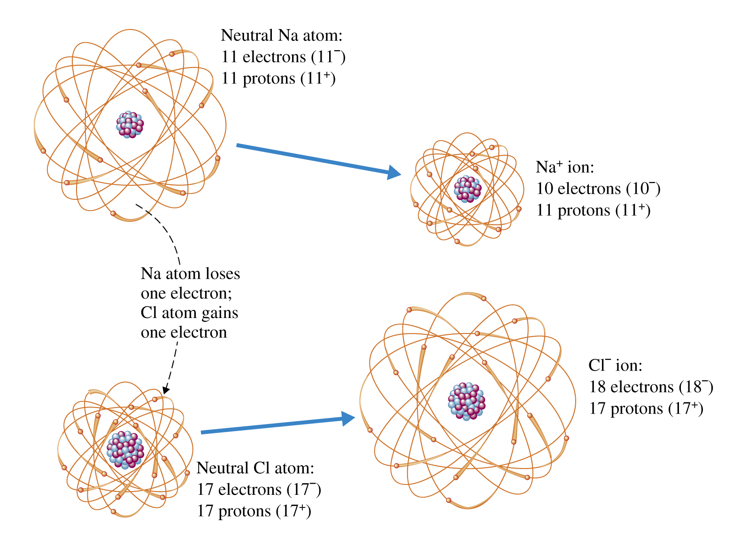
Figure 4.3 Loss of an electron from a sodium atom leaves it with one more proton than electrons, so it has a net electrical charge of + 1. When chlorine gains an electron, it has one more electron than protons, so it has a net electrical charge of - 1.

Slide 3
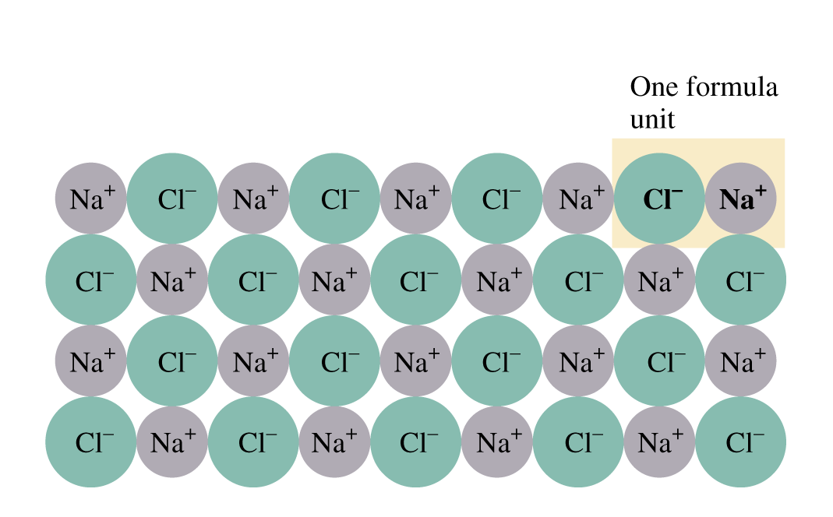
Figure 4.5 Two-dimensional cross section of an ionic solid (NaCl). No molecule can be distinguished in this structure. Instead, we can recognize a basic formula unit that is repeated indefinitely.

Slide 4
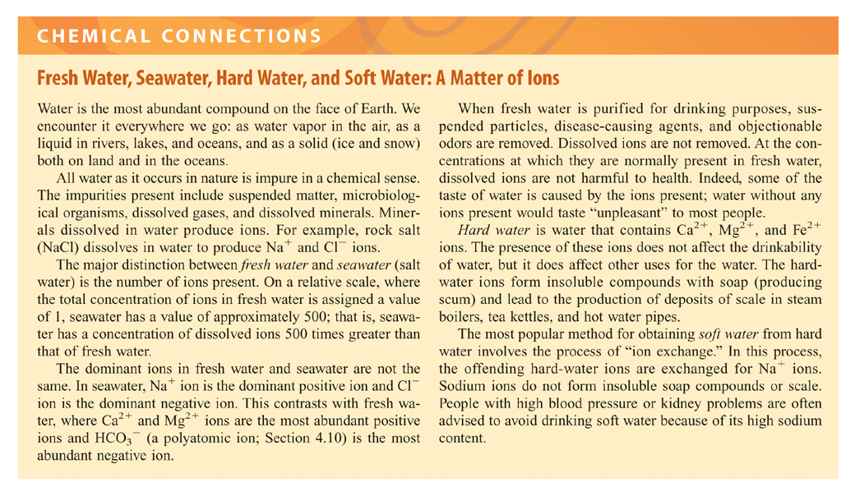

Slide 5
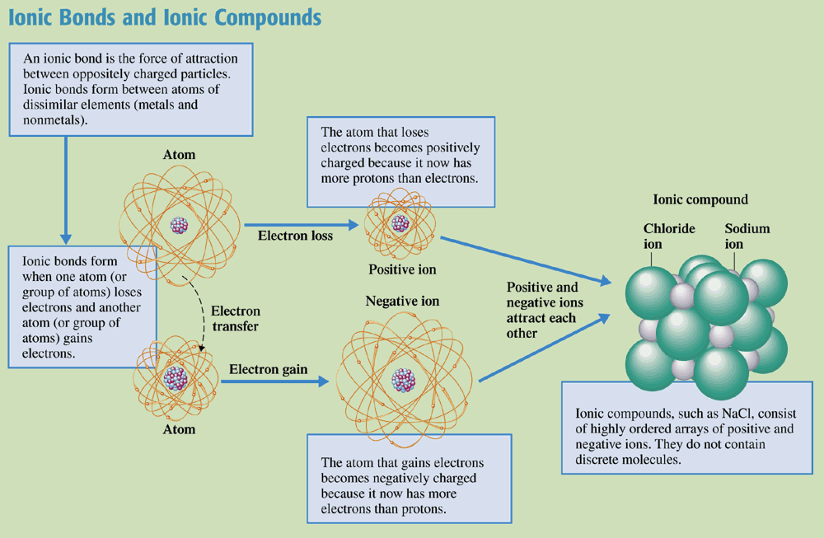
Chemistry at a Glance:
Ionic Bonds and Ionic Compounds

Slide 6
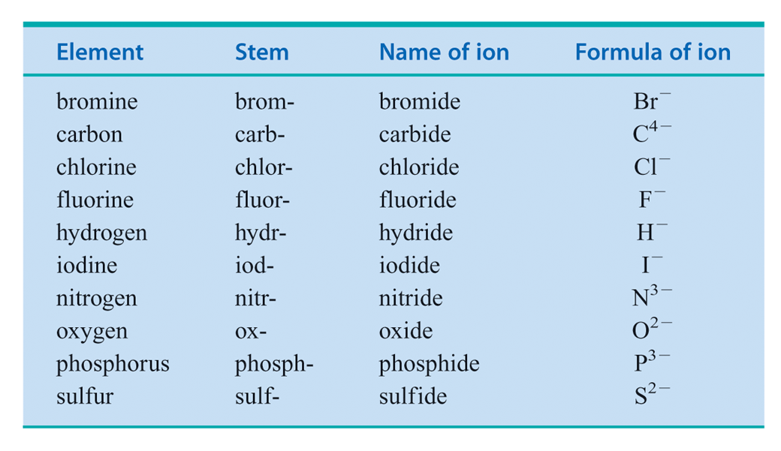
Table 4.2 Names of Selected
Common Nonmetallic Ions.

Slide 7
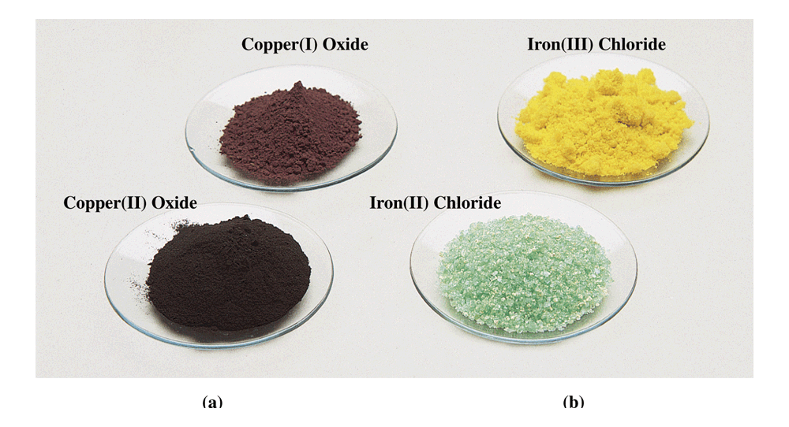
Figure 4.7 (a) Copper (II) oxide (CuO) is black, whereas copper (I) oxide (Cu2O) is reddish brown. (b) Iron (II) chloride (FeCl2) is green, whereas iron (III) chloride (FeCl3) is bright yellow.

Slide 8
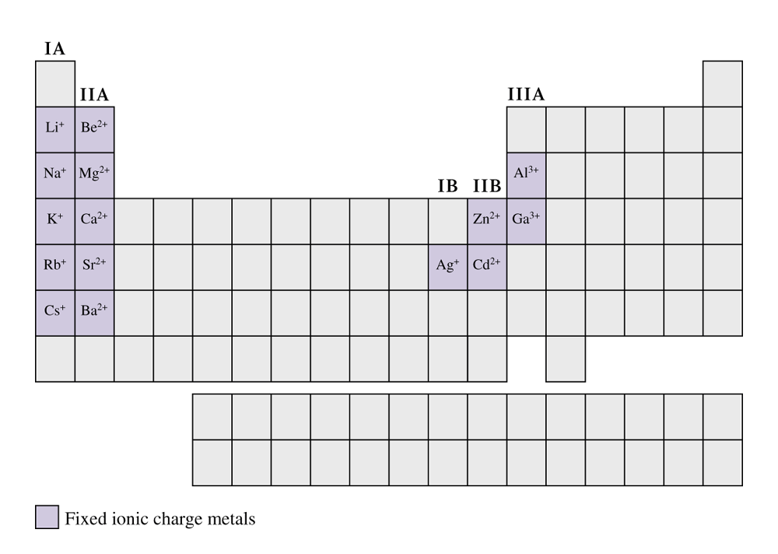
Figure 4.8 A periodic table in which the metallic elements that exhibit a fixed ionic charge are highlighted.

Slide 9
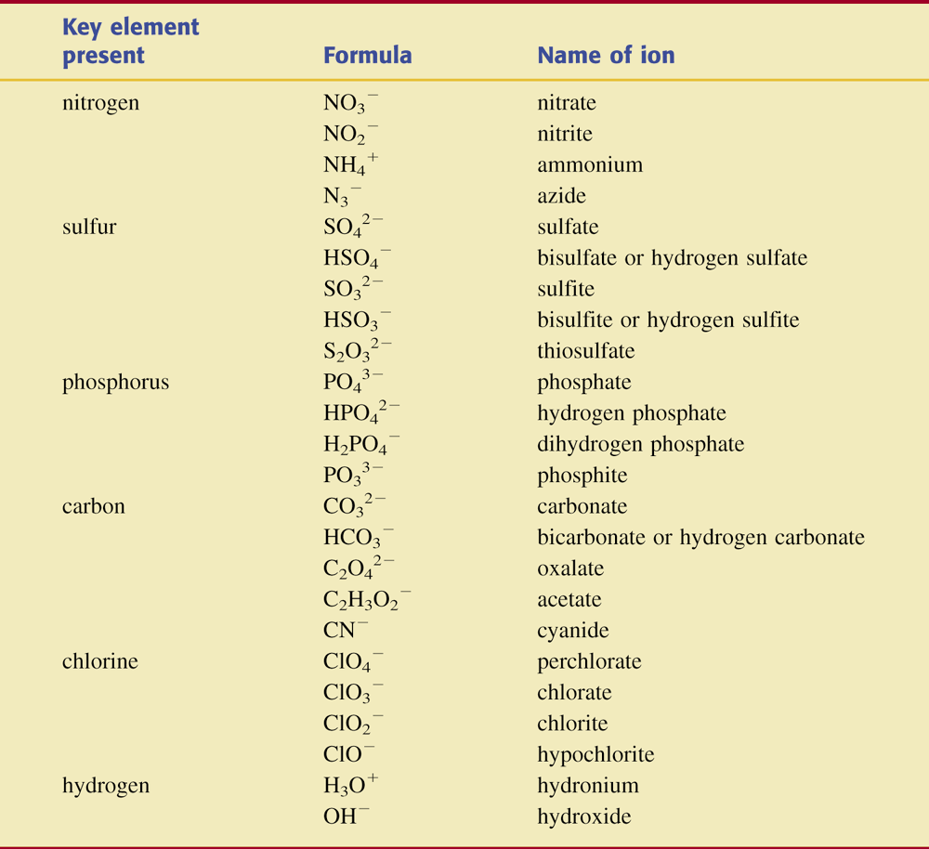
Table 4.3 Formulas and Names of Some Common Polyatomic Ions.

Slide 10
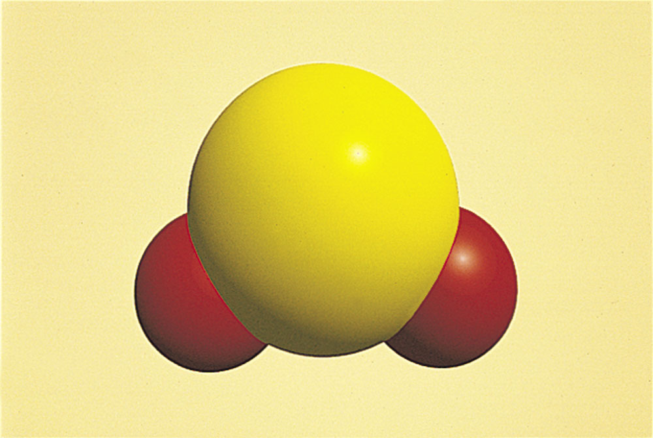
Figure 4.9 The sulfur dioxide (SO2) molecule.

Slide 11
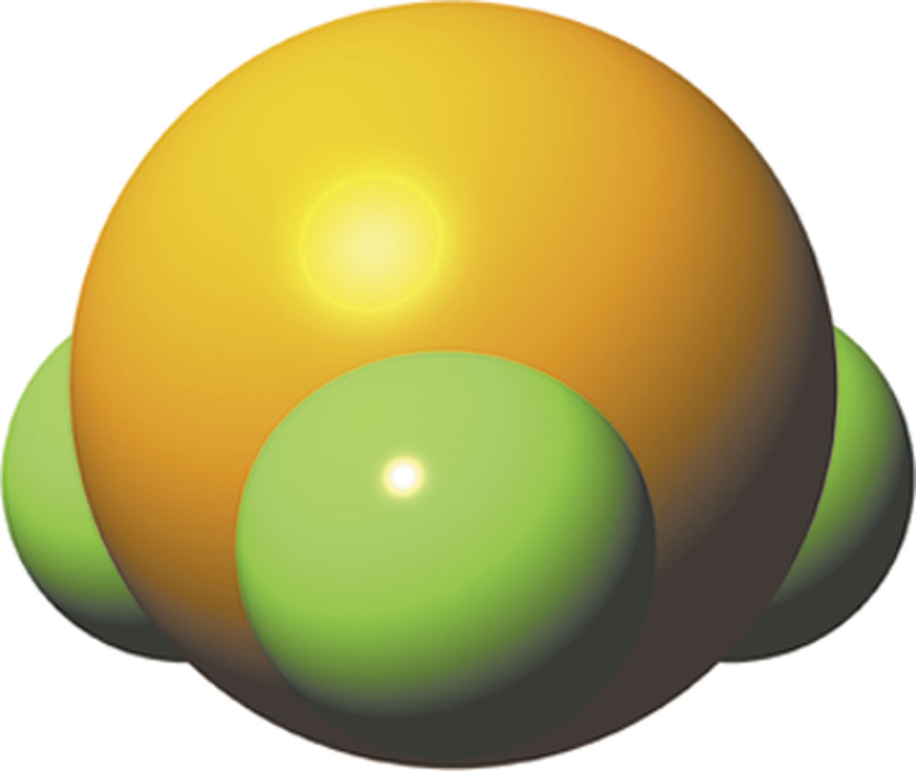
Figure 4.10 The phosphorus trifluoride
(PF3) molecule.

Slide 12
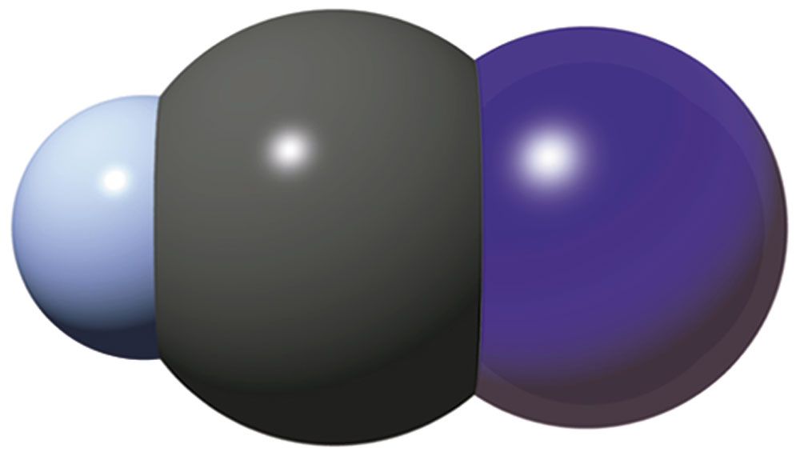
Figure 4.11 The hydrogen cyanide (HCN) molecule.

Slide 13
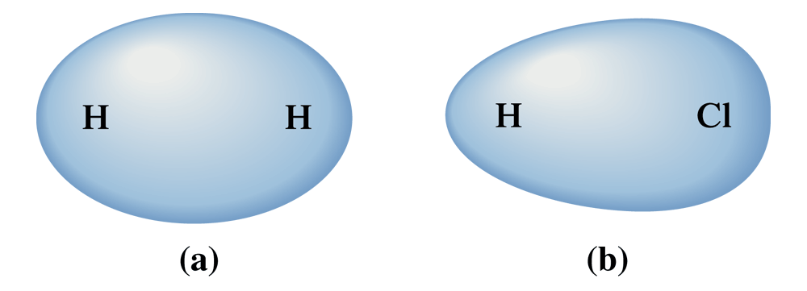
Figure 4.15 (a) In the nonpolar covalent bond present in H2 (H - H), there is a symmetrical distribution of electron density between the two atoms; that is, equal sharing of electrons occurs. (b) In the polar covalent bond present in HCL (H - Cl), electron density is displaced toward the Cl atom because of its greater electronegativity; that is, unequal sharing of electrons occurs.

Slide 14
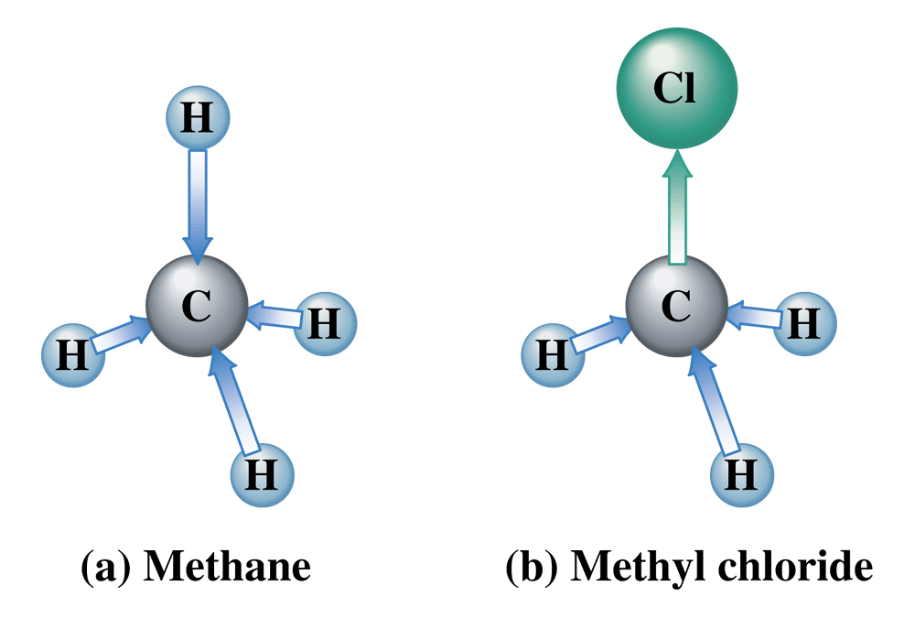
Figure 4.16 (a) Methane (CH4) is a nonpolar tetrahedral molecule. (b) Methyl chloride (CH3Cl) is a polar tetrahedral molecule. Bond polarities cancel in the first case, but not in the second.

Slide 15
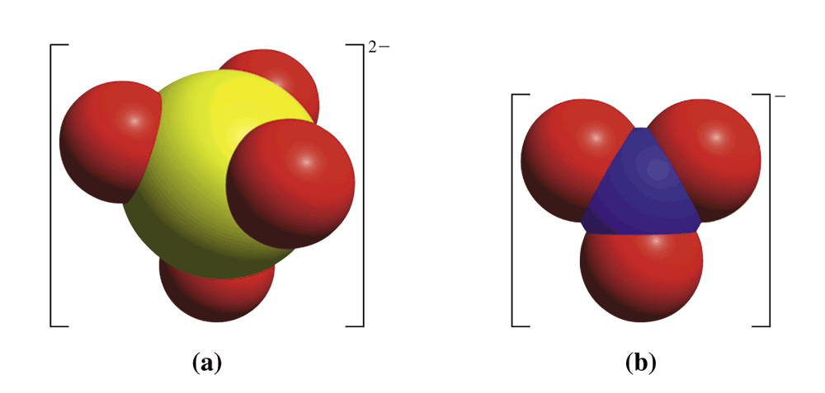
Figure 4.17 Models of (a) a sulfate ion (SO4 2-)

