Slide 1

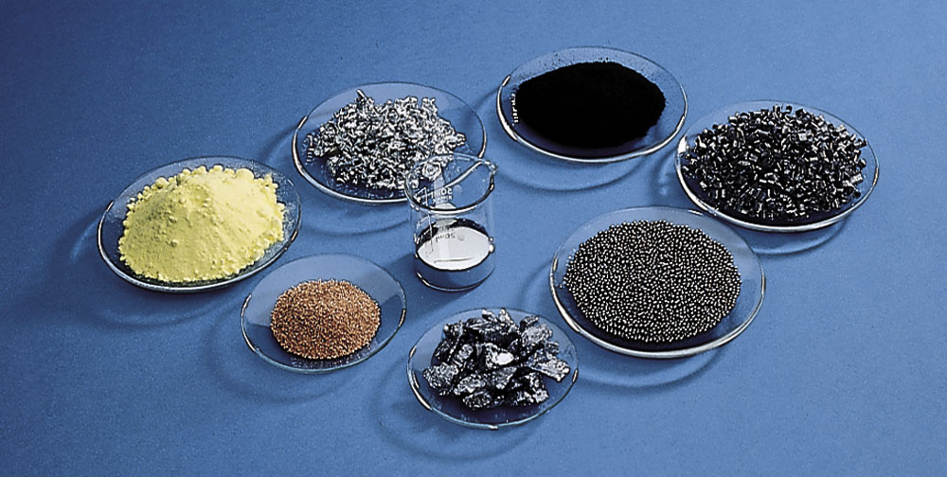
Figure 6.5 The mass of a mole is not a set number of grams; it depends on the substance.

Slide 2
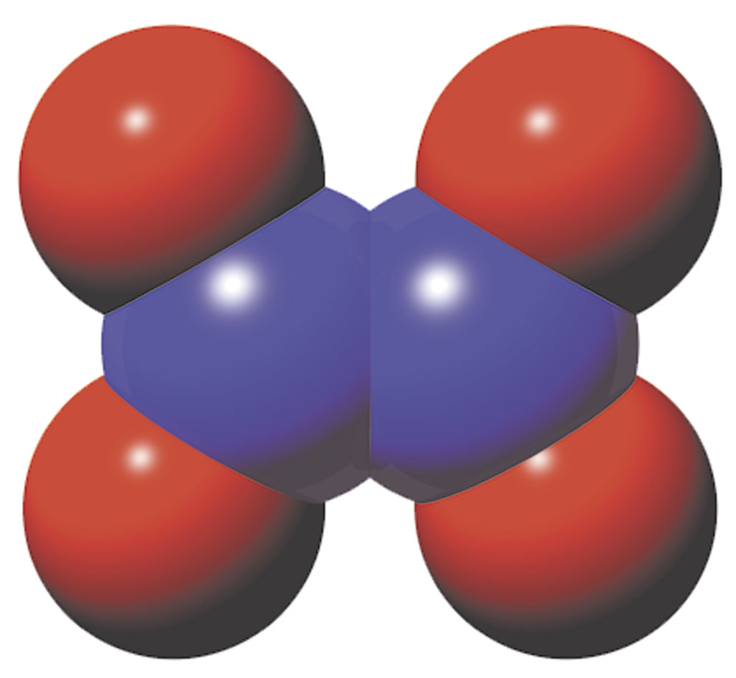
Figure 6.6 A computer-generated model of the molecular structure of N2O4. One molecule of N2O4 contains two atoms of N and four atoms of O.

Slide 3
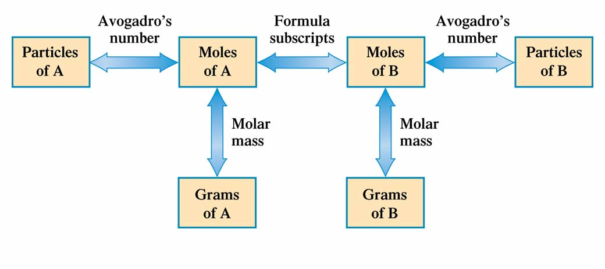
Figure 6.7 In solving chemical-formula-based problems, the only "transitions" allowed are those between quantities (boxes) connected by arrows. Associated with each arrow is the concept on which the required conversion factor is based.

Slide 4
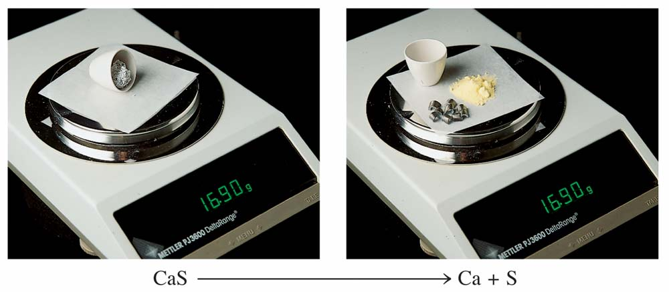
Figure 6.8 When 16.90 g of compound CaS (left) is decomposed into its constituent elements the Ca and S produced (right) has an identical mass of 16.90 grams.

Slide 5
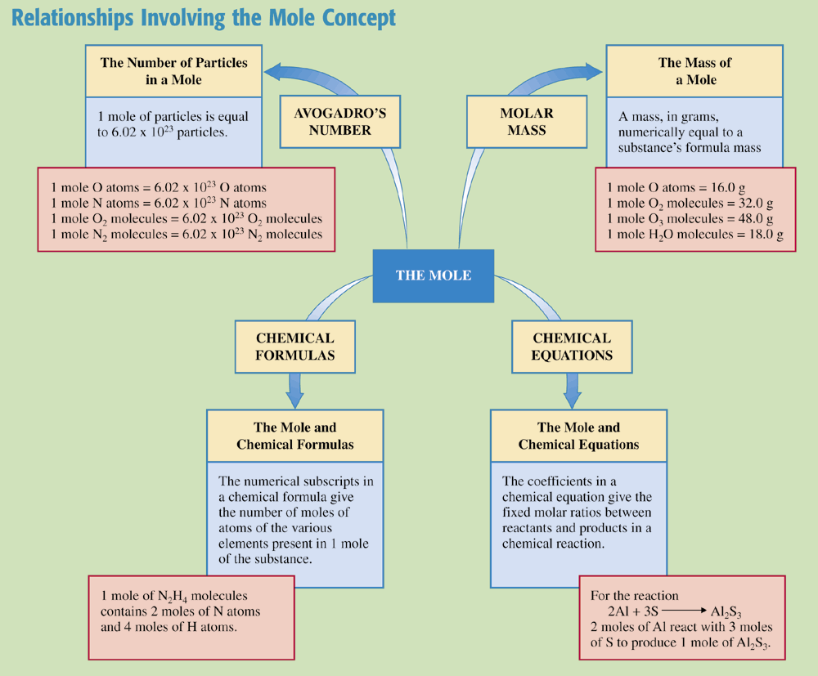
Chemistry at a Glance:
Relationships Involving the Mole Concept

Slide 6
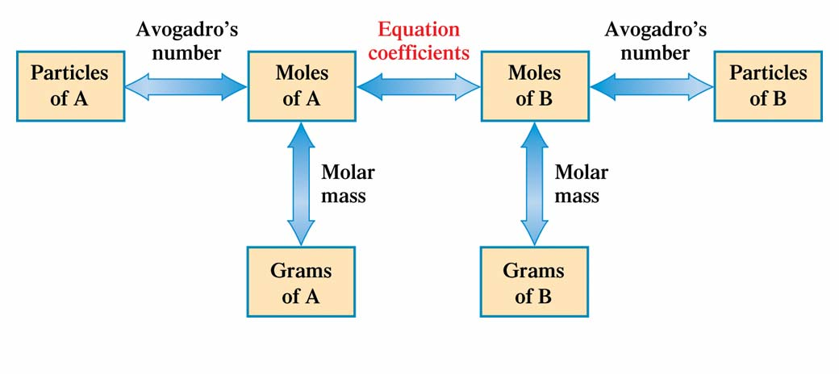
Figure 6.9 In solving chemical equation - based problems, the only "transitions" allowed are those between quantities (boxes) connected by arrows. Associated with each arrow is the concept on which the required conversion factor is based.

Slide 7
