Slide 1
Collision Theory
Basic concept: reactant particles - atoms, molecules, or ions, must collide with each other to react.
Number of effective collisions per unit time determine the speed (rate) of the reaction
Factors that influence number of effective collisions:
  collision frequency
  correct orientation
  correct energy (E_{a})

Slide 2
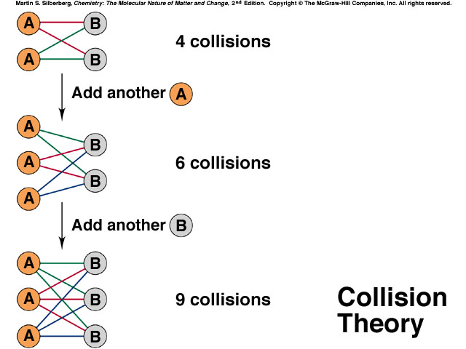
Collision Frequency
Examine the diagram and write a CONCLUSION

Slide 3
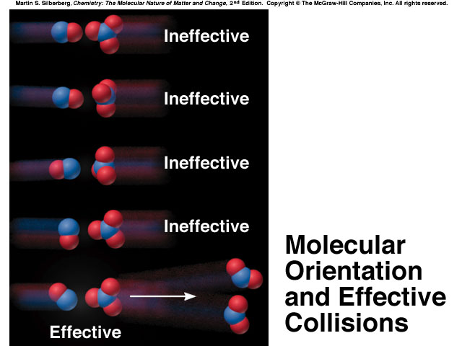
Define an effective collision in terms of orientation.

Slide 4
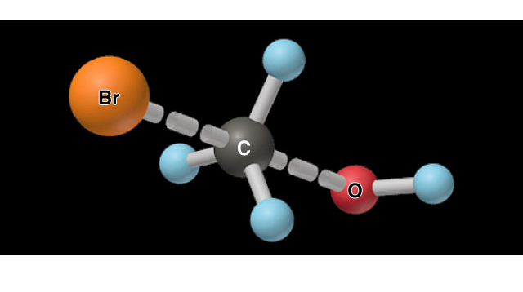
Transition Theory
Effective collisions result when the orientation is such that reactant bonds are lined up to be broken and product bonds can be formed.
Effective collisions will not occur unless there is sufficient energy, energy of activation (E_{a})
Nature of the Transition State in the
Reaction Between CH₃Br and OH⁻

Slide 5
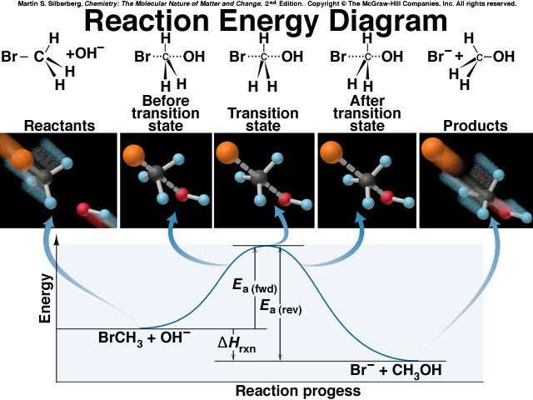
Need to be able to draw and interpret.

Slide 6
Example
NOCl₂*
Ea/ (reverse) = 2 kJ
E_{a} (forward) = 85 kJ
NOCl + Cl
Energy ↑
Δ H =
NO + Cl₂
Progress of reaction →
Write overall reaction
Draw out possible activated complex
Calculate enthalpy.

Slide 7
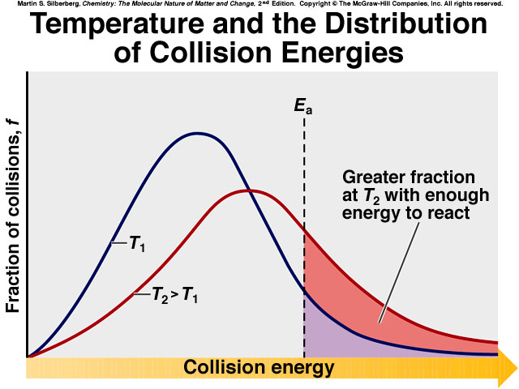
Explain concept depicted in this diagram.

Slide 8
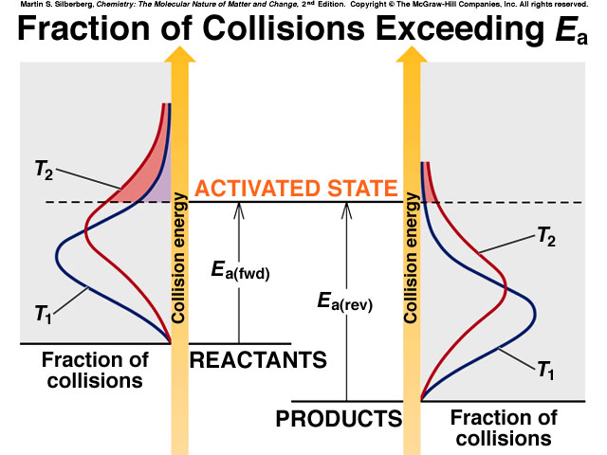
Explain the fewer collisions for the reverse reaction.

Slide 9
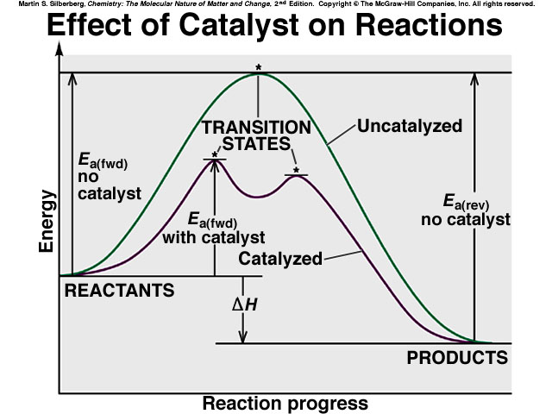
What effect does adding a catalyst
have on a reaction?

Slide 10
Reaction Rate Law
Proportionality converted to equality
Rate = k [A]^{m} [B]^{n}
  k - rate constant
  independent of other quantities in reaction
  depends on nature of reactants and temperature
  units will vary
Exponents m & n are called the reaction orders
define how the rate is effected by the concentration of each reactant.
For example, if the rate doubles when the concentration of A doubles, the rate depends on [A]¹, so a = 1; first order with respect to A.
If the rate quadruples when the concentration of B doubles,
the rate depends on [B]², so b = 2; second order with respect to B

Slide 11
Reaction Mechanisms
Elementary steps:
1. NO₂ + NO₂ → NO₃ + NO
2. NO₃ + CO → NO₂ + CO₂
_________________________
NO₂ + CO → NO + CO₂ Overall reaction
NO₃ is the reaction intermediate
Elementary reactions are classified by the number of molecules on the reactant side.

Slide 12
Rate- determining step
is the slowest step in the reaction mechanism
Conclusion:
Rate Law is determined by experiment.
Mechanism is an hypothesis (good guess) about the way the reaction occurs.
Example:

