Slide 1
ISOTOPES, NUCLIDES
E
protons, p
neutrons, n
nucleons, protons and neutrons
alpha, α
beta, β
positron, β
gamma, γ
A
n⁺
Z

Slide 2
NUCLEAR STABILITY
Modes of Radioactive Decay
Alpha decay–heavy isotopes: ⁴₂He or α
Beta decay–neutron rich isotopes: e⁻ or β⁻
Positron emission–proton rich isotopes: β⁺
Electron capture–proton rich isotopes: x-rays
Gamma-ray emission(γ )– Decay of nuclear
excited states
Spontaneous fission– very heavy isotopes

Slide 3
Natural Radioactive Decay Processes
Reason for
Nuclear Radioactive Emitted Nuclear Change in
Instability Process Radiation Change N/Z Ratio
Excess Mass α decay α Loss of 2 protons and Slight
2 neutrons occurs increase
N/Z too high β ⁻ decay β A neutron is converted Decrease
into a proton and an
electron.
N/Z too low β ⁺ decay β a proton is converted Increase
into a neutron and a
positron.
N/Z too low Electron Neutrino A proton combines with Increase
capture an inner-shell electron
to become a neutron.
Energetically γ emission Gamma ray Loss of excess nuclear None
energy occurs.
4
2
0
-1
0
+1

Slide 4
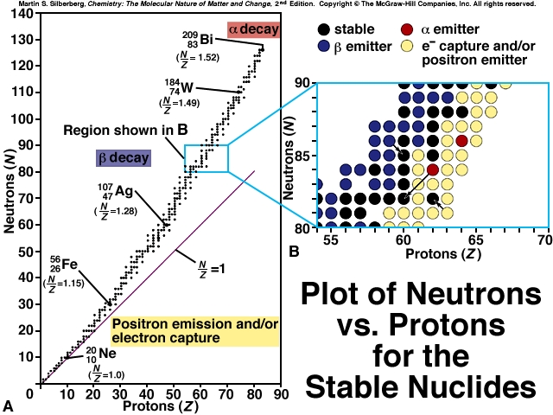

Slide 5
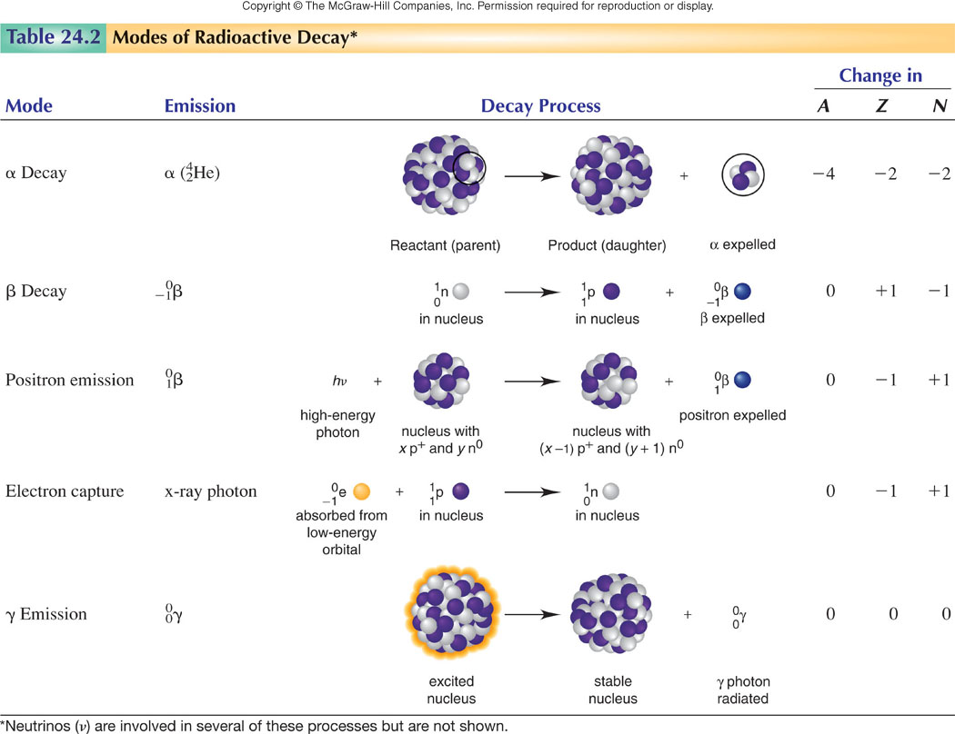

Slide 6
Natural Decay Series for Uranium-238
²³⁸U ²³⁴ Th
²³⁴Pa
²³⁴U ²³⁰ Th ²²⁶Ra ²²²Rn ²¹⁸Po ²¹⁴Pb
²¹⁸At ²¹⁴Bi ²¹⁰ Tl
²¹⁴Po ²¹⁰Pb ²⁰⁶Hg
= α decay ²¹⁰Bi ²⁰⁶Tl
= β⁻ decay ²¹⁰ Po ²⁰⁶Pb
²³⁸U: 8 α decays and 6 β decays leaves you with ²⁰⁶Pb

Slide 7
Nuclear Equations
²³⁸U₉₂ ²³⁴ Th ₉₀ + ⁴He₂
parent isotope daughter particle
Class Examples
Notation
Bombarding
particle
↓
If radioactive
M (a, b) M’*
Bombarded
nucleus
→ Product
nucleus
↓
Emitted
particle
Example: ²⁵Mg (α, p) ²⁸Al*
Class example

Slide 8
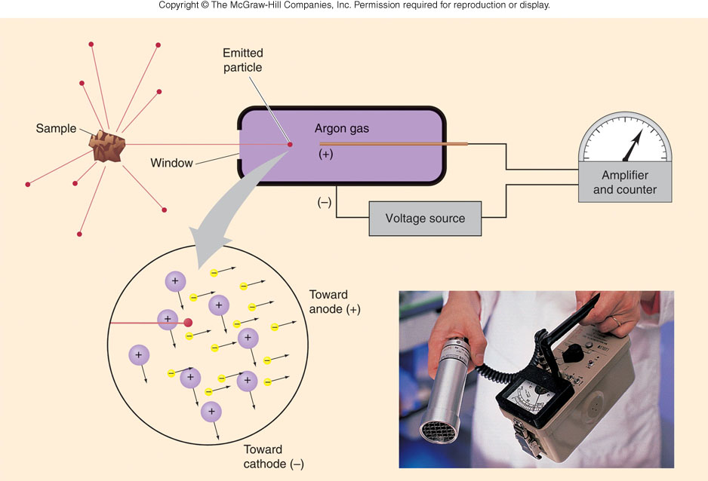
Geiger counter
Particles per unit time (activity)

Slide 9
Rate of Radioactive Decay
Rate independent of temperature
implies E_{a} = 0
EXPLAIN? Draw diagram
First Order Reactions: A → B
rate law = ?
Conc. - time relationship?
Half- life ?

Slide 10
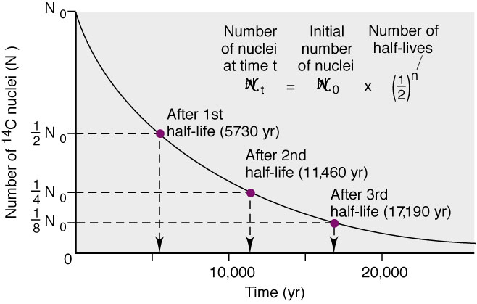
Decrease in Number of ¹⁴C Nuclei Over Time

Slide 11
NUCLEAR ENERGY
Binding Energy: E_{b}
amount of energy if nucleus were formed directly by combination of neutrons and protons
¹₁p + ¹₀n → ²₁ H
1.007825 g/mol 1.008665 g/mol 2.01410 g/mol
Δ m = mass products - total mass reactants
2.01410 g/mol - 2.016490 g/mol
= - 0.00239 g/mol
Mass defect converted to energy

Slide 12
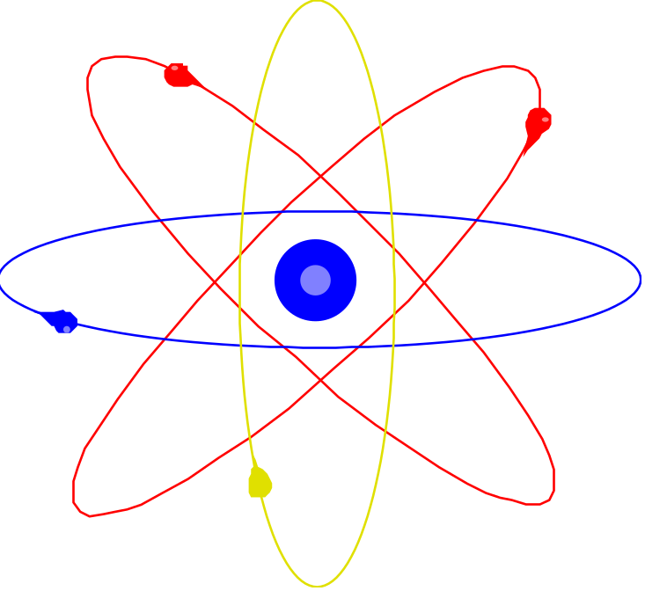
Mass → Energy
EINSTEIN’S EQUATION FOR THE CONVERSION OF MASS INTO ENERGY
E = mc²
m = mass (kg)
c = Speed of light = 2.998 x 10⁸ m/s
E = (-2.39 x 10⁻⁶ Kg) (2.998 x 10⁸ m/s)²
= - 2.15 x 10¹¹J = - 2.15 x 10⁸ kJ
Class problem

Slide 13
Sample Problem 24.6
Calculating the Binding Energy per Nucleon
PROBLEM:
Iron-56 is an extremely stable nuclide. Compute the binding energy per nucleon for ⁵⁶Fe and compare it with that for ¹²C (mass of ⁵⁶Fe atom = 55.934939 amu; mass of ¹H atom = 1.007825 amu; mass of neutron = 1.008665 amu).
PLAN:
Find the mass defect, Δm; multiply that by the MeV equivalent and divide by the number of nucleons.
SOLUTION:
Mass Defect = [(26 x 1.007825 amu) + (30 x 1.008665 amu)] - 55.934939
Δm = 0.52846 amu
(0.52846 amu)(931.5 MeV/amu)
Binding energy =
= 8.790 Mev/nucleon
56 nucleons
¹²C has a binding energy of 7.680 MeV/nucleon, so ⁵⁶Fe is more stable.

Slide 14
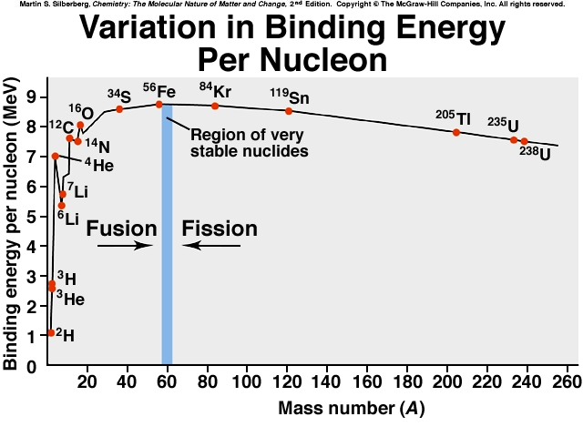

Slide 15
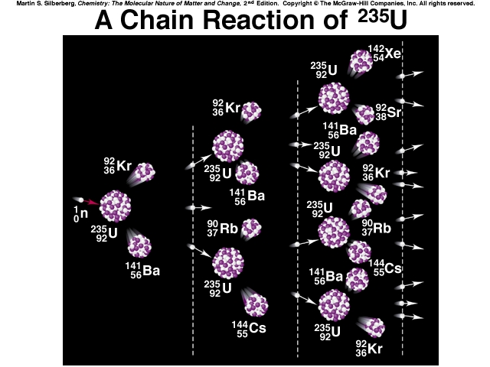

Slide 16
Units of Radiation Dose
rad = Radiation-absorbed dose
The quantity of energy absorbed per kilogram of tissue:
1 rad = 1 x 10⁻² J/kg
rem = Roentgen equivalent for man
The unit of radiation dose for a human:
1 rem = 1 rad x RBE
RBE = 10 for α
RBE = 1 for x-rays, γ-rays, and β’s

