Slide 1
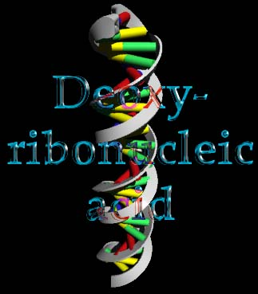
DNA
Topics to be covered include
Nucleotides and DNA.
Double helix.
Base pairing and double helix.
Sequence of bases in DNA and synthesis of proteins.
DNA replication and its significance to forensic science.
Recombinant DNA technology.

Slide 2
DNA strands that code for protein synthesis Vs. strands that contain repeated sequence of bases.
Restriction Fragment Length Polymorphism (RFLP).
RFLP technique and interpretation of DNA band patterns.
Polymerase Chain Reaction (PCR).
RFLP Vs. PCR.
Short Tandem Repeat (STR).
Nuclear Vs. Mitochondrial DNA.
DNA computerized data base in criminal investigation.
Preservation of blood stains for DNA analysis.
Added Useful Websites for your review:
http://www.biology.washington.edu/fingerprint/dnaintro.html
http://www.biology.arizona.edu/human_bio/problem_sets/DNA_forensics_1/DNA_forensics.html
http://whyfiles.org/014forensic/genetic_foren.html
http://whyfiles.org/014forensic/genetic_foren2.html
http://www.fbi.gov/hq/lab/handbook/examsdna.htm
http://arbl.cvmbs.colostate.edu/hbooks/genetics/medgen/dnatesting/dnatest_tech.html

Slide 3
Fundamental Terminology
DNA: abbreviation for deoxyribonucleic acid- the molecules carrying the body’s genetic information. DNA is double-stranded in the shape of a double helix
Chromosome: a rodlike structure in the cell nucleus, along witch the genes are located. It is composed of DNA surrounded by other material, mainly proteins
Polymer: a substance composed of a large number of atoms. These atoms are usually arranged in repeating units, or monomers

Slide 4
Fundamental Terminology
Nucleotide: the unit of DNA consisting of one of four bases-adenine, guanine, cystine, or thymine-attached to a phosphate sugar group
Proteins: polymers of amino acids that play basic roles in the structures and functions of living things
Amino acids: the building blocks of proteins. There are 20 common amino acids. Amino acids are linked together to form a protein. They types of amino acids and the order in which they’re linked determine the character of each protein

Slide 5
Fundamental Terminology
(continued)
Human Genome: the total DNA context found within the nucleus of a cell. In humans, it is composed of approximately 3 billion base pairs of genetic information
Replication: the synthesis of new DNA form existing DNA
Polymerase Chain Reaction (PCR): a technique for replicating or copying a portion of a DNA strand outside a living cell. This technique leads to millions of copies of the DNA strand

Slide 6
Fundamental Terminology
(continued)
Restriction Enzymes: chemicals that act as scissors to cut DNA molecules at specific locations
Restriction Fragment Length Polymorphisms (RFLP): different fragment lengths of base pairs that result from cutting a DNA molecules with restriction enzymes
Hybridization: the process of joining two complementary strands of DNA together to form a double-stranded molecule

Slide 7
Fundamental Terminology
(continued)
Short Tandem Repeats (STRs): regions of a DNA molecule that contain short segments consisting of three to seven repeating base pairs
Multiplexing: a technique that simultaneously detects more than one DNA marker in a single analysis
Amelogenin gene: a genetic locus found useful for determining gender

Slide 8
Fundamental Terminology
(continued)
Mitochondria: small structures located outside the nucleus of a cell. These structures are responsible for supplying energy to the cell. Maternally inherited DNA is found in each mitochondria
Sequencing: a procedure used to determine the order of the base pairs that comprise DNA
Substrate control: an unstained object adjacent to an area upon which biological material had been deposited
Buccal cells: cells derived from the inner cheek lining

Slide 9
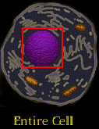
The Cell
The smallest unit of life
The nucleus is the “brain” of the cell
  contains all the genetic info the cell needs to exist & to reproduce
    In most types of cells, genetic information is organized into structures called chromosomes

Slide 10
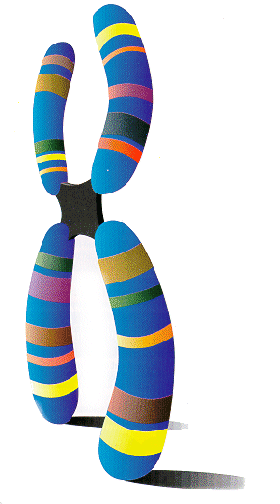
Chromosomes
In most types of cells, genetic information is organized into structures called chromosomes
  usually X shaped
    Y chromosome in males
  23 pairs in humans
    one from mother & one from father

Slide 11
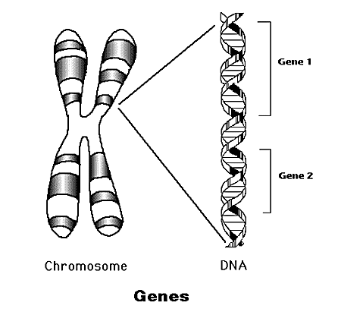
Genes
Each chromosome contains hundreds to thousands information blocks called genes
Each gene is the blueprint for a specific type of protein in the body
  only identical twins will have all the genes identical

Slide 12
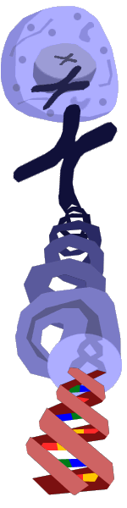
Chromosomes
Each chromosome is a single polymeric molecule called DNA
  if fully extended the molecule would be about 1.7 meters long
  unwrapping all the DNA in all your cells
    cover the distance from earth to moon 6,000 times

Slide 13
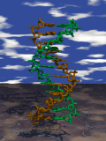
Structure of DNA

Slide 14
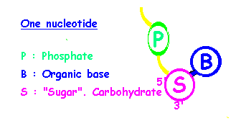
Nucleotides
DNA is a polymer built from monomers called nucleotides
Each nucleotide is consists of
  deoxyribose
    pentose sugar
  phosphoric acid
  a nitrogenous base

Slide 15
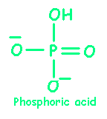
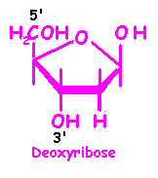
Building Blocks of Backbone
The phosphate
The sugar

Slide 16
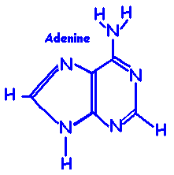
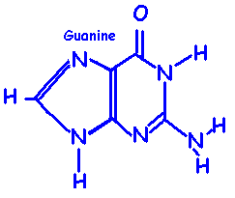
Nitrogenous Bases
The Purines
  Adenine (A)
  Guanine (G)

Slide 17
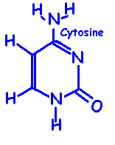
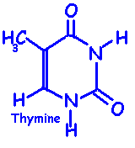
Nitrogenous Bases
The Pyrimidines
  Cytosine (C)
  Thymine (T)

Slide 18
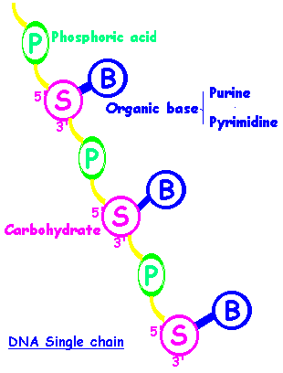
The DNA Backbone
The monomers are linked together by phosphodiester bridges (bonds)
  links the 3’ carbon in the ribose of one nucleotide to the 5’ carbon in the ribose of the adjacent nucleotide

Slide 19
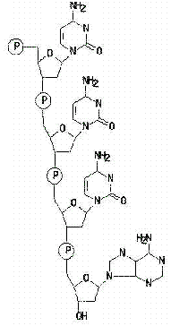

Slide 20
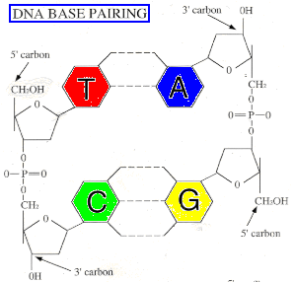
The DNA Double Helix
DNA is normally a double stranded macromolecule
Two polynucleotide chains are held together by H-bonding
  A always pairs with T
  C always pairs with G

Slide 21
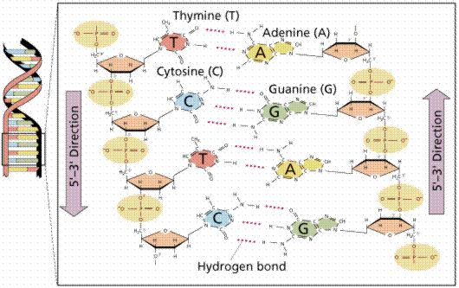

Slide 22
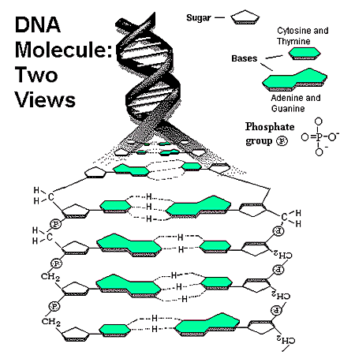

Slide 23
Nucleotide Order/Coding
5’ T-T-G-A-C-T-A-T-C-C-A-G-A-T-C 3’
3’ A-A-C-T-G-A-T-A-G-G-T-C-T-A-G 5’
In a double helix the strands go in opposite directions

Slide 24
Functions of DNA
Two Functions
  To transmit information from one generation of cells to the next
  To provide the information for the synthesis of components (proteins) necessary for cellular function

Slide 25
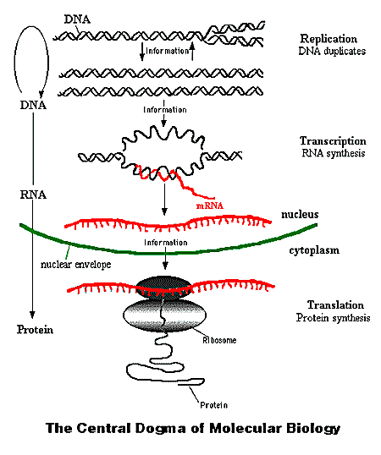

Slide 26
DNA Fingerprinting
The basic structure of everyone’s DNA is the same
  the difference between people is the ordering of the base pairs
Every person can be distinguished by the sequence of their base pairs
  millions of base pairs make this impractical
  a shorter method uses repeating patterns that are present in DNA

Slide 27
VNTR’s
DNA strands contain information which directs an organism’s development
  exons
Also contain stretches which appear to provide no relevant genetic information
  introns
  repeated sequences of base pairs
    Variable Number Tandem Repeats (VNTRs)
    can contain anywhere from 20 to 200 base pairs

Slide 28
VNTRs
All humans have some VNTRs
VNTRs come from the genetic information donated by parents
  can have VNTRs from mother, father or a combination
  will not have a VNTR that is from neither parent

Slide 29
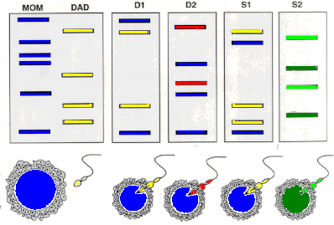
D1 = biological daughter of both parents
D2 = child of mother & former husband
S1 = couple’s biological son
S2 = adopted son

Slide 30
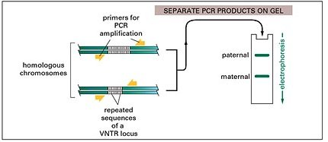
VNTR Analysis
Usually an individual will inherit a different variant of the repeated sequence from each parent

Slide 31
VNTR Analysis
PCR primers bracket the locus
PCR reaction forms a nucleotide chain from the template

Slide 32
VNTR Analysis
The length of the amplified DNA & its position after electrophoresis will depend on the number or repeated bases in the sequence

Slide 33
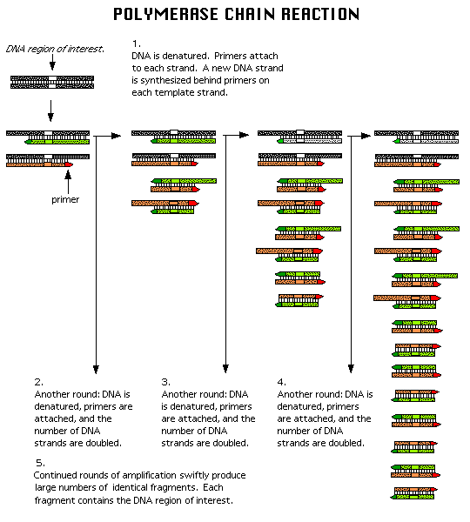

Slide 34
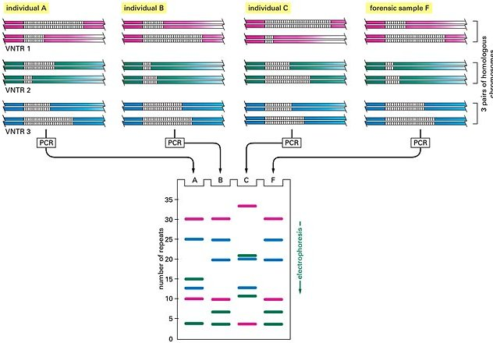
Analysis used 3 different VNTR loci for each suspect giving
6 bands

Slide 35
Although some individuals have several bands in common,
the overall pattern is distinctive for each

Slide 36
Suspects A & C can be eliminated
B remains a suspect

