Slide 1
EDTA Titrations
Ethylenediamine-tetra-acetic acid
is the most widely used reagent of
a class of materials known as chelates, or
polydentate ligands.

Slide 2
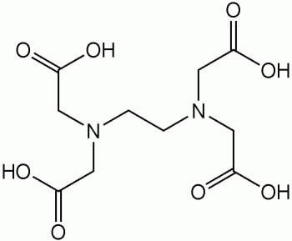

Slide 3
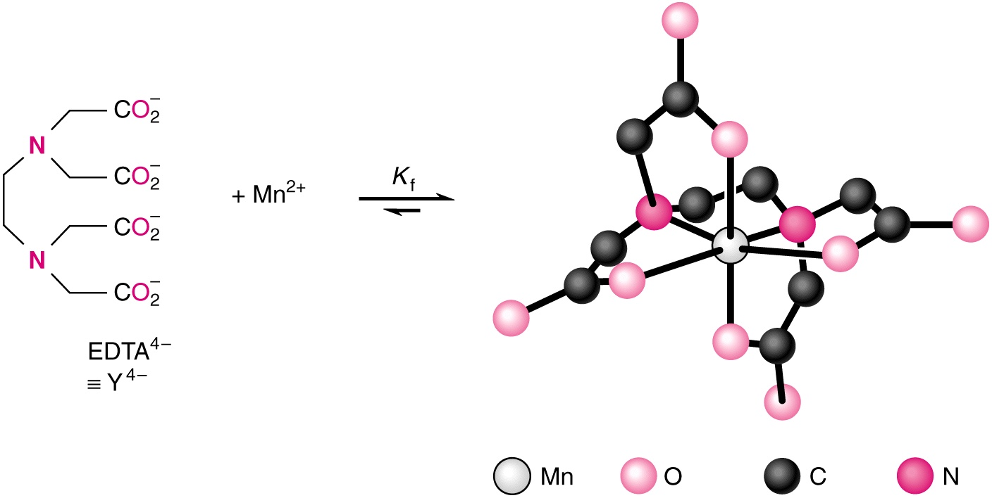
EDTA form strong 1 : 1 complexes with many metal ions; the coordination is through the 4 O atoms and 2 N atoms

Slide 4
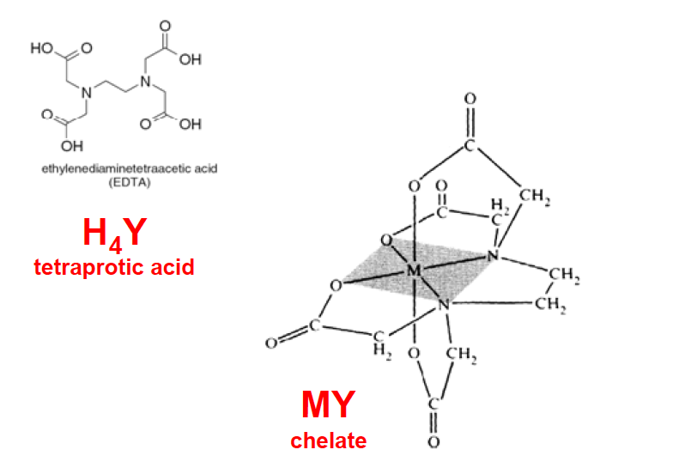

Slide 5
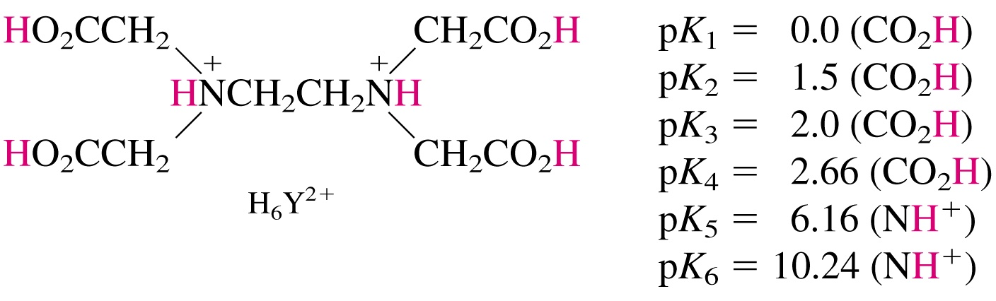
EDTA is a hexa-pronated ligand; the 6 of the pKa values of EDTA are given below:

Slide 6
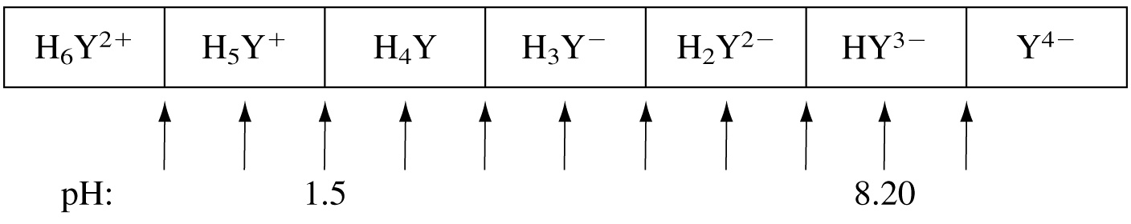
Predominant form of EDTA as a function of pH

Slide 7
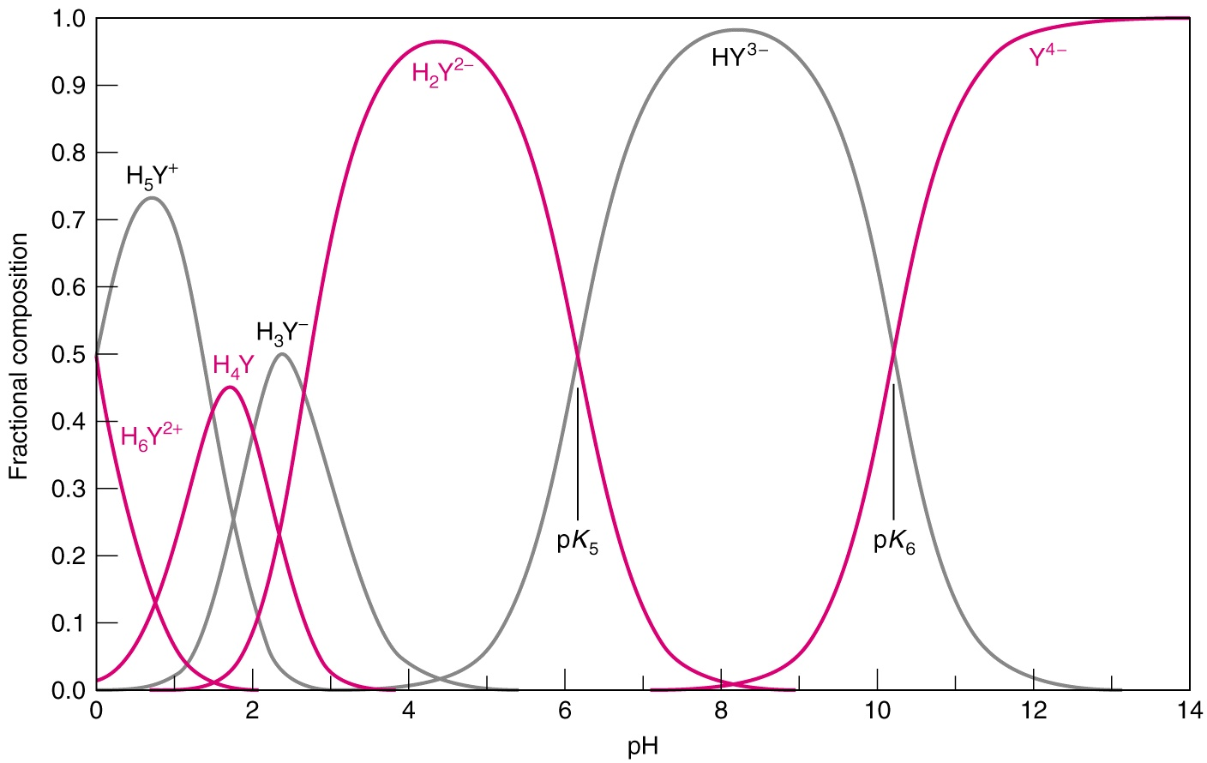
Graph of Predominant form of EDTA as a function of pH

Slide 8
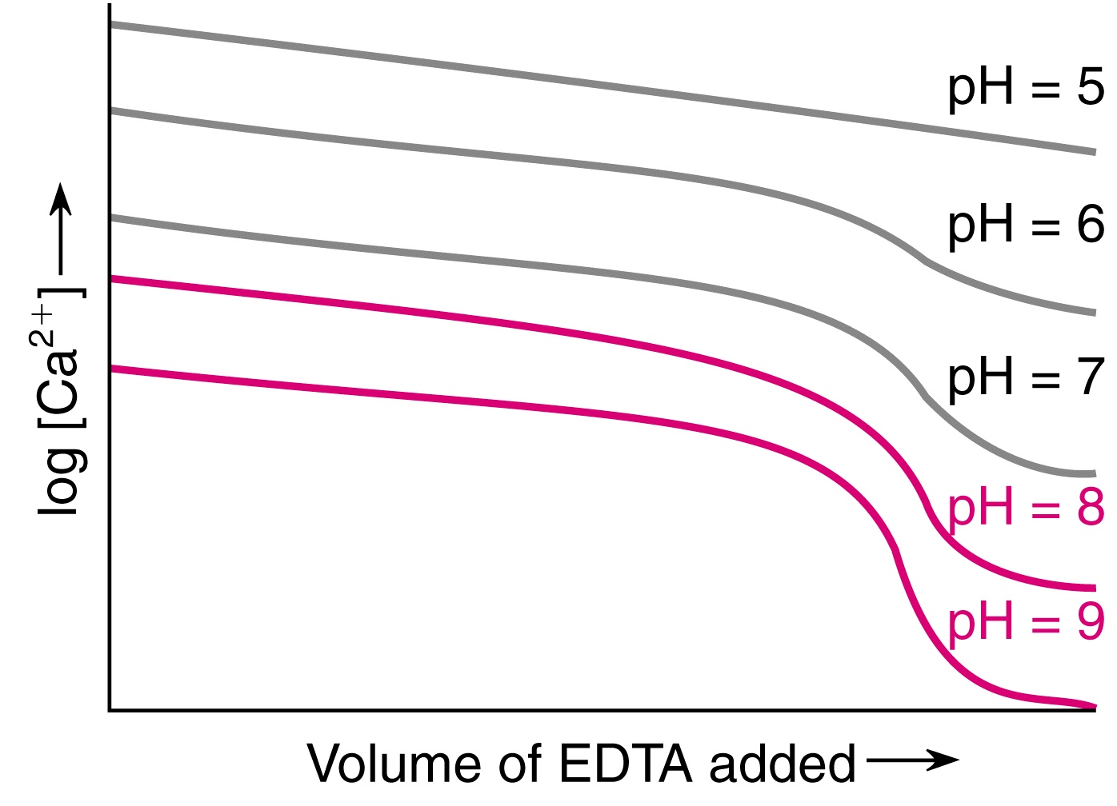
Effect of pH on the end point in the EDTA titration of Ca⁺²

Slide 9
Formation Constants K_{f} for polydentate metal-complexes
The formation reaction for polydentate ligands that form a 1 : 1 complex with metal ions is defined by the reaction
M^{+n} + Y⁻⁴ < === > MY ^{n-4}
and the formation constant
K_{f} = [MY ^{n-4} ] / [M^{+n}] [Y⁻⁴]
Since the K_{f} values for most metal-edta complexes are large, it is customary to report them as log₁₀ K_{f}

Slide 10
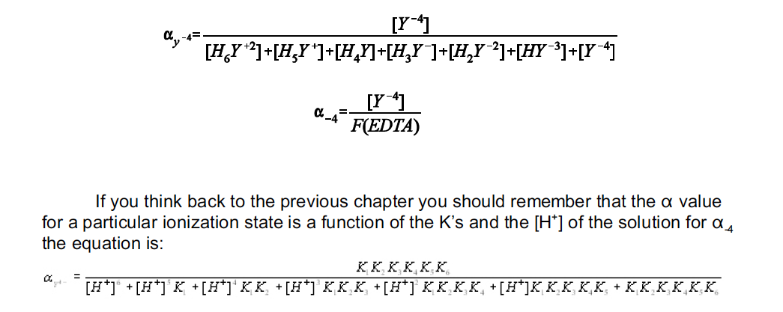
pH Dependence of Y⁻⁴

Slide 11
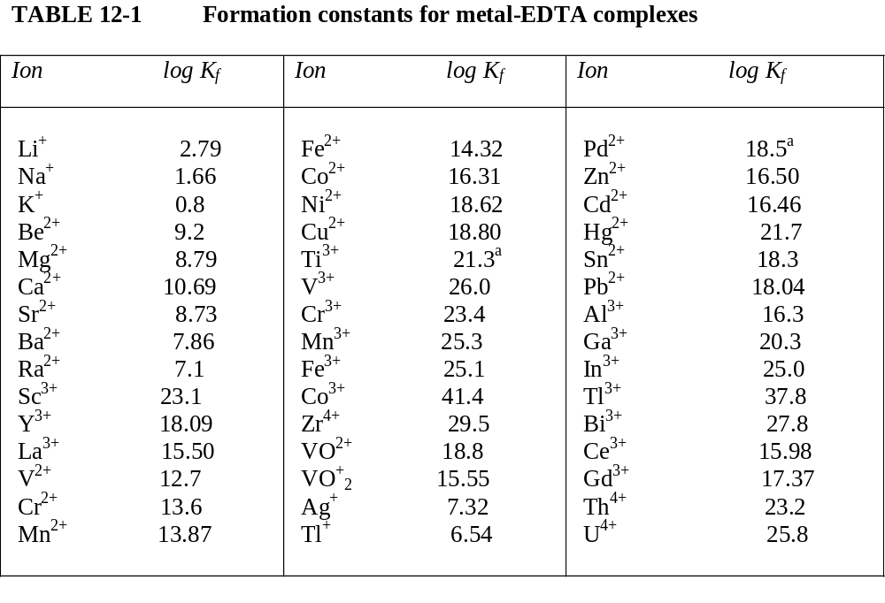

Slide 12
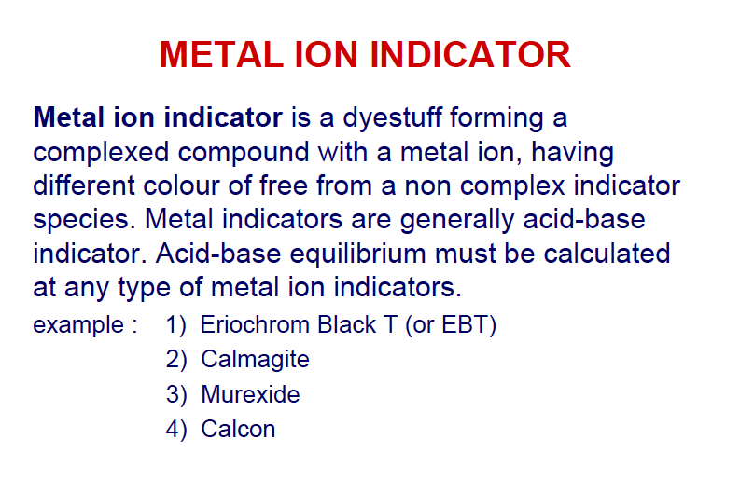

Slide 13
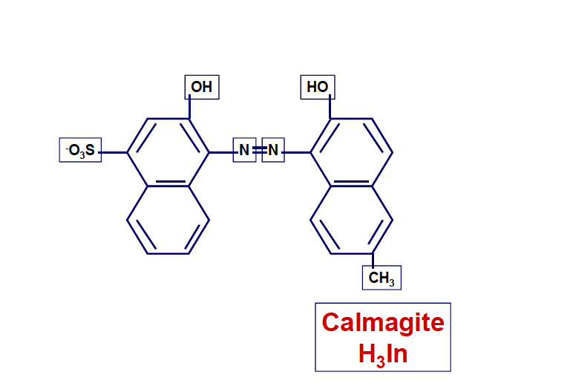

Slide 14
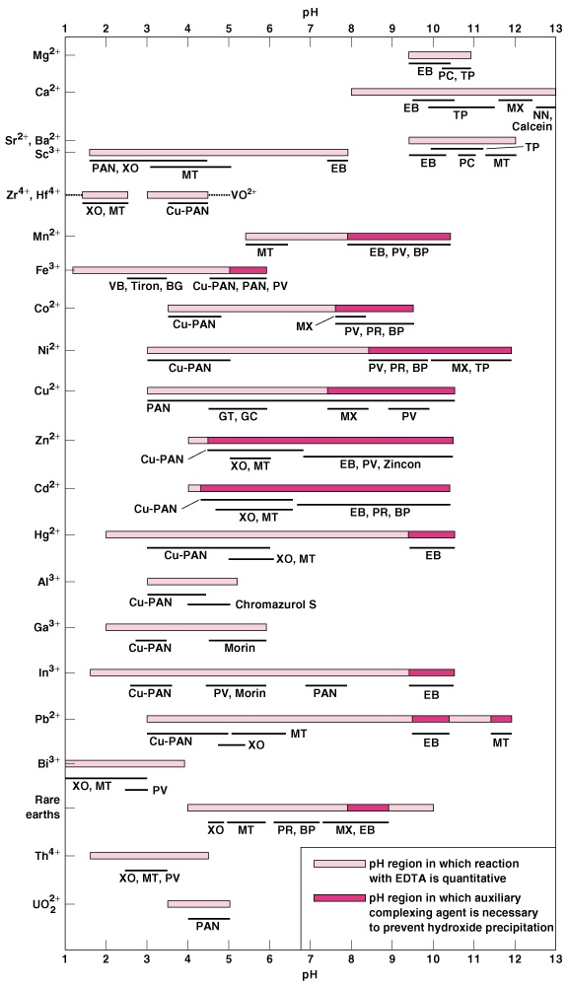
pH regions and suggested indicators for EDTA titrations of several metal ions.

Slide 15
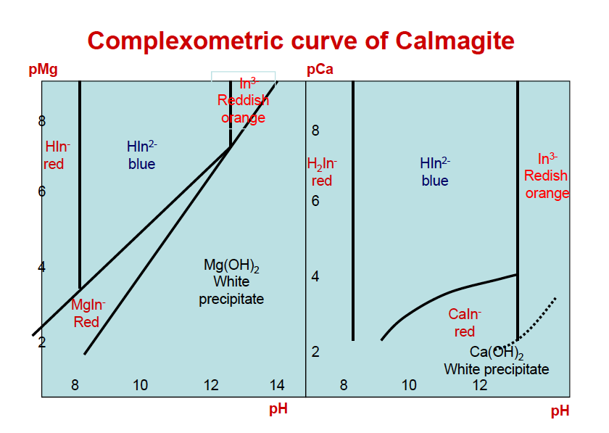

Slide 16
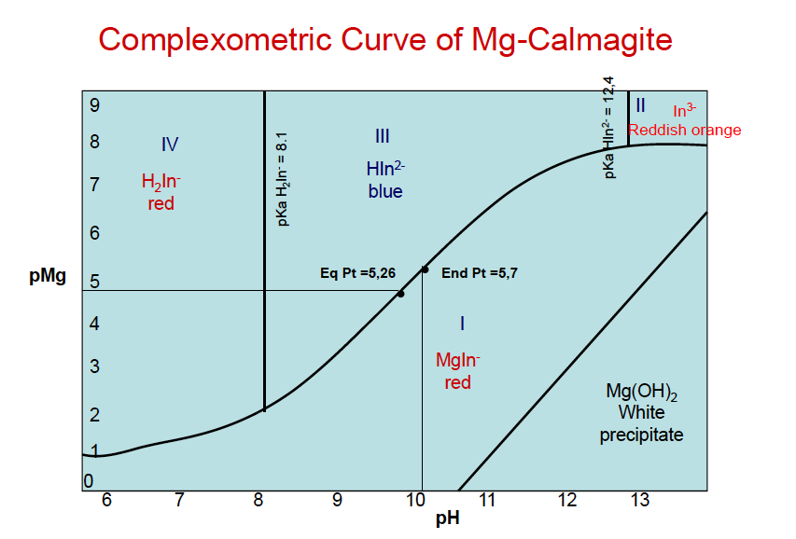

Slide 17
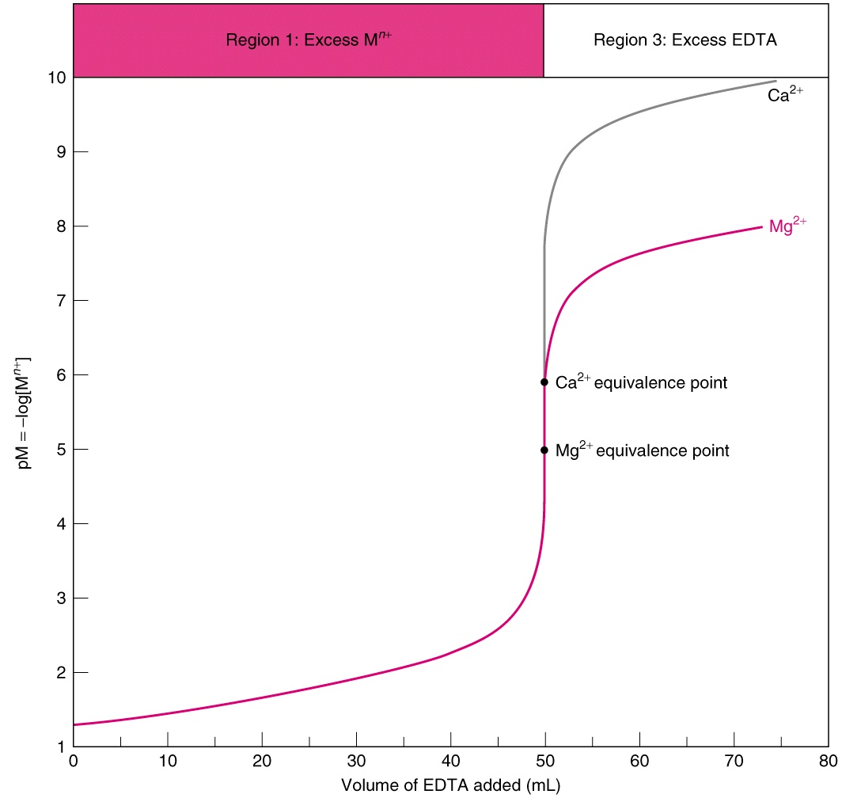

Slide 18
Graph of Predominant form of EDTA as a function of pH

Slide 19
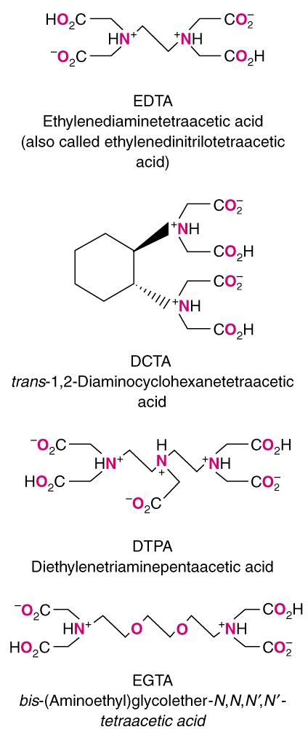
Additional analogs of edta that are analytically important. All of these also strong 1 : 1 complexes with metal ions.

Slide 20
Formation Constants K_{f} for ligand metal-complexes
The formation reaction for polydentate ligands that form a 1 : 1 complex with metal ions is defined by the reaction
M^{+n} + Y⁻⁴ < === > MY ^{n-4}
and the formation constant
K_{f} = [MY ^{n-4} ] / [M^{+n}] [Y⁻⁴]
Since the K_{f} values for most metal-edta complexes are large, it is customary to report them as log₁₀ K_{f.} log₁₀ K_{f} for several metal-edta complexes are given in the next slide.

Slide 22
Effect of pH on the end point in the EDTA titration of Ca⁺²

Slide 23
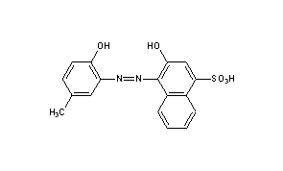
Calmagite Indicator for EDTA Titrations
Calmagite indicator has two -OH groups with acidic protons. The color of calmagite changes depending on whether or not these protons are present.

Slide 24
At pH=10
one proton is present and the color of the indicator is blue uncomplexed with calcium.
A calcium or magnesium ion can displace both protons to form a calmagite-metal complex, which has a red color.

Slide 25
Ca²⁺ and Mg²⁺ can be titrated using EDTA as the titrant and calmagite indicator because the EDTA binds Ca²⁺ and Mg²⁺ more strongly than the indicator.

Slide 26
At the endpoint, the EDTA will bind all of the metal, leaving the calmagite with no metal ions.
Ca-Calmagite === > Calmagite
Endpoint
EDTA === > Ca-EDTA

Slide 27
pH regions and suggested indicators for EDTA titrations of several metal ions.

Slide 28
Figure 12-7 Titration curves for edta titrations of Mg⁺² and Ca⁺²
Note that the plot is of pM vs Volume of edta. The shape of the curve is very similar to that of acid base titration curves.

