Slide 1

EDTA
EthyleneDiamineTetraacetic Acid, a compound that forms strong 1:1 complexes with most metal ions.
EDTA is a hexaprotic system, designated H₆Y²⁺. The highlighted, acidic hydrogen atoms are the ones that are lost upon metal-complex formation.

Slide 2
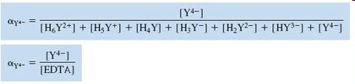

The neutral acid of EDTA is tetraprotic, with the formula H₄Y. Or the disodium salt, Na₂H₂Y·2H₂O
But it is the most basic form that is associated with metal binding
We can define α for each species as the fraction of EDTA in that form.

Slide 3
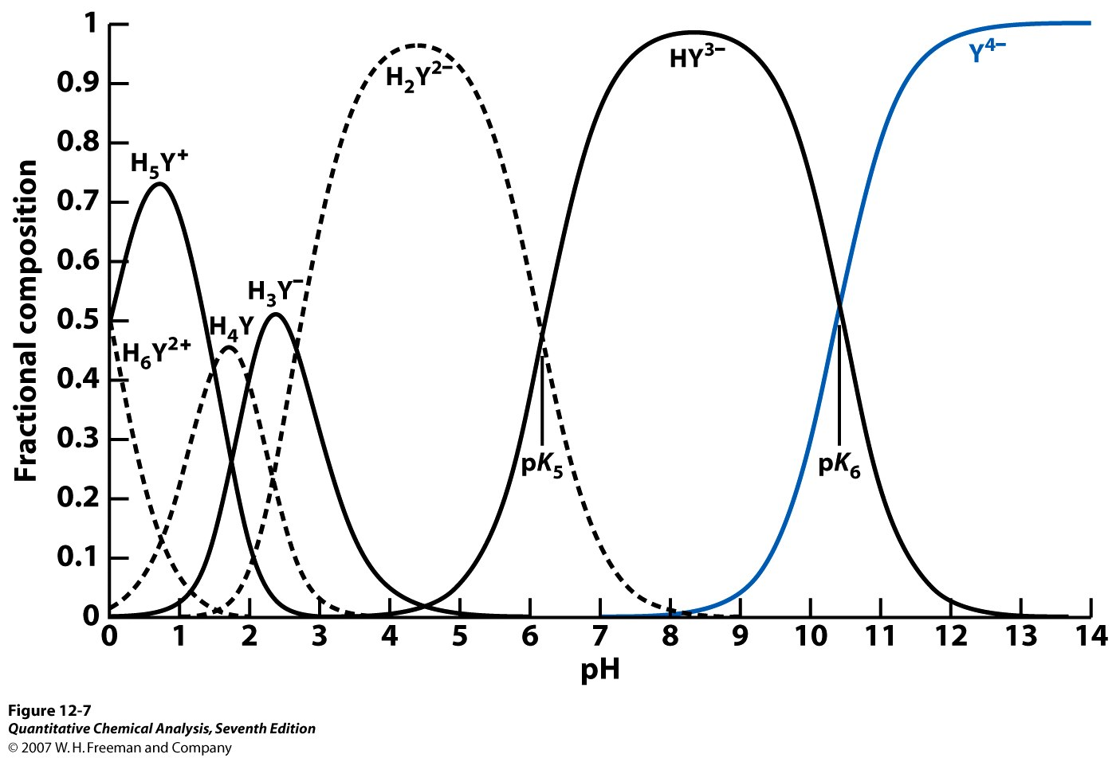
Fractional composition diagram for EDTA

Slide 4
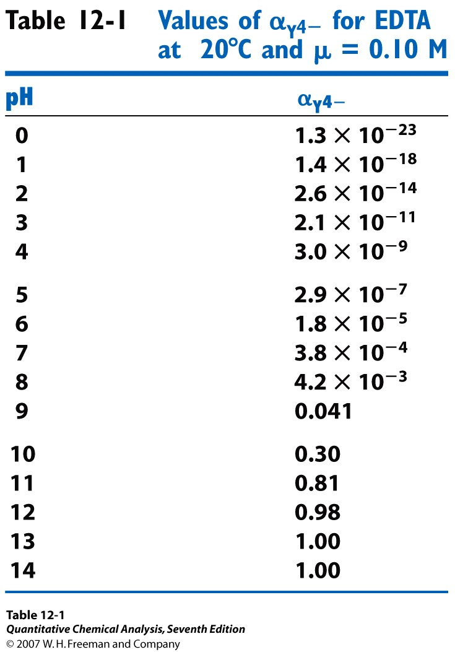

Slide 5




The equilibrium constant for the reaction of a metal with a ligand is called the formation constant, K_{f}, or the stability constant
The number is called the conditional formation constant, or the effective formation constant. It describes the formation of MY^{n−4} at any particular pH.

Slide 6
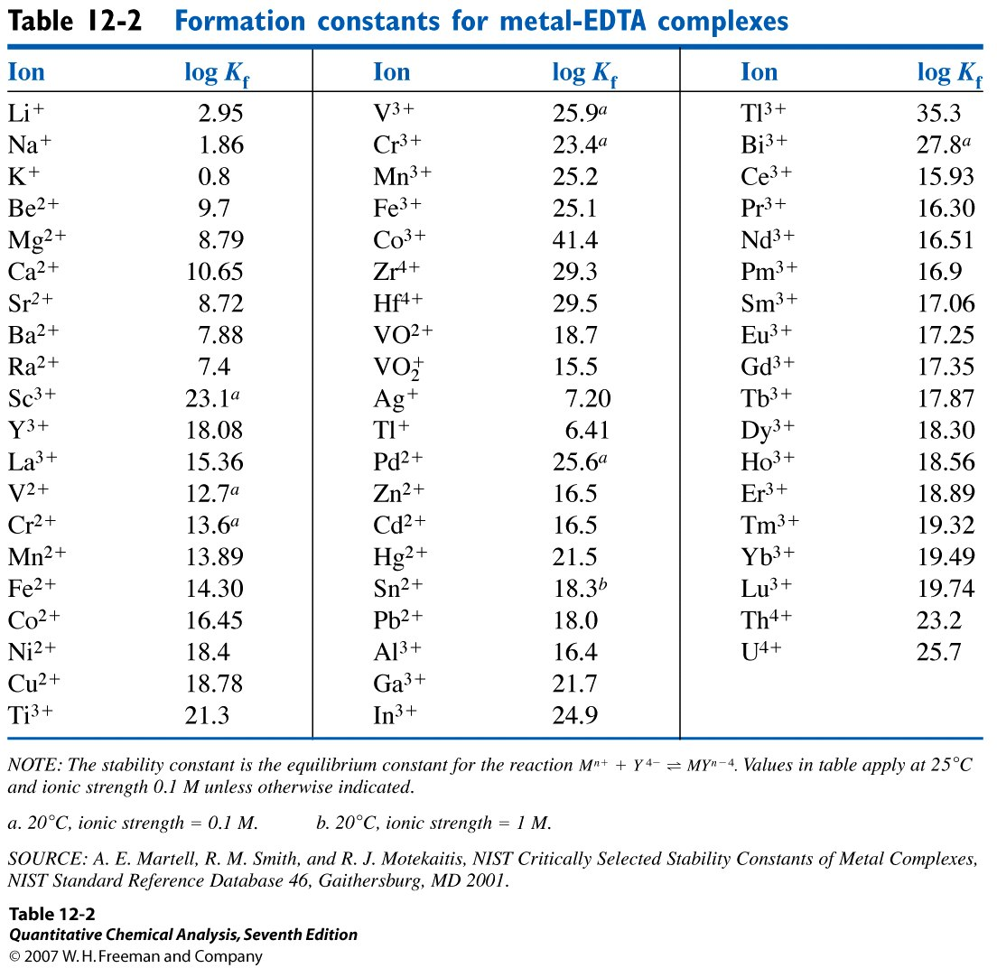

Slide 7

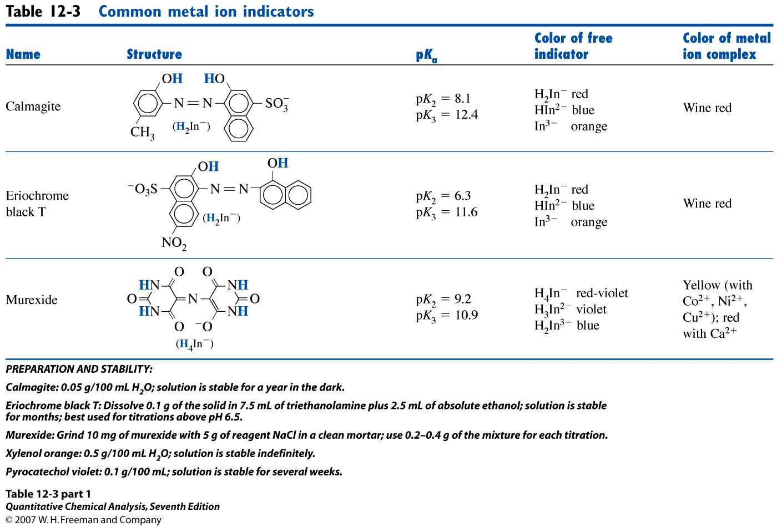
Must be run ~ pH=10

