Slide 1

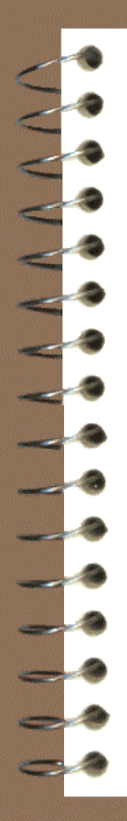
Fingerprints
Contributors to fingerprint technology.
Ridge characteristics.
Fingerprint as a permanent feature of human anatomy.
Major fingerprint patterns and their subclasses.
Using Henry’s system for fingerprint classification.
Visible, plastic, and latent fingerprints

Slide 2
Techniques for developing latent fingerprints on non-porous objects.
Chemical techniques for developing prints on porous objects.
Preserving a developed latent fingerprint.
Enhancing latent fingerprint by digital imaging.
http://onin.com/fp/
http://whyfiles.org/014forensic/fingerprint.html
http://www.fbi.gov/hq/lab/handbook/examlatp.htm
Nomenclature
Anthropometry: a system of identification of individuals by measurements of parts of the body, developed by Alphonse Bertillon
Ridge characteristics (Minutiae): ridge endings, bifurcations, enclosures, and other ridge details, which must match in two fingerprints in order for their common origins to be established
Portrait parle/: a verbal description of a perpetrator’s physical characteristics and dress provided by an eyewitness

Slide 3
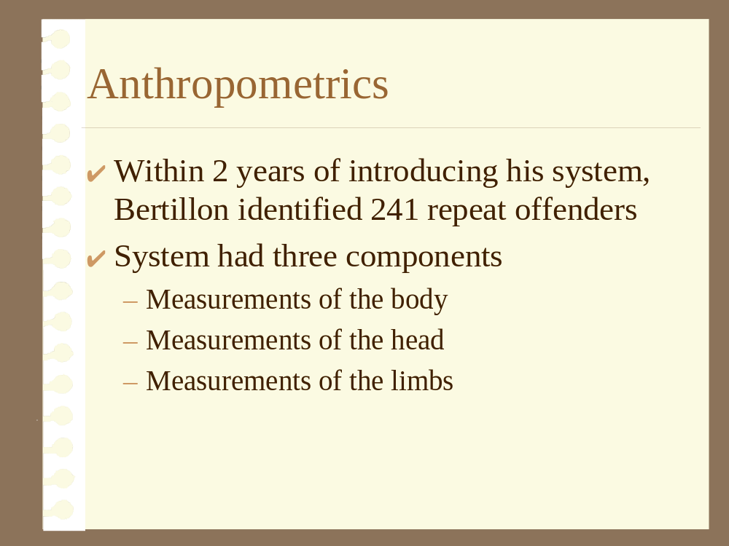
Nomenclature
Latent fingerprint: a fingerprint made by the deposit of oils and /or perspiration. It is invisible to the naked eye
Loop: a class of fingerprints characterized by ridgelines that enter from one side of the pattern and curve around to exit from the same side of the pattern
Whorl: a class of fingerprints that includes ridge patterns that are generally rounded or circular in shape and have two deltas
Arch: a class of fingerprints characterized by ridgelines that enter the print from one side and flow out the other side

Slide 4
Nomenclature
Visible Print: a fingerprint made when the finger deposits a visible material such as ink, dirt, or blood, onto a surface
Plastic Print: a fingerprint impressed in a soft surface
Iodine fuming: a technique for visualizing latent fingerprints by exposing them to iodine vapors
Sublimation: a physical change from the gaseous state
Ninhydrin: a chemical reagent used to develop latent fingerprints on porous materials by reacting with amino acids in perspiration

Slide 5
Nomenclature
Super glue fuming: a technique for visualizing latent fingerprints on nonporous surfaces by exposing by exposing them to cyanoacrylate vapors; named for the commercial products, Super Glue
Digital imaging: a process through which a picture is converted into a series of square electronic dots known as pixels. Manipulation of the picture is accomplished through computer software that changes the numerical value of each pixel
Pixel: an electronic square dot that is used to compose a digital image

Slide 6
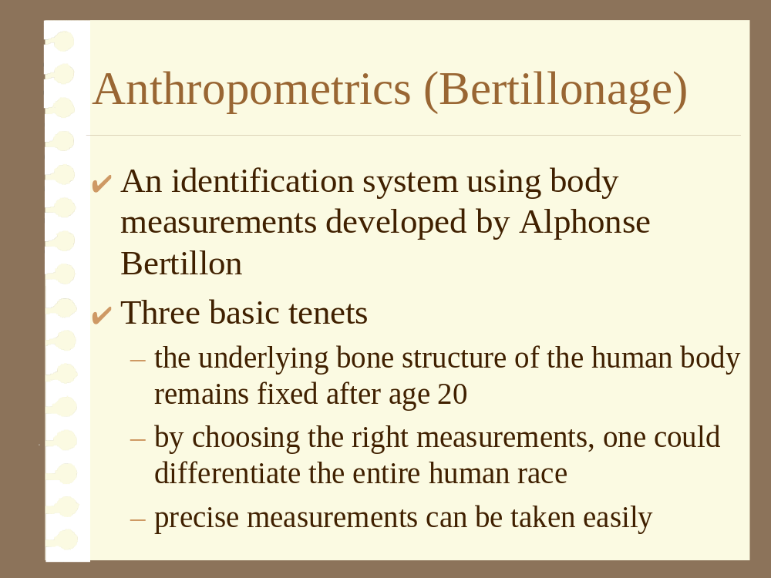

Slide 7
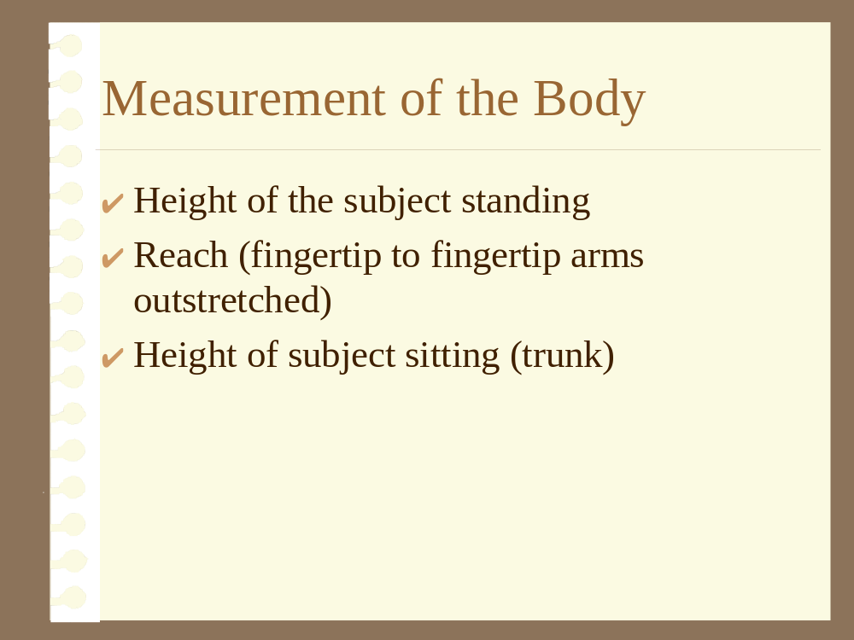

Slide 8
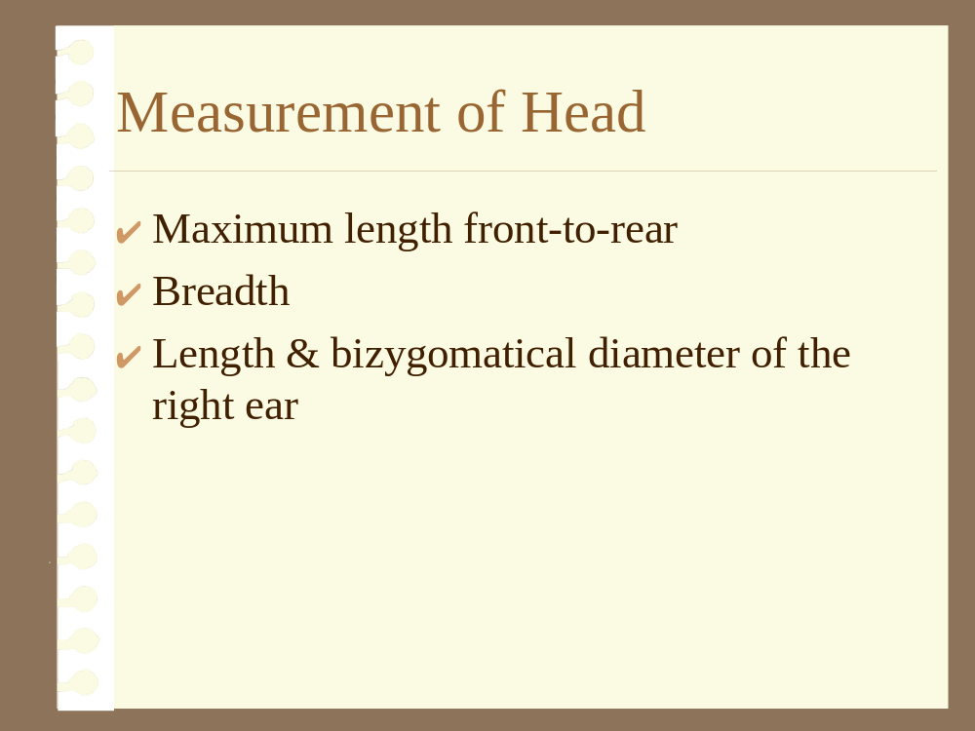

Slide 9
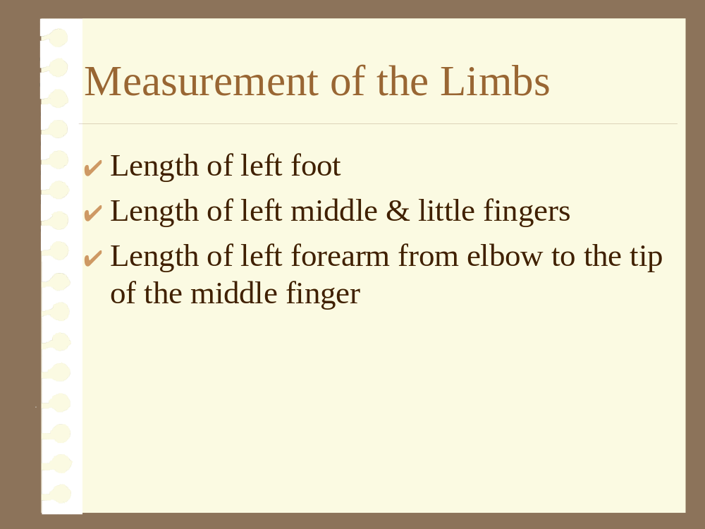

Slide 10
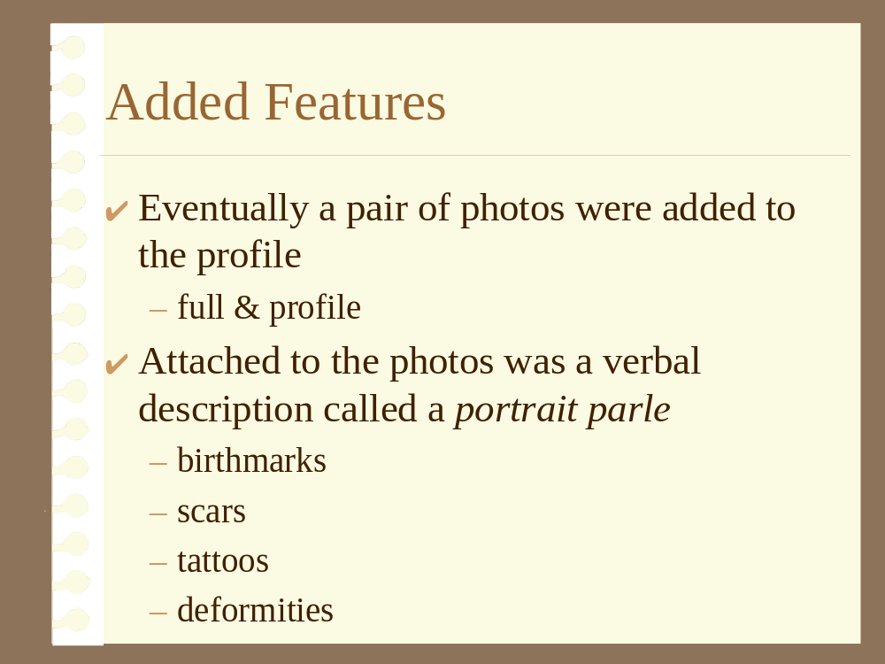

Slide 11
Problems with
Anthropometrics

Success dependent on making carefully &
time consuming measurement on everyone
arrested

The system was difficult for most people to
master

Impossible to use
Bertillonage
on a person
who had not been arrested

