Slide 1

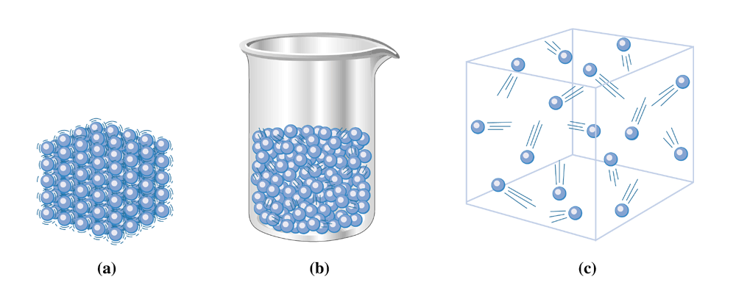
Figure 7.3 (a) In a solid, the particles (atoms, molecules, or ions) are close together and vibrate about fixed sites. (b) The particles in a liquid, though still close together, freely slide over one another. ( c) In a gas, the particles are in constant random motion, each particle being independent of the others present.

Slide 2
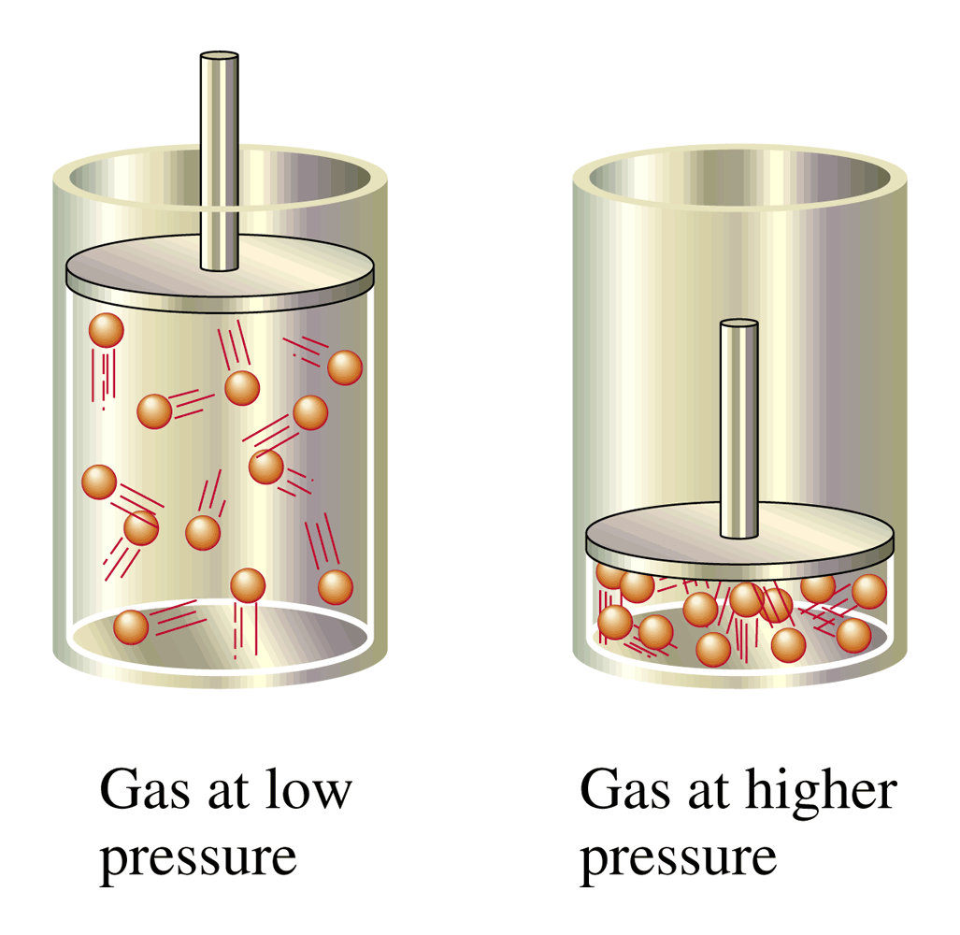
Figure 7.5 When a gas is compressed, the amount of empty space in the container is decreased. The size of the molecules does not change; they simply move closer together.

Slide 3
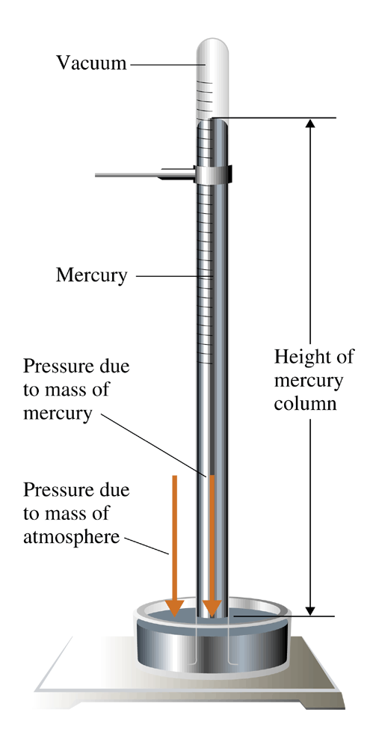
Figure 7.6
The essential components of a mercury barometer are a graduated glass tube, a glass dish, and liquid mercury.

Slide 4
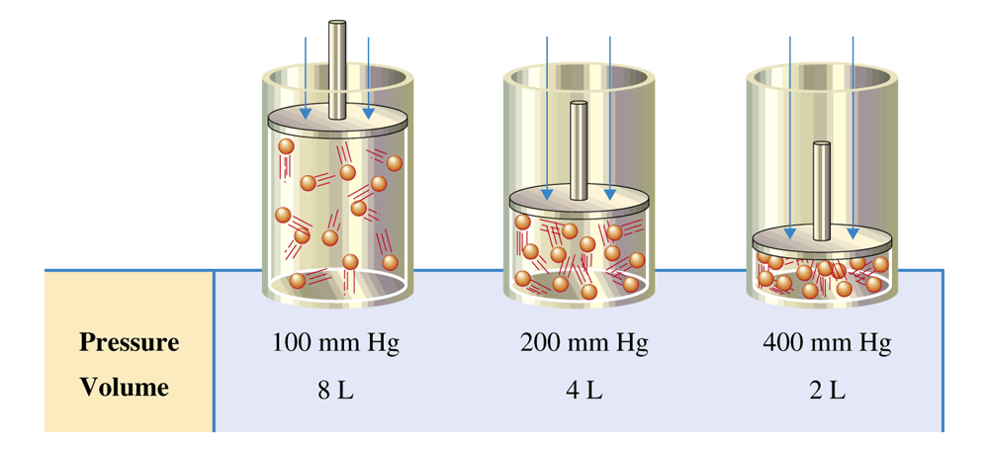
Figure 7.8 Data illustrating the inverse proportionality associated with Boyle's law.

Slide 5
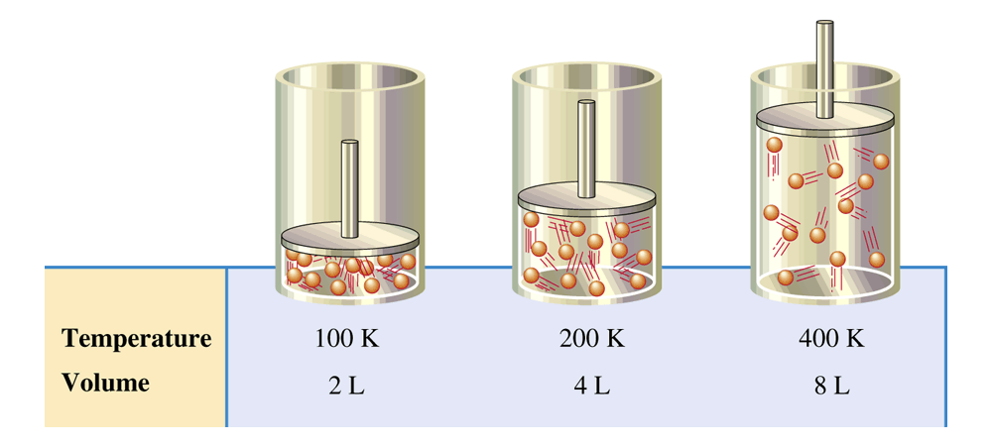
Figure 7.12 Data illustrating the direct proportionality associated with Charles's law.

Slide 6
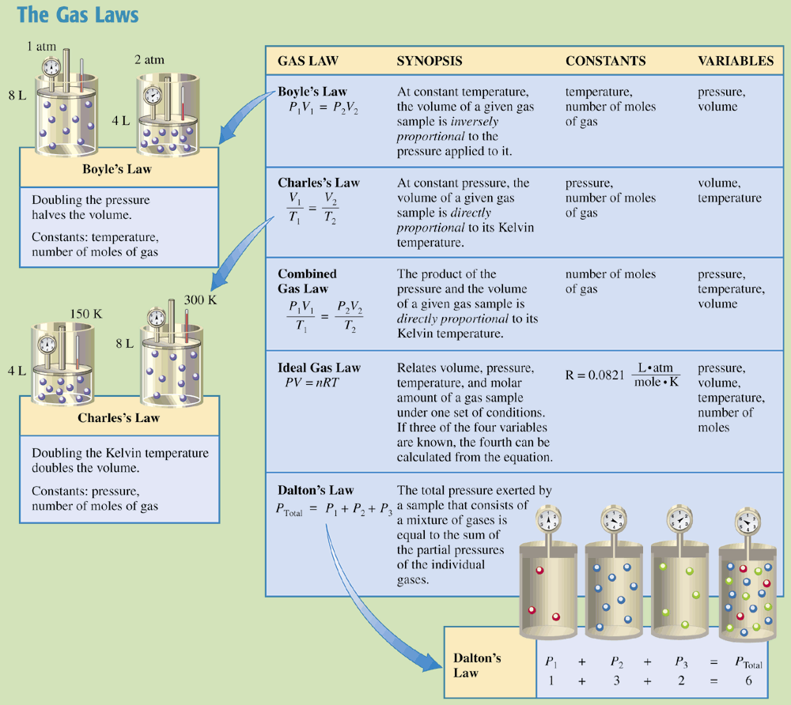
Chemistry at a Glance:
The Gas Laws

Slide 7
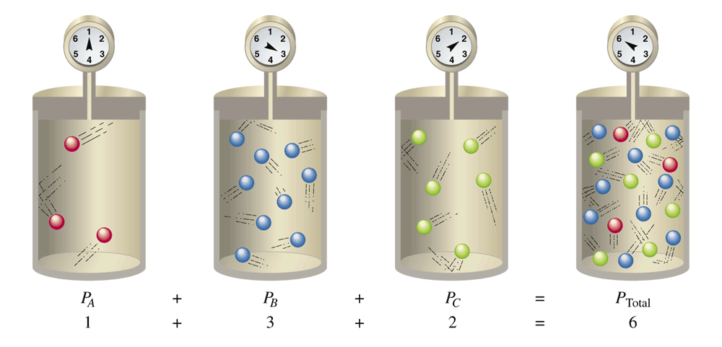
Figure 7.14 A set of four containers can be used to illustrate Dalton's law of partial pressures. The pressure in the fourth container (the mixture of gases) is equal to the sum of the pressures in the first three containers (the individual gases).

Slide 8
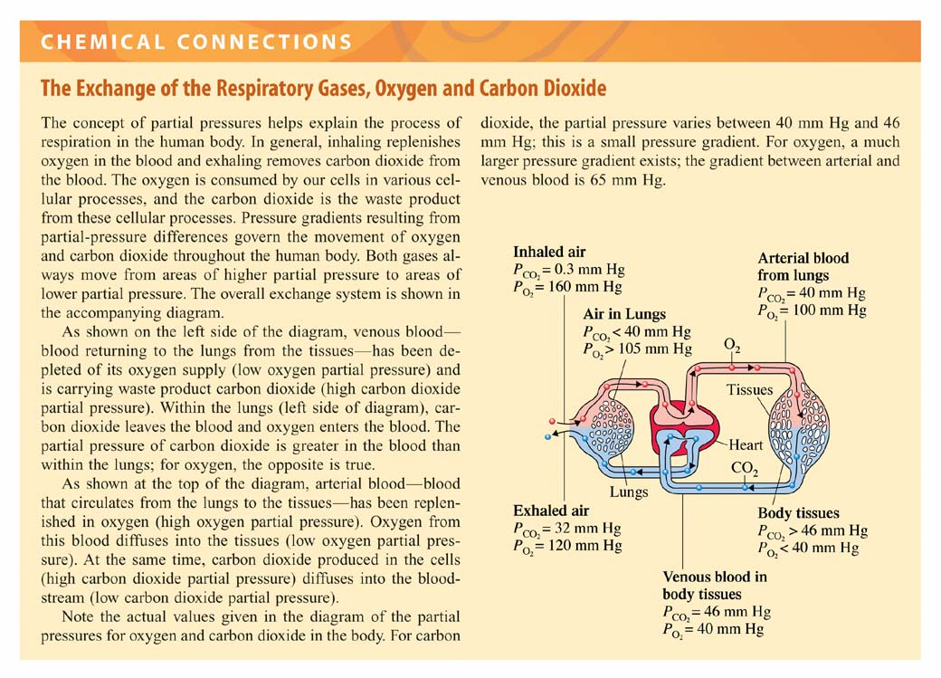

Slide 9
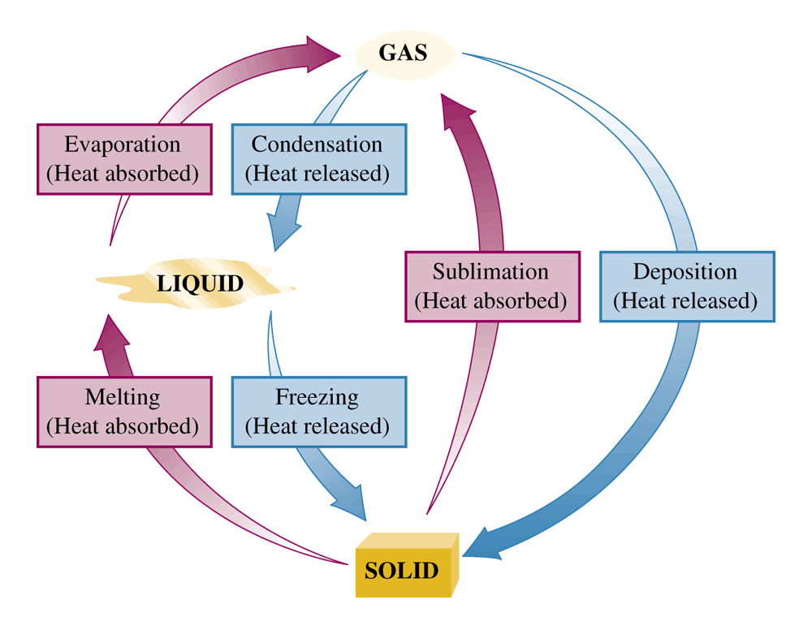
Figure 7.15 There are six changes of state possible for substances.

Slide 10
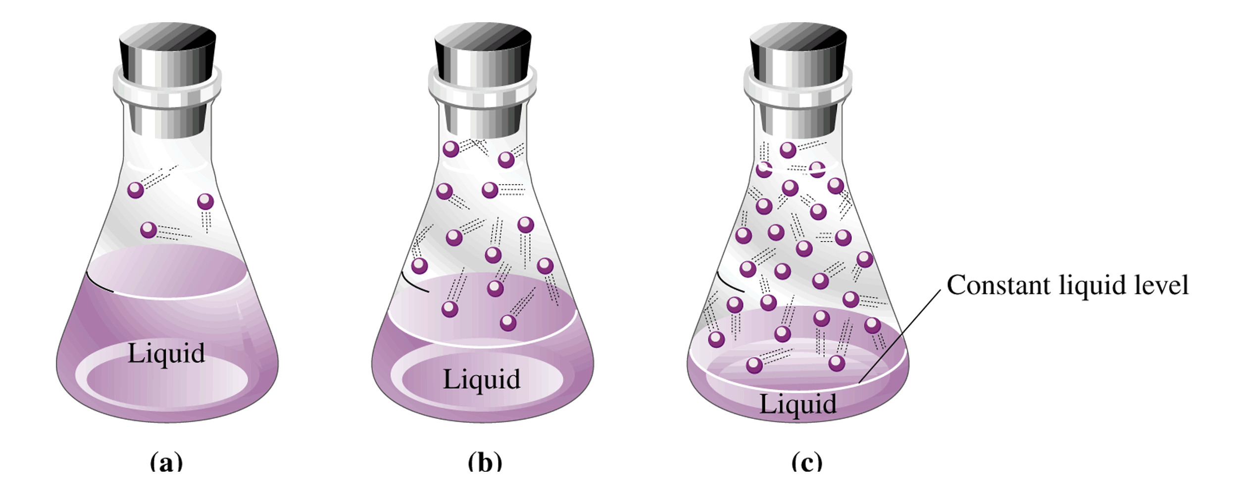
Figure 7.17 In the evaporation of a liquid in a closed container (a), the liquid level drops for a time (b) and then becomes constant (ceases to drop). At that point a state of equilibrium has been reached in which the rate of evaporation equals the rate of condensation (c).

Slide 11
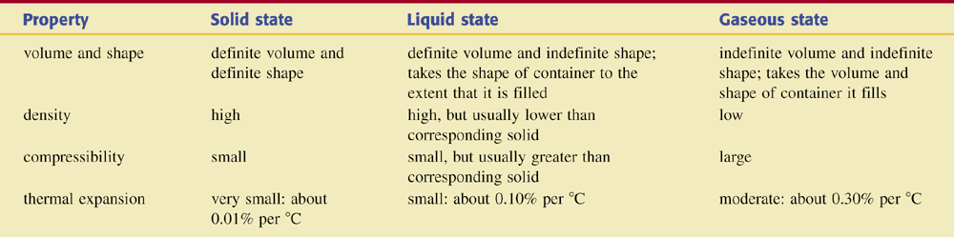
Table 7.1 Distinguishing Properties of Solids, Liquids, and Gases.

Slide 12
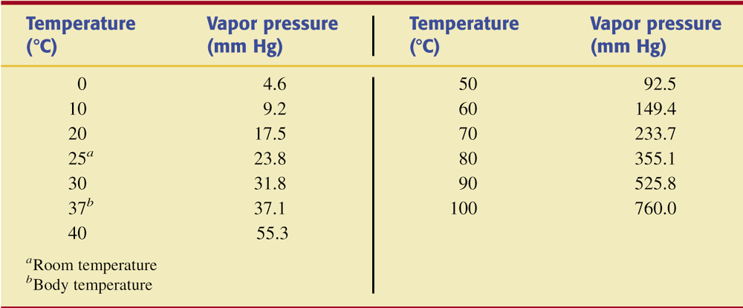
Table 7.2 Vapor Pressure of Water at
Various Temperatures.

Slide 13
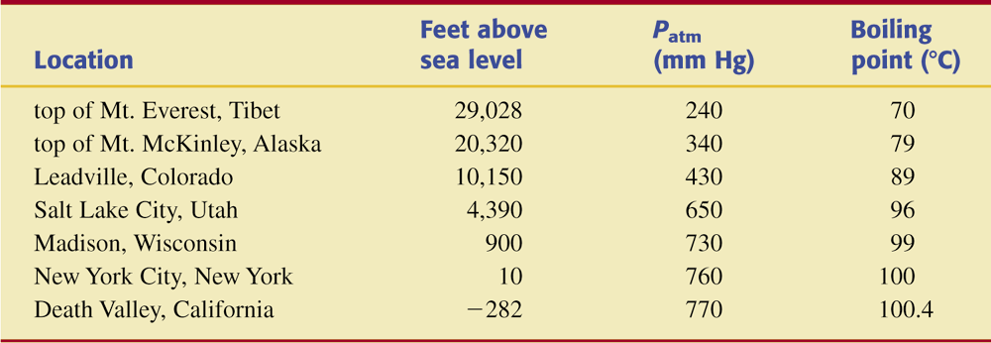
Table 7.3 Boiling Point of Water at Various Locations That Differ in Elevation.

Slide 14
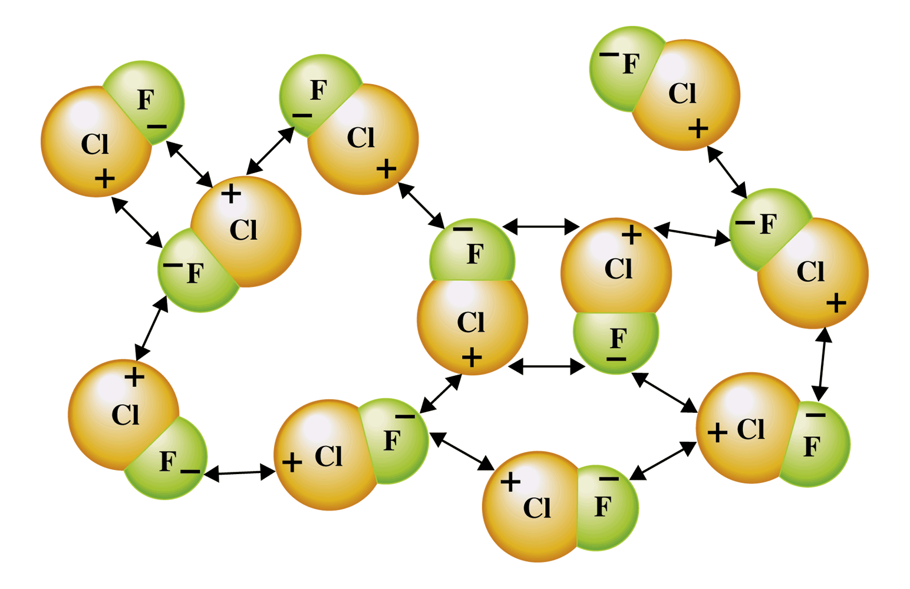
Figure 7.20 There are many dipole-dipole interactions possible between randomly arranged ClF molecules. In each interaction, the positive end of one molecule is attracted to the negative end of a neighboring ClF molecule.

Slide 15
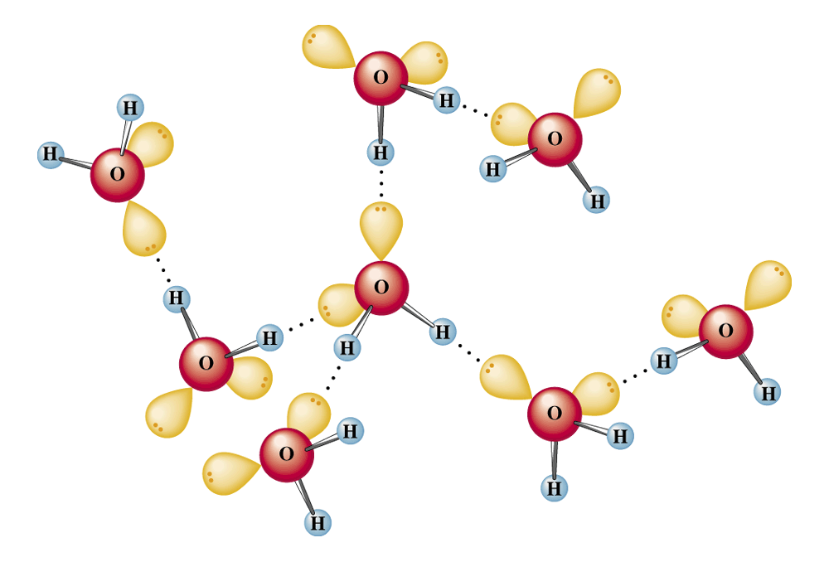
Figure 7.21 Depiction of hydrogen bonding among water molecules. The dotted lines are the hydrogen bonds.

Slide 16
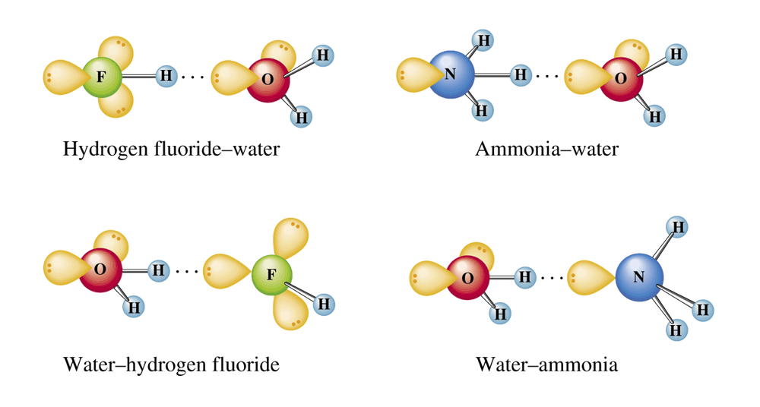
Figure 7.22 Diagrams of hydrogen bonding involving selected simple molecules. The solid lines represent covalent bonds; the dotted lines represent hydrogen bonds.

Slide 17
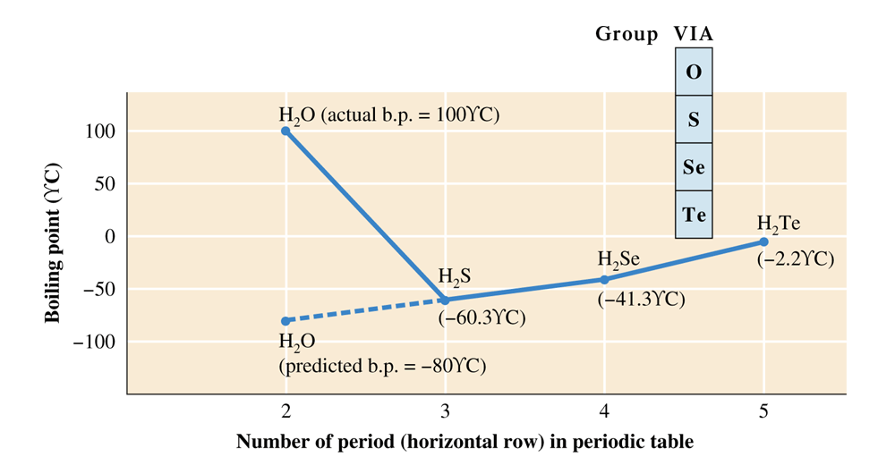
Figure 7.23 If there were no hydrogen bonding between water molecules, the boiling point of water would be approximately - 80C.

Slide 18
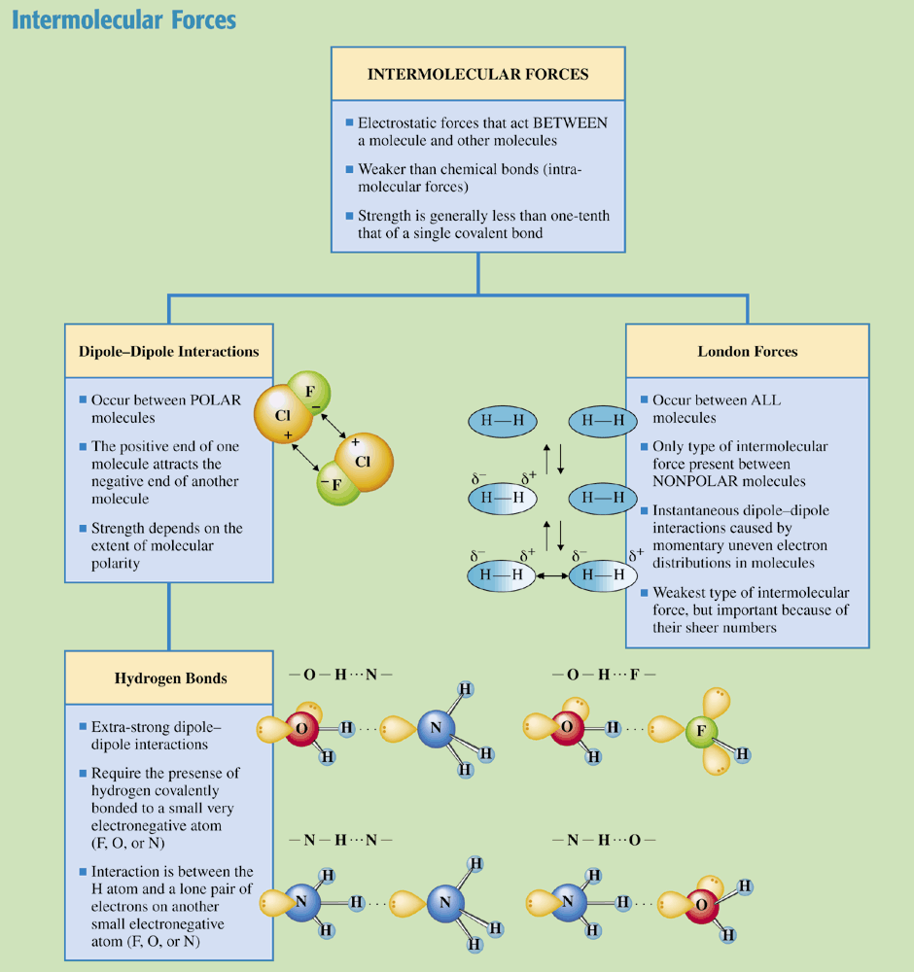
Chemistry at a Glance:
Intermolecular Forces

Slide 19
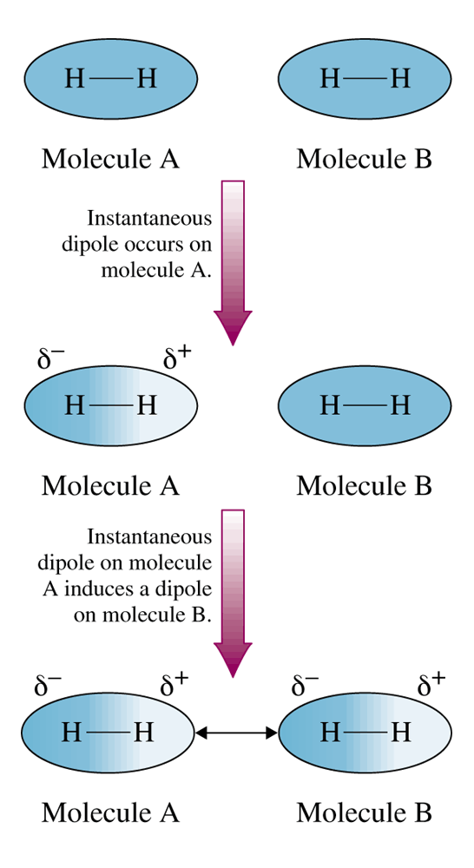
Figure 7.24
Nonpolar molecules such as H2 can develop instantaneous dipoles and induced dipoles. The attractions between such dipoles, even through they are transitory, create London forces.

