Slide 1
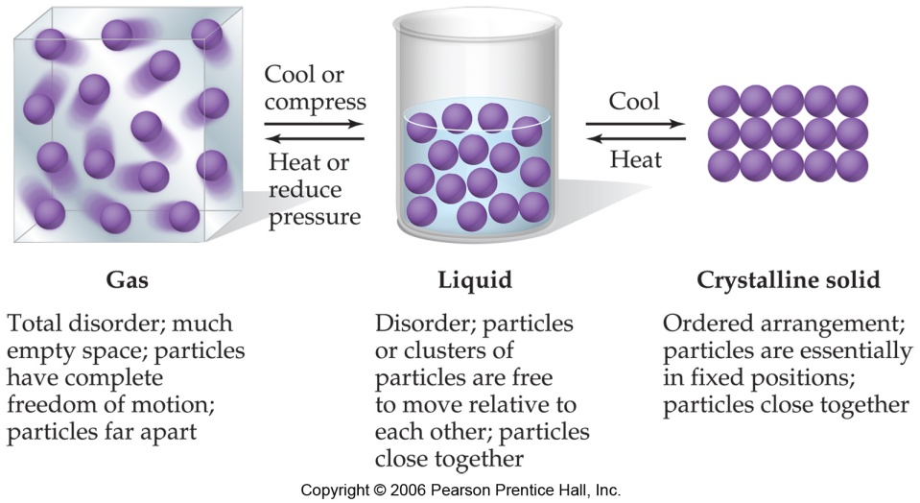
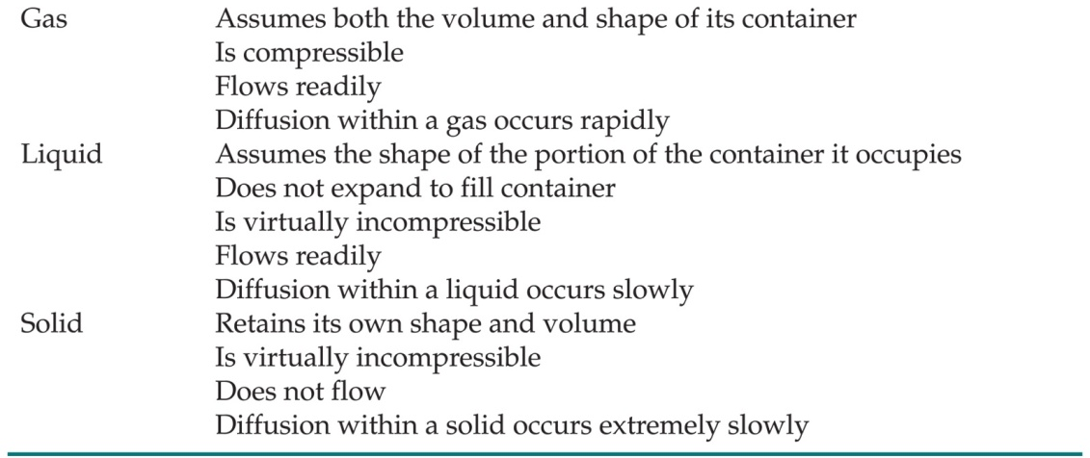
The States of Matter
The state a substance is in at a particular temperature and pressure depends on two antagonistic entities:
  1) The kinetic energy of the particles
  2) The strength of the attractions between the particles

Slide 2
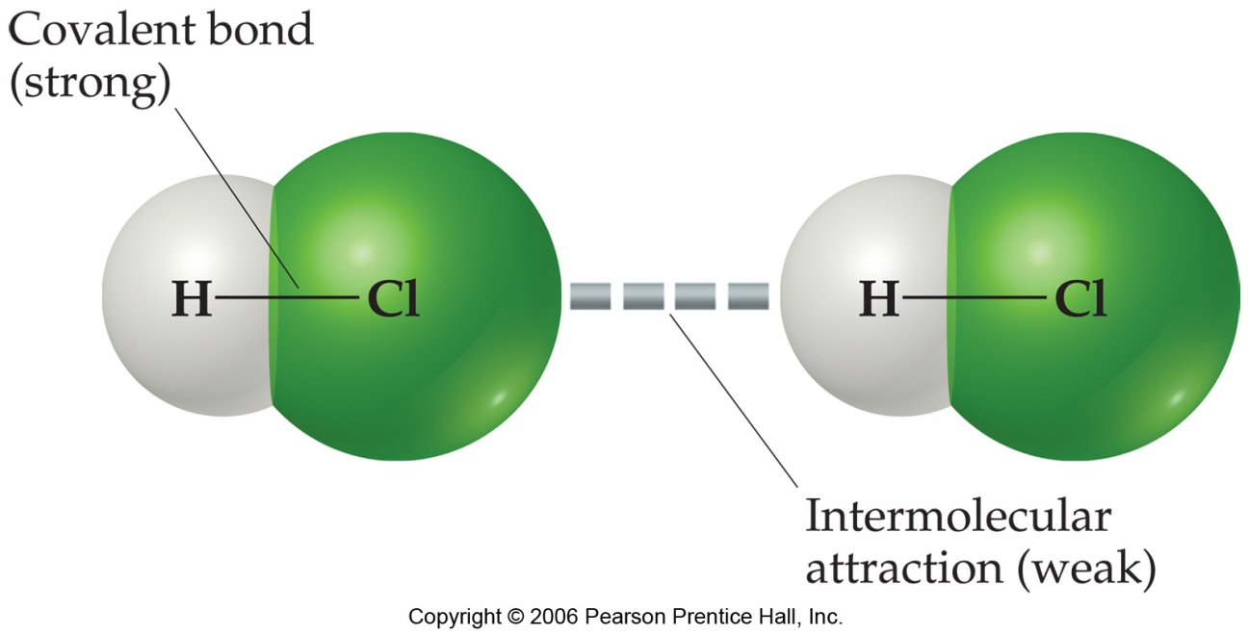
Intermolecular Forces
They are, however, strong enough to control physical properties such as boiling and melting points, vapor pressures, and viscosities.

Slide 3
Intermolecular Forces
These intermolecular forces as a group are referred to as van der Waals forces.

Slide 4
van der Waals Forces
Dipole-dipole interactions
Hydrogen bonding
London dispersion forces

Slide 5
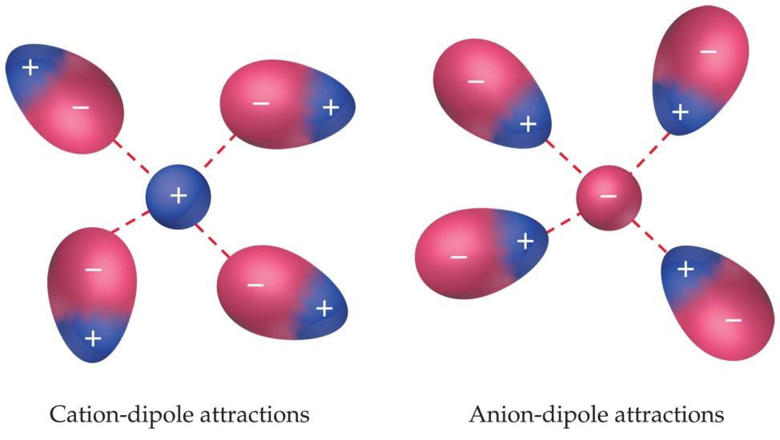
Ion-Dipole Interactions
A fourth type of force, ion-dipole interactions are an important force in solutions of ions.
The strength of these forces are what make it possible for ionic substances to dissolve in polar solvents.

Slide 6
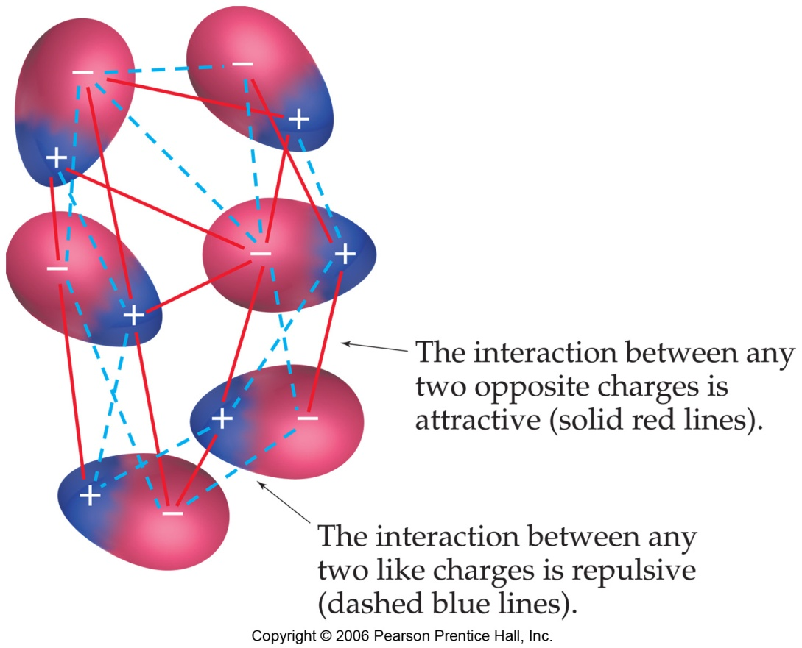
Dipole-Dipole Interactions
Molecules that have permanent dipoles are attracted to each other.
  The positive end of one is attracted to the negative end of the other and vice-versa.
  These forces are only important when the molecules are close to each other.

Slide 7
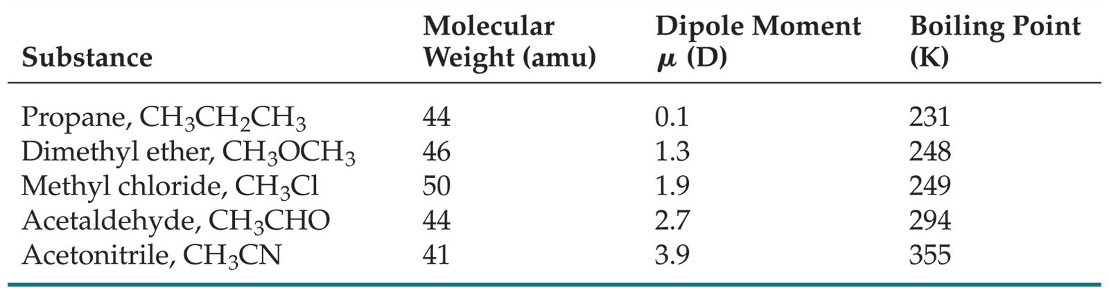
Dipole-Dipole Interactions
The more polar the molecule, the higher is its boiling point.
Within SAME molecular family, the larger the molecule, the higher is its boiling point.

Slide 8
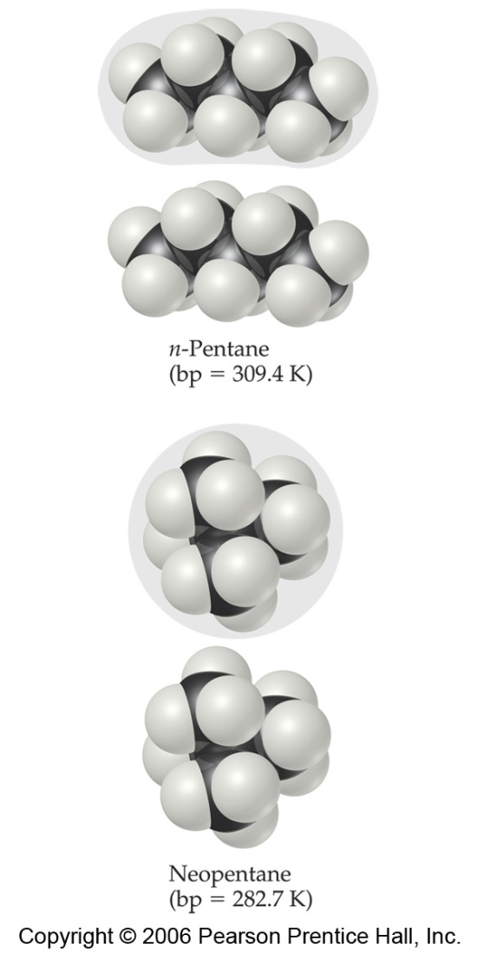
Factors Affecting London Forces
The SHAPE of the molecule affects the strength of dispersion forces: Long, Skinny molecules (like n-pentane tend to have Stronger dispersion forces than short, fat ones (like neopentane).
This is due to the increased surface area in n-pentane.

Slide 9
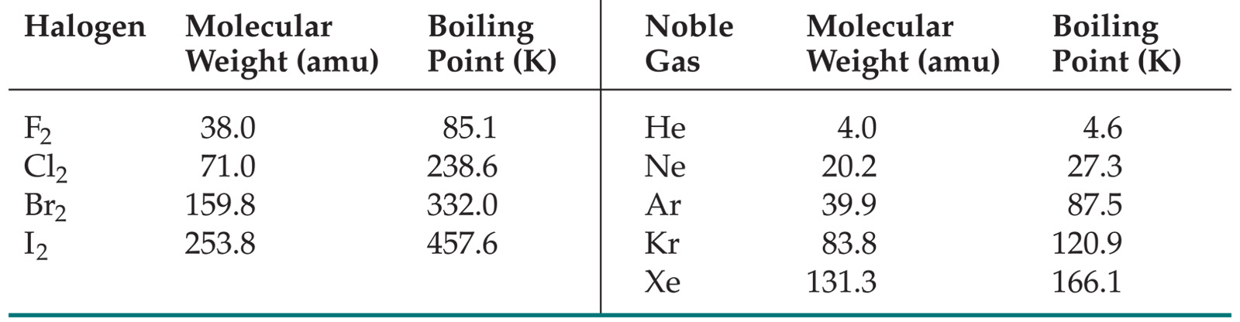
Factors Affecting London Forces
The strength of dispersion forces tends to increase with Increased molecular weight.
Larger atoms have larger electron clouds, which are easier to polarize.

Slide 10
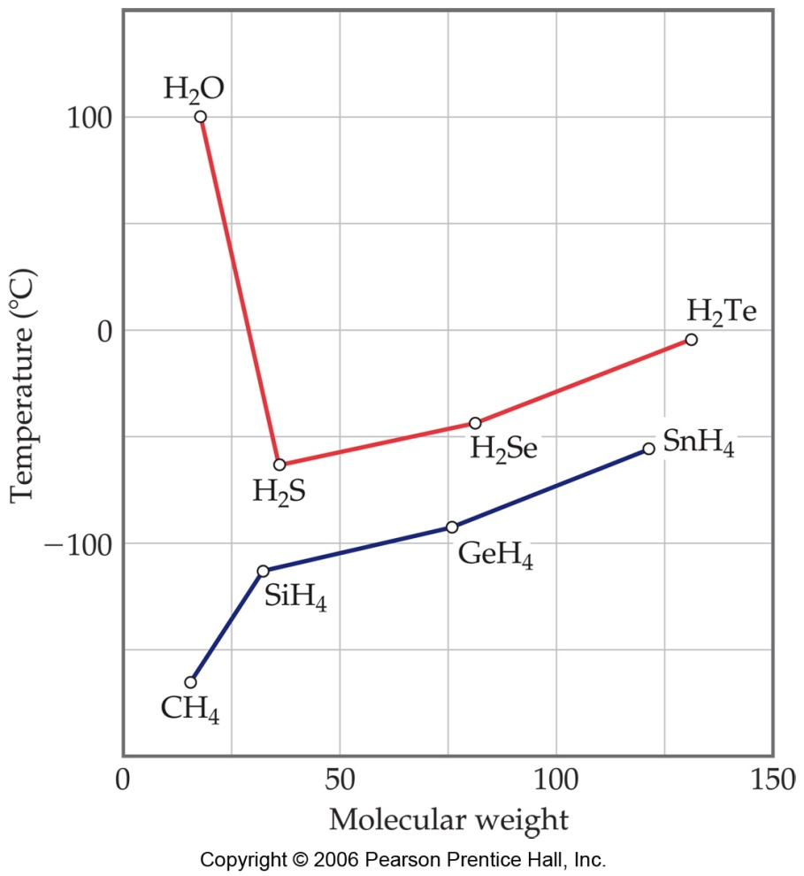
How Do We Explain This?
The nonpolar series (SnH₄ to CH₄) follow the expected trend.
The polar series follows the trend from H₂Te through H₂S, but Water is quite an anomaly.

Slide 11
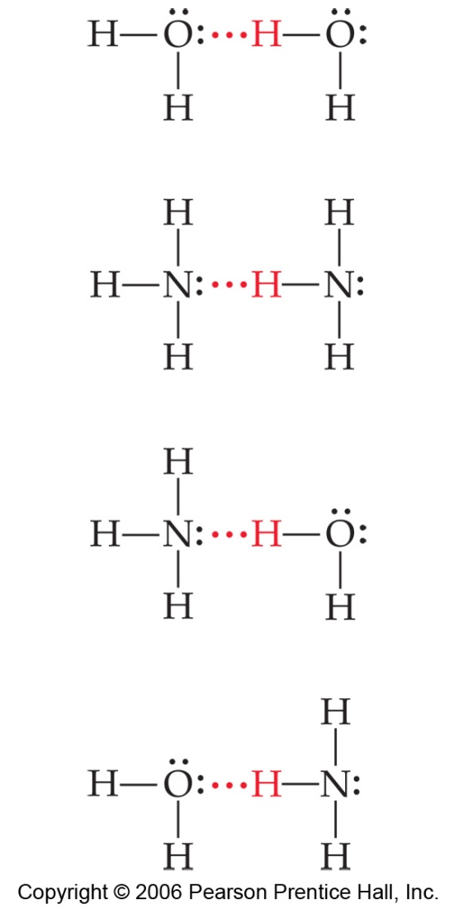
Hydrogen Bonding
The dipole-dipole interactions experienced when H is bonded to N, O, or F are unusually strong.
We call these interactions hydrogen bonds.

Slide 12
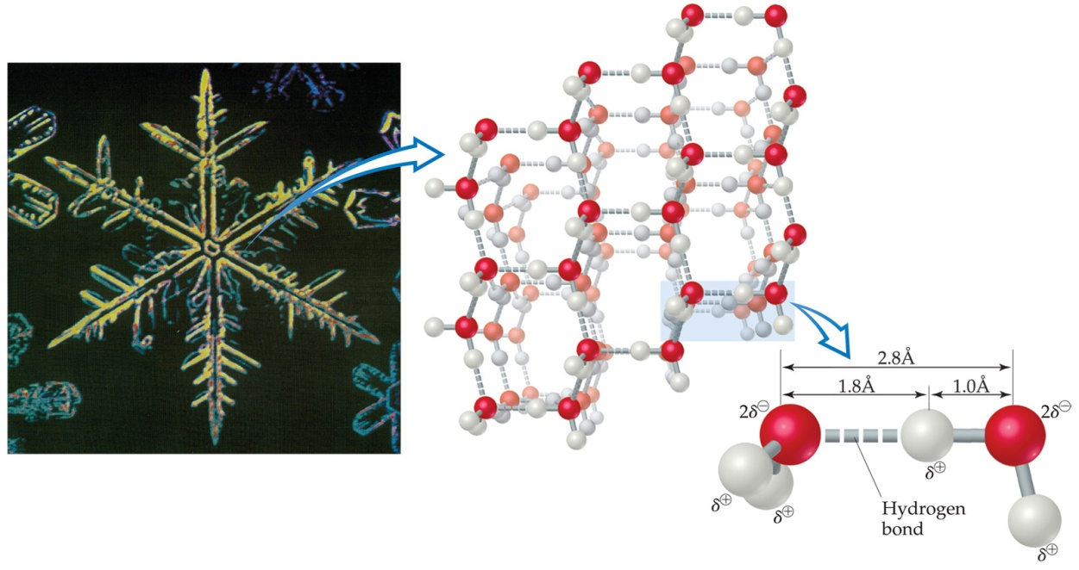
Hydrogen Bonding
Hydrogen bonding arises in part from the high electronegativity of nitrogen, oxygen, and fluorine.
Also, when hydrogen is bonded to one of those very electronegative elements, the hydrogen nucleus is exposed.

Slide 13
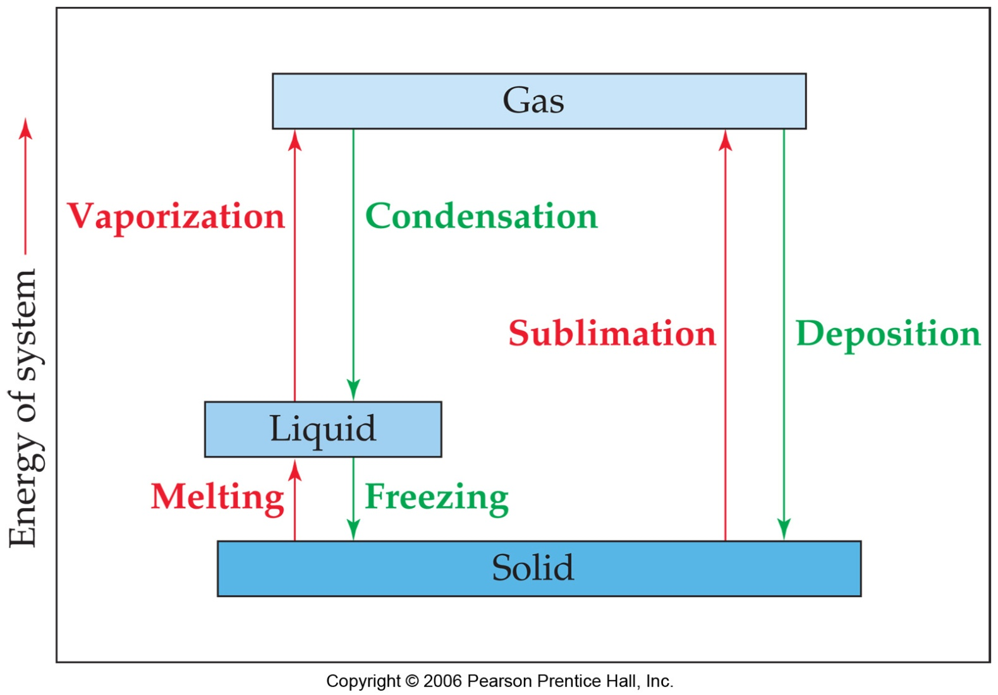
Phase Changes

Slide 14
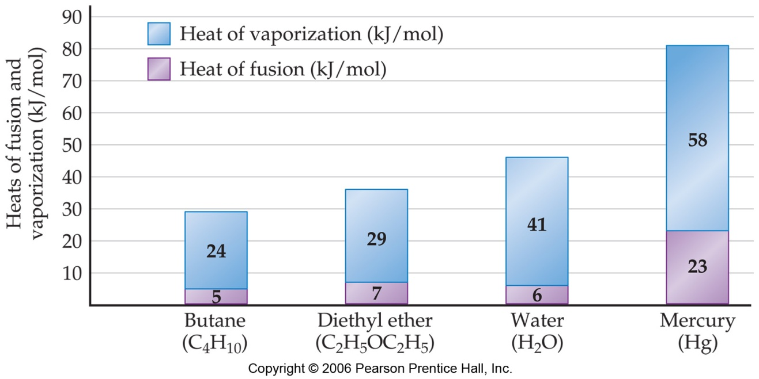
Energy Changes Associated with Changes of State
ΔH Heat of Fusion: Energy required to change a solid at its melting point to a liquid.

Slide 15
Energy Changes Associated with Changes of State
ΔH Heat of Vaporization: Energy required to change a liquid at its boiling point to a gas.

Slide 16
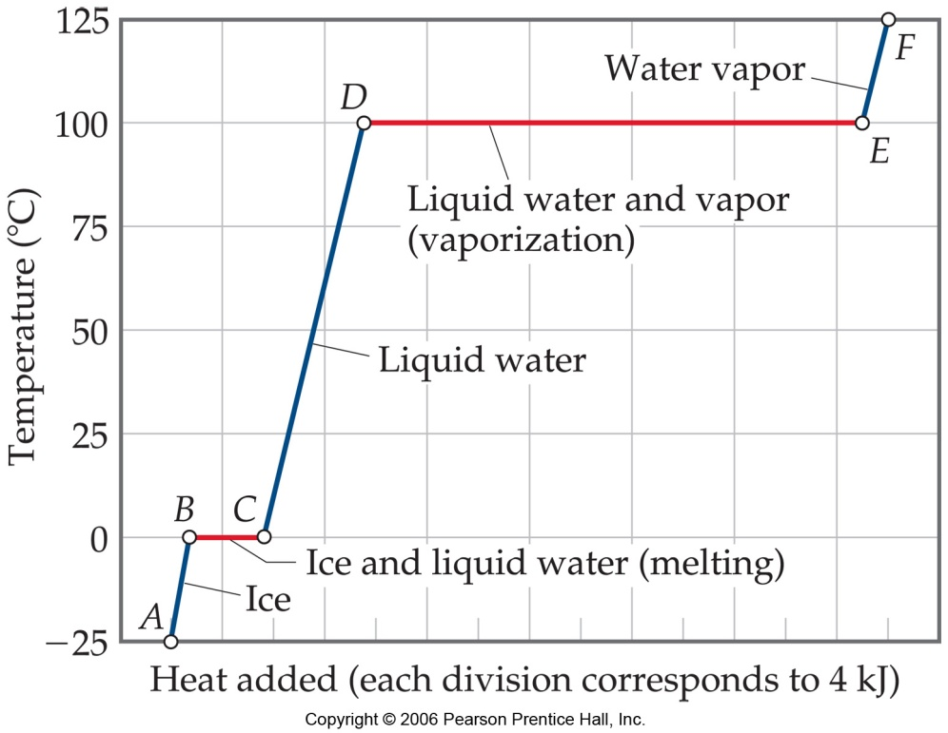
Energy Changes Associated with Changes of State
The heat added to the system at the melting and boiling points goes into pulling the molecules farther apart from each other.
The temperature of the substance does not rise during the phase change.

Slide 17
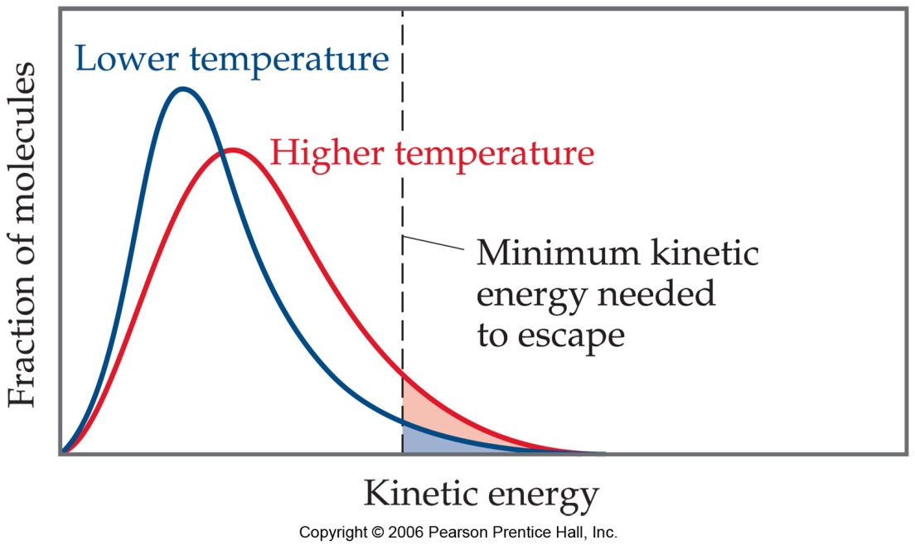
Vapor Pressure
At any temperature, some molecules in a liquid have enough energy to escape.
As the temperature rises, the fraction of molecules that have enough energy to escape increases.

Slide 18
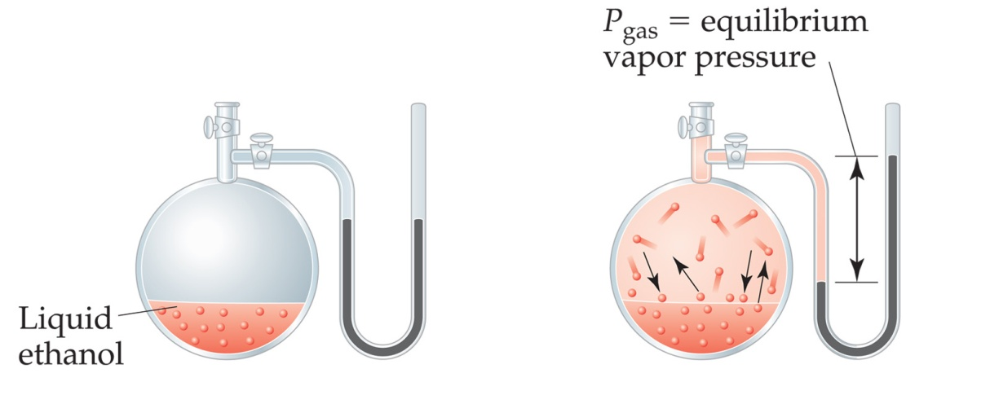
Vapor Pressure
The liquid and vapor reach a state of dynamic equilibrium: liquid molecules evaporate and vapor molecules condense at the same rate.

Slide 19
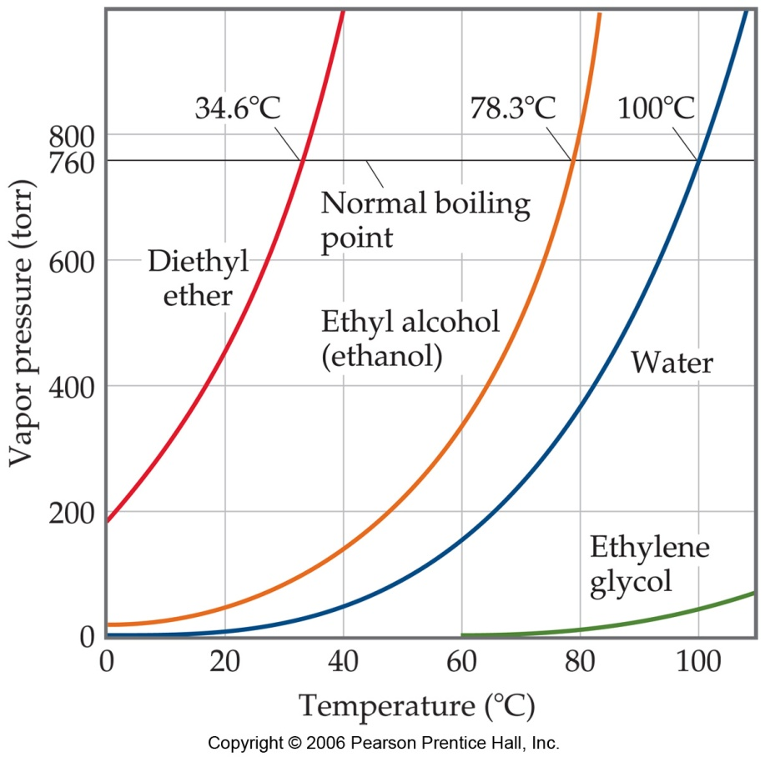
Vapor Pressure
The BOILING POINT of a liquid is the temperature at which its vapor pressure equals atmospheric pressure.
*The normal boiling point is the temperature at which its vapor pressure is 760 torr.

Slide 20
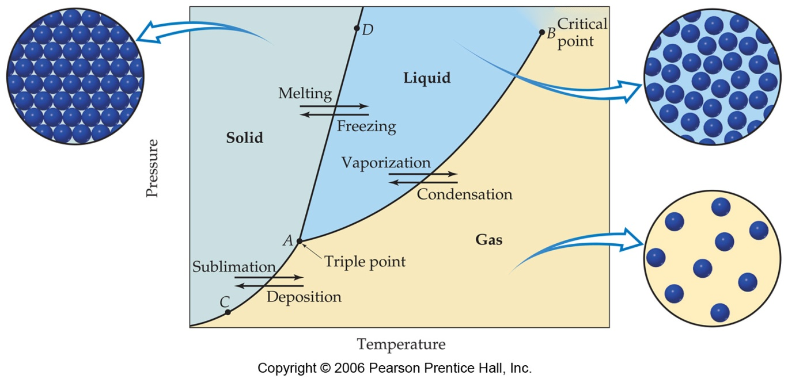
Phase Diagrams
Phase diagrams display the state of a substance at various pressures and temperatures and the places where equilibria exist between phases.

Slide 21
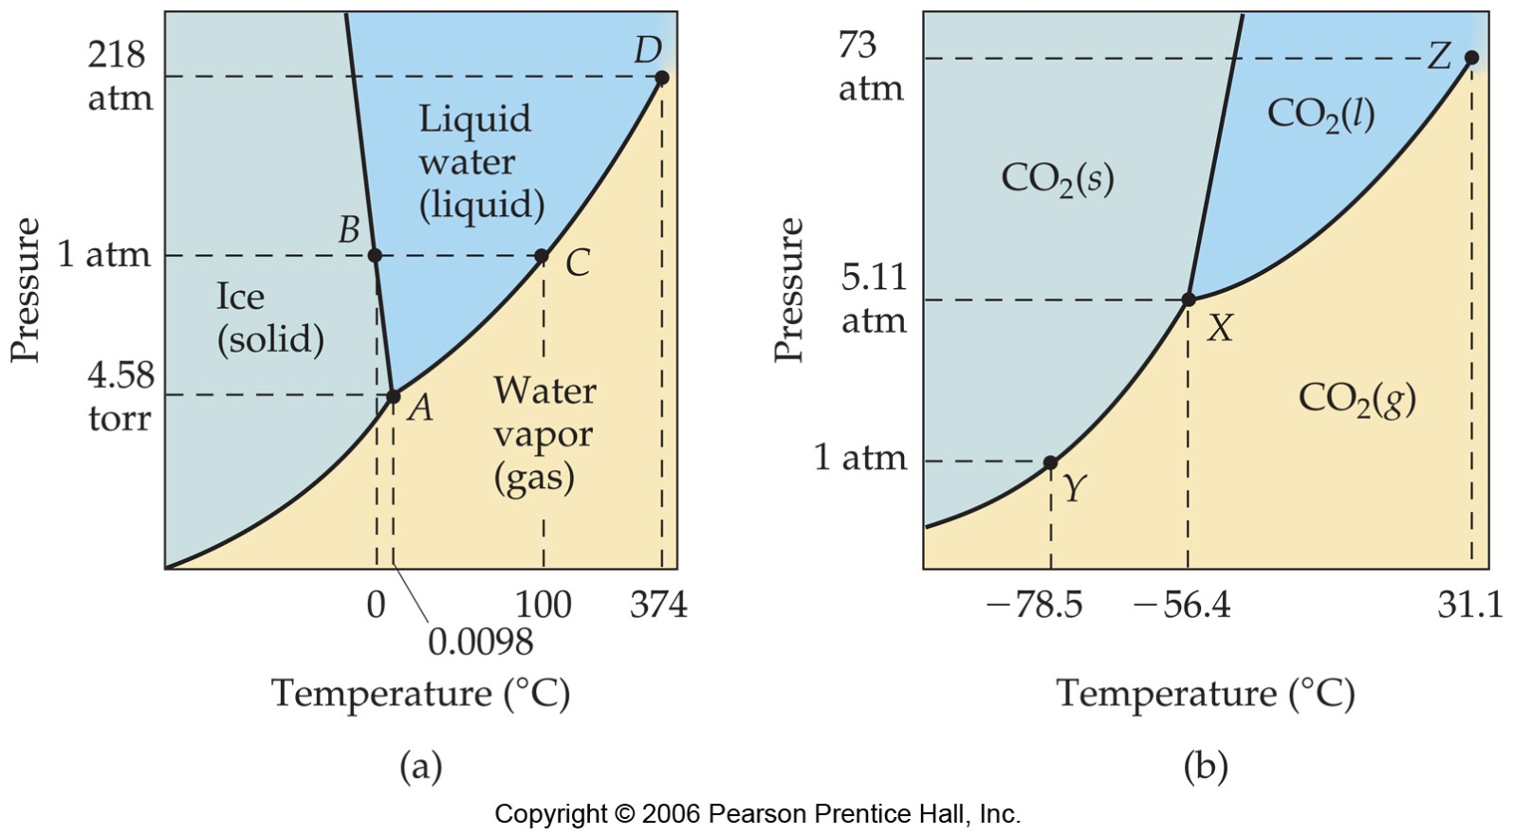
Phase Diagram of Water
Note the high critical temperature and critical pressure:
  These are due to the strong van der Waals forces between water molecules.

Slide 22
Phase Diagram of Water
The slope of the solid–liquid line is negative.
  This means that as the pressure is increased at a temperature just below the melting point, water goes from a solid to a liquid.

Slide 23
Phase Diagram of Carbon Dioxide
Carbon dioxide cannot exist in the liquid state at pressures below 5.11 atm; CO₂ sublimes at normal pressures.

Slide 24
Phase Diagram of Carbon Dioxide
The low critical temperature and critical pressure for CO₂ make supercritical CO₂ a good solvent for extracting nonpolar substances (such as caffeine).

Slide 25
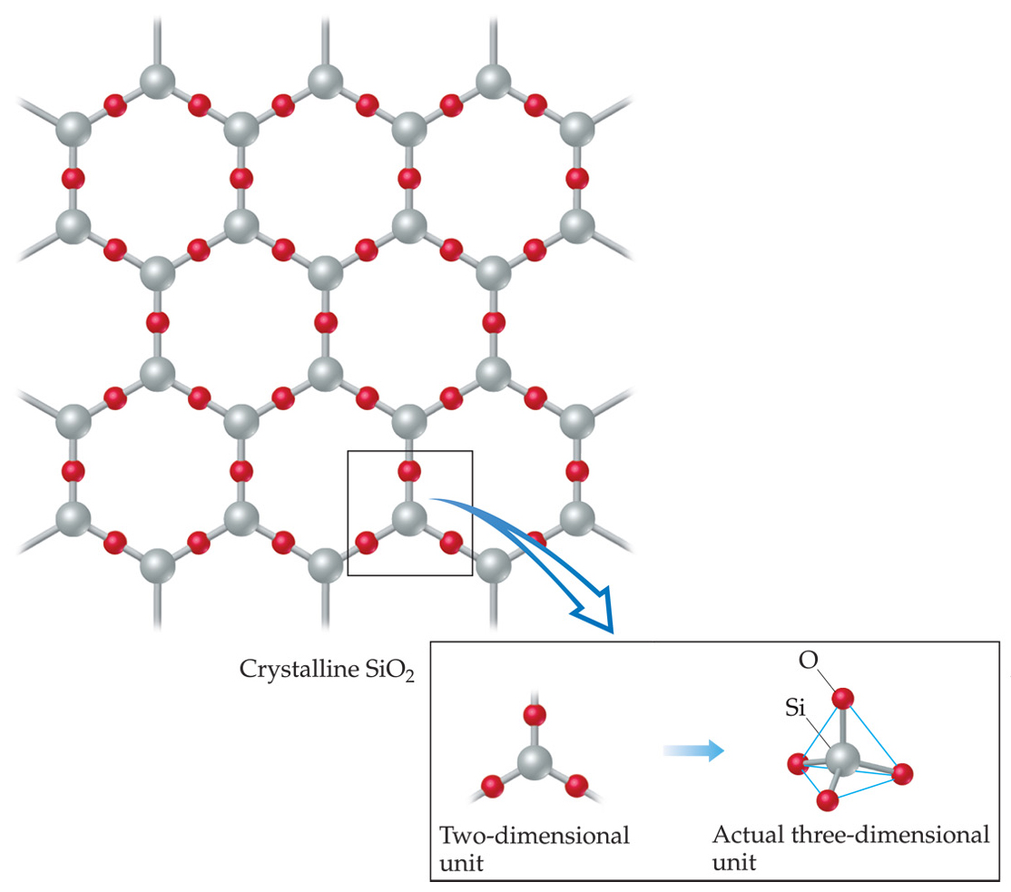
Solids
We can think of solids as falling into two groups:
  Crystalline—particles are in highly ordered arrangement.

Slide 26
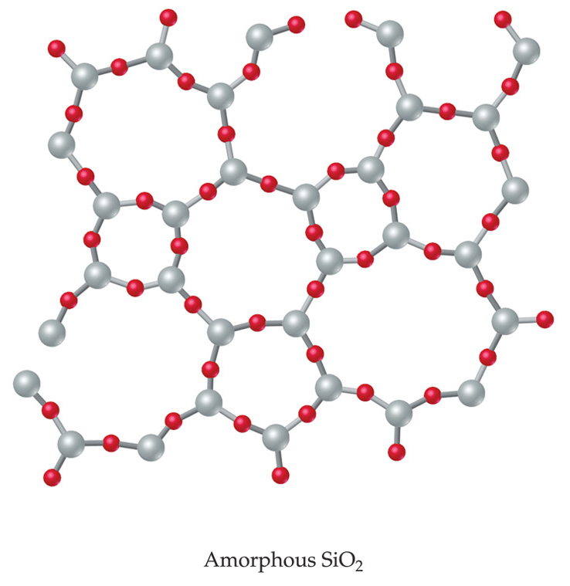
Solids
  Amorphous—no particular order in the arrangement of particles.

Slide 27
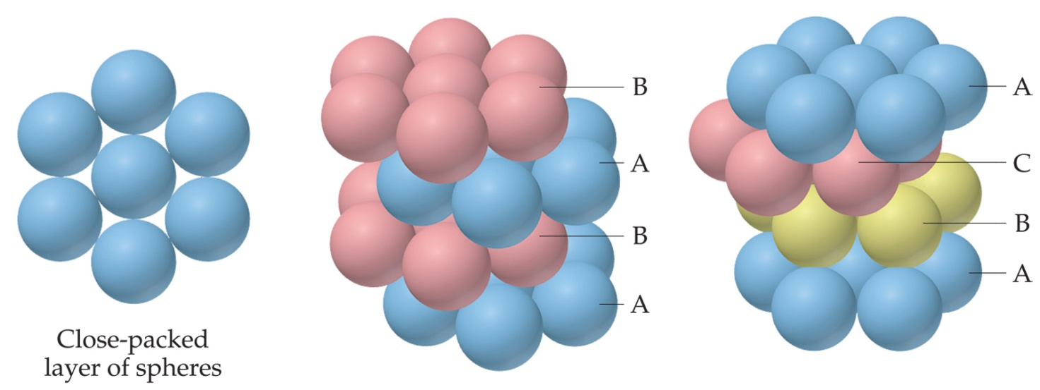
Attractions in Ionic Crystals
In ionic crystals, ions pack themselves so as to maximize the attractions and minimize repulsions between the ions.

Slide 28
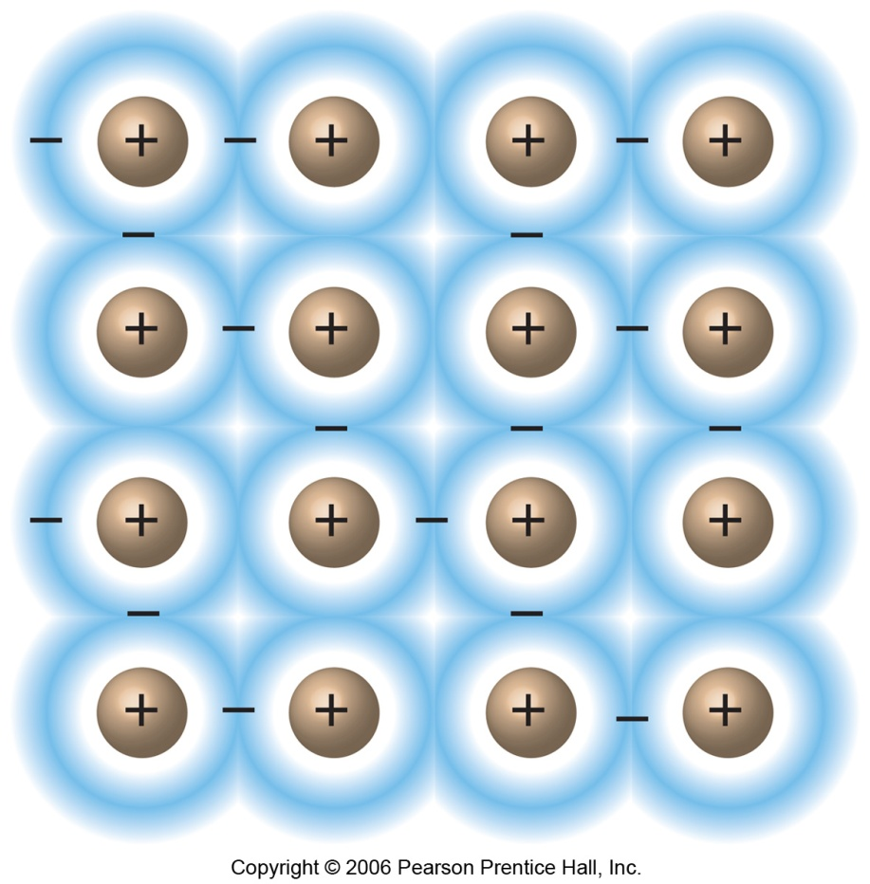
Metallic Solids
Metals are not covalently bonded, but the attractions between atoms are too strong to be van der Waals forces.
In metals, valence electrons are delocalized throughout the solid.

