Slide 1
Assumptions of the Kinetic Theory of Gases
1. Gases are composed of separate, tiny particles called molecules
2. Gas molecules are in constant, rapid, straight line motion (which means that gas molecules have kinetic energy ( KE = ½ mv² )
3. The collisions between molecules are completely elastic (when molecules collide, there is no exchange of energy
4. The molecules of a gas have no attraction or repulsion for each other
5. Each molecule in a gas has a different velocity

Slide 2
Derivation of the Ideal Gas Law from the Kinetic Theory
Consider a room that has the shape of a cube. There will be six surfaces in that room. The pressure on each of those six surfaces will be the same. Now, imagine a single gas molecule in this room. When that gas molecule strikes the walls of the room, a force will be exerted.

Slide 3
Derivation of the Ideal Gas Law from the Kinetic Theory
Physicists consider a force to have been exerted when there is a change in the momentum of a particle. Momentum (p) is calculated by multiplying the mass of the particle (m) by the velocity (u) of the particle. We will use u for velocity so that we do not confuse it with volume (v).

Slide 4
Derivation of the Ideal Gas Law from the Kinetic Theory
If the particle collision with the surface is a perfectly elastic collision, then there will be no change in energy. However, the particle will rebound in the exact opposite direction with exactly the same momentum. If the velocity of the particle is u before the collision, then the velocity after collision is -u.

Slide 5
Derivation of the Ideal Gas Law from the Kinetic Theory
Then, the change in velocity can be determined by :
➔u = velocity before - velocity after
➔u = u - (-u) = 2u
➔p = m ➔u = m(2u) = 2mu
This force exerted on one side must be the same for all sides.

Slide 6
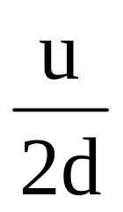
Derivation of the Ideal Gas Law from the Kinetic Theory
The particle must travel a distance of 2d before it strikes the same surface again. The number of times the particle strikes the same surface will depend on how fast it travels, u, and the distance between each event:
# of times the particle strikes the surface per unit time =

Slide 7
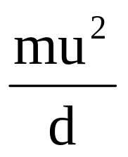
Derivation of the Ideal Gas Law from the Kinetic Theory
The total force exerted by this single gas particle on one surface will be:
Force exerted by the particle = 2 mu x
Force =

Slide 8
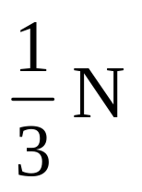
Derivation of the Ideal Gas Law from the Kinetic Theory
This is the force exerted by a single particle. Now consider that there must be a large number of particles in this space. Let the number of particles be represented by N. How many of these particles will be striking the surface of interest?

Slide 9
Derivation of the Ideal Gas Law from the Kinetic Theory
The total force exerted on this surface can now be determined:
Total Force = x

Slide 10
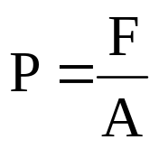
Derivation of the Ideal Gas Law from the Kinetic Theory
The pressure exerted on this surface is found by:
Force = x
A = d²

Slide 11
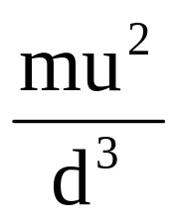
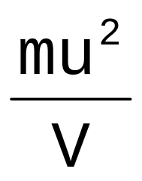
Derivation of the Ideal Gas Law from the Kinetic Theory
The pressure can now be determined :
P =
d³ = V
P =

Slide 12
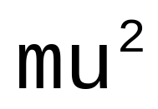
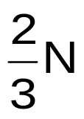
Derivation of the Ideal Gas Law from the Kinetic Theory
Rearrange this equation to obtain:
PV =
Recall that KE = ½ mu²
PV = (½ )( )
PV = (KE )( )

Slide 13
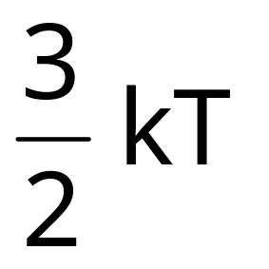
Derivation of the Ideal Gas Law from the Kinetic Theory
The Boltzmann relationship between kinetic energy and temperature is:
KE =

Slide 14
Derivation of the Ideal Gas Law from the Kinetic Theory
Replace KE with this term:
PV = ( )( )
or: PV = NkT
Since N = number of particles, then dividing N by Avogadro’s number produces number of moles which can be represented by n.

Slide 15
Derivation of the Ideal Gas Law from the Kinetic Theory
If Boltzmann’s constant, k, is divided by Avogadro’s number, a single constant is obtained which will be called R, the gas constant. The final equation becomes:
PV = nRT
Which is called the ideal gas law

Slide 16
Dalton’s Law of Partial Pressures
1. In a mixture of gases, each gas exerts its own
pressure independent of all other gases.
2. P_{total} = P₁ + P₂ +……. P_{n}

Slide 17
Example of Dalton’s Law of
Partial Pressures
In a mixture of nitrogen, N₂, oxygen, O₂, and argon, Ar,
- the volume of the container is 2.0 L
- the pressure of nitrogen is 325 torr
- the pressure of the oxygen is 535 torr
- the pressure of the argon is 78.0 torr
What is the total pressure of the gas in this container?

Slide 18
Grahms Law of Diffusion - 1
1. Diffusion is the process in which molecules of
a liquid are changed in vapor and then fill the
space available in the container.
2. Molecular motion (movement) is described by
the kinetic theory. This motion possesses
kinetic energy ( KE = ½ mv² )
3. Consider the case in which two (2) gases are
present. Both gases have the same average
kinetic energy because both gases are at the
same temperature.

Slide 19
Grahms Law of Diffusion - 2
4. The kinetic energy of both gases must be equal.
(KE)₁ = (KE)₂
5. (KE)₁ = ½ m₁(v₁)² and (KE)₂ = ½ m₂(v₂)²
6. Then, (KE)₁ = (KE)₂ and ½ m₁(v₁)² = ½ m₂(v₂)²
7. This equation can be simplified as:

Slide 20
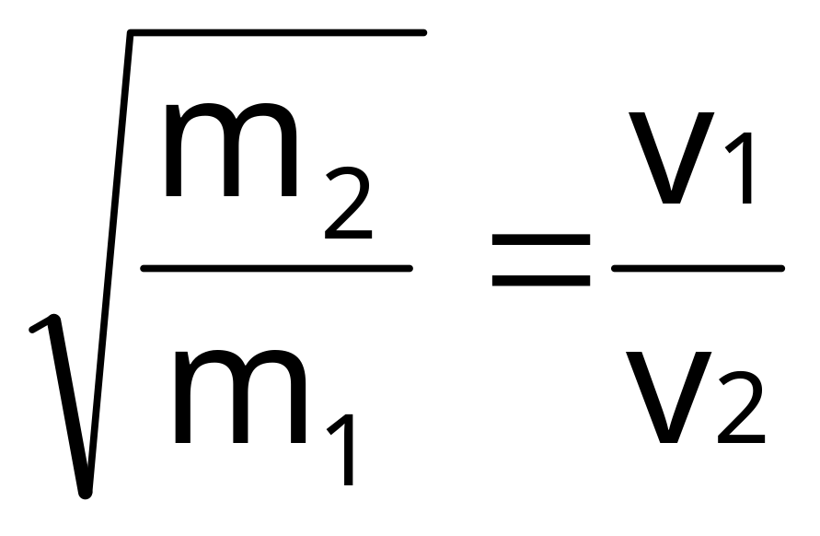
Grahms Law of Diffusion - 3

