Slide 1
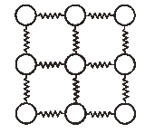
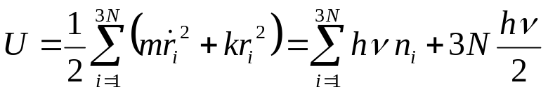
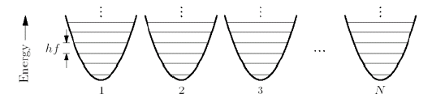
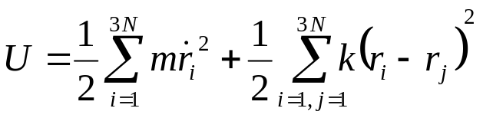
Einstein’s Model: Solid composed of Equivalent Oscillators
In 1907, Einstein developed the first quantum-mechanical model of solids that was able to qualitatively describe the low-T heat capacity of the crystal lattice. Although this was a crucial step in the right direction, the model was incomplete.
In Einstein’s model, all oscillators are identical, and their frequencies are the same:
ħω
1
2
3
3N
However, Einstein’s model ignores the fact that the atomic vibrations are coupled together: the potential energy of an atom in the crystal depends on the distance from its neighbors:
This energy is not a sum of single-particle energies. Thus, the calculation of the partition function may look rather difficult. But a system of N coupled three-dimensional oscillators is equivalent to a system of 3N independent one-dimensional oscillators. the price to be paid is that the independent oscillators are not of the same frequency; the normal modes of vibration of a solid have a wide range of frequencies. These modes are not related to the motion of single atoms, but to the collective motion of all atoms in the crystal – vibrational modes or sound waves.

Slide 2
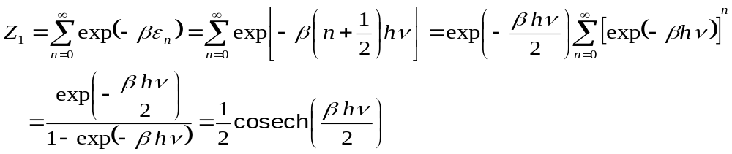

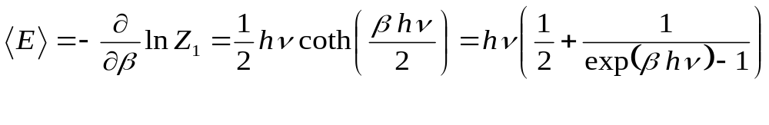

Einstein’s Model of a Solid
In 1907 Einstein, in the first application of quantum theory to a problem other than radiation, modeled a solid body containing N atoms as a collection of 3N harmonic oscillators. The partition function of a single oscillator:
The oscillators are independent of each other, thus:
The mean energy:
This looks familiar: the same energy would have a photon of frequency ν.
The internal energy is not a directly measurable quantity, and instead we measure the heat capacity:
Limits:
high T (k_{B}T>>hν):
equipartition
low T (k_{B}T<<hν):
The Einstein model predicts much too low a heat capacity at low temperatures!

Slide 3
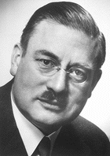
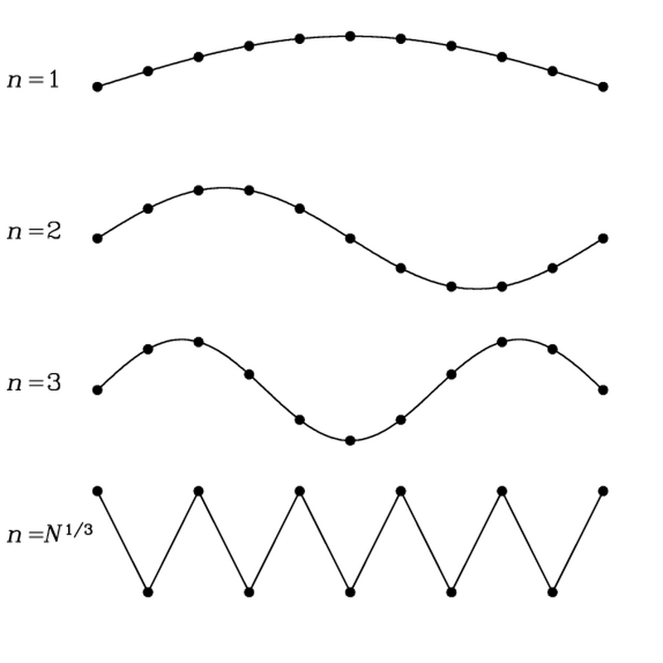
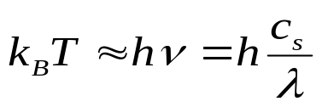
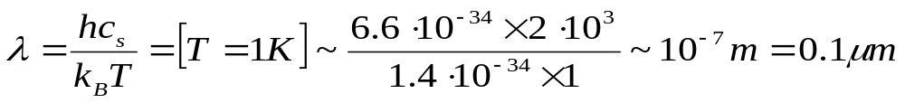
Debye’s Theory of the Heat Capacity of Solids
Debye’s model (1912) starts from the opposite point of view, treating the solid as a continuum, i.e., the atomic structure is ignored. A continuum has vibrational modes of arbitrary low frequencies, and at sufficiently low T only these low frequency modes are excited. These low frequency normal modes are simply standing sound waves.
Nobel 1936
If we quantize this elastic distortion field, similar to the quantization of the e.-m. field, we arrive at the concept of phonons, the quanta of this elastic field. For the thermal phonons, the wavelength increases with decreasing T :
c_{S} – the sound velocity
These low-energy modes remain active at low temperatures when the high-frequency modes are already frozen out. Large values of λ that correspond to these modes justify the use of a continuum model.
There is a close analogy between photons and phonons: both are “unconserved” bosons. Distinctions: (a) the speed of propagation of phonons (~ the speed of sound waves) is by a factor of 10⁵ less than that for light, (b) sound waves can be longitudinal as well as transversal, thus 3 polarizations (2 for photons), and (c) because of discreteness of matter, there is an upper limit on the wavelength of phonons – the interatomic distance.

Slide 4
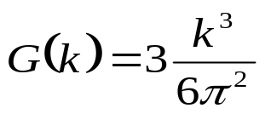
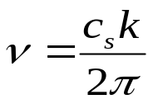
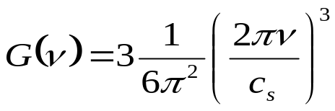
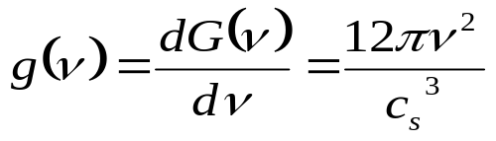
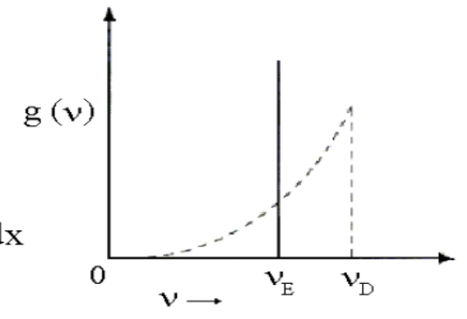
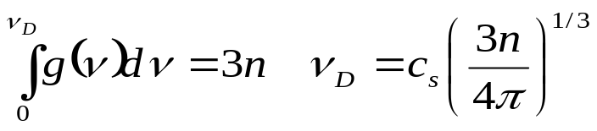
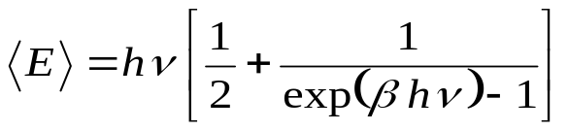
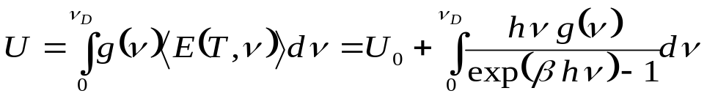
Density of States in Debye Model
For a macroscopic crystal, the spectrum of sound waves is almost continuous, and we can treat ν is a continuous variable. As in the case of photons, we start with the density of states per unit frequency g(ν). The number of modes per unit volume with the wave number < k:
- multiplied by 3 since a sound wave in a solid can have three polarizations (two transverse and one longitudinal).
- this eq. only holds for sufficiently low ν
(= large wavelengths and the continuous approximation is valid). There is also an upper cut-off for the frequencies (λ ≤ interatomic distances), the so-called Debye frequency ν_{D}, which depends on the density n:
c_{S} ~3 km/s, a~0.2 nm, ν_{D}~10¹³ Hz
Each normal mode is a quantized harmonic oscillator. The mean energy of each mode:
and
is the total energy per unit volume. The U₀ term comes from the zero-point motion of atoms. It reduces the cohesive energy of the solid (the zero point motion in helium is sufficient to prevent solidification at any T at normal pressure), but since it does not depend on T, it does not contribute to C. Note that we ignored this term for phonons, where it is ∞. In QED, this unobservable term is swept under the rug by the process known as renormalization.

Slide 5
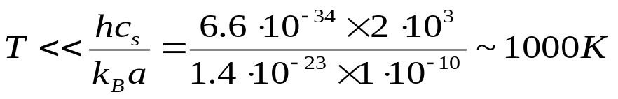
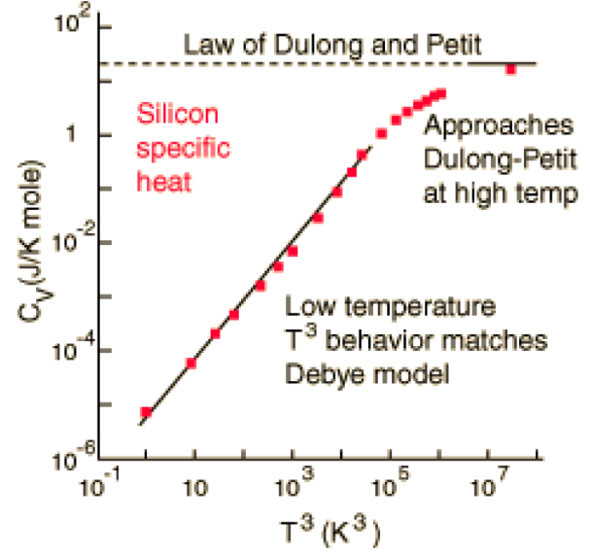
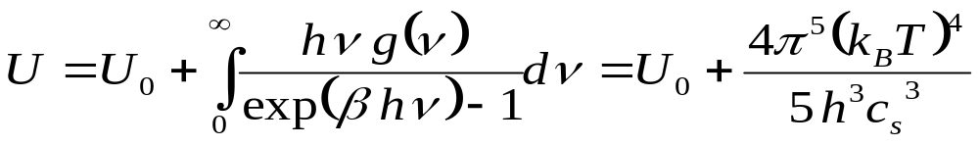
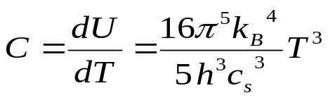
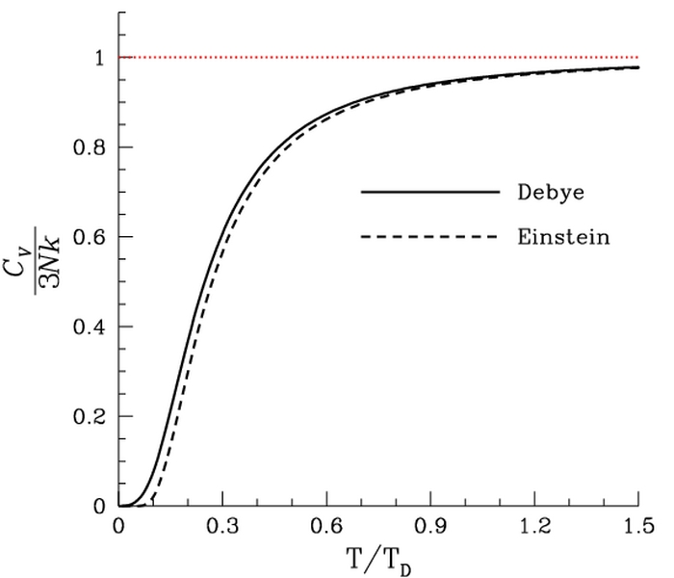
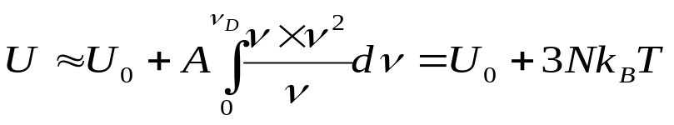
The Heat Capacity in Debye’s Model
At low temperatures, we can choose the upper limit as ∞ (the high-frequency modes are not excited, the energy is too low). How low should be T :
The low-T heat capacity:
Thus, Debye’s model predicts that in the limit of sufficiently low T, the heat capacity due to vibrations of the crystal lattice (in a metal electrons also contribute to C) must vary as T³, and not as ν²exp(- hν/k_{B}T), as in Einstein’s model. (Roughly speaking, the number of phonons ~ T³, their average energy is proportional to T).
At high temperatures, all the modes are excited (the number of phonons does not increase any more), and the heat capacity approaches the equipartition limit, C=3Nk_{B} .

Slide 6
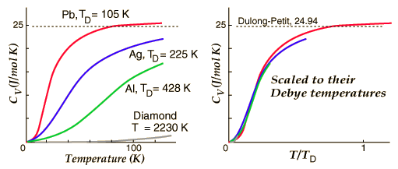
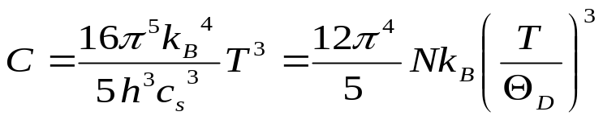
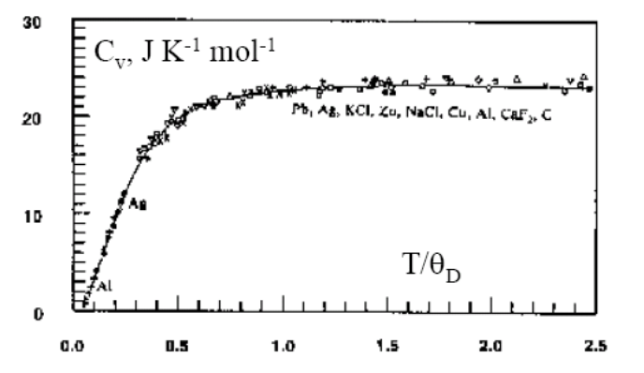
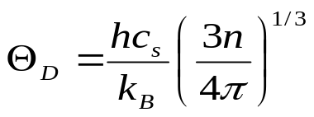
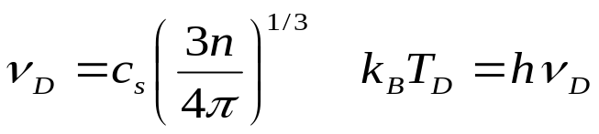
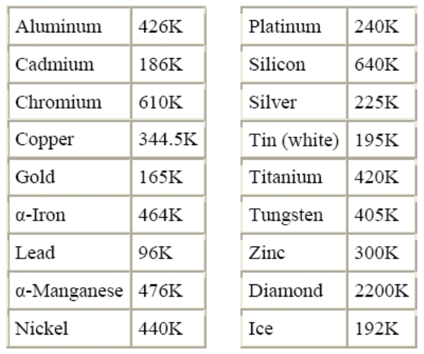
Debye Temperature
The material-specific parameter is the sound speed. If the temperature is properly normalized, the data for different materials collapse onto a universal dependence:
The normalization factor is called the Debye temperature:
It is related to the maximum frequency ν_{D}, the Debye frequency:
The higher the sound speed and the density of ions, the higher the Debye temperature. However, the real phonon spectra are very complicated, and Θ_{D} is better to treat as an experimental fitting parameter.

