Slide 1
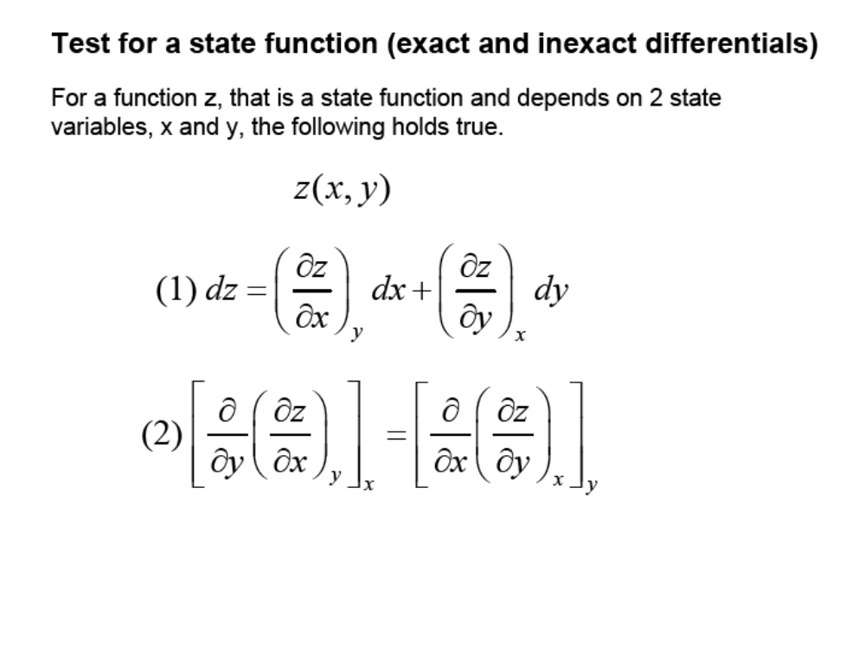

Slide 2
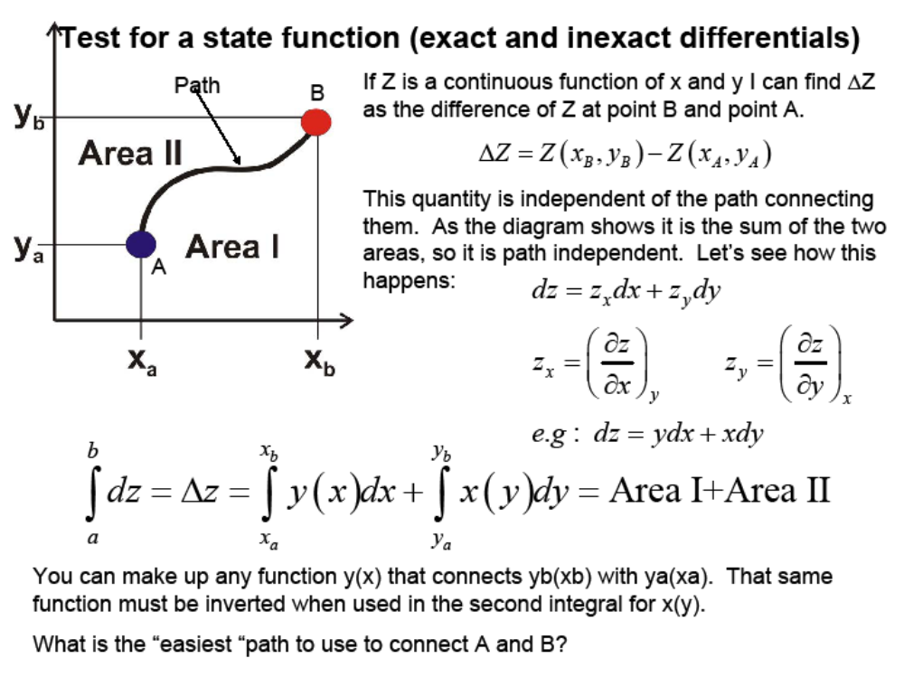

Slide 3
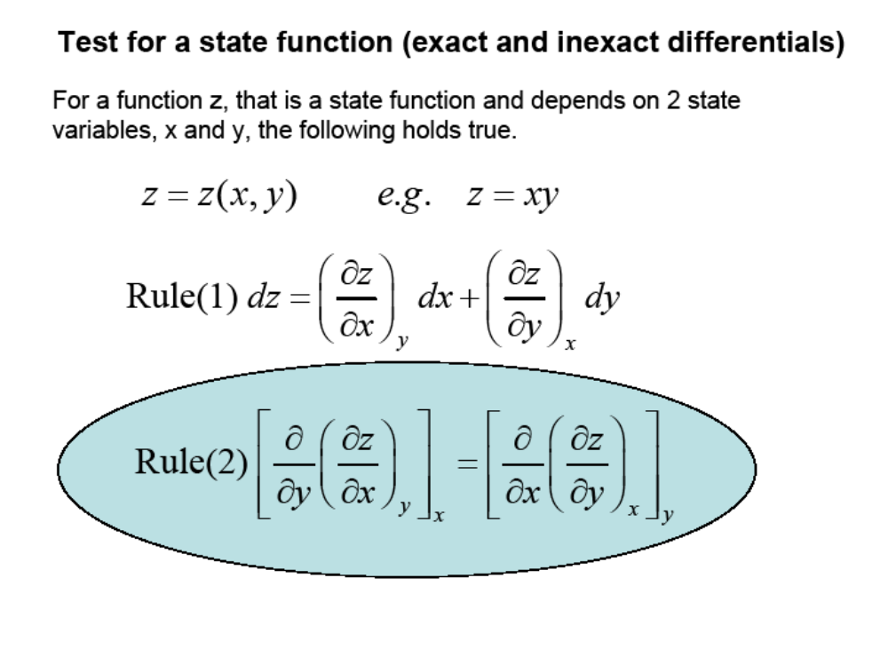

Slide 4
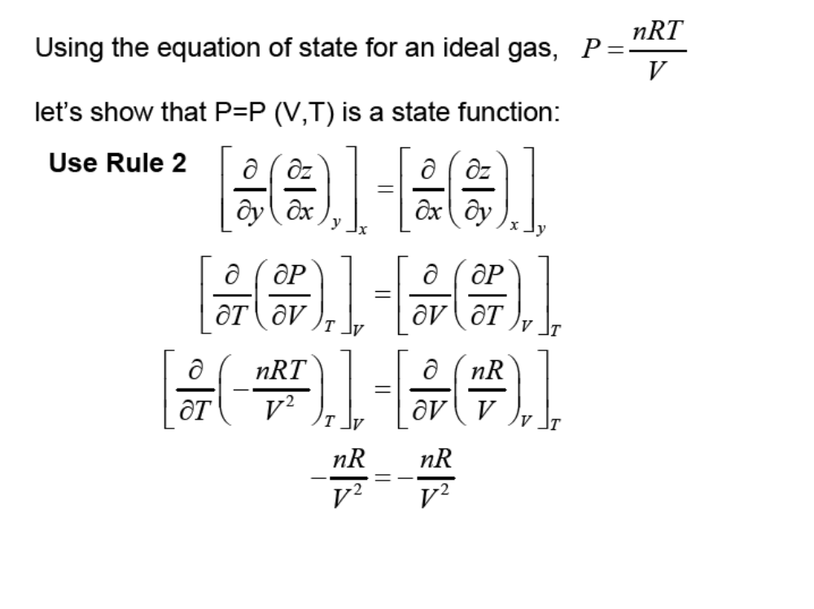

Slide 5
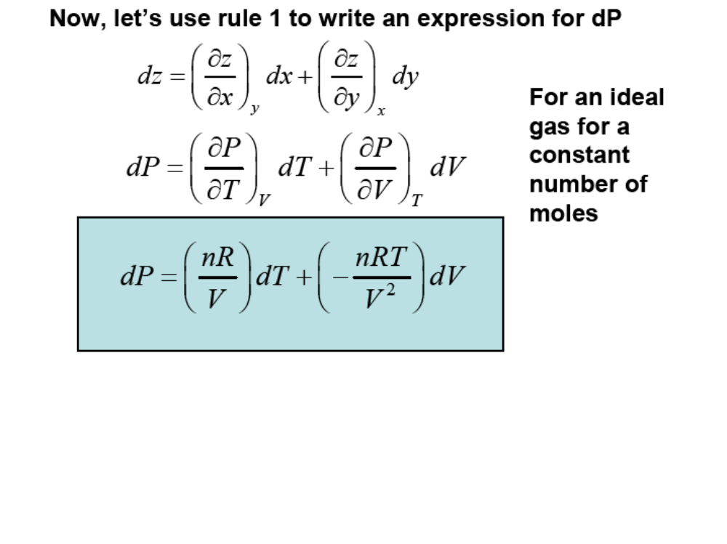

Slide 6
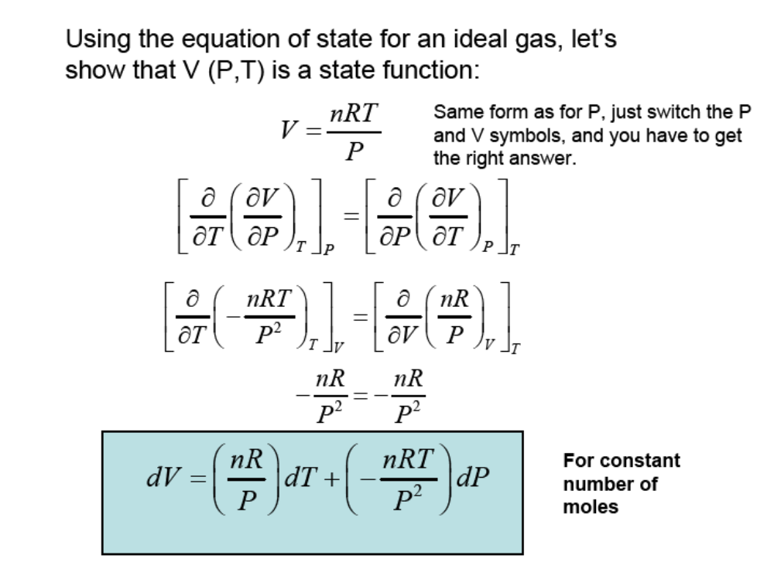

Slide 7
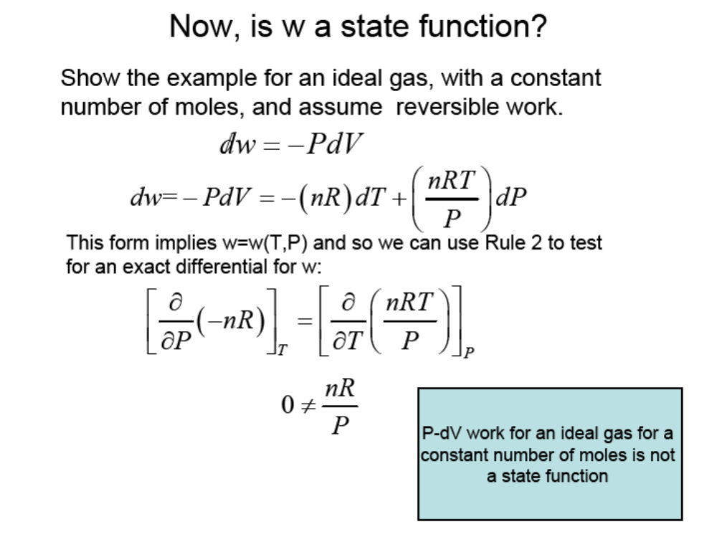

Slide 8
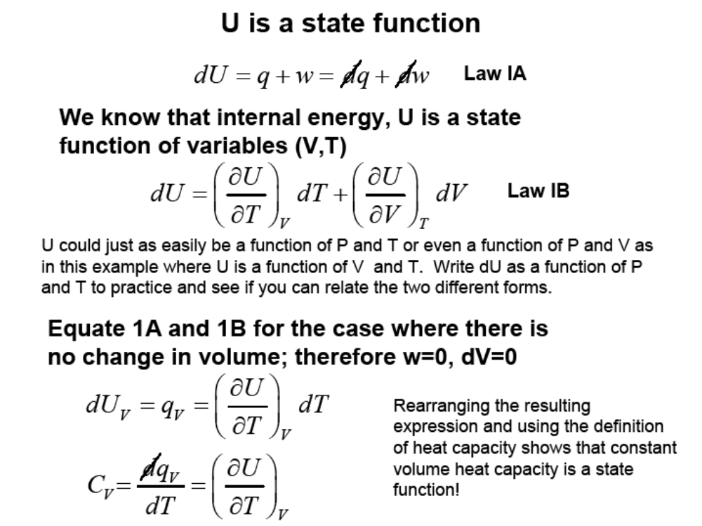

Slide 9
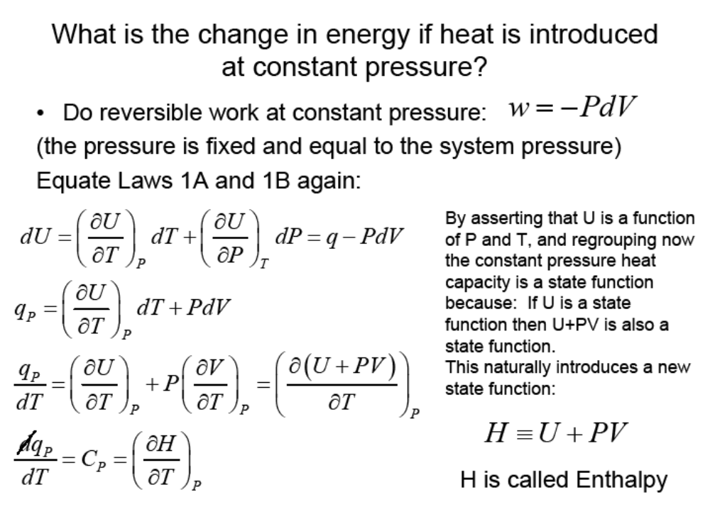

Slide 10
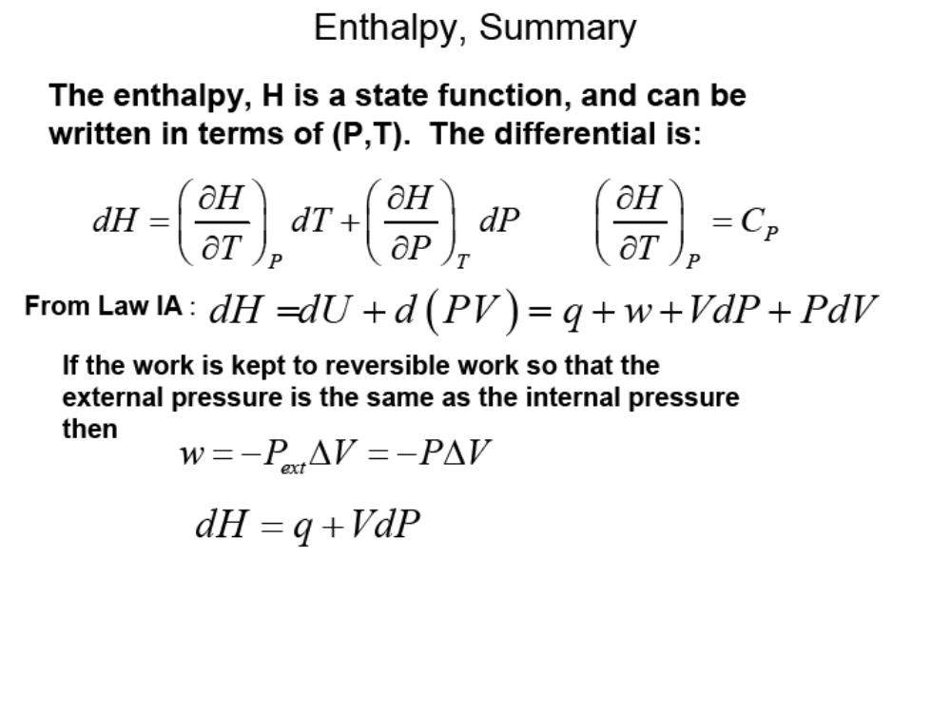

Slide 11
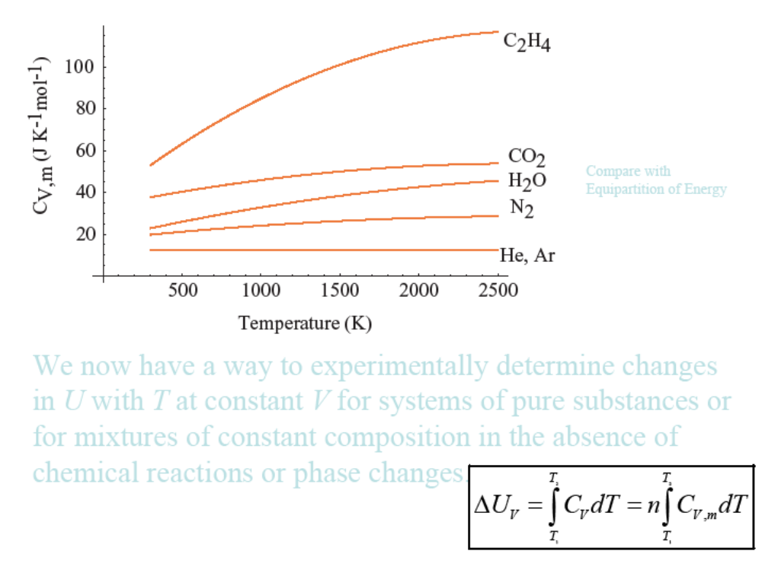

Slide 12
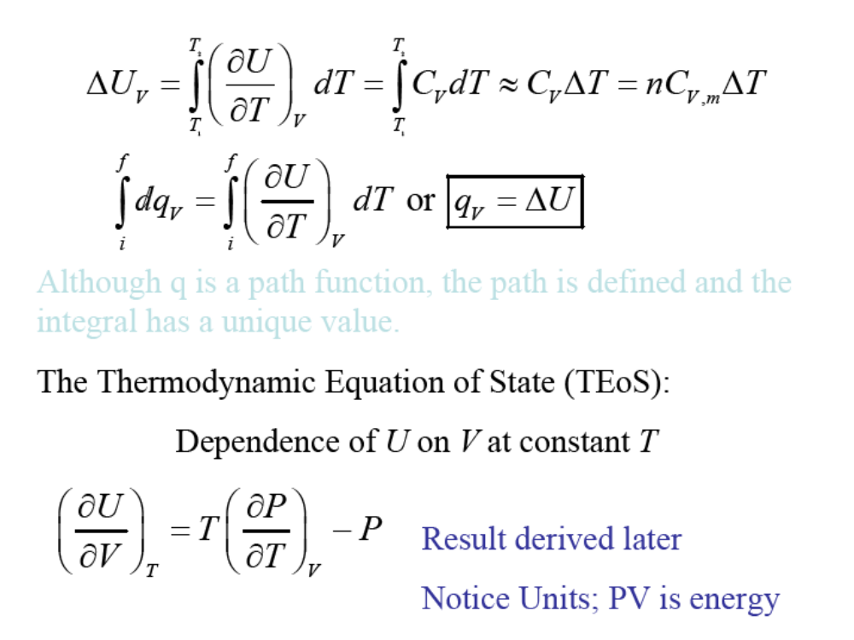

Slide 13
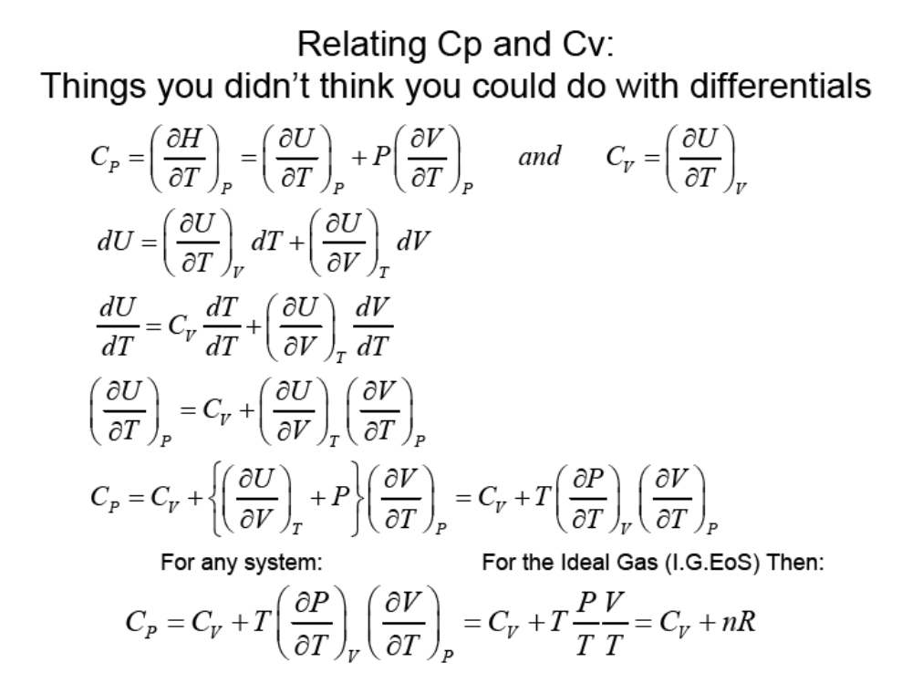

Slide 14
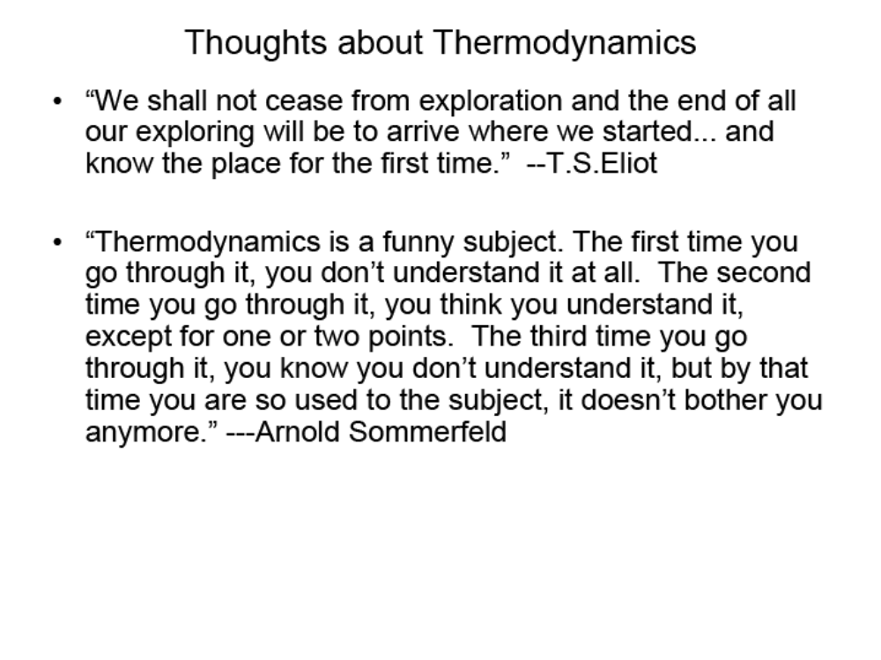

Slide 15
P(V,T) is a state function for an ideal gas with a constant number of moles
V(P,T) is a state function for an ideal gas with a constant number of moles
W (P,T) (and hence q) is not a state function (for an ideal gas with a constant number of moles)
U(V,T) is a state function, U(P,T) is another state function
Enthalpy, H = U+PV is a state function, and is most conveniently written as H(P,T)
C_{p} and C_{v} are measurable and state functions and can be used to determine changes in U and H

