Slide 1

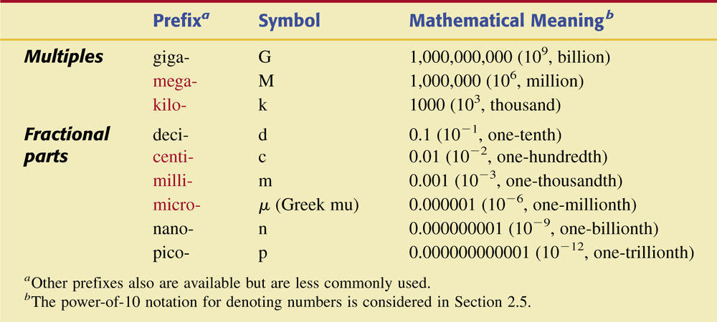
Table 2.1 Common Metric System Prefixes with Their Symbols and Mathematical Meanings.

Slide 2
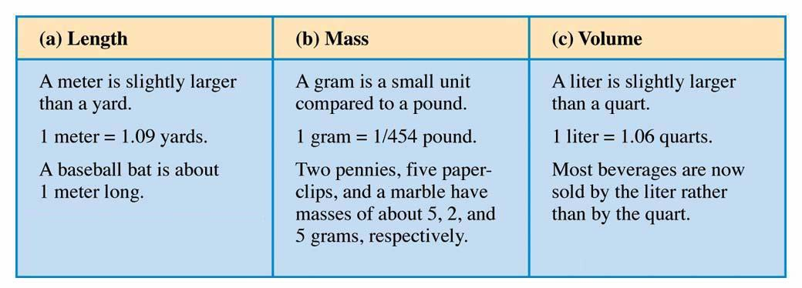
Figure 2.2 Comparisons of the base metric system units of length (meter), mass (gram), and volume (liter) with common objects.

Slide 3
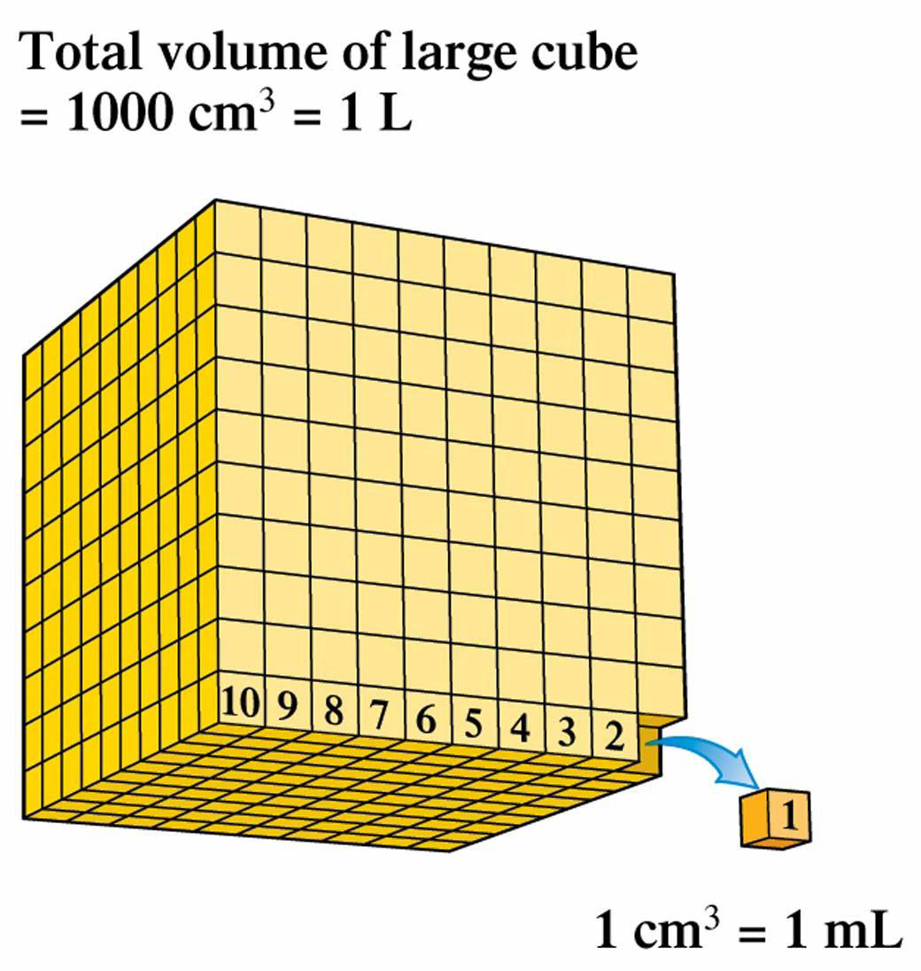
Figure 2.3
A cube 10 cm on a side has a volume of 1000 cm³, which is equal to 1 L.

Slide 4
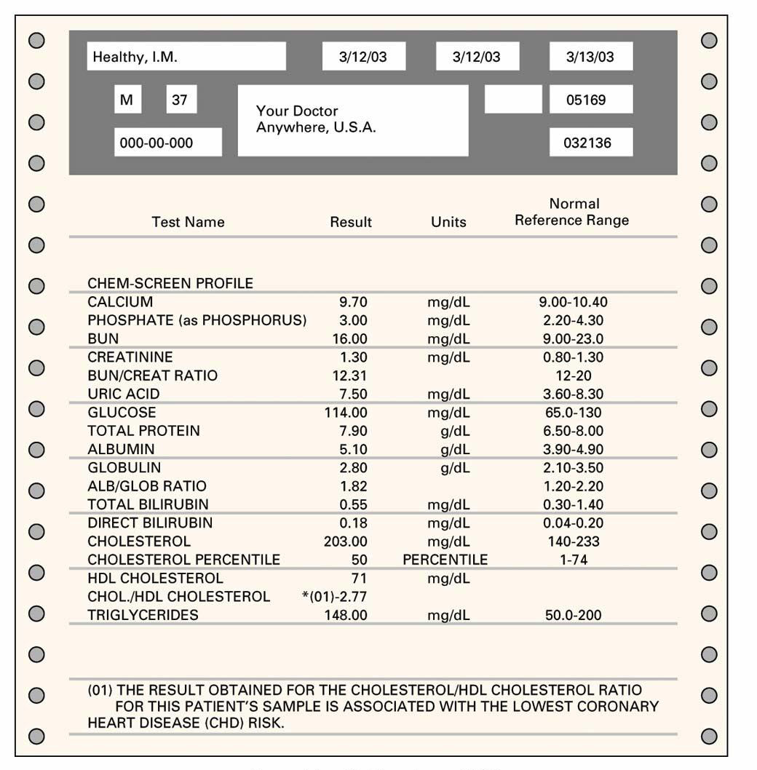
Figure 2.4
The use of the concentration unit milligrams per deciliter (mg/dL) is common in clinical laboratory reports.

Slide 5
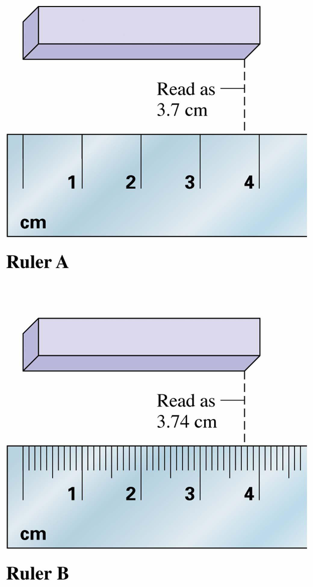
Figure 2.5
The scale of a measuring device determines the magnitude of the uncertainty for the recorded measurement.

Slide 6
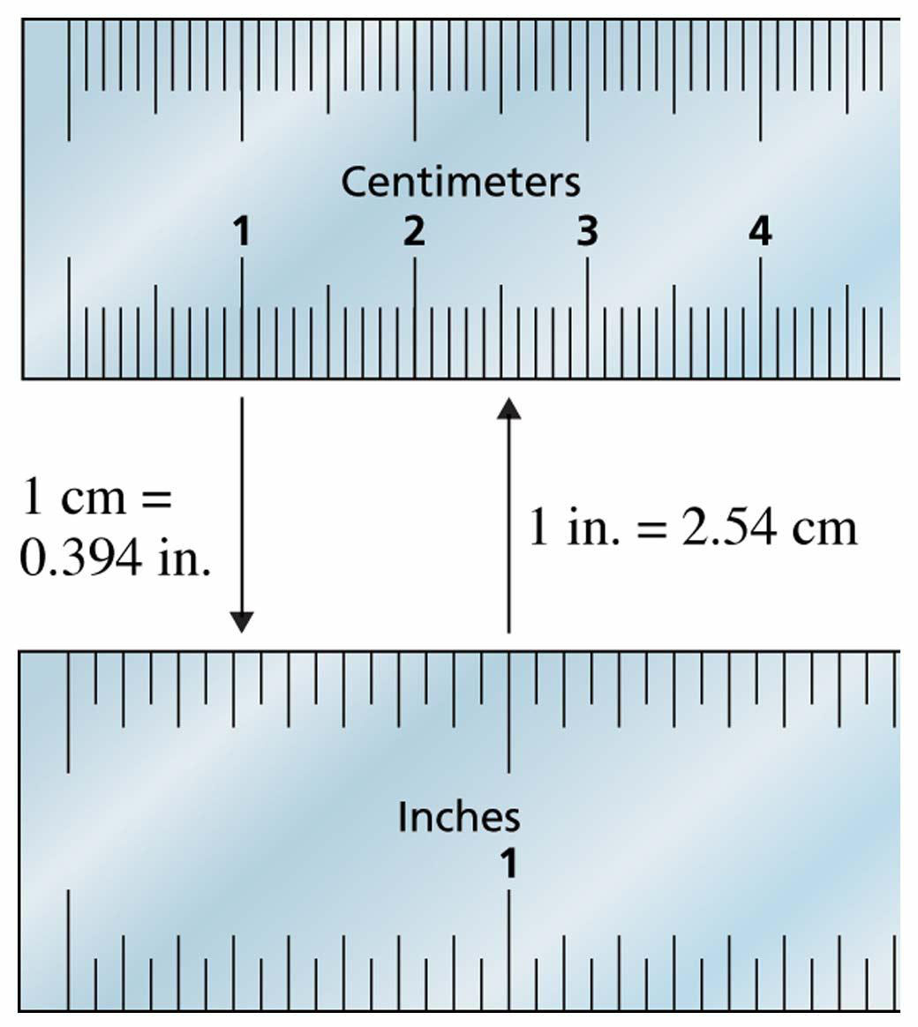
Figure 2.7
It is experimentally determined that 1 inch equals 2.54 centimeters, or 1 centimeter equals 0.394 inch.

Slide 7
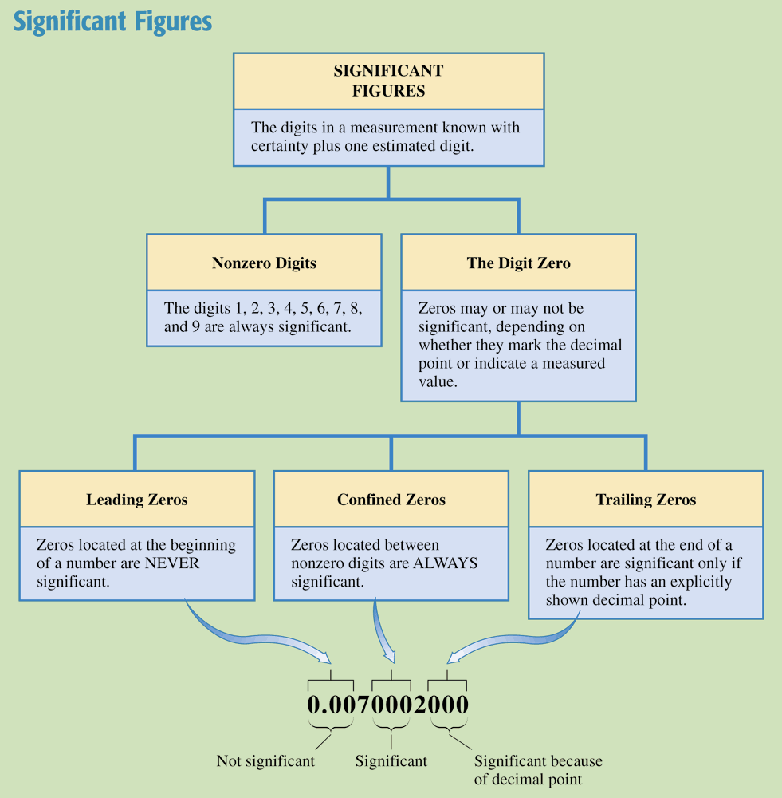
Chemistry at a Glance:
Significant Figures

Slide 8
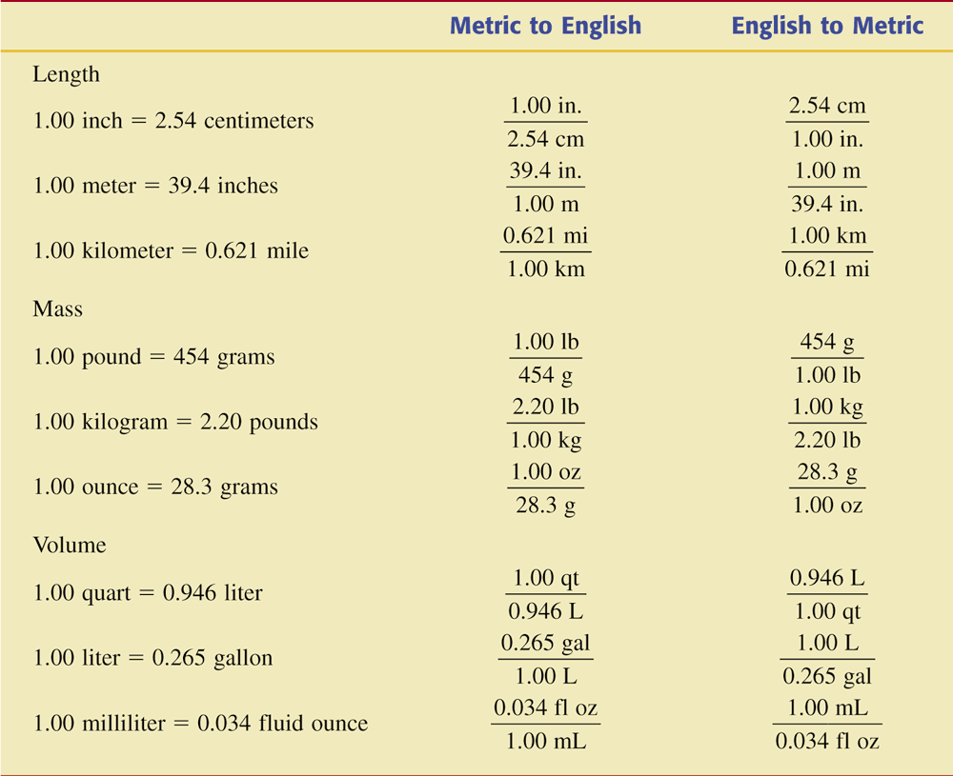
Table 2.2 Equalities and Conversion Factors That Relate the English and Metric Systems of Measurement.

Slide 9
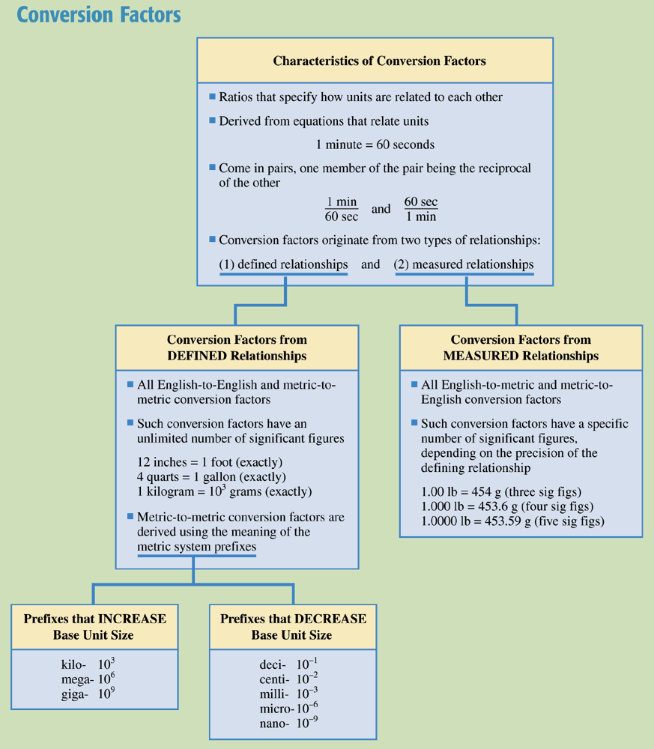
Chemistry at a Glance:
Conversion Factors

Slide 10
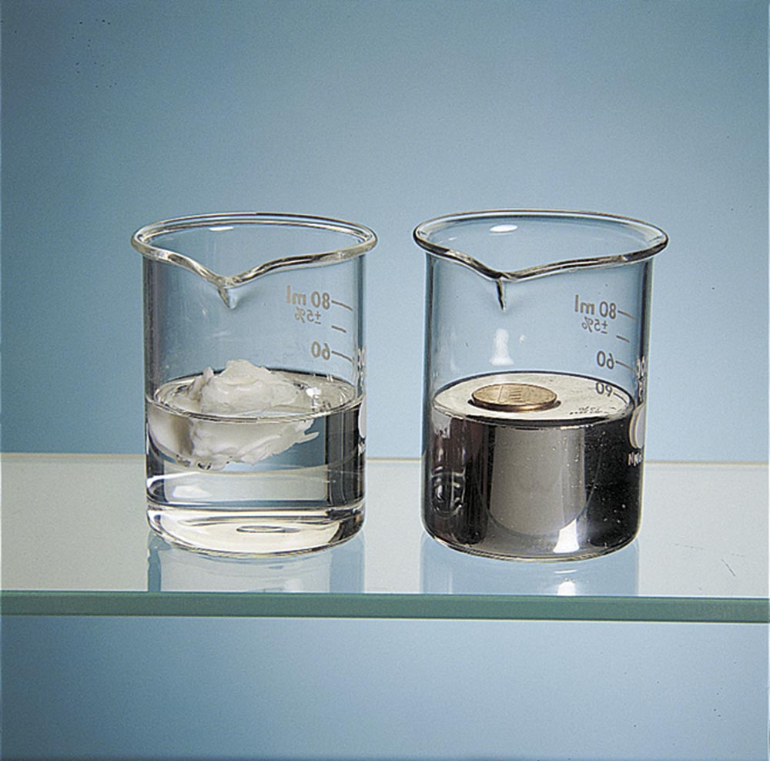
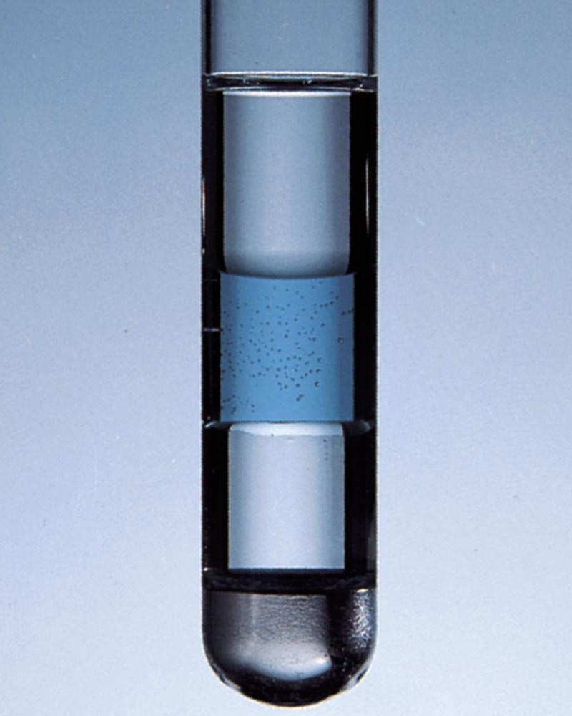
Figure 2.7 (a) The penny is less dense than the mercury it floats on. (b) Liquids that do not dissolve in one another and that have different densities float on one another, forming layers.

Slide 11
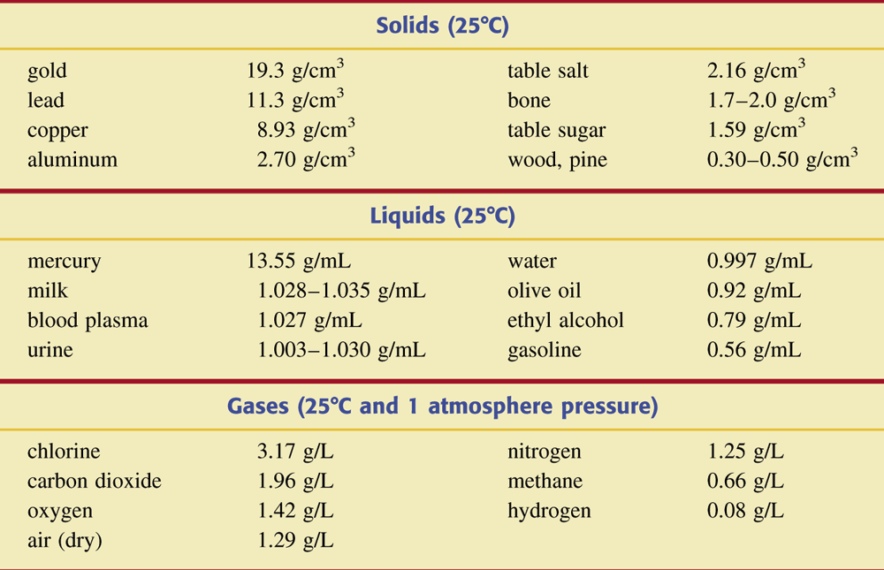
Table 2.3 Densities of Selected Substances

Slide 12
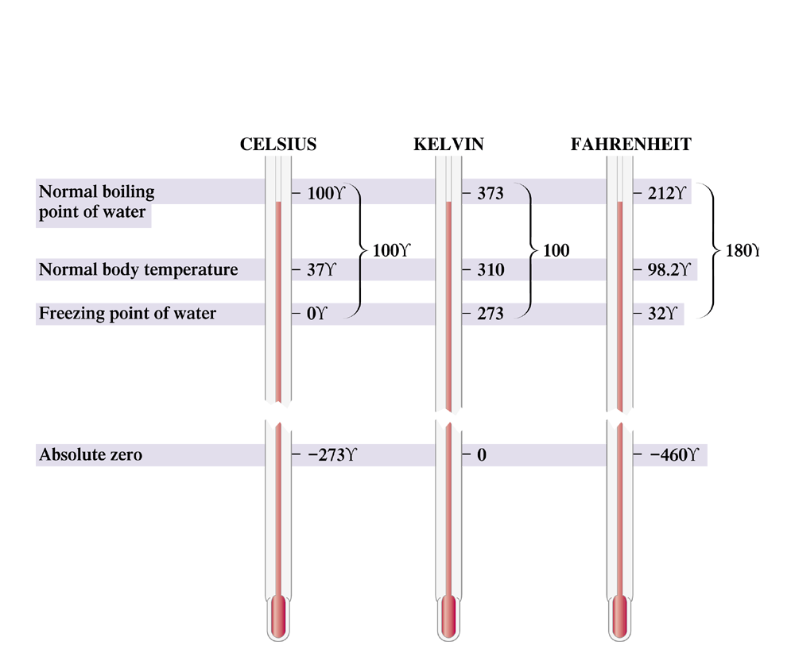
Figure 2.10 The relationships among the Celsius, Kelvin, and Fahrenheit temperature scales are determined by the degree sizes and the reference point values.

Slide 13
