Slide 1
Chapter 24 : Nuclear Reactions
and Their Applications
24.1 Radioactive Decay and Nuclear Stability
24.2 The Kinetics of Radioactive Decay
24.3 Nuclear Transmutation: Induced Changes in Nuclei
24.6 The Interconversion of Mass and Energy
24.7 Applications of Fission and Fusion
Reading assignment see details on last side
24.4 The Effects of Nuclear Radiation on Matter
24.5 Applications of Radioisotopes

Slide 2
Radioactivity
Reason
Spontaneous
Unstable
Nuclear
Transmutation
Stable
Stability
Curve
Type
Equations

Slide 3
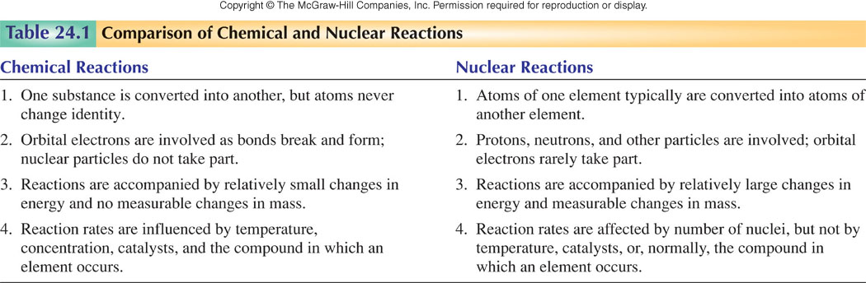

Slide 4
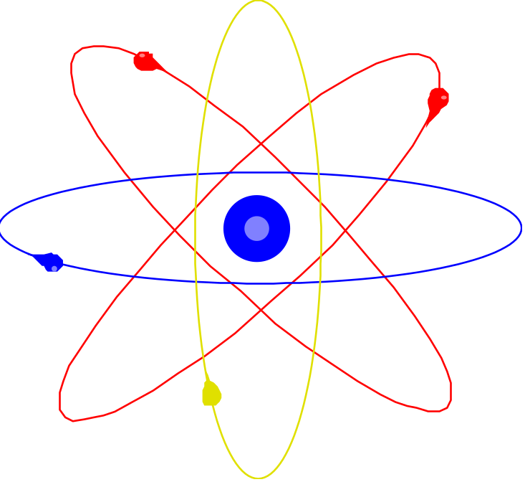
Reason
Stability
N ____ p⁺ stable
____ n
Fe ____ p⁺ close within stable range
____ n 1:1 or 1:1.15 ratio
Pb ____p⁺ unstable
____ n

Slide 5
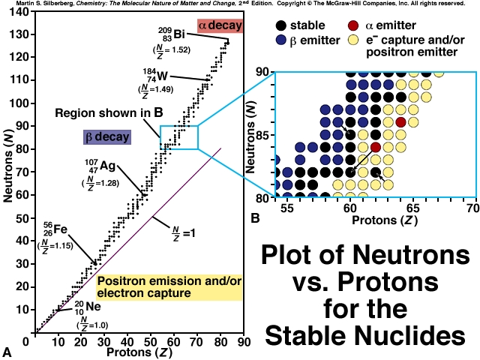

Slide 6
NUCLEAR STABILITY
Modes of Radioactive Decay
Alpha decay–heavy isotopes: ⁴₂He or α
Beta decay–neutron rich isotopes: e⁻ or β⁻
Positron emission–proton rich isotopes: β⁺
Electron capture–proton rich isotopes: x-rays
Gamma-ray emission(γ )– Decay of nuclear
excited states
Spontaneous fission– very heavy isotopes

Slide 7

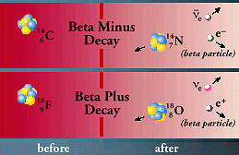

Radioactive Decays
The three types of nuclear radioactive decay are alpha, beta and gamma emission.
An alpha particle is a Helium 4 nucleus (two protons and two neutrons). It is produced by nuclear fission in which a massive nucleus breaks apart into two less-massive nuclei (one of them the alpha particle). This is a strong interaction process.
A beta particle is an electron. It emerges from a weak decay process in which one of the neutrons inside an atom decays to produce a proton, the beta electron and an anti-electron-type neutrino. Some nuclei instead undergo beta plus decay, in which a proton decays to become a neutron plus a positron (anti-electron or beta-plus particle) and an electron-type neutrino.
A gamma particle is a photon. It is produced as a step in a radioactive decay chain when a massive nucleus produced by fission relaxes from the excited state in which it first formed towards its lowest energy or ground-state configuration.

Slide 8
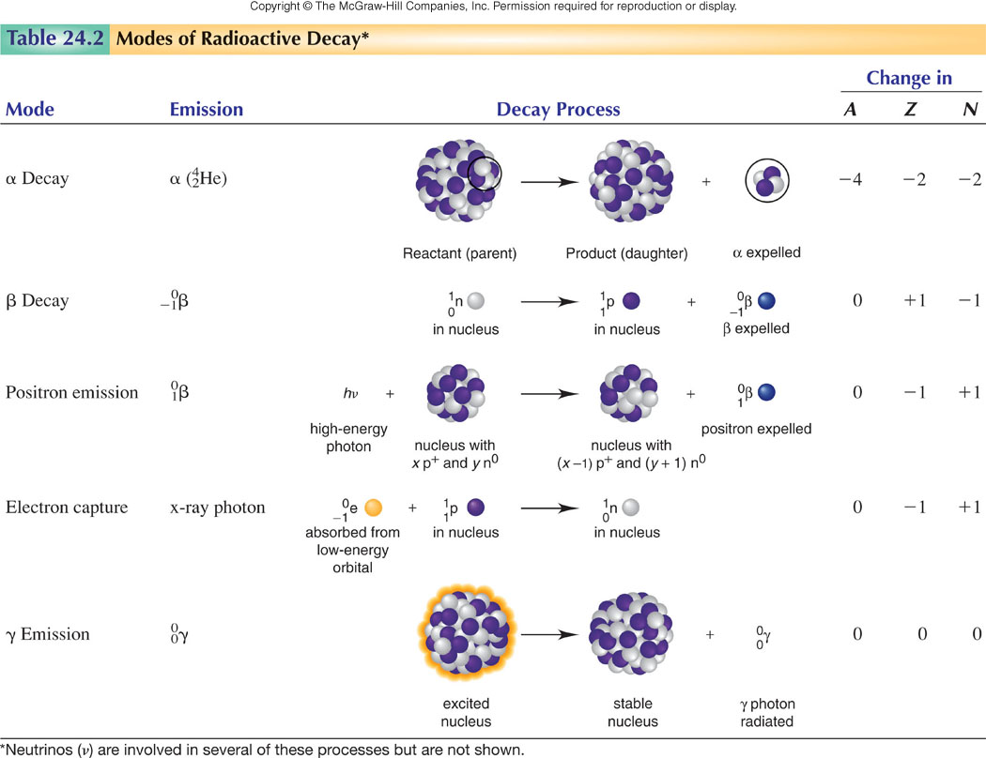

Slide 9
Nuclear Stability and Mode of Decay
Very few stable nuclides exist with N/Z < 1.
The N/Z ratio of stable nuclides gradually increases a Z increases.
All nuclides with Z > 83 are unstable.
Elements with an even Z usually have a larger number of stable nuclides than elements with an odd Z.
Well over half the stable nuclides have both even N and even Z.
Predicting the Mode of Decay
Neutron-rich nuclides undergo β decay.
Neutron-poor nuclides undergo positron decay or electron capture.
Heavy nuclides undergo α decay.

Slide 10
Natural Decay Series for Uranium-238
²³⁸U ²³⁴ Th
²³⁴Pa
²³⁴U ²³⁰ Th ²²⁶Ra ²²²Rn ²¹⁸Po ²¹⁴Pb
²¹⁸At ²¹⁴Bi ²¹⁰ Tl
²¹⁴Po ²¹⁰Pb ²⁰⁶Hg
= α decay ²¹⁰Bi ²⁰⁶Tl
= β⁻ decay ²¹⁰ Po ²⁰⁶Pb
²³⁸U: 8 α decays and 6 β decays leaves you with ²⁰⁶Pb

Slide 11
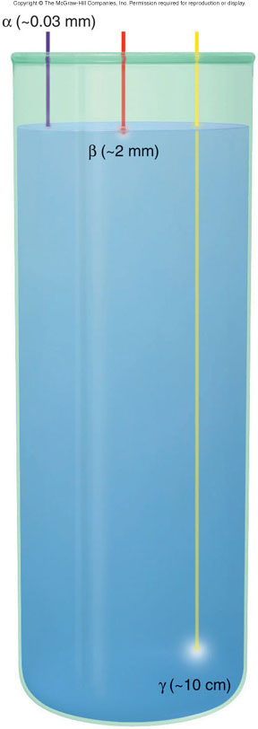
Figure 24.8
Penetrating power of radioactive emissions
Nuclear changes cause chemical changes in surrounding matter by excitation and ionization.
Penetrating power is inversely related to the mass and charge of the emission.

Slide 12
Nuclear Equations
²³⁸U₉₂ ²³⁴ Th ₉₀ + ⁴He₂
parent isotope daughter particle
Class Examples
Notation
Bombarding
particle
↓
If radioactive
M (a, b) M’*
Bombarded
nucleus
→ Product
nucleus
↓
Emitted
particle
Example: ²⁵Mg (α, p) ²⁸Al*
Class example

Slide 13
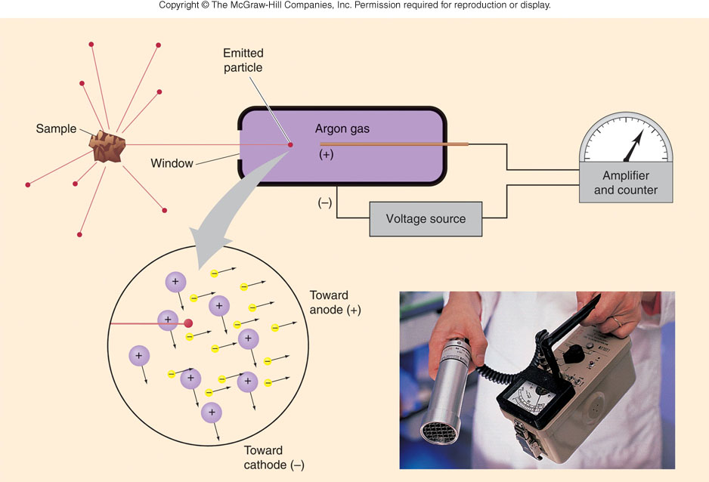
Geiger counter
Particles per unit time (activity)

Slide 14
Rate of Radioactive Decay
Rate independent of temperature
implies E_{a} = 0
EXPLAIN? Draw diagram
First Order Reactions: A → B
rate law = ?
Conc. - time relationship?
Half- life ?

Slide 15
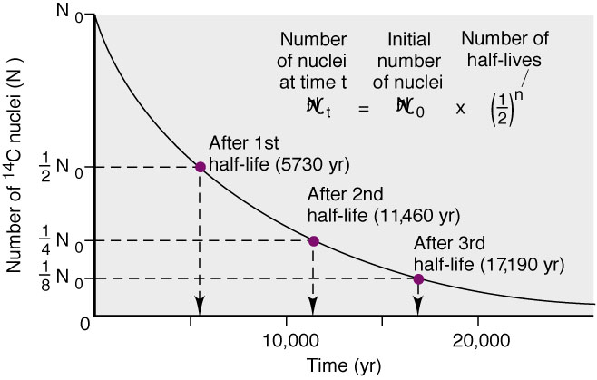
Decrease in Number of ¹⁴C Nuclei Over Time

Slide 16
Decay Constants (k) and Half-lives (t_{1/2}) of Beryllium Isotopes and others
Nuclide k t_{1/2}
⁷₄Be 1.30 x 10⁻²/day 53.3 day
⁸₄Be 1.0 x 10¹⁶/s 6.7 x 10⁻¹⁷s
⁹₄Be Stable
¹⁰₄Be 4.3 x 10⁻⁷/yr 1.6 x 10⁶ yr
¹¹₄ Be 5.02 x 10⁻²/s 13.8 s
²³⁸U t_{1/2} = 4.5 X 10⁹ yrs ²¹⁴Po t_{1/2} = 1.6 X 10 ⁻⁴ yrs

Slide 17
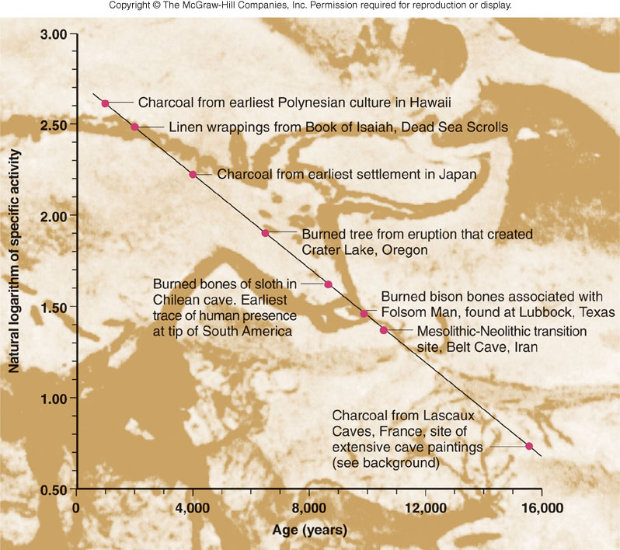
Figure 24.5
Radiocarbon dating for determining the age of artifacts

Slide 18
The Interconversion of Mass and Energy
E = mc²
The mass of the nucleus is less than the combined masses of its nucleons. The mass decrease that occurs when nucleons are united into a nucleus is called the mass defect.
ΔE = Δmc²
Δm = ΔE / c²
The mass defect (Δm) can be used to calculate the nuclear binding energy in MeV.
1 amu = 931.5x10⁶ eV = 931.5MeV

Slide 19
NUCLEAR ENERGY
Binding Energy: E_{b}
amount of energy if nucleus were formed directly by combination of neutrons and protons
¹₁p + ¹₀n → ²₁ H
1.007825 g/mol 1.008665 g/mol 2.01410 g/mol
Δ m = mass products - total mass reactants
2.01410 g/mol - 2.016490 g/mol
= - 0.00239 g/mol
Mass defect converted to energy

Slide 20
Mass → Energy
EINSTEIN’S EQUATION FOR THE CONVERSION OF MASS INTO ENERGY
E = mc²
m = mass (kg)
c = Speed of light = 2.998 x 10⁸ m/s
E = (-2.39 x 10⁻⁶ Kg) (2.998 x 10⁸ m/s)²
= - 2.15 x 10¹¹J = - 2.15 x 10⁸ kJ
Class problem

Slide 21
Sample Problem 24.6
Calculating the Binding Energy per Nucleon
PROBLEM:
Iron-56 is an extremely stable nuclide. Compute the binding energy per nucleon for ⁵⁶Fe and compare it with that for ¹²C (mass of ⁵⁶Fe atom = 55.934939 amu; mass of ¹H atom = 1.007825 amu; mass of neutron = 1.008665 amu).
PLAN:
Find the mass defect, Δm; multiply that by the MeV equivalent and divide by the number of nucleons.
SOLUTION:
Mass Defect = [(26 x 1.007825 amu) + (30 x 1.008665 amu)] - 55.934939
Δm = 0.52846 amu
(0.52846 amu)(931.5 MeV/amu)
Binding energy =
= 8.790 Mev/nucleon
56 nucleons
¹²C has a binding energy of 7.680 MeV/nucleon, so ⁵⁶Fe is more stable.

Slide 22
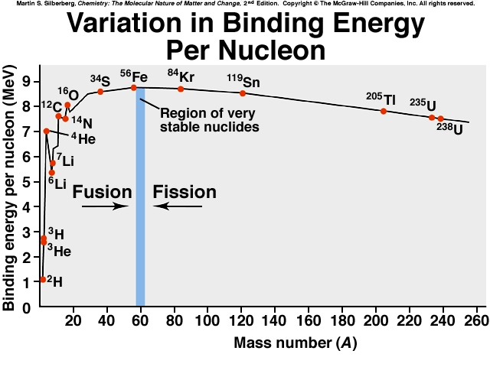

Slide 23
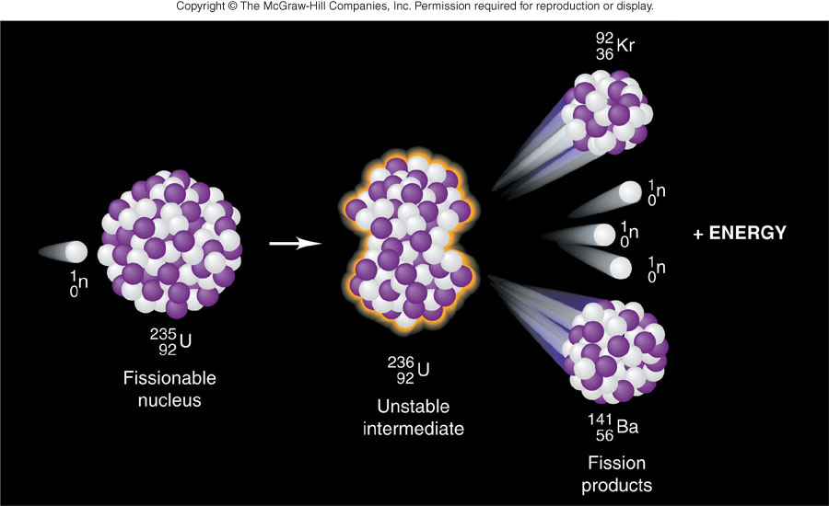

Slide 24
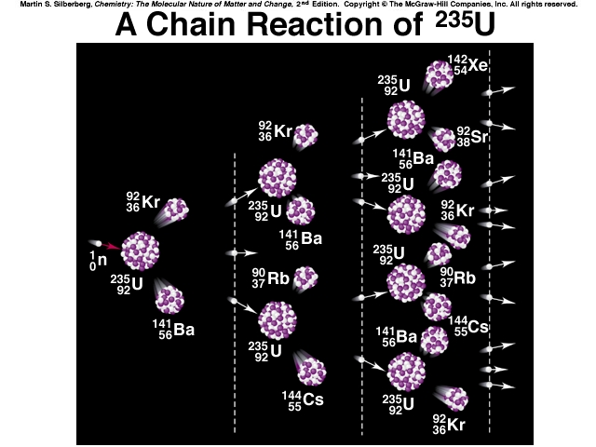

Slide 25
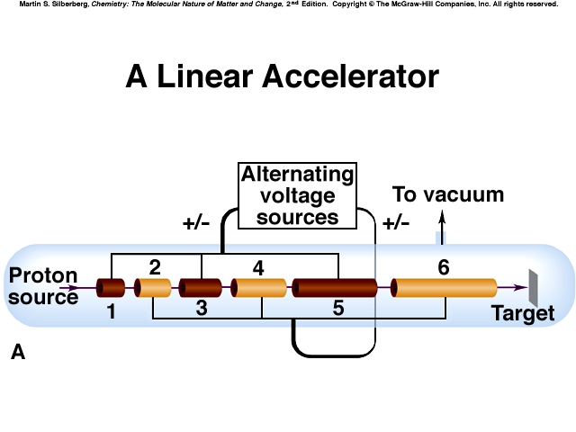
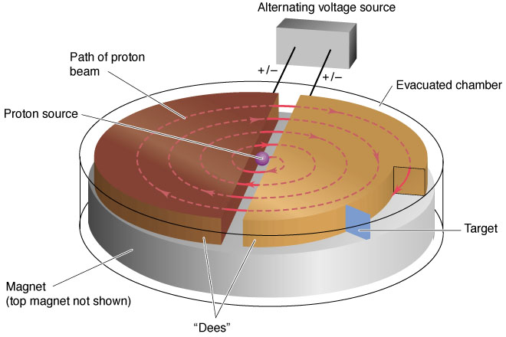
The Cyclotron Accelerator

Slide 26
Units of Radiation Dose
rad = Radiation-absorbed dose
The quantity of energy absorbed per kilogram of tissue:
1 rad = 1 x 10⁻² J/kg
rem = Roentgen equivalent for man
The unit of radiation dose for a human:
1 rem = 1 rad x RBE
RBE = 10 for α
RBE = 1 for x-rays, γ-rays, and β’s

Slide 27
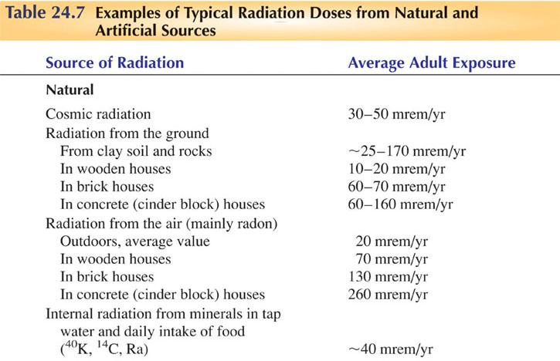
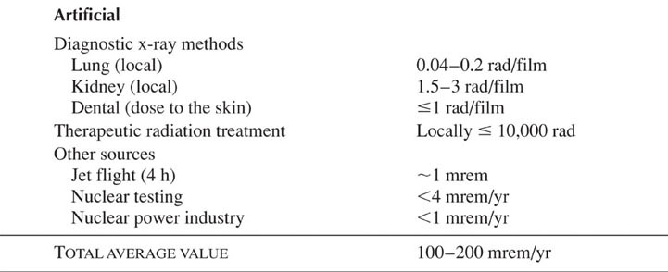
Copyright © The McGraw-Hill Companies, Inc. Permission required for reproduction or display.

Slide 28
Special Project Assignment
Chapter 24
  Read Sections 24.4 and 24.5
  Prepare a 2 minute presentation on some aspect of nuclear chemistry uses today.
  Due: Class discussion Thursday
  Special Project grade [50 points]

