Slide 1
Osmosis and Osmotic Pressure
Osmosis: The selective passage of solvent molecules through a porous membrane from a dilute solution to a more concentrated one.
Osmotic pressure (π or ∏): The pressure required to stop osmosis.
π = i⋅MRT (Approximate Form)
R = 0.08206 (L⋅atm)/(mol⋅K)

Slide 2
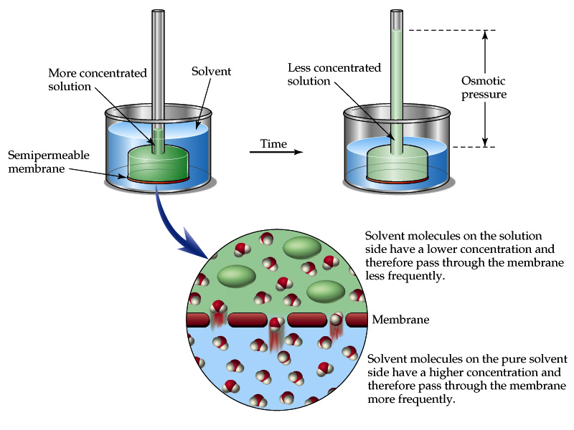
Osmosis and Osmotic Pressure

Slide 3
Osmosis and Osmotic Pressure

Slide 4
Osmosis and Osmotic Pressure
Isotonic: Solutions have equal concentration of solute, and so equal osmotic pressure.
Hypertonic: Solution with higher concentration of solute.
Hypotonic: Solution with lower concentration of solute.

Slide 5
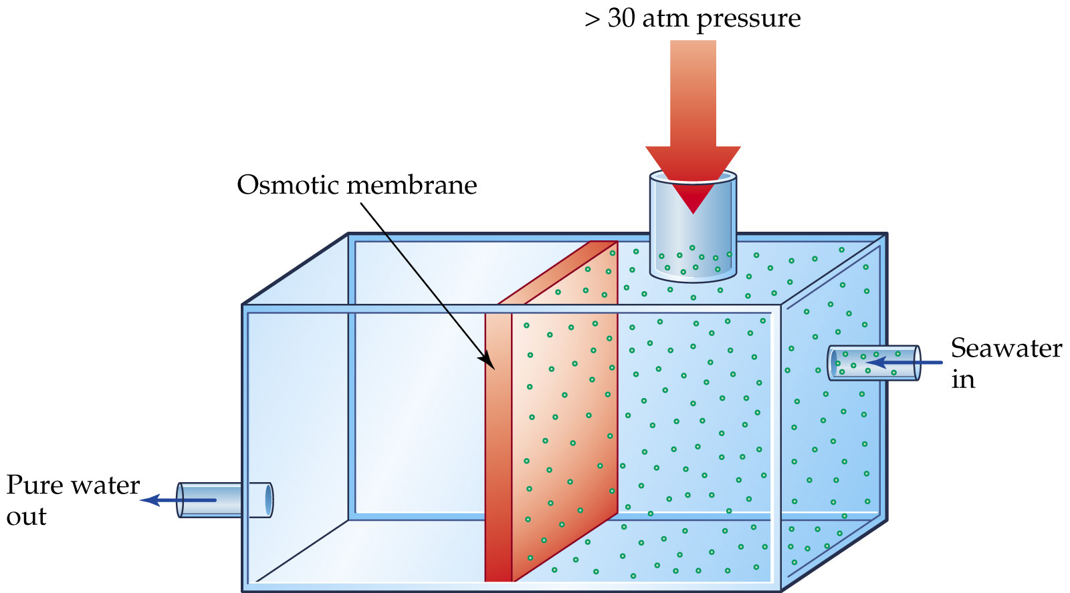
Uses of Colligative Properties
Desalination:

