Slide 1
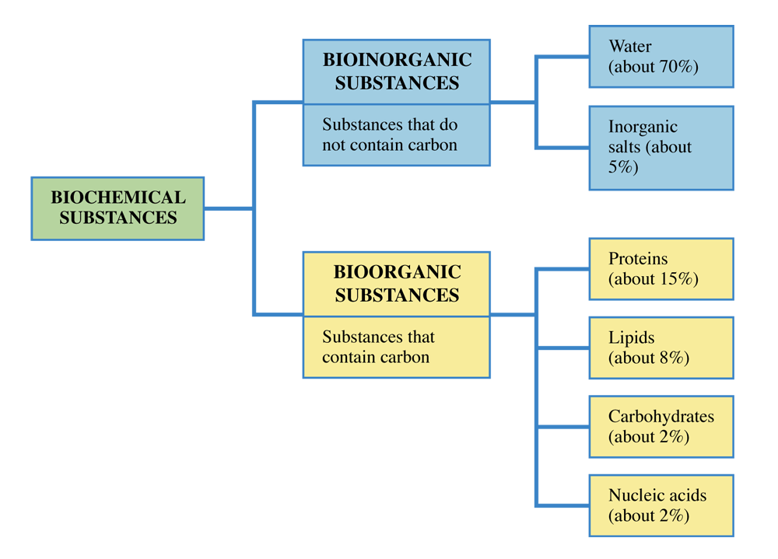
Mass composition data for the human body in terms of major types of biochemical substances.

Slide 2
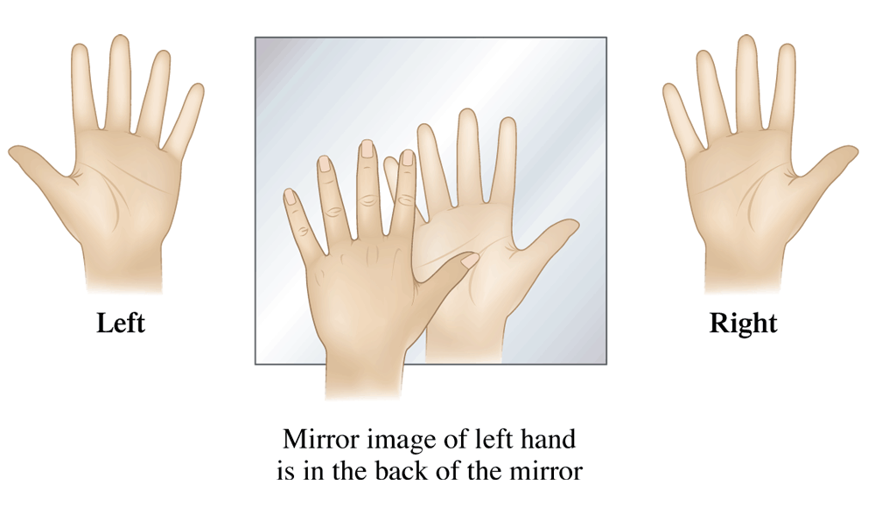
The mirror image of the right hand is the left hand. Conversely, the mirror image of the left hand is the right hand.

Slide 3
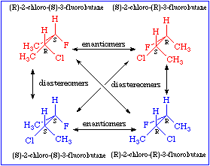
Enantiomers and Diastereomers

Slide 4
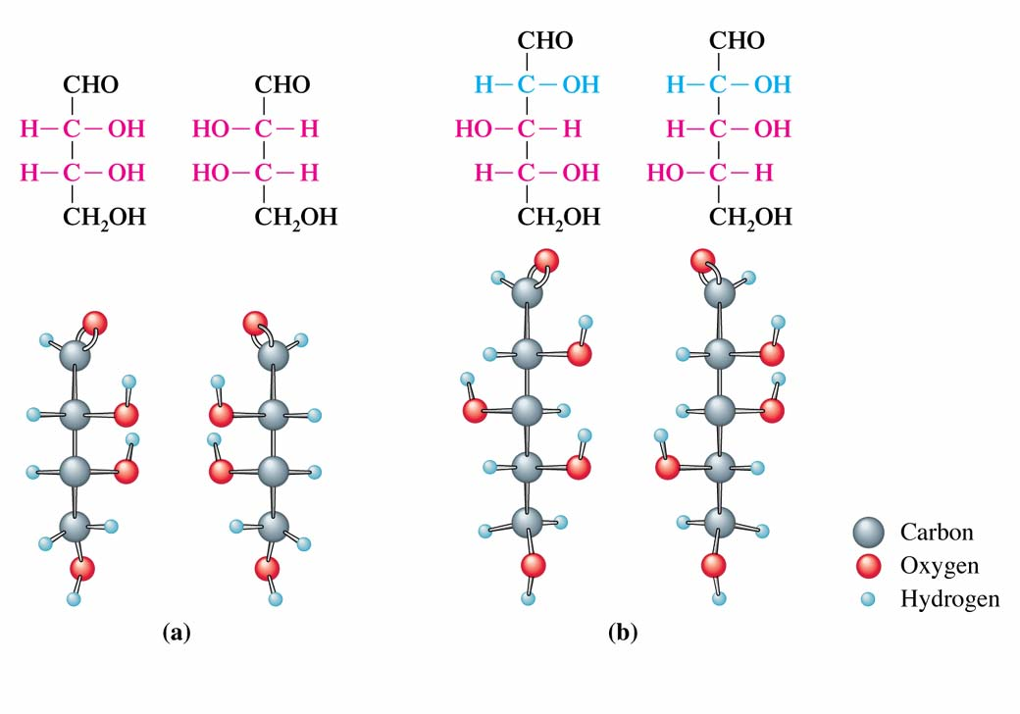
Enantiomers and Diastereomers

Slide 5
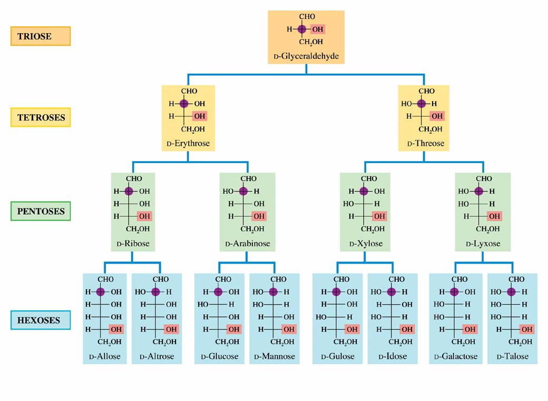
Fischer projections and common names for
D aldoses containing three, four, five, and six carbon atoms.

Slide 6
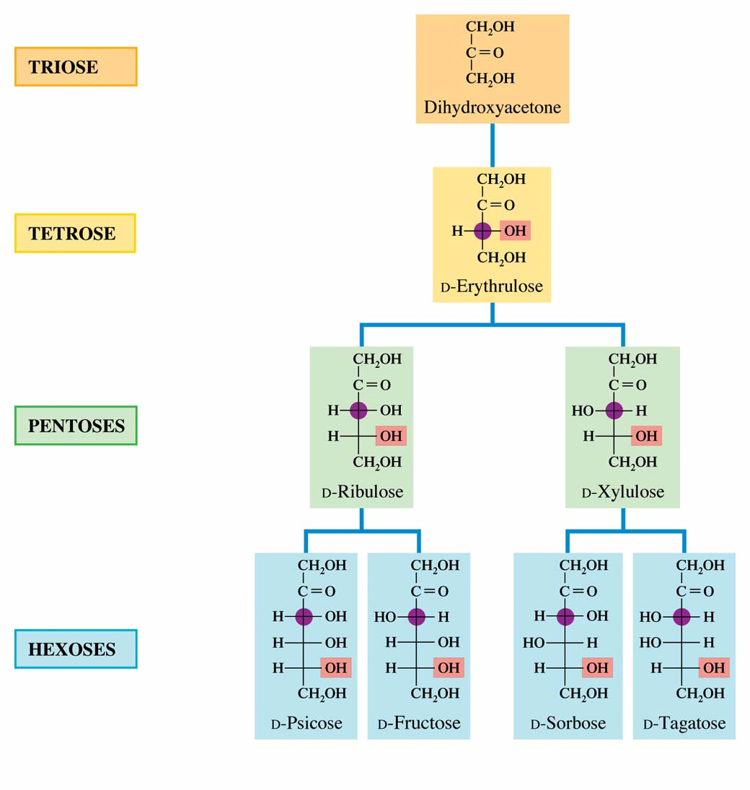
Fischer projections and common names for D ketoses containing three, four, five, and six carbon atoms.

Slide 7
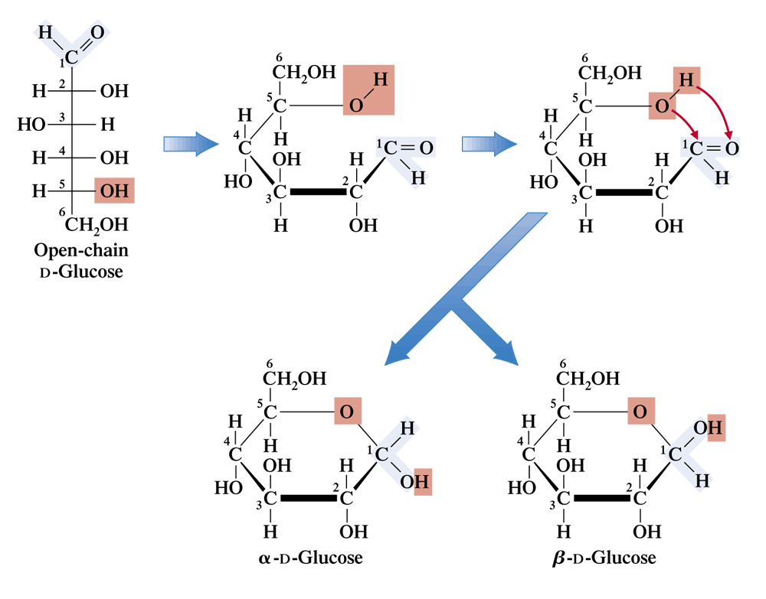

Slide 8
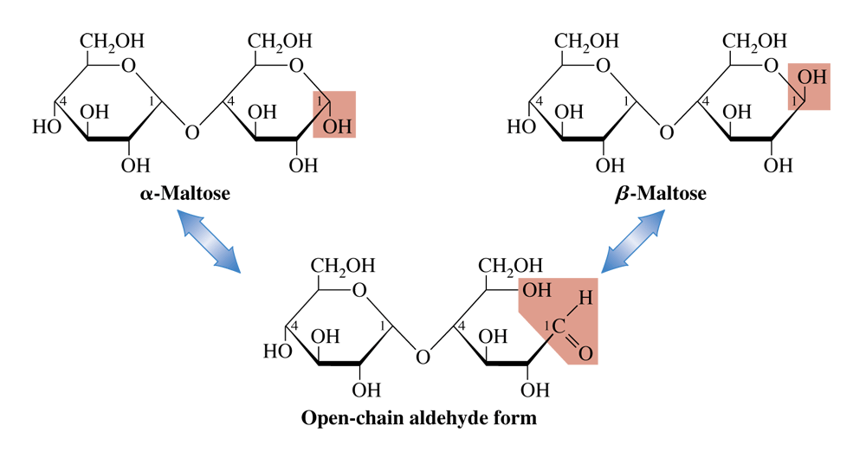
The three forms of maltose present in aqueous solution.

Slide 9
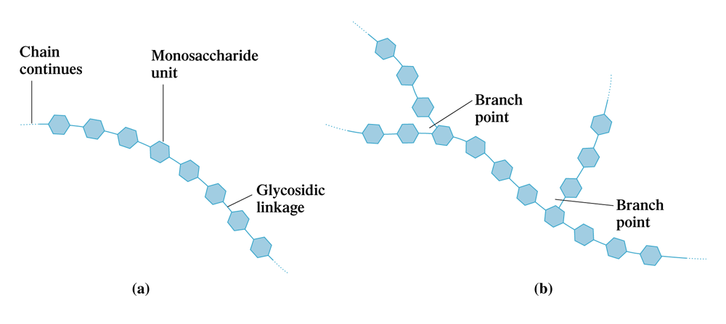
Some polysaccharides have a linear chain structure (a); others have a branched chain structure (b).

Slide 10
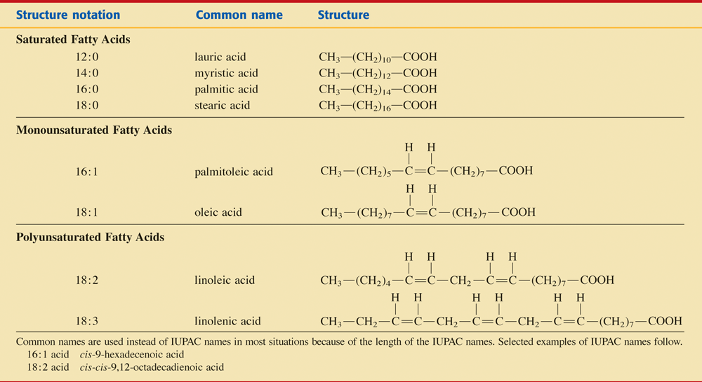
Selected Fatty Acids of Biological Importance.

Slide 11
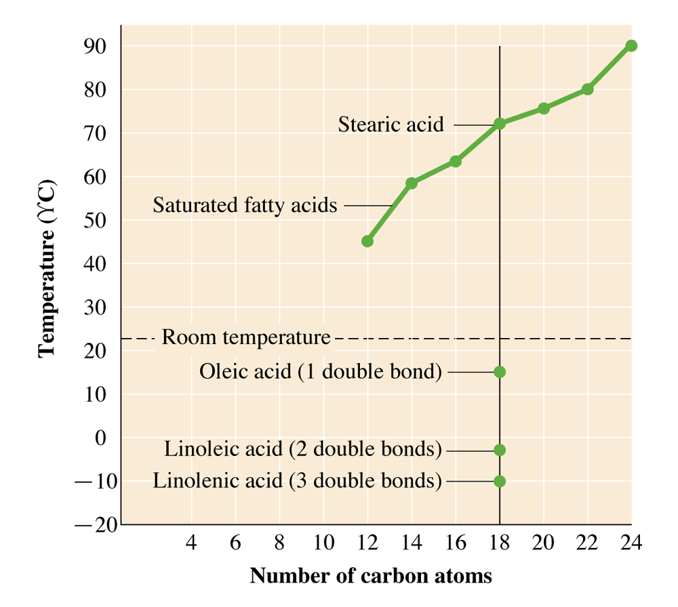
Melting point of a fatty acid depends on the length of the carbon chain and on the number of double bonds present in C-chain.

Slide 12
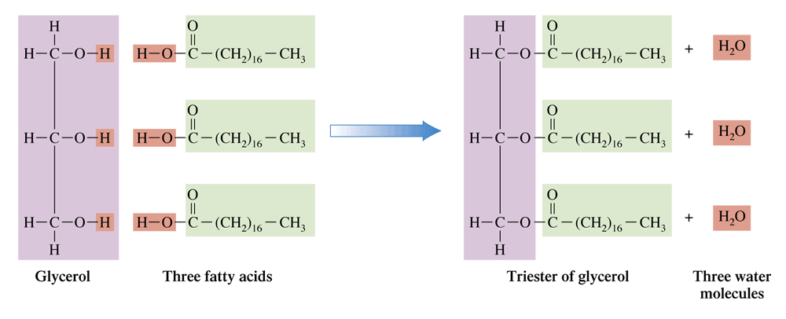
Triple esterification reaction between glycerol and three molecules of stearic acid (18:0 acid). Three molecules of water are a by-product of this reaction.

Slide 13
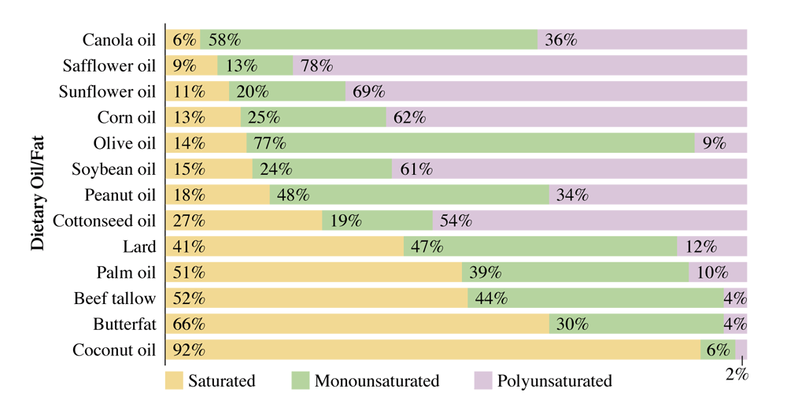
Percentages of saturated, monounsaturated, and polyunsaturated fatty acids in the triacylglycerols of various dietary fats and oils.

Slide 14
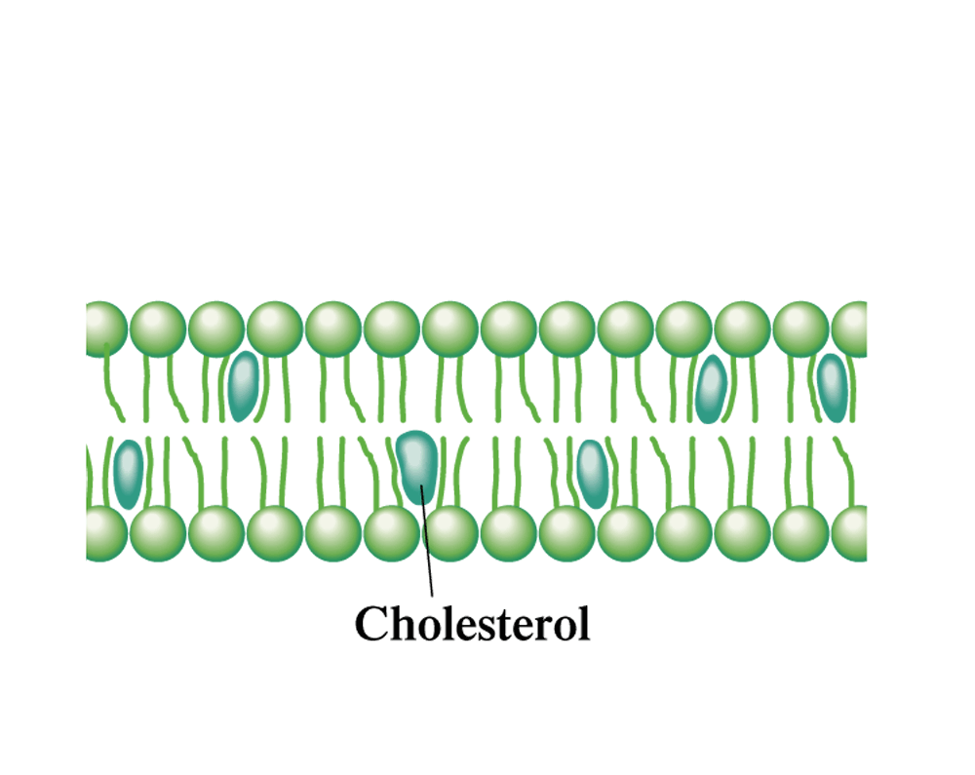
Cholesterol molecules fit between fatty acid chains in a lipid bilayer. They regulate the rigidity of the structure.

Slide 15
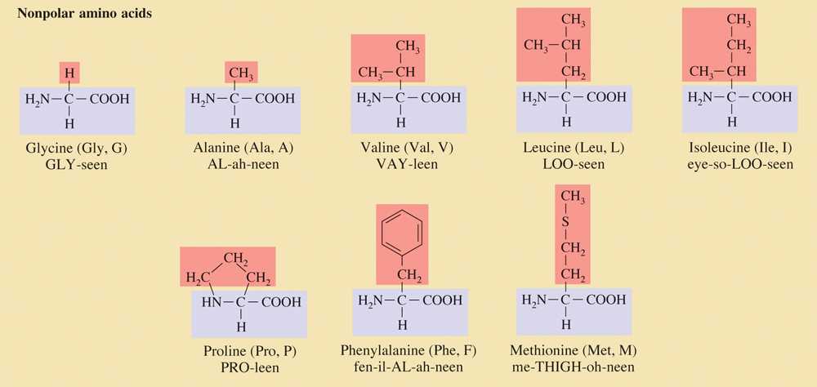
The 20 Standard Amino Acids, Grouped According to Side-Chain Polarity.

Slide 16
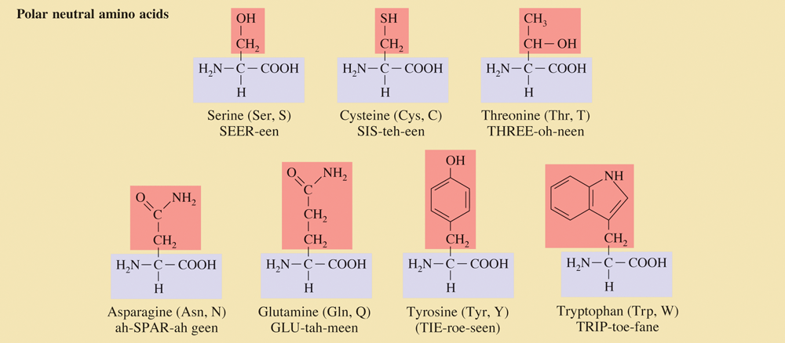
The 20 Standard Amino Acids, Grouped According to Side-Chain Polarity. (cont’d)

Slide 17
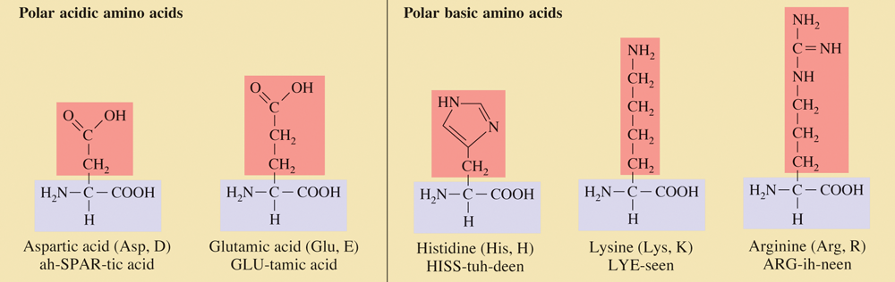
The 20 Standard Amino Acids, Grouped According to Side-Chain Polarity. (cont’d)

Slide 18
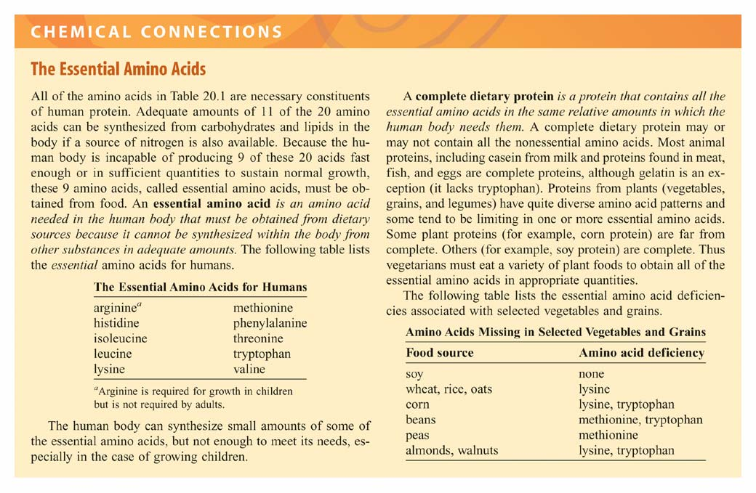

Slide 19
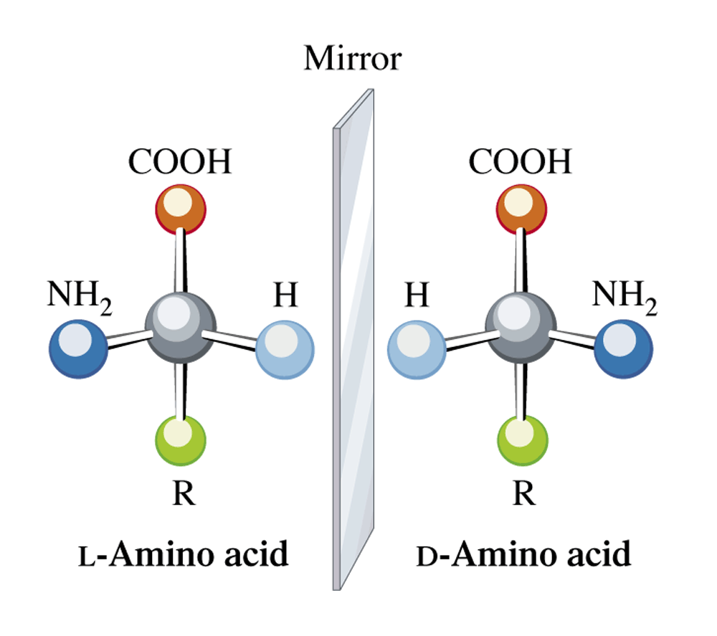
Designation of handedness in standard amino acid structures involves aligning the carbon chain vertically

Slide 20
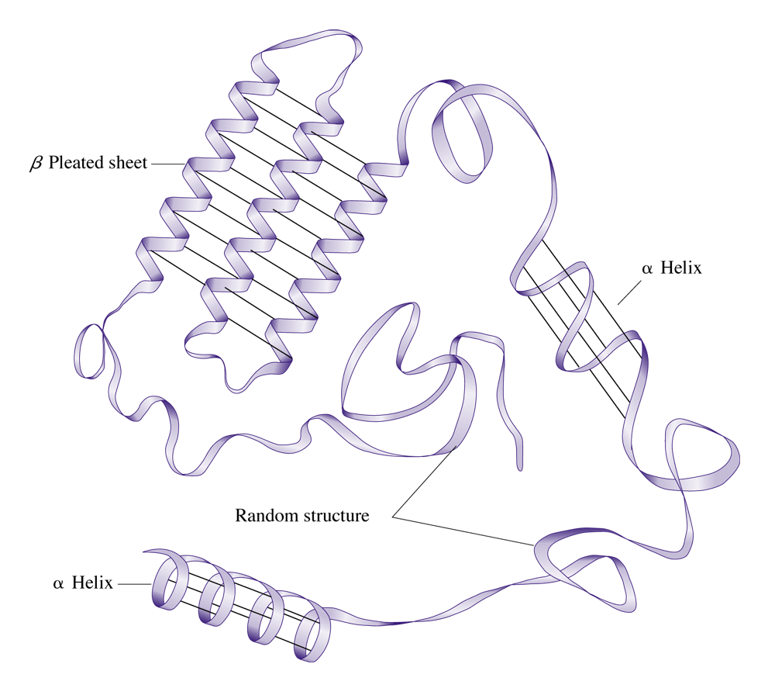
The secondary structure of a single protein often shows areas of a helix and b pleated sheet configurations, as well as areas of random coiling.

Slide 21
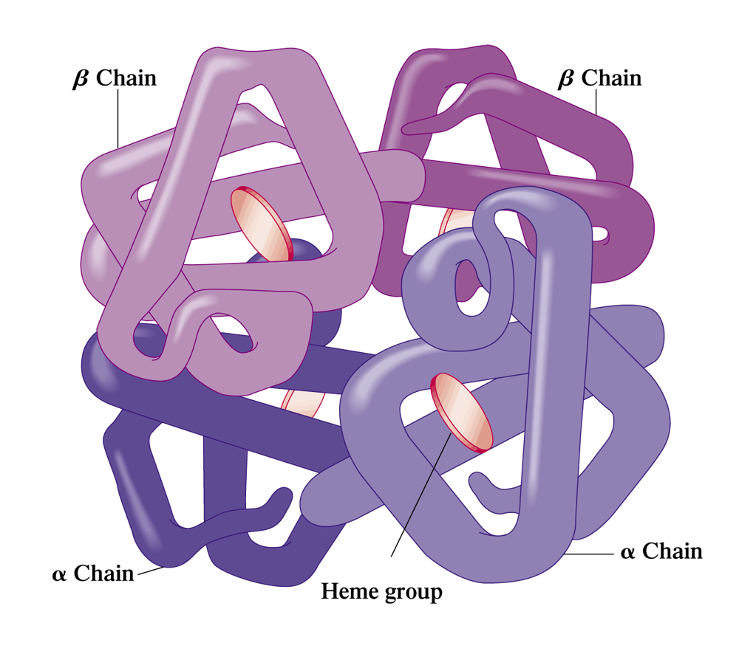
A schematic diagram showing the tertiary and quaternary structure of the oxygen-carrying protein hemoglobin.

Slide 22
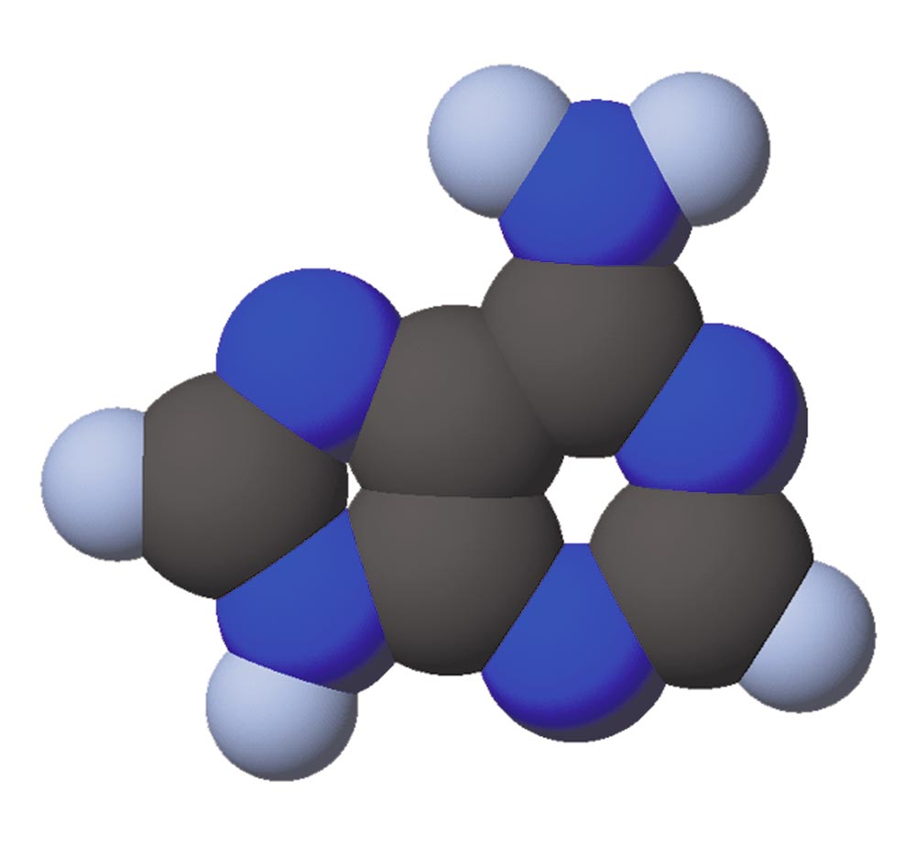
A space-filling model of the heterocyclic nitrogen-containing base adenine.

Slide 23
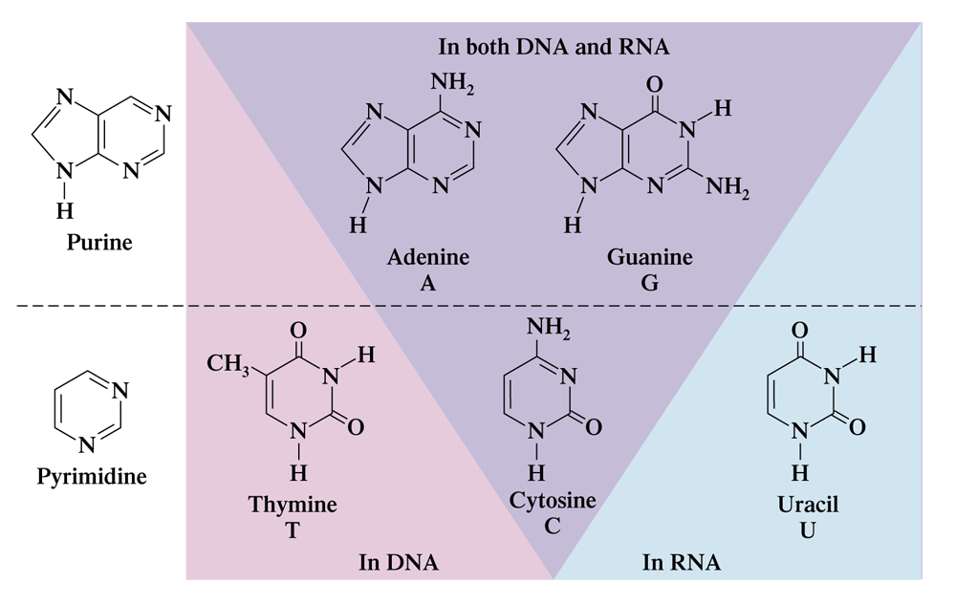
Two purine bases and three pyrimidine bases are found in the nucleotides present in nucleic acids.

Slide 24
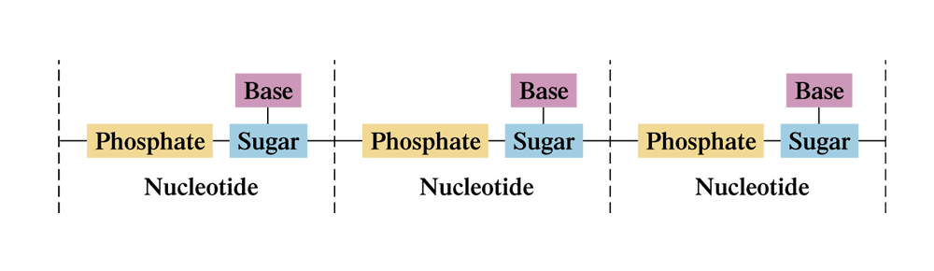
The general structure of a nucleic acid in terms of nucleotide subunits.

Slide 25
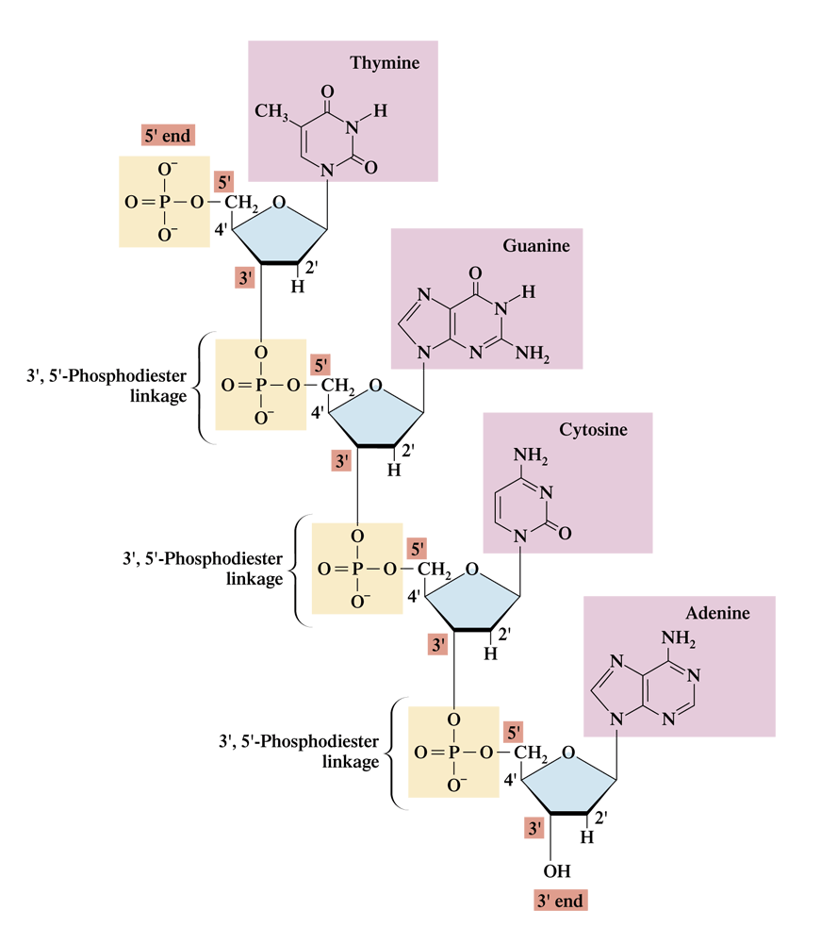
A four-nucleotide-long segment of DNA. (The choice of bases was arbitrary.)

Slide 26
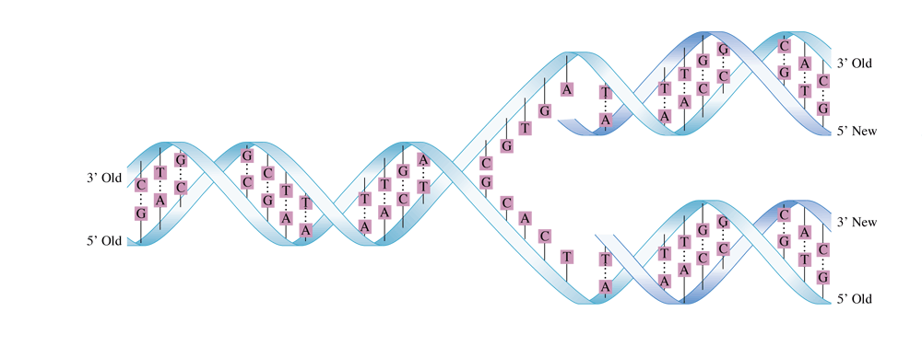
In DNA replication, the two strands of the DNA double helix unwind, the separated strands serving as templates for the formation of new DNA strands. Free nucleotides pair with the complementary bases on the separated strands of DNA. This process ultimately results in the complete replication of the DNA molecule.

Slide 27
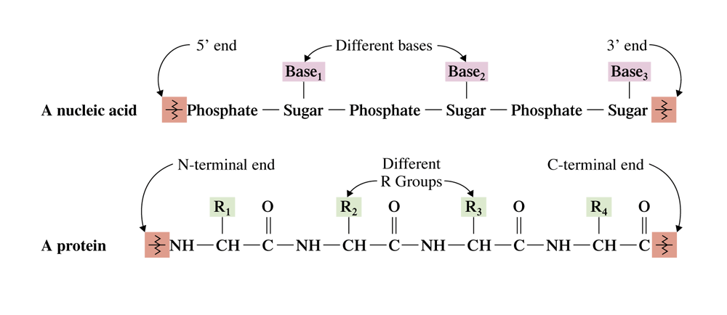
A comparison of the general primary structures of nucleic acids and proteins.

Slide 28
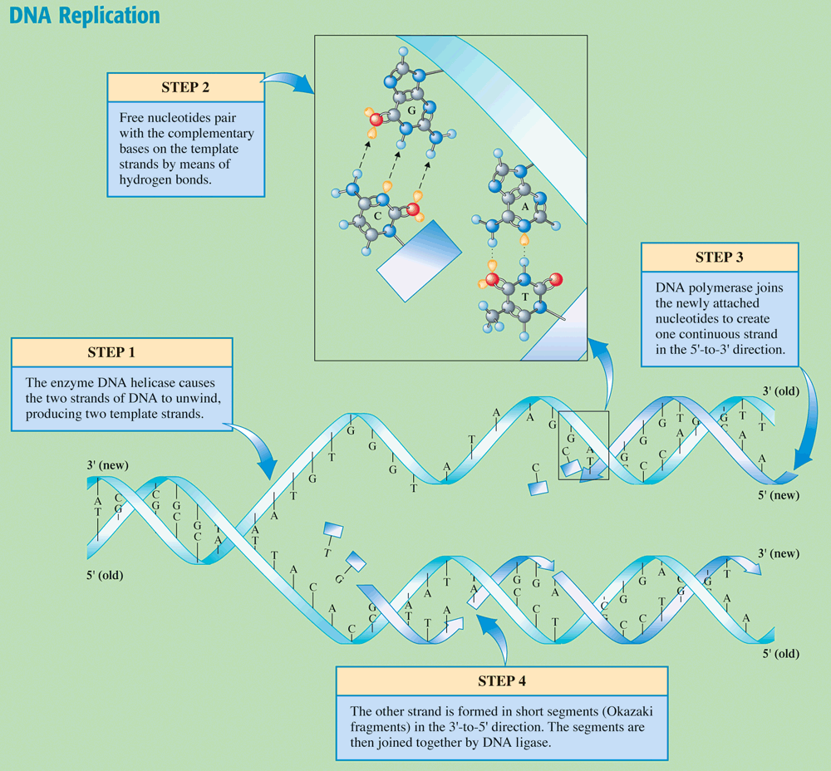
Chemistry at a Glance:
DNA Replication

Slide 29
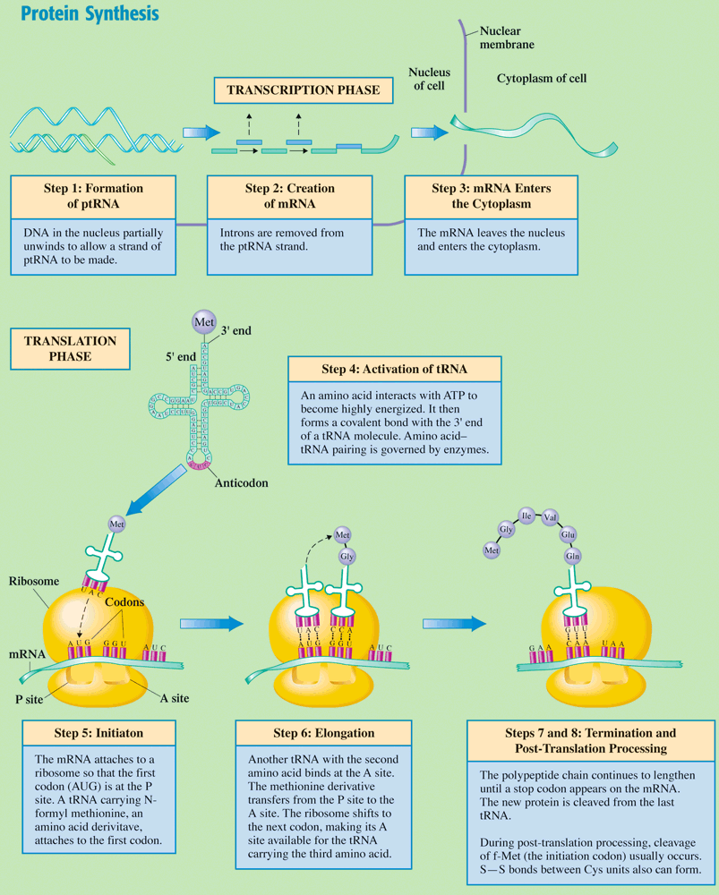
Chemistry at a Glance:
Protein Synthesis

Slide 30
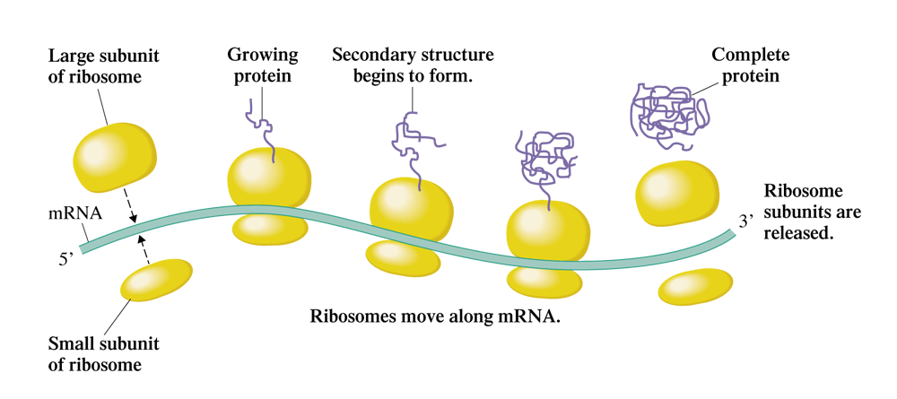
Several ribosomes can simultaneously proceed along a single strand of mRNA one after another. Such a complex of mRNA and ribosomes is called a polysome.

