Slide 1
What is Chemistry?
The Study of MATTER and its TRANSFORMATIONS
The Study of connections between molecular and macroscopic event
Why Study Chemistry?
Chemistry is central to our understanding of other sciences.
Learn Fundamental Physical Models
Gain Technical Perspective on Current Events
Develop Problem Solving Skills
Chemistry is also encountered in everyday life
Appreciate Life’s Little/BIG Mysteries

Slide 2
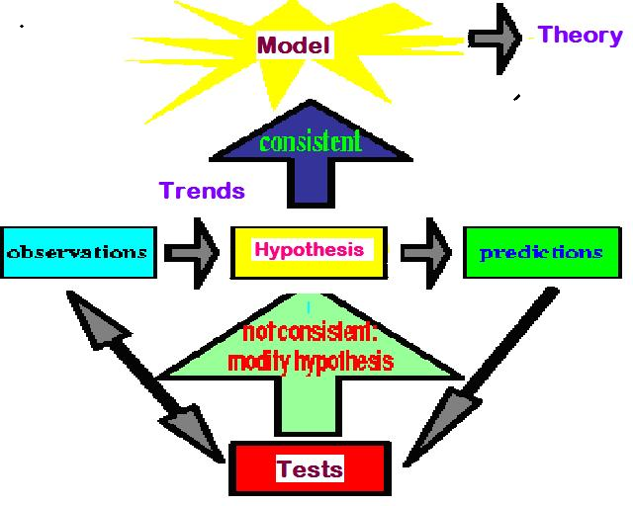
Flow Diagram Depicting the Scientific Method

Slide 3
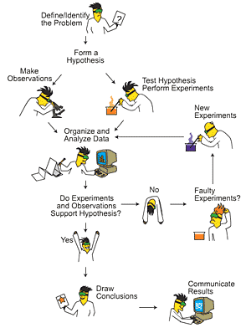
Identify TRENDS
Don’t Reject Data that
Does not agree with
Your Hypothesis

Slide 4
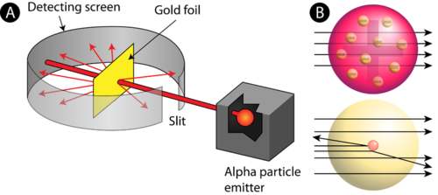
Rutherford Experiment
Only ~ 1/40,000 alpha particles will “Bounce Back”
Yet Rutherfood DID NOT ignore the “possible” Anomalous results
But rather focused on them – Resulting in the Atomic Model

Slide 6
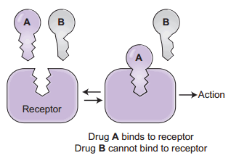
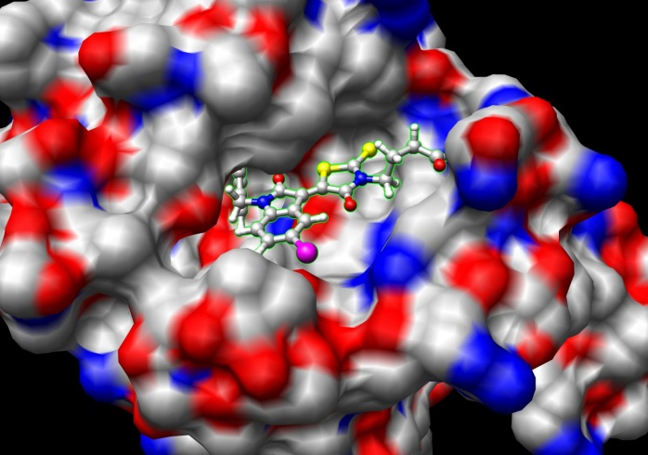
LOCK AND KEY MODEL FOR PHARMOCOLOGY
But Both Receptor and Drug Bind at the Atomic Level

Slide 7
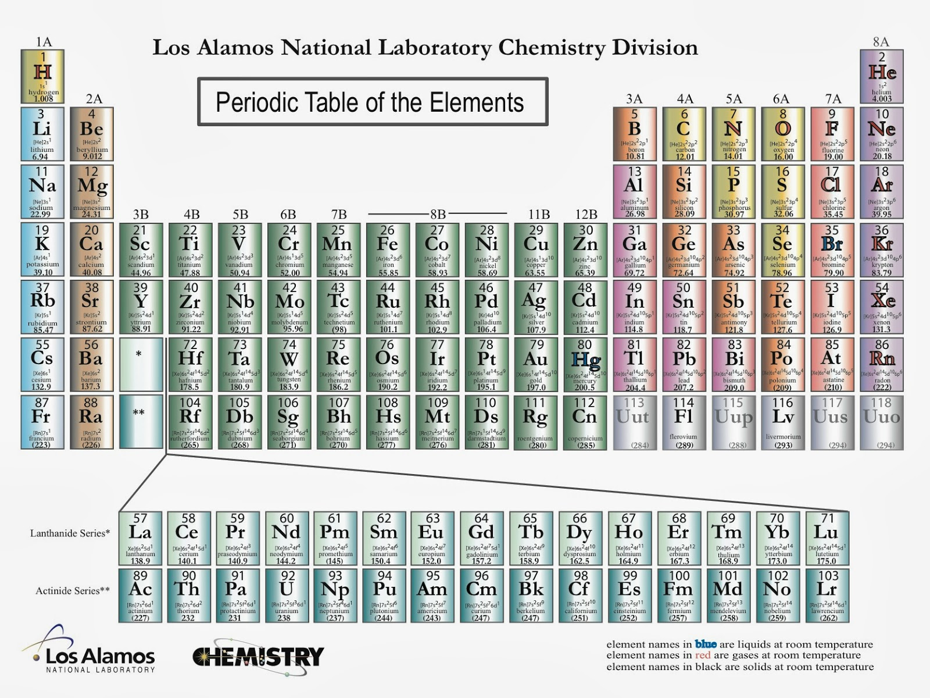
The Elements
If a pure substance cannot be decomposed (at the macroscopic level ) into something else, then the substance is an element.
There are 118 Elements Known
Each element is given a unique chemical symbol (one or two letters).
Elements are Building Blocks of Matter.
Chemical symbols with one letter have that letter capitalized (H, B, C, N)
Chemical symbols with two letters have only first letter capitalized (He, Be).
Element 118 == Ununoctium (118) ?

Slide 8
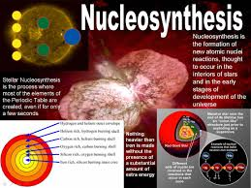

We’re Made of Star Stuff * Carl Sagan
Real Hubble Image of SuperNova
Larger Elements Generated By FUSION in Stars and During SuperNova Explosion

Slide 9
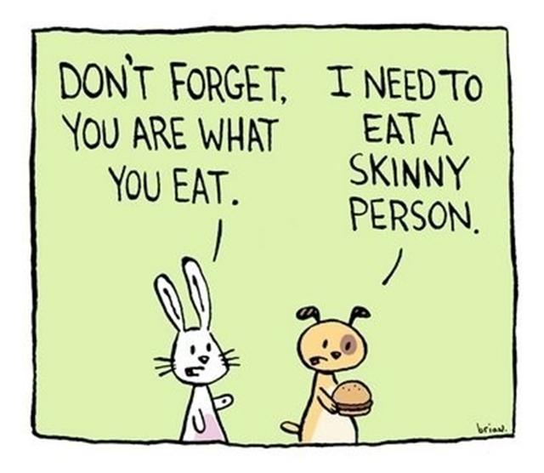
We Are What We Eat
But do you recall munching some Molybdenum or snaking on Selenium?
Some 60 chemical elements are found in the body, but what all of them are doing there is still unknown. Roughly 96 percent of the mass of the human body is made up of just four elements: Oxygen, Carbon, Hydrogen and Nitrogen, with a lot of that in the form of water.
The remaining 4 percent is a sparse sampling of the Periodic Table of Elements
Some of the more prominent representatives are called macronutrients, whereas those appearing only at the level of parts per million or less are referred to as micronutrients. These nutrients perform various functions, including the building of bones and cell structures, regulating the body's pH, carrying charge, and driving chemical reactions.

Slide 10
Oxygen (65%) and Hydrogen (10%) are predominantly found in water, which makes up about 60 percent of the body by weight. It's virtually impossible to imagine life without water
Carbon (18%) is synonymous with life. Its central role is due to the fact that it has four bonding sites that allow for the building of long, complex chains of molecules. Moreover, carbon bonds can be formed and broken with a modest amount of energy, allowing for the dynamic organic chemistry that goes on in our cells.
Nitrogen (3%) is found in many organic molecules, including the amino acids that make up proteins, and the nucleic acids that make up DNA.
Calcium (1.5%) is the most common mineral in the human body — nearly all of it found in bones and teeth. Ironically, calcium's most important role is in bodily functions, such as muscle contraction and protein regulation. In fact, the body will actually pull calcium from bones (causing problems like osteoporosis) if there's not enough of the element in a person's diet.
Phosphorus (1%) is found predominantly in bone but also in the molecule ATP, which provides energy in cells for driving chemical reactions.
Potassium (0.25%) is an important electrolyte (meaning it carries a charge in solution). It helps regulate the heartbeat and is vital for electrical signaling in nerves.
Sulfur (0.25%) is found in two amino acids that are important for giving proteins their shape.
Sodium (0.15%) is another electrolyte that is vital for electrical signaling in nerves. It also regulates the amount of water in the body.

Slide 11
Chlorine (0.15%) is usually found in the body as a negative ion, called chloride. This electrolyte is important for maintaining a normal balance of fluids.
Magnesium (0.05%) plays an important role in the structure of the skeleton and muscles. It also is necessary in more than 300 essential metabolic reactions.
Iron (0.006%) is a key element in the metabolism of almost all living organisms. It is also found in hemoglobin, which is the oxygen carrier in red blood cells. Half of women don't get enough iron in their diet.
Fluorine (0.0037%) is found in teeth and bones. Outside of preventing tooth decay, it does not appear to have any importance to bodily health.
Zinc (0.0032%) is an essential trace element for all forms of life. Several proteins contain structures called "zinc fingers" help to regulate genes. Zinc deficiency has been known to lead to dwarfism in developing countries.
Copper (0.0001%) is important as an electron donor in various biological reactions. Without enough copper, iron won't work properly in the body.
Iodine (0.000016%) is required for making of thyroid hormones, which regulate metabolic rate and other cellular functions. Iodine deficiency, which can lead to goiter and brain damage, is an important health problem throughout much of the world.
Selenium (0.000019%) is essential for certain enzymes, including several anti-oxidants. Unlike animals, plants do not appear to require selenium for survival, but they do absorb it, so there are several cases of selenium poisoning from eating plants grown in selenium-rich soils.

Slide 12
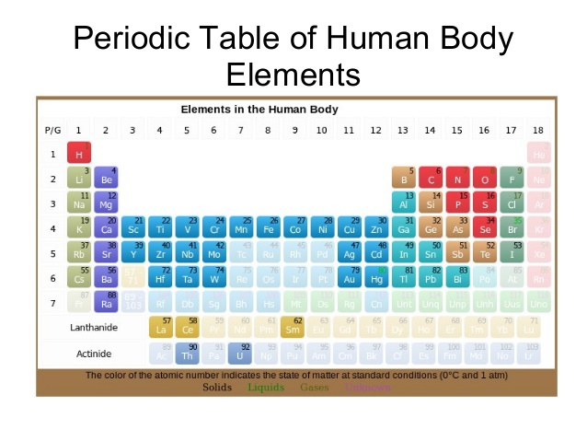
Manganese (0.000017%) is essential for certain enzymes, in particular those that protect mitochondria — the place where usable energy is generated inside cells — from dangerous oxidants.
Molybdenum (0.000013%) is essential to virtually all life forms. In humans, it is important for transforming sulfur into a usable form. In nitrogen-fixing bacteria, it is important for transforming nitrogen into a usable form.
Cobalt (0.0000021%) is contained in vitamin B12, which is important in protein formation and DNA regulation.
And there are several other elements — such as Silicon, Boron, Nickel, Vanadium and Lead — that may play a biological role but are not classified as essential.

Slide 13
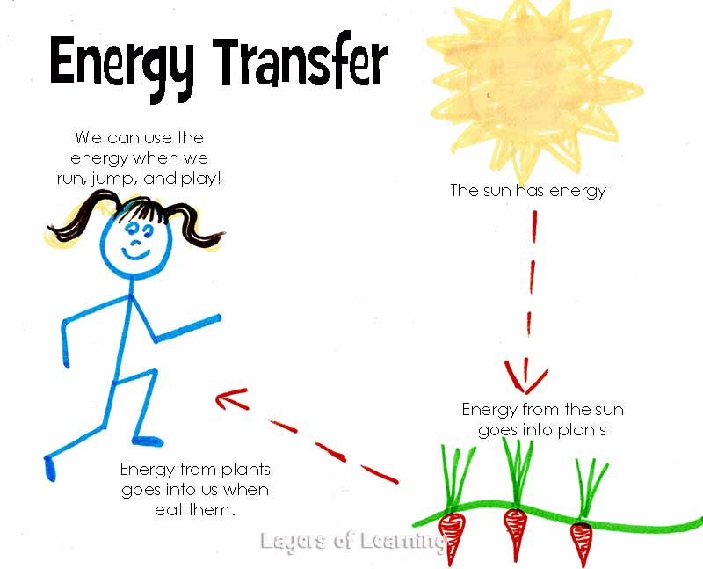

Slide 14
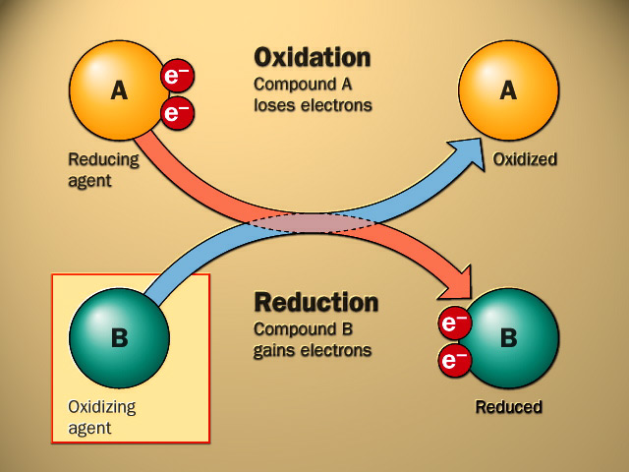
Oxidation Reduction

Slide 15
Alternate Views of Redox
Gain O – Oxidation
Lose O - Reduction
Lose H – Oxidation
Gain H – Reduction

Slide 17
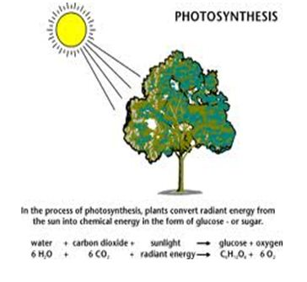

Slide 18
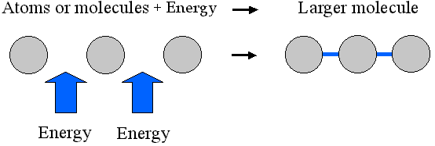
PLANTS ABSORB SOLAR ENERGY AND
STORE ENERGY IN CHEMICAL BONDS

Slide 19
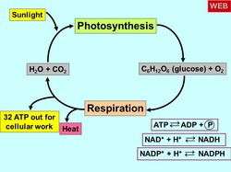

Slide 20
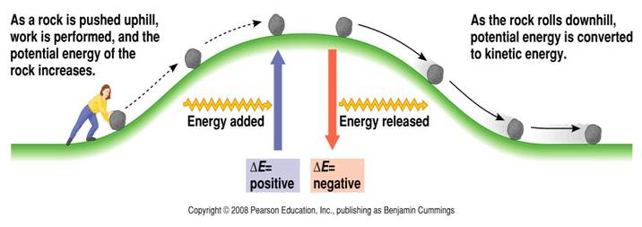
Chemistry
Studies the Energy Stored and Released
in Chemical Bonds
CO₂ + H₂O + Solar Energy ➔ Carbohydrates ➔ CO₂ + H₂O + Energy for Life

Slide 21
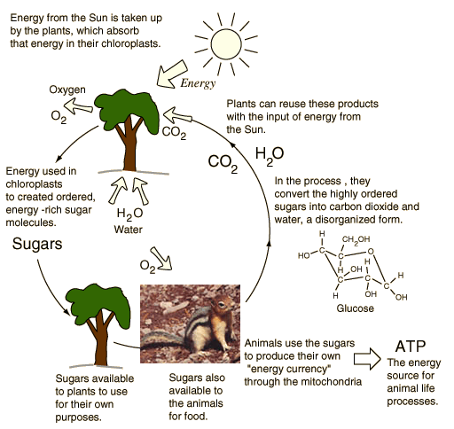

Slide 22
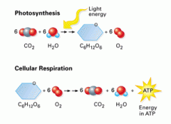
CO₂ is REDUCED
SOLAR Energy
Is stored in Chemical Bonds within SUGAR
SUGAR is OXIDIZED
Energy is Released
To Drive Our Life

Slide 23
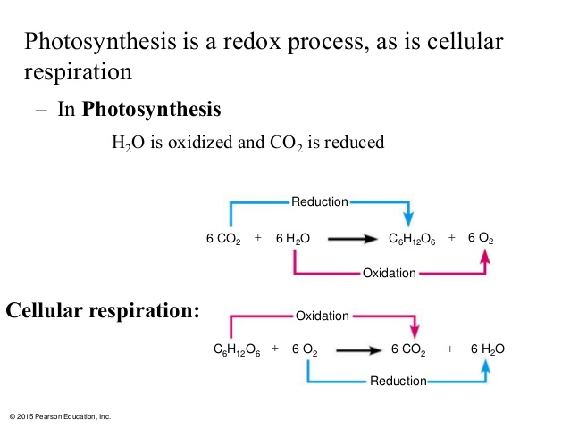

Slide 24
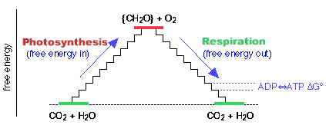

Slide 25
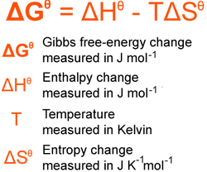

Slide 26
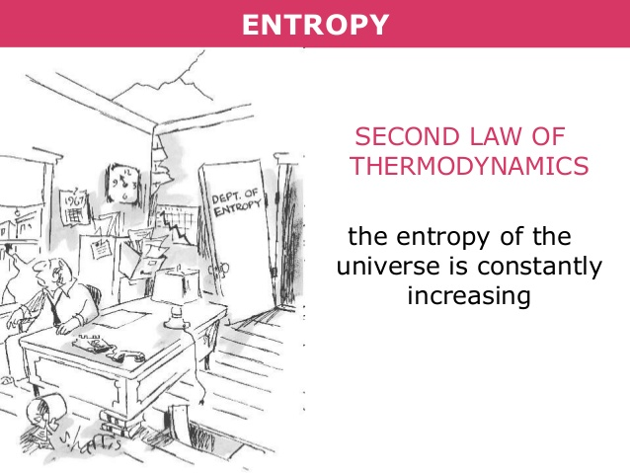

Slide 27
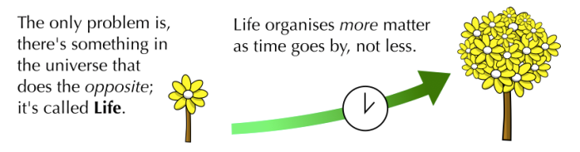

Slide 28
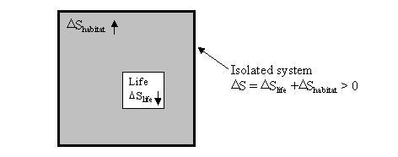
ENTROPY (ΔS) OF THE UNIVERSE

