Slide 1
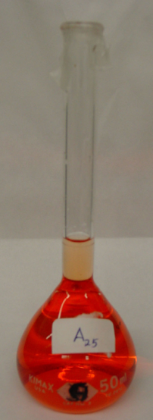
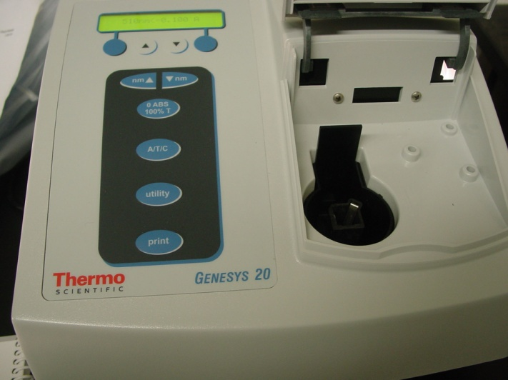
Spectrophotometric Determination of Iron
Quantitative spectrophotometric analysis will be employed to determine the concentration of iron in an unknown solution.
A calibration curve for absorbance data for a series of iron standards will be obtained. A linear equation expressing the Beer-Lambert law will be used to determine the concentration of iron in an unknown sample.

Slide 2
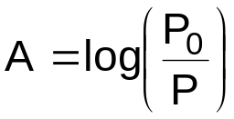
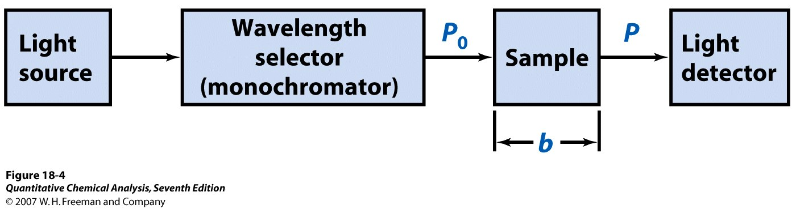
Beer-Lambert Law: the fraction of incident light absorbed, A, is a function of the thickness and the concentration of absorbing molecules in the light’s path.
A = ε b C
ε = the molar absorptivity constant
b = optical path length, often 1 cm
C = the concentration in moles/liter
Inside a spectrophotometer

Slide 3


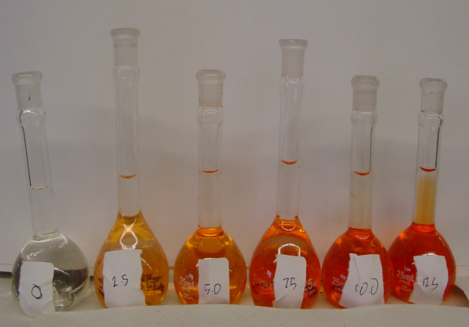
Preparation of Standards: Mix and let stand.
Add appropriate amounts of standard iron solution to volumetric flasks using good burette techniques.
Add hydroxylamine to reduce Fe³⁺ to Fe²⁺
Add sodium acetate salt, pH = 8
Add o-phenanthroline, AKA phen, bidentate ligand

Slide 4
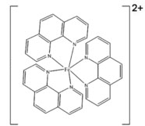
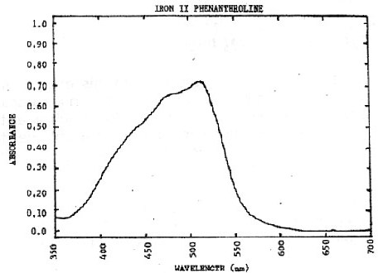
Absorbance Spectrum
phen
Tris (1,10-phenanthroline)iron(II)
Red-orange complex
λ_{max} = 508 nm

Slide 5
Using the Genesys 20 Spectrophotometer
Allow the instrument to warm up for 30 minutes before using it.
Press A/T/C to select absorbance as the mode shown on the display.
Press nm▲or nm▼ to select the proper wavelength.
Insert you blank into the cell holder and close the sample door.
Press 0 ABS/100%T to set the black to 0 A.
Remove your blank, using the same curette, insert your sample into the cell holder. The sample measurement appears on the LCD display.

Slide 6
Curette Preparation Reminders:
Prepare a blank by filling an empty curette ¾ full with De-Ionized Water.
Seal the curette with a lid.
Remember:
All curettes should be wiped clean and dry on the outside with a tissue.
Handle curettes only by the top edge of the ribbed sides.
All solutions should be free of bubbles.
Always position the curette so the light path (indicated by the arrow) passes through the clear walls.

Slide 7
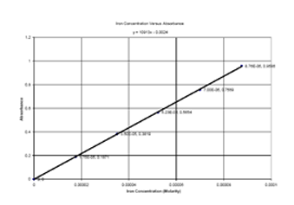
Data Analysis
Calculate the molarity of iron in the standard solutions, M₁V₁=M₂V₂
Construct a Calibration Curve (Absorbance vs. Concentration). (Directions for Excel 2007 available.)
Use the equation of the best fit line for your calibration curve to calculate the amount of iron in your unknown.

