Slide 1
Reaction Mechanisms
A reaction mechanism is a sequence of molecular events, or reaction steps, that defines the pathway from reactants to products.

Slide 2
Reaction Mechanisms
Single steps in a mechanism are called elementary steps (reactions).
An elementary step describes the behavior of individual molecules.
An overall reaction describes the reaction stoichiometry.

Slide 3
Reaction Mechanisms
NO₂(g) + CO(g) → NO(g) + CO₂(g) Overall
1) NO₂(g) + NO₂(g) → NO(g) + NO₃(g) Elementary
2) NO₃(g) + CO(g) → NO₂(g) + CO₂(g) Elementary
The chemical equation for an elementary reaction is a description of an individual molecular event that involves the breaking and/or making of chemical bonds.

Slide 4
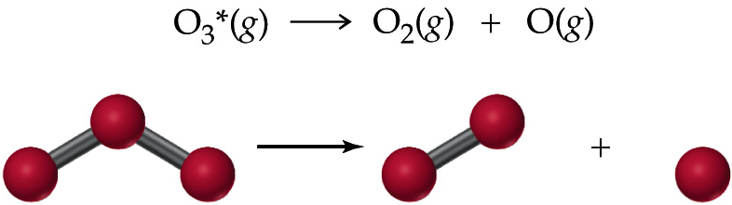
Reaction Mechanisms
Molecularity: is the number of molecules (or atoms) on the reactant side of the chemical equation.
Unimolecular: Single reactant molecule.

Slide 5
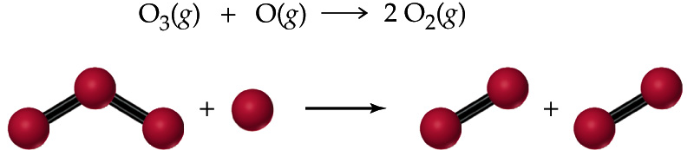
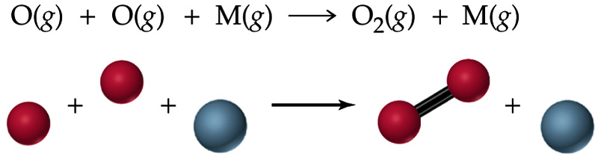
Reaction Mechanisms
Bimolecular: Two reactant molecules.
Termolecular: Three reactant molecules.

Slide 6
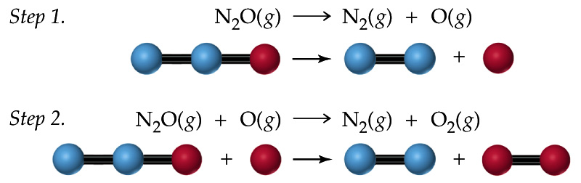
Reaction Mechanisms
Determine the overall reaction, the reaction intermediates, and the molecularity of each individual elementary step.

Slide 7
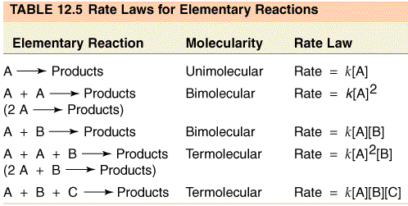
Rate Laws and Reaction Mechanisms
Rate law for an overall reaction must be determined experimentally.
Rate law for elementary step follows from its molecularity.

Slide 8
Rate Laws and Reaction Mechanisms
The rate law of each elementary step follows its molecularity.
The overall reaction is a sequence of elementary steps called the reaction mechanism.
Therefore, the experimentally observed rate law for an overall reaction must depend on the reaction mechanism.

Slide 9
Rate Laws and Reaction Mechanisms
The slowest elementary step in a multistep reaction is called the rate-determining step.
The overall reaction cannot occur faster than the speed of the rate-determining step.
The rate of the overall reaction is therefore determined by the rate of the rate-determining step.

Slide 10
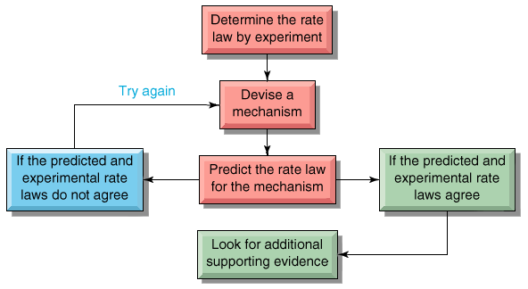
Rate Laws and Reaction Mechanisms

Slide 11
Rate Laws and Reaction Mechanisms
The following reaction has a second-order rate law:
    H₂(g) + 2 ICl(g) → I₂(g) + 2 HCl(g) Rate = k[H₂][ICl]
Devise a possible mechanism.
The following substitution reaction has a first-order rate law:
    Co(CN)₅(H₂O)^{2–}(aq) + I– → Co(CN)₅I^{3–}(aq) + H₂O(l)
    Rate = k[Co(CN)₅(H₂O)^{2–}]
Suggest a mechanism in accord with the rate law.

Slide 12
Rate Laws and Reaction Mechanisms
The following reaction has a second-order rate law:
    H₂(g) + 2 ICl(g) → I₂(g) + 2 HCl(g) Rate = k[H₂][ICl]
Option 1: 2ICl + H2---> 2HCl + I2 (termolecular)
Option 2: H2 + ICl ----> HI + HCl (slow)
HI + ICl---> HCl + I2 (fast)
Option 3: H2 + ICl ---> HI + HCl (fast)
HI + ICl ---> HCl + I2 (slow)
Option 4: H2 + ICl ---> HICl + H (slow),
  H + ICl ----> HCl + I (fast),
  HICl----> HCl + I (fast), I + I ---> I2 (fast).

Slide 13
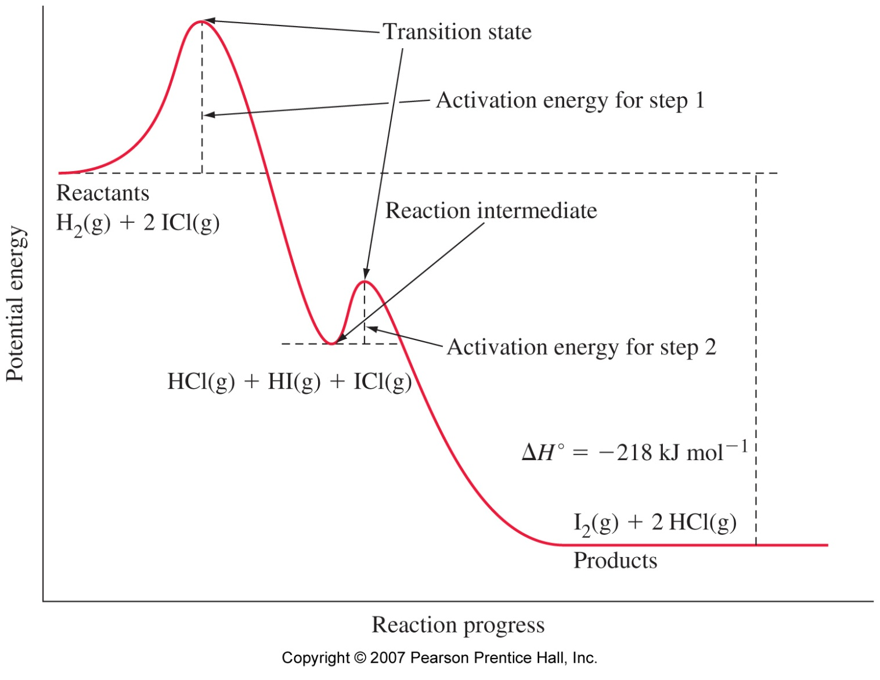
Slow Step Followed by a Fast Step

Slide 14
Fast Reversible Step Followed by a Slow Step
d[P]
2NO(g) + O₂(g) → 2 NO₂(g)
= -k_{obs}[NO₂]²[O₂]
dt
Postulate a mechanism:
k₁
k₁
2NO(g) N₂O₂(g)
[N₂O₂]
=
[NO]²
= K[NO]²
fast
k₋₁
k₋₁
k₁
[N₂O₂]
K =
=
k₋₁
[NO]
k₂
d[NO₂]
slow
N₂O₂(g) + O₂(g) 2NO₂(g)
= k₂[N₂O₂][O₂]
dt
d[I₂]
k₁
2NO(g) + O₂(g) → 2 NO₂(g)
= k₂ [NO]²[O₂]
dt
k₋₁

