Slide 1
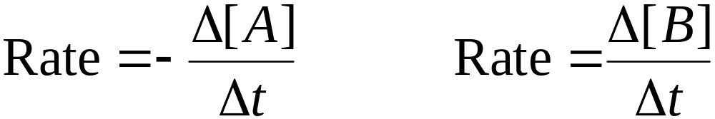
Reaction Rates
Reaction Rate: The change in the concentration of a reactant or a product with time (M/s).
Reactant → Products
aA → bB

Slide 2
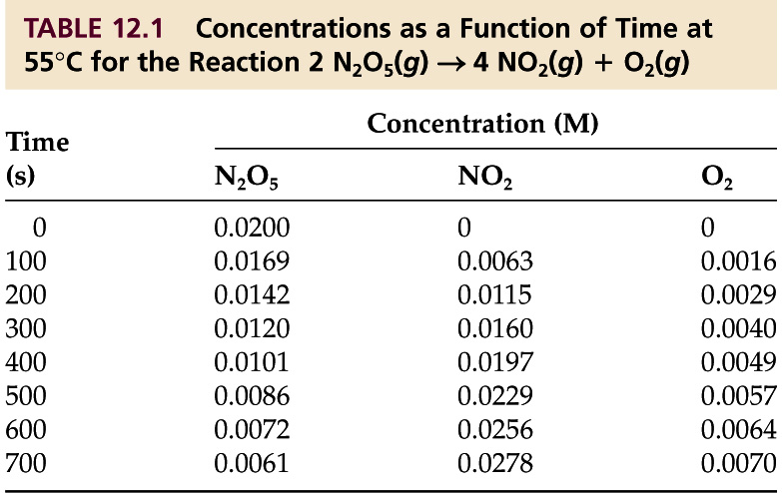
Reaction Rates
Consider the decomposition of N₂O₅ to give NO₂ and O₂: 2 N₂O₅(g) 4 NO₂(g) + O₂(g)

Slide 3
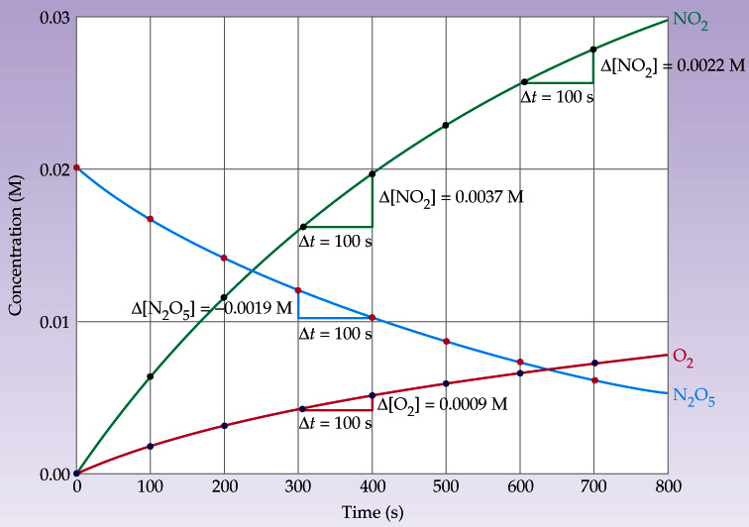
Reaction Rates

Slide 4
Rate Law & Reaction Order
Rate Law: Shows the relationship of the rate of a reaction to the rate constant and the concentration of the reactants raised to some powers.
For the general reaction:
aA + bB → cC + dD rate = k[A]^{x}[B]^{y}
x and y are NOT the stoichiometric coefficients.
k = the rate constant

Slide 5
Rate Law & Reaction Order
Reaction Order: The sum of the powers to which all reactant concentrations appearing in the rate law are raised.
Reaction order is determined experimentally:
  By inspection.
  From the slope of a log(rate) vs. log[A] plot.

Slide 6
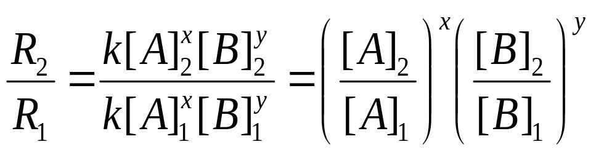
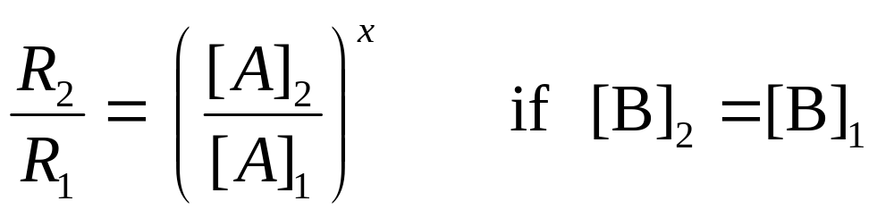
Rate Law & Reaction Order
Determination by inspection:
aA + bB → cC + dD
  Rate = R = k[A]^{x}[B]^{y} Use initial rates (t = 0)

Slide 7
Rate Law & Reaction Order
The reaction of nitric oxide with hydrogen at 1280°C is: 2 NO_{(g)} + 2 H_{2(g)} → N_{2(g)} + 2 H₂O_{(g)}
From the following data determine the rate law and rate constant.
E
x
p
e
ri
m
e
n
t
[
NO
]
[
H
]
I
n
iti
a
l
Ra
t
e
(M/
s
)
2
1
5
.
0
x 1
0
–
3
2
.
0
x
1
0
–
3
1
.
–
5
25 x 10
2
1
0
.
0
x
1
0
–
3
2
.
0
x 1
0
–
3
5
.
0
x 1
0
–
5
3
1
0
.
0
x
1
0
–
3
4
.
0
x 1
0
–
3
1
0
.
0
x
1
0
–
5

Slide 8
Rate Law & Reaction Order
The reaction of peroxydisulfate ion (S₂O₈²⁻) with iodide ion (I⁻) is:
  S₂O₈²⁻_{(aq)} + 3 I⁻_{(aq)} → 2 SO₄²⁻_{(aq)} + I₃⁻_{(aq)}
From the following data, determine the rate law and rate constant.
E
x
p
e
ri
m
e
n
t
[S
O
2
-
]
[I⁻]
I
n
iti
a
l
Ra
t
e
(M/
s
)
2
8
1
0
.
0
8
0
0
.
0
3
4
2
.
2
x 1
0
-
4
2
0
.
0
8
0
0
.
0
1
7
1
.
1
x 1
0
-
4
3
0
.
1
6
0
.
0
1
7
2
.
2
x 1
0
-
4

Slide 9
Rate Law & Reaction Order
Determination by plot of a log(rate) vs. log[A]:
aA + bB → cC + dD
  Rate = R = k[A]^{x}[B]^{y}
  (take log of both sides)
  Log(R) = log(k) + x·log[A] + y·log[B]
  = const + x·log[A] if [B] held constant

Slide 10
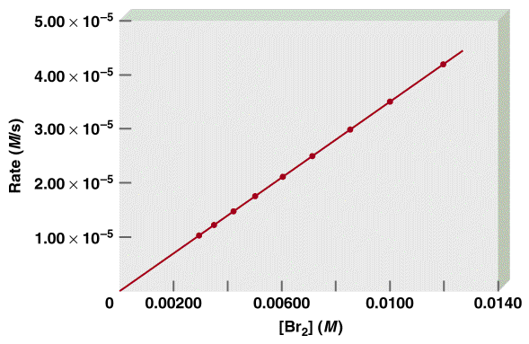
Rate Law & Reaction Order
Rate Constant: A constant of proportionality between the reaction rate and the concentration of reactants.
rate ∝ [Br₂]
rate = k[Br₂]

Slide 11
First-Order Reactions
First Order: Reaction rate depends on the reactant concentration raised to first power.
Rate = k[A]
where Rate = -Δ[A] = -d[A]
Δt dt

Slide 12
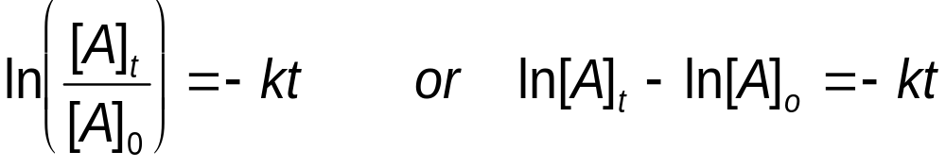
First-Order Reactions
Using calculus we obtain the integrated rate equation:
Plotting ln[A]_{t} against t gives a straight line of slope –k. An alternate expression is:

Slide 13
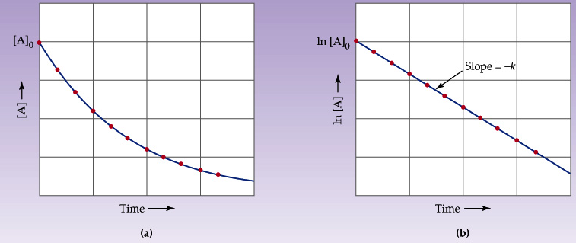
First-Order Reactions
Identifying First-Order Reactions:

Slide 14
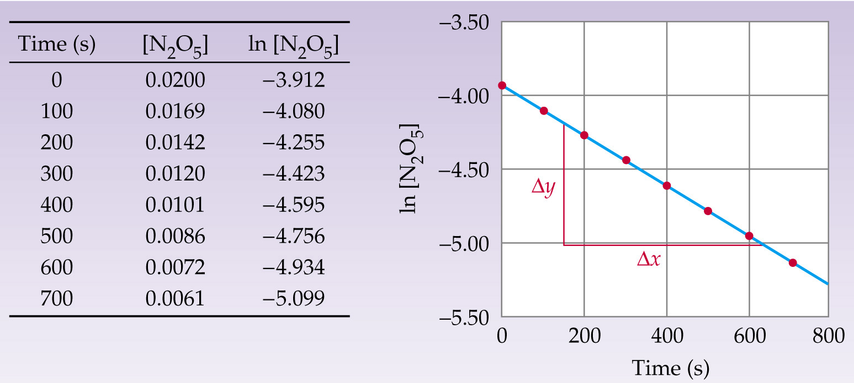
First-Order Reactions
Show that the decomposition of N₂O₅ is first order and calculate the rate constant.

Slide 15
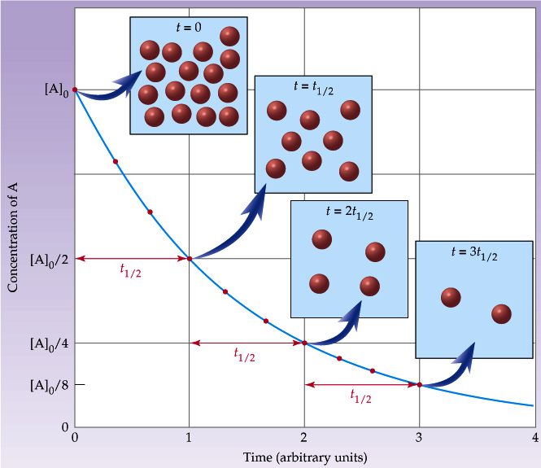
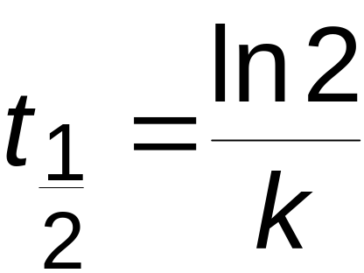
First-Order Reactions
Half-Life:
Time for reactant
concentration to
decrease by half
its original value.

Slide 16
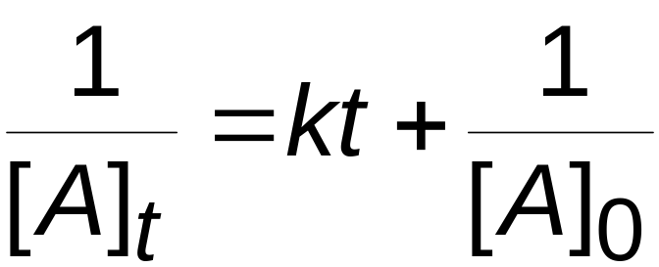
Second-Order Reactions
A → Products
A + B → Products
  Rate = k[A]² or Rate = k[A][B]
These can then be integrated to give:

Slide 17
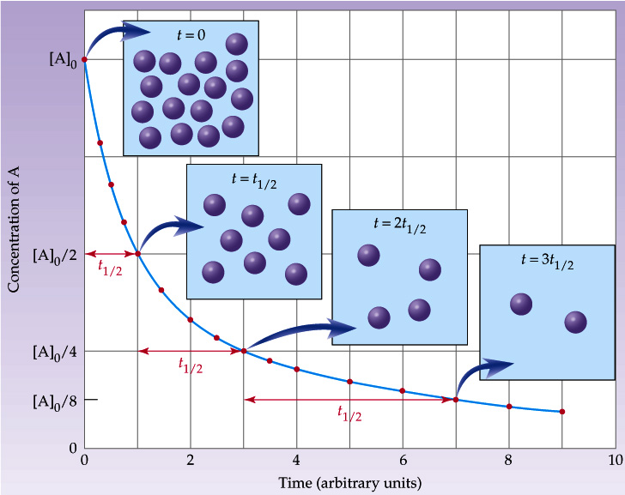
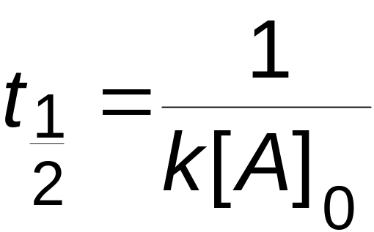
Second-Order Reactions
Half-Life:
Time for reactant
concentration to
decrease by half
its original value.

Slide 18
Second-Order Reactions
Iodine atoms combine to form molecular iodine in the gas phase.
I_{(g)} + I_{(g)} → I_{2(g)}
This reaction follows second-order kinetics and k = 7.0 x 10^{–1} M^{–1}s^{–1} at 23°C. (a) If the initial concentration of I was 0.086 M, calculate the concentration after 2.0 min. (b) Calculate the half-life of the reaction if the initial concentration of I is 0.60 M and if it is 0.42 M.

