Slide 1

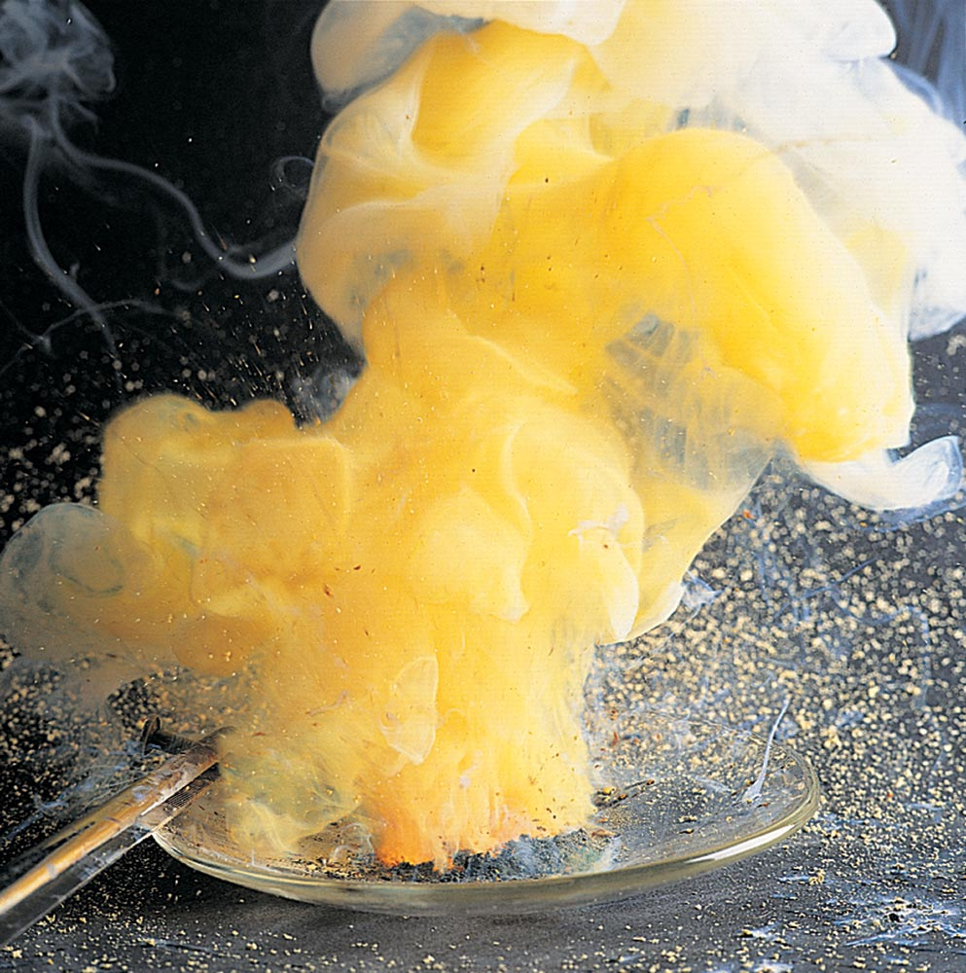
Figure 9.1 When a hot nail is stuck into a pile of zinc and sulfur, a fiery combination reaction occurs and zinc sulfide forms.
Source: James Scherer

Slide 2
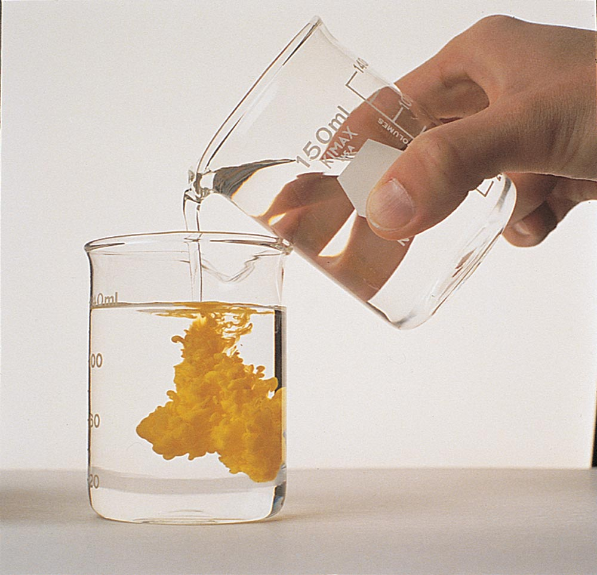
Figure 9.2 A double-replacement reaction involving solutions of potassium iodide and lead(II) nitrate (both colorless solutions) produces yellow, insoluble lead(II) iodide as one of the products.
2KI(aq) + Pb(NO3)2(aq) → 2KNO3(aq) + PbI2(s)
Source: James Scherer

Slide 3
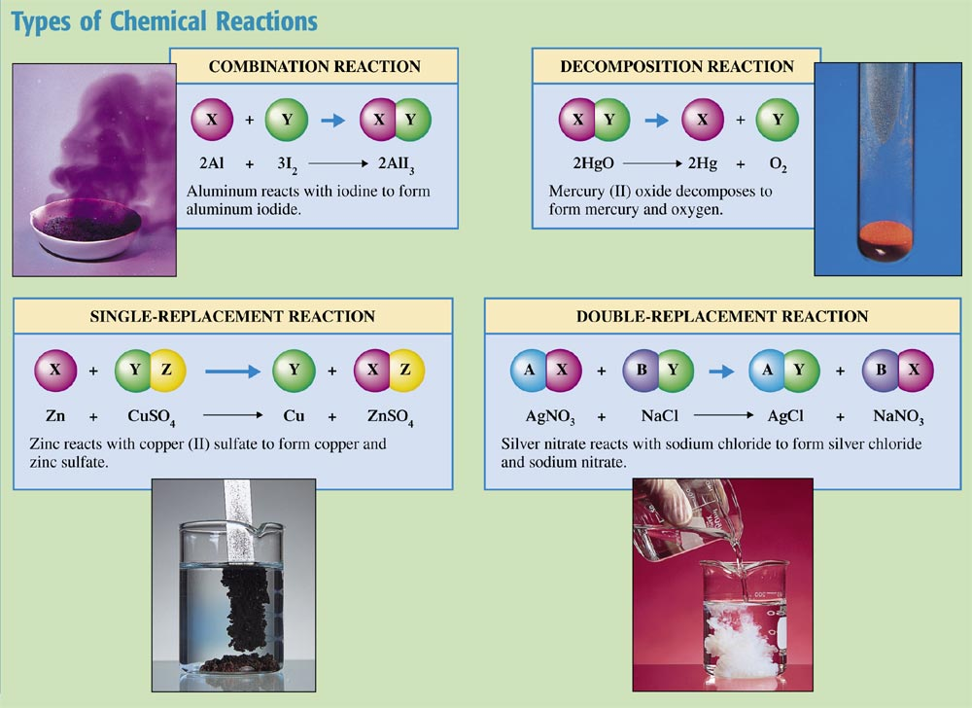
Chemistry at a Glance:
Types of Chemical Reactions

Slide 4
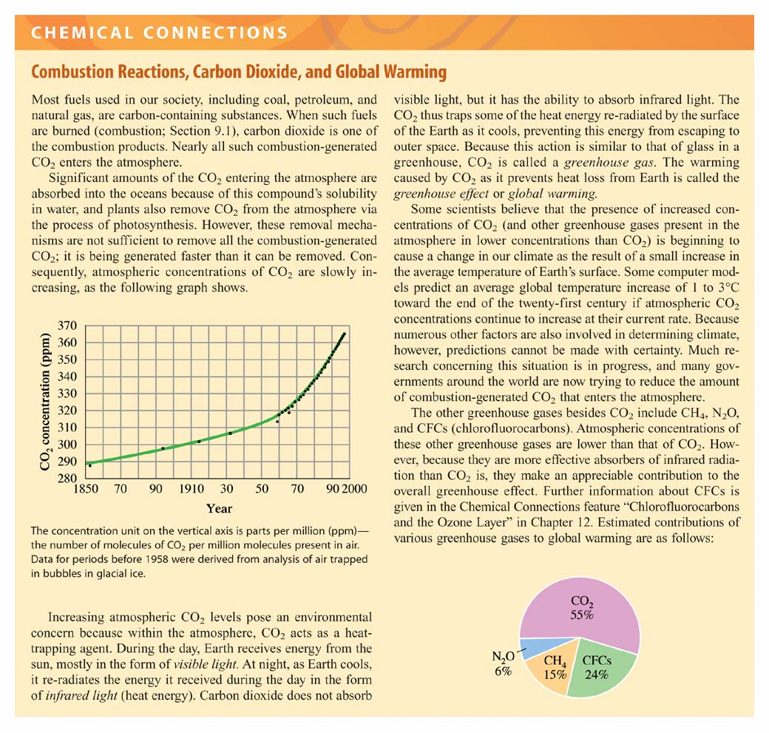

Slide 5
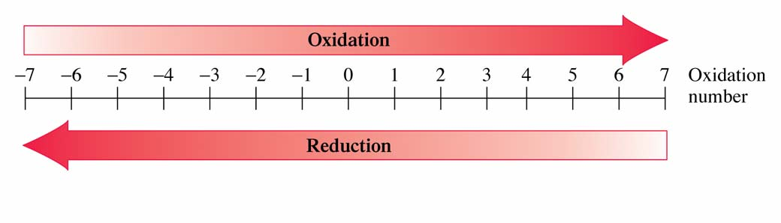
Figure 9.4 An increase in oxidation number is associated with the process of oxidation, a decrease with the process of reduction.

Slide 6
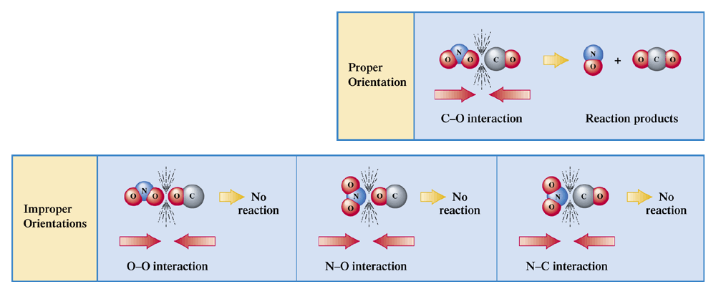
Figure 9.6 In the reaction of NO2 with CO to produce NO and CO2, the most favorable collision orientation is one that puts an O atom from NO2 in close proximity to the C atom of CO.

Slide 7
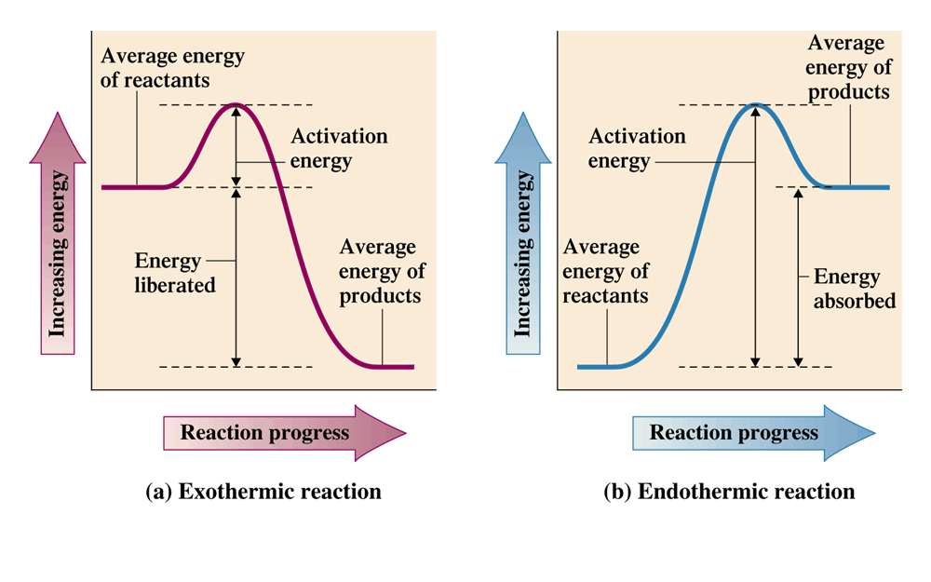
Figure 9.7 Energy diagram graphs showing the difference between an exothermic and an endothermic reaction.

Slide 8
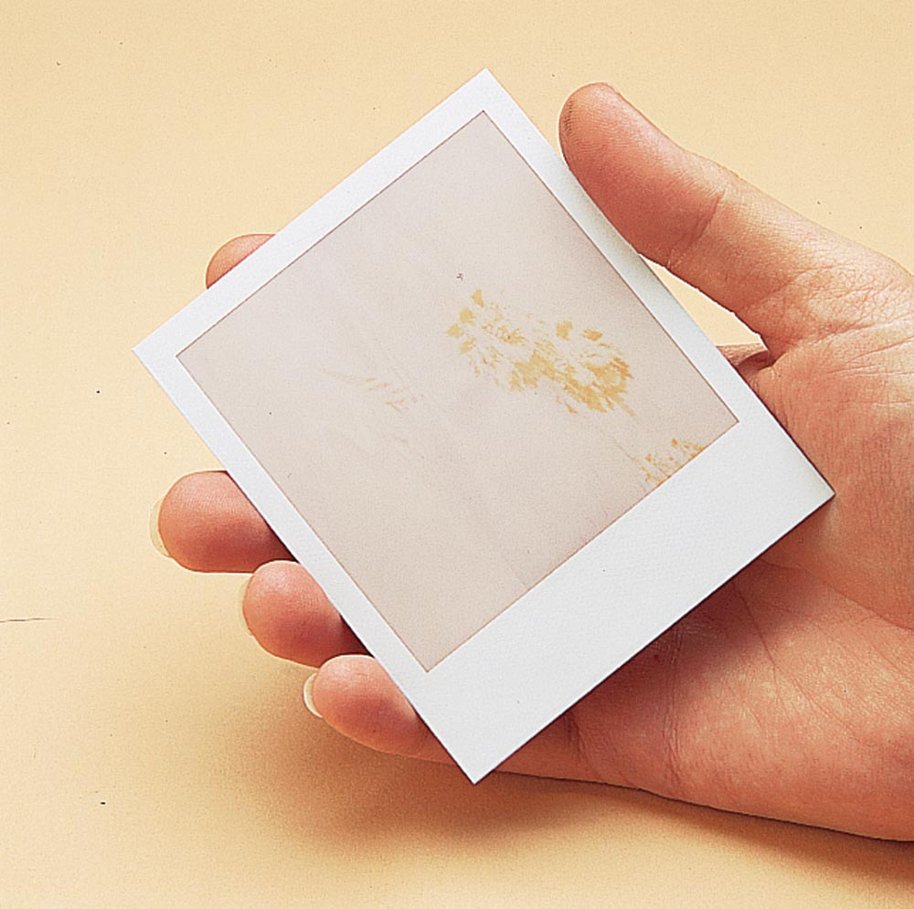

Figure 9.9 You may have noticed that pictures from an “instant camera” develop more rapidly on warm days than on cold days. The chemical reactions involved in the development process occur faster at higher temperatures.

Slide 9
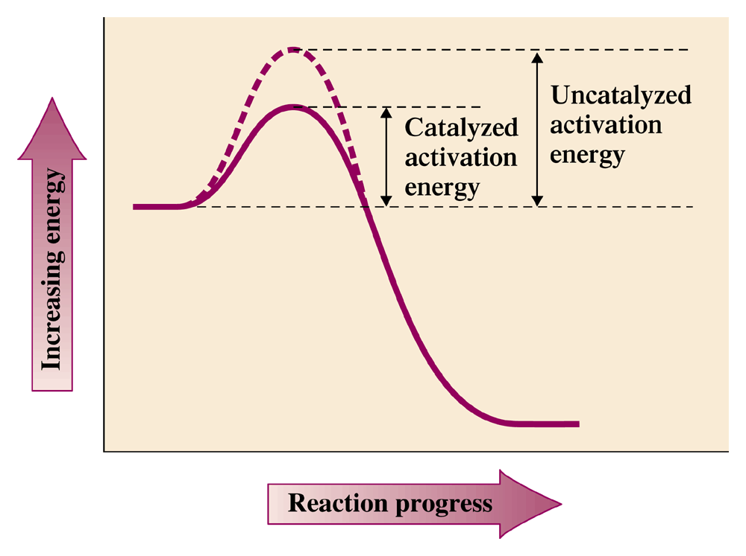
Figure 9.10 Catalysts lower the activation energy for chemical reactions. Reactions proceed more rapidly with the lowered activation energy.

Slide 10
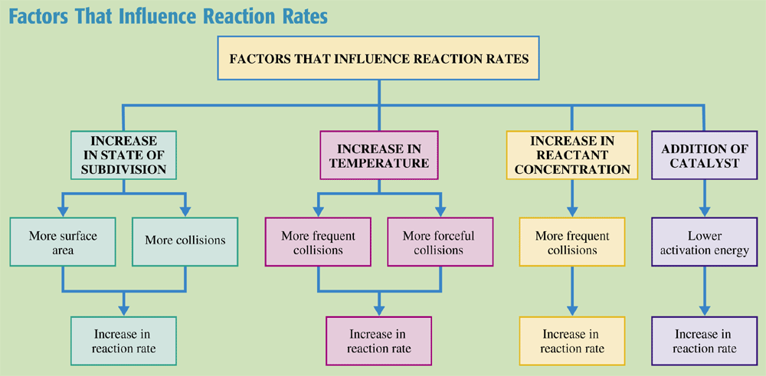
Chemistry at a Glance:
Factors That Influence Reaction Rates

Slide 11
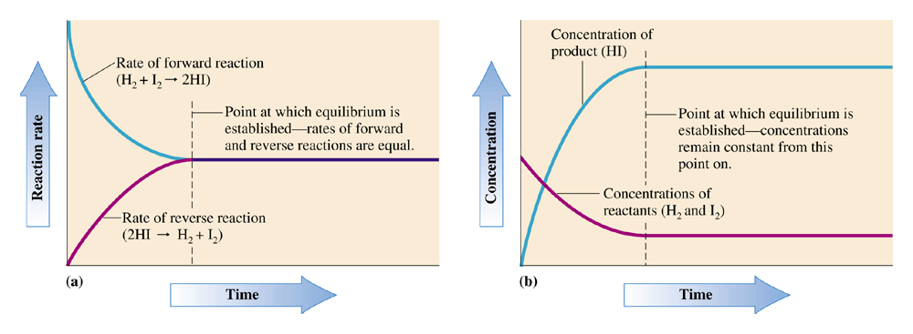
Figure 9.12 Graphs showing how reaction rates and reactant concentrations vary with time for the chemical system H2-I2-HI.

Slide 12
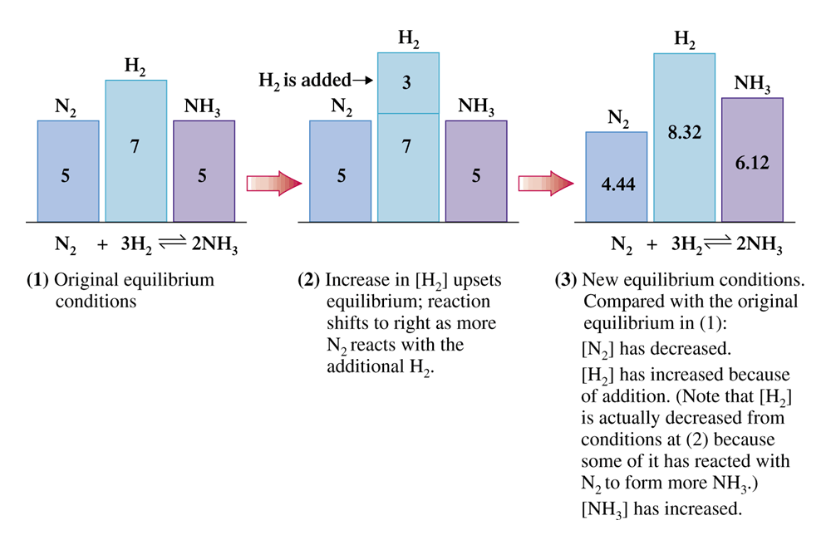
Figure 9.14 Concentration changes that result when H2 is added to an equilibrium mixture involving the system.

Slide 13
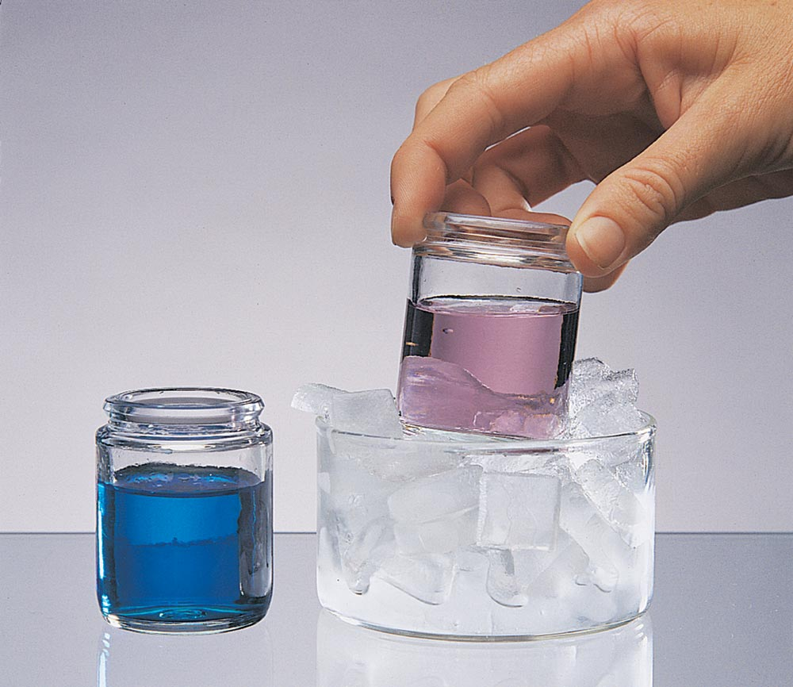
Figure 9.15 Effect of temperature change on the equilibrium mixture.

Slide 14
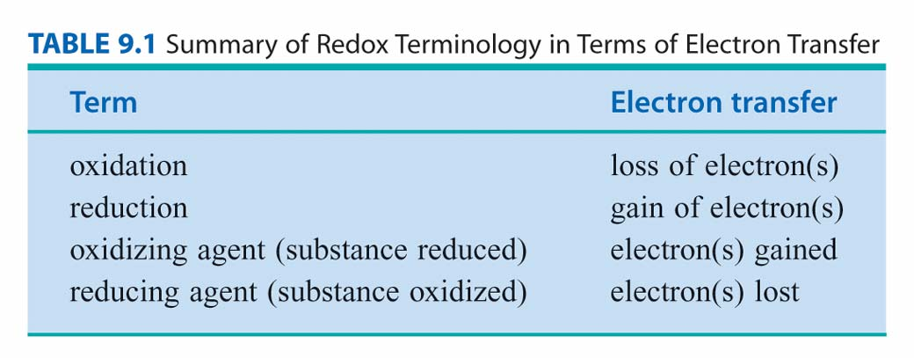

Slide 15
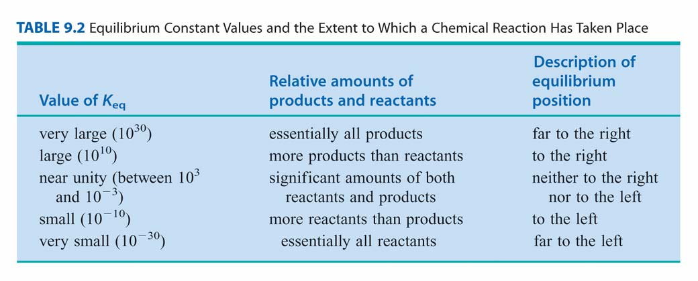

Slide 16
