Slide 1

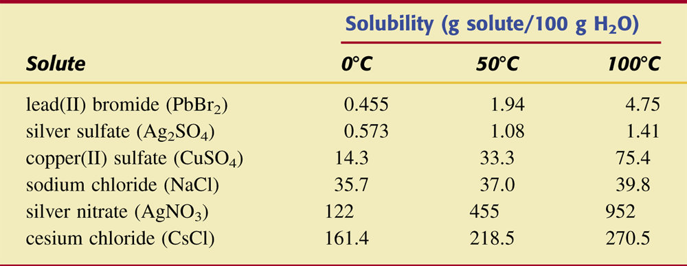
Table 8.1 Solubilities of Various Compounds in Water at 08C, 508C, and 1008C.

Slide 2
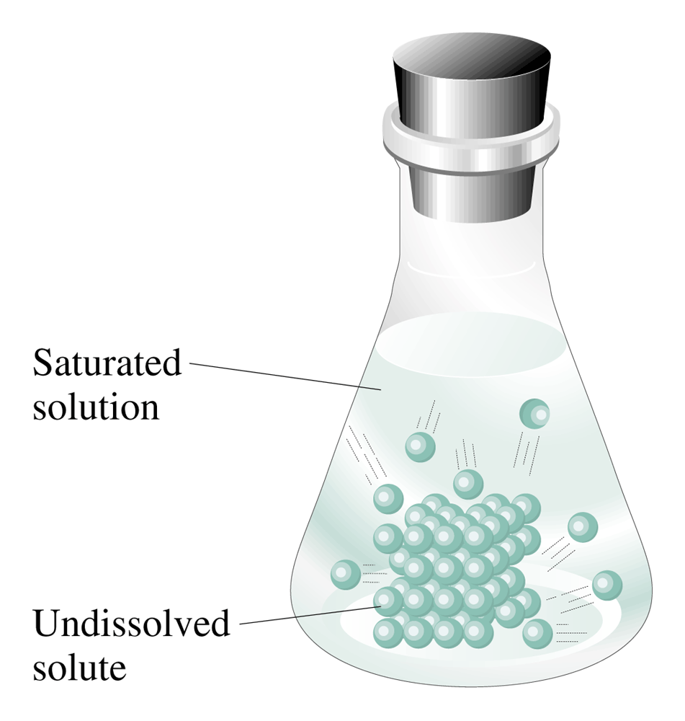
Figure 8.3 In a saturated solution, the dissolved solute is in a dynamic equilibrium with the undissolved solute.

Slide 3
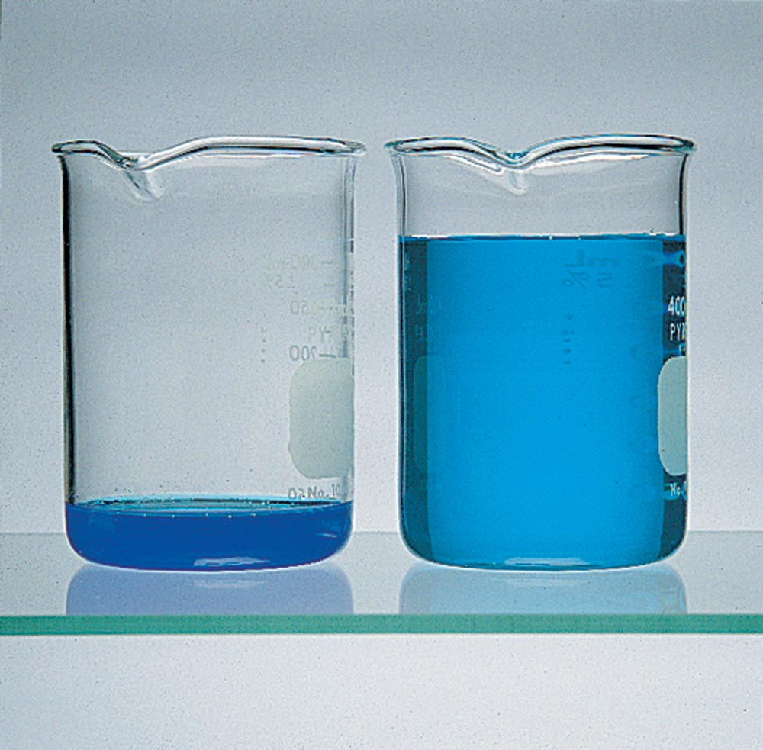
Figure 8.4 Both solutions contain the same amount of solute. A concentrated solution (left) contains a relatively large amount of solute compared with the amount of solvent. A dilute solution (right) contains a relatively small amount of solute compared with the amount of solvent.

Slide 4
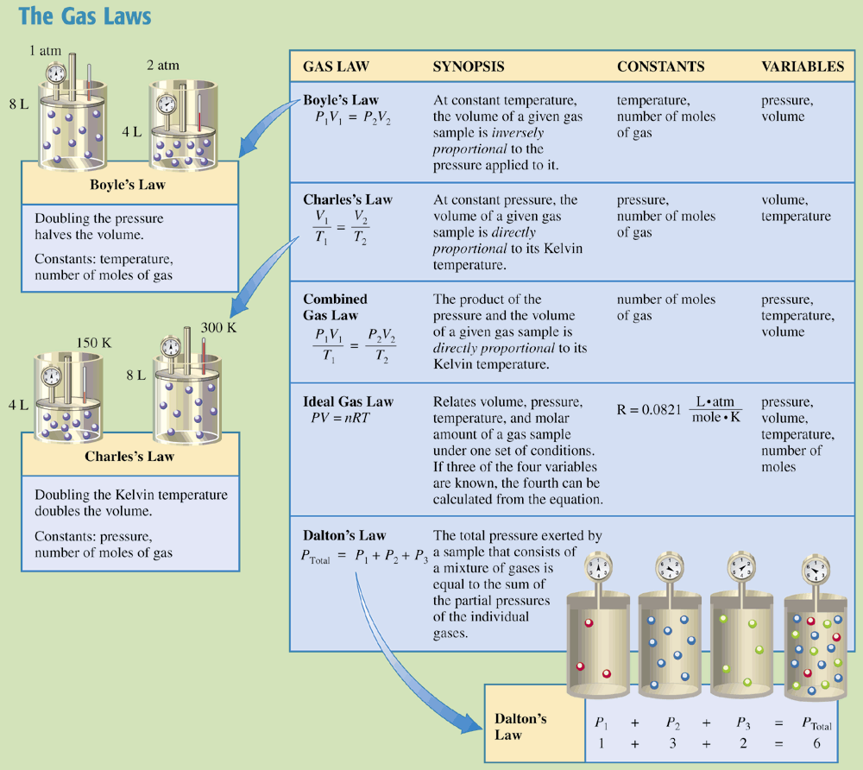
Chemistry at a Glance:
The Gas Laws

Slide 5
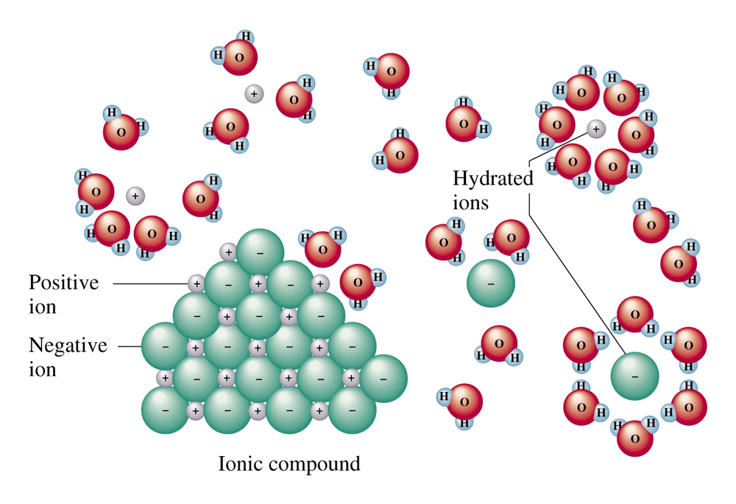
Figure 8.5 When an ionic solid, such as sodium chloride, dissolves in water, the water molecules hydrate the ions.

Slide 6
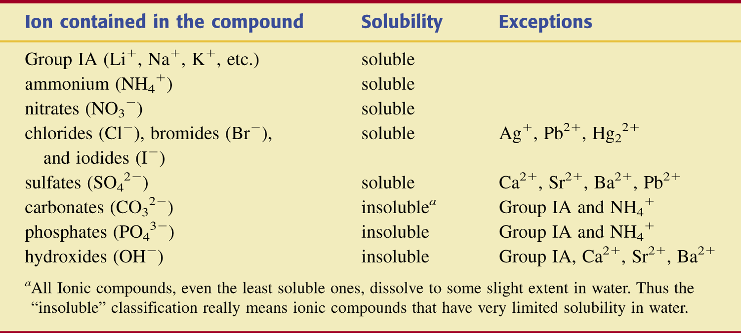
Table 8.2 Solubility Guidelines for Ionic Compounds in Water.

Slide 7
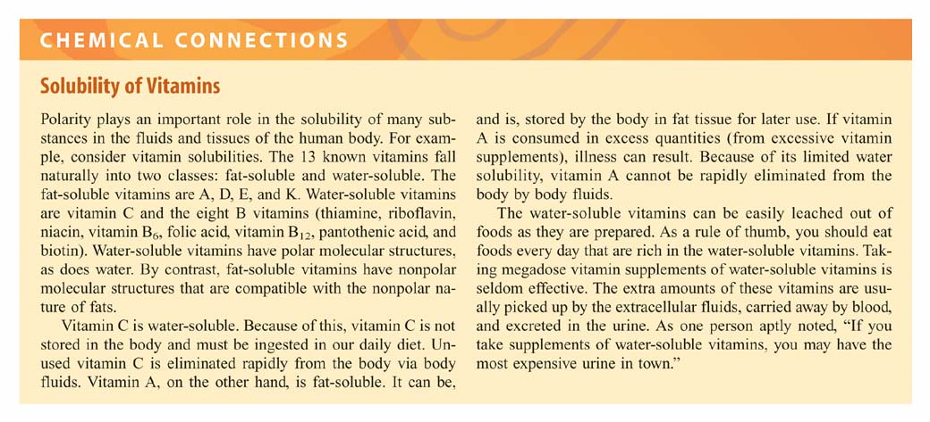

Slide 8
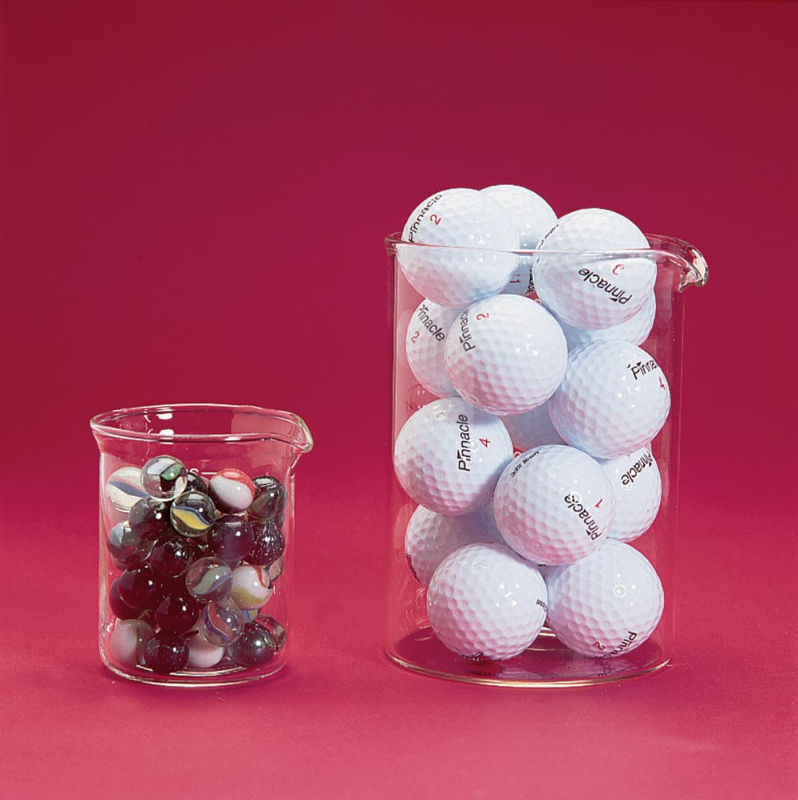
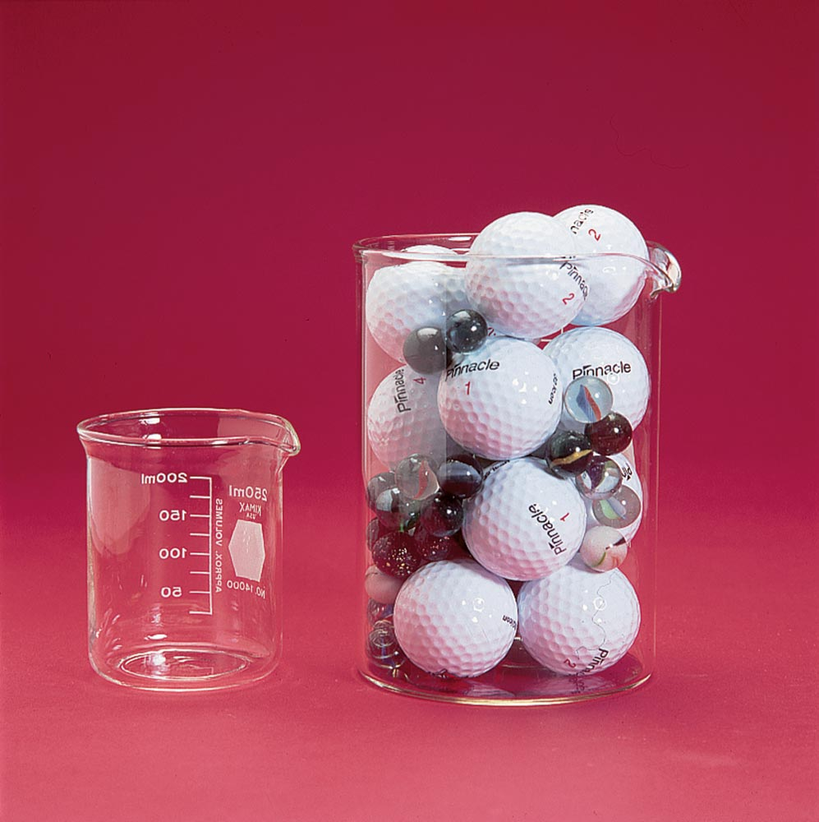
Figure 8.7 When volumes of two different liquids are combined, the volumes are not additive.

Slide 9
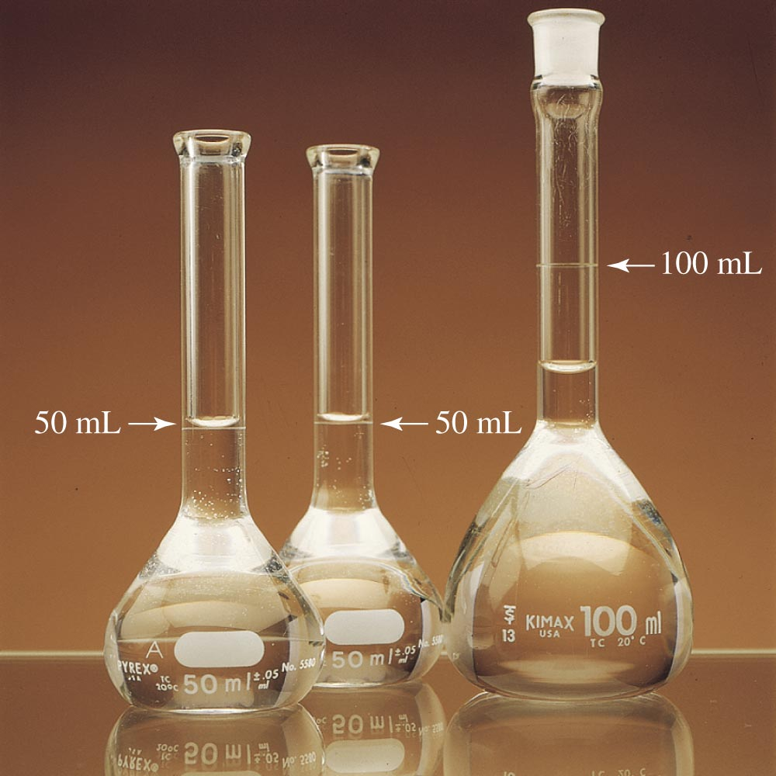
Figure 8.8 Identical volumetric flasks are filled to the 50.0-mL mark with ethanol and with water.

Slide 10
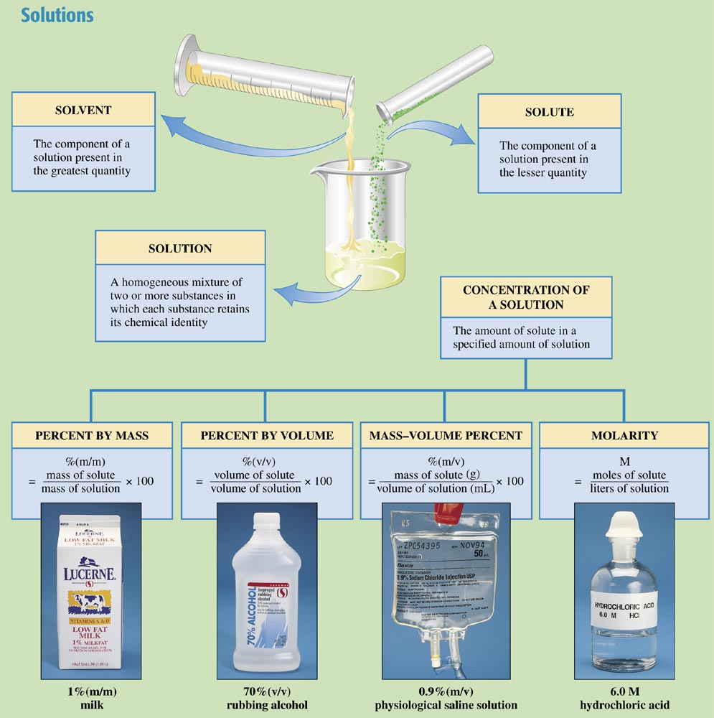
Chemistry at a Glance:
Solutions

Slide 11
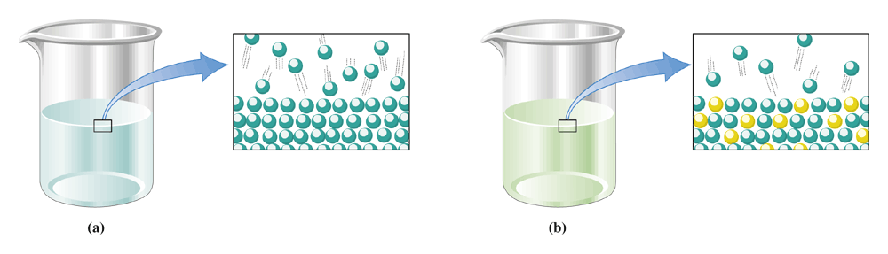
Figure 8.11 Close-ups of the surface of a liquid solvent (a) before and (b) after solute has been added.

Slide 12
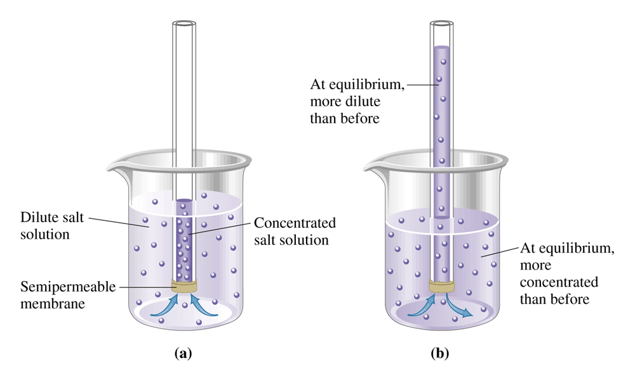
Figure 8.13 (a) Osmosis, the flow of solvent through a semipermeable membrane from a dilute to a more concentrated solution. (b) At equilibrium, the molecules move back and forth at equal rates.

Slide 13
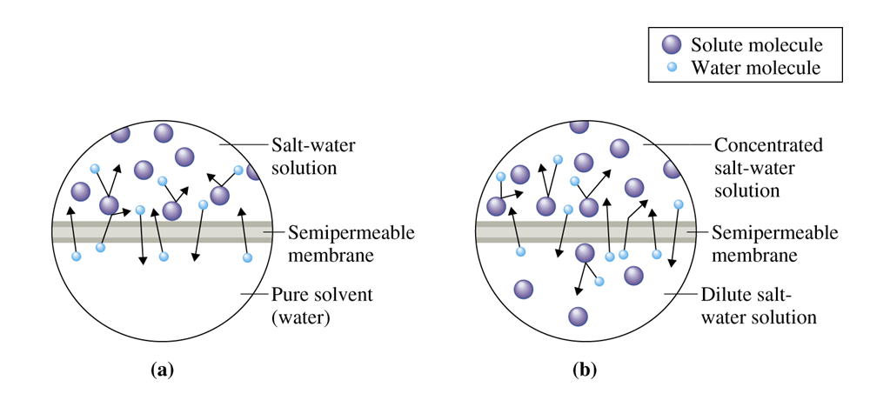
Figure 8.14 Enlarged views of a semipermeable membrane separating (a) pure water and a salt-water solution, and (b) a dilute salt-water solution and a concentrated salt-water solution.

Slide 14
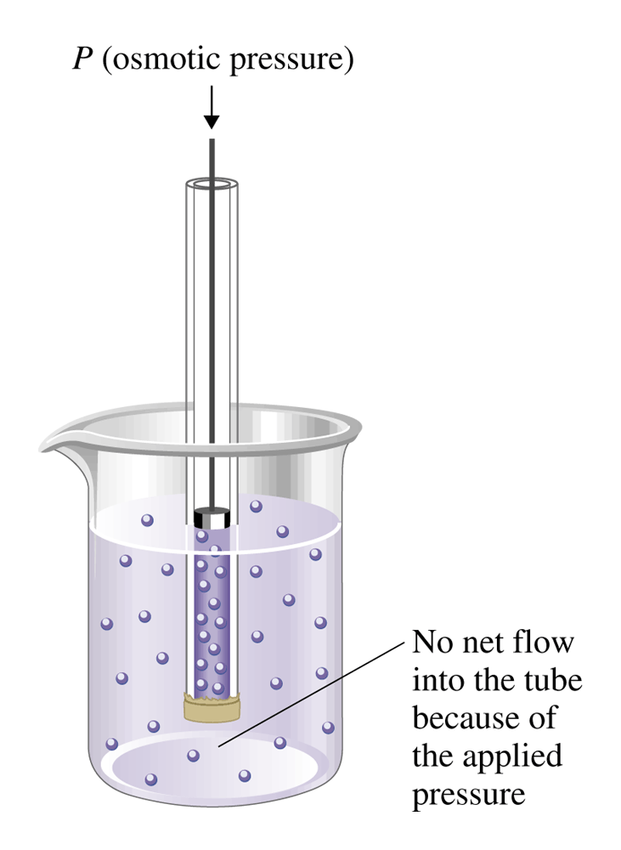
Figure 8.15
Osmotic pressure is the amount of pressure needed to prevent the solution in the tube from rising as a result of the process of osmosis.

Slide 15
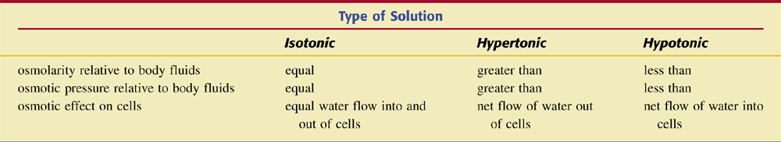
Table 8.3 Characteristics of Isotonic, Hypertonic, and Hypotonic Solutions.

Slide 16
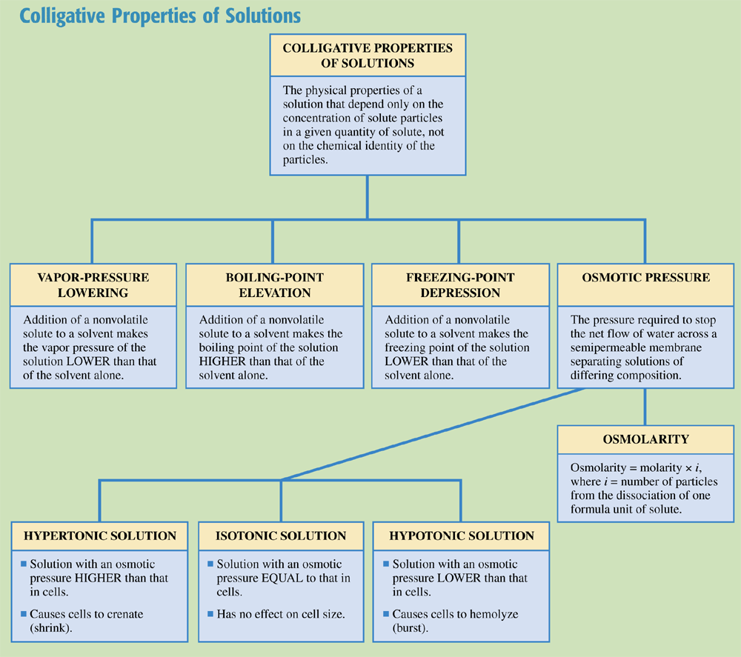
Chemistry at a Glance:
Colligative Properties of Solutions

Slide 17
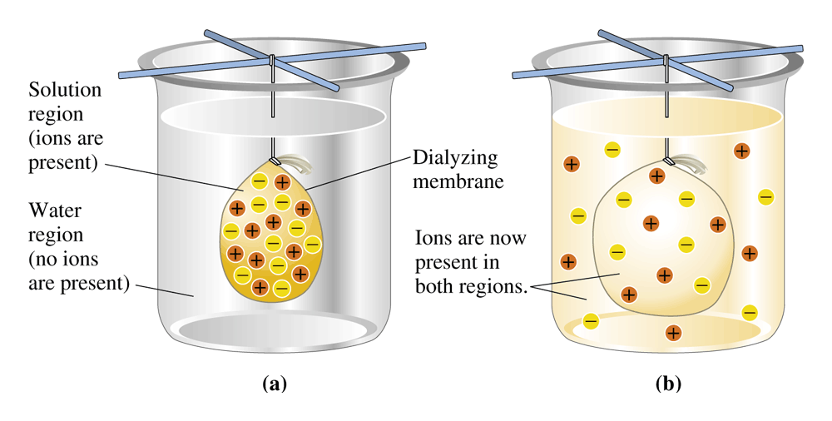
Figure 8.18 In dialysis, there is a net movement of ions from a region of higher concentration to a region of lower concentration. (a) Before dialysis. (b) After dialysis.

Slide 18
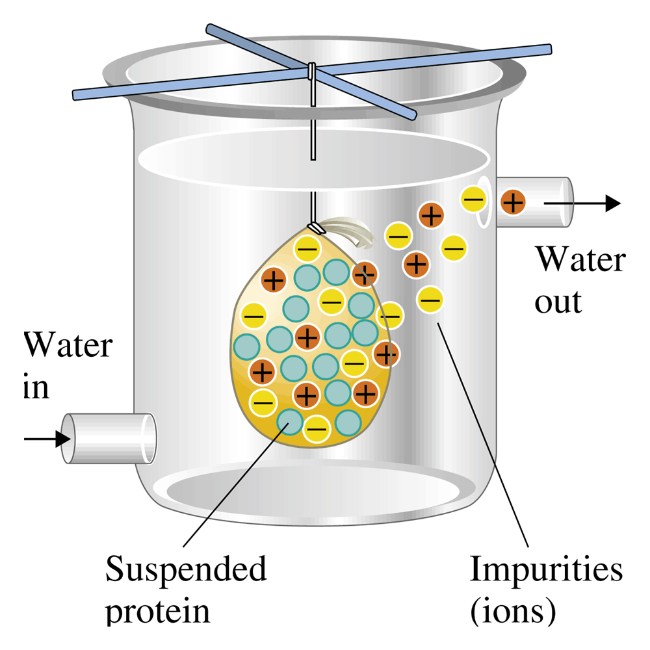
Figure 8.19 Impurities (ions) can be removed from a solution by using a dialysis procedure.

