Slide 1
Chemical Thermodynamics
Overview:
Entropy – a measure of disorder or randomness
Second Law of Thermodynamics
    The entropy of the universe
    increases for spontaneous processes
Third Law of Thermodynamics
    Entropy at absolute zero is zero. S_{(0 K)} = 0
Free Energy
    A criterion for spontaneity
    Its relationship with equilibrium constant

Slide 2
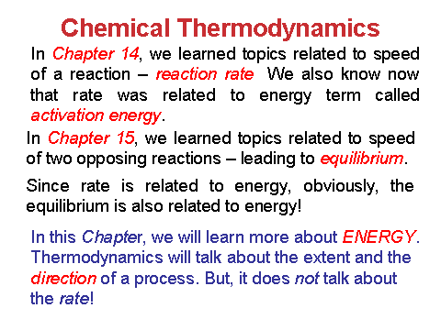

Slide 3
Things to Recall…!
A brief review of Chapter 5 is necessary.
Universe = System + Surroundings
Any portion of the universe that we choose or focus our attention on.
The rest of the universe beyond the system.
Consider a chemical reaction in a beaker…
The chemical components are the system
The solvents and the container and beyond are the surroundings.

Slide 4
First Law of Thermodynamics:
Energy cannot be created nor destroyed.
Therefore, the total energy of the universe is a constant.
In otherwords,
ΔE_{univ} = ΔE_{sys} + ΔE_{surr} = 0
(Law of Conservation of Energy)
Energy can, however, be converted from one
form to another or transferred from a system to
the surroundings or vice versa.

Slide 5
E (Internal Energy)
= Potential energy + Kinetic energy
The energy of an object has due to its relationship to another object.
The energy that the objects get or have due to their motion.
Chemical energy is a form of potential energy: Atoms in a chemical bond have energy due to their relationship to each other.
Atoms move through
space.
Molecules rotate.
Atoms in bonds vibrate.

Slide 6
We cannot determine E, instead we work with ΔE.
ΔE = energy difference between initial and final
state of the system
i.e., ΔE = E_{final} - E_{initial}
Remember! The internal energy (E) is a “State Function”
State Function: Parameter that depend only on the current state of a system.
For changes in state functions, we need to know only the initial and final states – the pathway does not matter.
Temperature, volume, E and H are state functions.
Heat (q) and work (w) are NOT state functions.

Slide 7
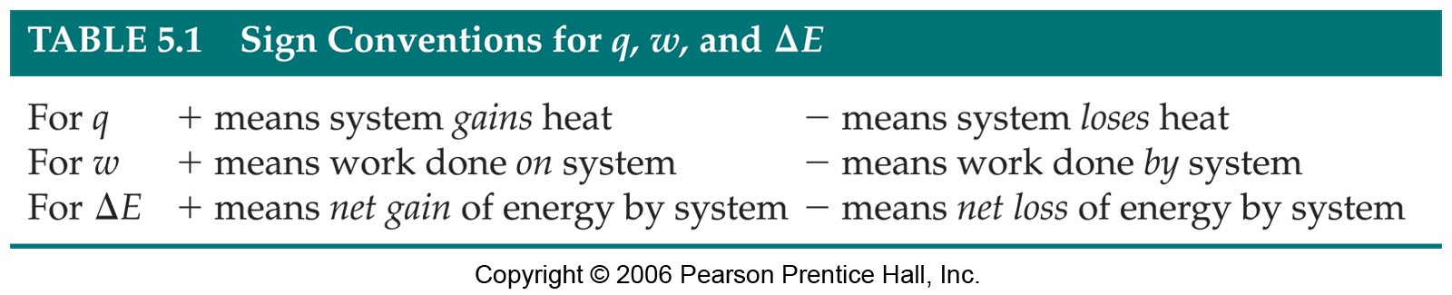
Thermodynamic meaning of Energy is
the ability to do work or transfer heat.
Remember! The change in internal energy (ΔE) is related to the amount of heat transferred and the amount of work done.
i.e., ΔE = q + w
Remember! The sign conventions for q, w and ΔE
Note! We are focusing on system rather than on surroundings.

Slide 8
H = E + PV
ΔH= Δ(E+PV)
If Constant P then
ΔH= ΔE+PΔV
But ΔE= q_{p}+ w and -pΔV= w thus
ΔH= q_{p} + w – w = q_{p}
ΔH = q_{p}; enthalpy change equals heat transferred at constant pressure
ΔE = q_{v}; internal energy change equals heat transferred at constant volume
Refer Chapter 5, Page 164

Slide 9
Enthalpy (ΔH)
Endothermic
- The system gains heat from the surroundings
Exothermic
- The system loses heat to the surroundings

Slide 10
Number of Microstates and Entropy
The connection between Number of Microstates (Ω) and entropy (S) is given by Boltzmann’s Formula:
S = k lnΩ
k = Boltzmann’s constant = R/N_{a}
= 1.38 x 10⁻²³ J/K
• The dominant configuration will have the largest Ω; therefore, S is greatest for this configuration

Slide 11
Type of Processes
SPONTANEOUS
NON-SPONTANEOUS
(chemistry has special meanings here!)

Slide 12
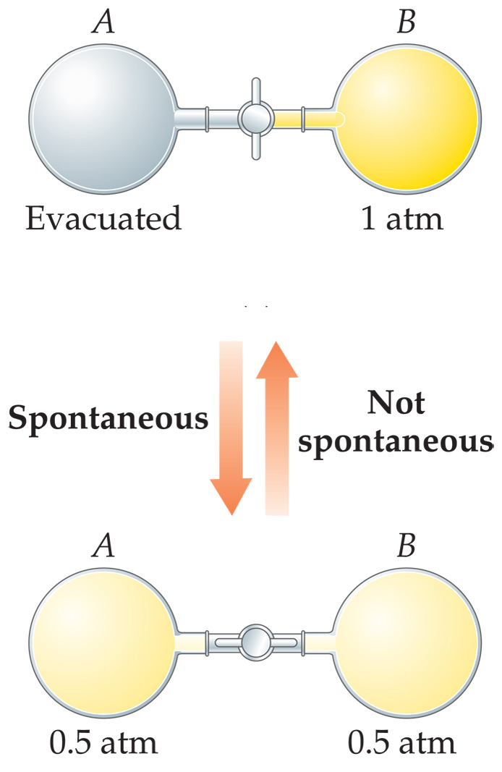
19.1 Spontaneous Processes
Spontaneous processes are those that can proceed without any outside intervention.
The gas in vessel B will spontaneously effuse into vessel A, but once the gas is in both vessels, it will not spontaneously

Slide 13
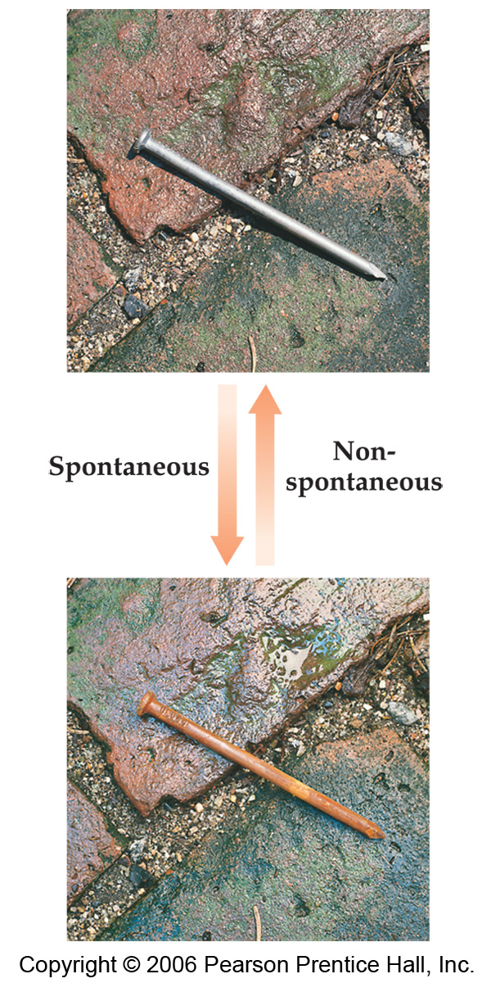
Characteristics of Spontaneous Processes
  Processes that are spontaneous in one direction are non-spontaneous in the reverse direction.
For example:
Rusting of a nail.
Water flowing down-hill

Slide 14
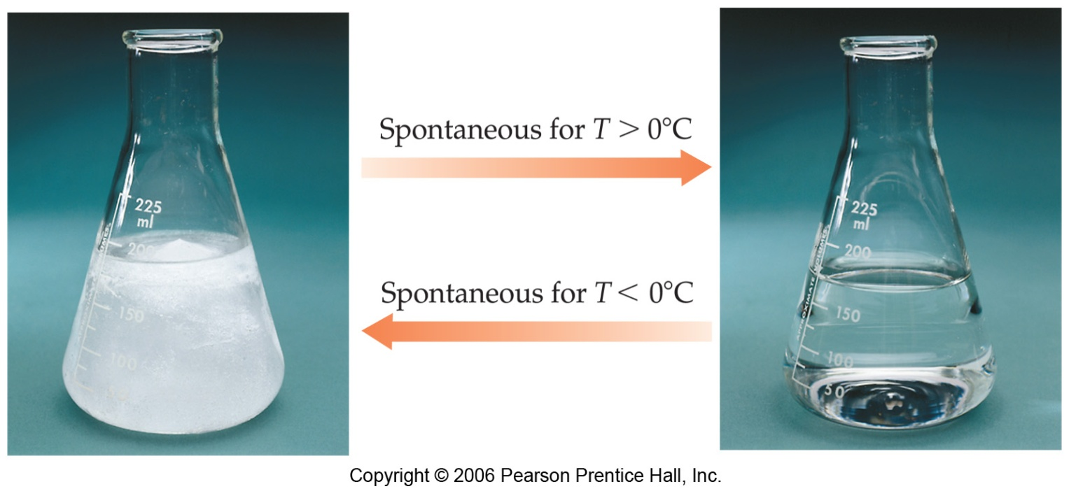
Characteristics of Spontaneous Processes – Contd…
Processes that are spontaneous at one temperature may be nonspontaneous at other temperatures.
For example:
Above 0°C, it is spontaneous for ice to melt.
Below 0°C, the reverse process is spontaneous.
What about the process at 0°C?
The process is at equilibrium.
H₂O (s)
H₂O (l)

Slide 15
Think about this…
Consider the vaporization of liquid water to steam at a pressure of 1 atm. Boiling point of Water is 100°C
Is the process endothermic or exothermic?
In what temperature range, the process is spontaneous?
In what temperature range, the process is non-spontaneous?
At what temperature, the two phases will be in equilibrium?

Slide 16
What is the reason for a spontaneity?
Can we say ΔH or ΔE is responsible?
Many spontaneous processes are exothermic
(ΔH < 0 or ΔE < 0)
BUT Number of spontaneous processes are also endothermic (ΔH > 0 or ΔE > 0)
For example:
athletic ice packs of the
melting of ice is a spontaneous process.
The second Law of Thermodynamics provides better understanding!

Slide 17
Reversible & Irreversible processes
Reversible Processes
  In a reversible process the system changes in such a way that the system and surroundings can be put back in their original states by exactly reversing the process.
The reversible process is kind of an ideal situation! Almost all real-world processes are irreversible!
Irreversible Processes
Irreversible processes cannot be restored by exactly reversing the change to the system.

Slide 18
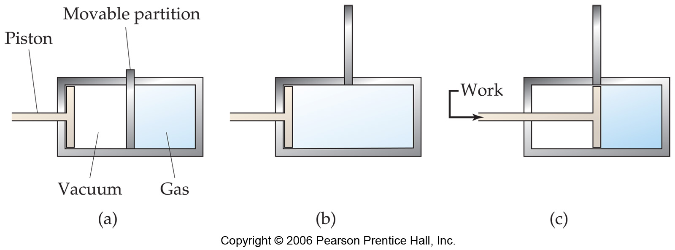
Reversible & Irreversible processes (continued)…
For example: A gas expands against no pressure
(a spontaneous process)
The gas will not contract unless we apply pressure. That is surrounding need to do work.
In general, all spontaneous processes are irreversible.

Slide 19
Second Law of Thermodynamics
(In words)
The entropy of the universe does not change for a reversible (non-spontaneous) process. ΔS_{rev} =0
The entropy of the universe increases
for irreversible (spontaneous) process. ΔS_{rev} > 0

Slide 20
Second Law of Thermodynamics (continued)…
(In mathematical equation)
For reversible processes:
ΔS_{univ} = ΔS_{sys} + ΔS_{surr} = 0
For irreversible processes:
ΔS_{univ} = ΔS_{sys} + ΔS_{surr} > 0
The truth is… “as a result of all spontaneous processes the entropy of the universe increases.”
In fact, we can use this criterion (ΔS) to predict whether the process will be spontaneous or not?

Slide 21
Entropy and the Second Law – (continued)…
Like Internal energy, E, and Enthalpy, H, Entropy (S) is a state function.
Thus, the changes in Entropy (ΔS) depends only on the initial and final state of the system and not on the path taken from one state to the other.
Therefore,
ΔS = S_{final} − S_{initial}

Slide 22
19.2 Entropy and the Second Law
A term coined by Rudolph Clausius in the 19th century.
Entropy (S) – a measure probability and because probability favors randomness; it as a measure the disorder/order.
At the intermolecular level, we can say that Entropy increases when a liquid or solid changes to a gas. (gases more disordered/more possible configurations than found in liquid)
At the atomic level, Entropy is related to the various modes of motion in a molecule. (Atoms in molecule themselves can undergo motions!)

Slide 23
Entropy and the Second Law – (continued)…
For example:
Entropy increases (ΔS > 0) when a solid melts
to the liquid.
Entropy increases (ΔS > 0) when a liquid
evaporates to the gas.
Entropy increases (ΔS > 0) when a solute is
dissolved in a solvent.
Crystalline solids have proper orientation. Molecules in liquid are less ordered.
    Solution is more random than separate solute and solvent.

Slide 24
Entropy and the Second Law – (continued)…
The entropy tends to increase with increase in
  Temperature.
  Volume.
  The number of independently moving molecules.
➔ This concept leads to 3rd law
For example, In a chemical reaction, increase in number of gas molecules will result in increase in entropy.
For example, N₂O₄ (g) → 2 NO₂ (g)
1 molecule 2 molecules
ΔS > 0
(Positive)

Slide 25
Predicting sign of Entropy
In general, ΔS is positive in a chemical reaction, if
liquids or solutions formed from solids
Gases formed from solids or liquids
number of gas molecule increased during reaction.
Thus, it is possible to make qualitative predictions about the entropy!

Slide 26
Practice Exercise
Indicate whether the following processes results in an increase (ΔS positive) or decrease (ΔS negative) in entropy of the system?
CO₂(s) → CO₂(g)
CaO(s) + CO₂(g) → CaCO₃(s)
HCl(g) + NH₃(g) → NH₄Cl(s)
2SO₃ (g) → 2SO₂(g) + O₂(g)
AgCl(s) → Ag⁺(aq) + Cl⁻(aq)
N₂(g) + O₂(g) → 2NO(g)

Slide 27
Entropy and the Second Law (continued)…
Another useful definition for entropy:
For an isothermal process,
ΔS is equal to the heat that would be transferred (added or removed) if the process were reversible, q_{rev} divided by the temperature at which the process occurs.
q_{rev}
T
Unit of ΔS is J/K
At constant T
ΔS =
What is an isothermal process?
Process occurring at constant temperature.
Example – Melting of solid at its melting point temperature
Vaporization of liquid at its boiling point temperature

Slide 28
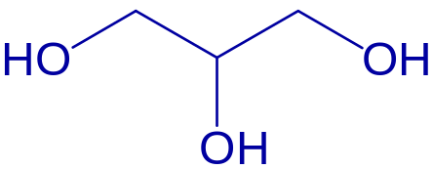
Sample exercise:
Glycerol has many applications including its use in food products, drugs and personal care products.
The normal freezing point of glycerol is 18.0°C,
and its molar enthalpy of fusion is 18.47 kJ/mol.
When glycerol(l) solidifies at its normal freezing point,
does its entropy increase or decrease?
Calculate ΔS when 1.0 g of glycerol freezes at 18.0°C.
Glycerol
Molecular weight of glycerol = 92.09 g/mol ; 0°C = 273.15 K
Entropy decreases, because when liquid solidifies, less degrees of freedom for molecular motion.
-18.47 kJ
1mol
1000 J
1 kJ
1 mol
92.09 g
q =
(1.0 g)
= -200.56 J
Note! The entropy is negative because liquid freezes to solid. There is less disorder or less randomness
q_{rev}
T
-200.56 J
(18.0 + 273.15) K
ΔS =
=
= -0.69 J/K

Slide 29
Sample exercise:
Glycerol has many applications including its use in food products, drugs and personal care products.
The normal freezing point of glycerol is 18.0°C,
and its molar enthalpy of fusion is 18.47 kJ/mol.
When glycerol(l) solidifies at its normal freezing point,
does its entropy increase or decrease?
Calculate ΔS when 1.0 g of glycerol freezes at 18.0°C.
Glycerol
Molecular weight of glycerol = 92.09 g/mol ; 0°C = 273.15 K
Entropy decreases, because when liquid solidifies, less degrees of freedom for molecular motion.
-18.47 kJ
1mol
1000 J
1 kJ
1 mol
92.09 g
q =
(1.0 g)
= -200.56 J
Note! The entropy is negative because the liquid freezes to solid. There is less disorder or less randomness
q_{rev}
T
-200.56 J
(18.0 + 273.15) K
ΔS =
=
= -0.69 J/K

Slide 30
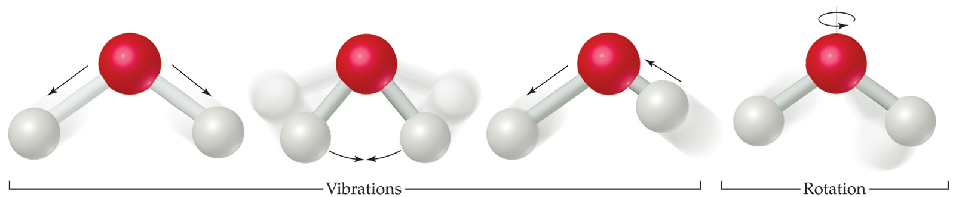
Entropy on the Molecular Scale
Molecules exhibit several types of motion:
  Translational: Movement of the entire
  molecule from one place to another.
  Vibrational: Periodic motion of atoms toward and away from one another within
  a molecule.
  Rotational: Rotation of the molecule on
  about an axis like a spinning tops.
Notes:
€

Slide 31
Entropy and Temperature
Remember this…
Entropy increases with the freedom of motion of molecules.
Therefore, S(g) > S(l) > S(s)
We are now convinced that the more random molecular motions results in more entropy and hence molecule gains more energy.
So, if we lower the temperature, what will happen to the molecular motions and the energy?

Slide 32
Entropy and Temperature (continued)…
As the temperature decreases, the energy associated with the molecular motion decreases.
As a result…
Molecules move slowly (translational motion)
Molecules spin slowly (Rotational motion)
Atoms in molecules vibrate slowly.
This theme leads to the Third Law of Thermodynamics!

Slide 33
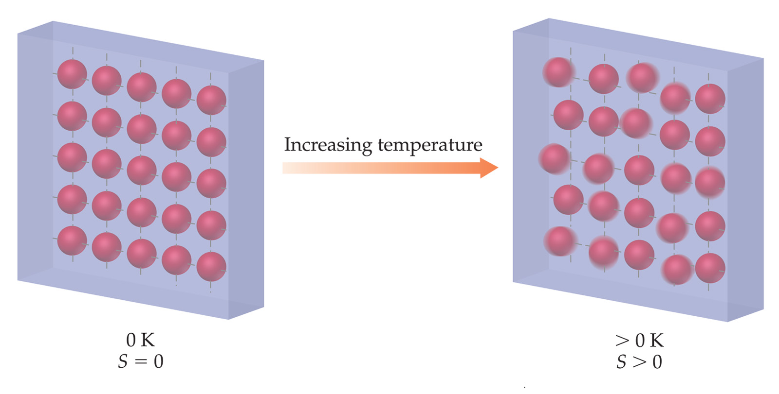
Third Law of Thermodynamics
At absolute zero (0 K) temperature, theoretically all modes of motion stops (no vibration, no rotation and no translation!)
Thus, the 3rd Law of Thermodynamics states that the entropy of a pure crystalline substance at absolute zero is 0.

Slide 34
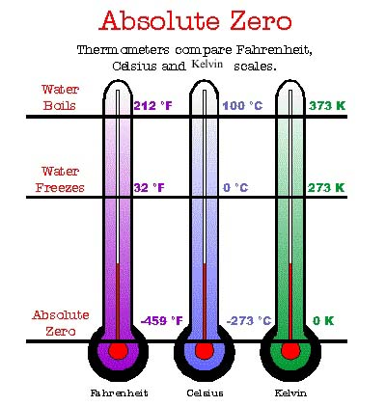
What is Absolute Zero?
Thermometers compare Fahrenheit, Celsius and Kelvin scales.

Fahrenheit Celsius Kelvin

Slide 35
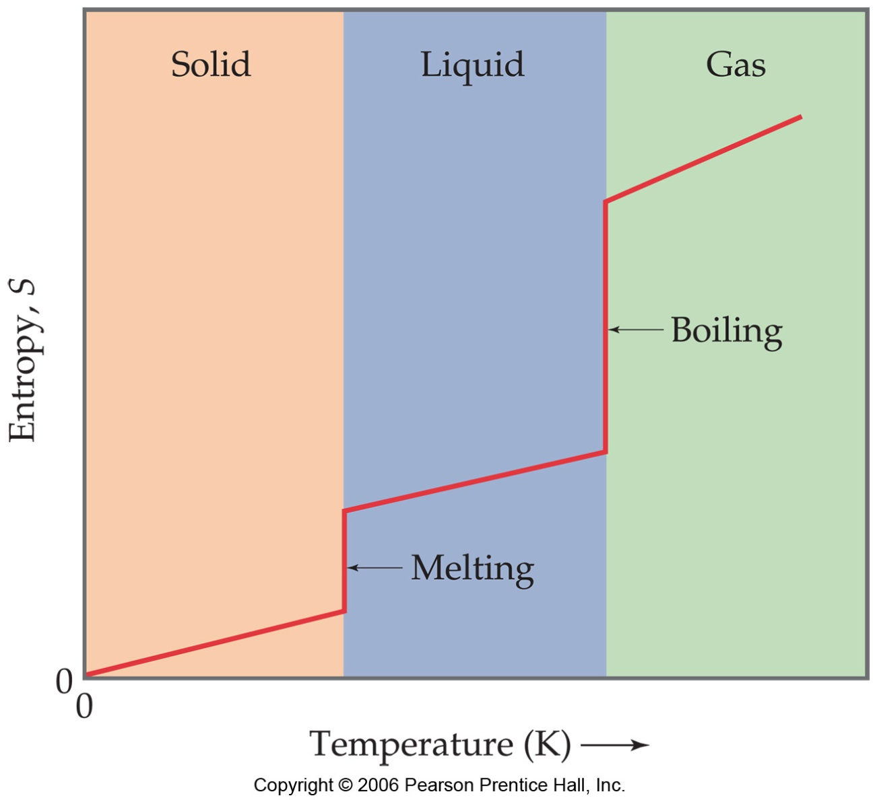
Entropy and Temperature
This figure explains the effect of temperature on Entropy
Entropy increases as the temperature of crystalline solid is heated from absolute zero.
Note the vertical jump in entropy corresponding to phase changes.
Remember! S(g) > S(l) > S(s)

Slide 36
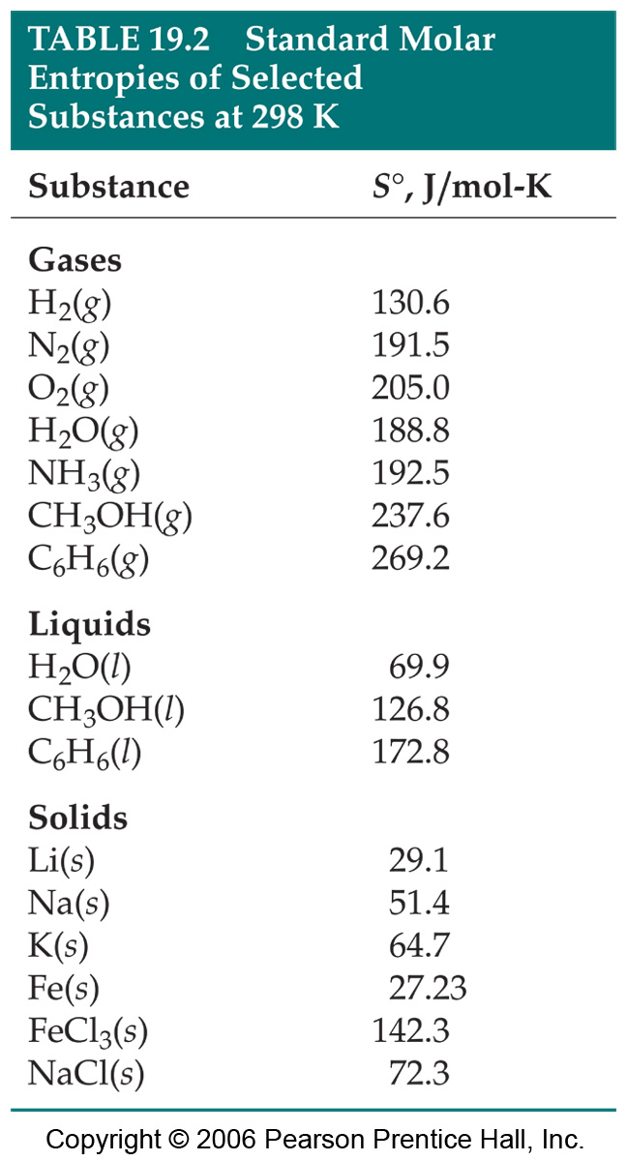
19.4 Entropy Changes in Chemical Reactions
Entropies are usually tabulated as molar quantities with units of J/mol-K.
The molar entropy values of substances in their standard state is called Standard molar entropies denoted as S°.
Standard state of a pure substance with each component at one mole and at 1 atm pressure and generally at 298.15 K.

Slide 37
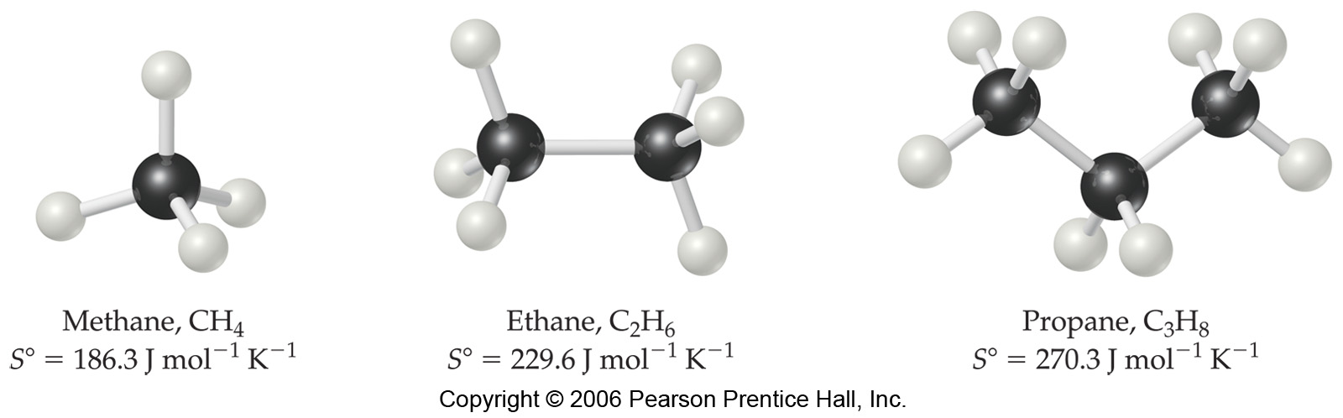
Some observations about the value of S⁰ in table 19.2
Unlike ΔH_{f}°, the S° is NOT zero for pure elements in their standard state.
As expected, S° for gases is greater than liquids and solids.
S° increases as the molar mass increases.
As the number of atoms in a molecule increases, S° also increases. (see below)

Slide 38
Entropy Changes in Chemical Reactions (continued)…
One can also calculate
ΔS° for a chemical reaction:
ΔSº= Σ_{n}Sº(products) -Σ_{m}Sº(reactants)
m and n are the coefficients in the chemical reaction.

Slide 39
Calculate ΔS° for the synthesis of ammonia from N₂(g) and H₂(g) at 298 K.
N₂(g) + 3 H₂(g) → 2 NH₃(g)
ΔS° = 2S°(NH₃) – [S°(N₂) + 3S°(H₂)]
From the table, substitute the corresponding S° values:
ΔS° = 2mol(192.5 J/mol-K) – [1mol(191.5 J/mol-K) + 3mol(130.6 J/mol-K)]
= -198.3 J/K
Note! ΔS° is negative
Entropy decreases as number of gas molecules decreases.

Slide 40
ΔS for this reaction is negative.
Do you think, this rxn did not obey the 2nd law?
Note that ΔS here really is ΔS_{system}
The 2nd Law of Thermodynamics relates to what?
ΔS_{universe} >0
Thus what must be true of ΔS_{surrounding}?
This is only possible if ΔS_{surrounding} actually increase and why does this happen?
It happens because the Q(heat) produced by the EXOTHERMIC reaction here causes more disorder in the surroundings.
In fact causes more TOTAL disorder than it caused ORDER in the system!

Slide 41
Entropy Changes in Surroundings
What is a Surroundings?
Apart from system and Rest of the Universe!
In other words, Surrounding can be defined as a large constant-temperature heat source that can supply heat to system (or heat sink if the heat flows from the system to the surroundings).
Thus, the change in entropy of the surroundings depends on how much heat is absorbed or given off by the system.
−q_{sys}
T
ΔS_{surr} =

Slide 42
Entropy Changes in Surroundings (continued)…
For a reaction at constant pressure, q_{sys} is simply the enthalpy change for the reaction(ΔHº_{rxn}).
− ΔHº_{rxn}
T
At constant pressure:
ΔS_{surr} =
(That is, open to the atmosphere)
For the same ammonia synthesis, we can now calculate ΔS_{surr}
N₂(g) + 3 H₂(g) → 2 NH₃(g)
− ΔHº_{rxn}
T
ΔS_{surr} =
So, we need to calculate, ΔHº_{rxn}
ΔH°_{rxn} = ΣnH°(products) - ΣmH°(reactants)

Slide 43
Entropy Changes in Surroundings (continued)…
ΔHº_{rxn} = 2 ΔH_{f}°[NH₃(g)] – ΔH_{f}°[N₂(g)] – 3 ΔH_{f}°[H₂(g)]
From Appendix C from Brown,
ΔH°_{rxn} = 2(-46.19 kJ) – 0 kJ – 3(0 kJ)
= -92.38 kJ
− ΔH°_{rxn}
T
- (-92.38 kJ)
298 K
ΔS_{surr} =
=
= 310 J/K
Note the magnitude of ΔS_{surr} with respect to ΔS_{sys}
ΔS_{univ} = ΔS_{sys} + ΔS_{surr}
= -198.3 + 310 = 112 J/K
Thus, for any spontaneous process, ΔS_{univ} > 0

Slide 44
19.5 Gibbs Free Energy
We learned that even some of the endothermic processes are spontaneous if the process proceeds with increase in entropy (ΔS positive).
However, there are some processes occur spontaneously with decrease in entropy! And most of them are highly exothermic processes (ΔH negative)
Thus, the spontaneity of a reaction seems to relate both thermodynamic quantity namely Enthalpy and Entropy!
Willard Gibbs (1839-1903): He related both H and S.
He defined a term called ‘free energy’, G
G = H – TS
---------------- (1)

Slide 45
19.5 Gibbs Free Energy (continued)…
Like, Energy (E), Enthalpy (H) and Entropy (S), the free energy is also a state function.
So, at constant temperature, the change in free energy of the system ΔG can be written from eqn. (1) as,
ΔG = ΔH – TΔS
---------------- (2)
We also know that,
ΔS_{univ} = ΔS_{sys} + ΔS_{surr}
---------------- (3)
At constant T and P, we have the expression for ΔS_{surr}:
- q_{sys}
T
-ΔH_{sys}
T
ΔS_{surr}
=
=
---------------- (4)

Slide 46
Substituting eq. 4 in eq. 3, we get:
-ΔH_{sys}
T
ΔS_{univ} = ΔS_{sys} +
ΔH_{sys}
T
ΔS_{univ} = ΔS_{sys} –
---------------- (5)
Multiply eq. 5 with –T on both sides, we get:
–TΔS_{univ} = –TΔS_{sys}
+ ΔH_{sys}
–TΔS_{univ} = ΔH_{sys} –TΔS_{sys}
---------------- (6)
Compare eq. 2 (ΔG = ΔH – TΔS) with eq. 6:
We get two very important relationships!!
ΔG = – TΔS_{univ}
---------------- (7)
Leading to ΔG = ΔH_{sys} –TΔS_{sys}
---------------- (8)

Slide 47
Significance of free energy relationships
First, consider:
ΔG = – TΔS_{univ}
According to 2nd law of thermodynamics, all spontaneous processes should have ΔS_{univ} > 0
That means, ΔG will be negative. In other words, sign of ΔG determines the spontaneity of the process.
At constant temperature;
Spontaneous | ΔS_{universe} > 0 | ΔG < 0
Non-spontaneous | ΔS_{universe} < 0 | ΔG > 0
Equilibrium | ΔS_{universe} = 0 | ΔG = 0
This is why, we can use ΔG as the criterion to predict the spontaneity rather than ΔS_{univ} (2nd law), because eq. 8 relates ΔG with entropy and enthalpy of the system.

Slide 48
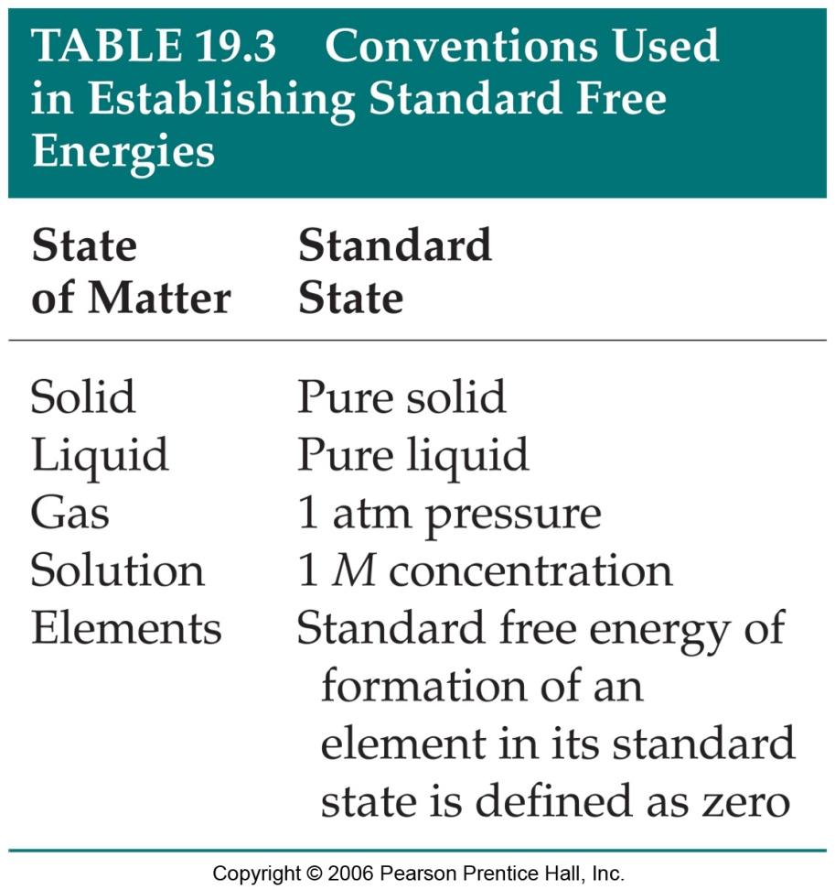
Standard Free Energy Changes
Analogous to standard enthalpies of formation, we can also calculate standard free energies of formation, ΔG° for any chemical reaction. [Because, free energy is a state function]
ΔG° = ΣnΔG°(products) − ΣmΔG°(reactants)
_{f}
_{f}
where n and m are the stoichiometric coefficients.
In ΔGº, ‘º’ refers to substance in its standard state at 25°C (298 K). See table 19.3 ➔

Slide 49
19.6 Free Energy and Temperature
Although, we calculated ΔG at 25°C using ΔG_{f}º values, we often encounter reaction occurring at other than standard temperature conditions. How do we handle this? How T affects the sign of ΔG?
There are two parts to the free energy equation:
  − ΔH°— the enthalpy term
  TΔS° — the entropy term
The temperature dependence of free energy, then comes from the entropy term.
ΔG = ΔH –TΔS
The sign of ΔG, which tells us whether a process is spontaneous, will depend on the sign and magnitude of ΔH and –TΔS terms.

Slide 50
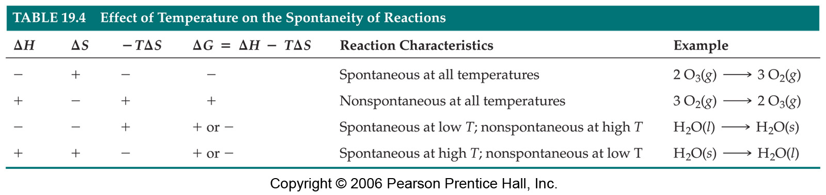
19.6 Free Energy and Temperature (continued)…
Look at the Table 19.4 to understand the effect of each of these terms on the overall spontaneity of the reaction.
Think about this

Based on the above theme, can you explain,
Why freezing of water is spontaneous at lower temperature?
Why melting of ice is spontaneous at higher temperature?

Slide 51
19.7 Free Energy and Equilibrium
Under conditions that are NOT standard state, we must use ΔGº rather than ΔG to predict the direction of the reaction. The relationship between these two terms is given by,
ΔG = ΔG° + RT lnQ
(Under standard conditions, all concentrations are 1 M, so Q = 1 and lnQ = 0; the last term drops out.)
Where, R is the gas constant (8.314 J/K.mol), T is temperature in Kelvin, Q is reaction quotient.

Slide 52
19.7 Free Energy and Equilibrium (continued)…
Let us consider two special cases when a system wants to reach an equilibrium (ΔG = 0):
Case 1: suppose ΔGº is highly negative, then the term RT lnQ tend to become more positive so that the net ΔG reaches zero while approaching equilibrium. In other words RT lnQ will become more positive only when Q > 1. That is reaction should favor more product to have value of Q greater than one.

Slide 53
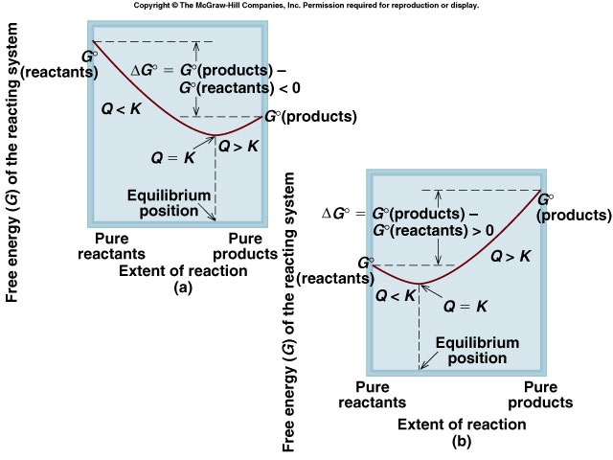
19.7 Free Energy and Equilibrium (continued)…
Case 2: suppose ΔG° is highly positive, then the term RT lnQ tend to become more negative so that the net ΔG reaches zero while approaching equilibrium. In other words RT lnQ will become more negative only when Q < 1. That is reaction should favor more reactant to have value of Q less than one.
These two cases are pictorially explained figures (a) and (b).
Case 1
Case 2

Slide 54
19.7 Free Energy and Equilibrium (continued)…
Thus, at equilibrium ΔG = 0 and Q = K (equilibrium constant)
So, eqn (1) becomes;
0 = ΔG° + RT ln K
------------------------ (2)
ΔG° = – RT ln K
(or)
K = e^{−ΔG°/RT}
Thus, we have a very useful equation relating ΔG° and the equilibrium constant K.

Slide 55
Summary of Key Equations
ΔS_{univ} = ΔS_{sys} + ΔS_{surr} > 0 (For spontaneous process)
ΔS_{univ} = ΔS_{sys} + ΔS_{surr} = 0 (For non-spontaneous process)
ΔS° = ΣnS°(products) – ΣmS°(reactants)
For an isothermal process and at constant P,
ΔH°_{rxn} = ΣnH_{f}°(products) – ΣmH_{f}°(reactants)
ΔG = ΔH – TΔS
ΔG°_{rxn} = ΣnG_{f}°(products) – ΣmG_{f}°(reactants)
ΔG = ΔG° + RT ln Q
ΔG° = – RT ln K
q_{rev}
T
− ΔH°_{rxn}
T
ΔS_{sys}=
ΔS_{surr}=

