Slide 1
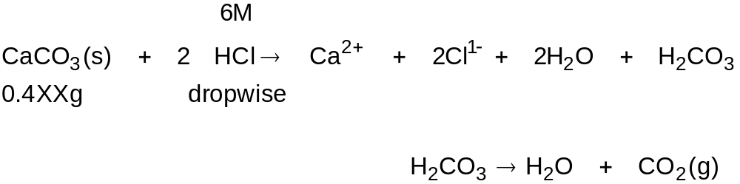
Convert all calcium into Ca²⁺ ions
Heat soln to drive carbon dioxide off!
Transfer soln to 250.0 mL volumetric flask
Calculate the molarity of Ca²⁺ from mass, molar mass and volume.

Slide 2
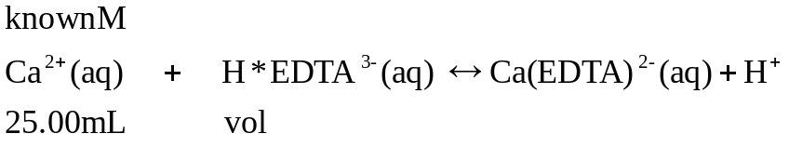

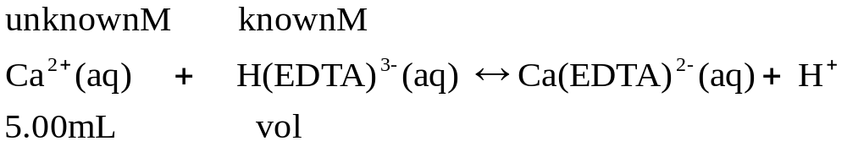
When Ethylenediaminetetraacetic acid (EDTA) is added to a solution containing calcium ions, a calcium EDTA complex forms in solution:
Titrations One and Two: determine the molarity EDTA
Titrations Three and Four: determine of an unknown Ca²⁺ conc
AND Ksp of unknown calcium salt
http://en.wikipedia.org/wiki/Eriochrome_Black_T
IMPORTANT: Step III D (2) ADD 4 – 6 ML pH 10 BUFFER!

Slide 3
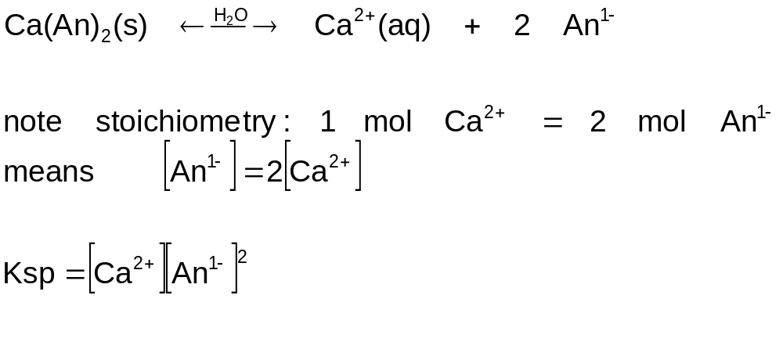
Ksp of unknown calcium salt:
sparingly soluble in water, monovalent anion, An¹⁻
Molarity known from third and fourth titrations

