Slide 1
A Summary of Redox Terminology
Fig. 21.1

Slide 2
Half-Reaction Method for Balancing Redox Reactions
The half-reaction method–Divides the overall redox reaction into
oxidation and reduction half-reactions
It separates the oxidation and reduction steps, which reflects their actual physical separation in electrochemical cells.
It makes it easier to balance redox reactions that take place in acidic or basic solutions, which is common in these cells.
It (usually) does not require assigning O.N.s. (In cases where the half-reactions are not obvious, we assign O.N.s to determine which atoms undergo a change and write the half-reactions using the species that contain those atoms.)

Slide 3
Steps for Balancing Redox Equations by the
Half-Reaction Method: Acidic solution
See hand out for complete set of steps for any type reaction.
Step 1: Divide the skeleton reaction into two half-reactions, each of
which contains the oxidized and reduced forms of one of the
species.
Step 2: Balance the atoms and charges in each half-reaction. @ Atoms: 1. atoms other than O and H
2. O [by adding H₂O to the O deficient side]
3. H [by adding H⁺ to the H deficient side].
Charge is balanced by adding electrons (e⁻). To the left, reactant side, for the reduction equation and to the right, product side, for the oxidation equation

Slide 4
Steps for Balancing Redox Equations by the
Half-Reaction Method: Acidic solution
Continued
Step 3: Multiply each half-reaction by some integer to make the
number of e⁻ gained = the number of e⁻ lost.
Step 4: Add the balanced half-reactions and include states of matter
Step 5: Check that the atoms and charges are balanced.

Slide 5
Electrochemistry
Voltaic Cells
  Diagram
  Emf
    Tables
    Calculations
  ΔG and emf
  Nernst Equation
Electrolysis
  Diagram
  Faraday’s Law
  Application

Slide 6
An Overview of Electrochemical Cells
There are two types of electrochemical cells based upon the general thermodynamic nature of the reaction:
  1) A voltaic cell (or galvanic cell) uses a spontaneous reaction to generate electrical energy. The reacting system does work on the surroundings. All batteries contain voltaic cells.
  2) An electrolytic cell uses electrical energy to drive a nonspontaneous reaction (ΔG > 0), the surroundings do work on the reacting system.

Slide 7
Electrochemical cells have several common features:
1) They have two electrodes:
  Anode–The oxidation half-reaction takes place at the anode.
Cathode–The reduction half-reaction takes place at the cathode
The electrodes are dipped into an electrolyte, a solution that contains a mixture of ions and will conduct electricity.

Slide 8
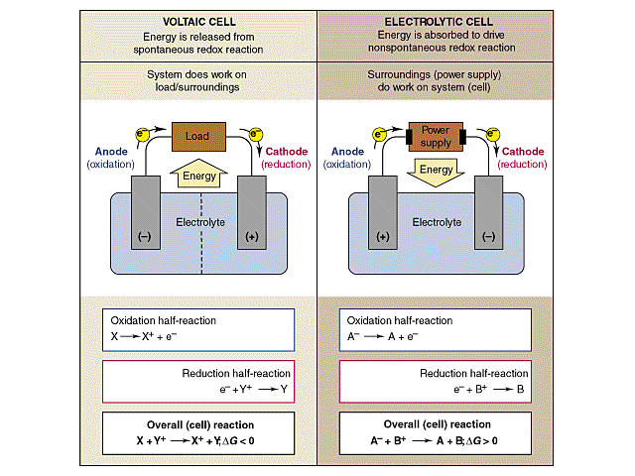
General Characteristics of Voltaic and Electrolytic Cells

Slide 9
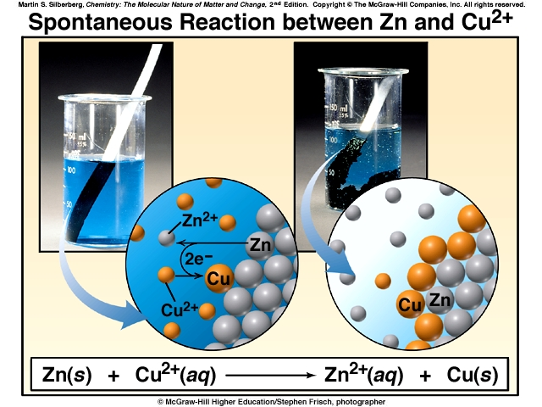
The Spontaneous Reaction Between Zinc and Copper(II) Ion
~ 1800 First Battery - Alessandro Volta

Slide 10
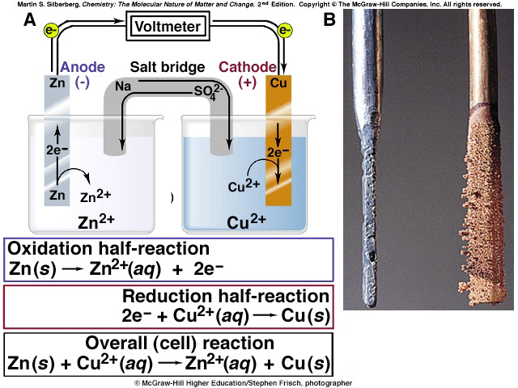
A Voltaic Cell based on the
Zinc-Copper Reaction
Active and inactive
electrodes.

Slide 11
Notation for a Voltaic Cell
There is a shorthand notation for describing the components of a voltaic cell. For example, the notation for the Zn/Cu²⁺ cell is:
Zn_{(s)} | Zn²⁺_{(aq)} || Cu²⁺_{(aq)} | Cu_{(s)}
Examples: Draw the diagram for the voltaic cell represented by:
Cr_{(s)} | Cr³⁺_{(aq)} || Ag⁺_{(aq)} | Ag_{(s)}
Write the half reactions and overall reaction for this cell.

Slide 12
Electrochemical Cell
Go to Standard Electrode Potential Document/Sites

Slide 13
Cell Voltage
Electromotive force: emf
  driving force of voltaic cell
  max. potential difference between electrodes
  depends on: nature of reaction, conc., and temperature of cell
Symbol: E
  Units: volts
  1 volt = 1 J/coul or J = coul x volts
  Standard emf - Eº [tables 25ºC, 1 atm, 1 M]

Slide 14
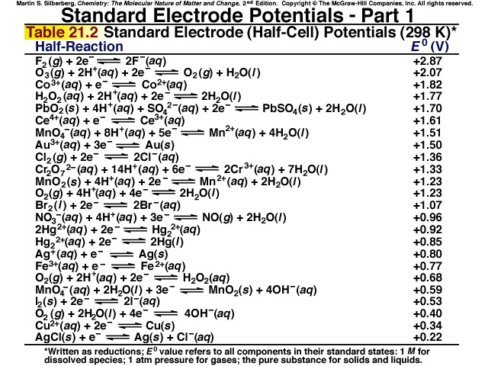

Slide 15
Effects of Conc. On Voltage
Qualitative
As cell operates: Reactants → Products
  reactant conc. ___________
  product conc. ____________
  EMF ________________
SPONTANEITY AND REDOX REACTIONS
  + EMF = SPONTANEOUS
  - EMF = NONSPONTANEOUS
  0 EMF = EQUILIBRIUM

Slide 16
Standard Voltage
E_{cell} = E _{cathode} + (E _{anode})
  E_{cathode} , _______________
  E_{anode,} _______________
  Sign of E_{anode} is opposite sign on table.
  Example #3 class problems

Slide 17
Emf and Free Energy
ΔG measures spontaneity (-)
emf measures of spontaneity (+)
Must be relationship ΔG = - nF E
  n is # moles of electrons transferred
F is Faraday’s constant: electrical charge of 1 mole of electrons
F = 96,500 coul/mole electrons

Slide 18
The Effect of Concentration on Cell Potential, emf.
The relationship between cell potential and concentration is based upon the free energy and its relation to concentration.
ΔG = ΔGº + RT ln Q
Since ΔG is related to E_{cell} , we substitute in their values, and divide each side by -nF, and we get the Nernst equation: E_{cell} =Eº_{cell} -RT ln Q nF

Slide 19
E_{cell} = Eº_{cell} -(RT/nF )(ln Q)
We substitute R and F, and operate the cell at 25ºC (298 K), so we get:
E_{cell} = E_{cell} - 0.0257 V ln Q
n
E_{cell} = E_{cell} - 0.0591 V log₁₀Q
n
(at 25ºC)

Slide 20
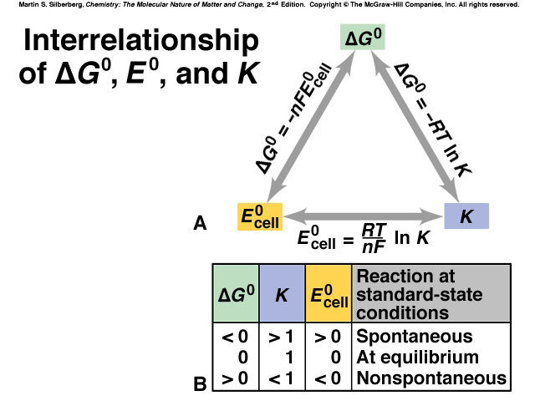
Outcome:
Be able to compare or calculate Δ G, Emf, or K using these equations.

Slide 21
Electrolysis
Breaking down with electricity
Electricity causes the chemical change
Comparison of Voltaic and Electrolytic Cells
Cell Type Δ G E_{cell} Name Process Sign
Voltaic < 0 > 0 Anode Oxidation -
Voltaic < 0 > 0 Cathode Reduction +
Electrolytic > 0 < 0 Anode Oxidation +
Electrolytic > 0 < 0 Cathode Reduction -

Slide 22
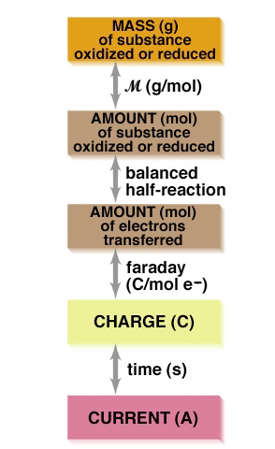
A Summary Diagram for the
Stoichiometry of Electrolysis
Outcome: Find any value on chart given any other value.
1 Faraday = 96,500 coul / mol e⁻s
1 coulomb = ampere X seconds

