Slide 1
Thermochemistry
Study of energy transformations and transfers that accompany chemical and physical changes.
Terminology
  System
  Surroundings
  Heat (q) transfer of thermal energy
  Chemical energy - E stored in structural unit

Slide 2
Energy [capacity to do work]
POTENTIAL [stored energy]
KINETIC [energy of matter]
  K.E. = 1/2 mu²
  Units JOULES (J) = Kg m²/ s²
First Law of Thermodynamics
( Law of Conservation of Energy )
“The Total Energy of the Universe is Constant”
Universe = E_{System} + E_{Surroundings} = 0

Slide 3
Enthalpy Property of matter
Heat content, symbol H
Endothermic or Exothermic
Fixed at given temperature
Directly proportional to mass
Quantitative
  ΔH⁰ reaction = ∑a ΔH⁰ products - ∑b ΔH⁰ reactants
  ΔH⁰ = q reaction and q reaction = - q water
  q = (mass)(specific heat)(Δtemp)

Slide 4
Change in Enthalpy = H
Enthalpy is defined as the system’s internal energy
plus the product of its pressure and volume.
H = E + PV
For Exothermic and Endothermic Reactions:
H = H _{final} - H _{initial} = H _{products} - H _{reactants}
Exothermic : H _{final} H _{initial} H 0
Endothermic : H _{final} H _{initial} H 0
Draw enthalpy diagrams

Slide 5
Gases
Sublimation
Deposition
H⁰_{sub}
Condensation
- H⁰_{vap}
- H⁰_{sub}
Vaporization
H⁰_{vap}
Liquids
Freezing
- H⁰_{fus}
Melting
H⁰_{fus}
Sublimation
Solids
Deposition

Slide 6
Special H’s of Reactions
When one mole of a substance combines with oxygen in a combustion
reaction, the heat of reaction is the heat of combustion( H_{comb}):
C₃H_{8 (g)} + 5 O_{2 (g)} 3 CO_{2 (g)} + 4 H₂O_{(g)}
H = H_{comb}
When one mole of a substance is produced from it’s elements, the
heat of reaction is the heat of formation ( H_{f} ) :
Ca_{(s)} + Cl_{2 (g)} CaCl_{2 (s)}
H = H_{f}
When one mole of a substance melts, the enthalpy change is the
heat of fusion ( H_{fus}) :
H₂O_{(s)} H₂O_{(L)}
H = H_{fus}
When one mole of a substance vaporizes, the enthalpy change is the
heat of vaporization ( H_{vap}) :
H₂O_{(L)} H₂O_{(g)}
H = H_{vap}

Slide 7
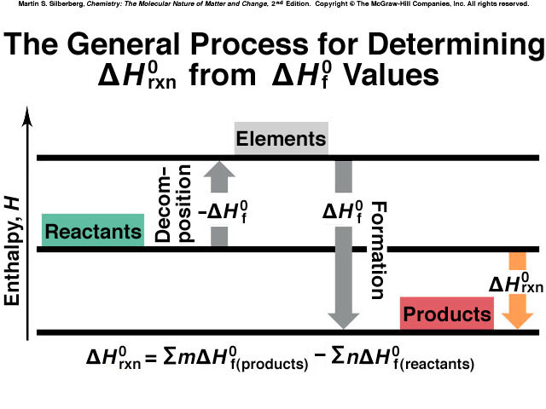
Fig. 6.14

Slide 8
Bond Energies
Energy of a reaction is the result of breaking the bonds of the reactants and forming bonds of the products.
ΔH⁰ reaction = ∑bonds broken + ∑bonds formed
  breaking bonds requires energy – endothermic(+)
  forming bonds releases energy – exothermic (-)

Slide 9
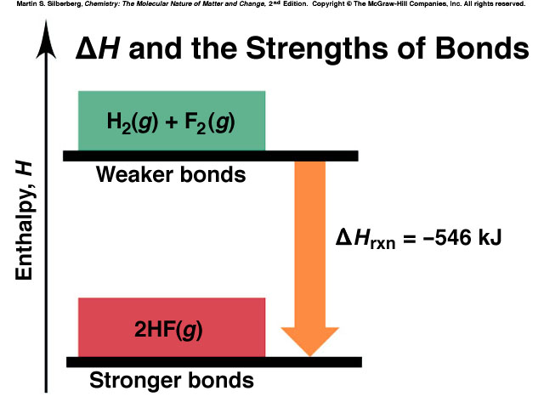
Fig. 6.10

Slide 10
Calorimetry
Laboratory Measurements
Calorimeter is device used to measure temperature change.
q = (mass)(specific heat)(Δtemp)
  Heat capacity = amount of heat to raise temperature 1ºC.
  Specific heat = amount of heat to raise temperature of 1g of substance 1ºC.
  J/g- ºC or molar heat J/ mol- ºC
  heat lost =heat gained

Slide 11
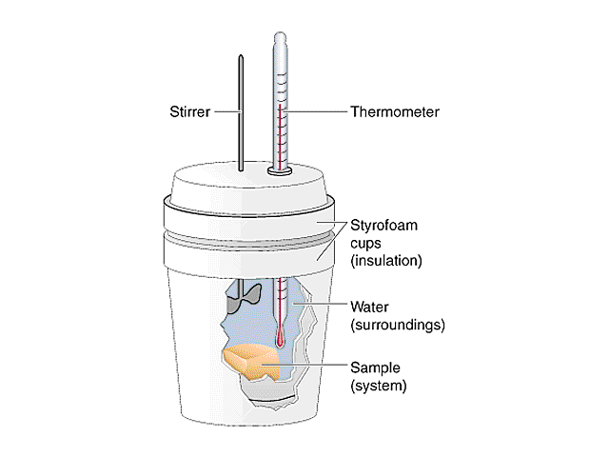
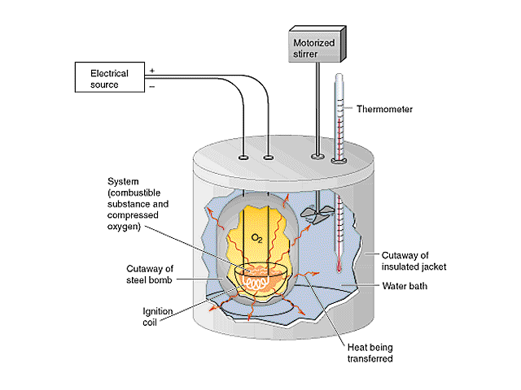
Calorimeters
Lab
Coffee-Cup
Bomb

Slide 12
Specific Heat Capacity and Molar Heat Capacity
Heat Capacity and Specific Heat
q = Quanity of Heat
q
T
heat capacity = = c
q = constant x T
J
Specific heat capacity =
.
g K
q = c x mass x T
Molar Heat Capacity
q
(C) =
moles x T
J
mol K
“C” has units of:
.

Slide 13
Stoichiometry
Thermochemical Equation CH₄ + 2 O₂ → CO₂ + 2 H₂O + 890 kJ
  ΔH [-] exothermic, heat product
  ΔH [+] endothermic, heat reactant
  heat can be calculated using balanced chemical reaction including enthalpy information.
Example: Calculate the amount of heat released when 67 grams of oxygen is used.

Slide 14
Hess’s Law of Heat Summation
The enthalpy change of an overall process is the sum of the enthalpy changes of its individual steps.
  Need overall final reaction and individual reactions with enthalpy change.
  Example: Calculate the enthalpy for the reaction
  N₂ + 2 H₂ → N₂ H₄ ΔH = ???
  Given: N₂ + 3 H₂ → 2 N H₃ ΔH = - 92.4 kJ
  N₂ H₄ + H₂ → 2 N H₃ ΔH = - 183.9 kJ
ΔH reaction = ΔH₁ + ΔH₂ + ΔH₃ + ….

Slide 15
Entropy
Examples and activities
Summary
Disorder favored for spontaneous reactions
Symbol S
Units: J / Kelvin or J / K• mol
Sº standard conditions [25ºC and 1 atm]
ΔS>0 [+] more disorder - favored
Tables [elements]
ΔS⁰ reaction = ∑a S⁰ products - ∑b S⁰ reactants
Examples - Practice Problems

Slide 16
Spontaneity
Need to consider both ΔH and ΔS
Examples: ΔH ΔS
  Combustion of C __(-)__ __+__
  Ice melting __(+)__ __+___
Second Law of Thermodynamics
  In any spontaneous process there is always an increase in the entropy of the universe
  ΔS_{universe} = ΔS_{system} + ΔS_{surrounding}
  Entropy of the universe is increasing.

Slide 17
Third Law of Thermodynamics
  Entropy of a perfect crystal at 0 Kelvin is 0
  Based on this statement can use Sº values from the tables and calculate ΔS_{rxn}
  ΔS⁰ reaction = ∑a S⁰ products - ∑b S⁰ reactants
Outcome: Determine ΔS⁰ Rxn both qualitatively and quantitatively
Conclusion: ΔG⁰ = ΔH⁰ - TΔS⁰ SPONTANEITY DEPENDS ON ΔH, ΔS & T

Slide 18
Free Energy
Gibbs free energy–This is a function that combines the
systems enthalpy and entropy:
New Thermo Quantity
When a reaction occurs some energy known as Free Energy of the system becomes available to do work.
Symbol G
  Reactions Δ G spontaneous — [release free energy] nonspontaneous + [absorb free energy] equilibrium 0

Slide 19
Free Energy
Quantitative
For a given reaction at constant T and P Δ G = ΔH – TΔS
  ΔH and ΔS are given or calculated from tables
  Remember T is absolute [Kelvin scale]
  watch units on ΔH and ΔS, they need to match
Can also use Free Energy Tables ΔG⁰ reaction = ∑a ΔG⁰ products - ∑b ΔG⁰ reactants

Slide 20
Reaction Spontaneity and the Signs of
Hº, Sº, and Gº
Hº Sº -T Sº Gº Description
- + - - Spontaneous at all T
+ - + + Nonspontaneous at all T
+ + - + or - Spontaneous at higher T;
Nonspontaneous at lower T
- - + + or - Spontaneous at lower T;
Nonspontaneous at higher T
Table 20.1 (p. 879)

Slide 21
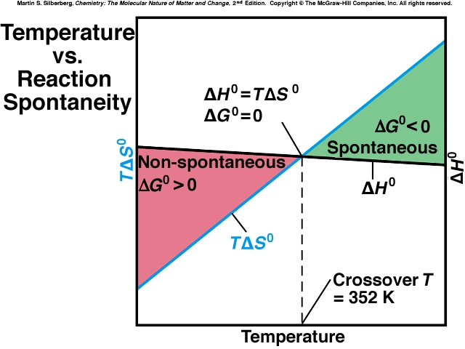
Qualitative

Slide 22
Temperature & Spontaniety
Quantitative
  ΔG = ΔH – TΔS
  Use to calculate ΔG at different T

Slide 23
Free Energy and its relationship with Equilibria and Reaction Direction
  ΔGº = -RT ln K

Slide 24
The Relationship Between Gº and K at 25ºC
Gº (kJ) K Significance
200 9 x 10 ⁻³⁶ Essentially no forward reaction;
100 3 x 10 ⁻¹⁸ reverse reaction goes to
50 2 x 10 ⁻⁹ completion.
10 2 x 10 ⁻²
1 7 x 10 ⁻¹
0 1 Forward and reverse reactions
-1 1.5 proceed to same extent.
-10 5 x 10¹
-50 6 x 10⁸
-100 3 x 10¹⁷ Forward reaction goes to
-200 1 x 10³⁵ completion; essentially no
reverse reaction.
Table 20.2 (p. 883)

Slide 25
Qualitative Summary
Free Energy and Equilibrium Constant
Δ G < 0 spontaneous and K_{c} determines extent of reaction (K>1 or large favors products)
ΔG⁰ K 0 = 1 at equilibrium <0 (-) >1 spontaneous forward reaction >0 (+) <1 nonspontaneous forward reaction

Slide 26
Free Energy and Equilibrium Constant
Quantitative
ΔG = ΔG⁰ + RT lnQ
  ΔG at any conditions and ΔG ⁰ standard conditions
  at equilibrium ΔG = 0 and Q = K therefore: 0 = ΔG⁰ + RT lnQ and ΔG⁰ = – RT lnK
  R = 8.314 J/mol• K and T in Kelvin
Outcome: Be able to calculate G and K and interpret results.

Slide 27
Thermochemistry Summary
Study of energy transformations and transfers that accompany chemical and physical changes.
First Law of Thermodynamics:
  Energy of the Universe is constant
Second Law of Thermodynamics:
  Entropy of the universe increasing
Third Law of Thermodynamics:
  Entropy of a perfect crystal at 0 Kelvin is zero.

Slide 28
Spontaneity
Occurs without outside intervention
Enthalpy
  ΔH⁰ reaction = ∑a ΔH⁰ products - ∑b ΔH⁰ reactants
  ΔH⁰ = q reaction and q reaction = - q water
  q = (mass)(specific heat)(Δtemp)
Entropy
  ΔS⁰ reaction = ∑a S⁰ products - ∑b S⁰ reactants
Free Energy
  ΔG⁰ reaction = ∑a ΔG⁰ products - ∑b ΔG⁰ reactants
  ΔG⁰ reaction = ΔH - T ΔS

Slide 29
Nonstandard Conditions
ΔG = ΔG⁰ + RT ln Q for nonstandard conditions
  when at equilibrium Q = K and ΔG = 0
  ΔG⁰ = -RT ln K
    R = 8.314 J/mole Kelvin
ΔG and K both are extent of reaction indicators.
  ΔG < 0 K >1 spontaneous product favored
  ΔG > 0 K<1 non spontaneous reactant favored
  ΔG = 0 K =1 equilibrium

