Slide 1
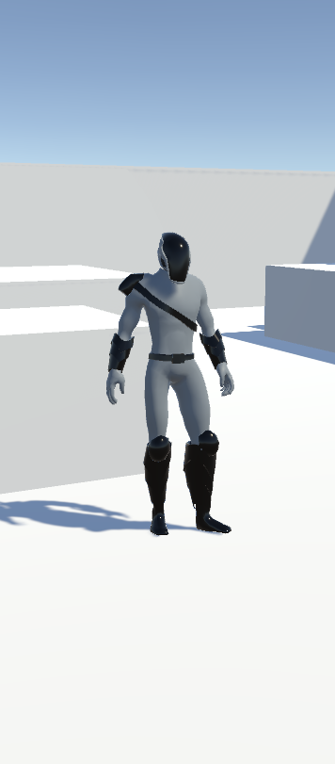
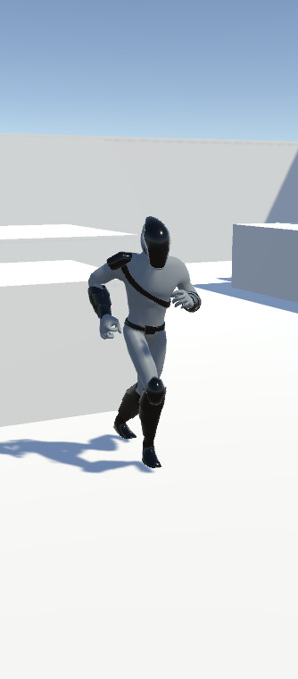
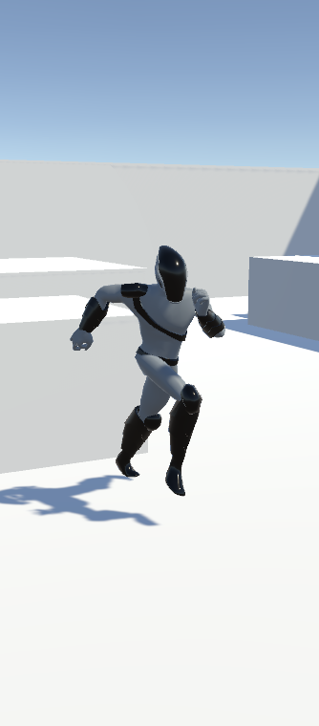
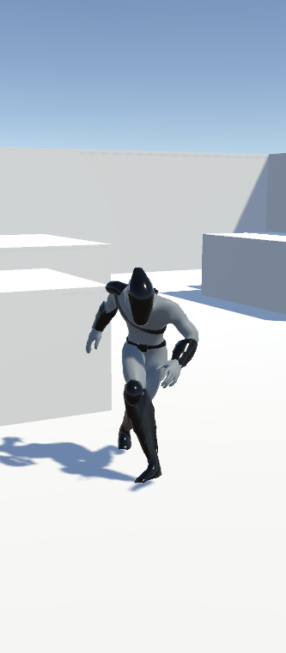
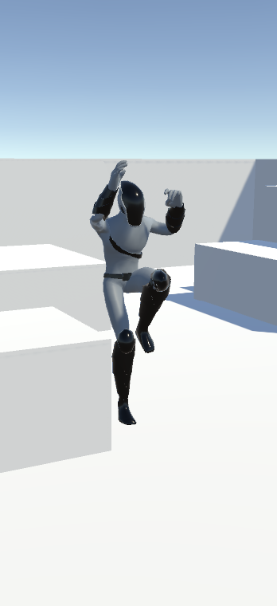
Free Camera Move Script Included (no cinemachine)
Options to move camera holding right click and mouse scrollwheel to zoom in/out
v
v
v
v
IDLE
Standard Run
PC
WASD
Arrows
Joystick
Left stick
Sprint
PC
Left Shift
Joystick
Button X
Crouch
PC
Left Ctrl
Joystick
Button B
Jump
PC
Space
Joystick
Button Y

