Slide 1
Drug Repurposing For Parkinson’s Disease
Team OSPL
Sherry yangnan319@gmail.com
Marcel marcel.alavi@gmail.com
Ryan ryan@epiblast.ai
Sac saclearn75@gmail.com

Slide 2
The Problem:
No Disease-Modifying Drugs: Existing Parkinson’s treatments only manage symptoms—they do not halt or reverse disease progression.
The Biological Gap: Environmental toxins are proven drivers of Parkinson's, yet their underlying pathways remain an untapped reservoir for therapeutic discovery.
The Opportunity: We lack a framework that connects real-world toxin exposure incidence to targetable molecular mechanisms that can guide drug repurposing.

Slide 3
The Solution:
Our drug repurposing approach pinpoints candidate Parkinson’s therapeutics by correlating epidemiological toxin data with overlapping molecular pathways shared by both toxins and known disease treatments.

Slide 4
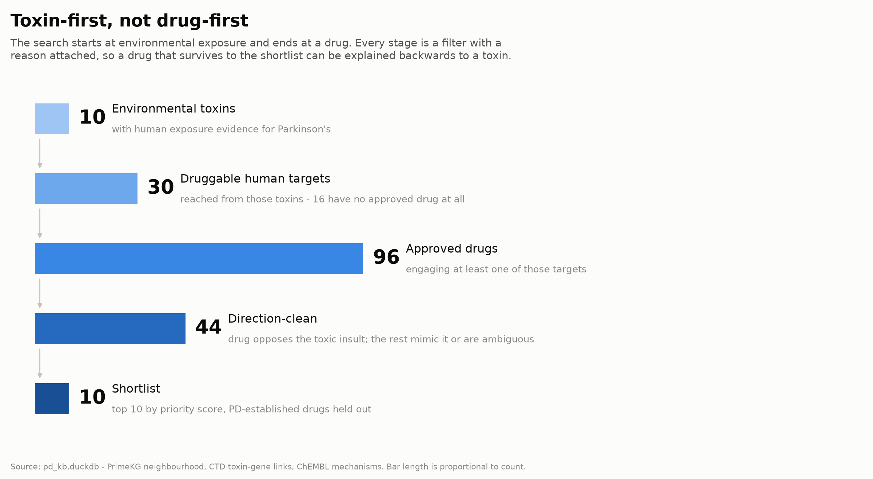

Slide 5
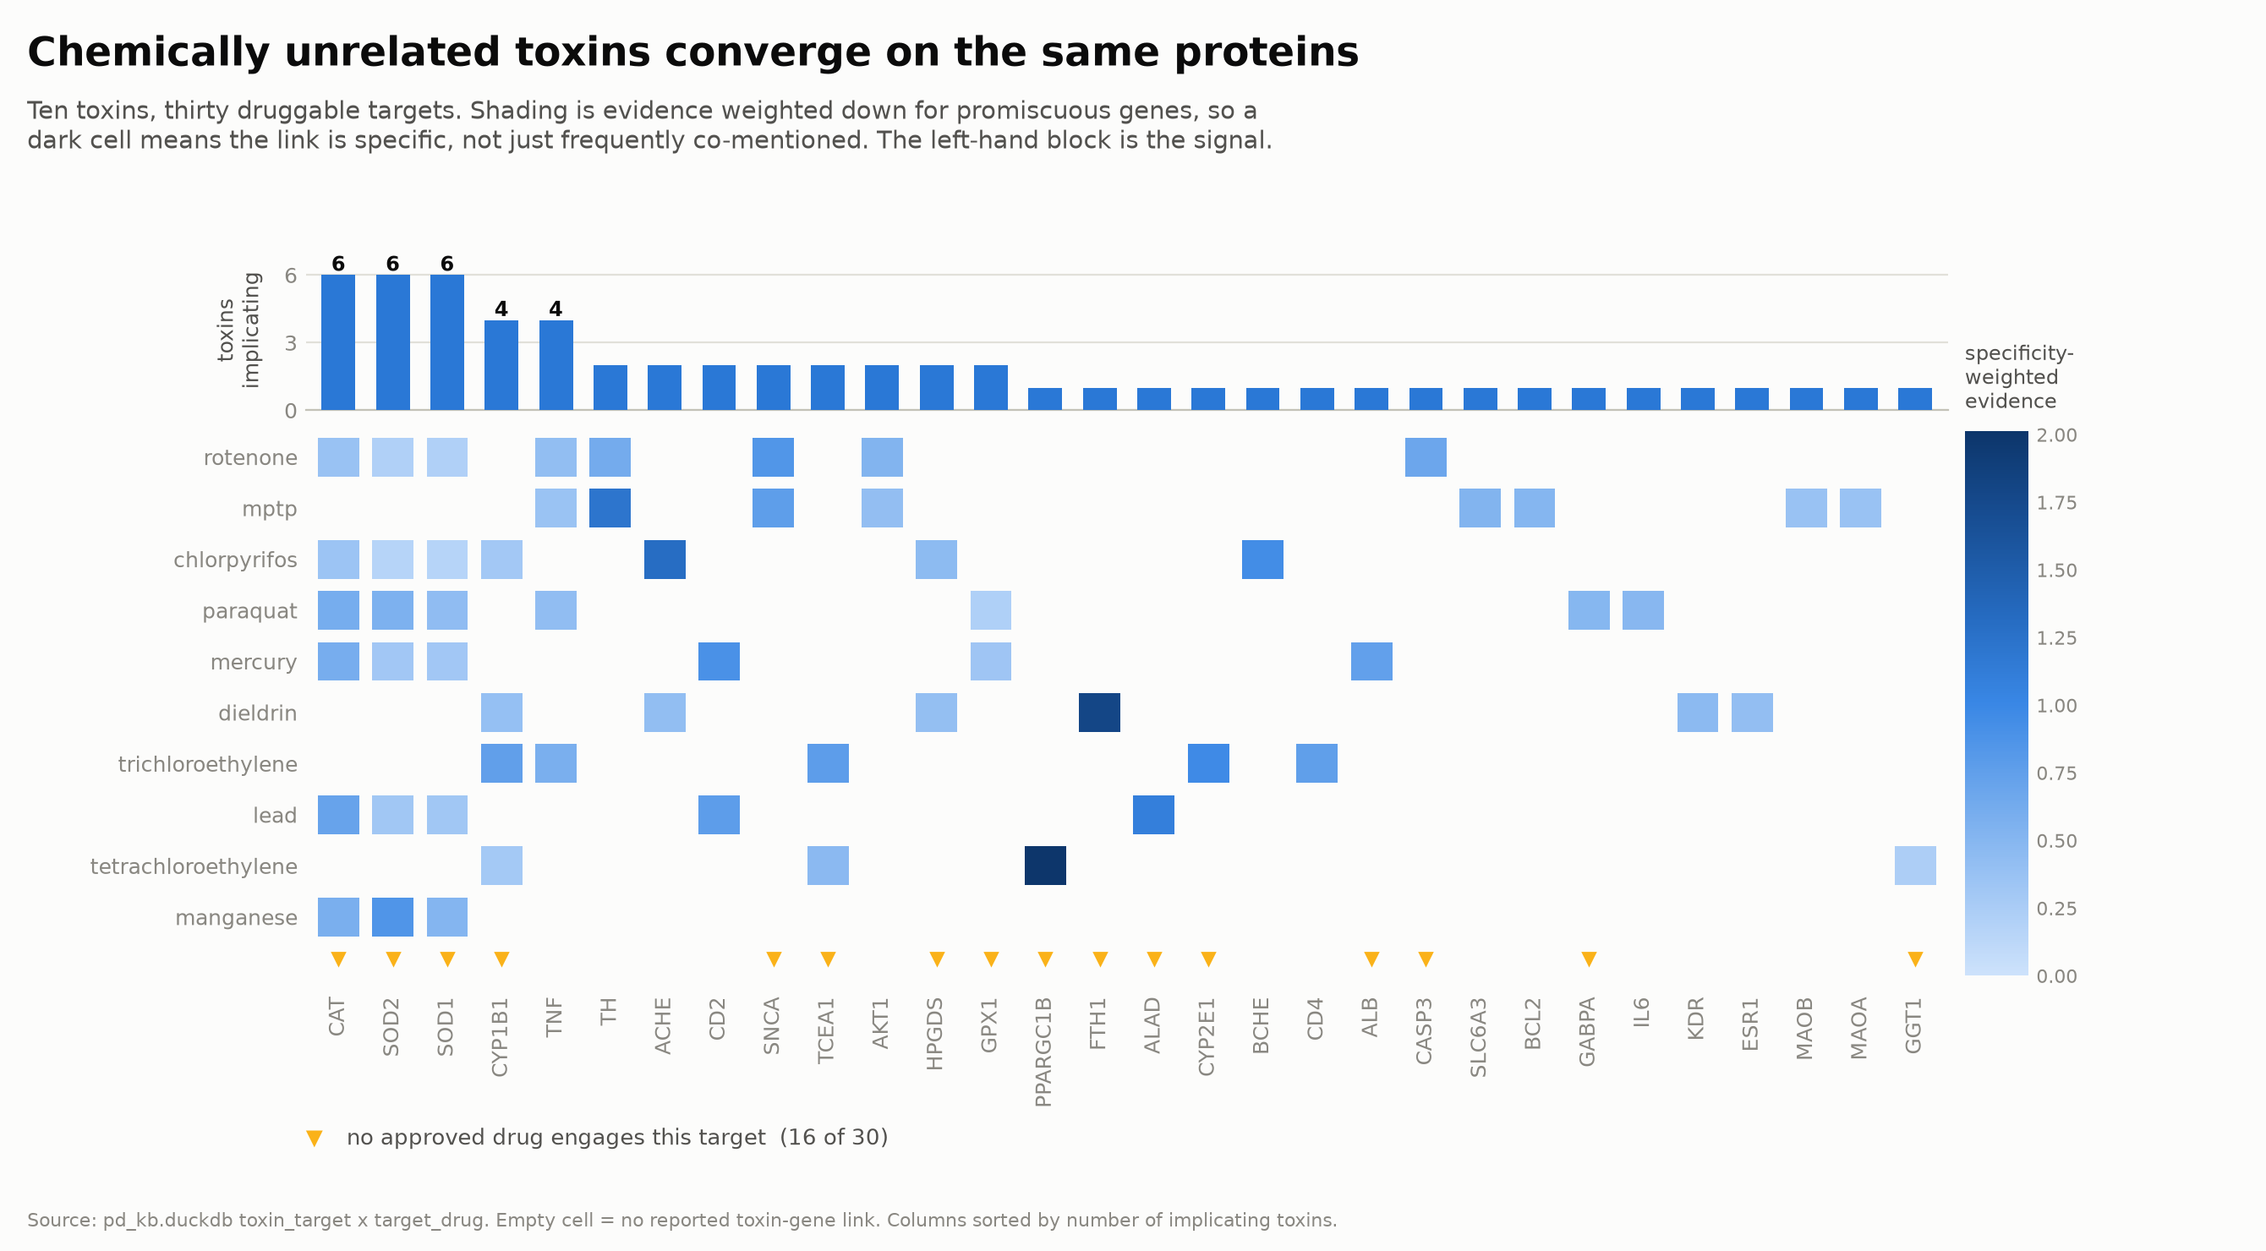

Slide 6
