Slide 1

Non-stationary rainfall modelling
Sydney Horizon Fellow
conrad.wasko@sydney.edu.au

Slide 2
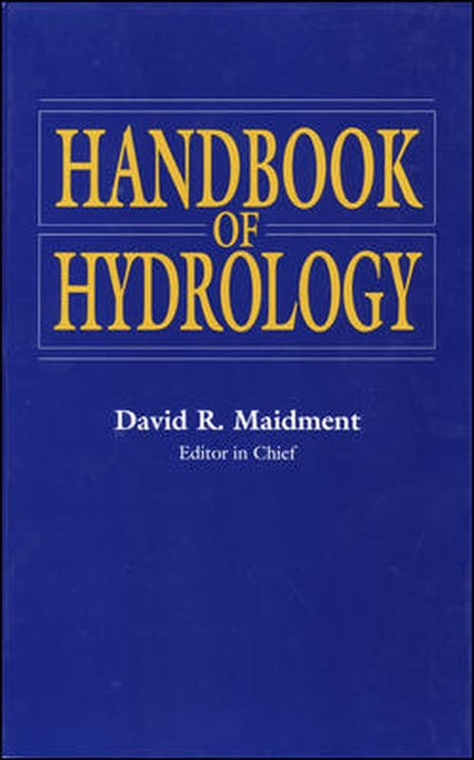
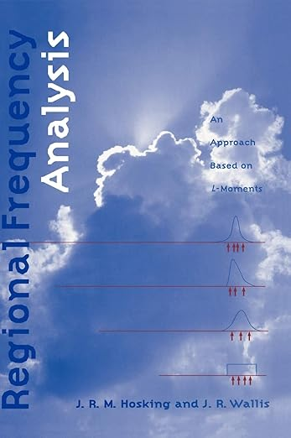
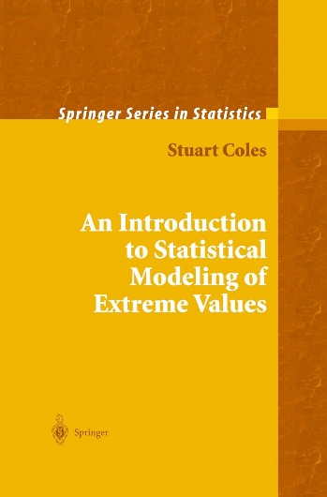
References
Stedinger, J., Vogel, R., Foufoula-Georgiou, E., 1993. Chapter 18 - Frequency analysis of extreme events, in: Maidment, D. (Ed.), Handbook of Hydrology. McGraw-Hill.

Slide 3
Outline
What is covered:
Why non-stationary extreme value analysis?
The very basics of extreme value theory (theoretical justification)
Fitting a stationary and non-stationary model
Exercise
A comment on deductive vs inductive reasoning
Extensions/applications
https://github.com/conradwasko/stahy2026
What is not covered:
Peak over threshold sampling and fitting
Different methods of parameter estimation

Slide 4
Motivation
Rare (low probability events)
AEP (annual exceedance probability) e.g. 0.01 or 1% or 1 in 100
ARI (average recurrence interval) e.g. 100 year
High consequence
How strong to make buildings to resist wind loads
How high to build sea walls to prevent overtopping from tides and waves
How large to make a reservoir to survive a drought
How big should a spillway be so a dam doesn’t fail
How many hospital beds do we need for a heatwave
We do this using extreme value theory.

Slide 5
Theoretical basis
The CLT: In probability theory, the Central Limit Theorem (CLT) states that, under appropriate conditions, the distribution of a normalized version of the sample mean converges to a standard normal distribution (source: Wikipedia).
In EVT: The Fisher–Tippett–Gnedenko theorem is a general result in extreme value theory regarding asymptotic distribution of extreme order statistics. The maximum of a sample of i.i.d random variables after proper renormalization can only converge in distribution to one of three possible distribution families: the Gumbel distribution, the Fréchet distribution, or the Weibull distribution – the parent of which is the Generalized Extreme Value (GEV) distribution (source: Wikipedia).

Slide 6
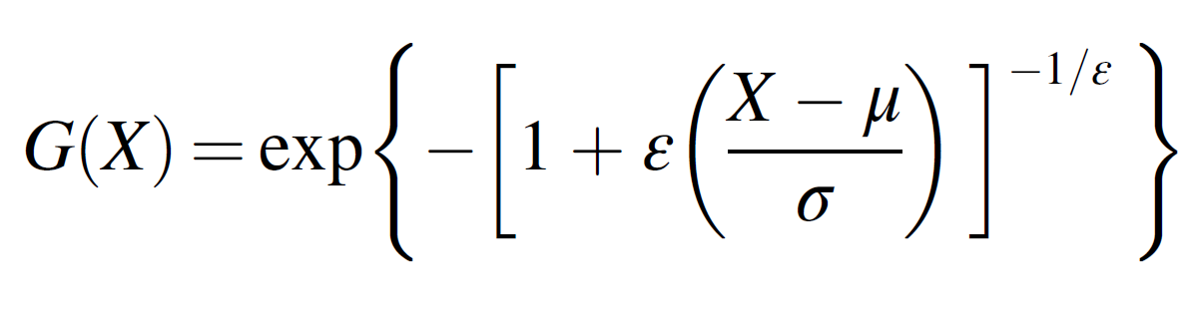
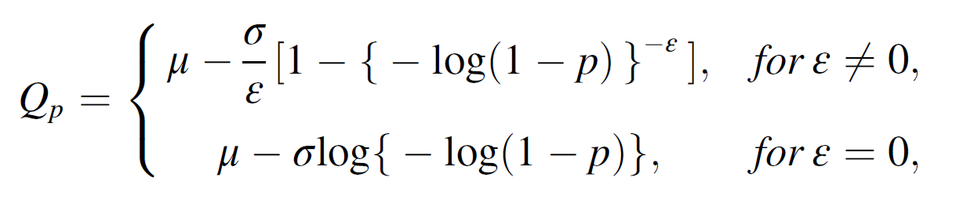
The GEV
location
shape
scale
Note: Hosking and Wallis, and Stedinger et al in Handbook of Hydrology have the shape parameter as the opposite (negative) of what I have here, which follows the Coles textbook.

Slide 7
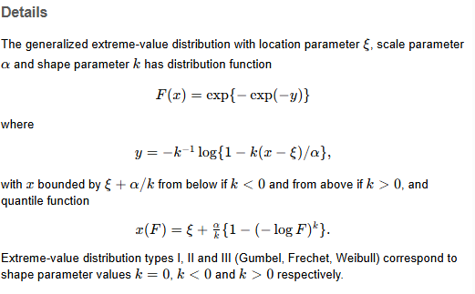
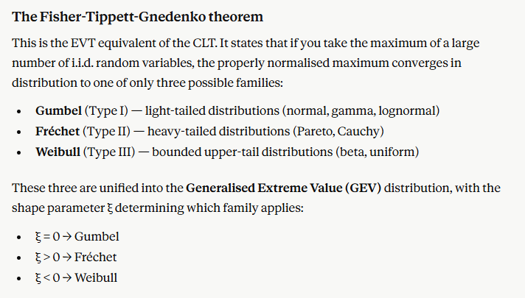
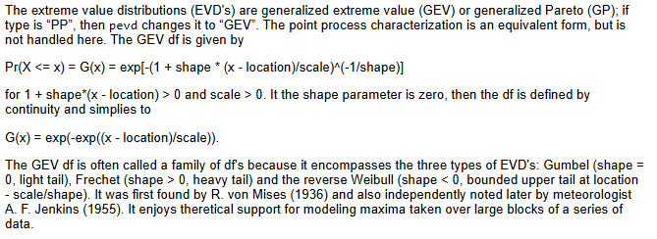
Tail behaviour
lmom R package
Claude
extRemes R package

Slide 8
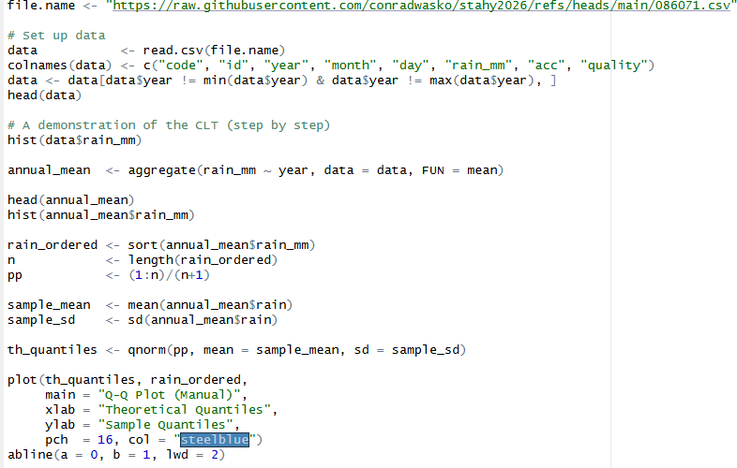
Demo

Slide 9
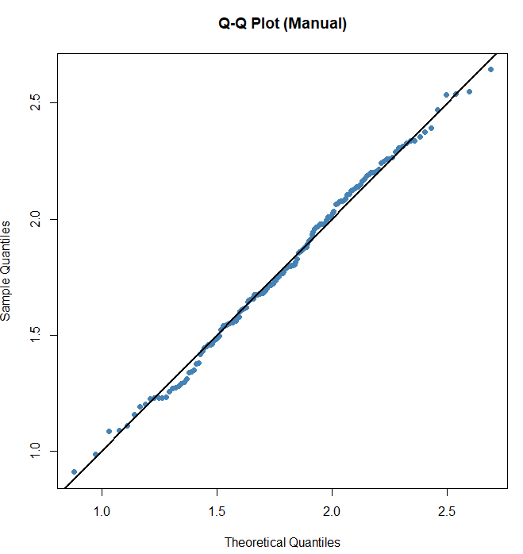
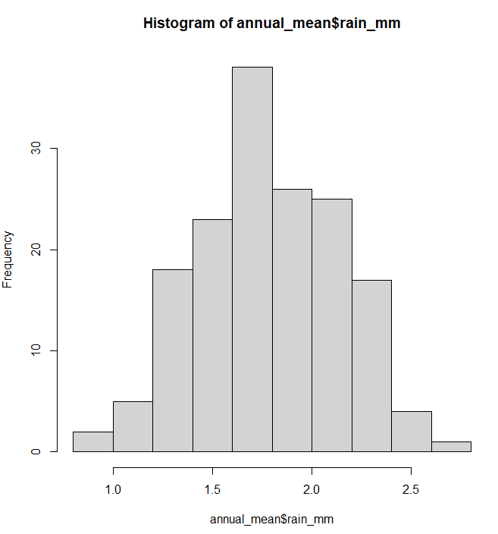

Slide 10
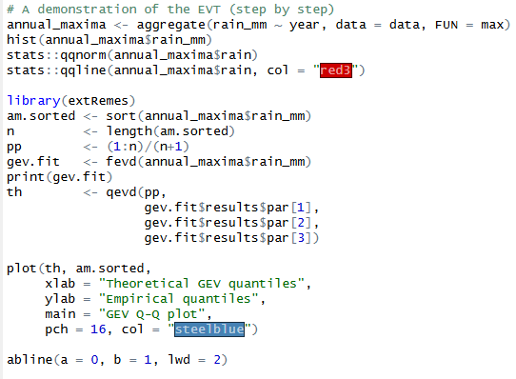

Slide 11
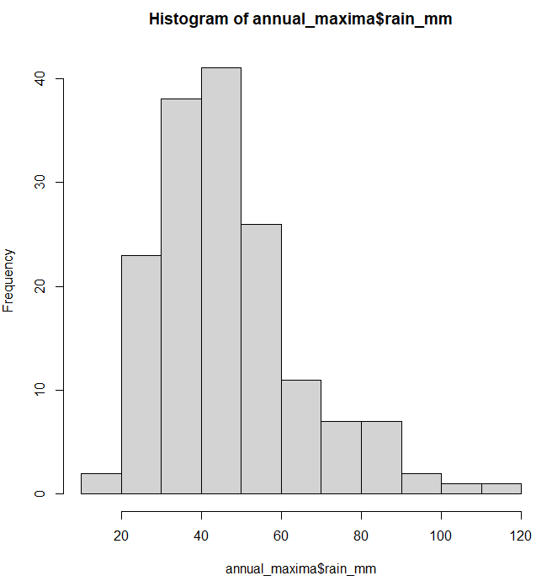
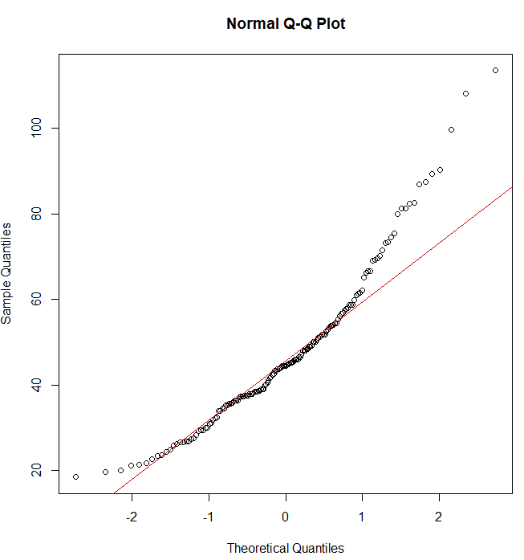

Slide 12
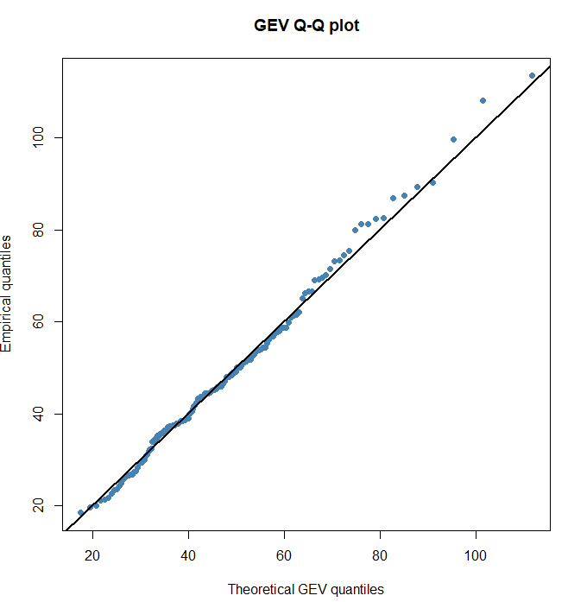

Slide 13
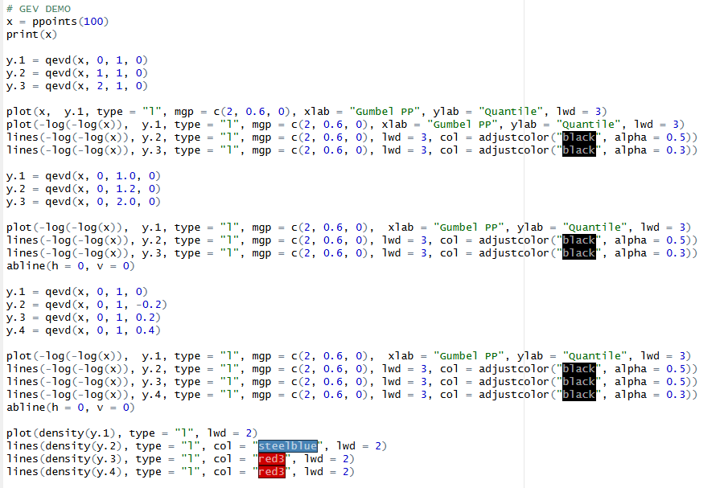

Slide 14
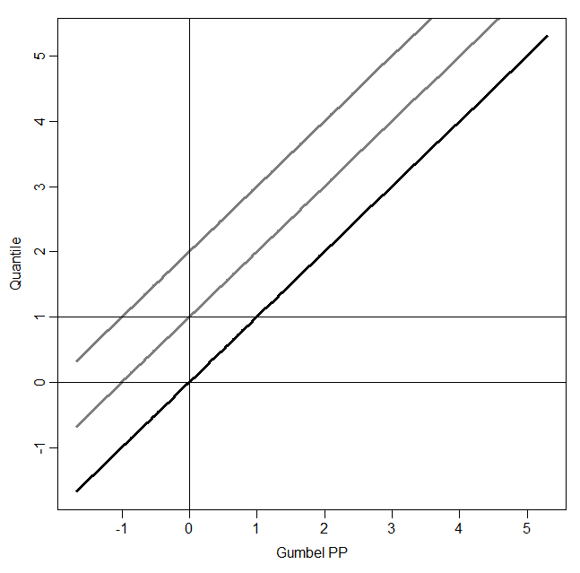
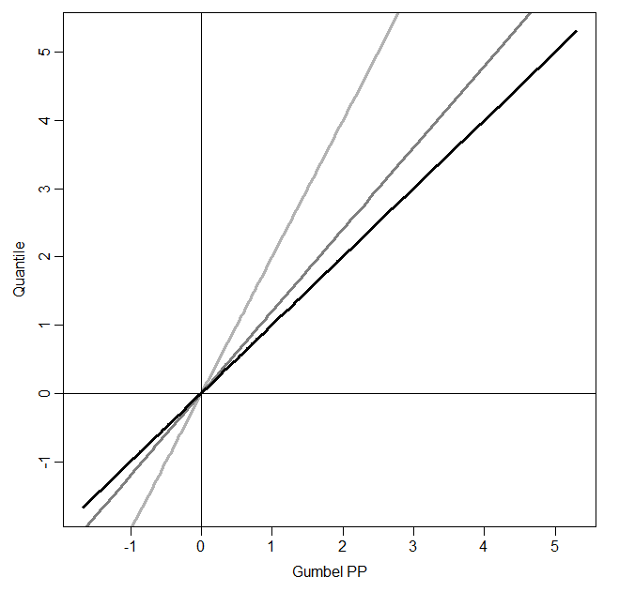
1/e

Slide 15
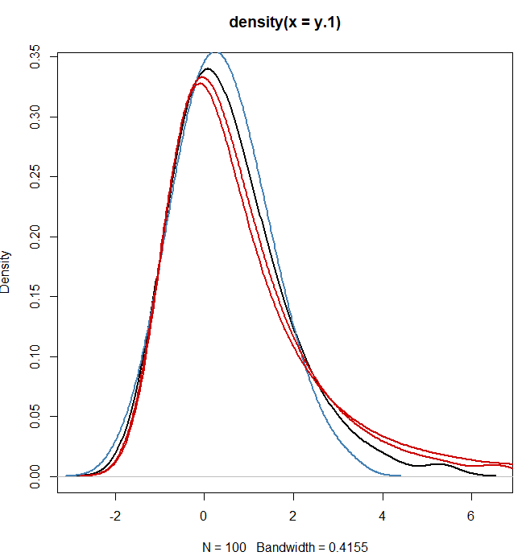
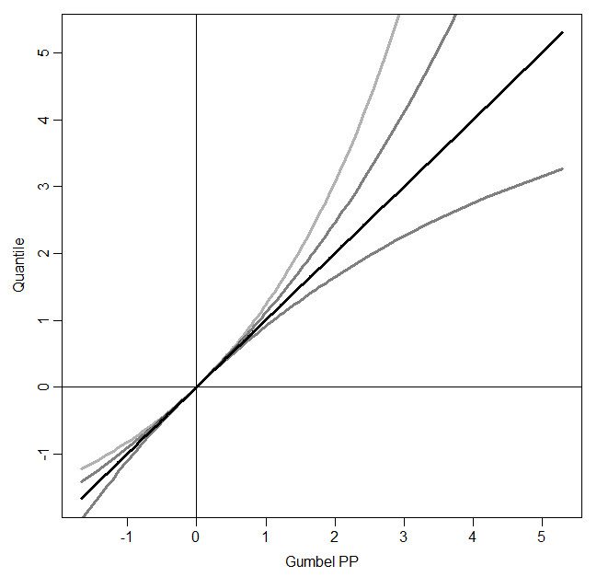

Slide 16
Model Choices
How to sample the data
annual maxima
peaks over a threshold (if you are interested in exceedances) and use the Generalised Pareto distribution (GPD)
How to fit the data
Method of Moments (MOM). Calculate the parameters directly from the moments of the distribution.
Maximum Likelihood Estimation (MLE). Maximize the log-likelihood function with respect to the parameters (location μ, scale σ, shape ξ).
L-Moments. Estimate the parameters using linear combinations of order statistics.
Bayesian Methods. Place priors on the parameters and use MCMC.

Slide 17
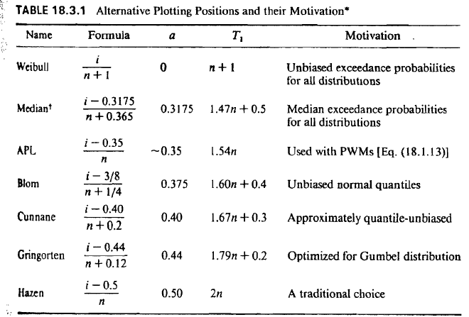
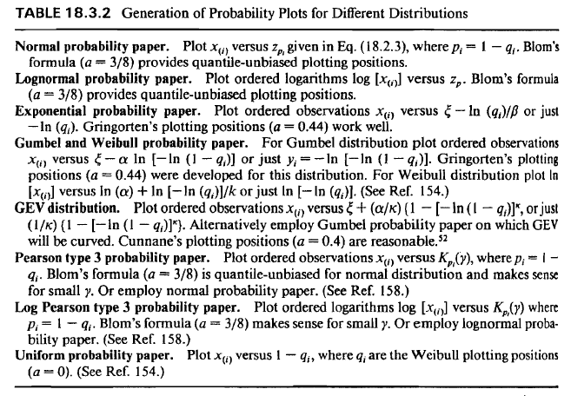
Plotting positions and probability plots

Slide 18
Non-stationarity
USER NOTE:
Add alt text for images that convey information, otherwise, mark it as decorative.
If the climate was also the same all the time, we could design for what we have already observed.
But the climate isn’t the same and we have a duty of care to estimate these rare events to be prepared.

Slide 19
The GEV
location
shape
scale

Slide 20
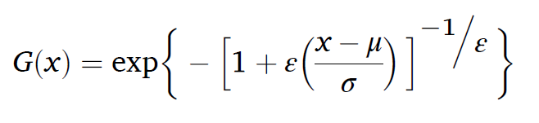
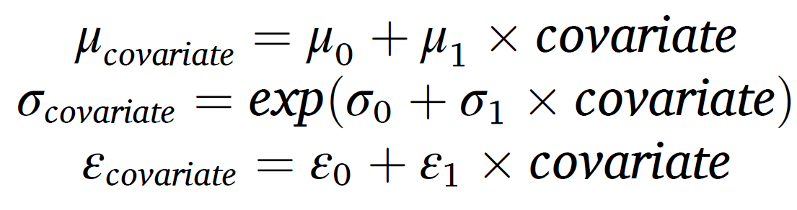
Non-stationary extreme value distribution
What form?
What covariate?

Slide 21
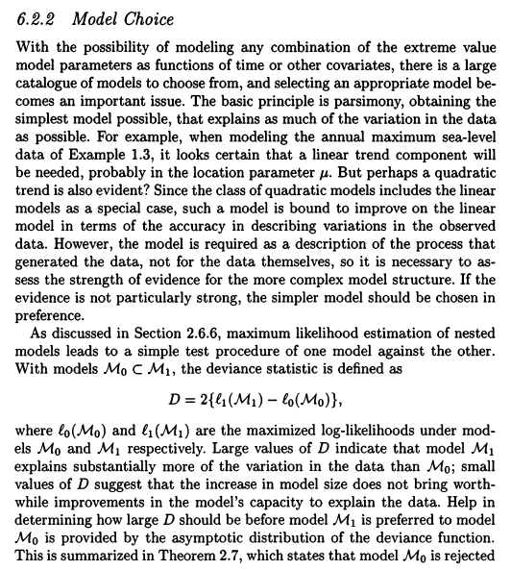
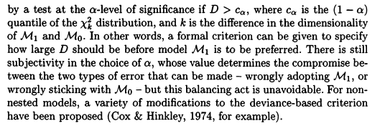
From Coles (2001)

Slide 22
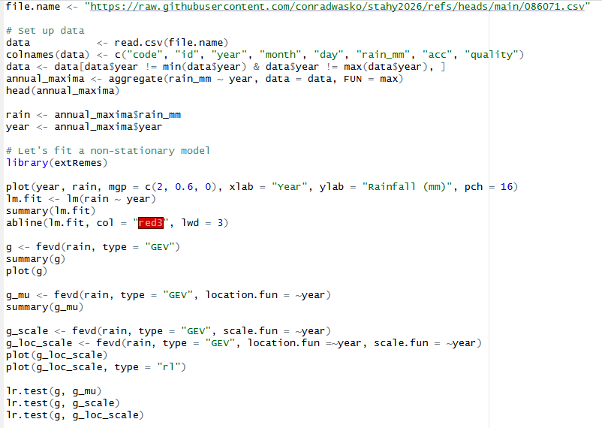

Slide 23
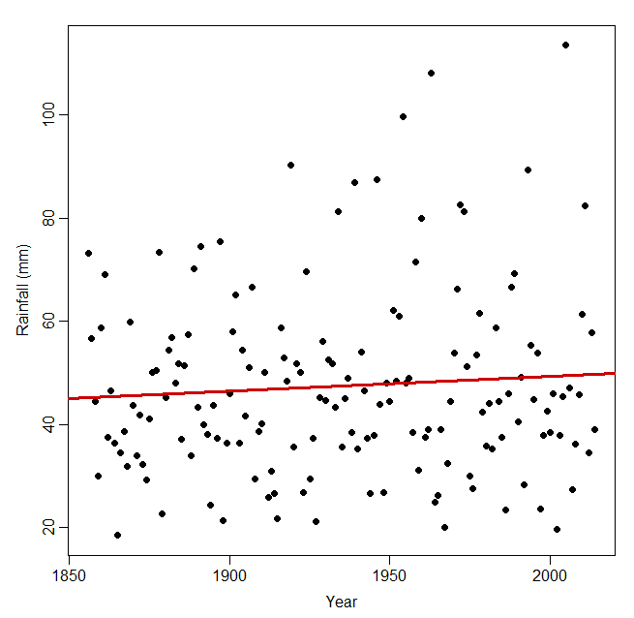
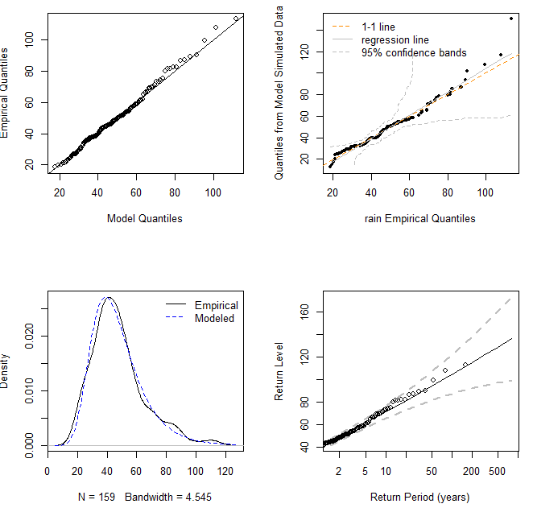

Slide 24
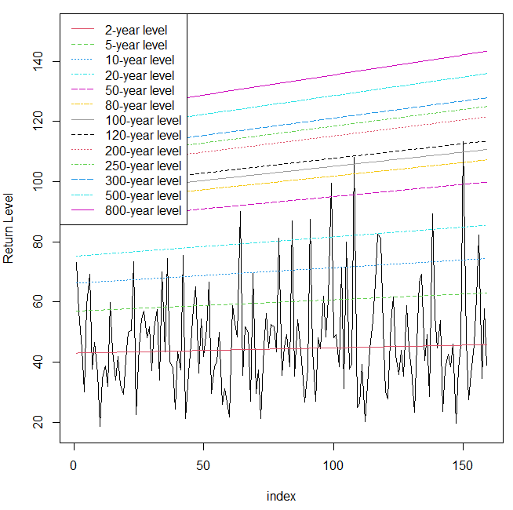
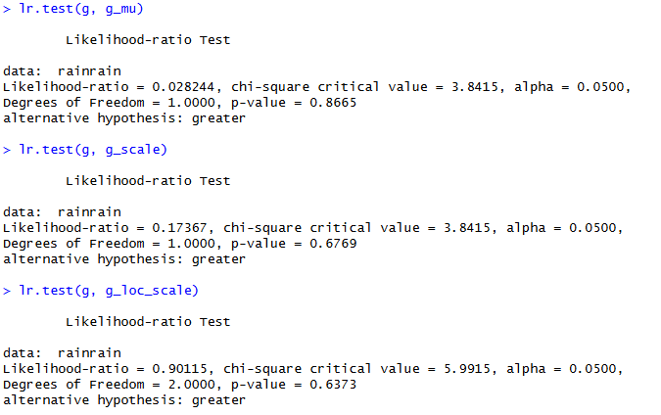

Slide 25
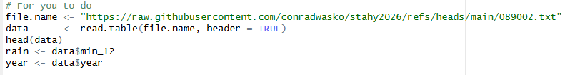
Now I want you to do an example…
- Does the data look like it comes from a GEV?
Would you fit a non-stationary model?
Which non-stationary model would you fit?

Slide 26
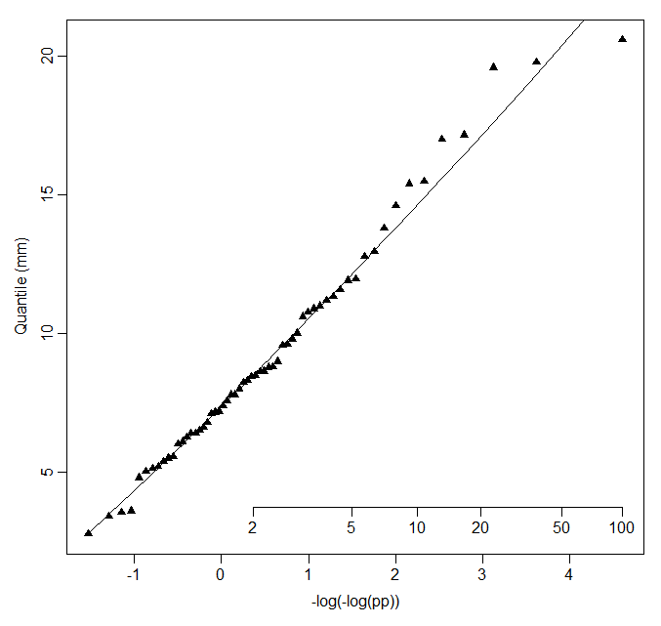
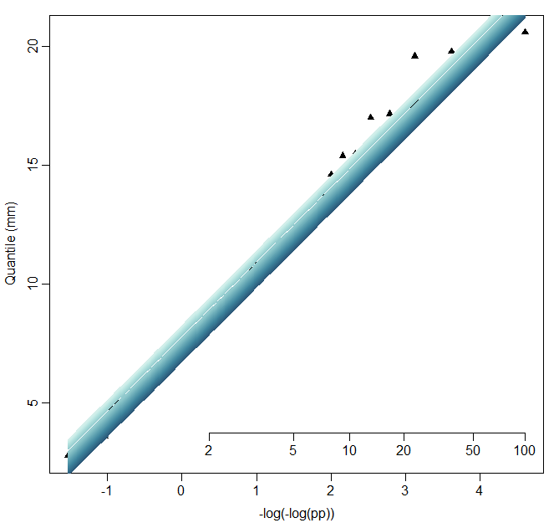

Slide 27
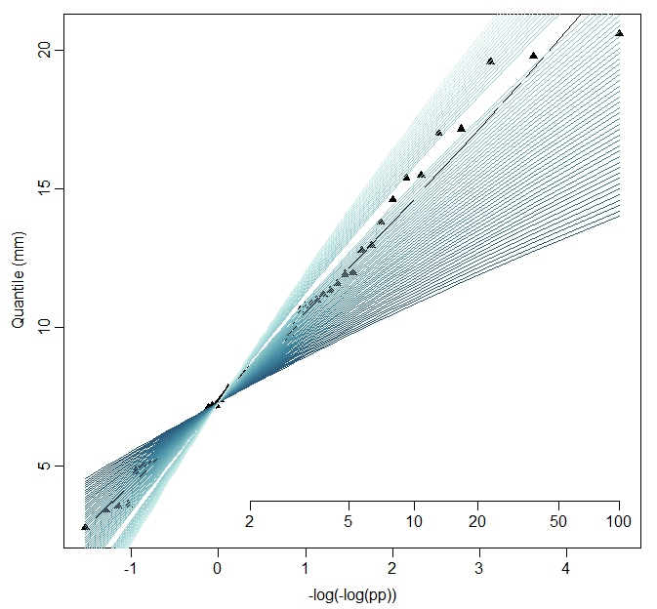
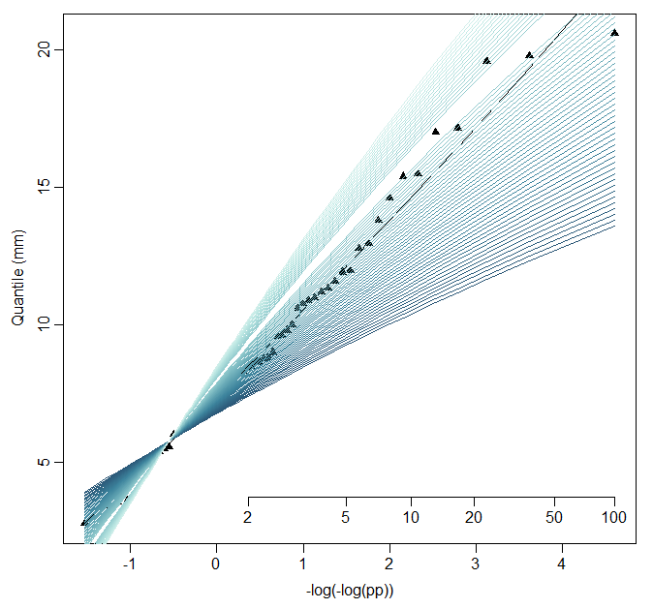
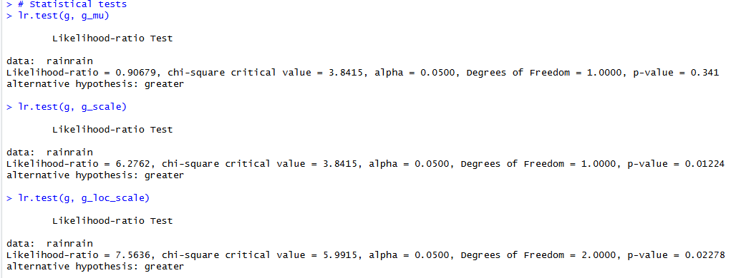

Slide 28
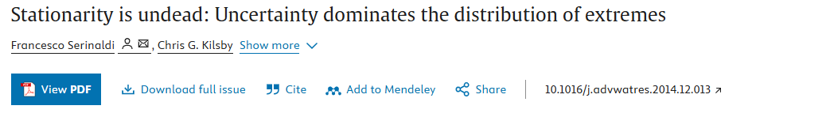
Inductive vs deductive reasoning
When the model structure cannot be inferred in a deductive manner and nonstationary models are fitted by inductive inference, model structure introduces an additional source of uncertainty so that the resulting nonstationary models can provide no practical enhancement of the credibility and accuracy of the predicted extreme quantiles, whereas possible model misspecification can easily lead to physically inconsistent results.

Slide 29
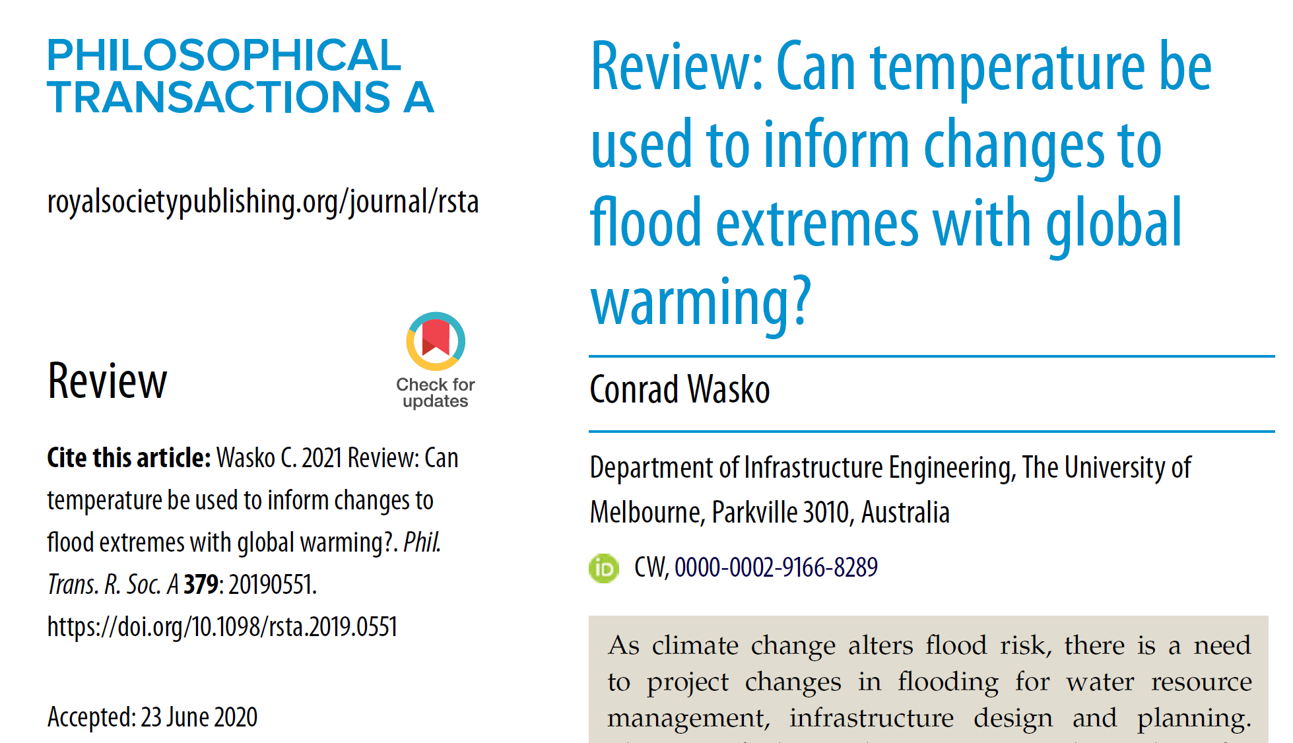
A physical basis
Clausius-Clapeyron relationship

Slide 30
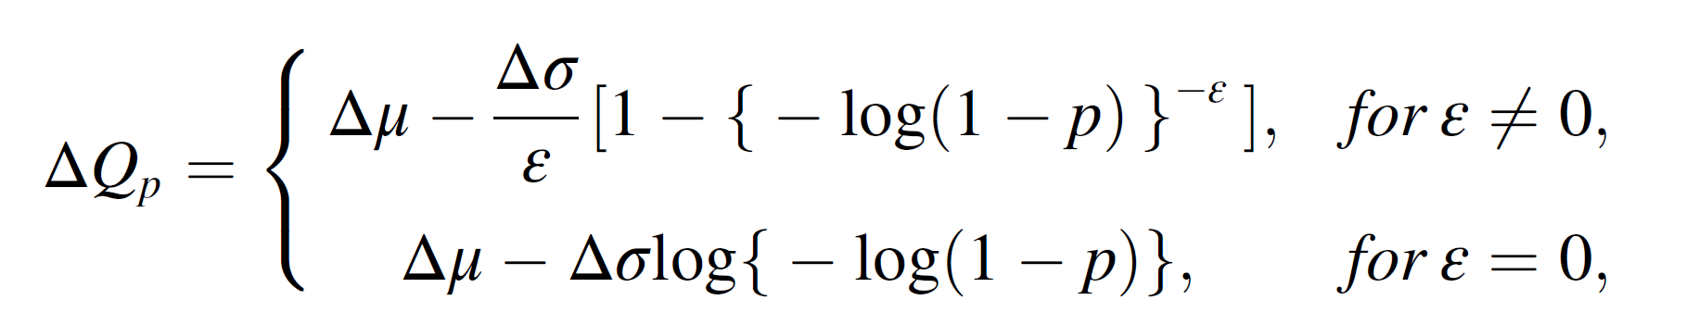

Slide 31
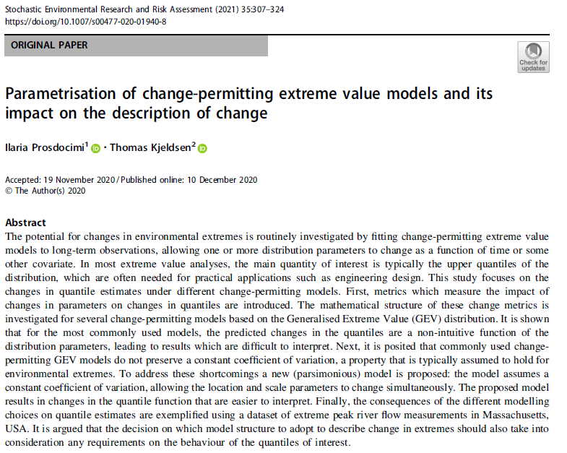

Slide 32
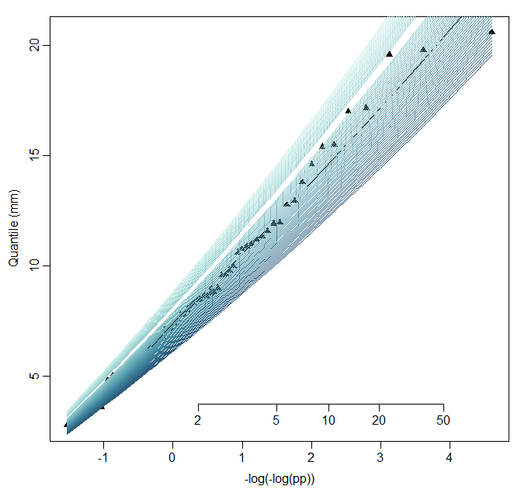

Slide 33
Further reading
- ‘best’ model
Jayaweera, L., Wasko, C., Nathan, R., 2025. Evidence for Non‐Stationarity in the GEV Shape Parameter When Modeling Extreme Rainfall. Water Resources Research 61, e2023WR036426.
Prosdocimi, I., Kjeldsen, T., 2021. Parametrisation of change-permitting extreme value models and its impact on the description of change. Stoch. Environ. Res. Risk Assess. 35, 307–324.
Stedinger, J. R., & Griffis, V. W. 2011. Getting from here to where? Flood frequency analysis and climate. Journal of the American Water Resources Association, 47(3), 506–513.
Serinaldi, F. and Kilsby, C.G., 2015. Stationarity is undead: Uncertainty dominates the distribution of extremes. Advances in Water Resources, 77, pp.17-36.
- ‘best’ covariate
Schlef, K.E., Kunkel, K.E., Brown, C., Demissie, Y., Lettenmaier, D.P., Wagner, A., Wigmosta, M.S., Karl, T.R., Easterling, D.R., Wang, K.J., François, B., Yan, E., 2023. Incorporating non-stationarity from climate change into rainfall frequency and intensity-duration-frequency (IDF) curves. Journal of Hydrology 616, 128757.
Jayaweera, L., Wasko, C., Nathan, R., 2024. Modelling non-stationarity in extreme rainfall using large-scale climate drivers. Journal of Hydrology 636, 131309.
Schlef, K.E., François, B., Robertson, A.W., Brown, C., 2018. A General Methodology for Climate-Informed Approaches to Long-Term Flood Projection—Illustrated With the Ohio River Basin. Water Resources Research 54, 9321–9341. https://doi.org/10.1029/2018WR023209

Slide 34

End slide with university and social links
Conrad Wasko
Sydney Horizon Fellow
Editor Journal of Hydrology X
first.last@sydney.edu.au
conrad.wasko@sydney.edu.au

