Slide 1
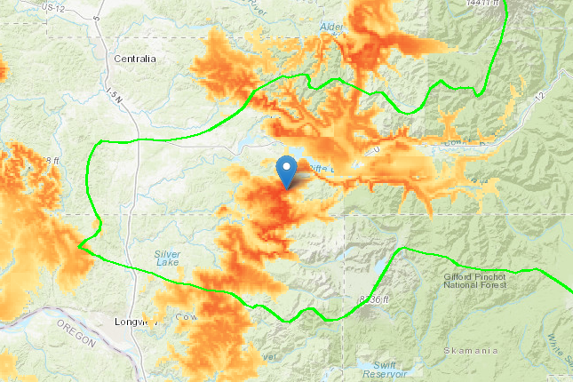
123.31 °W
123.31 °W
182.2 mi
123.31 °W
Low
High
123.31 °W
Match
Created on 1/1/1970 by the Seedlot Selection Tool

