Slide 1
COSC 310
Mapping For Change

Slide 2
Customer Info
-Kerry Rempel
-Professor in the School of Business at Okanagan College on the Kelowna campus
-Member of iSearchKelowna research team behind the Mapping for Change initiative
Notes:
(Reece)

Slide 3
Business Requirements
-Our goal is to extend an existing system, the iSearchKelowna mapping for change initiative, to perform a more thoughtful analysis of the data about local facilities
-Our task was to come up with meaningful visualizations from the provided data (a .csv file) instead of users manually performing analytics on this file.
Notes:
(Justin)

Slide 4
Vision
-The end goal of our project is to generate useful representations of the provided data, and to demonstrate what is possible with more info.
-Our deliverable would consist of a single, standardized report that would present these meaningful comparisons to viewers in a digestible way.
Notes:
(Justin)

Slide 5
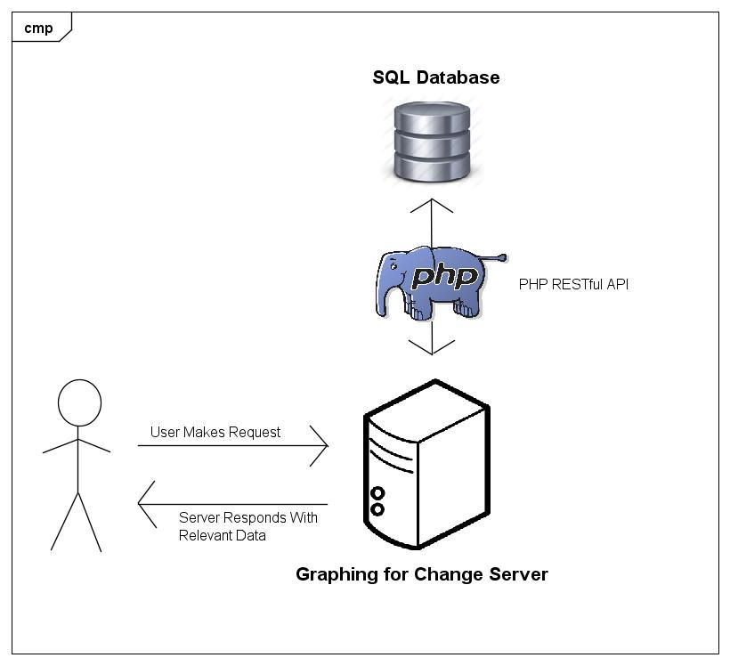
High Level
Architecture
Diagram

Slide 6
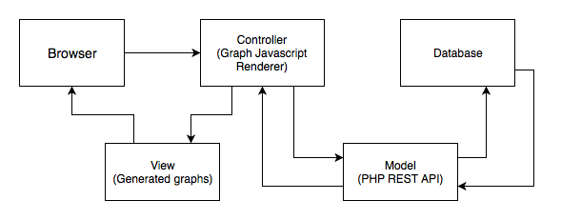
Model View Controller Arch.
Notes:
(Reece)

Slide 7
Configuration Management
-One team member is delegated as the git repository manager. The master branch cannot be directly pushed to under normal circumstances.
- The git repository is used for storing code relevant documentation, so that it is is on hand.
- We have relevant development environment knowledge under the “res” folder from to root of our repository
-PHPUnit test configuration is passed along with the repository.
Notes:
(Dan H.)

Slide 8
Configuration Management (Cont.)
Master was locked for the duration of sprints so that pull requests were essentially mandatory.
Our repository manager would then take peoples pull requests, make a new branch off of master, merge into this branch, test it, merge back into master, and run all unit tests again.
This was all done to minimize the risk of corrupting the mainline
Notes:
(Dan H.)

Slide 9
Plan Overview
The content of this project was conceived by the development team after talking to Kerry about her vision for what this project would accomplish.
Each sprint begins with a group meeting wherein we decide and delegate tasks to each group member. These tasks are listed and assigned on JIRA.
Agile methodologies and Extreme Programming philosophy is employed during sprint development.
Notes:
(Reece)

Slide 10
Planning Outcomes
-Agile methods allowed for a flat hierarchical structure where each member was actively contributing to the project.
-Extreme Programming with pair programming proved to be a valuable asset in achieving rapid, efficient development.
-JIRA proved to be a useful tool in coordinating group efforts during each sprint.
Notes:
(Reece)

Slide 11
Project Organization
Positions:
Kerry Rempel (Client)
Reece Walsh (Scrum Master)
Jeff Thomson (Product Owner Representative)
Daniel Herman (Repository Manager)
Zach Bentsen (Developer)
Thomas Reid (Developer)
Daniel Schwab (Developer)
Justin Habetz (Developer)
Notes:
(Reece)

Slide 12
Sprint 4 Overview
-Refactor data generation
-Write additional tests
-Clean up data transfer
-Break apart our graph display javascript file into smaller, more manageable files that are based around the graph section they display
-Fix any documentation errors
Notes:
(Reece)

Slide 13
Sprint 4 Outcomes
-All sprint tasks and goals were completed successfully
-Our codebase was successfully refactored to promote readability, efficiency, and correctness (more on this later)
Notes:
(Reece)

Slide 14
Risk Management
-We assumed that the graphs we created displayed meaningful comparisons. Our comparisons were formulated based off of correspondence from the client. These graphs have been verified through a client demo.
-Rely upon Content Delivery Networks for graphing capabilities. EG: Google content delivery network for the Google Charts Library.
Notes:
(Zach)

Slide 15
Risk Management (Cont.)
-We rely upon the availability and correctness of our hardware.
-Specifically, we rely upon our database to return requested data in a timely and error free manner. We also depend upon our web server to serve and request resources in an error free manner as well.
Notes:
(Zach)

Slide 16
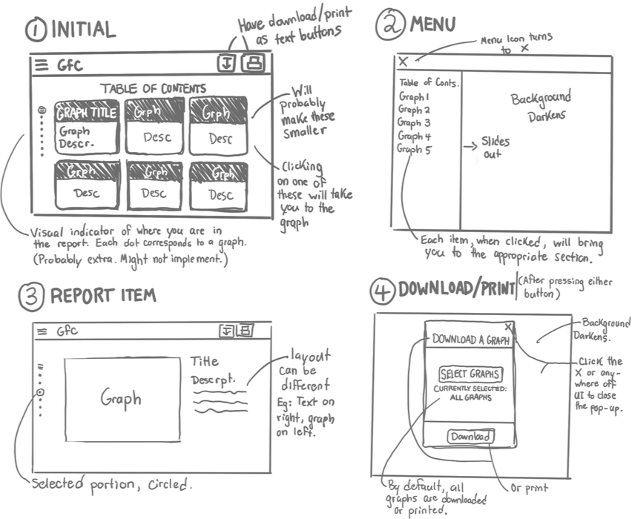
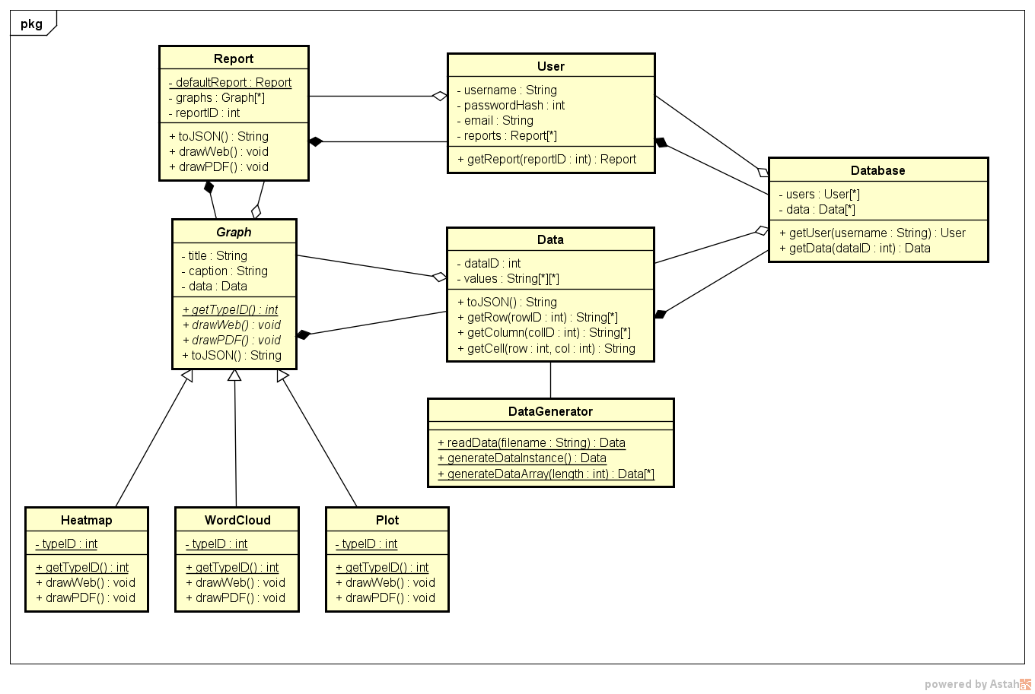
Design
Preliminary UI Design
Class Design Diagram
Notes:
(Reece / Jeff)

Slide 17
Design Interfaces
-The Representational State Transfer ( stylized as REST) API was used to deploy our PHP API. The pattern allowed us to separate PHP to database relations
Notes:
(Jeff)

Slide 18
Testing
-We use PHPUnit for any php code on the server. There is a configuration file passed around with the repository that specifies our automated test suite.
-We have a google charts json Parser/format verifier for testing the data sent back to the client from the server.
-When generating data, we are representing random behaviour, so it is somewhat difficult to test this method, so a statistical method is used.
Notes:
(Jeff / Dan H)

Slide 19
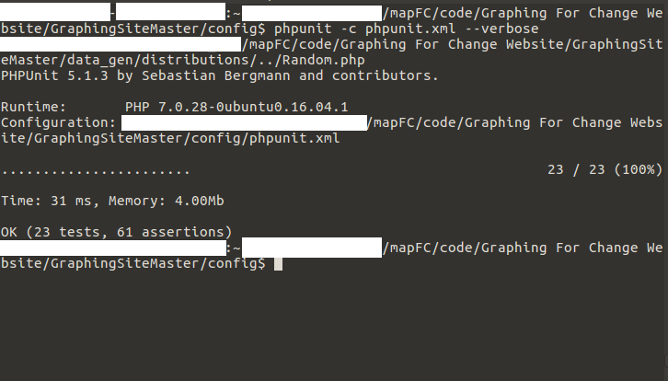
Testing
Output
Notes:
(Daniel H.)

Slide 20
Refactoring
-The javascript file that was used to render our graphs was broken up into smaller, more manageable file. Each file is used to render a section of graphs (EG: the Demographic section).
-Unified Random Number Generation, removed useless graph, broke some server side code into a distribution class, Removed a graph that the client did not want.
Notes:
(Reece)

Slide 21
Release Information
-Licensed under the GNU LGPL (Lesser General Public License)
-Allows for commercial use, distribution and modification
Notes:
(Dan S.)

Slide 22
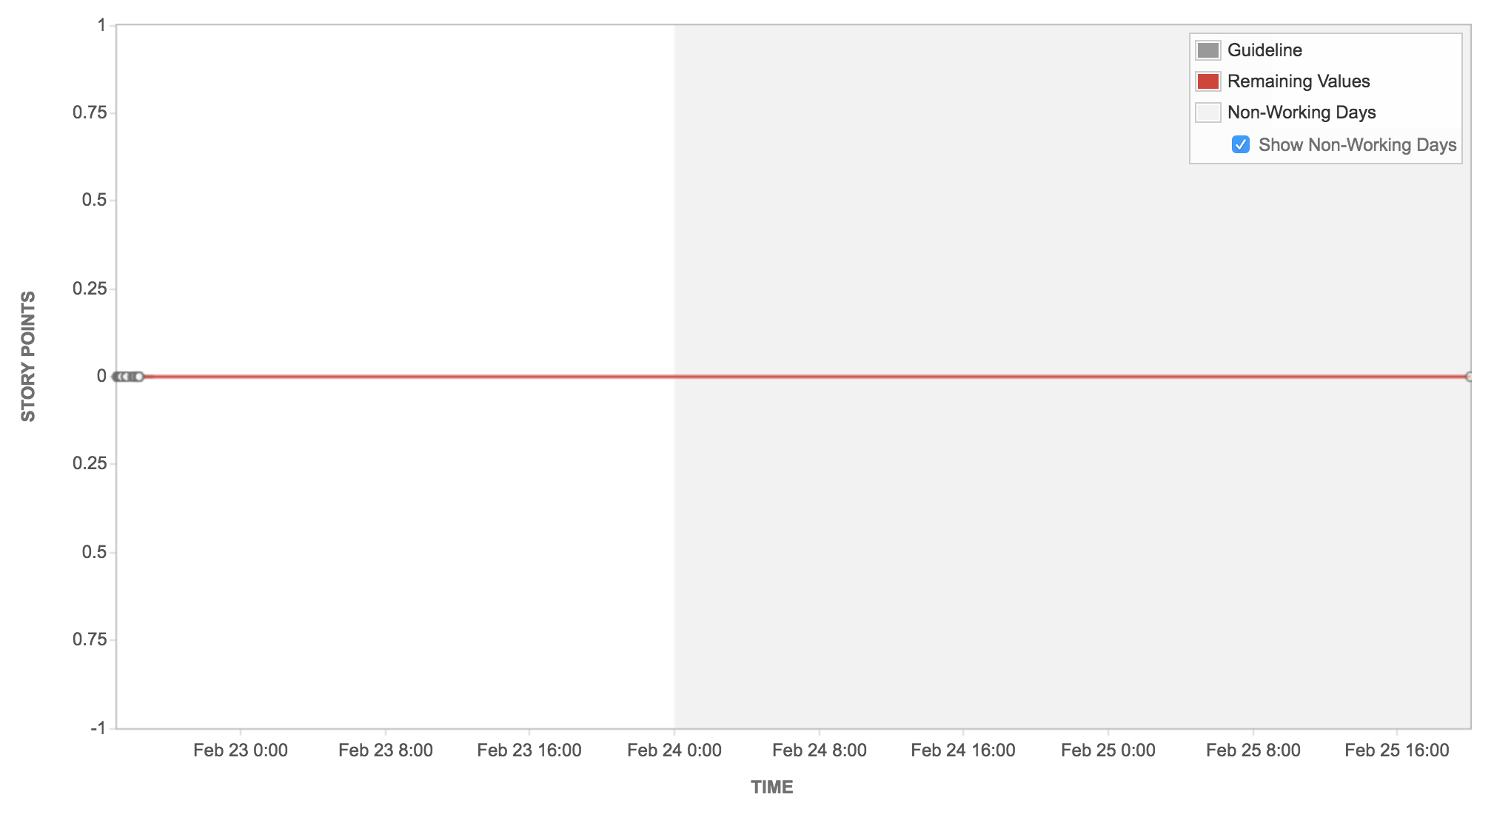
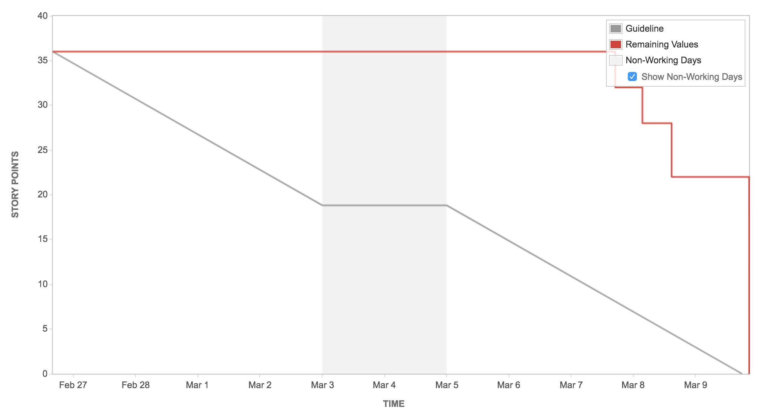
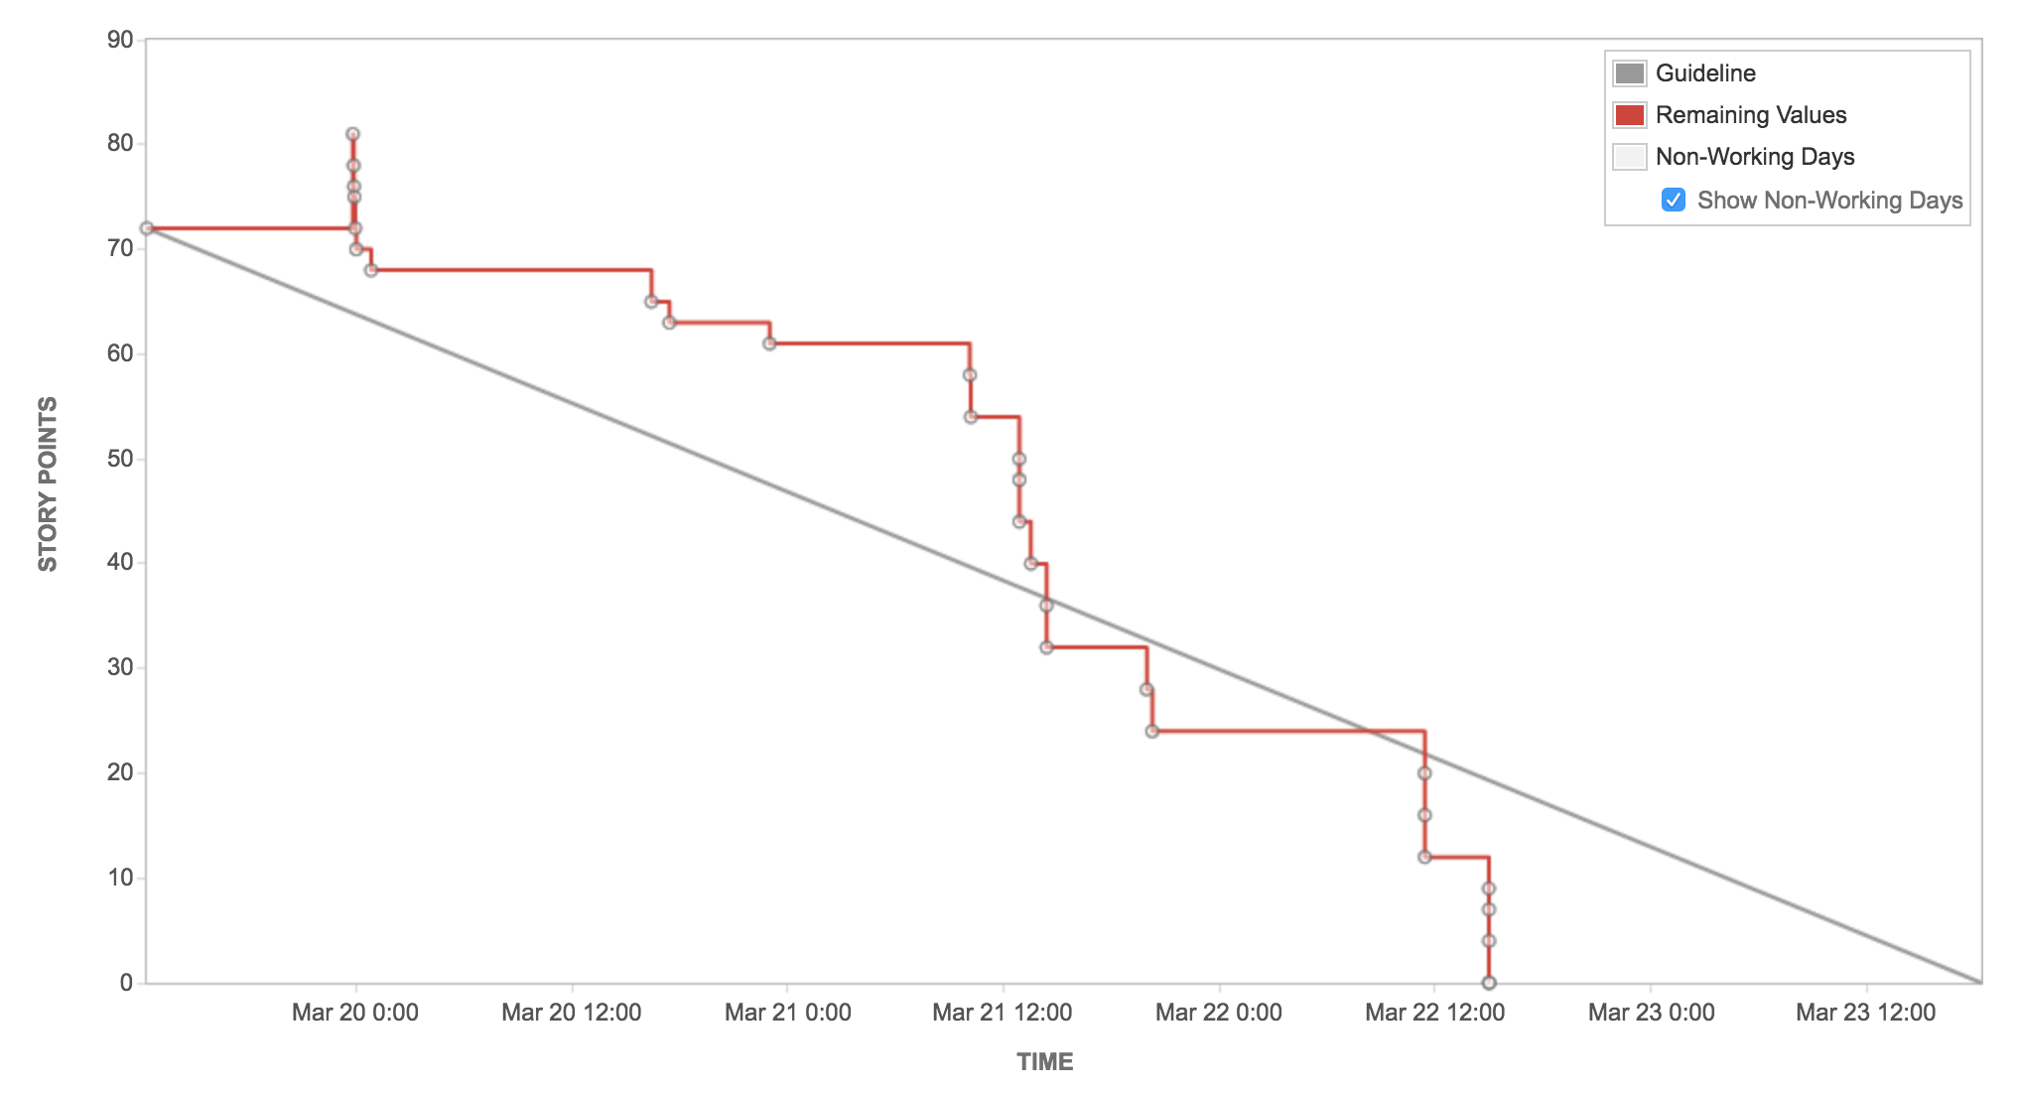
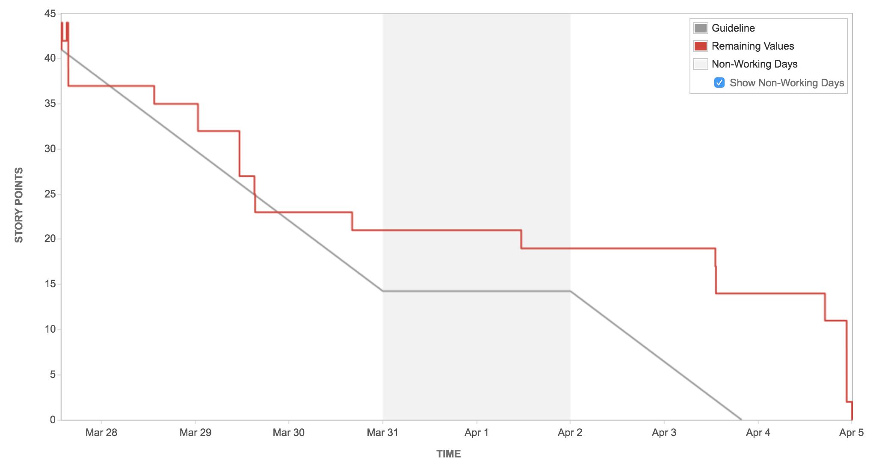
Sprint Burndown charts
Notes:
(Reece)

Slide 23
Summary
-We completed our project (in the alloted time) to the satisfaction of our client.
-Agile methodologies and Extreme Programming philosophy was employed successfully.
Notes:
(Reece)

