Slide 1
DIGITAL MARKETING AGENCY · GOA
SANCTIFY
Award-winning Advertising & Digital Marketing Agency in Goa
www.sanctify.in

Slide 2
OVERVIEW
What's inside
01
Who we are
04
Graphic design portfolio
02
What we do
05
What our clients say
03
Why Sanctify — results & reach
06
Let's work together
Sanctify — Digital Marketing Agency in Goa
02 / 21

Slide 3
Who we are
Vasco, South Goa · India
Established An award-winning advertising & digital marketing agency serving Goa for over 13 years.
One partner A full suite of services under one roof — strategy, creative, web and performance.
Measurable A competitive response rate and quantifiable results set us apart.
Creative An 'Amaze Creation Agency' — creative ideas paired with strategic execution.
Sanctify — Digital Marketing Agency in Goa
03 / 21
Notes:
Open with the Sanctify story: 13+ years, Vasco/South Goa, award-winning, full-service, results-driven.

Slide 4
01
SERVICES
What we do

Slide 5
COMPARE
A full-suite agency
Digital Performance marketing
Brand Creative & web
Search Engine Optimization (SEO)
Website design & development
Search Engine Marketing / PPC
Logo, branding & identity
Social Media Marketing (SMM)
Graphic design & collateral
Google, Meta & LinkedIn Ads
Online classifieds
Email marketing & Bulk SMS
Newspaper & outdoor ads
Sanctify — Digital Marketing Agency in Goa
05 / 21
Notes:
We cover the full journey from brand identity through website to demand generation.

Slide 6
BY THE NUMBERS
Why Sanctify
Track record
4.8/5
13+
2600+
100+
Top-rated agency
Years of experience
Daily website visitors
Websites developed
128 reviews
serving Goa
sanctify.in
and counting
Sanctify — Digital Marketing Agency in Goa
06 / 21
Notes:
Credibility markers pulled from the website. Numbers are the agency's stated figures.

Slide 7
BY THE NUMBERS
Search visibility we deliver
Organic reach
1200+
800+
1000+
URLs indexed
URLs on Google top pages
Keywords on page 1
across the site
for target keywords
of Google.co.in
Sanctify — Digital Marketing Agency in Goa
07 / 21

Slide 8
02
SELECTED WORK
Graphic Design Portfolio

Slide 9


PORTFOLIO
Social & search creatives
Google Map post — thumbnail update
Social media post — Hindustan Petroleum (HP Gas)
Sanctify — Digital Marketing Agency in Goa
09 / 21

Slide 10
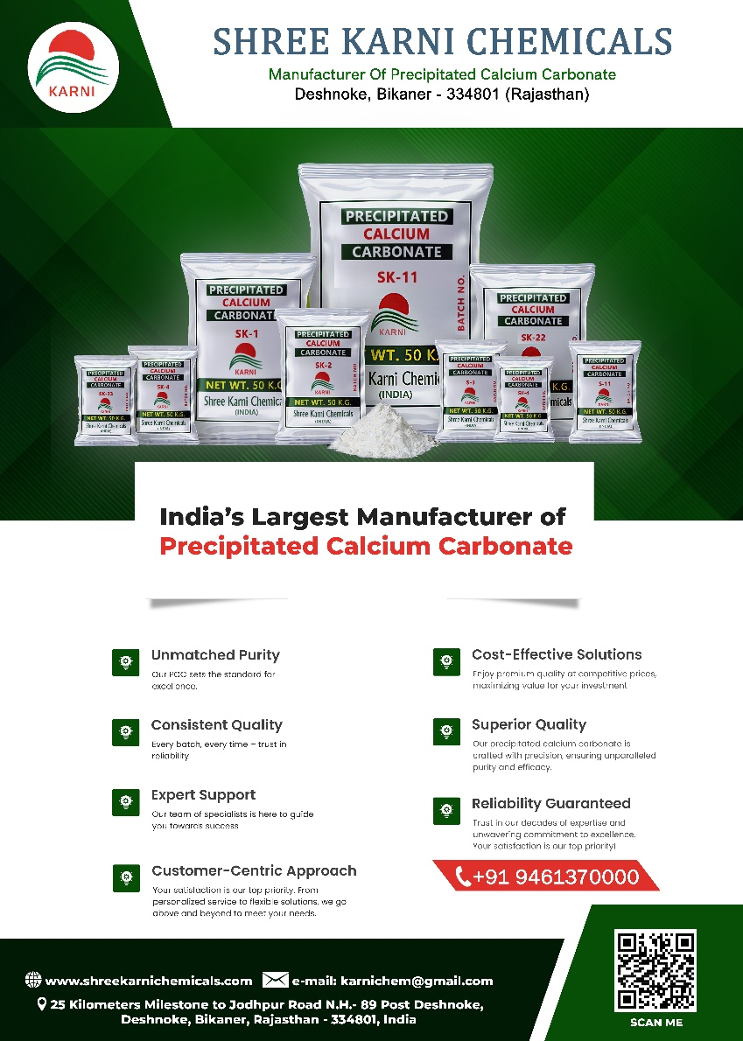
SHOWCASE
Print advertising
A4 flyer design — Karni Chemicals
Sanctify — Digital Marketing Agency in Goa
10 / 21

Slide 11
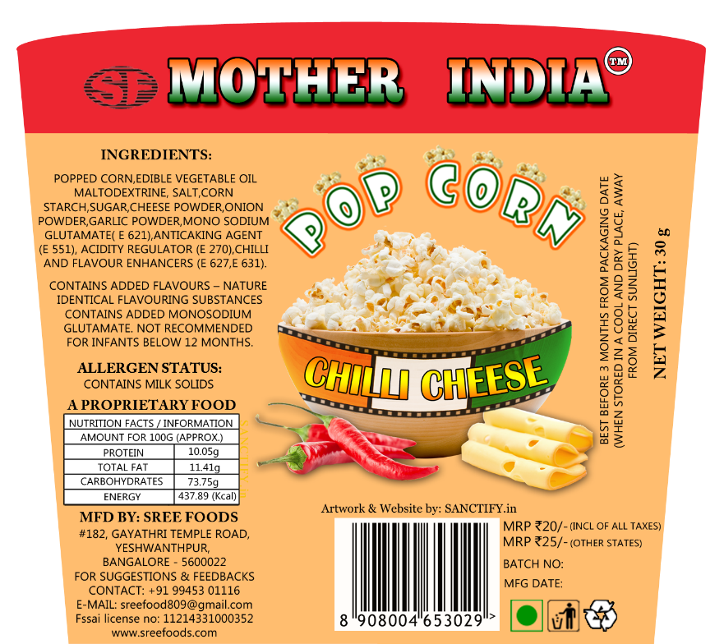
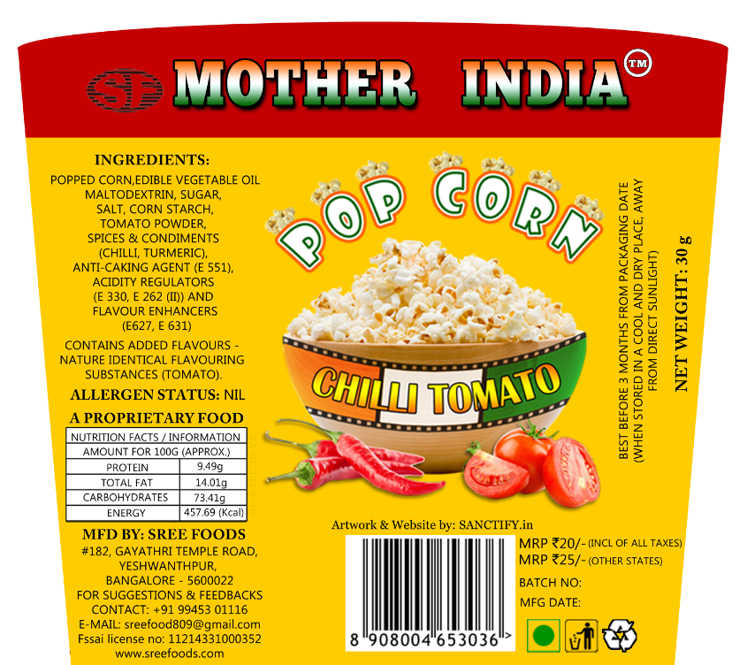
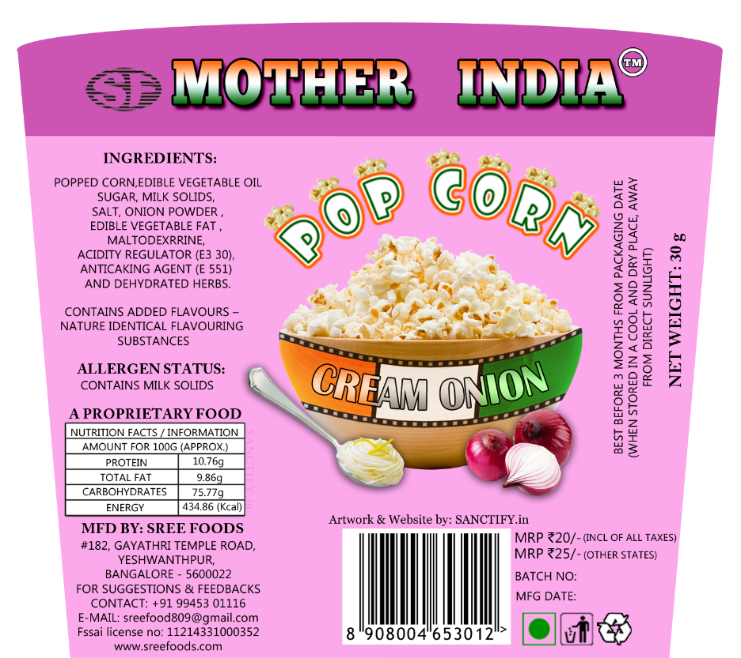
PORTFOLIO
Packaging design — popcorn tub covers
Flavour range
Chilli Cheese
Chilli Tomato
Cream Onion
Sanctify — Digital Marketing Agency in Goa
11 / 21

Slide 12
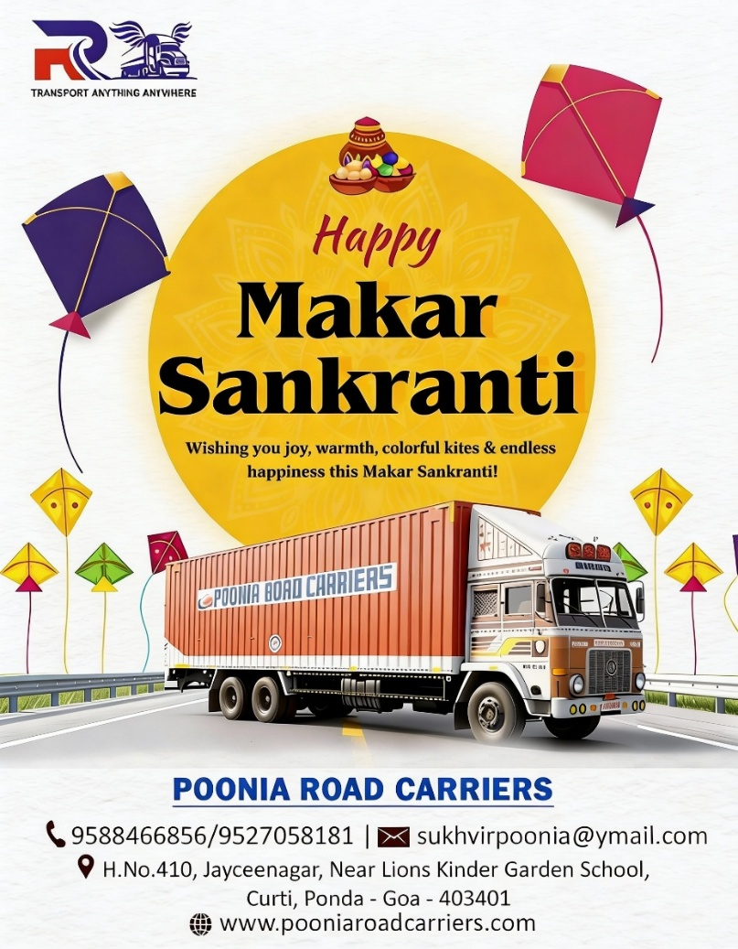

PORTFOLIO
Festival campaigns
Road Carrier — festival poster
Festival post
Sanctify — Digital Marketing Agency in Goa
12 / 21

Slide 13
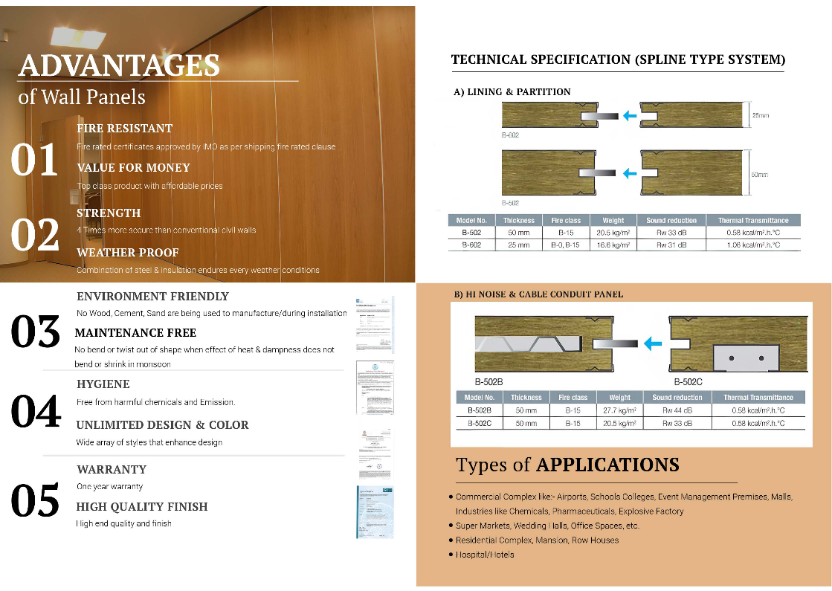

PORTFOLIO
Catalogue design
Inside page
Outside page
Sanctify — Digital Marketing Agency in Goa
13 / 21

Slide 14
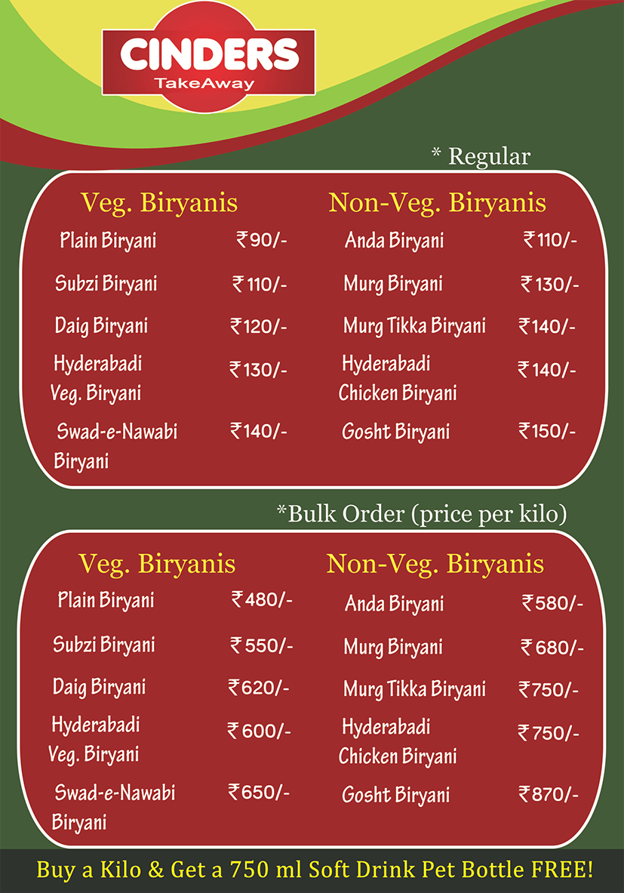

PORTFOLIO
Cinders Biryani — flyer
Front & back
Front
Back
Sanctify — Digital Marketing Agency in Goa
14 / 21

Slide 15


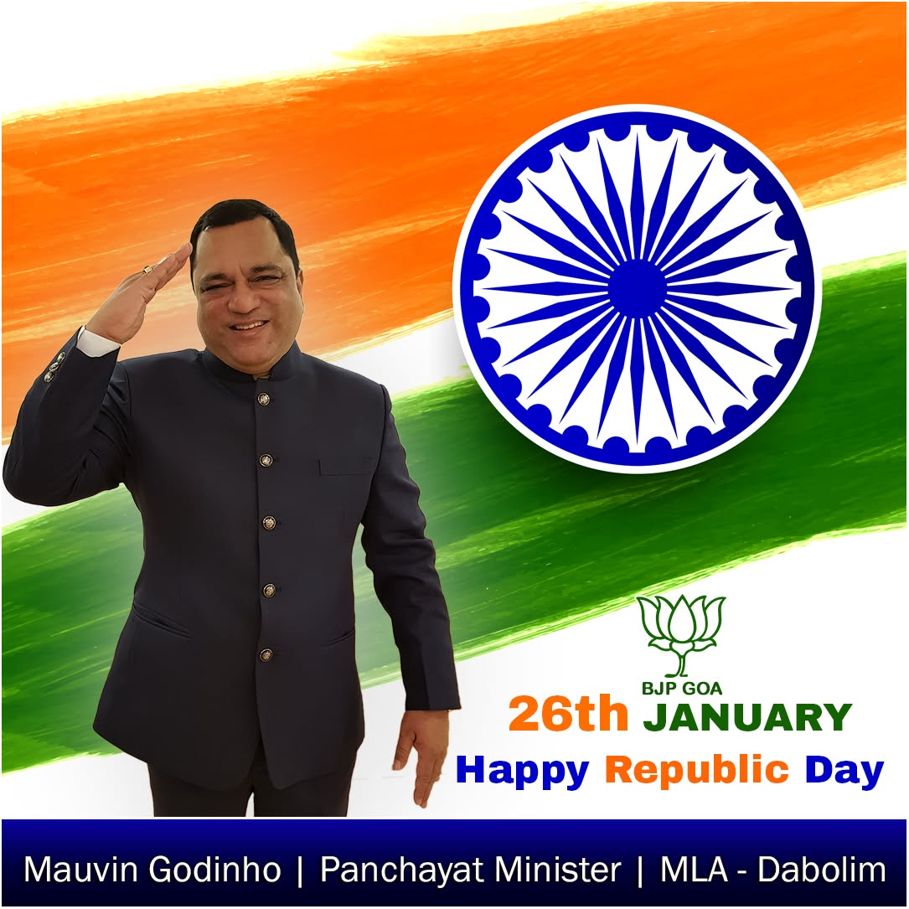
PORTFOLIO
Public-figure social media
Transport Minister Shri. Mauvin Godinho
Sanctify — Digital Marketing Agency in Goa
15 / 21

Slide 16
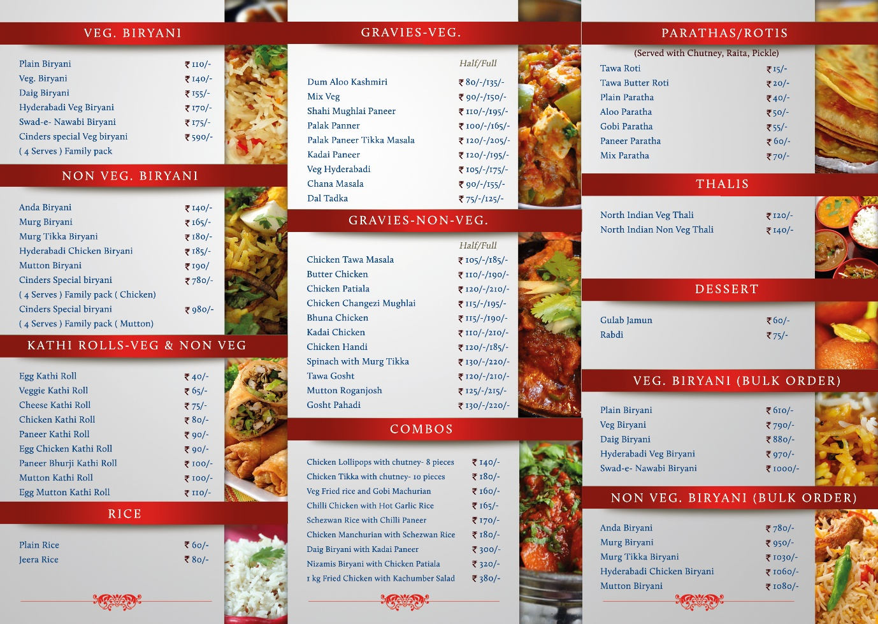
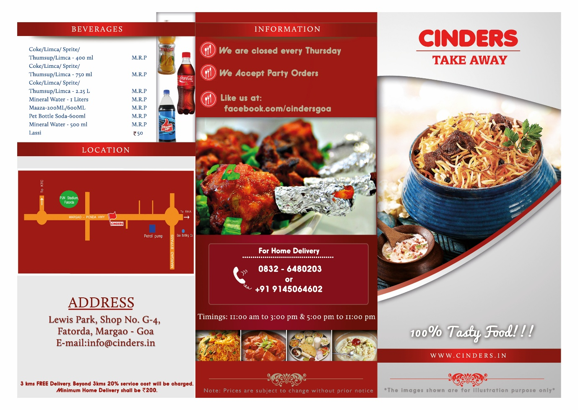
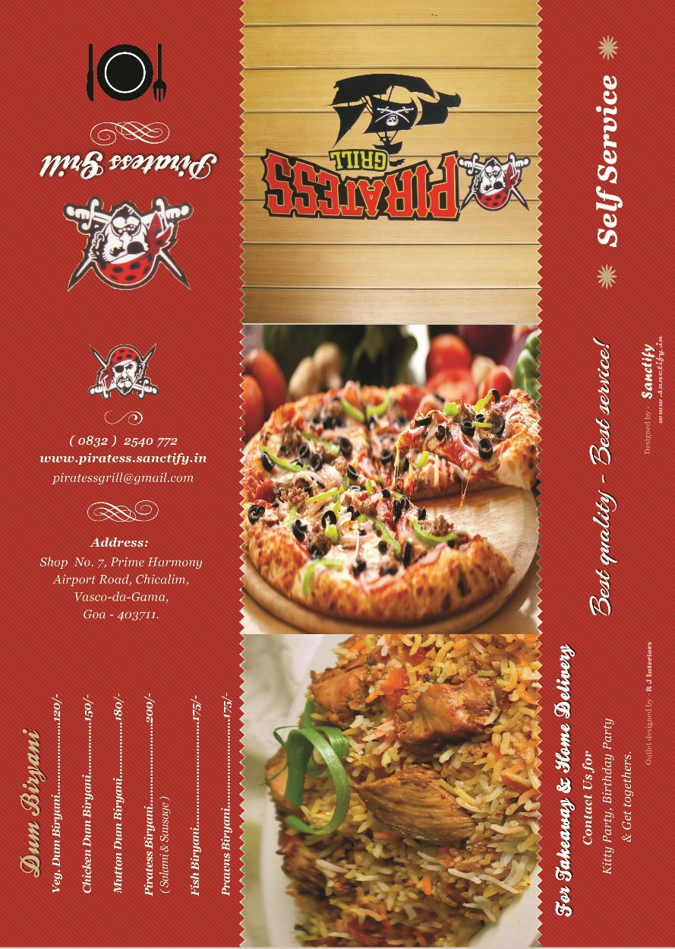
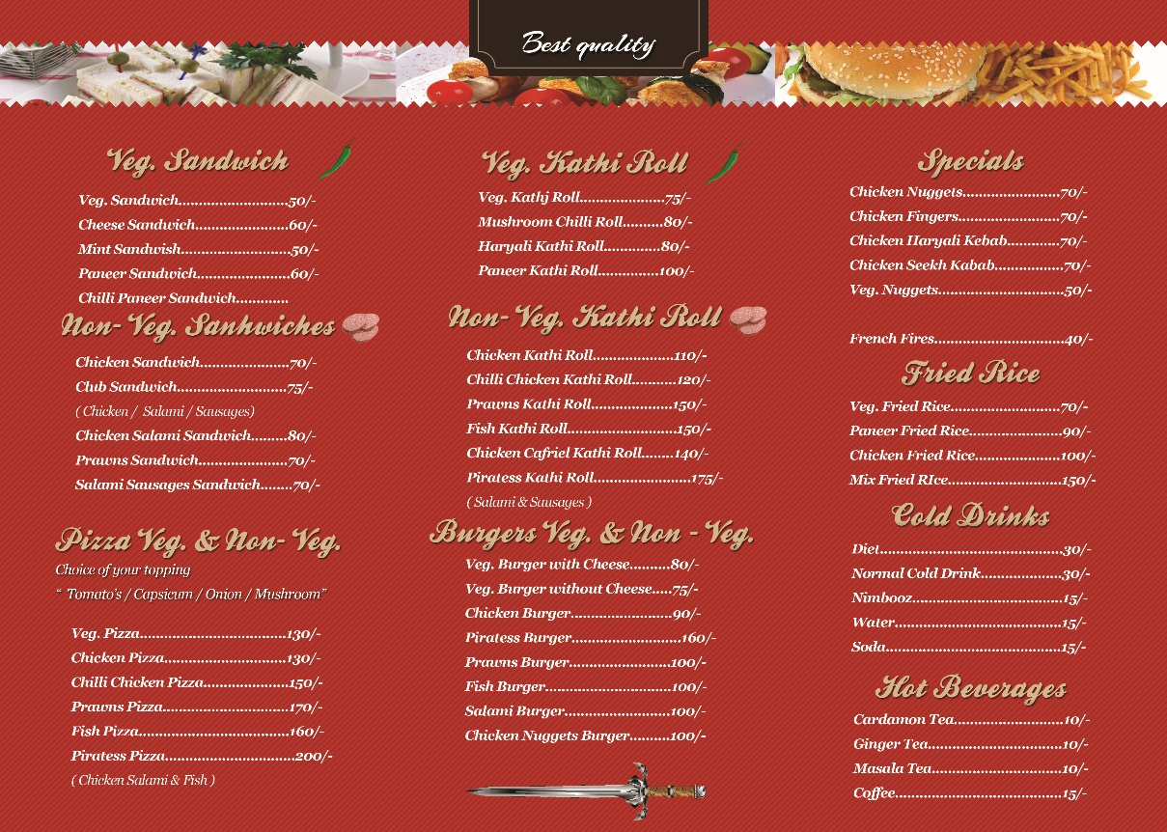
PORTFOLIO
Restaurant menu design
Sanctify — Digital Marketing Agency in Goa
16 / 21

Slide 17
03
TESTIMONIALS
What our clients say

Slide 18
“
Their expertise in SEO and social media helped us rank higher and win more customers — professional, responsive, and truly tuned to the local market.
Benz Nx — SEO & SMM services

Slide 19
“
They built our website and now run our social media — we're very happy with the results, and the team answers every query with real patience.
Pawan Raj — Web & digital marketing

Slide 20
Why businesses in Goa choose Sanctify
Local Over a decade of local expertise in the Goa market
Transparent Transparent, measurable results you can track
Full-suite SEO, web design and PPC under one roof
ROI-first A creative, results-driven approach focused on ROI
Sanctify — Digital Marketing Agency in Goa
20 / 21

Slide 21
GET IN TOUCH
Let's grow your brand
www.sanctify.in · Advertising & Digital Marketing Agency, Goa

