Slide 1
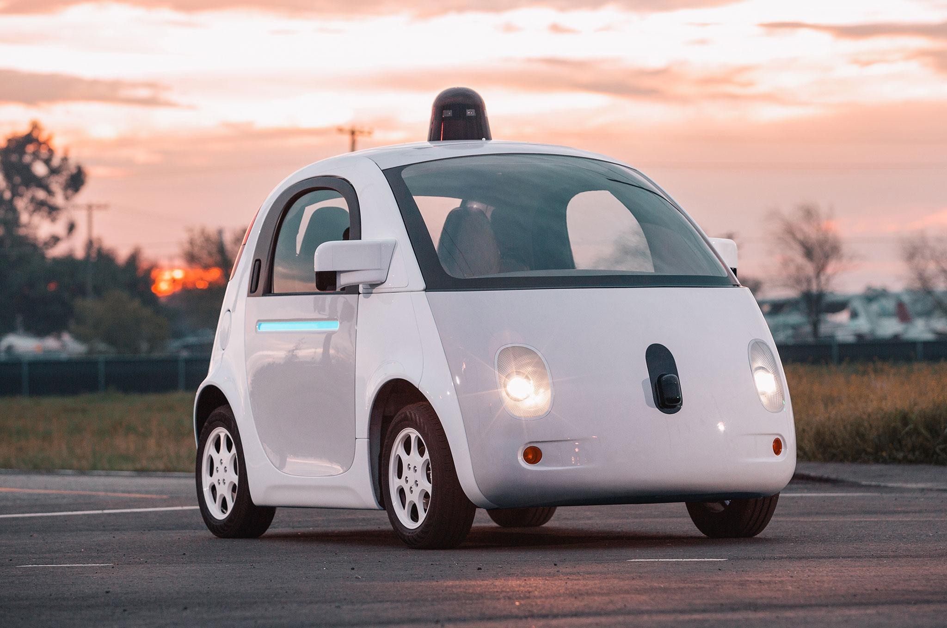
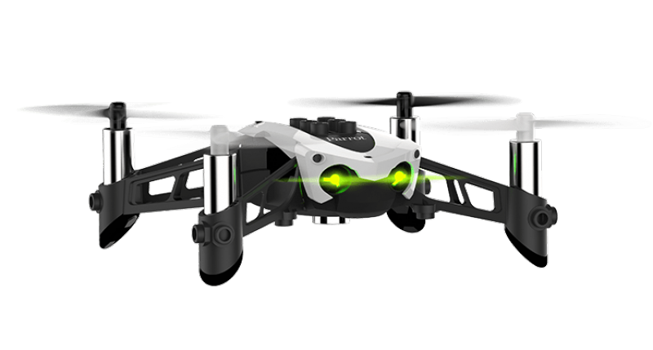
Blockbox
Using the blockchain to make our roads and skies safer
Notes:
We are using the blockchain to make our roads and skies safer Self driving cars and robot drones are coming, and will introduce a systemic risk to safety.

Slide 2
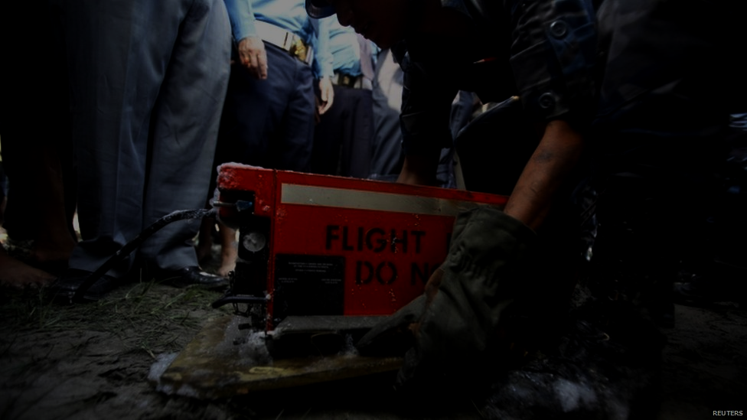
Benefits of a Virtual Blackbox
Independent review of safety data
Understand accidents
Make vehicles safer
Not destroyed in a crash
Reduce insurance premiums
Notes:
Just like we have “Blackboxes” in planes today, we want to use the blockchain as a globally distributed virtual blackbox for these new vehicles.
When a safety related event occurs, such as a crash or near miss, the vehicle will log the event to the blockchain.
Each Smart Vehicle will track these events via telemetry. This would include:
-Proximity
-Speeding
-NoIndication
-RedLight
---------------------
Why Blockchain - We need an independent trusted record of all events that all stakeholders can review but not change.
This data can be analysed to identify systemic safety problems and can be used to understand accidents.
These lessons will allow us to make these vehicles safer.
Unlike a physical blackbox, a virtual one does not need to be retrieved from a crashsite.
We imagine this will also reduce insurance premiums.
Each vehicle will record safety events on the blockchain by interacting with a single global smart contract.
Our prototype uses the Ethereum blockchain and the Azure cloud platform.

