Slide 1
Everyday PowerShell for System Administrators
Jimmy Taylor
IETA 2018
2018.02.07

Slide 2
Notes, Material, etc:
goo.gl/ooDVe5

Slide 3
Expectations

Slide 4

I am not
an expert.

Slide 5
"There’s a perception that you’re not ‘good enough’ to teach until you know everything"
Don Jones
Be the Master

Slide 6
Somewhat introductory session to PowerShell…

Slide 7
Somewhat intermediate session to PowerShell…

Slide 8
Be curious.

Slide 9
There are many ways to use PowerShell.

Slide 10
Objectives
- Embolden you
- Share what I've learned
- Provide examples
- Provide resources

Slide 11
What is PowerShell?

Slide 12
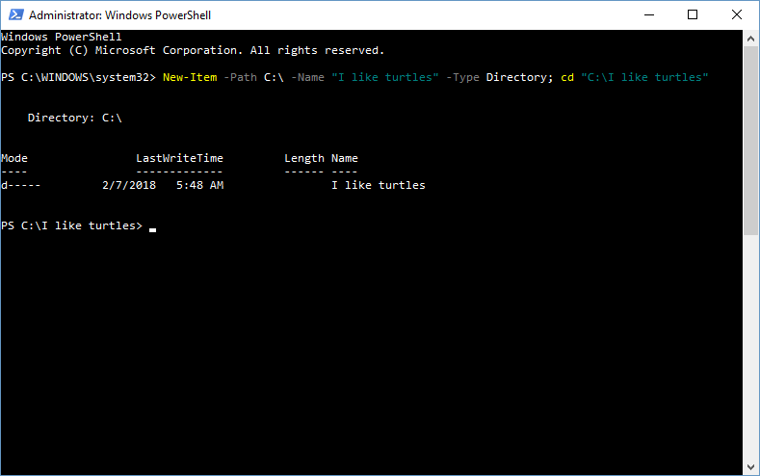

Slide 13
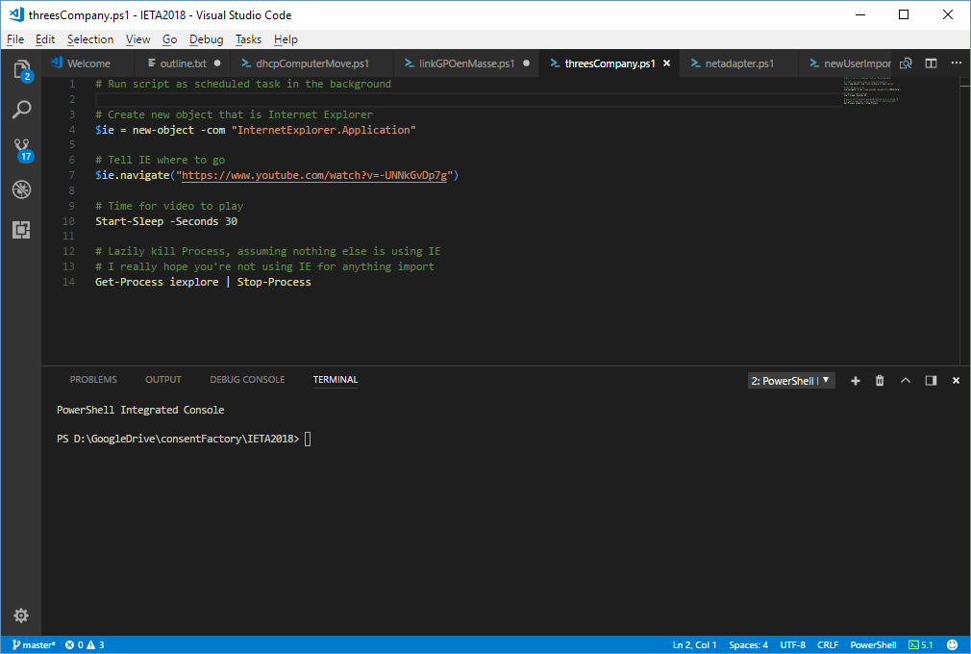

Slide 14
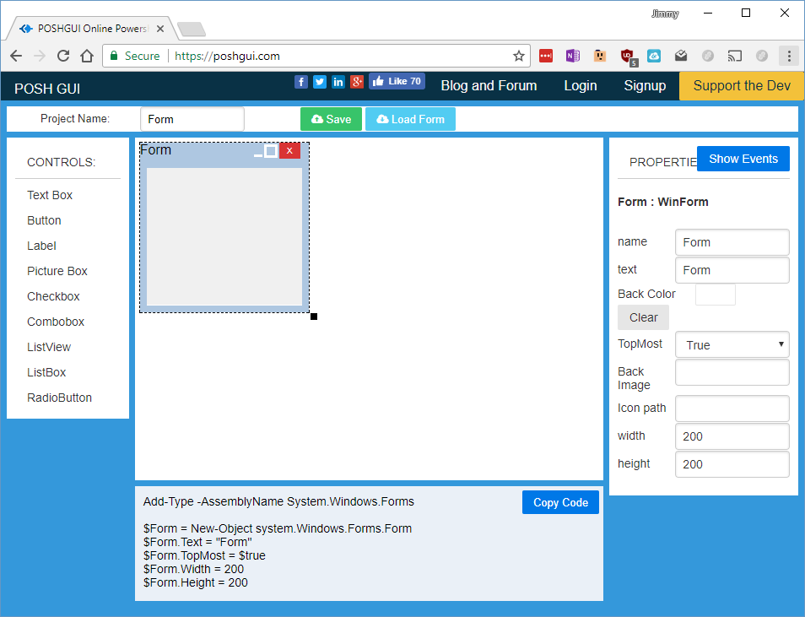

Slide 15
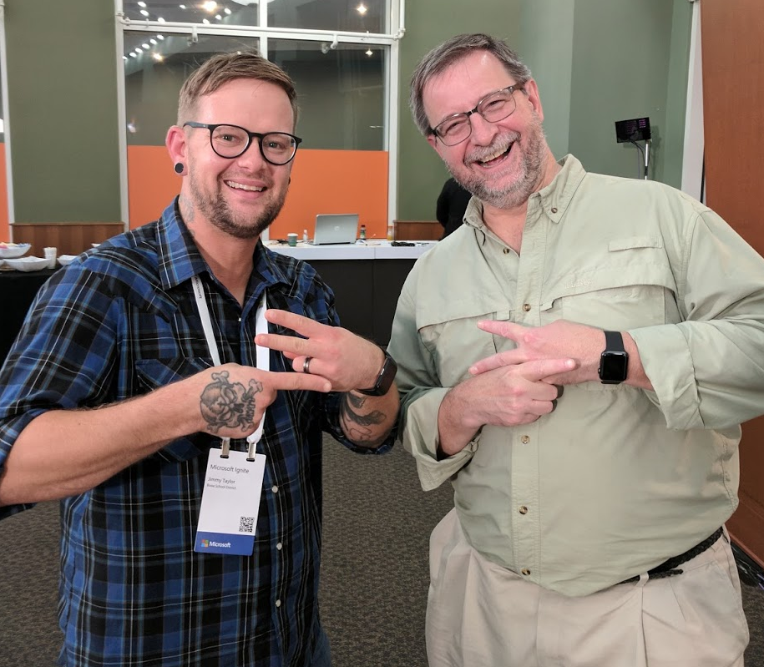
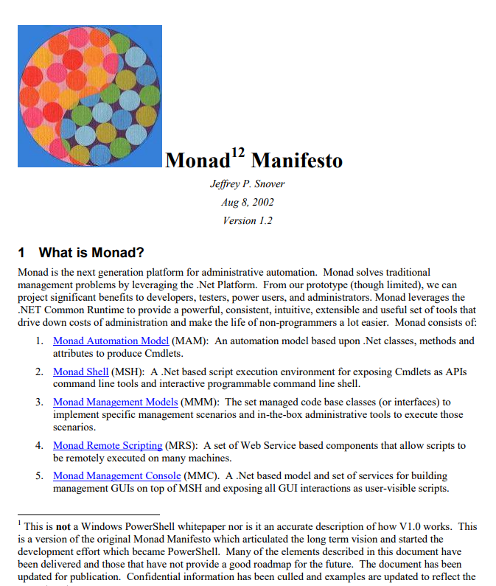

Slide 16
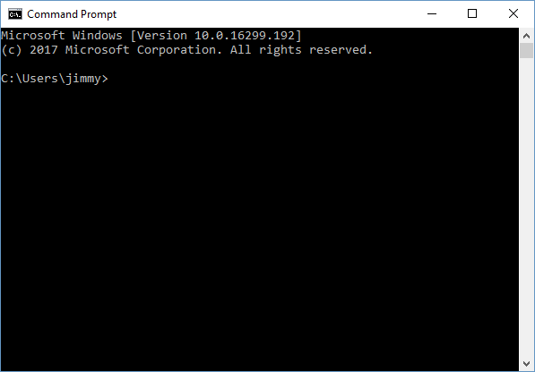
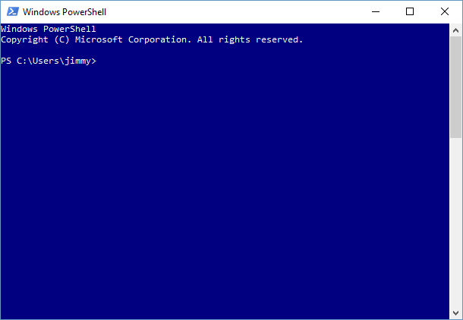
-->

Slide 17
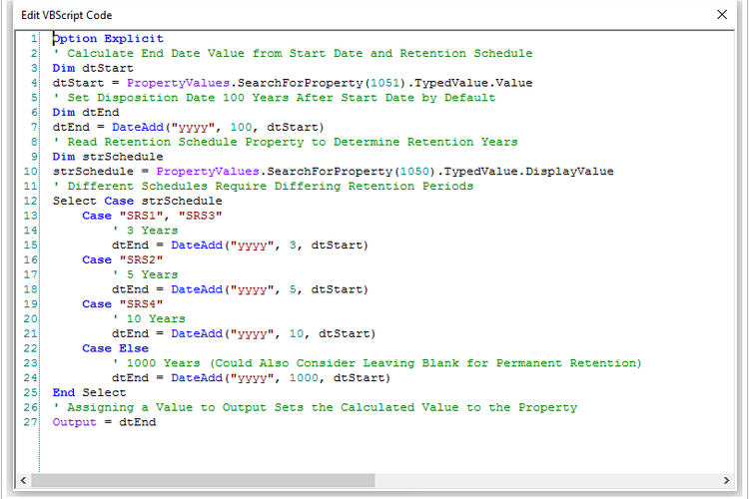
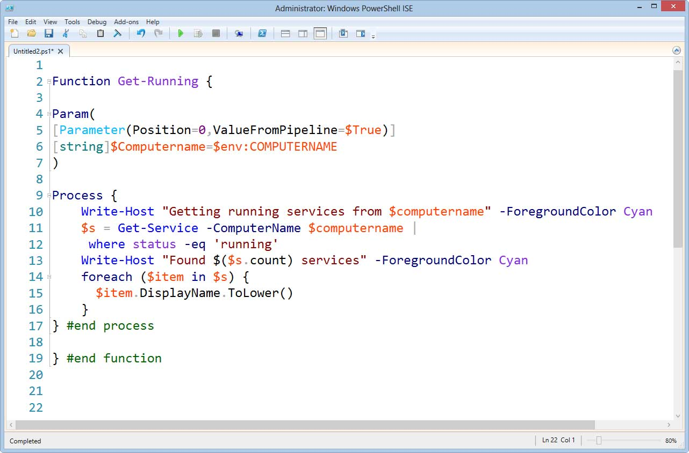
-->

Slide 18
$windows -ne $windowsPowerShell

Slide 19
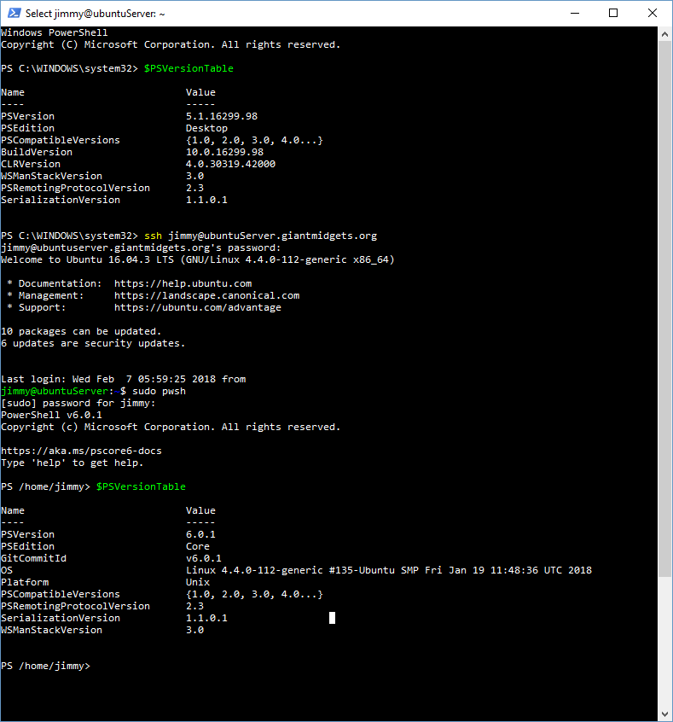
$windowsPowershell
-ne
$powershellCore

Slide 20
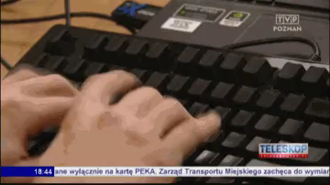
No more slides please…

Slide 22
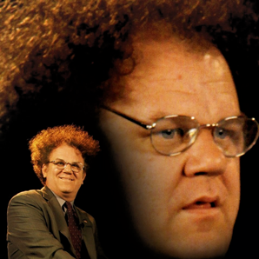
Contact Me (aka, shameless self-promotion)
goo.gl/ooDVe5
blog:
consentfactory.com
twitter:
@consentfactory
reddit:
reddit.com/r/k12sysadmin

