Slide 1



On-chip polarization-entangled photon-pair source based on silicon photonics integration
Laura González i Vilardaga
8 September 2026
Supervised by: Prof. Dr. Valerio Pruneri, Dr. Robin Camphausen, Dr. Javier Argüello-Luengo

Slide 2
Outline
Introduction
Our entangled photon source
Classical characterization
Quantum characterization – Quantum light generation
Quantum characterization – Entanglement certification
Conclusions & discussion

Slide 3
Outline
Introduction
Our entangled photon source
Classical characterization
Quantum characterization – Quantum light generation
Quantum characterization – Entanglement certification
Conclusions & discussion

Slide 4
Introduction
Presented approach
Classical characterization
Quantum characterization – Quantum light generation
Quantum characterization – Entanglement certification
Conclusions & discussion

Slide 5


Motivation
Solution?
QM

Slide 6
Motivation
Solution?
Device-independent QKD
QM

Slide 7
Motivation
Solution?
Device-independent QKD
QM
Entanglement source

Slide 8
Motivation
Solution?
Device-independent QKD
QM
Entanglement source
Polarization-entangled photon source (EPS)

Slide 9
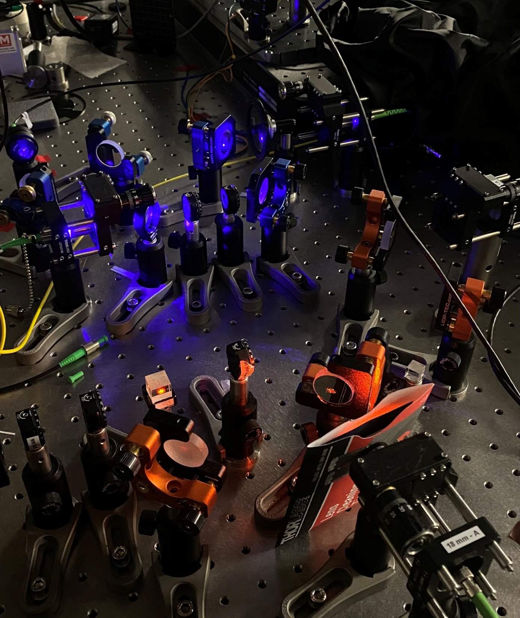
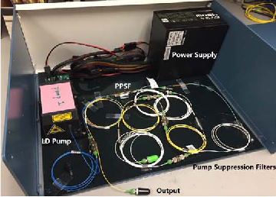
State of the art
Chen, Changjia et al. CLEO) (2018): 1-2.

Slide 10
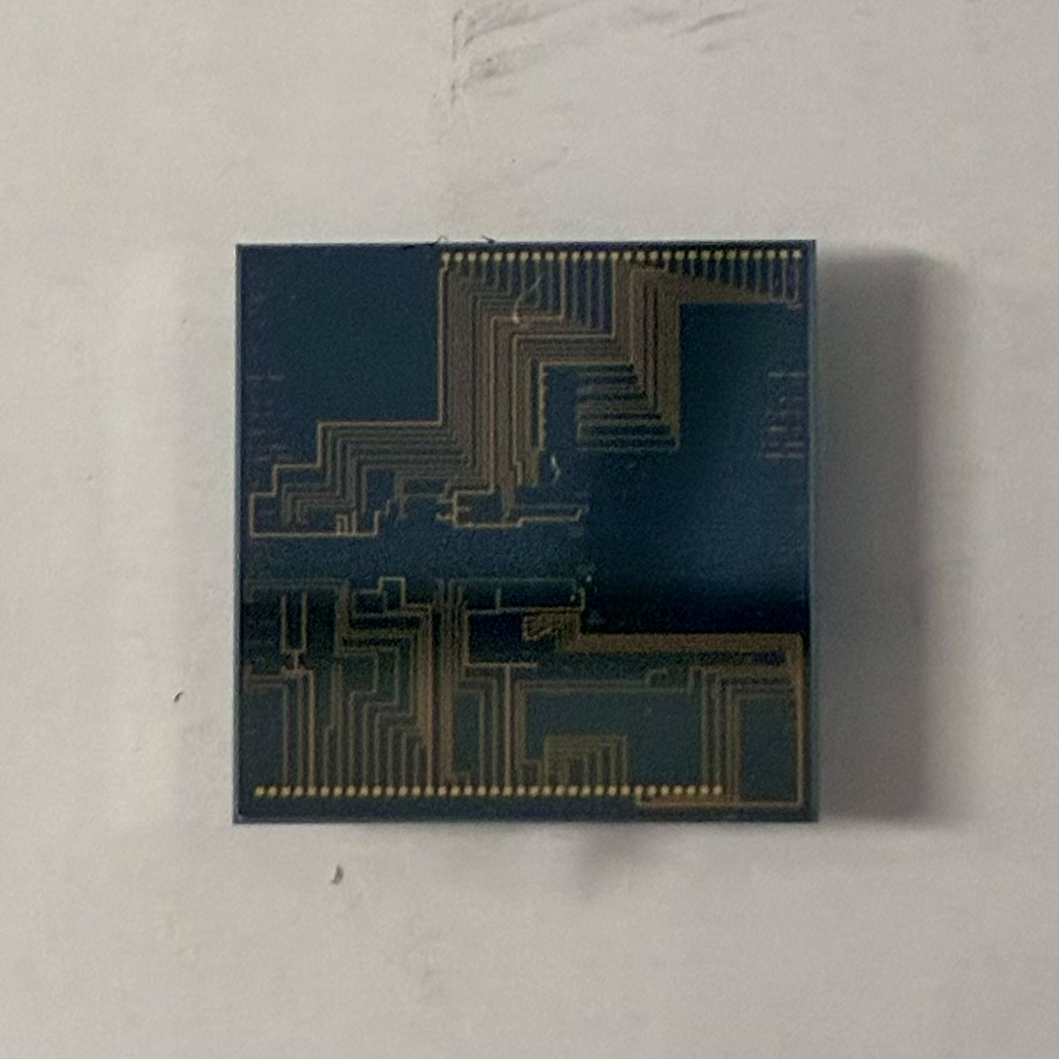
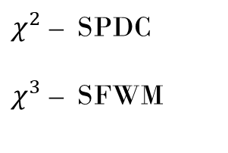
State of the art
$χ^{2}$ – SPDC
$χ^{3}$ – SFWM
Chen, Changjia et al. CLEO) (2018): 1-2.

Slide 11
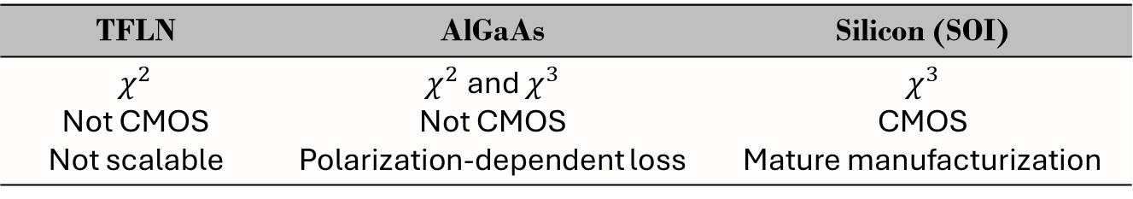
State of the art
$χ^{2}$ – SPDC
$χ^{3}$ – SFWM
Chen, Changjia et al. CLEO) (2018): 1-2.
TFLN | AlGaAs | Silicon (SOI)
$χ^{2}$ Not CMOS Not scalable | $χ^{2}$ and $χ^{3}$ Not CMOS Polarization-dependent loss | $$χ^{3}$$ CMOS Mature manufacturization

Slide 12
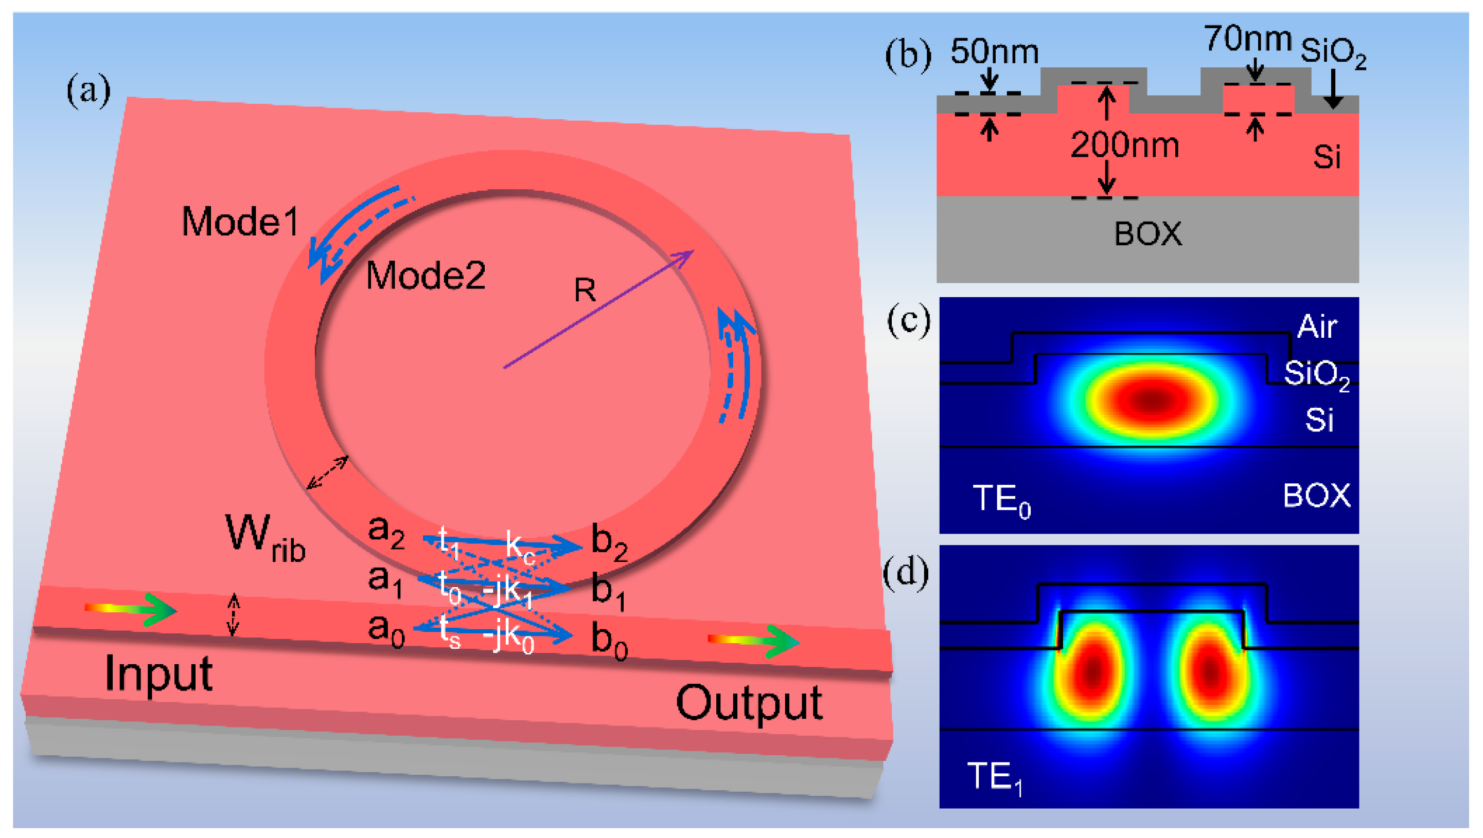
State of the art (silicon)
MRR
Matsuda et al. | Zhang et al. | Jing Suo et al.
No MRR Single pass waveguide | Two MRRs Active thermal tuning | Hybrid Sagnac off-chip
https://asktheman.xyz/
Ref
Figuras de los papers

Slide 13
Bottleneck
Too complex
High production costs
Not easily scalable
The gap:
Entirely on-chip
Passively stable
CMOS-compatible

Slide 14
Bottleneck
More complex
High production costs
Less scalable
The gap:
Entirely on-chip
Passively stable
CMOS-compatible
Monolithically integrated polarization-entangled EPS on SOI, stable by design

Slide 15
Thesis objectives
Construction of PIC setup
Classical characterization
Quantum light generation
Entanglement certification

Slide 16
Introduction
Presented approach
Classical characterization
Quantum characterization – Quantum light generation
Quantum characterization – Entanglement certification
Conclusions & discussion

Slide 17
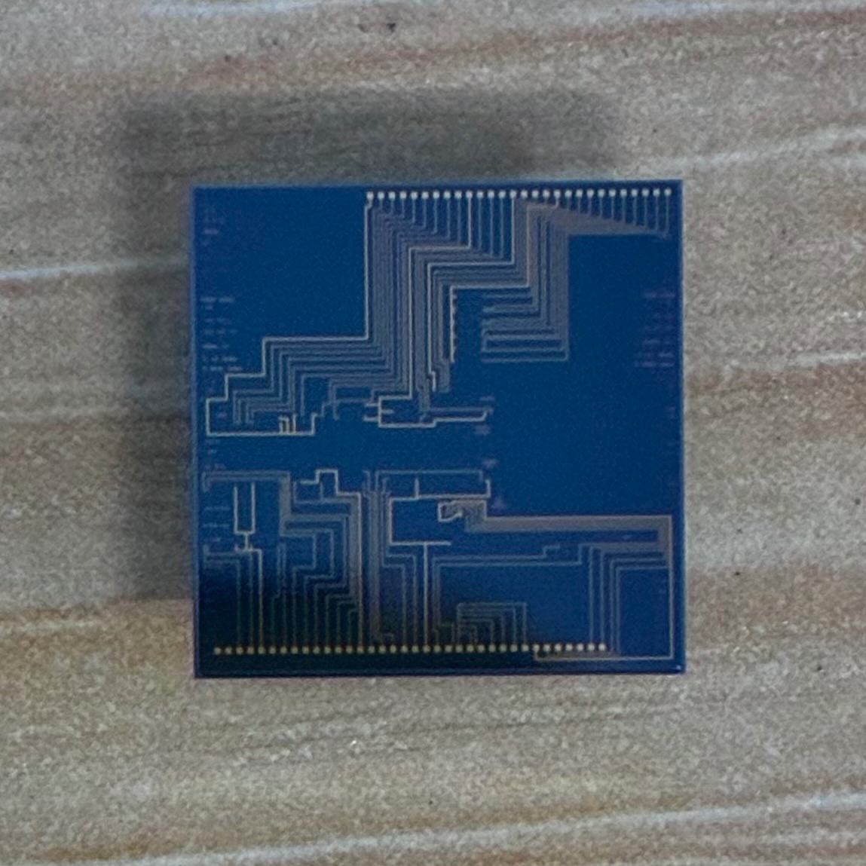
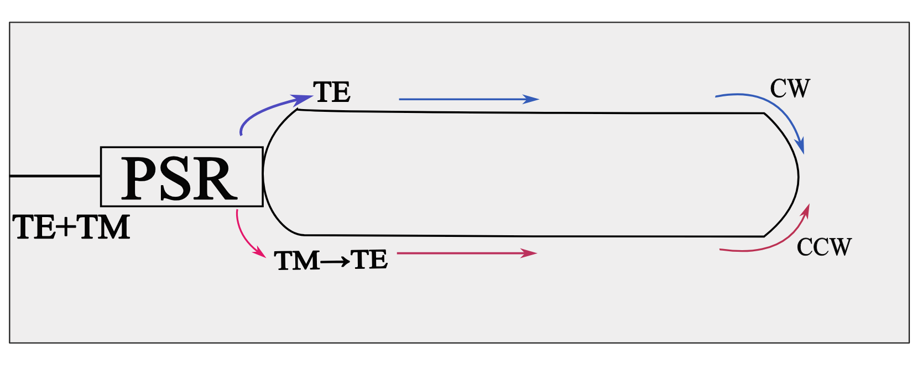
Photonic integrated circuit
Sagnac loop

Slide 18
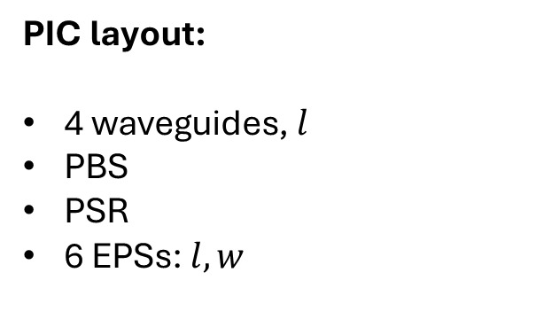
Photonic integrated circuit
PIC layout:
4 waveguides, $l$
PBS
PSR
6 EPSs: $l,w$
Sagnac loop

Slide 19
Introduction
Presented approach
Classical characterization
Quantum characterization – Quantum light generation
Quantum characterization – Entanglement certification
Conclusions & discussion

Slide 20
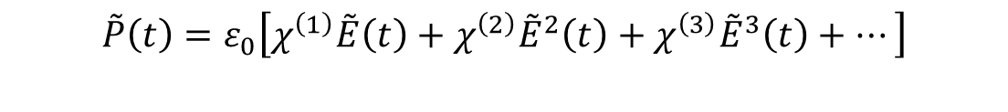
Nonlinear silicon photonics
Theory
Objectives
Setup
Results
$$\overset{˜}{P}\left(t\right)=ε_{0}\left[χ^{\left(1\right)}\overset{˜}{E}\left(t\right)+χ^{\left(2\right)}{\overset{˜}{E}}^{2}\left(t\right)+χ^{\left(3\right)}{\overset{˜}{E}}^{3}\left(t\right)+…\right]$$

Slide 21
Nonlinear silicon photonics
Theory
Objectives
Setup
Results
$$\overset{˜}{P}\left(t\right)=ε_{0}\left[χ^{\left(1\right)}\overset{˜}{E}\left(t\right)+χ^{\left(2\right)}{\overset{˜}{E}}^{2}\left(t\right)+χ^{\left(3\right)}{\overset{˜}{E}}^{3}\left(t\right)+…\right]$$
Four-wave mixing (FWM)

Slide 22
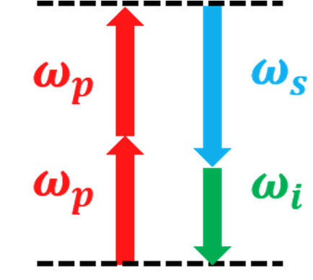
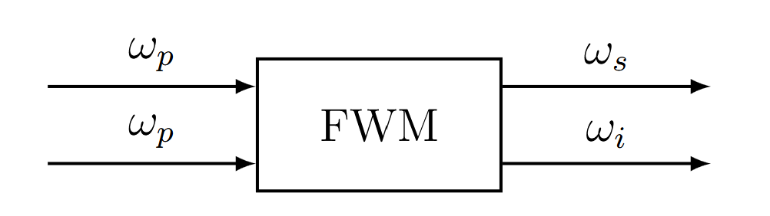

Nonlinear silicon photonics
Theory
Objectives
Setup
Results
$$\overset{˜}{P}\left(t\right)=ε_{0}\left[χ^{\left(1\right)}\overset{˜}{E}\left(t\right)+χ^{\left(2\right)}{\overset{˜}{E}}^{2}\left(t\right)+χ^{\left(3\right)}{\overset{˜}{E}}^{3}\left(t\right)+…\right]$$
Four-wave mixing (FWM)
Goswami 4(4), 041404 (16 Oct 2024)
$$2ω_{p}=ω_{\text{signal}}+ω_{\text{idler}}$$

Slide 23

Four-wave mixing (FWM)
Theory
Objectives
Setup
Results
$$2ω_{p}=ω_{\text{signal}}+ω_{\text{idler}}$$
Spontaneous FWM (SFWM)

Slide 24
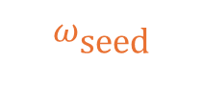
Four-wave mixing (FWM)
Theory
Objectives
Setup
Results
$$2ω_{p}=ω_{\text{signal}}+ω_{\text{idler}}$$
Spontaneous FWM (SFWM)
Stimulated FWM (classical)
$$ω_{\text{seed}}$$

Slide 25
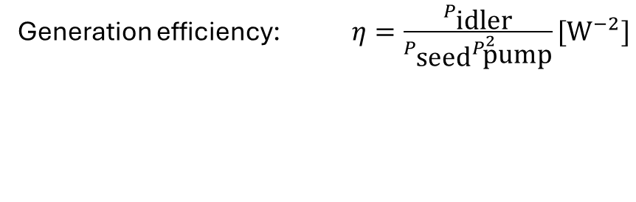
Four-wave mixing (FWM)
Theory
Objectives
Setup
Results
$$2ω_{p}=ω_{\text{signal}}+ω_{\text{idler}}$$
Spontaneous FWM (SFWM)
Stimulated FWM (classical)
$$ω_{\text{seed}}$$
Generation efficiency: $η=\frac{P_{\text{idler}}}{P_{\text{seed}}P_{\text{pump}}^{2}}[W^{−2}]$

Slide 26
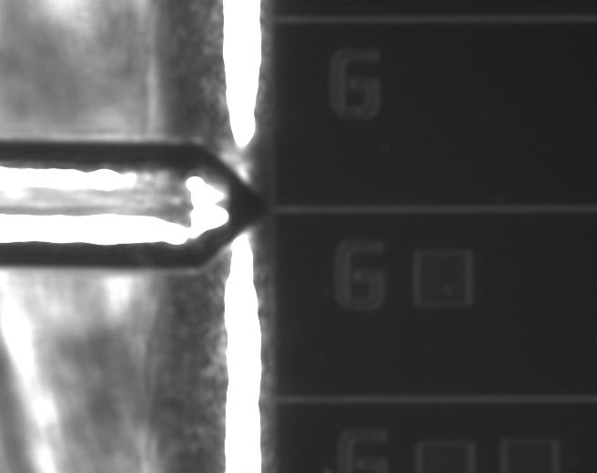
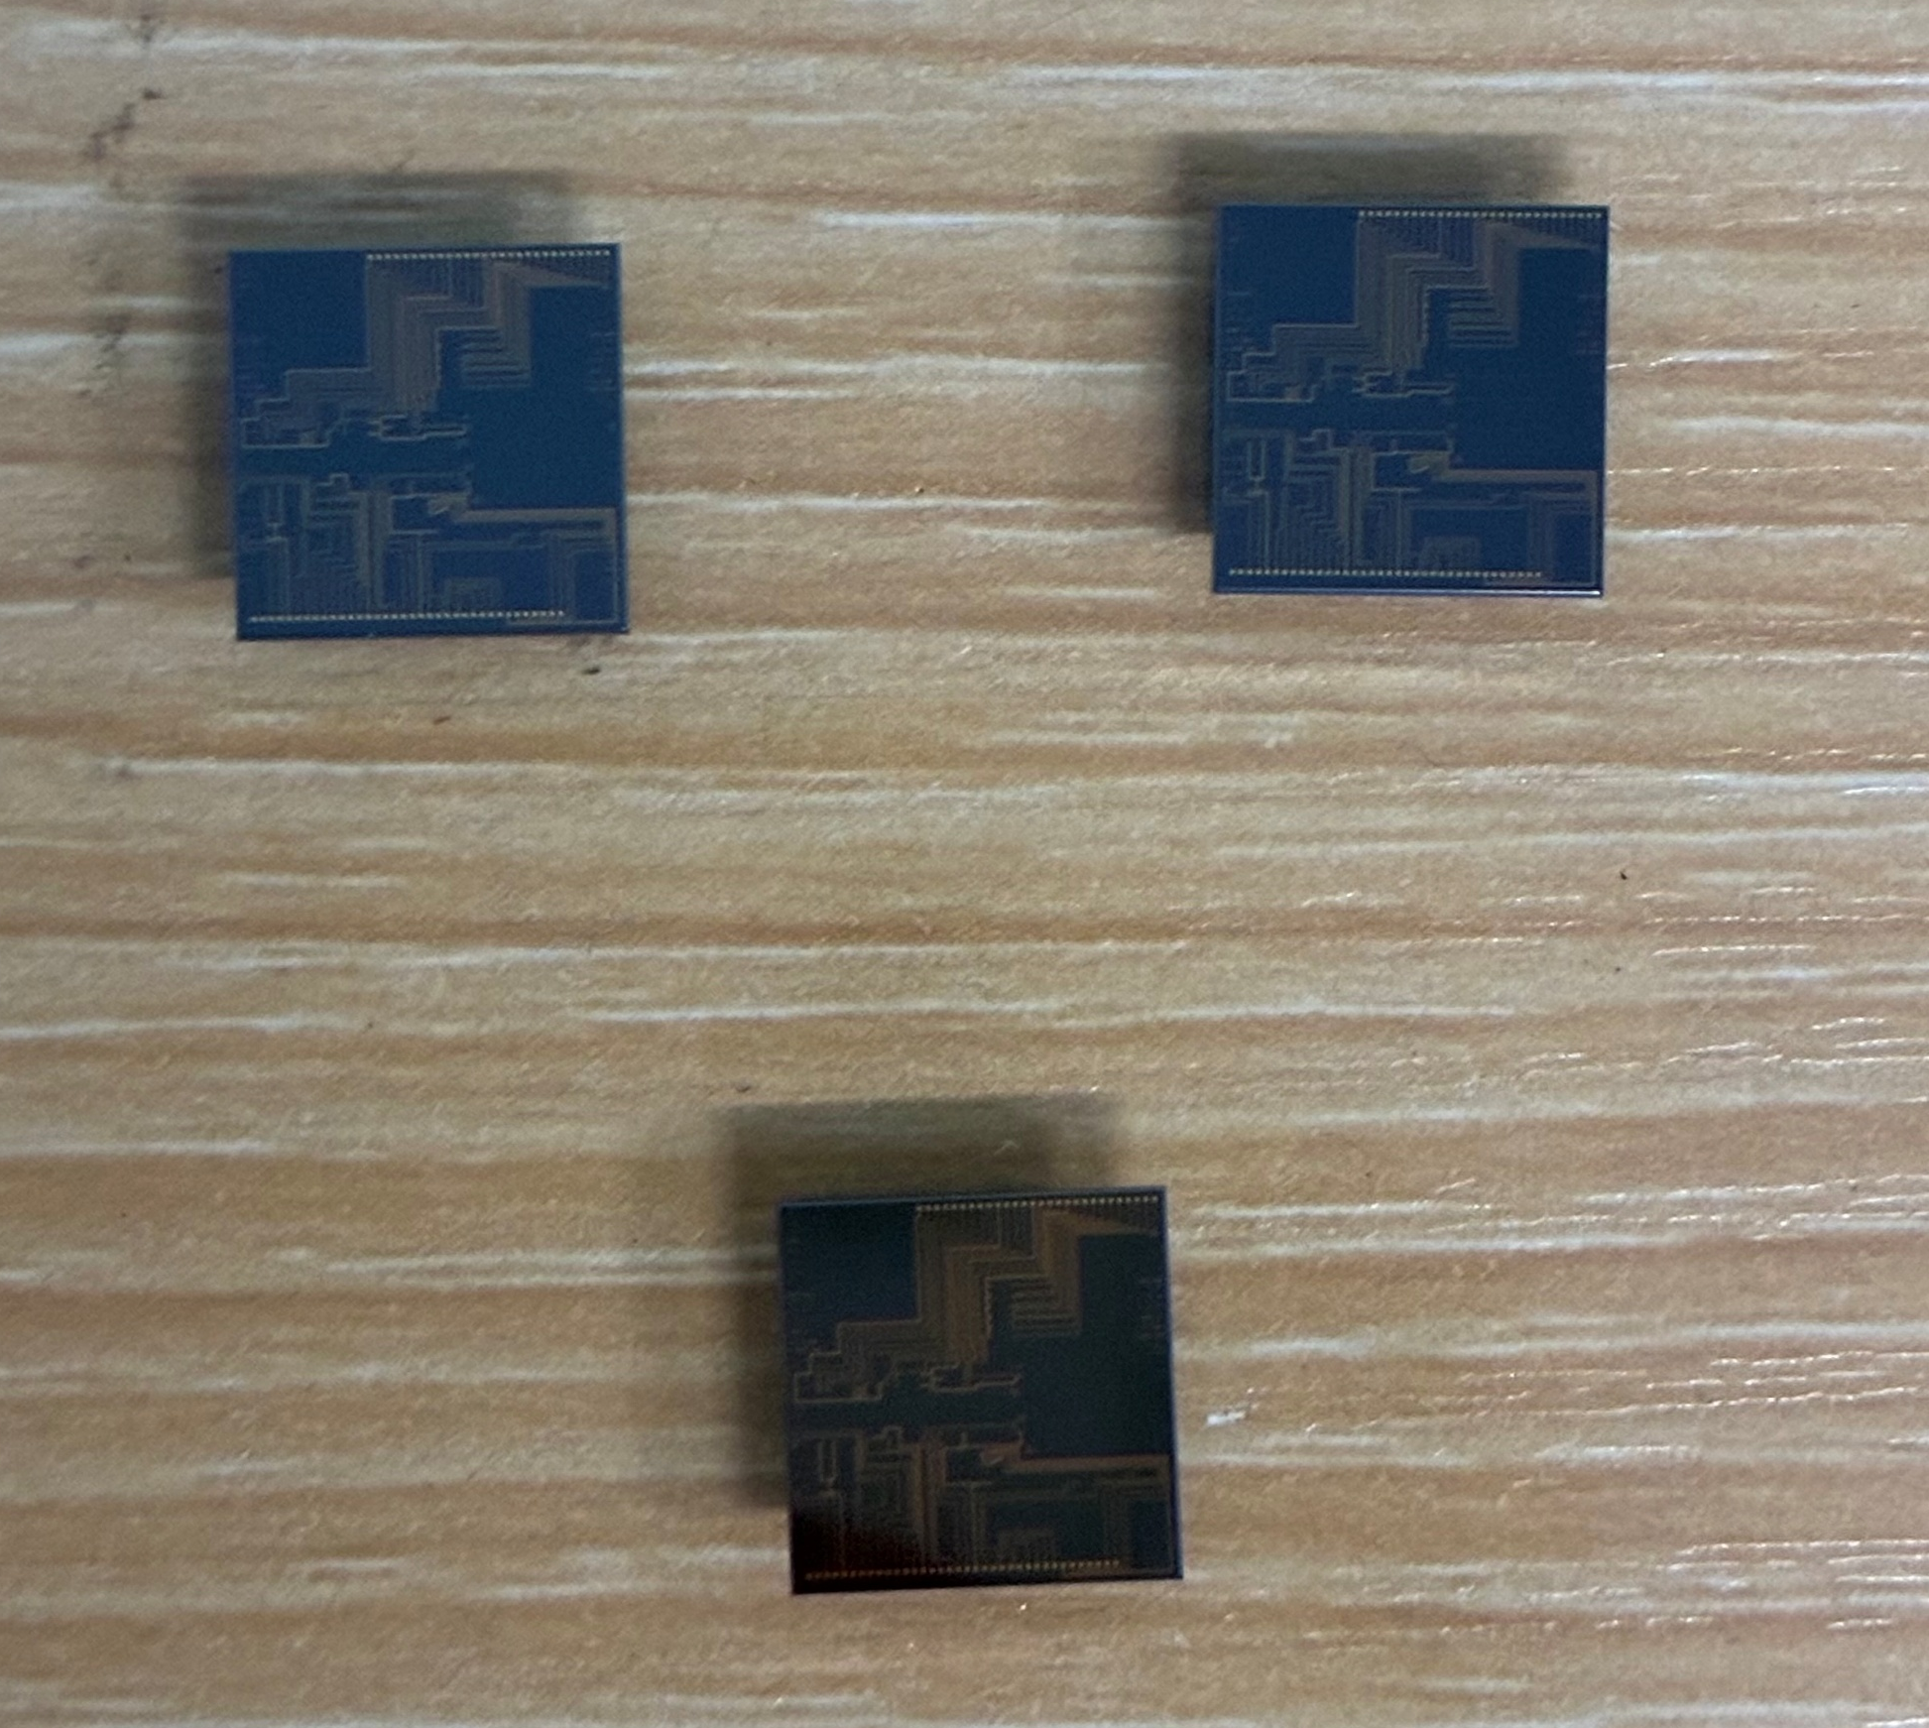
Propagation loss
& coupling loss
Theory
Objectives
Setup
Results

Slide 27
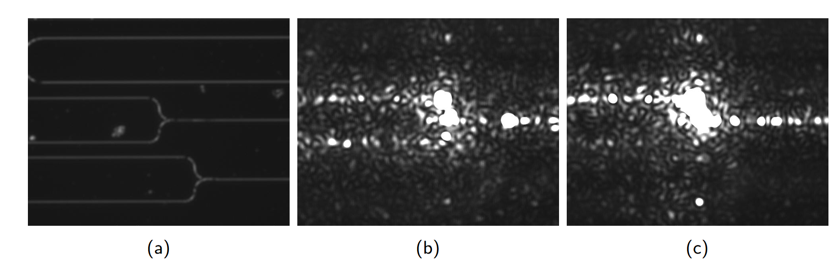
Propagation loss
& coupling loss
Theory
Objectives
Setup
Results
PBS & PSR extinction ratio

Slide 28
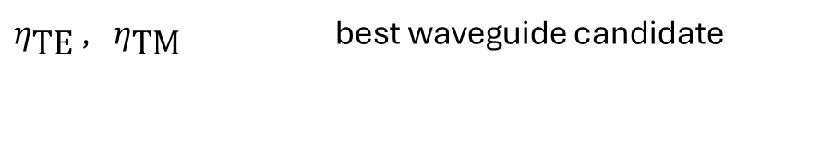
Propagation loss
& coupling loss
Theory
Objectives
Setup
Results
PBS & PSR extinction ratio
Stimulated FWM
$η_{\text{TE}}$ , $η_{\text{TM}}$ best waveguide candidate

Slide 29
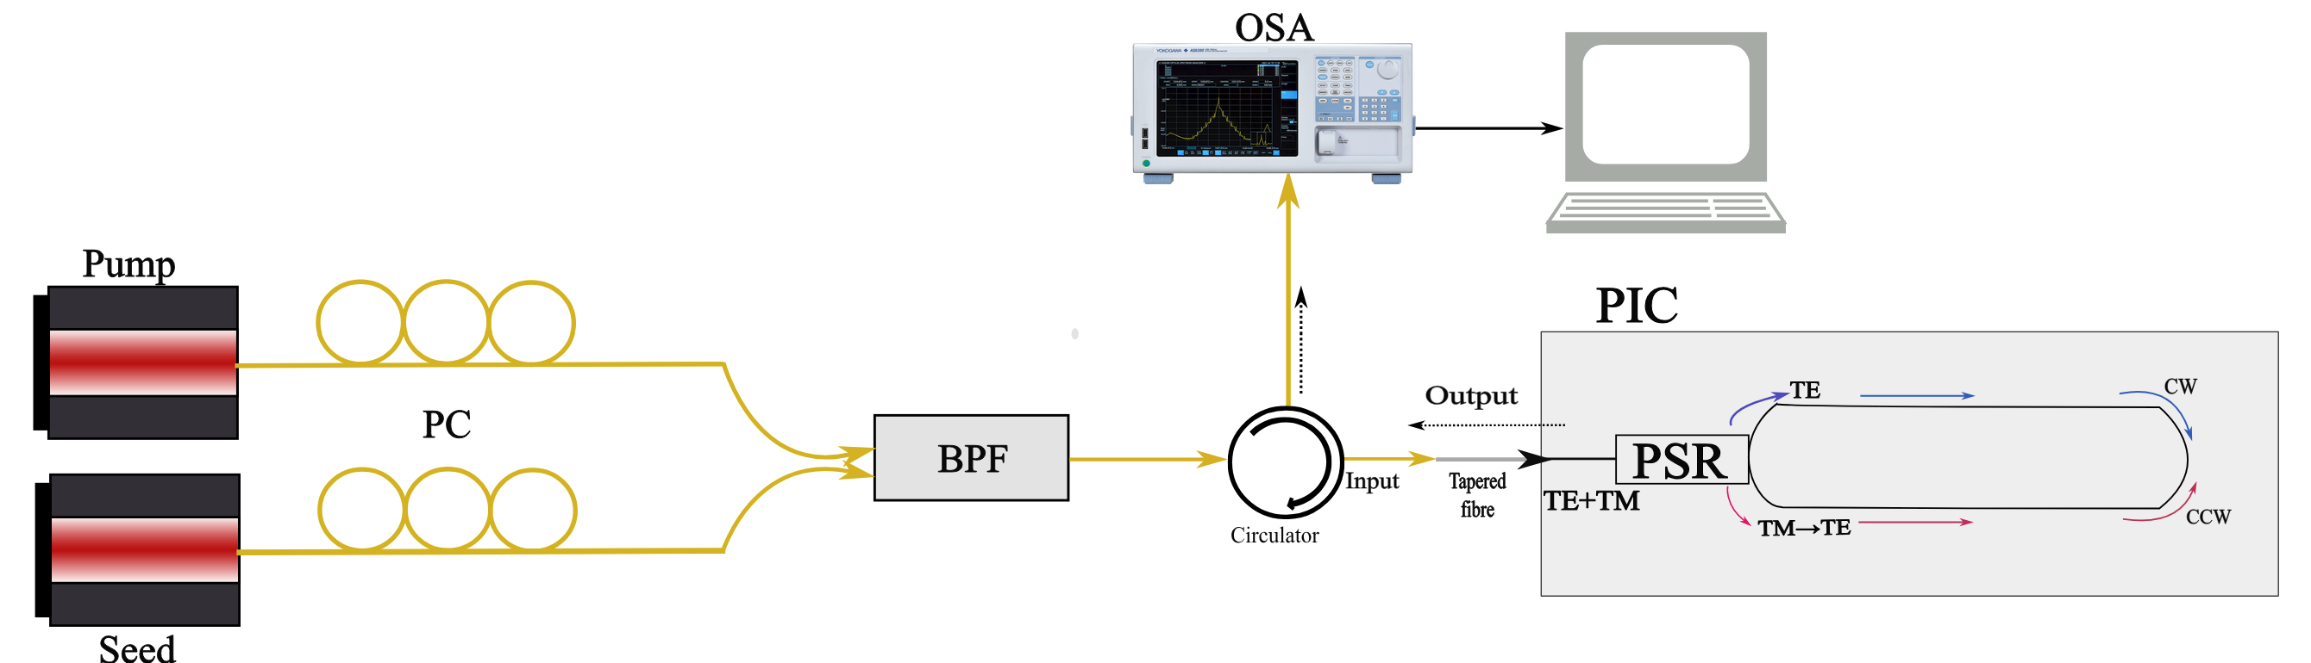
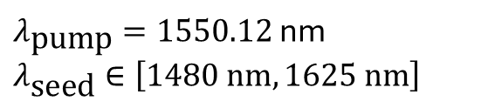
Theory
Objectives
Setup
Results
$λ_{\text{pump}}=1550.12$ nm
$$λ_{\text{seed}}∈\left[1480\text{ nm},1625\text{ nm}\right]$$
Telecom

Slide 30
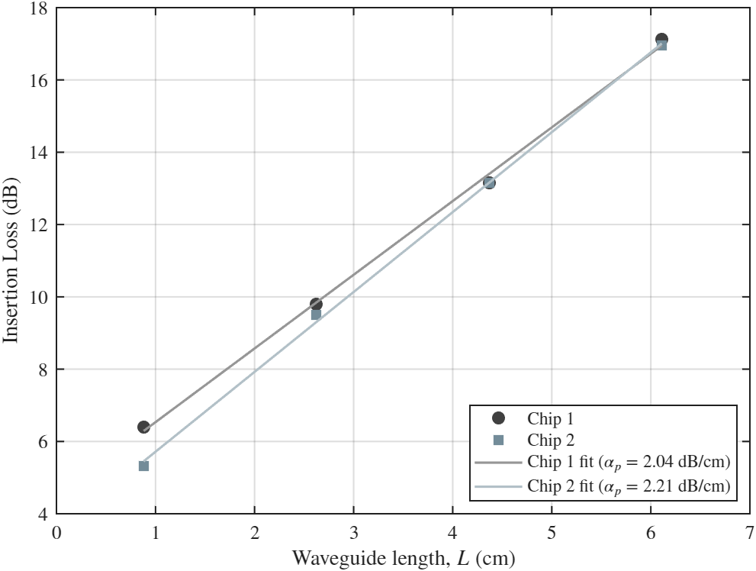
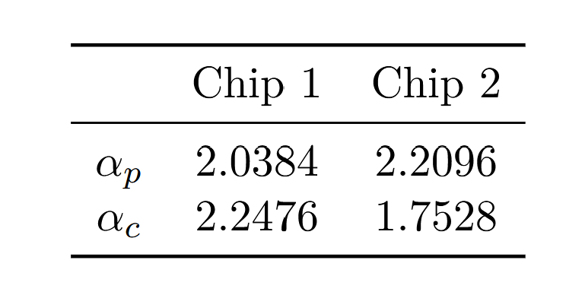
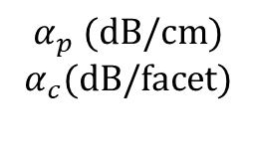
Propagation & coupling loss
Theory
Objectives
Setup
Results
$$α_{p} (dB/cm)$$
$$α_{c}(dB/facet)$$

Slide 31
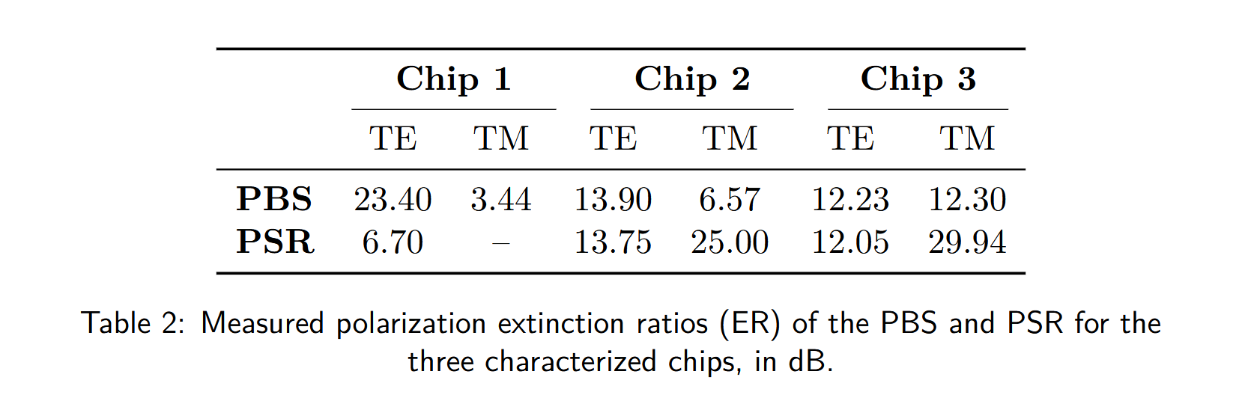
Polarization extinction ratio (ER)
Theory
Objectives
Setup
Results

Slide 32
Polarization extinction ratio (ER)
Theory
Objectives
Setup
Results

Slide 33
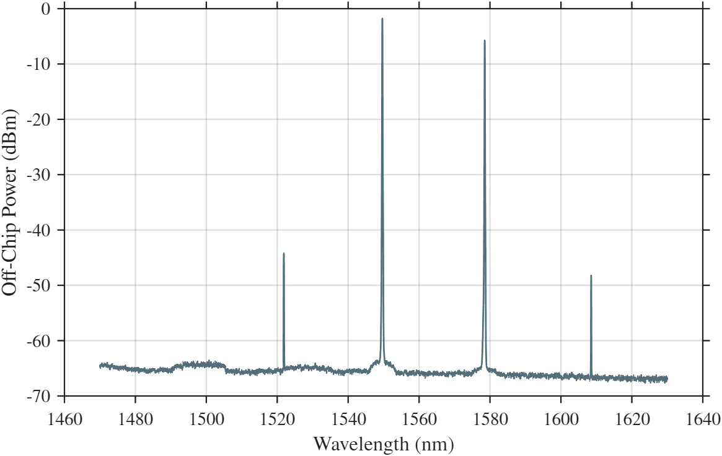
Stimulated FWM
Theory
Objectives
Setup
Results
Idea: put 2 more plots to see how signal+idler more depending on seed wvl
Put labels

Slide 34
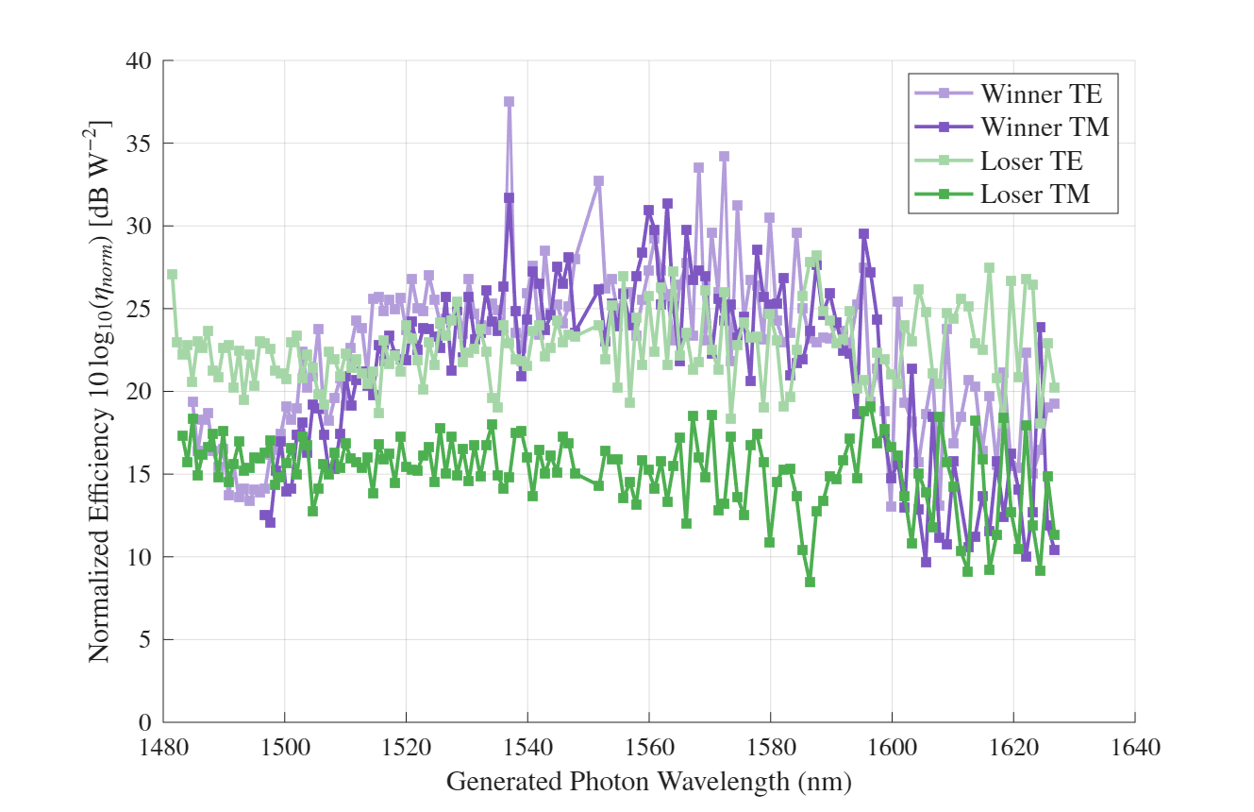
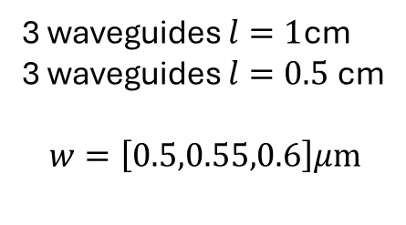
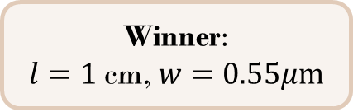
Stimulated FWM
Theory
Objectives
Setup
Results
3 waveguides $l=1$cm
3 waveguides $l=0.5$cm
$$w=\left[0.5,0.55,0.6\right]μm$$
Winner:
$l=1$cm, $w=0.55μm$

Slide 35
Introduction
Presented approach
Classical characterization
Quantum characterization – Quantum light generation
Quantum characterization – Entanglement certification
Conclusions & discussion

Slide 36
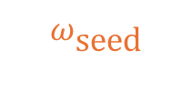
Spontaneous FWM (SFWM)
Theory
Objectives
Setup
Results
$$2ω_{p}=ω_{\text{signal}}+ω_{\text{idler}}$$
Spontaneous FWM (SFWM)
Spontaneous FWM (SFWM)
Stimulated FWM (classical)
$$ω_{\text{seed}}$$

Slide 37
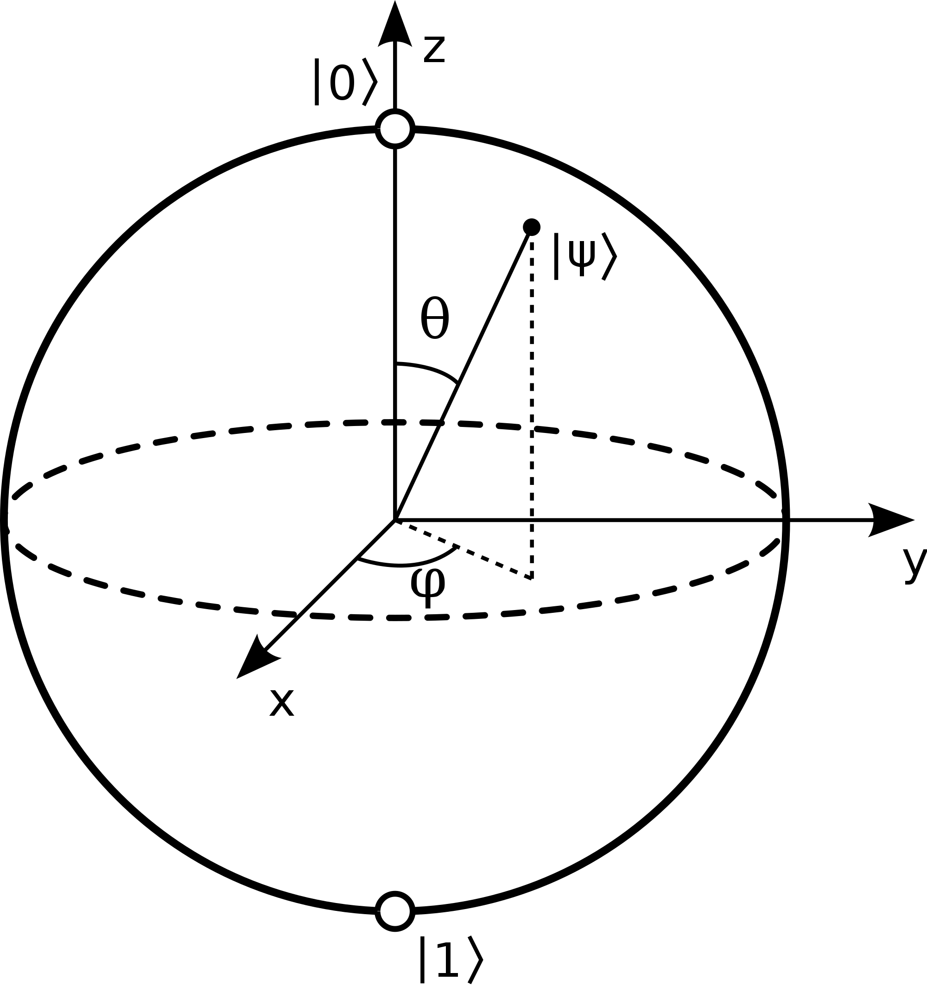
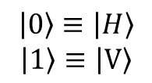
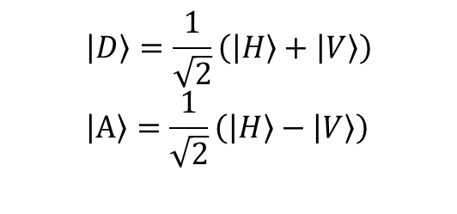
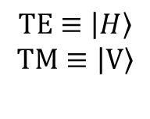
Polarization-encoded qubits
Polarization mode
Rectlinear basis
Diagonal basis
Theory
Objectives
Setup
Results
$TE≡\left|H\right\rangle$
$$TM≡\left|V\right\rangle$$
$$\left|0\right\rangle ≡\left|H\right\rangle$$
$$\left|1\right\rangle ≡\left|V\right\rangle$$
$$\left|D\right\rangle =\frac{1}{\sqrt{2}}\left(\left|H\right\rangle +\left|V\right\rangle \right) \\ \left|A\right\rangle =\frac{1}{\sqrt{2}}\left(\left|H\right\rangle −\left|V\right\rangle \right)$$
https://leimao.github.io/blog/Qubit-Bloch-Sphere/

Slide 38
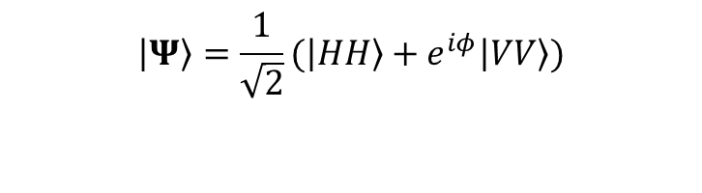
Polarization-encoded qubits
Polarization mode
Rectlinear basis
Diagonal basis
Theory
Objectives
Setup
Results
$TE≡\left|H\right\rangle$
$$TM≡\left|V\right\rangle$$
$$\left|0\right\rangle ≡\left|H\right\rangle$$
$$\left|1\right\rangle ≡\left|V\right\rangle$$
$$\left|D\right\rangle =\frac{1}{\sqrt{2}}\left(\left|H\right\rangle +\left|V\right\rangle \right) \\ \left|A\right\rangle =\frac{1}{\sqrt{2}}\left(\left|H\right\rangle −\left|V\right\rangle \right)$$
$$\left|Ψ\right\rangle =\frac{1}{\sqrt{2}}(\left|HH\right\rangle +e^{iφ}\left|VV\right\rangle )$$
Entangled state:
https://leimao.github.io/blog/Qubit-Bloch-Sphere/
Bell state: $\left|Φ^{+}\right\rangle =\frac{1}{\sqrt{2}}(\left|HH\right\rangle +\left|VV\right\rangle ≡\frac{1}{\sqrt{2}}(\left|DD\right\rangle +\left|AA\right\rangle )$

Slide 39

Entanglement generation: Sagnac
Theory
Objectives
Setup
Results
Sagnac loop
Output: $\left|Ψ\right\rangle =\frac{1}{\sqrt{2}}(\left|HH\right\rangle +e^{iφ}\left|VV\right\rangle )$
Improve slide more details in drawing maybe (output)

Slide 40
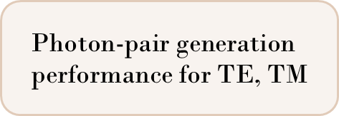
Theory
Objectives
Setup
Results
$$\text{Photon-pair generation performance for TE, TM}$$

Slide 41

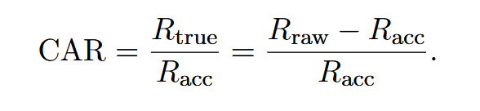
Figure of merit: Coincidences
Theory
Objectives
Setup
Results
Single counts // Coincidences
Raw cc // Acc cc
$$\text{Photon}\text{-}\text{pair generation performance for TE, TM}$$
Figure of merit: Coincidence-to-Accidental Ratio (CAR)

Slide 42
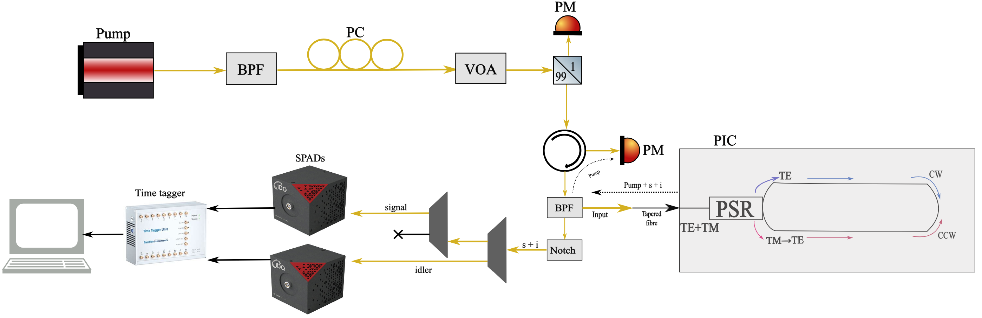
Theory
Objectives
Setup
Results

Slide 43
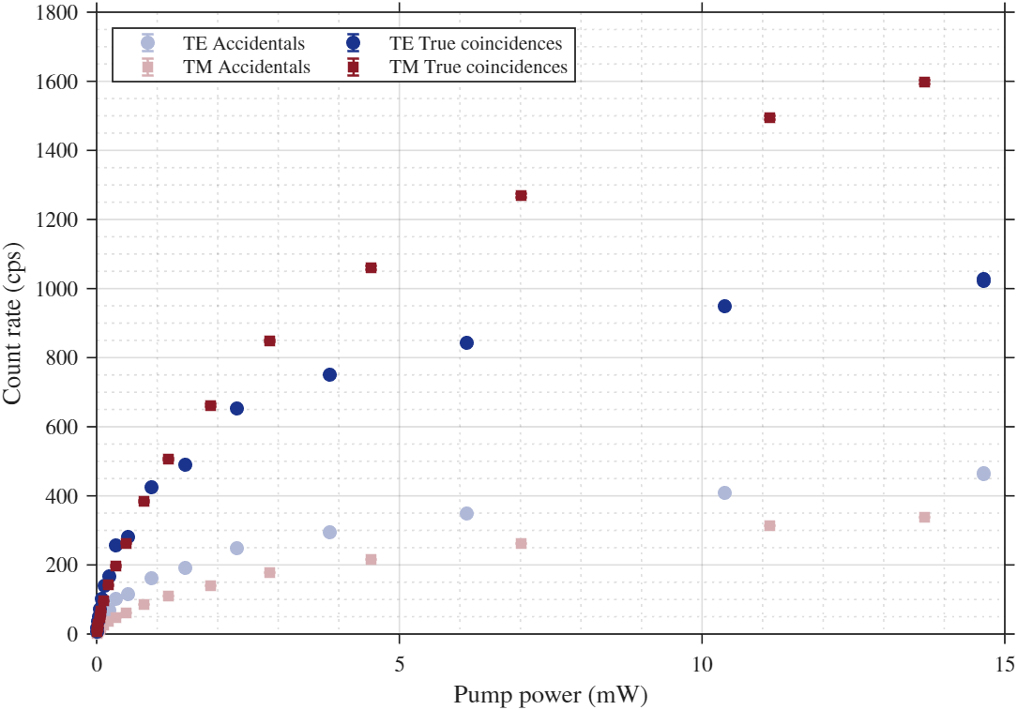
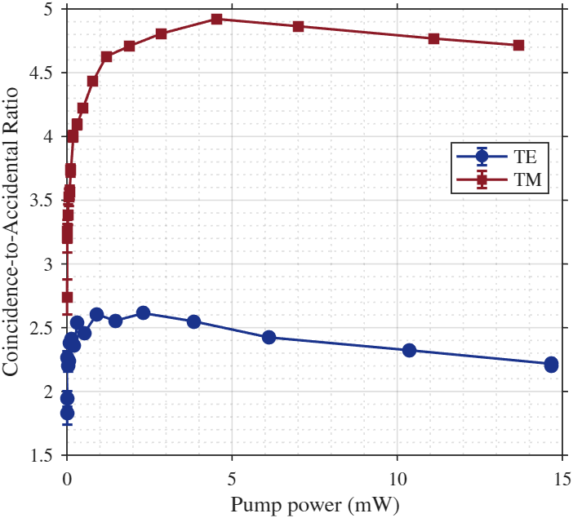
Quantum light generation
Theory
Objectives
Setup
Results

Slide 44
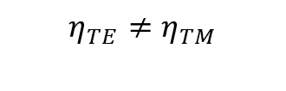
Quantum light generation
Theory
Objectives
Setup
Results
$$η_{TE}≠η_{TM}$$
Polarization–dependent background?
Pair-generation efficiency?

Slide 45

Quantum light generation
Theory
Objectives
Setup
Results
$\sim$x2
Polarization–dependent background?
Pair-generation efficiency?

Slide 46
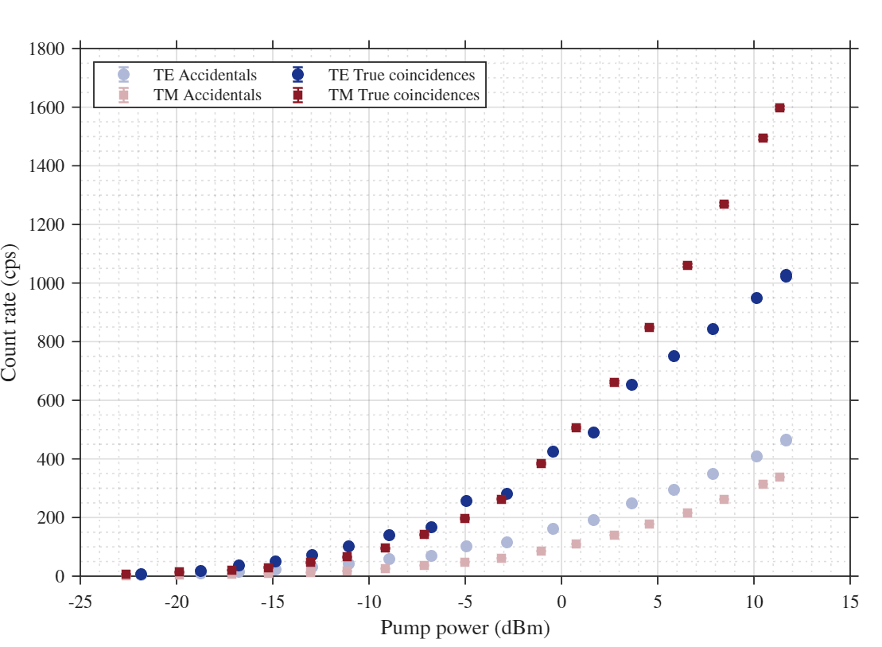
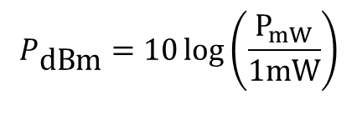

Quantum light generation
Theory
Objectives
Setup
Results
$$R_{\text{true}}≈R_{\text{acc}}$$
$$P_{\text{dBm}}=10\log\left(\frac{P_{mW}}{1\text{mW}}\right)$$
Polarization–dependent background?
Pair-generation efficiency?

Slide 47
Introduction
Presented approach
Classical characterization
Quantum characterization – Quantum light generation
Quantum characterization – Entanglement certification
Conclusions & discussion

Slide 48

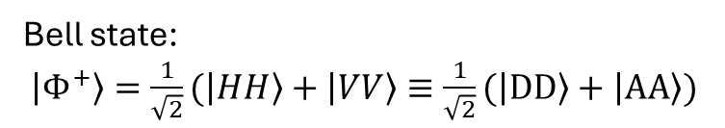
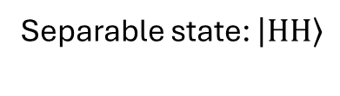

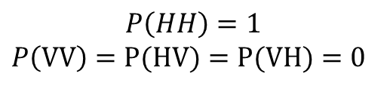
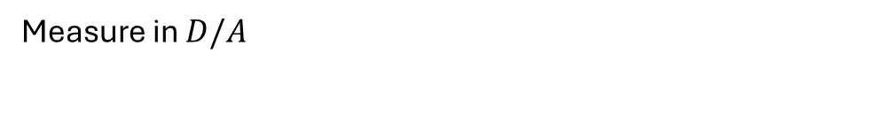
Projective measurement
Theory
Objectives
Setup
Results
Separable state: $\left|HH\right\rangle$
Bell state:
$\left|Φ^{+}\right\rangle =\frac{1}{\sqrt{2}}(\left|HH\right\rangle +\left|VV\right\rangle ≡\frac{1}{\sqrt{2}}(\left|DD\right\rangle +\left|AA\right\rangle )$
Measure in $H/V$
$$P\left(HH\right)=1$$
$$P\left(VV\right)=P(HV)=P(VH)=0$$
$P\left(HH\right)=P(VV)=$1/2
$$P\left(HV\right)=P(VH)=0$$
Measure in $D/A$
$P\left(DD\right)=P(DA)=P(AD)=P(AA)=$1/4
$P\left(AA\right)=P(AA)=$1/2
$$P\left(DA\right)=P(AD)=0$$
https://leimao.github.io/blog/Qubit-Bloch-Sphere/

Slide 49
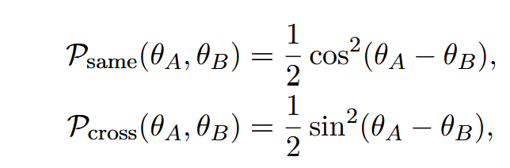

Phase-interference
Theory
Objectives
Setup
Results
$$\left|Ψ\right\rangle =\frac{1}{\sqrt{2}}(\left|HH\right\rangle +e^{iφ}\left|VV\right\rangle )$$
coincidence rate on any given channel pair oscillates sinusoidally as a function of the relative analyser angle

Slide 50
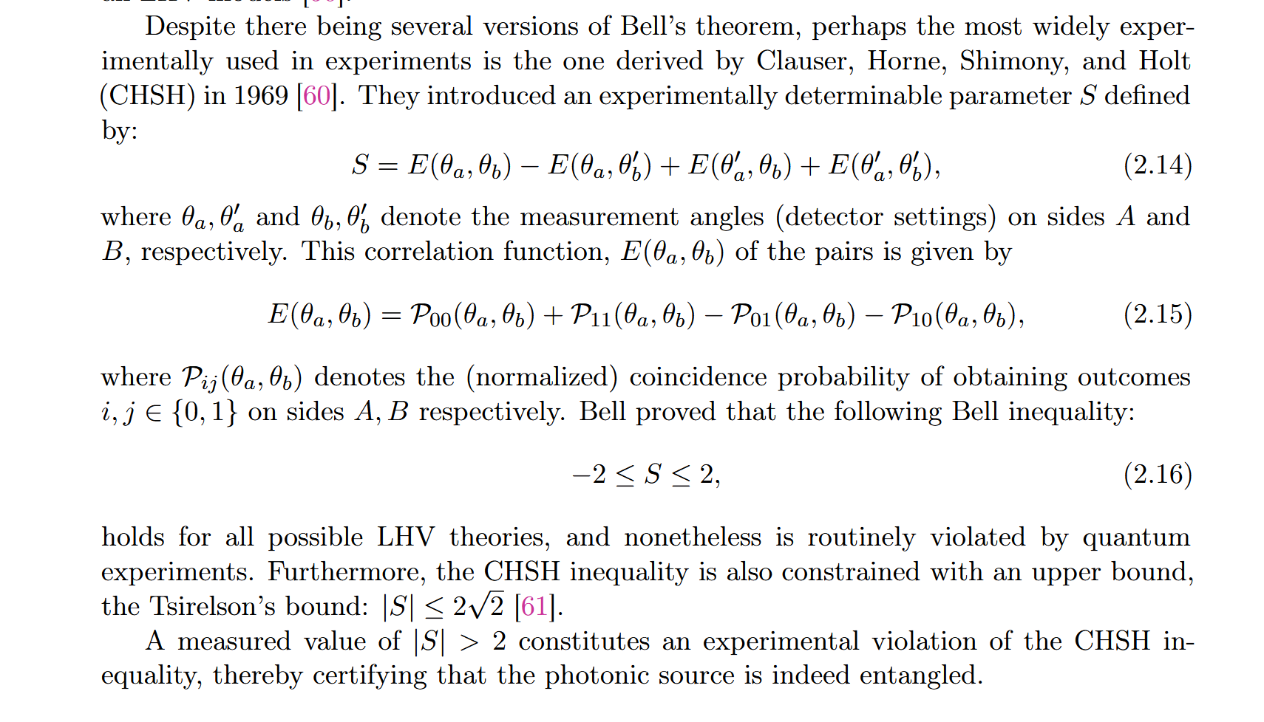
CHSH inequality
Theory
Objectives
Setup
Results
|S|>2

Slide 51
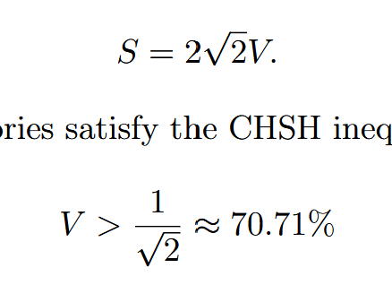

Theory
Objectives
Setup
Results
Perform projective measurements to calibrate PAMs
Characterize polarization correlations
Experimentally violate CHSH
Visibility

Slide 52

.
PAMs
Theory
Objectives
Setup
Results
Improve
Not clear
Make a not snspd (we changed detectors)

Slide 53


Basis calibration & reference-state
Theory
Objectives
Setup
Results
Coherent angular offset separable state

Slide 54



Two-photon interference fringes
Llegenda
Posar fit
Theory
Objectives
Setup
Results
$$C\left(θ_{B}\right)=a\cos\left(bθ_{B}+c\right)+d$$
$$V_{H/V}=84.13\%$$
$$V_{D/A}=88.66\%$$

Slide 55




Two-photon interference fringes
$$V_{H/V}=84.13\%$$
$$V_{D/A}=88.66\%$$
Llegenda
Posar fit
Theory
Objectives
Setup
Results
$$η_{TE}≠η_{TM}$$
$\left|Ψ\right\rangle \sim α\left|HH\right\rangle +β\left|VV\right\rangle$, $\left|α\right|≠\left|β\right|$
$H/V$— Larger amplitude iiiiiiiiiiiii dominates
$D/A$— Amplitude diffs are iiiiiiiiiiii averaged

Slide 56

Two-photon interference fringes
$$V_{H/V}=84.13\%$$
$$V_{D/A}=88.66\%$$
Llegenda
Posar fit
$$\sim 55º$$
Theory
Objectives
Setup
Results
X
Consistent with angular offset of
X

Slide 57





CHSH inequality violation
$$(θ_{B},θ_{B}′) ?$$
$$S\left(θ_{B},θ_{B}′\right)=E\left(0^{∘},θ_{B}\right)−E\left(0^{∘},θ_{B}′\right)+E\left({45}^{∘},θ_{B}\right)+E\left({45}^{∘},θ_{B}′\right)$$
Theory
Objectives
Setup
Results
From theory
Constrained bisector search
$$S_{{22.5}^{∘}/{67.5}^{∘}}=2.22±0.0078$$
$$C\left(θ_{B}\right)=a\cos\left(bθ_{B}+c\right)+d$$
$$S_{\text{bisector}}=2.41±0.008,$$
$$S_{\text{bisector}}=2.41+51.9σ$$
$$S_{{22.5}^{∘}/{67.5}^{∘}}=2.22+28.6σ$$

Slide 58
Introduction
Presented approach
Classical characterization
Quantum characterization – Quantum light generation
Quantum characterization – Entanglement certification
Conclusions & discussion

Slide 59
Reestate what we achieved: on-chip SOI...
CHSH violation
Immediate steps:
Need to optimize setup s.t TE/TM eff
Callibrate HWP s.t offset=45
Perhaps quantum state tomography for fidelity estimate
Future work:
- Emulation of free-space channel

Slide 60
Thank you

Slide 61
References
Hua, zhang, matsuda
photos

Slide 62

Thank you

Slide 64
.
Theory
Objectives
Setup
Results

Slide 67


Slide 68
Outline
Introduction
Presented approach
Classical characterization
Quantum characterization – Quantum light generation
Quantum characterization – Entanglement certification
Conclusions & discussion

Slide 69
Introduction
Presented approach
Classical characterization
Quantum characterization – Quantum light generation
Quantum characterization – Entanglement certification
Conclusions & discussion

