Slide 1
Movie Reviews vs. Box Office
Griffin Peifer, Michael Considine, Eddie Licea

Slide 2
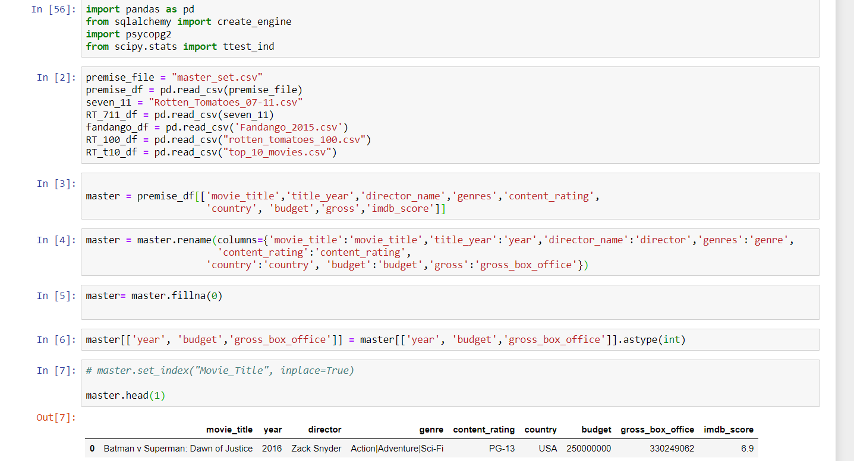
Extract
Selected five different data sets to capture a variety of ratings, movies, and box office revenue
Set the biggest data set as the “master”
Utilized master set as the source for box office
Utilized remaining sets as the source for ratings
Sources: Data.World & Kaggle.com

Slide 3
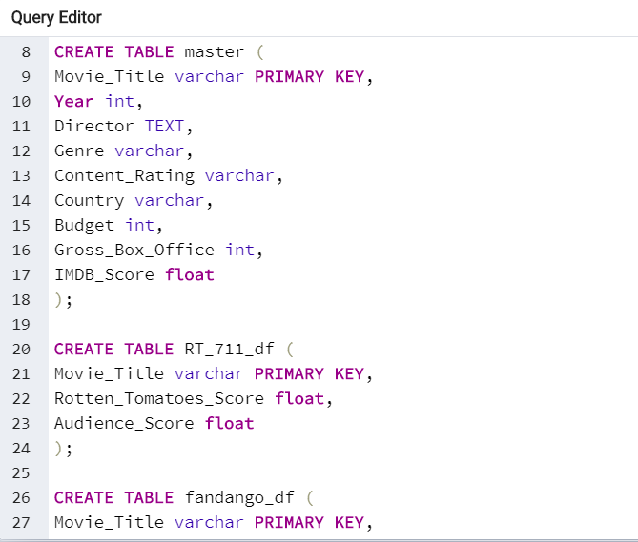
Transform
Renamed columns in all data sets to common names
Selected columns relevant to movie categorization and box office from Master data set
Selected only columns containing movie title and ratings from remaining sets
Eliminated null values and unnecessary text from all data sets
This was essential to effectively loading data into Postgres
Assigned movie title as the index for each data set to correlate each data set in SQL

Slide 4
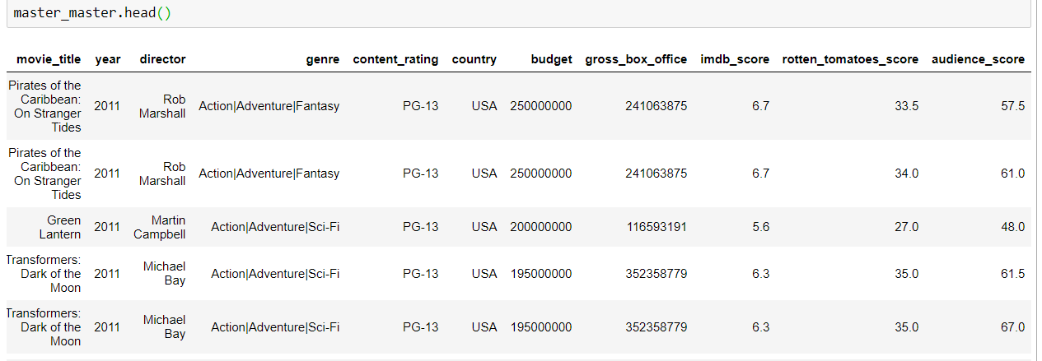
Load
Created all desired tables and variables in Postgres with movie_title as the primary key
Ran into issues loading data into Postgres due to null values
Merged all Rotten Tomatoes tables together before merging with the Master table
Refined columns in pandas after merge yielded x and y ratings columns

