Slide 1
Risk Signal Engine
From breaking news and social posts to explainable risk signals and a portfolio stress test
S&P Global × CRISIL · Code to Connect 2026 · Module B: Strategic Portfolio Stress Testing
1,325
1–10
seconds
real captured headlines and posts
explainable impact score
from headline to portfolio view
Apeksha Jain · ABV-IIITM Gwalior · individual submission · decision support, not investment advice
Notes:
(30 s) Hello, I am Apeksha Jain from ABV-IIITM Gwalior. This is Risk Signal Engine, my individual submission for Module B, strategic portfolio stress testing. In one sentence: it reads news and social posts, turns each item into an explainable risk signal, and stress-tests the portfolio the moment something material happens. Every number I show comes from a script in the repository, or is labelled simulated.

Slide 2
Problem and approach
Risk shows up in text before it shows up in data
Downgrades, probes, sanctions and rate moves break as headlines and posts
Credit analysts and risk teams triage them by hand: slow, noisy, duplicated
Nothing links a headline to the book's exposure until someone runs numbers
Approach: an NLP risk engine scores every item (sentiment, event, impact) and an event-driven stress engine reprices the book
Today
Headline breaks
Analyst reads it
Manual stress run, later
With the engine
Headline ingested
Scored + explained
Stress test triggered
Measured: median 204.7 ms per document (n = 200)
Risk Signal Engine · decision support, not investment advice
2 / 7
Notes:
(40 s) Credit risk shows up in text before it shows up in prices or ratings data: downgrades, regulatory probes, sanctions, rate surprises. Today an analyst reads the headline, decides whether it matters, and someone runs a stress test later, by hand. Nothing links the headline to the book's exposure in the moment. My approach: an NLP engine scores every item for sentiment, event type and a 1-to-10 impact, and an event-driven stress engine reprices the portfolio when a rule fires. The only speed claim I make is the measured one: a median of 204.7 milliseconds per document on a CPU laptop.

Slide 3
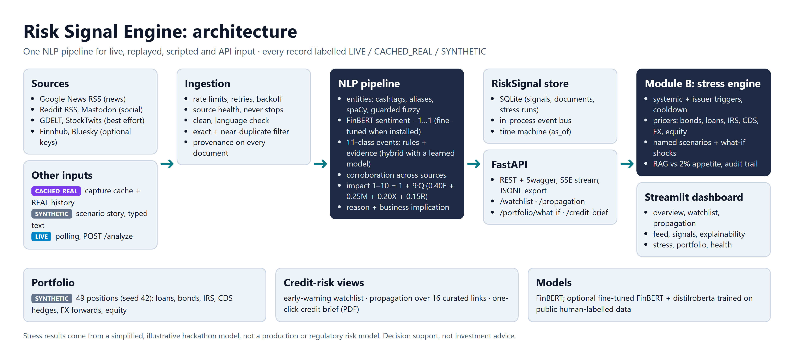
System design
One NLP pipeline for live, replayed, scripted and API input
Risk Signal Engine · decision support, not investment advice
3 / 7
Notes:
(45 s) Left to right. Real sources, Google News, Reddit and Mastodon, are used only because they passed our probe script; the others are skipped cleanly, and no adapter can crash the app. Everything, live, replayed, scripted or sent to the API, goes through one pipeline: cleaning and deduplication, entity resolution, FinBERT sentiment, event rules with evidence, and the impact score. Signals are stored and published on an event bus; the stress engine is a subscriber, and the FastAPI service and the Streamlit dashboard sit on top. Every record carries a provenance badge, and after a one-time model download the whole system runs offline.

Slide 4
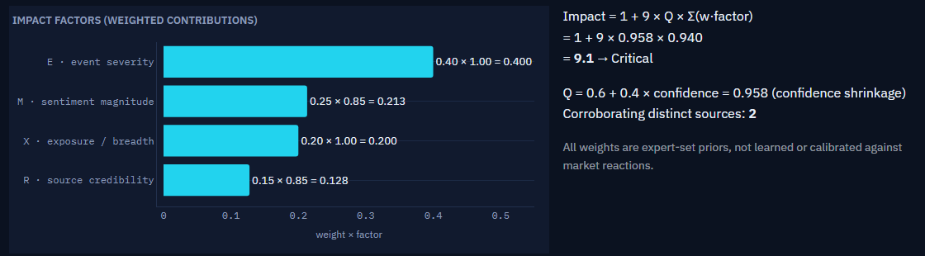
Implementation highlights
Every score is explained, every weight is published
NLP: entities, FinBERT sentiment, 11 event classes with evidence
Stress engine: news triggers with cooldown; bonds, loans, swaps, CDS, FX, equity
Credit views: watchlist, propagation, one-click credit brief
Engineering: one pipeline for every input, offline demo, time machine, audit trail
Factor contributions for a SYNTHETIC demo signal
Impact = 1 + 9 × Q × (0.40·E + 0.25·M + 0.20·X + 0.15·R)
E severity · M sentiment · X exposure · R credibility · Q confidence · uncalibrated expert priors
Risk Signal Engine · decision support, not investment advice
4 / 7
Notes:
(45 s) Three highlights. First, explainability: every score is decomposed. The impact formula is on the slide with the published weights: event severity, sentiment magnitude, exposure and source credibility, scaled by confidence. They are expert priors, not calibrated, and the dashboard says so. Second, the stress engine: news-only triggers, systemic or issuer-specific, with cooldown and corroboration, and simple pricers for bonds, loans, swaps, CDS, FX and equity. Third, credit views: an early-warning watchlist, propagation over curated links, a one-click credit brief, and a time machine over the real captured history.

Slide 5
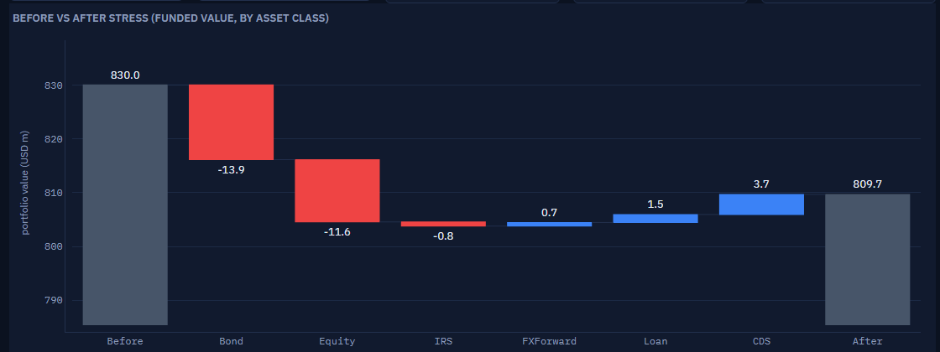
Key results and metrics
Accuracy: preliminary (labels pending human review)
0.653
0.81
0.898
204.7 ms
84 → 50
Sentiment
Events
Entities
Median latency
Stress runs
FinBERT · n = 147
rules · n = 147
n = 147
n = 200 docs
n = 911 real docs
AI-drafted labels: a smoke test, not a benchmark.
Scenario demo (simulated)
0.41% GREEN Tata Motors downgrade
1.32% AMBER Invasion (1 source)
2.45% RED Corroborated (2 sources)
REAL history: 1,325 docs → 54 simulated runs
Before → after, corroborated geopolitical shock
Simplified, illustrative hackathon stress model. Not a production or regulatory risk model.
Simulated losses · illustrative model, synthetic portfolio · not investment advice
5 / 7
Notes:
(60 s) Results, with n for every number. On 147 headlines and posts, FinBERT sentiment accuracy is 0.653, event classification 0.81, entity resolution 0.898. These labels were drafted by an AI assistant and are pending human review, so treat them as a smoke test. Median latency is 204.7 ms per document, p95 1085.2 ms, over 200 documents. Replaying 911 real captured documents, my false-trigger fixes cut simulated stress runs from 84 to 50. In the scripted demo, a Tata Motors downgrade gives 0.41% GREEN thanks to a CDS hedge; an invasion headline gives 1.32% AMBER; a second source corroborates it: 2.45% RED. These losses are simulated on a synthetic portfolio with an illustrative model, not investment advice.

Slide 6
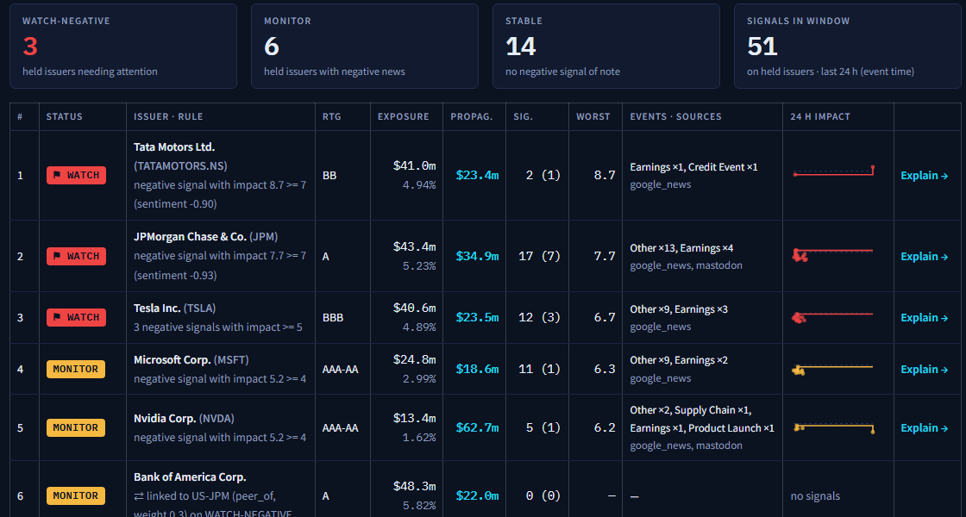
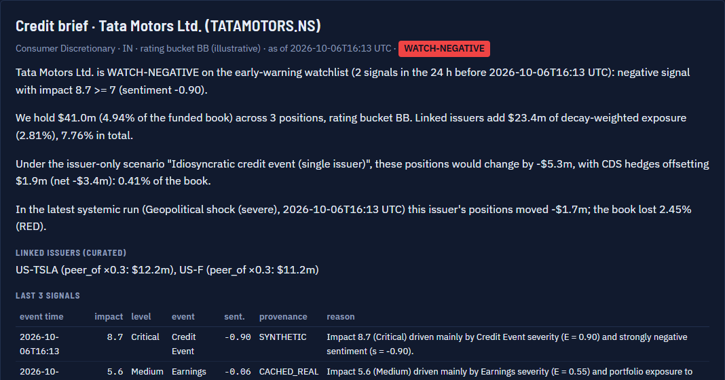
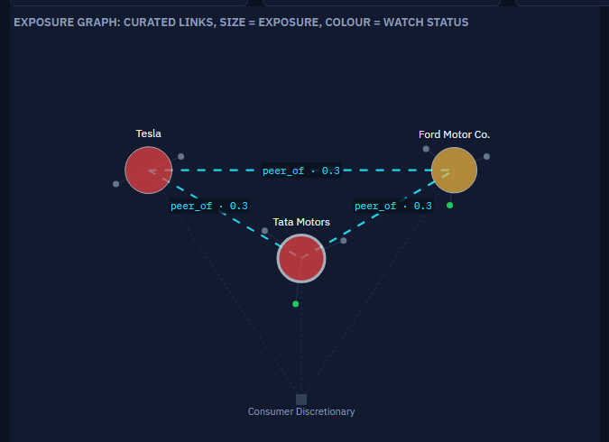
Domain impact and business value
Decision support for credit and portfolio risk
Credit analysts
Risk managers
Portfolio managers
see which held names need attention, and why
get an audited portfolio view when news breaks
see linked exposure and test their own shocks
Watchlist on real news
Credit brief (PDF)
Propagation graph
No ROI claims: earlier attention, triage with the reason shown, audit trail to the headline
Risk Signal Engine · decision support, not investment advice
6 / 7
Notes:
(40 s) Who uses it. Credit analysts see which held names need attention and exactly which rule fired. Risk managers get an audited, simulated portfolio view when news breaks, instead of waiting for the next scheduled run. Portfolio managers see linked exposure and test their own shocks with the what-if sliders. I make no ROI or time-saved claim. The value is earlier attention, triage by materiality with the reason shown, and an audit trail from every stress run back to the headline that triggered it. Linked exposure is an attention measure, not a contagion model.

Slide 7
Limitations and future work
Limitations
Future work
What already works
Uncalibrated impact weights
Rules still misfire at times
Headline-only news
Small AI-labelled eval set
Illustrative stress model
Calibrate on market moves
Licensed full-text news
Fine-tuned models (ready)
Streaming (Kafka)
Backtesting
Provenance on every record
One pipeline for all input
Real-data time machine
Trigger audit trail
Offline laptop demo
An honest, explainable bridge from text to portfolio risk, offline on a laptop
Risk Signal Engine · decision support, not investment advice
7 / 7
Notes:
(40 s) Honest limitations: the impact weights are uncalibrated priors, keyword rules still misfire on some real headlines, news is headline-only, the evaluation set is small and AI-labelled, and the stress model is illustrative on a synthetic portfolio. Next: calibrate impact on market moves, licensed full-text news, fine-tuned models from the ready training notebook, streaming and backtesting. What already works: provenance on every record, one pipeline for every input, and an offline demo on a laptop. Thank you, I am happy to take questions.

