Slide 1
About this portfolio
Logan pugsley
logan@pugsley.ca

Slide 2


How did you get here?
This portfolio is truly mine
Its infrastructure is hosted by me in the cloud, using Amazon Web Services (AWS)
Its code is custom written by me, using Python

Slide 3

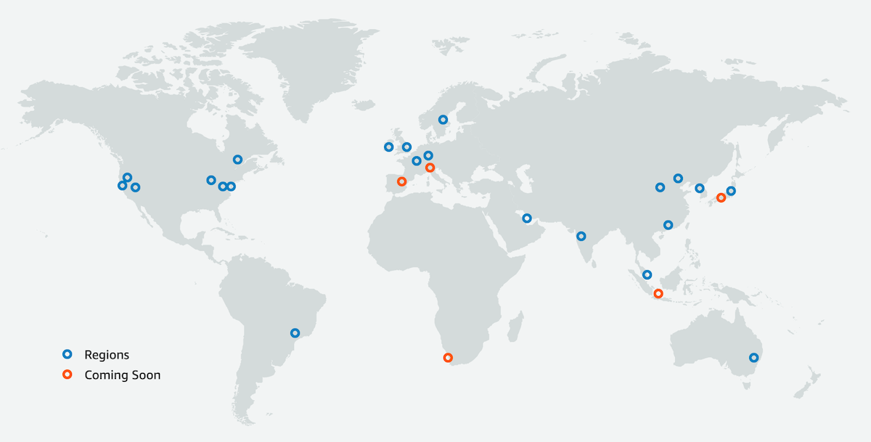
infrastructure
Cloud computing is the on-demand availability of computer system resources.
Amazon Web Services (AWS) is the world's most comprehensive and broadly adopted cloud, offering over 200 fully featured services from data centers globally.

Slide 4
Infrastructure diagram

Slide 6


Infrastructure: Server
The “server” that allows you to view this page through the internet is an Elastic Compute Cloud (EC2) instance on the AWS cloud, hosted in the ca-central-1 region in Canada
The server is executing the website’s code, and is essentially a virtual computer

Slide 7


Infrastructure: website url and dns
You can access this portfolio at https://www.logan.pugsley.ca
In the background, this URL uses a Domain Name System (DNS) Canonical Name (CNAME) record to forward you to an AWS Elastic Load Balancer
The load balancer sits between users and servers to distribute web traffic
You are sent to a given port on an Elastic Compute Cloud (EC2) instance, where the portfolio website is running
Using Amazon Certificate Manager (ACM), an Secure Sockets Layer (SSL) certificate allows you to securely connect to the EC2 instance
Try it! Instead of www.logan.pugsley.ca go to 35.182.148.117:8501
Now, you’ve connected directly to the EC2 instance
35.182.148.117:8501
www.logan.pugsley.ca

Slide 8

code
The code that produces this portfolio website was developed by me
It runs on Python, a programming language
The web front-end library used is called Streamlit, an open-source Python framework to deliver interactive apps

Slide 9
Further reading
https://aws.amazon.com/what-is-aws/
https://aws.amazon.com/about-aws/global-infrastructure/regions_az/
https://aws.amazon.com/ec2/
https://aws.amazon.com/elasticloadbalancing/
https://streamlit.io/

Slide 10
Thanks!
Contact me: logan@pugsley.ca

