Slide 1



http://github.com/mtnman38/tensorflow-examples
Don’t clone! Click the button!

Slide 2

A quick look at how to use

Slide 3
Everyone thinks TensorFlow is a framework for deep learning.
What TensorFlow really is, is a library a for efficient numerical computation.
But, it does offer APIs for easily estimating deep learning models.
We are going to learn about all of this today.

Slide 4
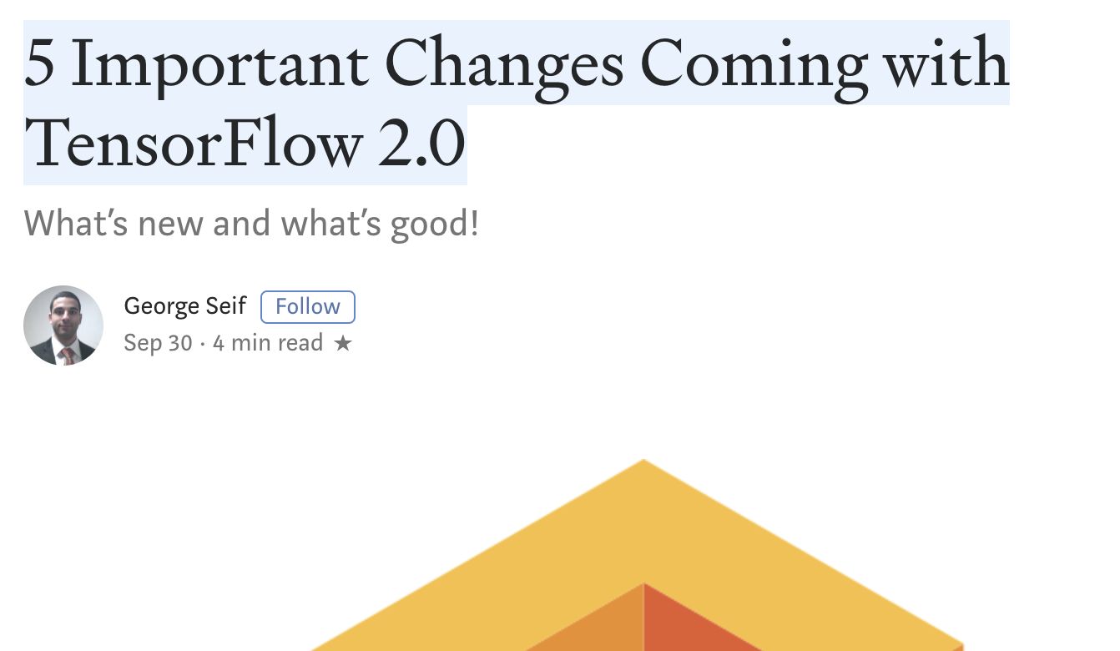



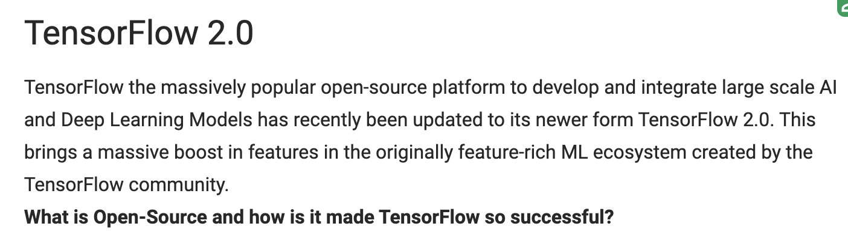
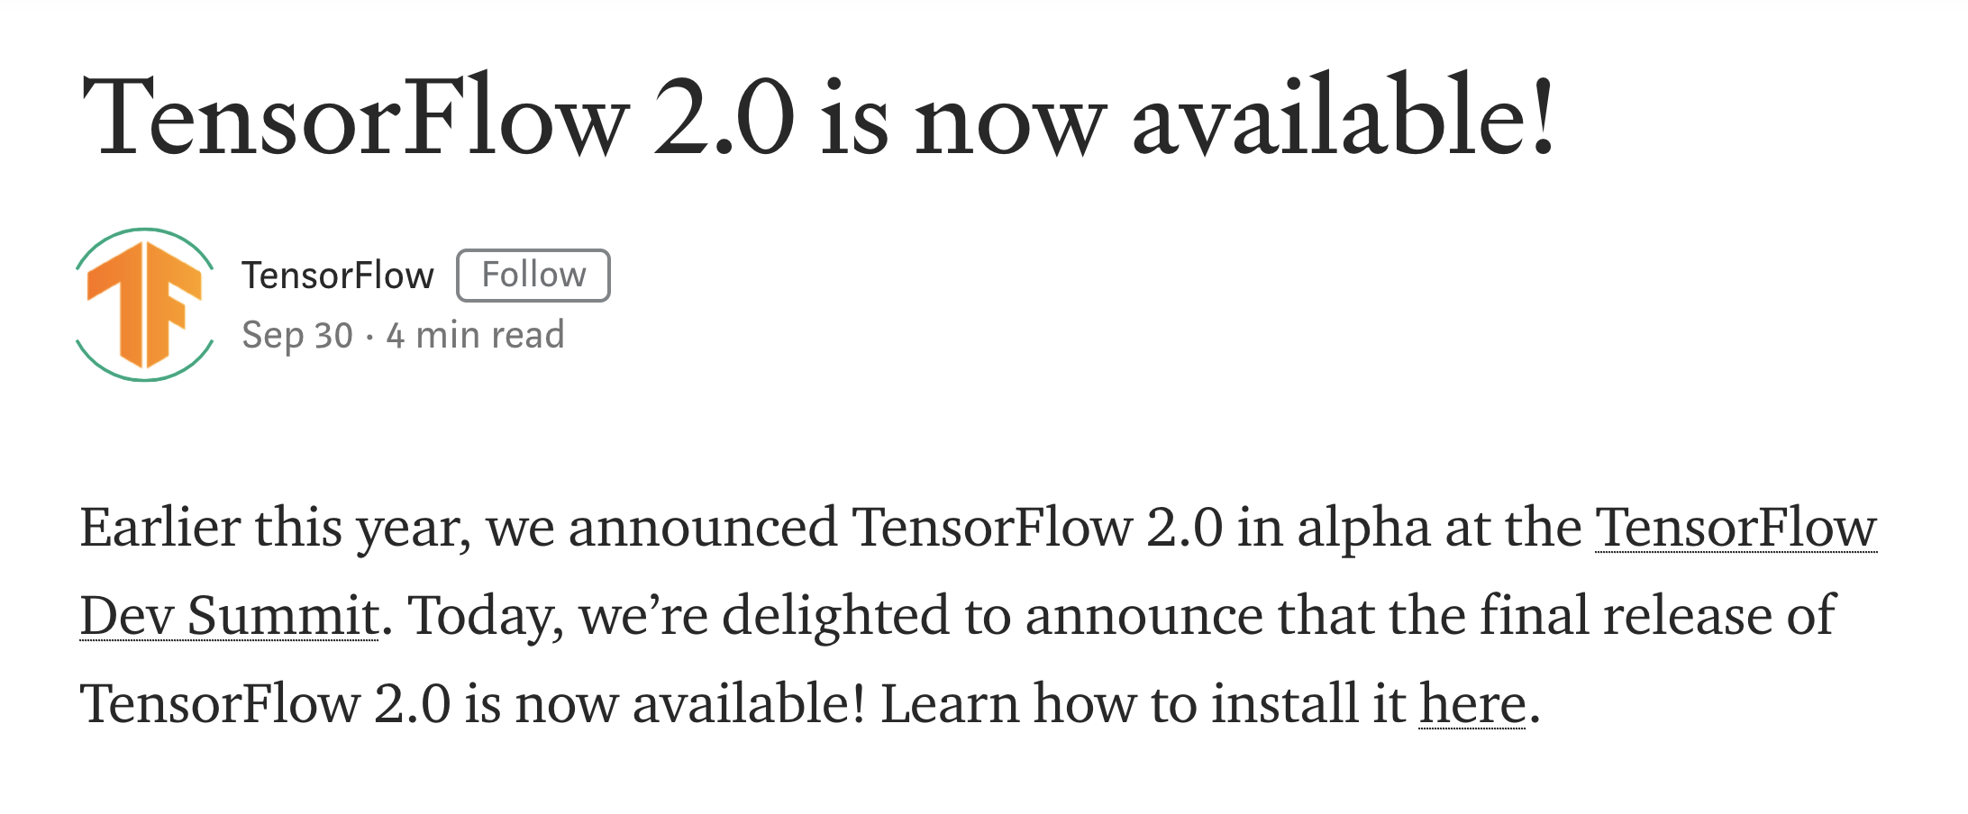
New to TensorFlow?

Slide 5
What is TensorFlow good for?
Basically, the name of the game is automatic differentiation.
Specifically, calculating gradients on tensors.
Turns out, this is what you need for deep learning.

Slide 6
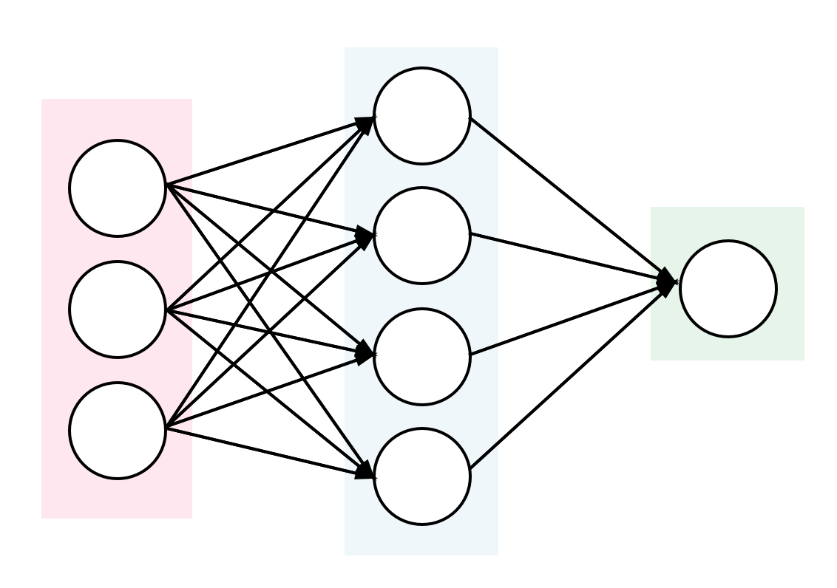
Hidden layer (intermediate layer to handle various interactions)
Inputs (variables in my data)
Output (variable in my data I’m predicting)

Slide 7
Each node is a dot product of previous nodes in the layer before it
2*a + 3*b + 5*c
a
b
2.0
c
3.0
5.0

Slide 8
Each node is a dot product of previous nodes in the layer before it
2*a + 3*b + 5*c
Loss function tells us how good our final value is!
a
b
2.0
c
101
3.0
Say we predict 101 and the true value is 100. Our loss function would indicate that.
5.0

Slide 9
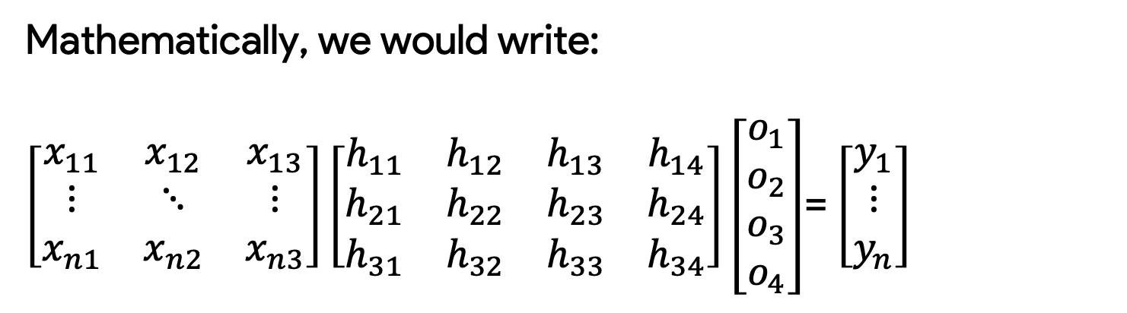
Mathematically, we would write:
$\left[\begin{matrix}x_{11} & x_{12} & x_{13} \\ ⋮ & ⋱ & ⋮ \\ x_{n1} & x_{n2} & x_{n3}\end{matrix}\right]\left[\begin{matrix}h_{11} & h_{12} & h_{13} & h_{14} \\ h_{21} & h_{22} & h_{23} & h_{24} \\ h_{31} & h_{32} & h_{33} & h_{34}\end{matrix}\right]\left[\begin{matrix}o_{1} \\ o_{2} \\ o_{3} \\ o_{4}\end{matrix}\right]$= $\left[\begin{matrix}y_{1} \\ ⋮ \\ y_{n}\end{matrix}\right]$
These are our unknowns.
This is our data.

Slide 10
Let’s go to the examples.
To follow along, open example_1_math.ipynb in the GitHub.

Slide 11
Inputs (variables in my data)
Linear regression is just a special case.
Just remove the hidden and you you see the familiar model.
Output (variable in my data I’m predicting)

Slide 12
Let’s go to example 2 and make an OLS model in TensorFlow.
To follow along, open example_2_ols.ipynb in the GitHub.

Slide 13
Finally, let’s see what we would do if we wanted to experiment quickly.
To follow along, open example_3_keras.ipynb in the GitHub.

