Slide 1
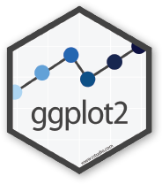

ggplot2
a whistlestop tour from basics to extensions
Constantin Ahlmann-Eltze
@const-ae

Slide 2
Outline
ggplot’s place in the tidyverse
How to use ggplot
Data visualization best practices
The Grammar of Graphics
Creating a ggplot extension

Slide 3
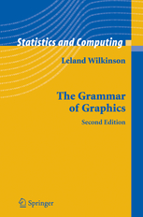
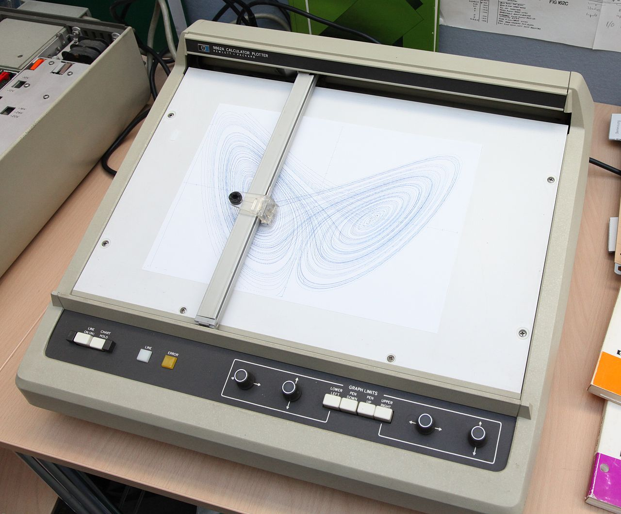
What does that name even mean?
+
=
Grammar of Graphics
Plotter

Slide 4

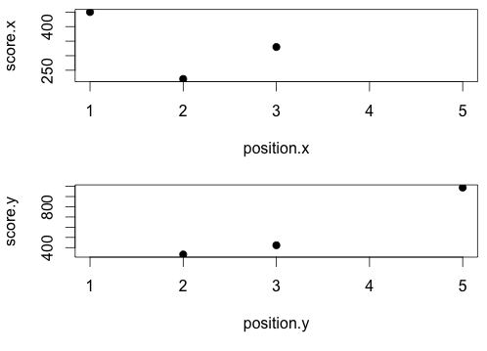
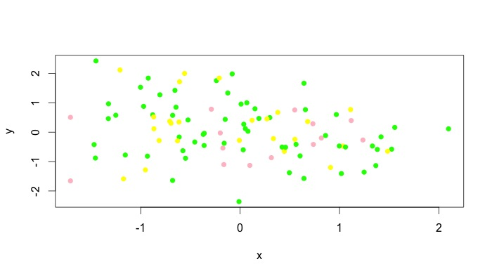
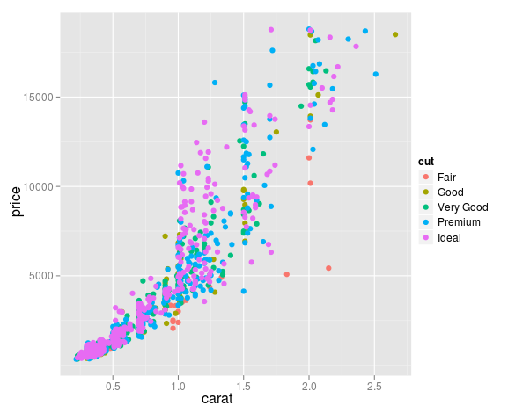
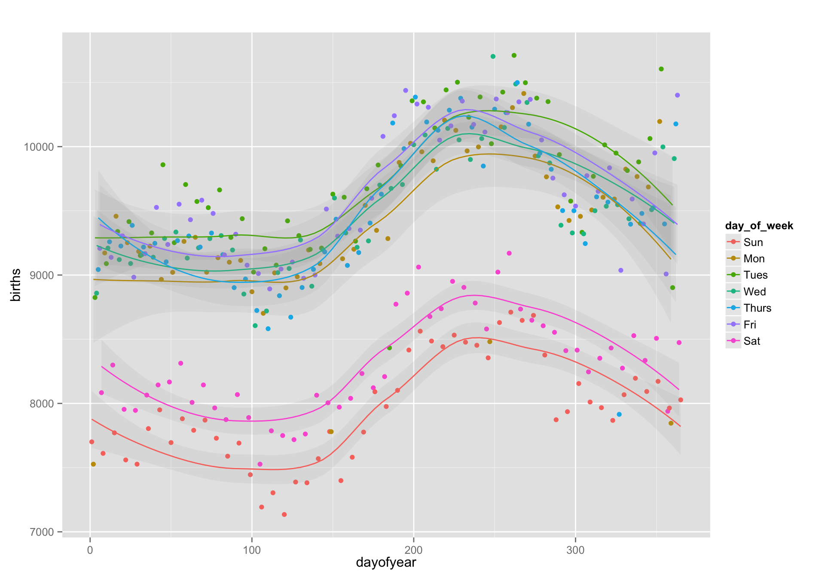
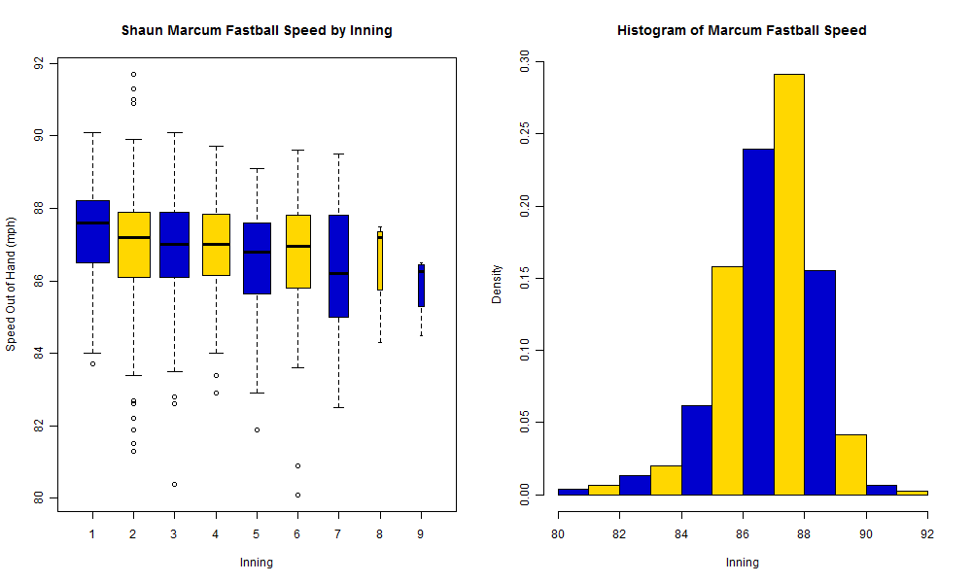
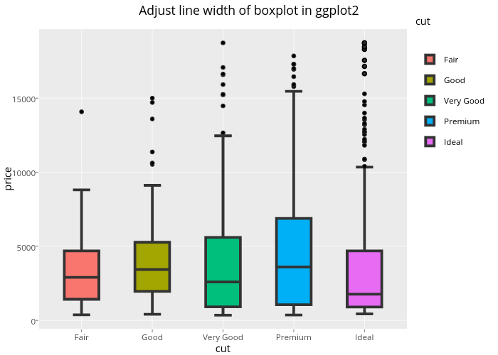
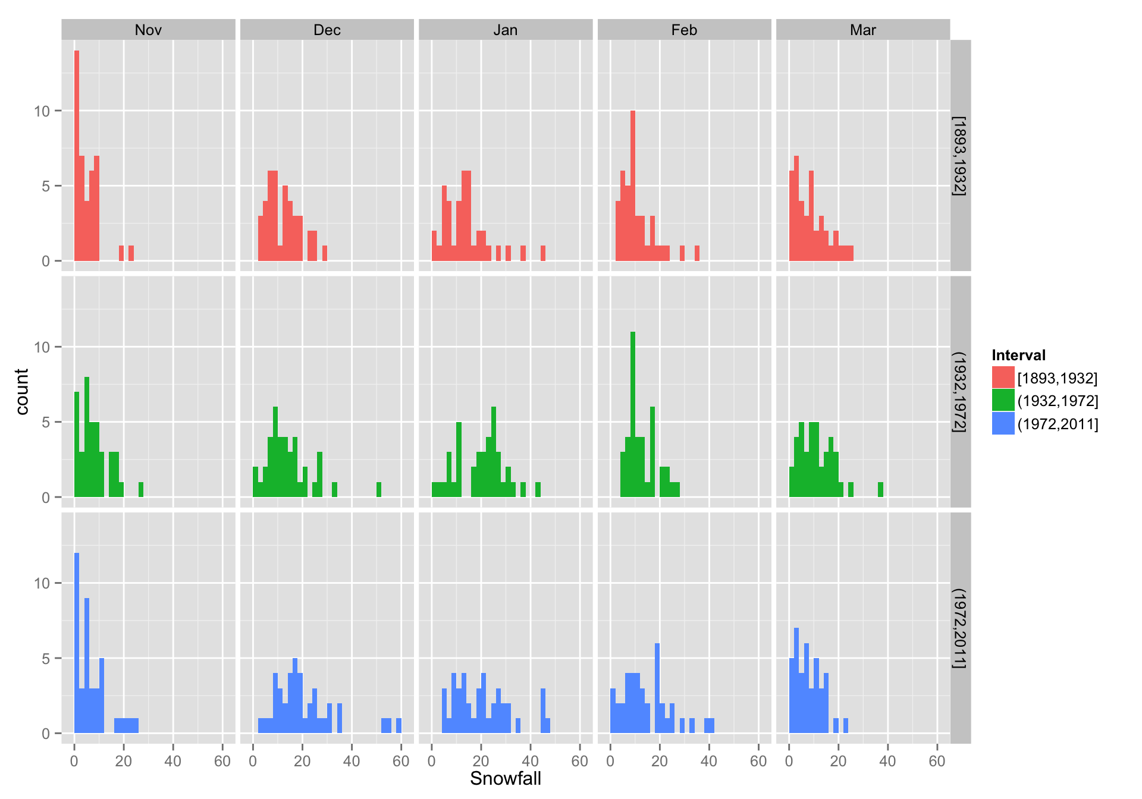
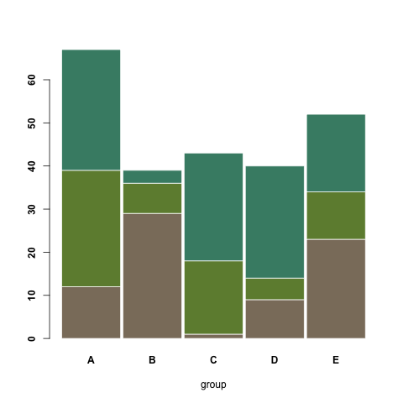
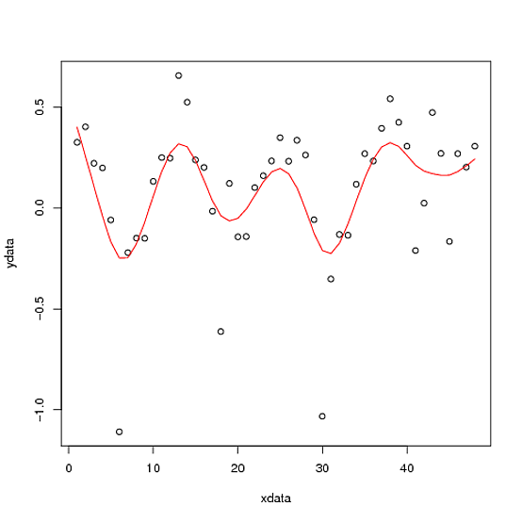
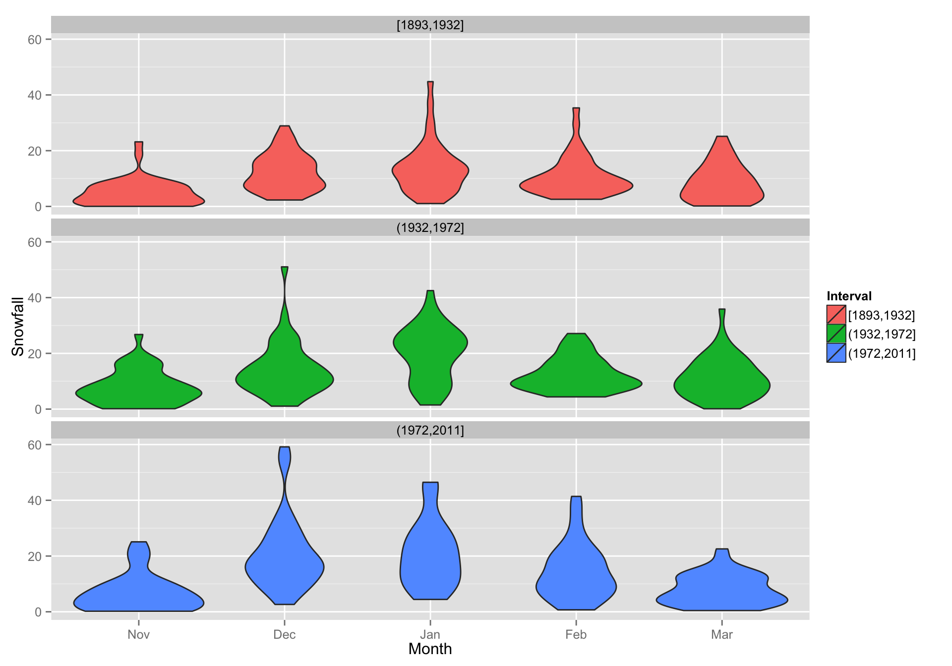
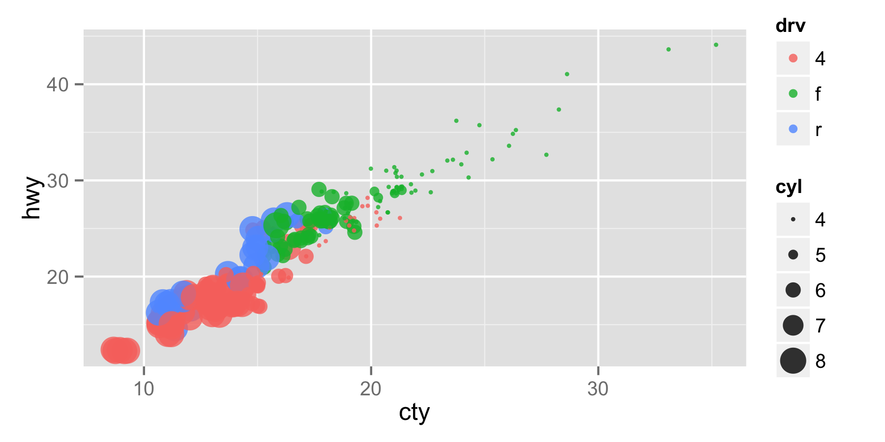

Slide 5
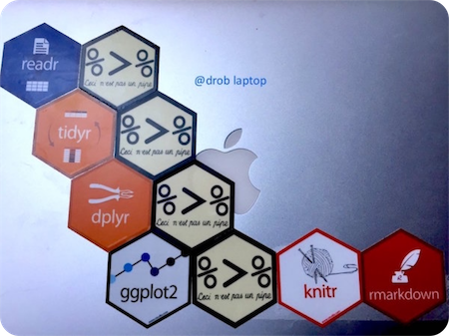
ggplot’s place in the tidyverse

Slide 6


Quickly iterate with ggplot
One-off
scatter plot
Data exploration
Publication
ready plots
Lattice
pheatmap
igraph

Slide 7
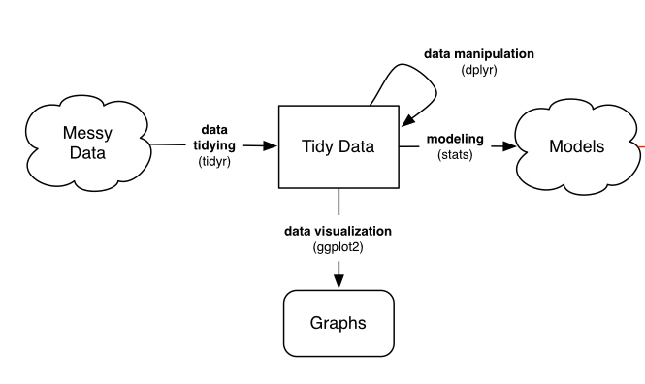
The Data Science Workflow
Figure adapted from http://varianceexplained.org/r/tidy-genomics-biobroom/

Slide 8
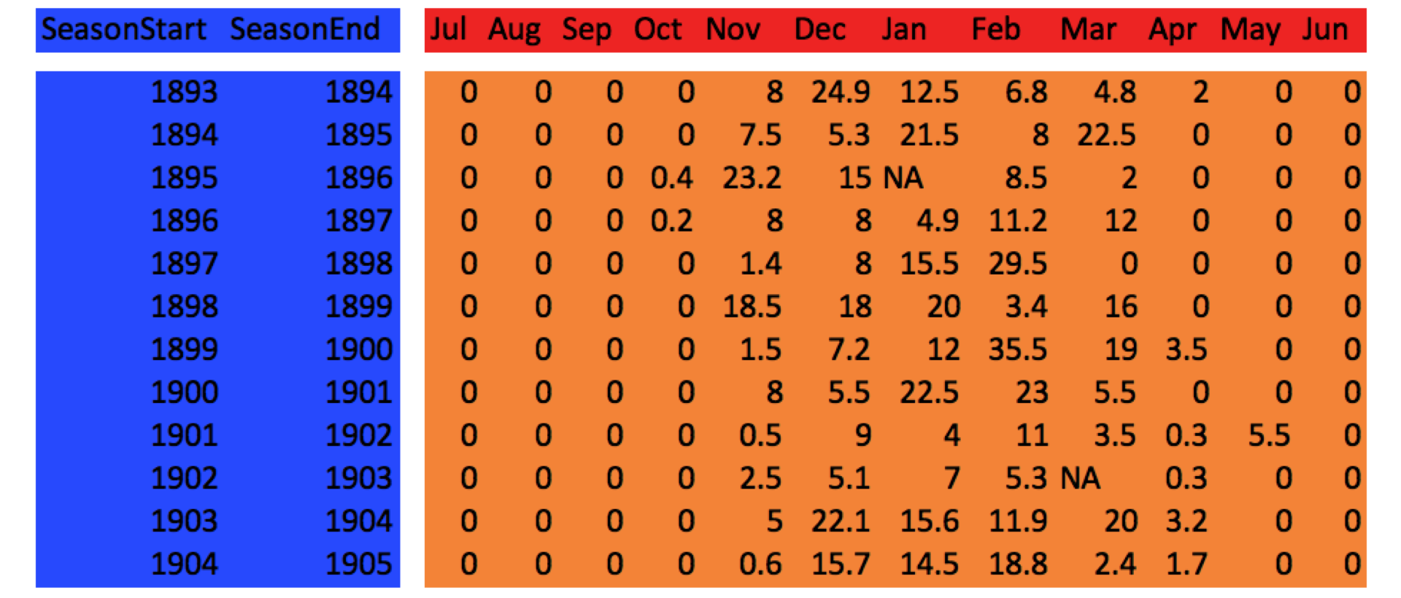
Untidy Data
Wide format data
http://eriqande.github.io/rep-res-web/lectures/ggplot_2_reshape_facets_stats.html

Slide 9
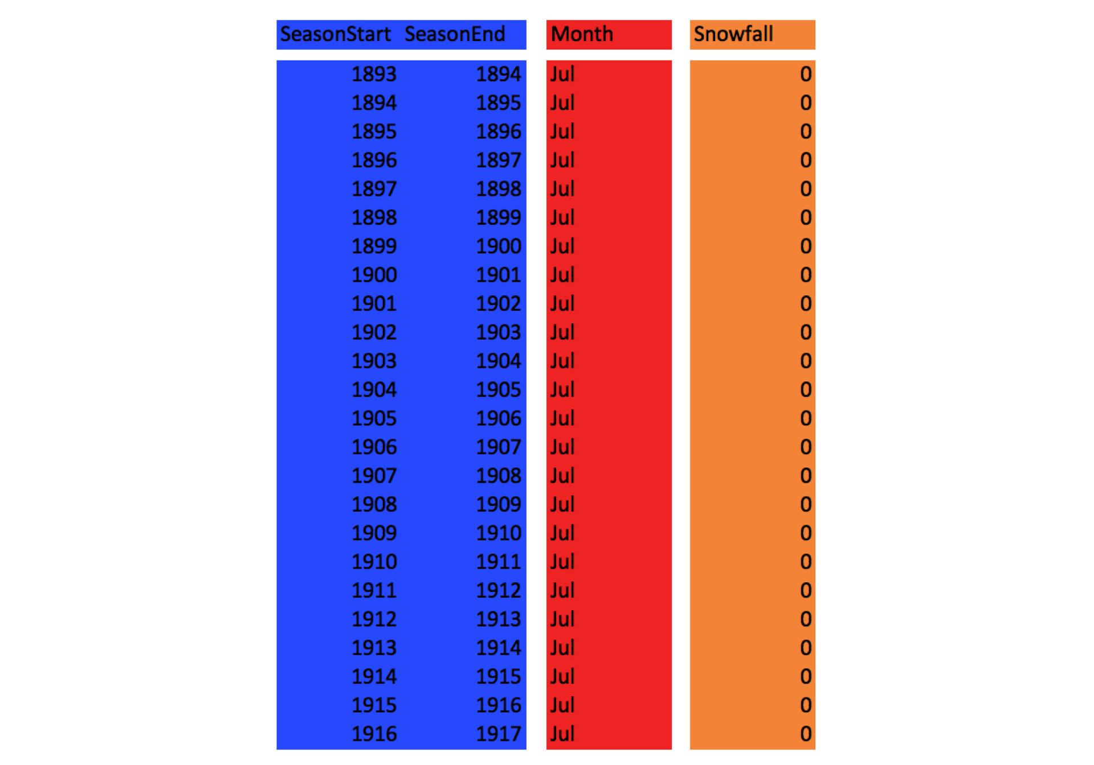
Tidy Data
Long format data
http://eriqande.github.io/rep-res-web/lectures/ggplot_2_reshape_facets_stats.html

Slide 10
Convert wide to long format
tidyr::gather
tidyr::spread

Slide 11
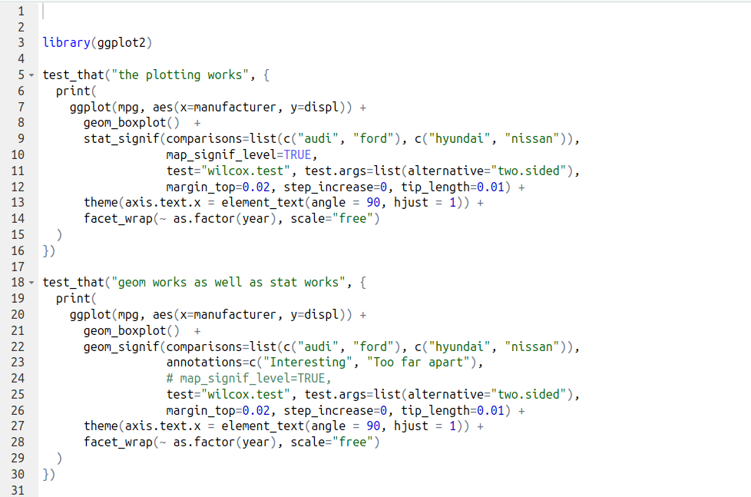
How to use ggplot

Slide 12
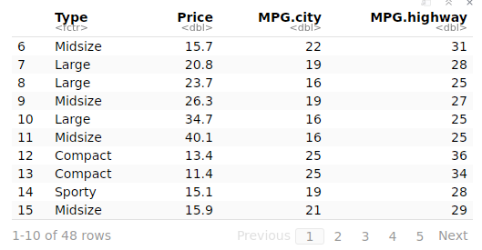
Carprice Data

Slide 13
ggplot Call
Mapping columns to aesthetics
The data in a data.frame
Step by Step adding elements
ggplot(carprize, aes(x=Price, y=MPG.city, color=Type) +
geom_point()
Layer to draw points
Layer to draw points

Slide 14
ggplot Call
ggplot(carprize, aes(x=Price, y=MPG.city, color=Type) +
geom_point() +
geom_smooth(method=”lm”)
Plot linear trend line

Slide 15
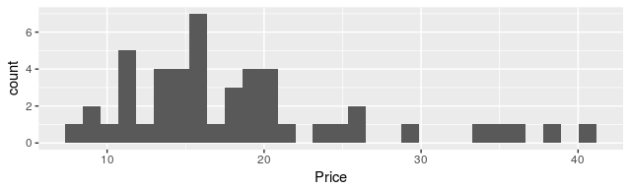
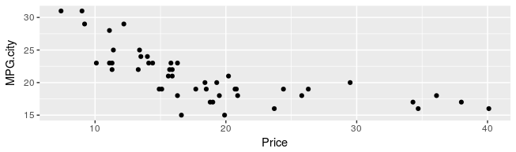
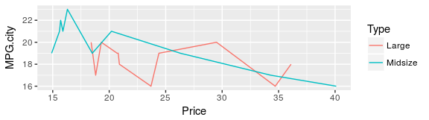
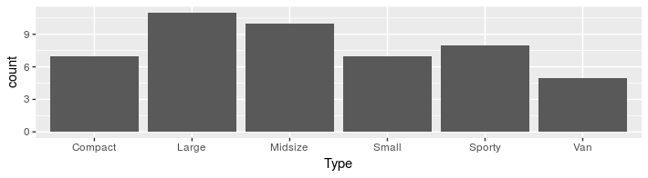
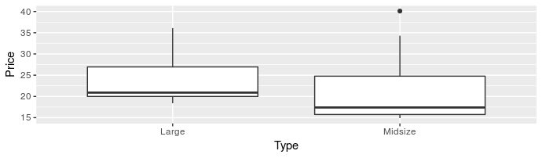
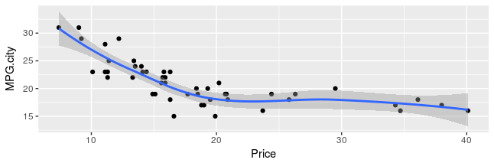
Layer Overview
geom_histogram
geom_point
geom_line
geom_bar
geom_boxplot
geom_smooth

Slide 16
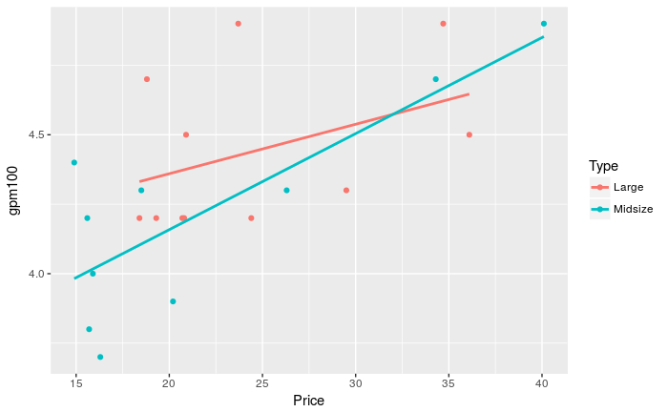
Demo
ggplot_demo.Rmd

Slide 17
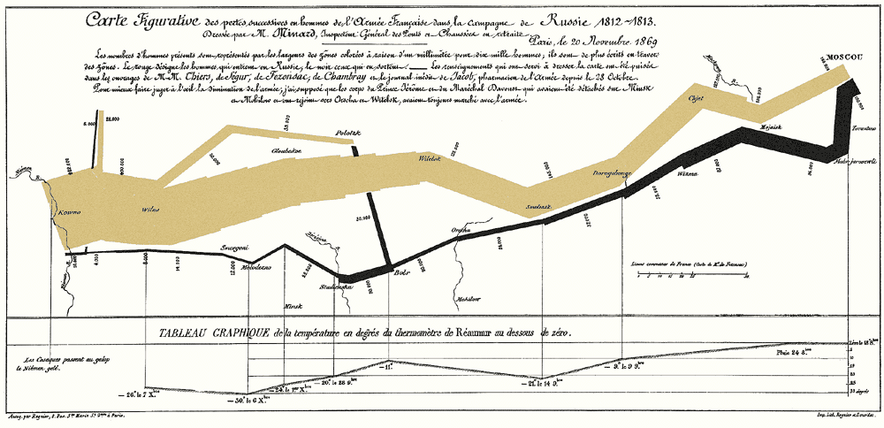
Visualization Best Practices

Slide 18
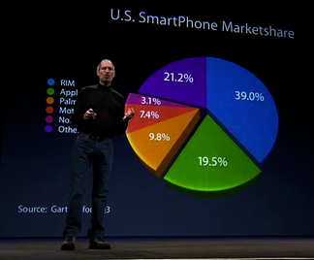
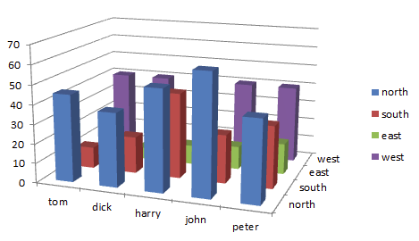
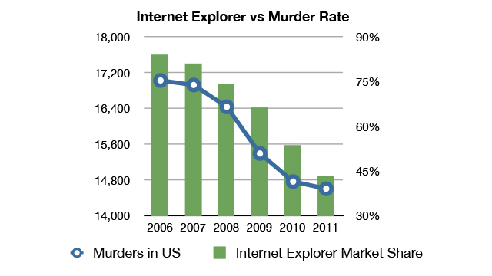
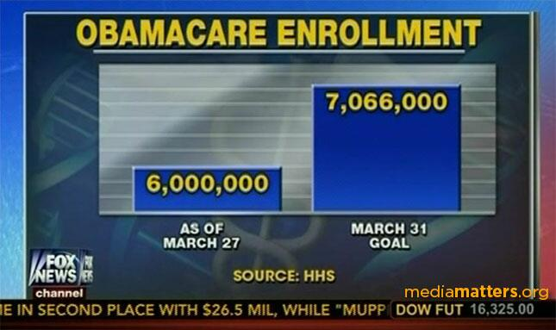
How not to do data visualization

Slide 19
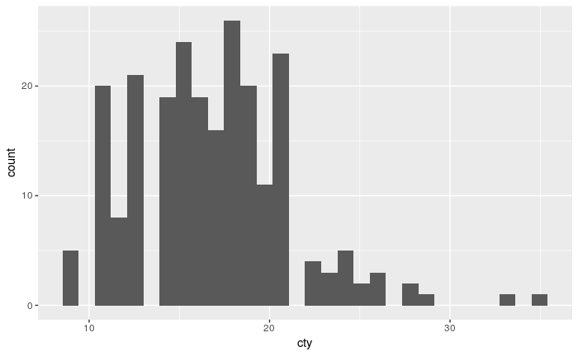
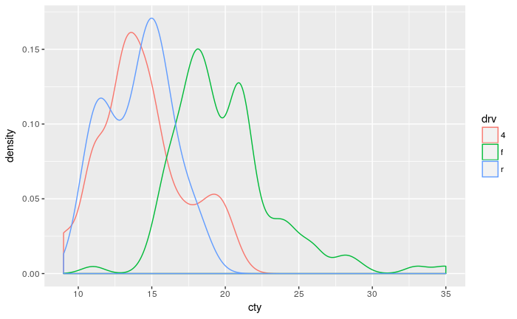
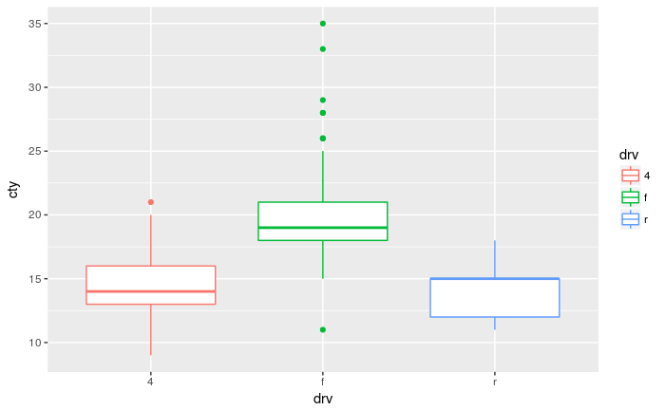
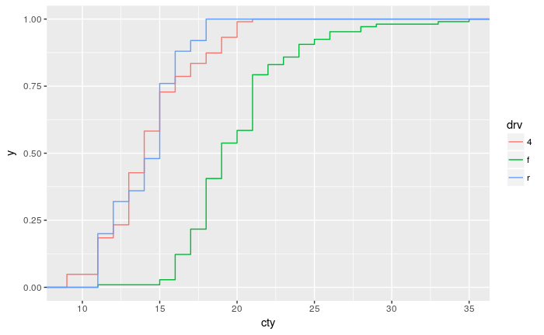
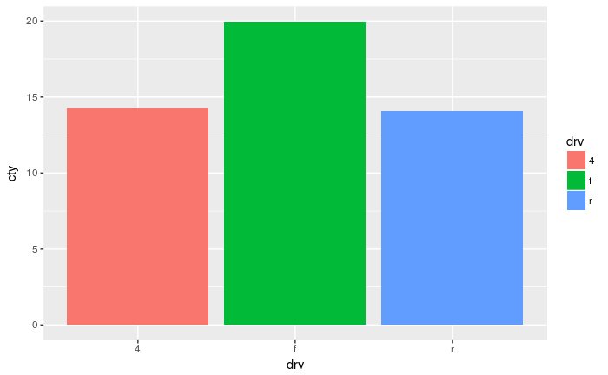
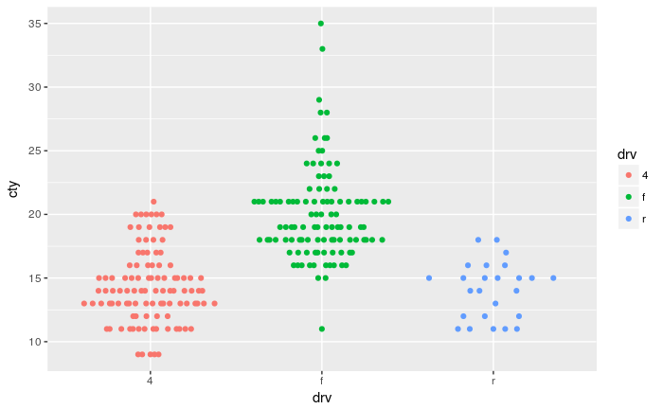
How to show 1D data?

Slide 20
How to show 1D data?
Histogram
  Nice and easy, but binning can be misleading
Density
  Choice of bandwidth can be difficult
Empirical distribution function
  No additional parameter necessary, but less intuitive
Bar plot
  Hides most of the data, but is intuitive
Boxplot
  Only makes sense if data is unimodal
Beeswarm
  Shows data directly, only possible for a medium number of points

Slide 21
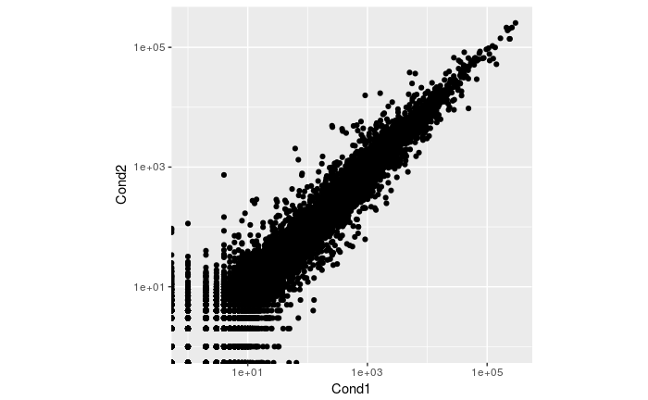
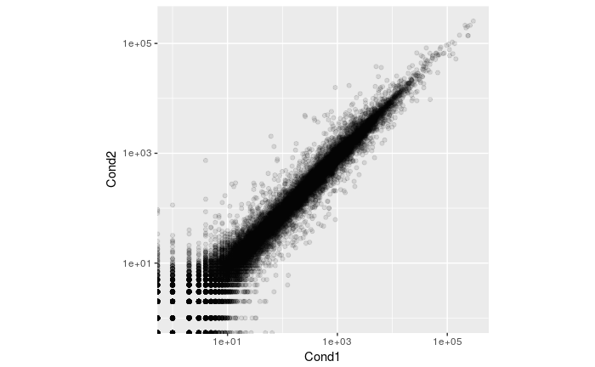
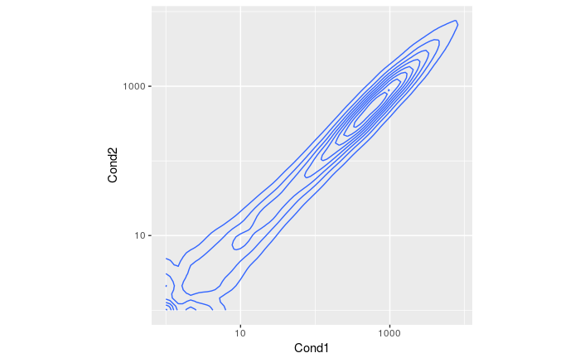
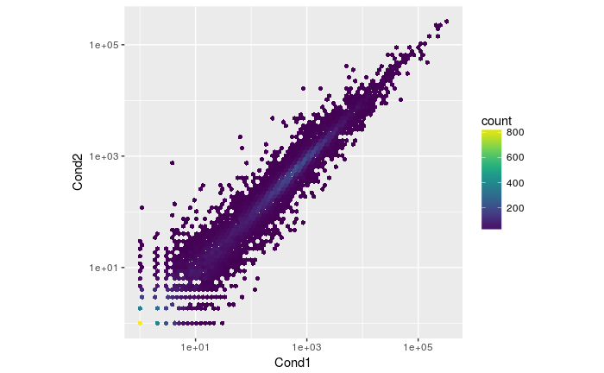
How to show 2D data?

Slide 22
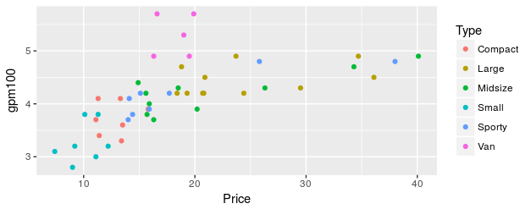
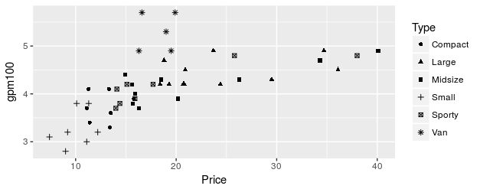
Higher dimensional Data
Color
Shape
Facets

Slide 23
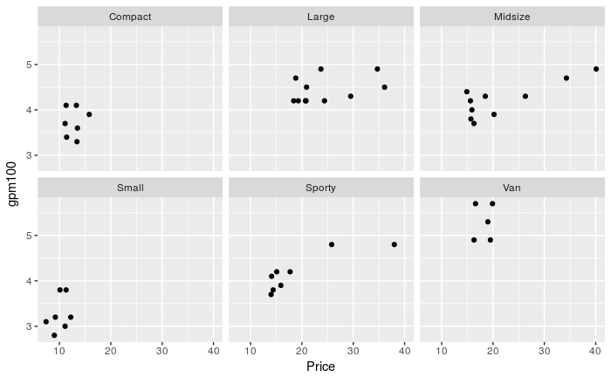
Higher dimensional Data
ggplot(carprize, aes(x=Price, y=MPG.city) +
geom_point() +
facet_wrap(~ Type)

Slide 24
Grammar of Graphics

Slide 25
Grammar of Graphics
thinking about how we can build on the grammar to learn how to create graphical “poems.”
Wickham, H. A Layered Grammar of Graphics. J. Comput. Graph. Stat. 19, 3–28 (2010).

Slide 26
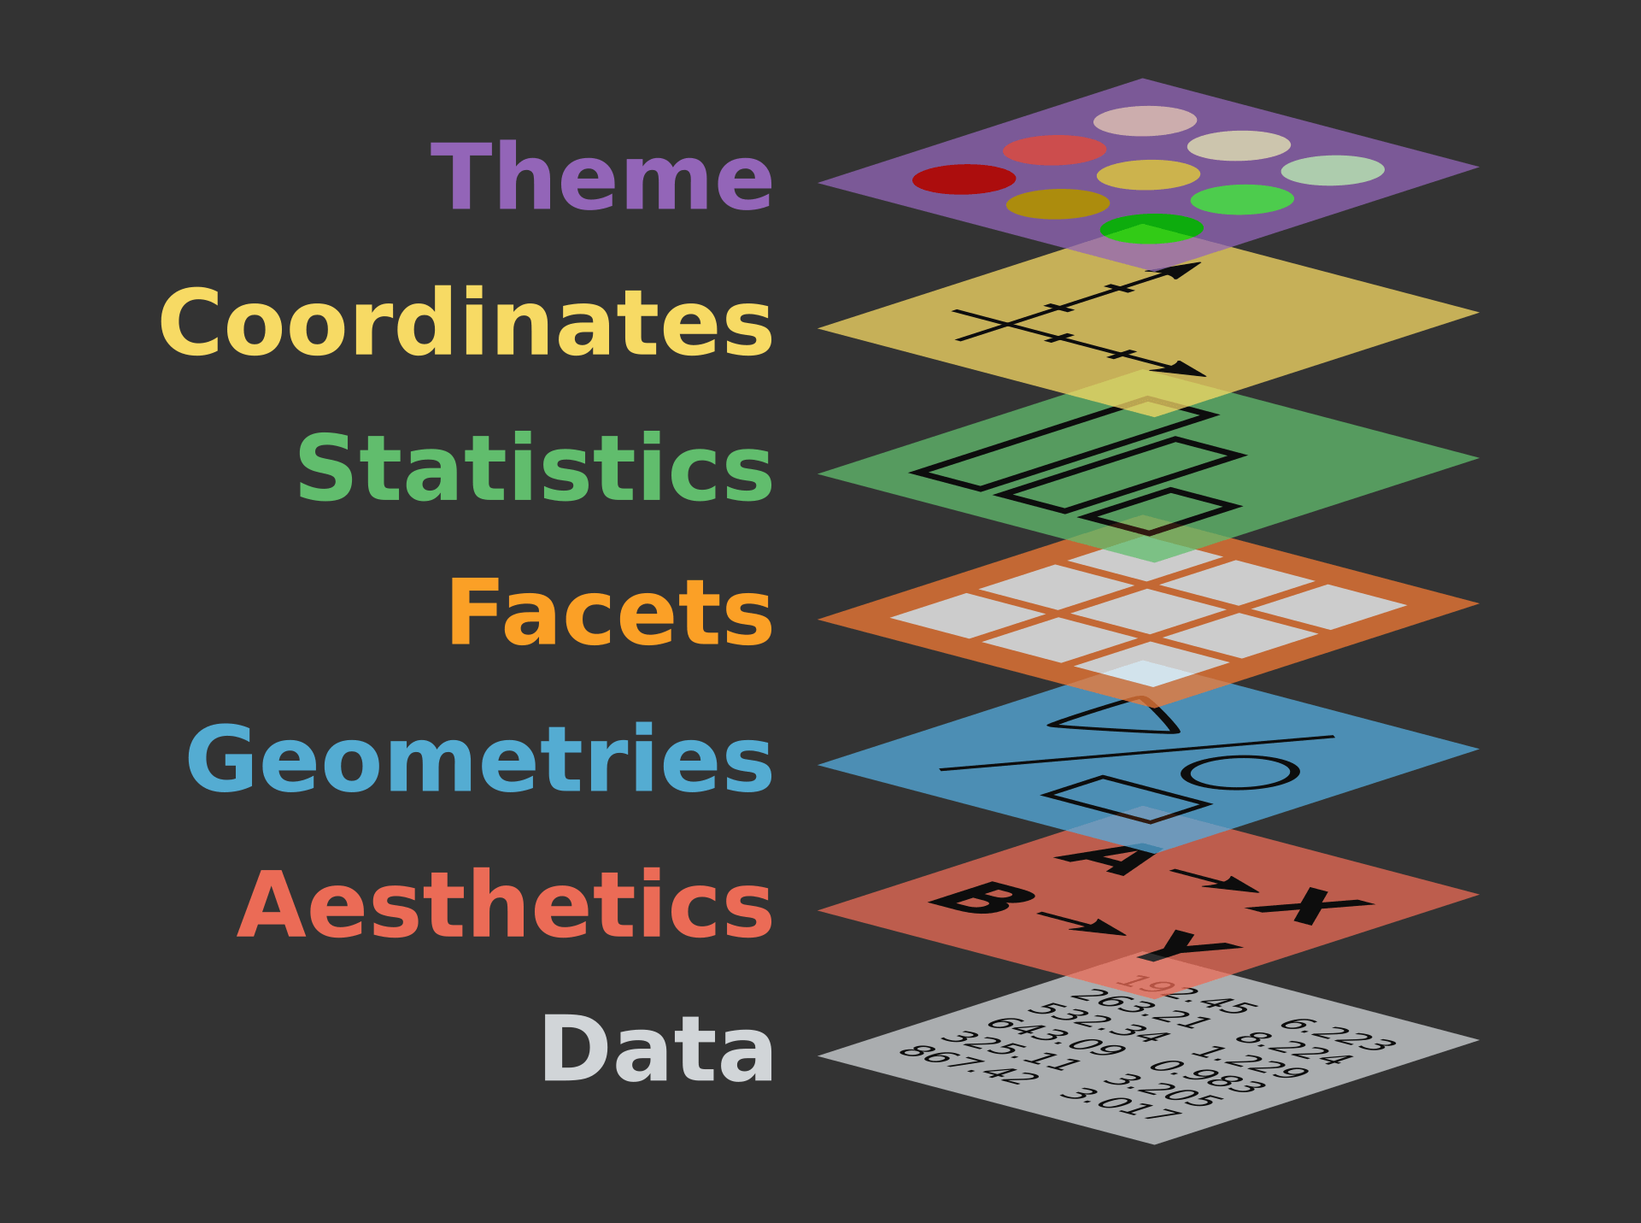
Grammar of Graphics
Image copied from http://behavioraleconomics-datascience.org/the-grammar-of-graphics-la-filosofia-revoluciono-data-analytics/

Slide 27
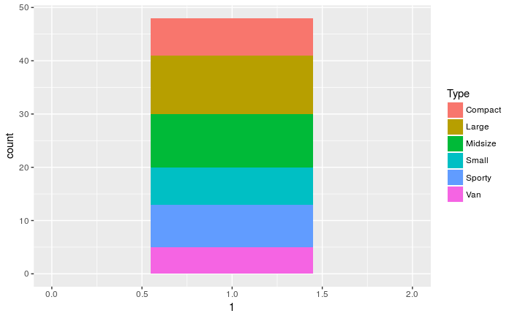
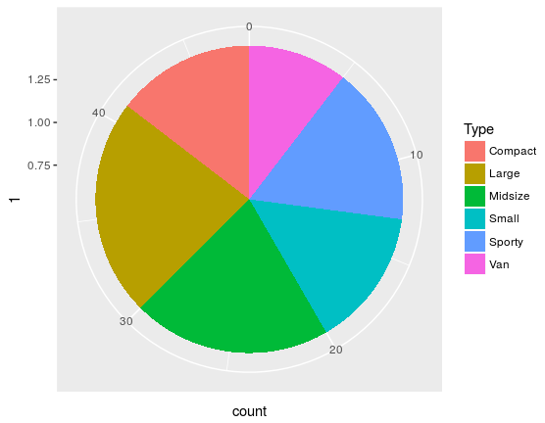
Gramar of Graphics:
Coordinate Systems
ggplot(carprize,
aes(x=1,fill=Type) +
geom_bar() +
xlim(0,2)
ggplot(carprize,
aes(x=1,fill=Type) +
geom_bar() +
coord_polar("y")
A pie chart is just a stacked bar-chart in polar coordinates

Slide 28
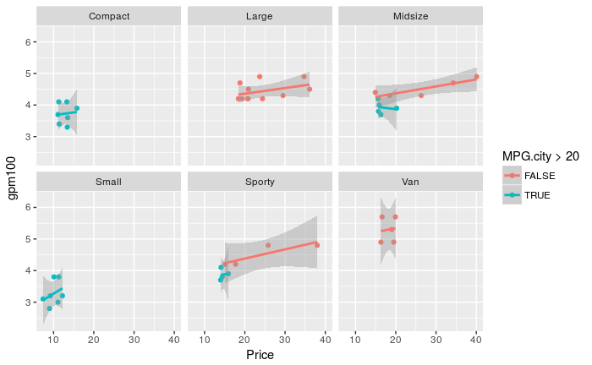
Statistics are computed by group and facet
ggplot(aes(x=Price, y=gpm100, color=MPG.city > 20)) +
geom_point() +
geom_smooth(method = "lm") +
facet_wrap(~ Type)

Slide 29
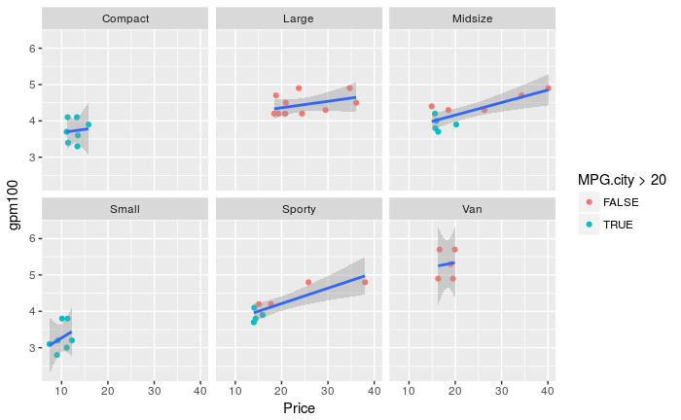
How to get one fit per facet?
ggplot(carprize, aes(x=Price, y=gpm100)) +
geom_point(aes(color=MPG.city > 20)) +
geom_smooth(method = "lm") +
facet_wrap(~ Type)

Slide 30

Creating a ggplot extension

Slide 31
ggplot Extensions
Since the v.2.0.0 release there is a common interface for creating extensions
Based on ggproto: a custom object system

Slide 32

Gallery: ggplot2-exts.org

Slide 33

Demo
chull_to_ggsignif.Rmd

Slide 34

ggsignif
ggplot2 extension to add significance annotations
Available at CRAN and
github.com/const-ae/ggsignif
Can automatically calculate p-values
library(ggsignif)
ggplot(mpg, aes(class, hwy)) +
geom_boxplot() +
geom_signif(comparisons = list(c("compact", "midsize"),
c("minivan", "suv")),
map_signif_level = TRUE, textsize=6) +
ylim(NA, 48)

Slide 35
Thanks for your attention
Constantin Ahlmann-Eltze
@const-ae

