Slide 1
Predictive Modelling to Understand the Relationship Between Gene Expression and Behavior

Slide 2

Glucocorticoids and Early Life Environment
The early life environment has long term influences on future health
Perinatal exposure to high levels of glucocorticoids has been linked to the development of:
heart disease
diabetes mellitus
depression and anxiety disorders

Slide 3
Synthetic Glucocorticoids (sGC)
Administered to women at risk for pre-term labor (~10% of pregnant women)
Reduces incidence of Respiratory Distress Syndrome
Due to wide-spread action of sGC, it is possible that sGC have unintended side-effects on neural development
Prenatal sGC exposure results in increased stress response in young children (Alexander et al., 2012)
Recent research suggests that the effects of sGC may be transmitted to subsequent generations (Iqbal et al., 2012)

Slide 4
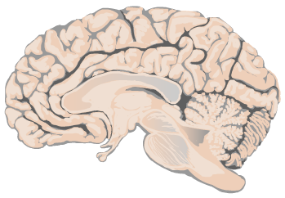
Prefrontal Cortex
Prefrontal cortex (PFC) has been shown to have an inhibitory influence on the HPA axis
Mediates behaviors such as locomotor activity
Objective: Determine how antenatal synthetic glucocorticoids (sGC) affect the PFC over multiple generations
Prefrontal Cortex

Slide 5
F₀: Treatment of Pregnant Guinea Pig with Betamethasone (1mg/kg) or saline
gd40-41
gd50-51
gd60-61
Experimental Method and Model
Post-Natal Day 40, PVN, PFC and HPC RNA/DNA was extracted from F_{1,} F₂ and F₃ female offspring
CONTROL
BETA
F₁
Males (8)
Males (8)
Females
(5)
Females
(5)
RNA- Sequencing (HPC, PVN & PFC)
Bisulfite DNA-Sequencing (HPC)
F₂
Males (8)
Males (8)
Tophat2 Alignment
Differential Expression Analysis
Predictive Modelling
Females
(5)
Females
(5)
Bismark Alignment
MethylKit Analysis
F₃
Males (8)
Males (8)
Females
(6)
Females
(4)

Slide 6
Antenatal sGC Results in Significant Changes in Locomotor Activity over 3 Generations
F1
F2
F2
Control Treatment
This work was completed by Vasilis Moisiadis

Slide 7
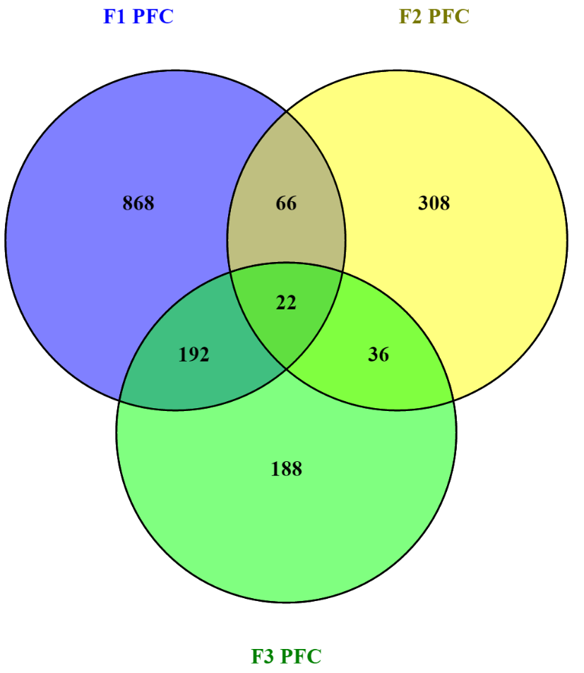
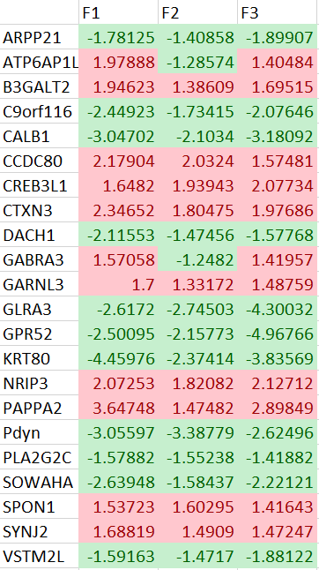

Slide 8
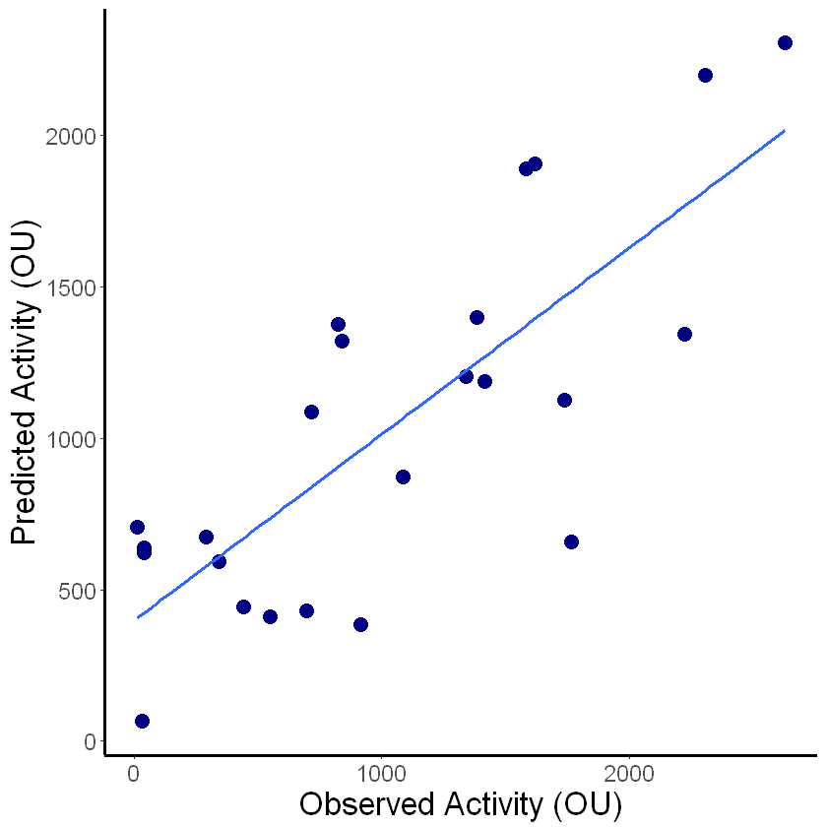
Multivariate Linear Regression
Use the expression of 4 genes to model the relationship between gene expression and Open Field Activity
Determine accuracy of model by plotting predicted value as a function of observed values and measuring R²
R²= 0.62
pValue=0.0008

Slide 9
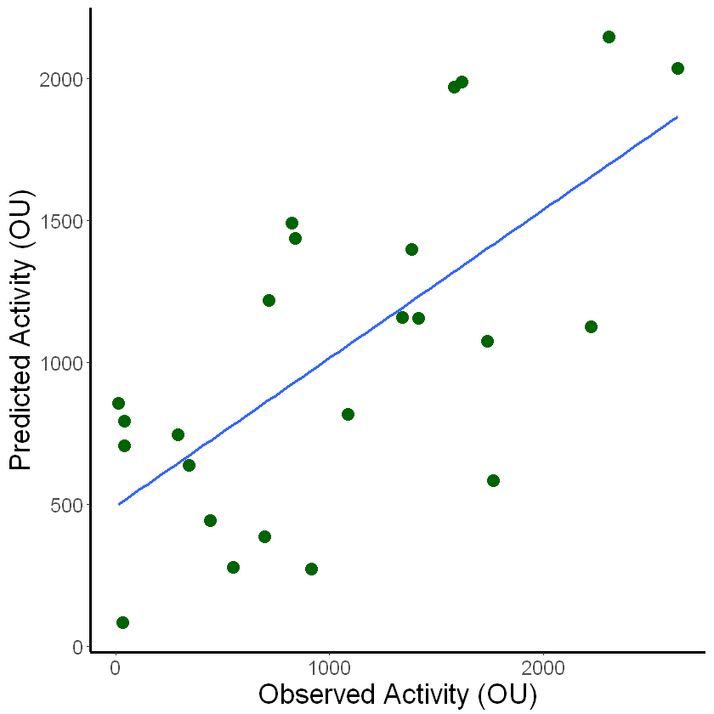
Multivariate Linear Regression with LOO Cross Validation
Leave One Out Technique: remove one sample of your dataset to use as ‘test’ dataset. Repeat for all samples
R²= 0.46
pValue=0.0003
Obtain focused genes for further investigation

Slide 10
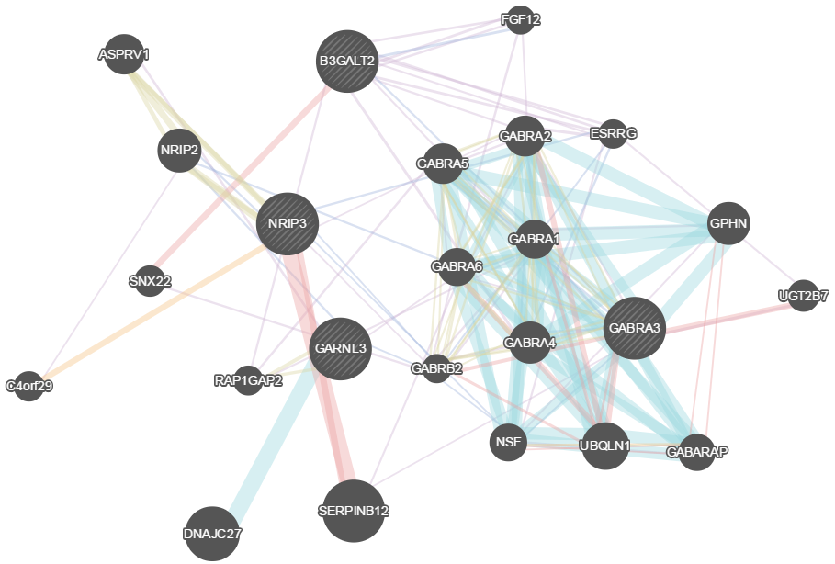
NRIP3
B3GALT2
GARNL3
GABRA3

Slide 11
RNASeq Validation

Slide 12
Model Validation
qPCR Data
Training Set:
Samples previously included in RNAseq
Test Set:
Novel Data

Slide 13
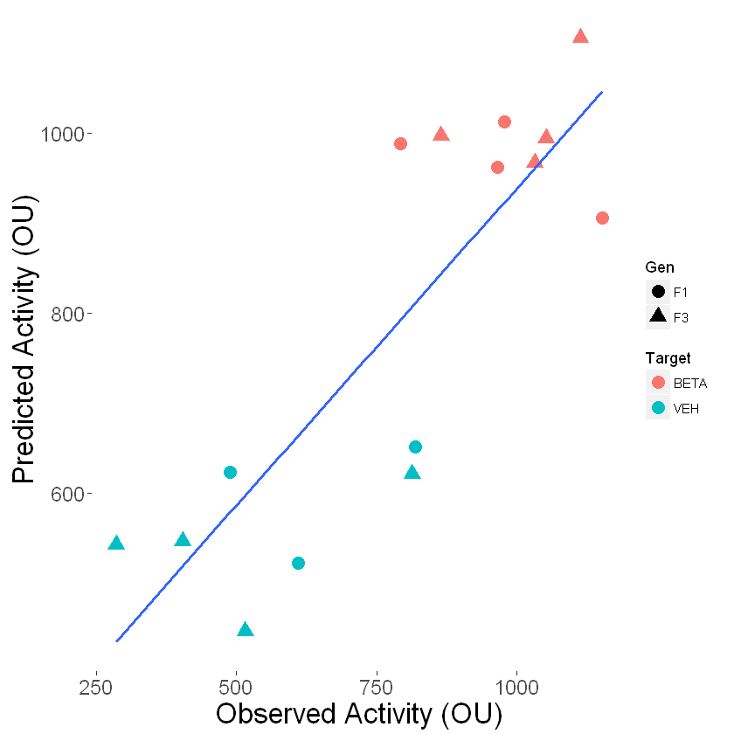
Model Validation: Training Set
Model is replicated on Cts of Training set data- but only fits F1 and F3 data
R²= 0.70 pValue=0.01

Slide 14
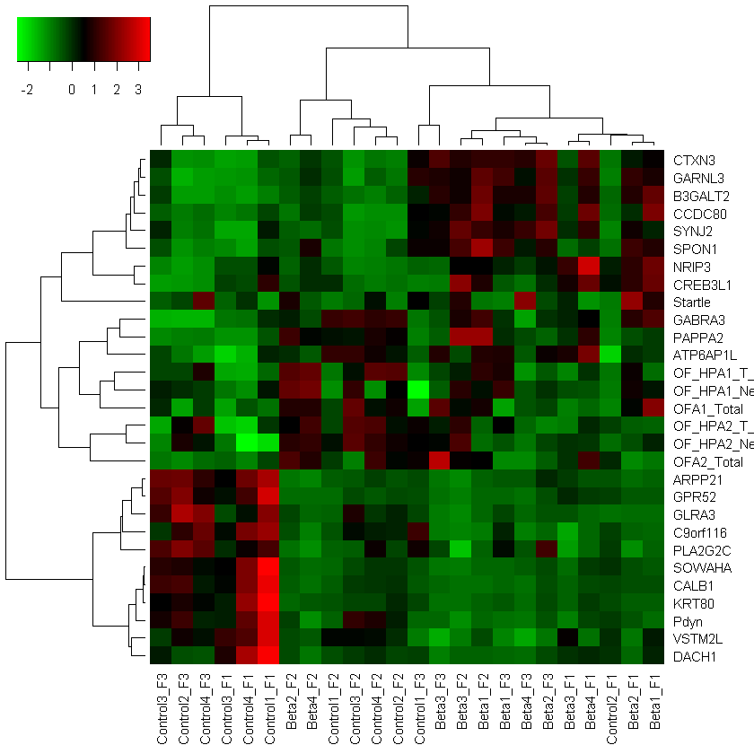

Slide 15
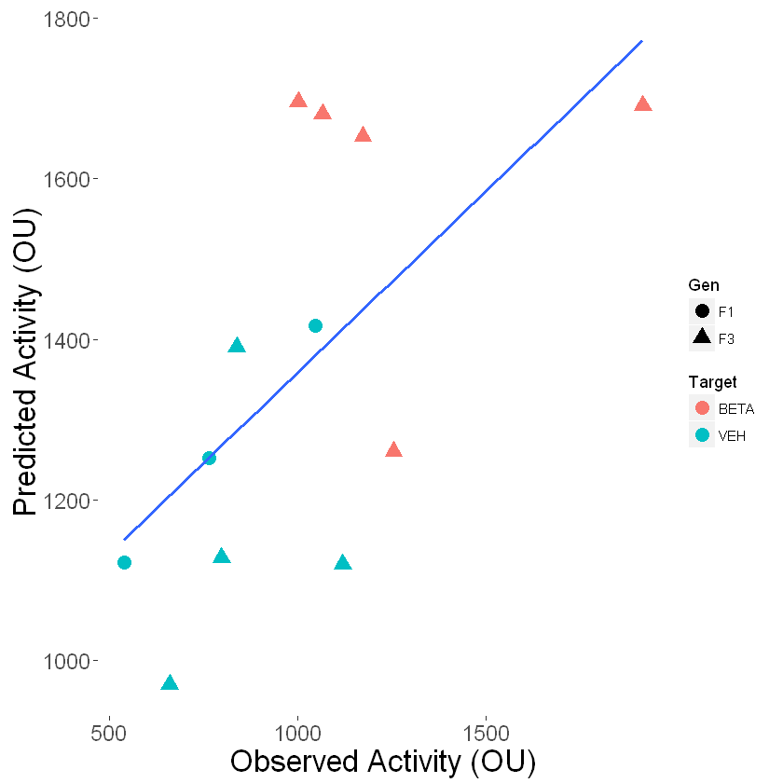
Model Validation: Test Set
Model from Training set is then fit directly to Test data
Model generalizes to novel data set
R²= 0.38 pValue=0.033

Slide 16
Model Genes as they Relate to Behavior in Literature
GABRA3 : GABA Receptor Subunit Alpha 3
Increased Expression with Methamphetamine Sensitization
KO also shows increased locomotor activity
B3GALT2 : Beta-1,3-Galactosyltransferase 2
KO shows increased locomotor activity
NRIP3 : Nuclear Receptor Interacting Protein 3 &
GARNL3 : GTPase Activating Rap/RanGAP Domain Like 3
No direct evidence found yet

Slide 17
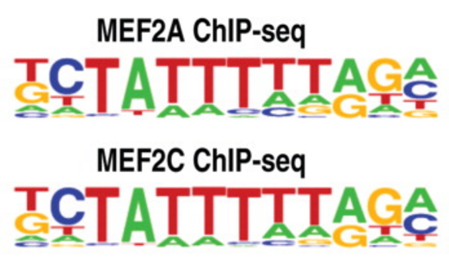
Model Genes: Transcription Factor Binding Sites
*
pValue = 0.009
qValue = 0.15
*
#
MEF2C has glucocorticoid responsive element in promoter region

Slide 18
Conclusion
PFC was the only region in which there was overlap in significantly differentially expressed genes over all 3 generations
Clustering analyses suggest F₂ animals are distinct from F₁ and F₃ offspring
Modelling suggests 4 genes may play a role in behavioral phenotypes observed
Differentially expressed genes have MEF2C binding site
MEF2C expression can be influenced by glucocorticoids via GRE site in promoter
Presents possible mechanism for effects of antenatal sGC exposure

