Slide 1

Predictive Modelling of Stress-Related Behaviour Through Gene Expression Following Prenatal Glucocorticoid Exposure
Andrea Constantinof, Vasilis G. Moisiadis, Alisa Kostaki, Stephen G. Matthews
Department of Physiology, OBGYN, Medicine
Fraser Mustard Research Institute
University of Toronto, Toronto, Canada

Slide 2

Glucocorticoids and Early Life Environment
The early life environment has long term influences on future health
Perinatal exposure to high levels of glucocorticoids has been linked to the development of:
heart disease
diabetes mellitus
depression and anxiety disorders

Slide 3

Synthetic Glucocorticoids (sGC)
Administered to women at risk for pre-term labor (~10% of pregnant women)
Reduces incidence of Respiratory Distress Syndrome
Paraventricular Nucleus
Hypothalamic Paraventricular Nucleus (PVN) plays a central role in regulating stress response and behaviour
Highly affected by antenatal synthetic glucocorticoid exposure

Slide 4
Experimental Method and Model
F₀: Treatment of Pregnant Guinea Pig with Betamethasone (1mg/kg) or saline
gd40-41
gd50-51
gd60-61
Post-Natal Day 40, PVN RNA was extracted from female offspring
CONTROL
BETA
RNA- Sequencing
Males
Males
Females
Females
Tophat2 Alignment
Differential Expression Analysis
Tophat2 Alignment
Behavioural Tests:
Startle Response (PND 23)
Open Field (PND 24)
EdgeR Differential Expression Analysis
Moisiadis VG, Constantinof A, et al. submitted, 2017

Slide 5
Antenatal sGC Results in Significant Changes in Behaviour
HPA Response to Open Field Stress
Total Locomotor Activity in the Open Field
Acoustic Startle Response
3000-
2500-
2000-
1500-
1000-
500-
0
2000-
1500-
1000-
500-
0
500-
400-
300-
200-
100-
0
Cortisol (ng\mL)
Startle Response
Ambulatory Activity (AU)
Control Treatment
Control Treatment
Control Treatment
Moisiadis VG, Constantinof A, et al. submitted, 2017

Slide 6
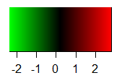
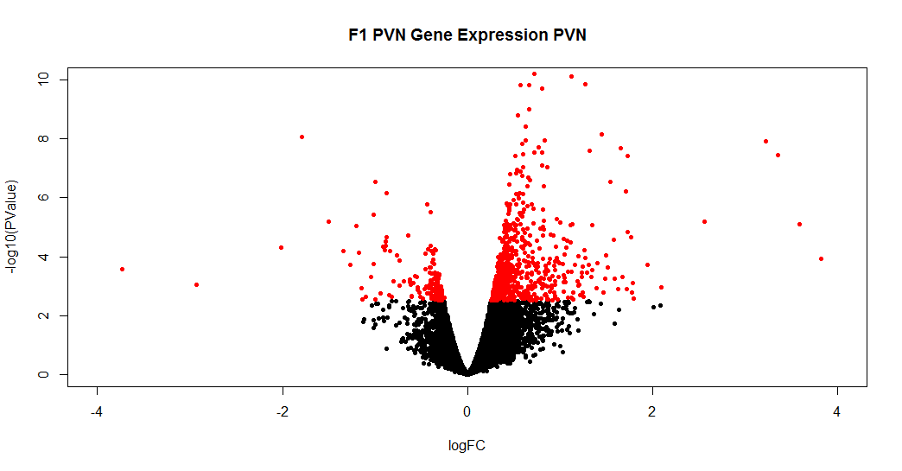
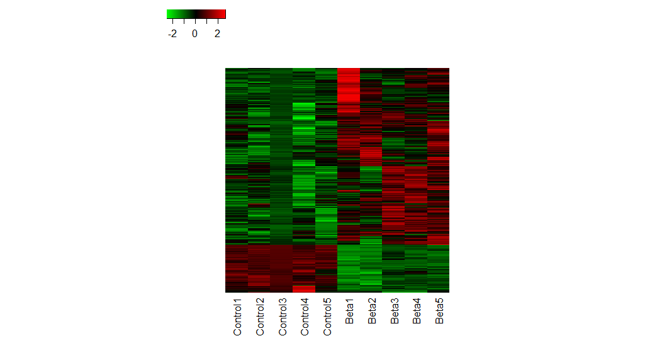
Antenatal sGC Results in Significant Changes in Gene Expression in PVN
Low
High
Control
Beta
161 genes
597 genes
-Log₁₀(p_value)
Significant (FDR< 5%)
Not Significant
Log₂(fold change)
Moisiadis VG, Constantinof A, et al. submitted, 2017

Slide 7
Objective
To determine the relationship between gene expression in the PVN and behaviour
Hypothesis
Transcriptional programming of the PVN by sGC is correlated to behavioural outcomes and can be used in predictive modelling
Methods
Principal Component Analysis
Multivariate Linear Regression

Slide 8
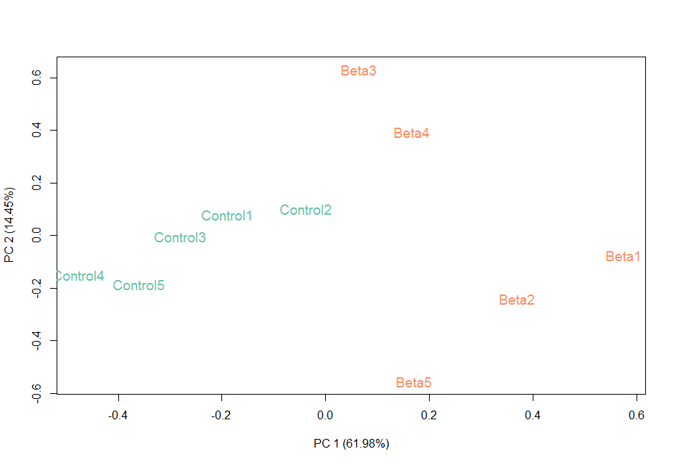
Principal Component Analysis (PCA)
PCA is useful to describe multi-dimensional data.
The expression of each gene = a new dimension
We can reduce the dimensions of the data to the first two Principal Components that describe the majority of variation within the dataset.
Beta3
Beta4
PC 2 (14.45%)
Control1
Control2
Control3
Beta1
Control4
Control5
Beta2
Beta5
PC 1 (61.98%)

Slide 9
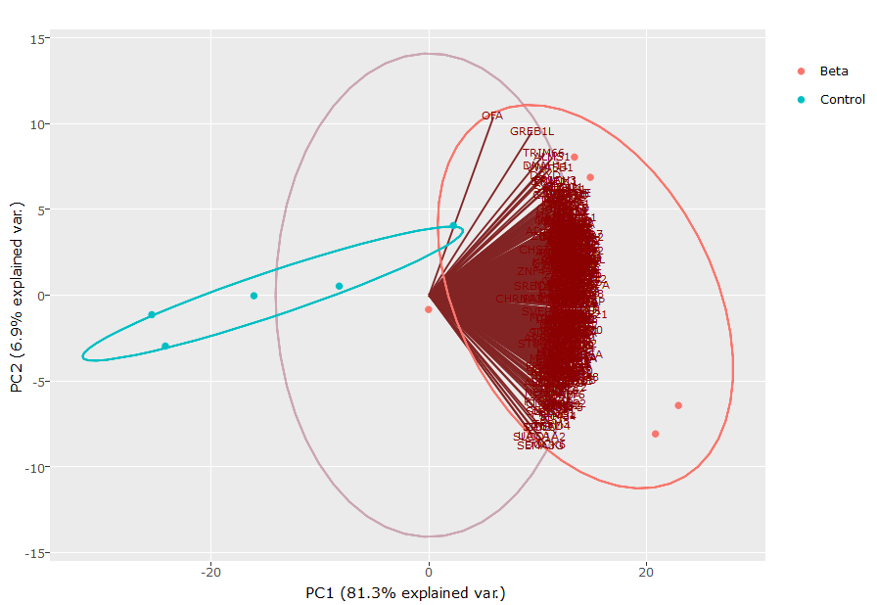
PCA of Gene Expression and Behaviour
Circle of Correlations and PCA:
Determine the relationship between gene expression and behaviour
Open Field Activity
Beta
Control
PC 2 (6.9%)
PC 1 (81.3%)

Slide 10
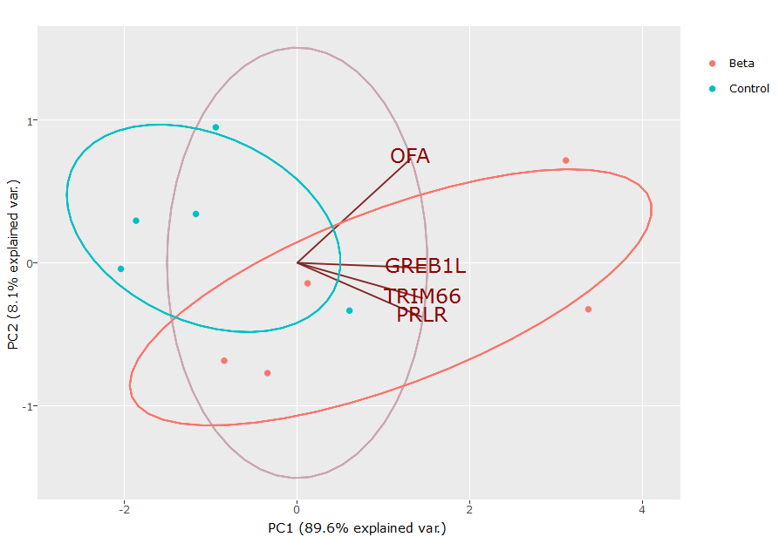
PCA of Gene Expression and Behaviour
PCA suggests that there may exist a relationship between the expression of GREB1L, TRIM66, PRLR and Open Field Activity
Relationship is tested with Linear Regression
Beta
Control
PC 2 (8.1%)
PC 1 (89.6%)

Slide 11
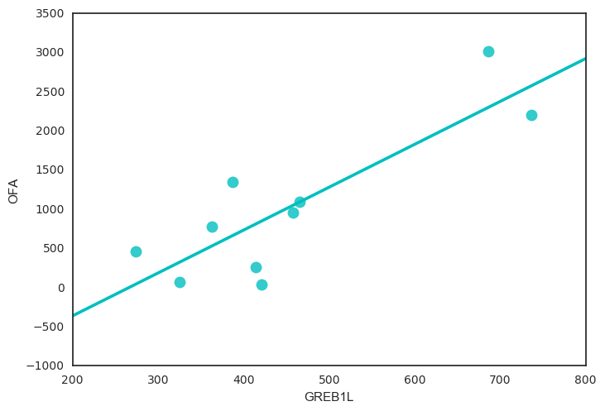
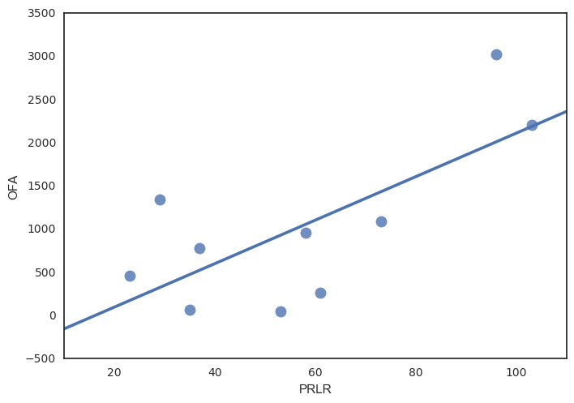
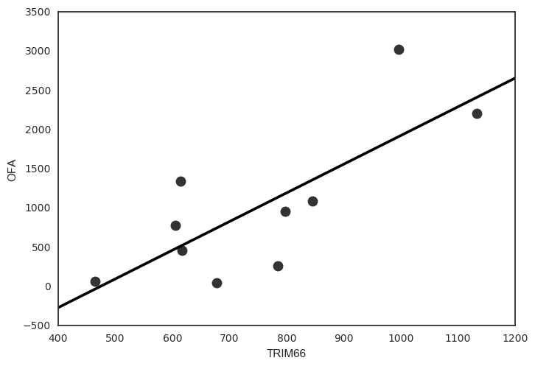
Linear Regression
GREB1L
R² =0.71, p= 0.002
PRLR
R²= 0.51, p= 0.019
TRIM66
R²=0.58, p=0.01
Observed Activity (OU)
Normalized Gene Expression (Counts)

Slide 12
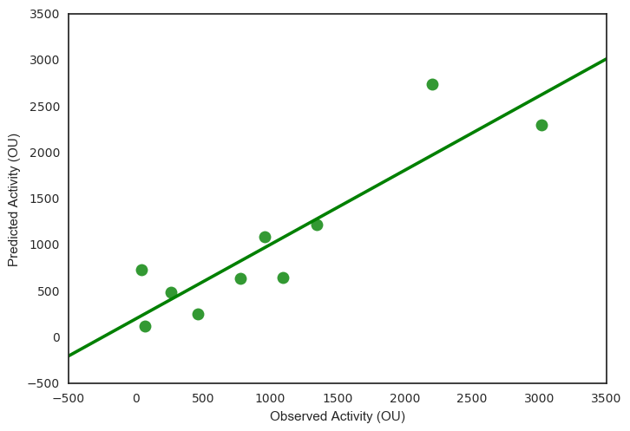
Multivariate Linear Regression Results
Use the expression of 3 genes to model the relationship between gene expression and Open Field Activity
Determine accuracy of model by plotting predicted value as a function of observed values and measuring R²
R²= 0.81
pValue=0.03
Predicted Activity (OU)
Observed Activity (OU)

Slide 13
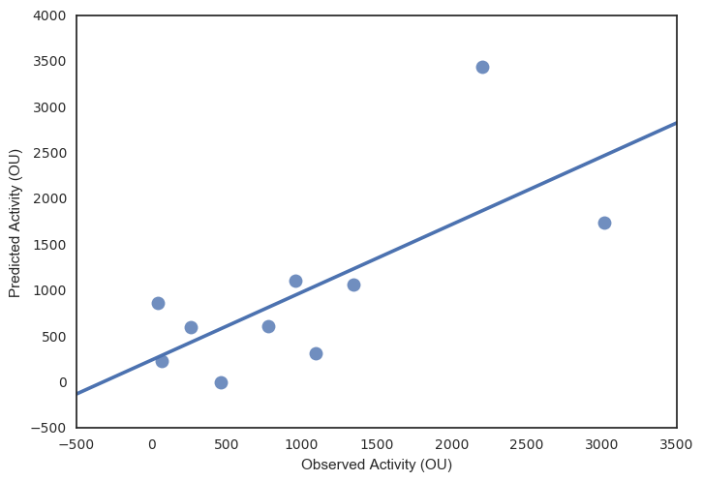
Multivariate Linear Regression Cross Validation
Leave One Out Technique: remove one sample of your dataset to use as ‘test’ dataset. Repeat for all samples
R²= 0.51
pValue=0.02
Predicted Activity (OU)
Obtain focused genes for further investigation
Observed Activity (OU)

Slide 14
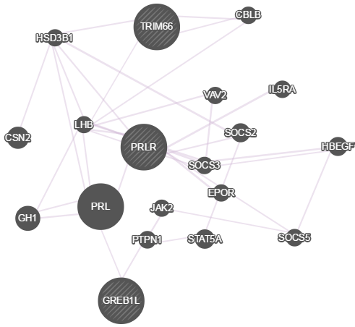
TRIM66: Transcription Regulation
PRLR: Prolactin Receptor
GREB1L: Estrogen Receptor Signaling
These genes are co-expressed
Image from genemania.com

Slide 15
Conclusions and Significance
PCA and linear regression analyses suggest that a relationship exists between the expression of Greb1l, Prlr and Trim66 and behaviour in the Open Field
Additional samples are required to fully validate the model
Insight into the potential mechanisms of antenatal sGC and how these molecular events may relate to behavior
Proof-of-Principal for the use of gene expression profiles in disease prediction, detection, and prevention
Targeted therapeutic intervention

Slide 16





Acknowledgements
Matthews’ lab
Dr. Stephen Matthews
Dr. Enrrico Bloise
Mohsen Javam
Alisa Kostaki
Vasilis Moisiadis
Guinevere Imperio
Stephanie Baello
Aya Sasaki
Tam Lye
Elizabeth Eng
Maria Sqapi
Alex Mouratidis
Andrada Naghi
Susmita Sarkar
Chi-Lan Tran
Loughlin Kelly

